Slide 1

Zubeen Garg: The Heartbeat of Assam:
A Legacy in Performing Arts
DR.SAMIKSHYA MADHUKULLYA

Slide 2
1
A Glimpse Into Assam
2
Musical Traditions of Assam
CONTENTS
3
Precursor: Legends of Music
4
The Arrival of a Phenomenon

Slide 3
5
Musical Fusion & Innovation
6
Lyrical Progress
CONTENTS
7
Discography & Cultural Impact
8
Beyond Borders

Slide 4
9
Cinema & Stage :Revival of Regional
Culture
10
Notable Films
CONTENTS
11
Electrifying Live Performances
12
Cultural Icon

Slide 5
13
Social Activism
14
Philanthrophy
CONTENTS
15
Connecting with Youths
16
Visual Aesthetics

Slide 6
17
Redefining Assamese Music
18
Revitalizing Assamese Cinema
CONTENTS
19
Voice of the People
20
Symbol of Unity

Slide 7
21
Enduring Influence
22
Global Ambassador for Assamese
Culture
CONTENTS
23
Challenges/Controversies
24
Tributes and Recognitions
23
Conclusion

Slide 8
PART .1
Assam at A Glimpse

Slide 9
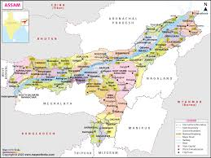
Assam at a Glance
Assam — nestled in the northeastern corner of India — is known for its rolling tea gardens, the mighty Brahmaputra River, and its incredible biodiversity.
But above all, Assam is a land of rhythm. Every season brings a festival, every emotion finds its tune, and every community celebrates life through dance and song.
Despite the geographical distance, THE cultures share a remarkable kinship — they express joy, sorrow, and pride through their performing arts.
Earlier Assam covered all the other states that is now known as the North East of India. Gradually the people began to create new states now divided in 7 states of Assam

Slide 10
PART .2
Musical Traditions of Assam

Slide 11
Bihu-The Folk Culture
Folk Instruments
Lyrics
TIn Assam, we have Bihu — the soul of Assamese folk culture. It’s not just a dance or a song; it’s the heartbeat of community life, celebrating harvest, youth, and renewal.
In Assam, instruments like the dhol, pepa, and gogona accompany songs like Borgeet and Lokogeet.
Talks about community, storytelling, and resilience — woven into melodies continents apart.

Slide 12
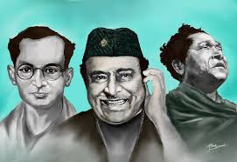
Presursor
Legends of Music
Before Zubeen,Dr. Bhupen Hazarika, known as the Bard of the Brahmaputra. His music carried messages of humanity, equality, and hope — echoing the struggles and dreams of ordinary people.
Jyoti Prasad Agarwala,Bishnu Prasad Rabha,Jayanta Hazarika,Khagen Mahanta are noteable among all others.
All used music not merely as entertainment but as education — as tools to awaken the conscience of their people.

Slide 13
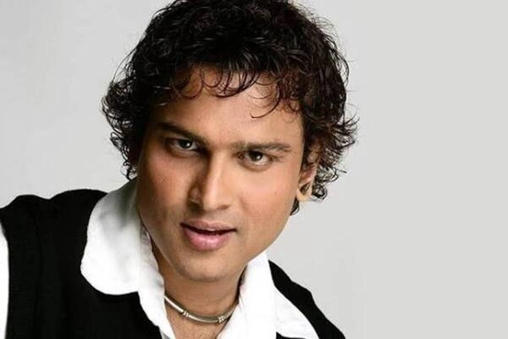
PART .3
The Arrival of a Phenomenon

Slide 14
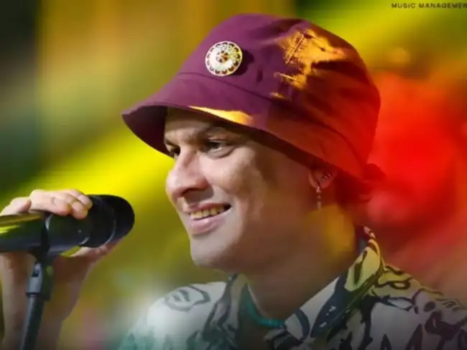
Profile and More
Born in 1972 in Meghalaya, Zubeen was a musical prodigy from a young age.
He debuted with the album Anamika in 1992 — a collection that instantly captured Assam’s heart.
Zubeen fused folk with pop, rock, and electronic elements — creating something both familiar and revolutionary.
In many ways, his experimentation parallels Ukrainian fusion bands like Vopli Vidopliassova, who blended folk with rock to re-energize national music.
Zubeen made Assamese music cool again — not just traditional, but timeless.

Slide 15
PART .4
Music Lyrics Fashion Cinemas and Activism

Slide 16
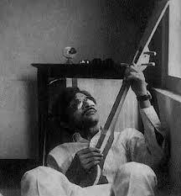
Assamese Music Before :The Pre-Reform Era
Before Zubeen entered the Assamese music scene in the early 1990s, the industry faced multiple challenges.
While legendary artists like Dr. Bhupen Hazarika, Jayanta Hazarika, Khagen Mahanta, and Dipali Borthakur had established a rich cultural foundation.
The Assamese music had become somewhat stagnant by the late 1980s. he younger generation began drifting toward Bollywood and Western pop, leaving regional music with a shrinking audience.

Slide 17
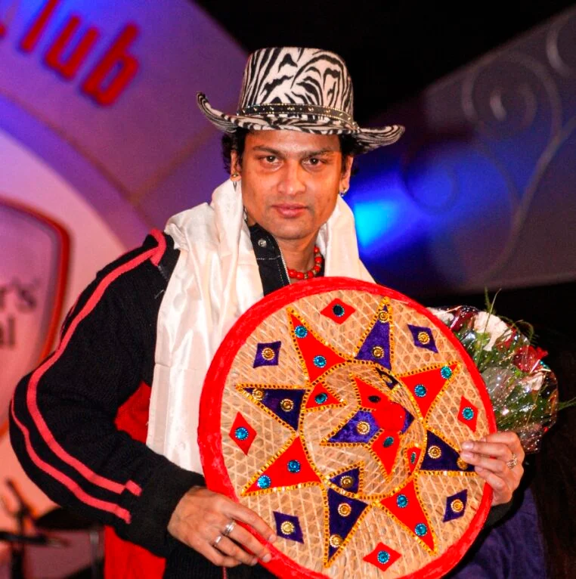
The Emergence of Zubeen Garg: Revolutionizing Sound and Style
In this context, Zubeen Garg entered the scene as a transformative force. He introduced a fresh sound that blended Assamese folk melodies with rock, pop, and electronic elements.
Zubeen was not just a singer; he was a composer, lyricist, and instrumentalist.
He expanded the Assamese music industry by introducing professional recording techniques, diversified genres, and cross-cultural collaborations.

Slide 18

Revival of Assamese Cinema and Cultural Identity
Zubeen’s impact on Assamese cinema was equally revolutionary. In the early 2000s, the Assamese film industry, or Jollywood, was struggling. Zubeen entered filmmaking and composed background scores, bringing technical excellence and emotional resonance.
Zubeen’s lyrics often touch on love, social justice, and identity. His song “Ya Ali” became a cross-national anthem, much like Sviatoslav Vakarchuk’s music in Ukraine, which inspired a generation of youth to believe in change.

Slide 19

Themes Cinemas AND Activism
Beyond music, Zubeen became a filmmaker and actor, reviving Assamese cinema through works like Mission China, Kanchanjangha, and Tumi Mur Mathu Mur.
These films weren’t just entertainment — they were cultural awakenings that brought audiences back to regional theaters.
He’s also a fearless activist. Zubeen has spoken out for environmental protection, indigenous rights, and social harmony.
Artists like them remind us that art is not just performance — it’s participation in humanity’s shared struggle for dignity.

Slide 20
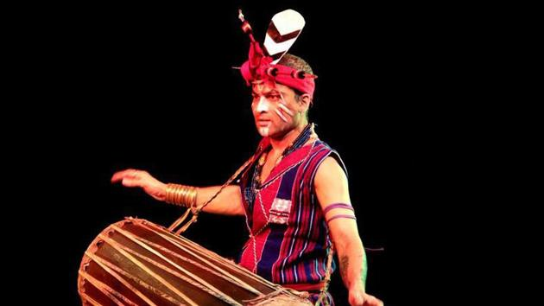

Aesthetics,Youth and Unity
Zubeen’s visual identity — his use of the traditional attires and contemporary fashion — symbolizes the balance between heritage and modernity.
Through mentorship and youth engagement, Zubeen has nurtured the next generation of Assamese artists, ensuring the continuity of folk heritage.
His concerts — electric, emotional, and deeply communal — remind us that performing arts connect hearts beyond language.
He’s more than a singer — he’s a symbol of unity who bridged ethnic, linguistic, and generational divides.

Slide 21
PART 5
An Extraordinary Humanitarian Side of Zubeen

Slide 22
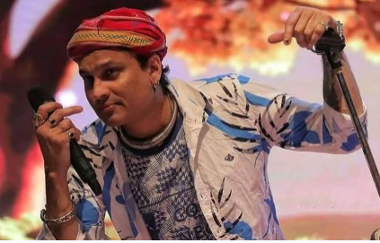
Legacy- Challenges-Global Impact
Zubeen’s journey hasn’t been without controversy. His outspoken nature has sparked debates and disagreements, but that too is part of his authenticity. Great artists challenge, question, and evolve.
From charity concerts for flood relief to the Kalaguru Artist Foundation supporting struggling musicians, Zubeen has always used his platform for compassion and community upliftment.
He stands today as a global ambassador for Assamese culture — taking the sounds of the Brahmaputra to stages across the world.
Donor and a social helper funding many in ilness, education and other issues.

Slide 23
Achievements and Awards
Over 18,000 recorded songs in more than ten languages, an extraordinary achievement in Indian music.
Recognition by the Government of Assam for his cultural and humanitarian contributions.
His international performances — in the UK, USA, Dubai, and Southeast Asia — have made him a global ambassador of Assamese identity. He represents the new face of regional Indian music in a globalized cultural environment.
Also nominatted for highest songs sang for Guiness World Record
Fourth Position in Limca Book of Records -4th Largest Funeral Gathering.
Zubeen Garg’s contributions have been recognized nationally and internationally. His notable achievements include:
National Film Award (2007) – Best Male Playback Singer for “Ya Ali” (Filmfare nomination).
Filmfare Awards (Eastern India) – Multiple wins for best singer and composer.
Global Assamese Excellence Award – For his role in promoting Assamese culture worldwide.
Assam State Film Awards – For both acting and music direction.

Slide 24
PART 6 His Demise and Funeral

Slide 25
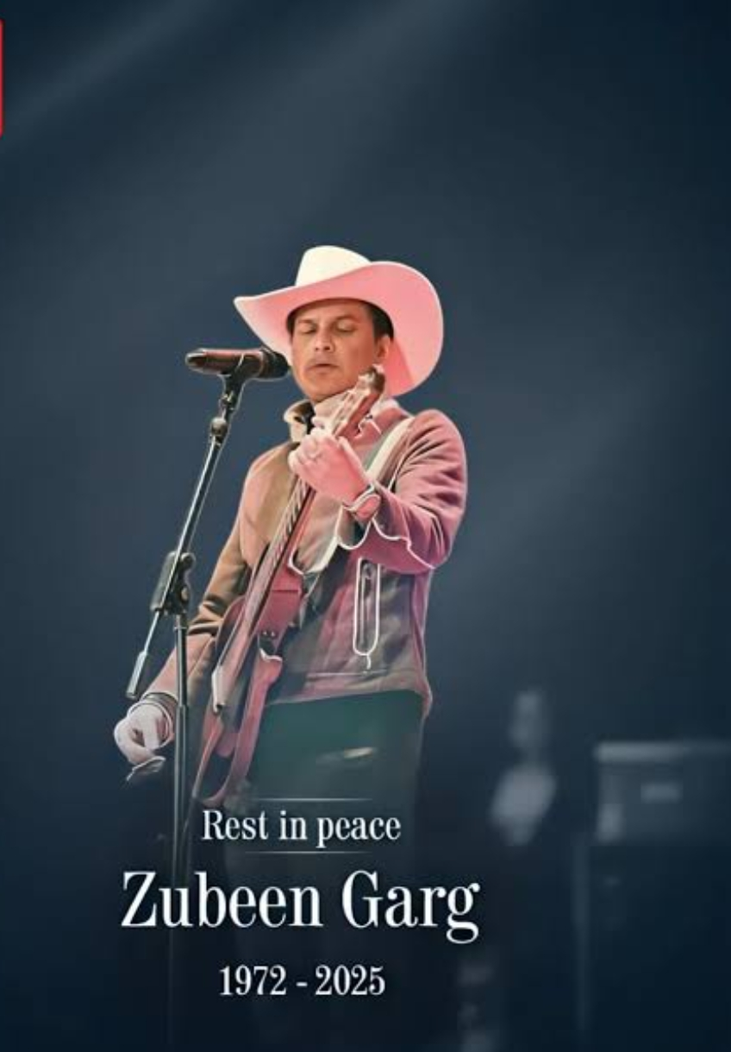
Untimely Demise of Zubeen Garg
19 September 2025 (age 52 years), Singapore
While attending a programme represting North-East in North East Festival held in Singapore in 2025
The last performance of him was “Tears in Heaven” on the streets of Singapore.
The entire state of Assam mourned his death for 5 days declaring the closure of all activities-trade and commerce .
The final cremation ritual took place in Sonapur,Kamrup,Assam.
His funeral was recorded as the 4th Largest Funeral Gathering by Limca Book of Records.
Even till date more than 1000 people are still visiting his funeral ground to offer prayers and services.

Slide 26
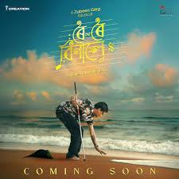
Conclusion- Reflection
Zubeen Garg represents more than a voice or a melody. He embodies an emotion, a revolution, and a legacy.
Through his journey, we see how performing arts can unite worlds as different as Assam and Ukraine — proving that creativity is humanity’s greatest common language.
His last movie “Roi Roi Binale” will release on 31st October 2025
As we reflect on this, let’s remember that every rhythm we hear — whether from a pepa in Assam or a bandura in Kyiv — carries the heartbeat of people who refuse to let their stories fade.

Slide 27
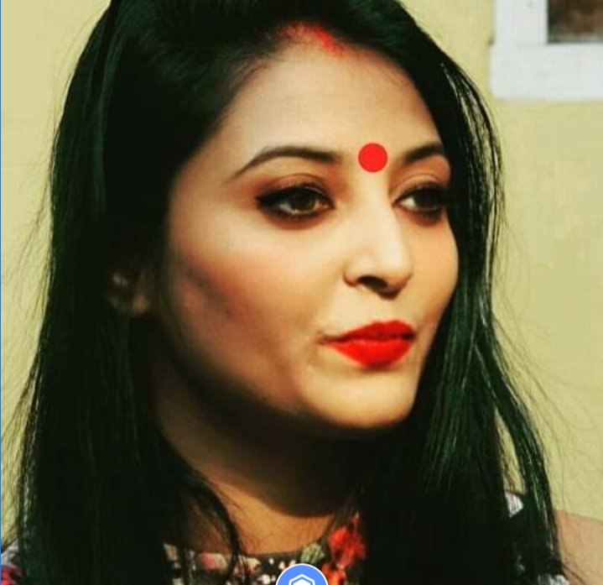
Presented by - Dr. Samikshya Madhukullya
Dr. Samikshya Madhukullya is a distinguished scholar and educator in the fields of Sociology and CulturalStudies.
She presently serves as a Faculty Member in the Department of Sociology at Krishna KantaHandiqui State Open University, Tezpur College, Assam, India, while also holding internationalappointments as an Assistant Professor in the Department of Sociology and Cultural Studies at 21stCentury Open University, USA, and as a Senior Faculty Member and Academic Advisor at Global Interfaith University, USA. In addition, she serves on the International Board of Scholarship at 21st Century Open University, Texas, USA, where she contributes to advancing global academic initiatives.
She previously served as a Guest Faculty in the Department of Cultural Studies at Tezpur University,Assam, where she taught and guided students for over one and a half years
. Dr. Madhukullya earned her Doctorate in Sociology from the University of Science &amp; Technology, Meghalaya (USTM) and is also arecipient of the UGC-NET and Junior Research Fellowship (JRF) in Folk Literature. She is currentlyengaged in her Post-Doctoral Research at 21st Century Open University, Texas, USA.
Email madhusami1000@gmail.com
+91-9365819755

Slide 28
Presented by - Dr. Samikshya Madhukullya
Dr. Madhukullya has made significant scholarly contributions, including the editing and co-editing of sixacademic volumes and the co-authorship of two reference books in the domains of Business Communication and Research Methodology. Her academic output further includes eight publications inUGC-CARE listed journals and five articles in Scopus-indexed journals, underscoring both the breadth and rigor of her research endeavors.
Her international engagement extends beyond academia, as she serves on several International Advisory Boards and Executive Committees of organizations based in Africa, where she actively contributes to interdisciplinary and cross-cultural scholarship. Her primary research interests span sociology, cultural studies, communication, folk traditions, and interfaith dialogue, reflecting a strong commitment to bridging diverse intellectual and cultural domains.
Renowned for her dedication to teaching, research, and global collaboration, Dr. Madhukullya continuesto play a pivotal role in shaping academic discourse and fostering intercultural and interfaith understanding on an international scale.
Email madhusami1000@gmail.com
+91-9365819755

Slide 29

Memories with The Legend Zubeen Garg

Slide 30
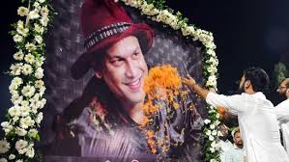
Legends Never Die- Even More Powerful After Death

