Slide 1
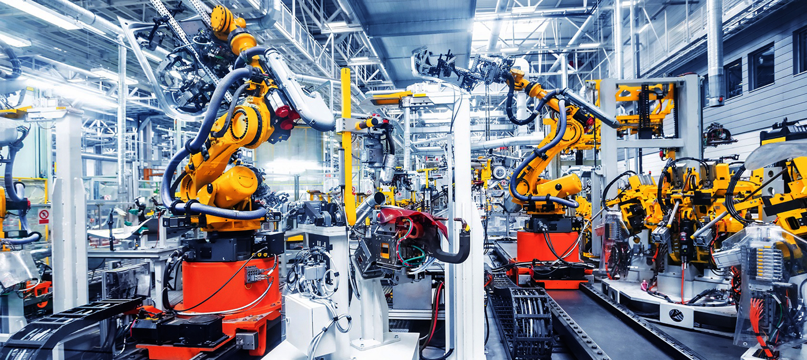
CAT-2022
Automation components
Pumps and Motors
Bearings and Casters
PCB Hold down and Bits
CNC Tools
3D Print Services
Measuring Instruments
Laser Engraving services
Spare parts
Fast delivery service
Rollers and Bumpers

Slide 2
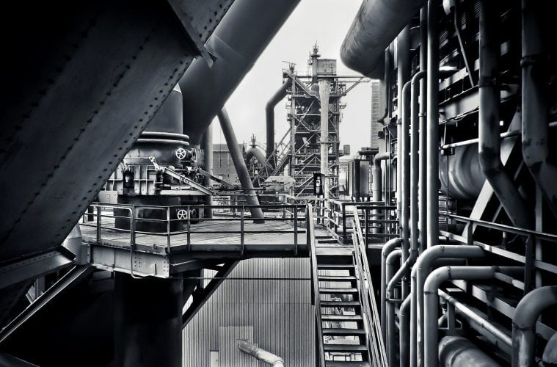
About us
MC is a Mexican company dedicated to the sale and distribution of consumables for the industry and sectors that demand quality products and a good price. It has extensive experience in the market, focused on customer service offering quality products and services with the most up-to-date technology and tools in our sector.
Mission: To be a competent company that provides excellent customer service, quality and speed in providing solutions.
Vision: To be a leading company in the sale and distribution of consumables for the industrial sector in Reynosa Tamaulipas.
Values: Honesty, respect for the client and his time.

Slide 3
SPARE PARTS & CONSUMABLES

Slide 4
Brands we can offer

Slide 5
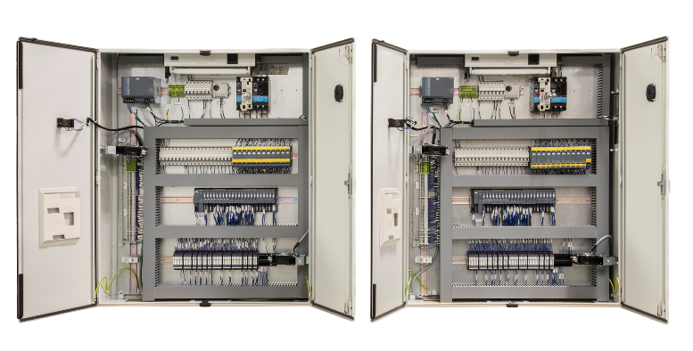
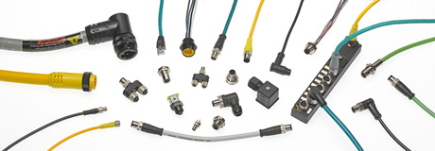
Automation components
HMI SCREENS
POWER SOURCES
PLC´S
EXPANSIONS
ENCLOSURES AND ACCESSORIES
TURRETS
INDICATOR LAMPS
BUTTONS
SWITCHES
WIRING AND CLEMS
SENSRORS AND FIBERS

Slide 6
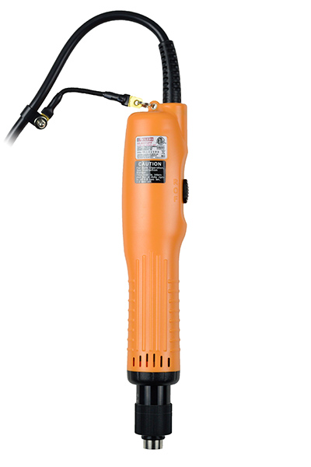
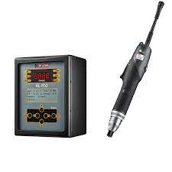
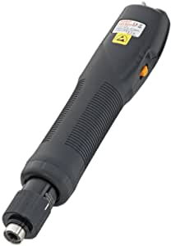
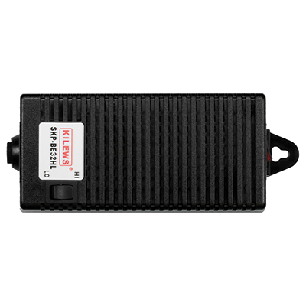
Kilews Screwdriver

Slide 7
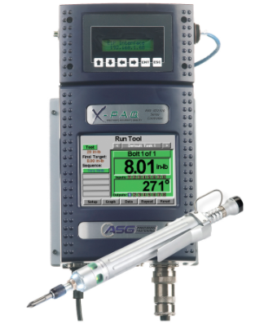
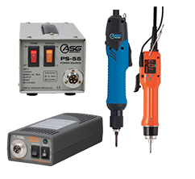
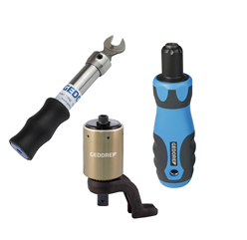
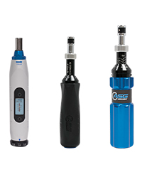
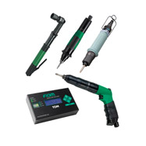
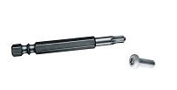
ASG Parts
XPAQ SD2500
ELECTRIC SCREWDRIVERS
GEDORE TORQUE
MANUAL SCREWDRIVERS
PNEUMATIC TORQUE CONTROL
HIOS INTRTORQUE
ASG, Division of Jergens, Inc. supplies a full range of products and solutions for assembly. We specialize in providing world class quality torque control and error-proofing products and offer a vast array of premium and value engineered solutions for your assembly needs.

Slide 8
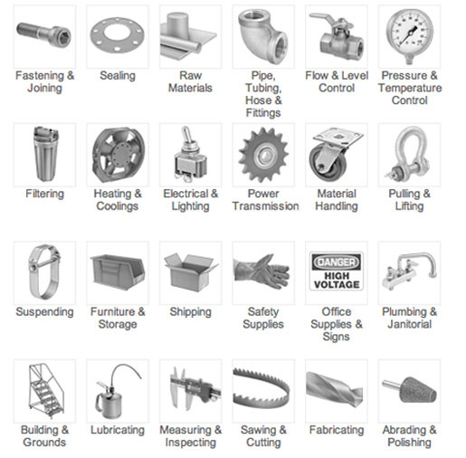
McMaster Products
¡Find your product now with us!

Slide 9
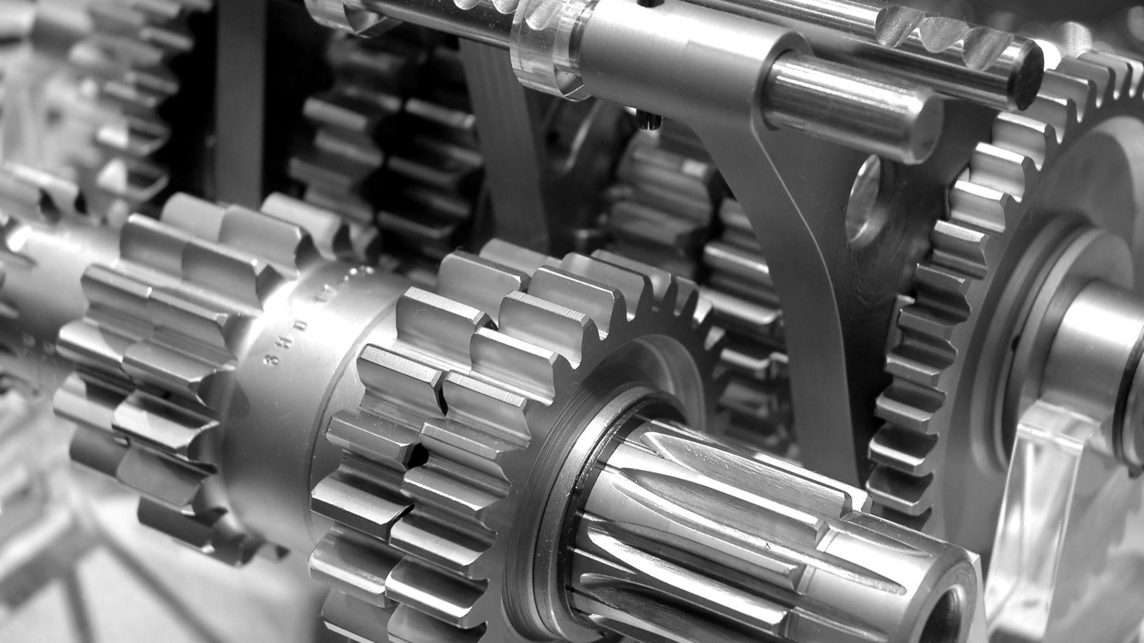
MISUMI Products
¡Find your product now with us!

Slide 10
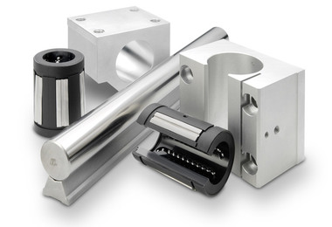
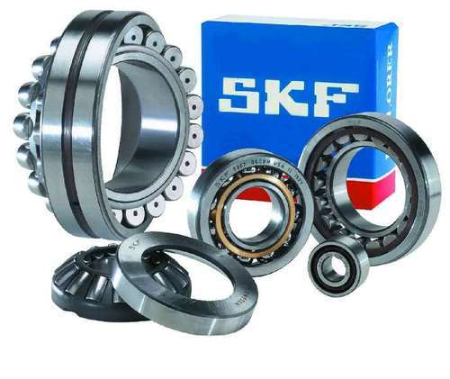
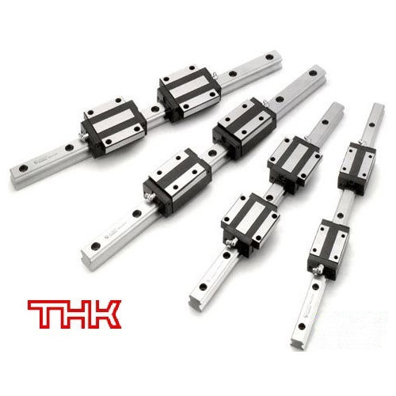
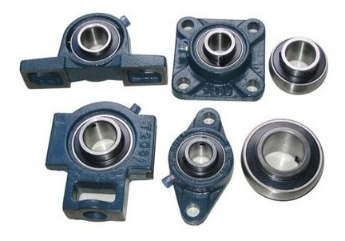
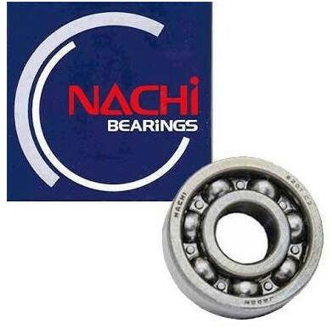
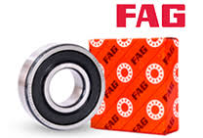
Guides and Bearings
LINEAR BEARINGS
BEARINGS
GUIDES
ROWBLOCKS
GREASES AND LUBRICANTS

Slide 11
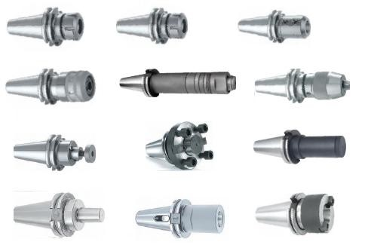
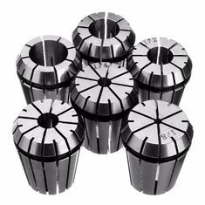
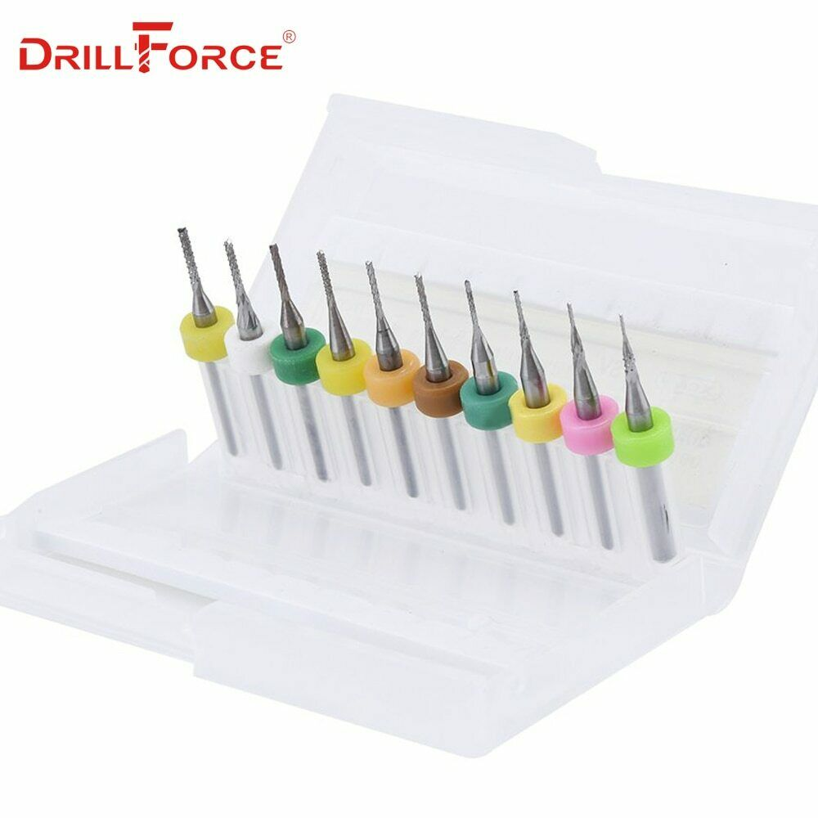
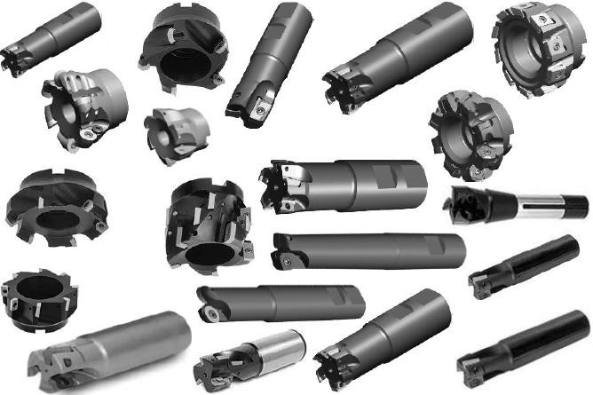
CNC Tools
CNC HOLDERS
NOZZLES
PINEAPPLES (INDEXABLE END MILL)
INSERTS
CUTTING TOOL
FASTENING KITS
BITS FOR PCB ROUTER

Slide 12
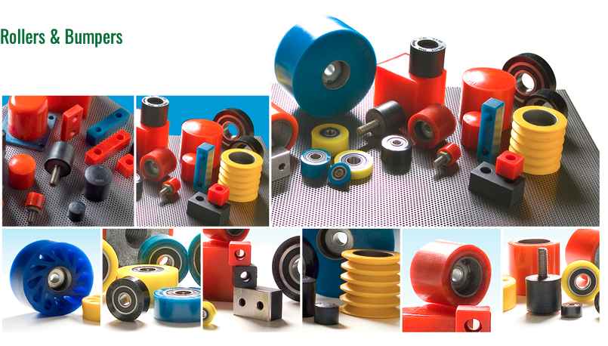
Rollers and Bumpers
Rubber rollers are often utilized in material handling, assembly, and manufacturing operations. Styles range between solid, finned, and Durasoft® with diameters from 1.50 in to 4.00 in. Material options include neoprene, nitrile, and polyurethane with shore hardnesses available from 20 to 95 durometer. Different mounting options are also available and include: roller only, bearing mount, threaded stud mount, and shaft mount.
Rubber bumpers and urethane bumpers, designed to guard, stop, align, and protect a machine or work piece during the manufacturing process. They are available in round, square, and rectangular shapes (standard and custom sizes available) with a variety of different styles that integrate well into an industrial application or commercial end product. These bumpers are available in black neoprene, white nitrile, or colored urethane, each with varying durometers.

Slide 13
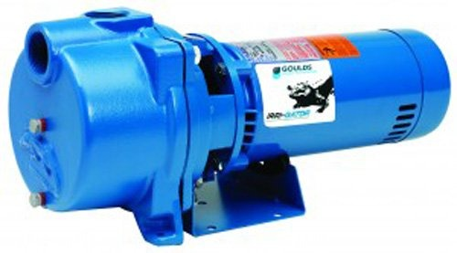
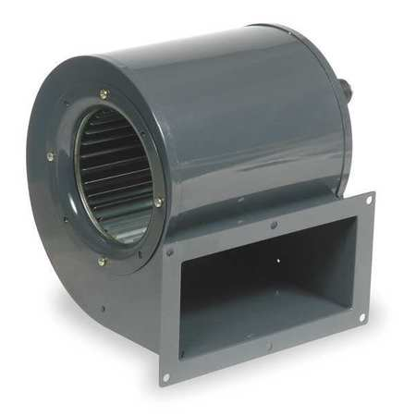
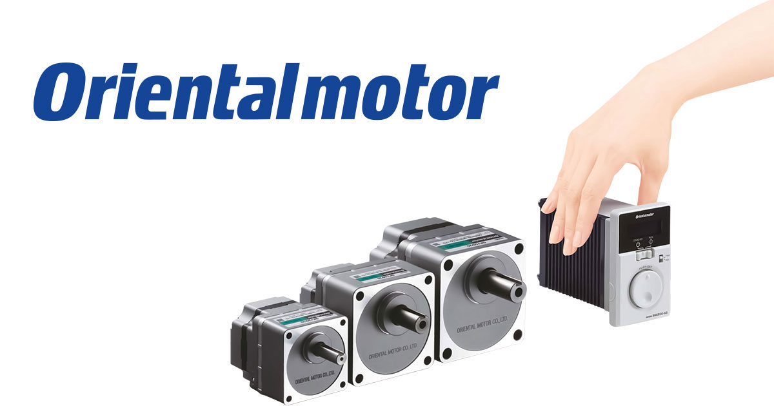
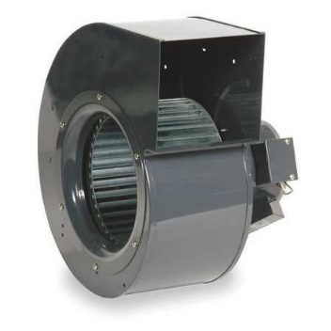
Pumps and Motors
INDUSTRIAL PUMPS
ELECTRIC MOTORS
SERVOMOTORS
BLOWERS
SPEED CONTROLLERS
FLOW CONTROLLERS

Slide 14
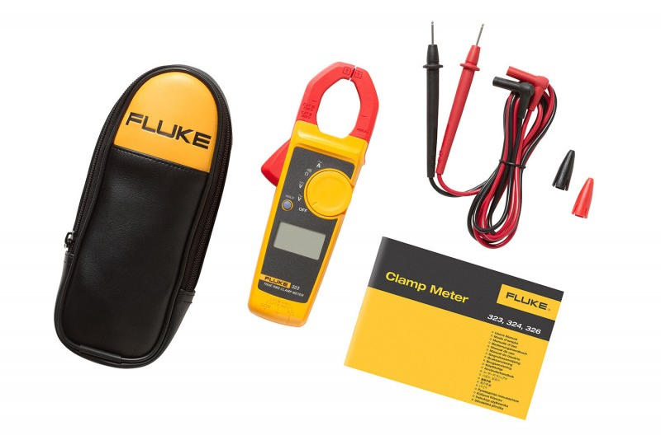
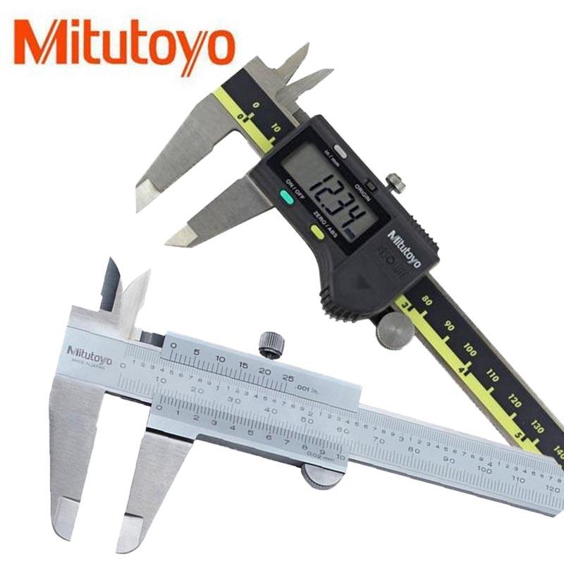
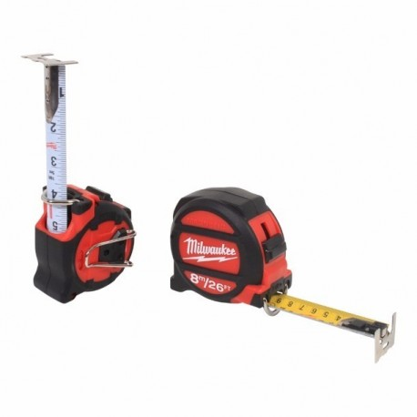
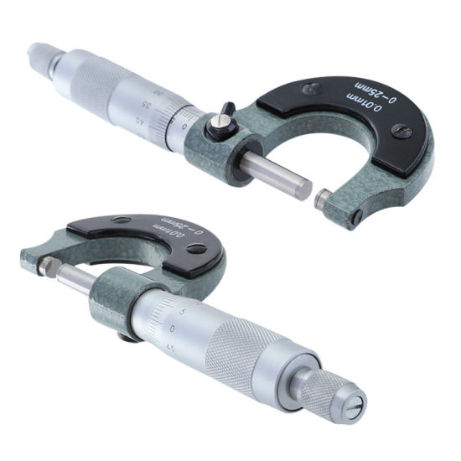
Measuring Instruments
DIGITAL CALIPERS
MICROMETERS
TAPE MEASURE
MULTIMETERS AND AMMETERS

Slide 15
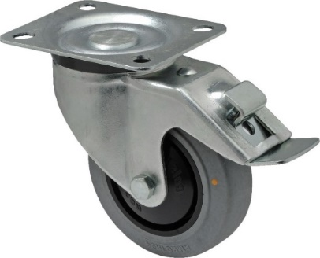
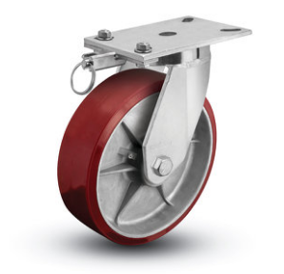
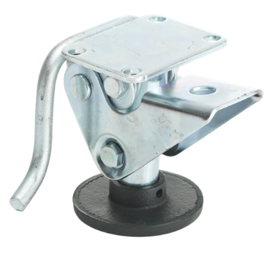
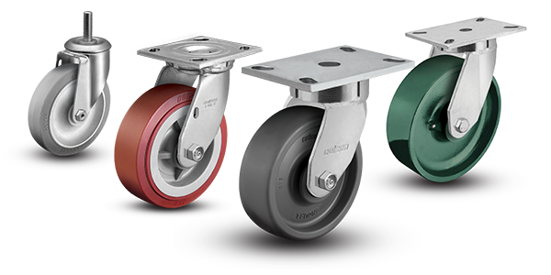
Casters
PHENOLIC AND POLYURETHANE HI-TECH CASTERS
FLOOR BRAKES
SWING BRAKES

Slide 16
SERVICES
Laser Engraving
3D Print
Machined spare parts and fixtures

Slide 17
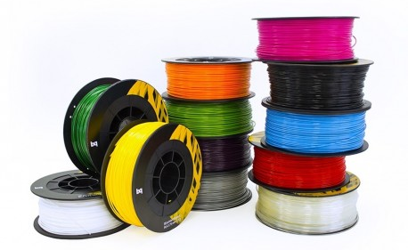
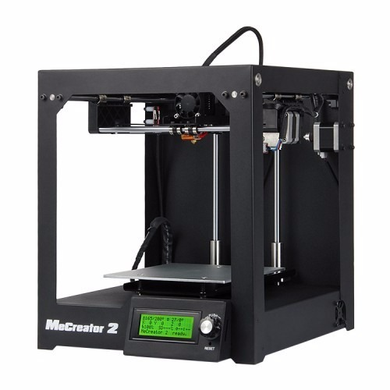
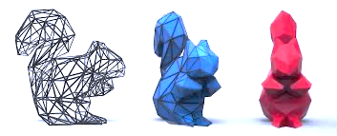
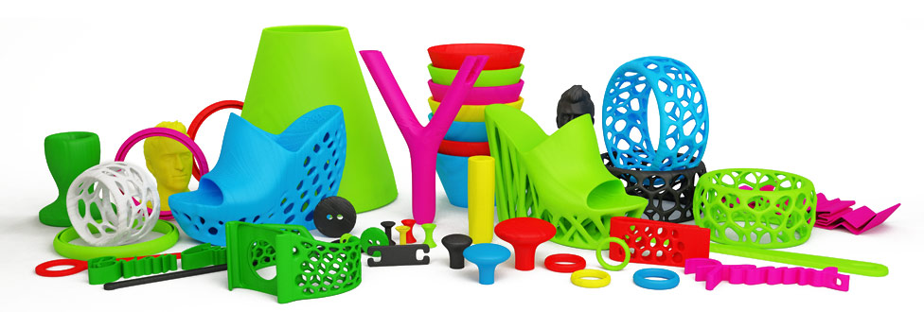
3D Print services
Design and fabrication
3D PRINTING FOR PROTOTYPING OR CUSTOM PROJECTS.
MATERIALS SUCH AS:
PLA
ABS
FILAFLEX
CARBON FIBER
NYLON
MULTICOLORED
POLYCARBONATE
FLAME RETARDANT
SILK

Slide 18
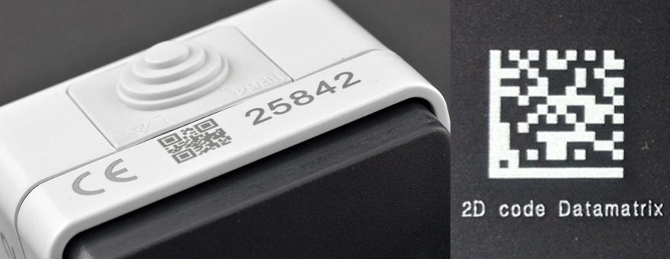
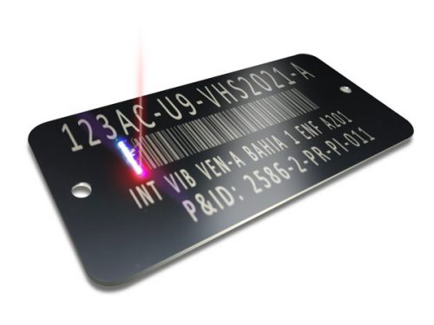
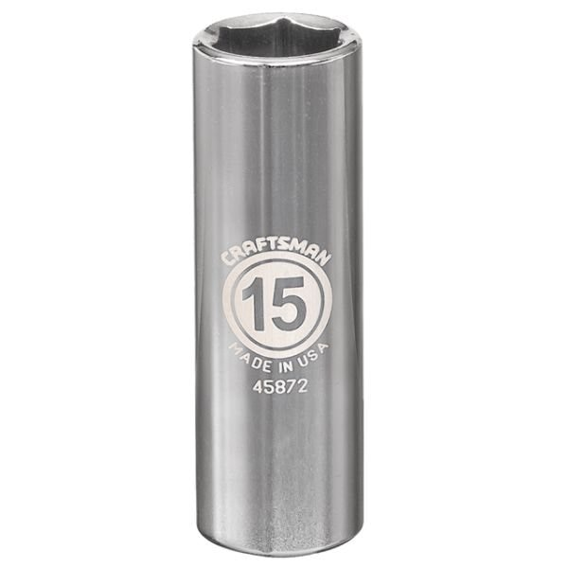
Laser engraving services
Fabrication and engraving
Laser engraving on:
Industrial parts
Fixtures
Pallets
Tools
Tags
Materials that can be engraved on:
Aluminum
Bronze
Polycarbonate
Plastics
Stainless
Types of codes:
QR
DATAMATRIX
BARCODES
SERIALS

Slide 19
HOW IT WORKS?
Customer Request by
Email
Whatsapp
Call us
(899) 917-8004
(899) 798-1642
+1 (956) 305-8867
Quote from us with available options, often next day shipping
Customer aprovement preferably before 1:00 pm
Delivery of urgent material with a referral

Slide 20
Sales
Phone: (899) 917-80-04 Mex
+1 (956) 305-8867 USA
info@cdmexconsumibles.com
https://www.cdmexconsumibles.com/
Reynosa, Tamaulipas México

