Slide 1

Creating a Simple Project: Bringing Coding Concepts to Life
This presentation explores the process of creating a simple project using coding, highlighting key concepts and demonstrating how to apply them in real-world scenarios.
by Gerard Vella
Newark School Malta.

Slide 2
Why Learn to Code? The Importance of Computational Thinking
Problem Solving
Logical Reasoning
Coding encourages you to break down complex problems into smaller, manageable steps, leading to efficient solutions.
It helps you develop logical thinking skills as you learn to create step-by-step instructions for a computer to follow.

Slide 3
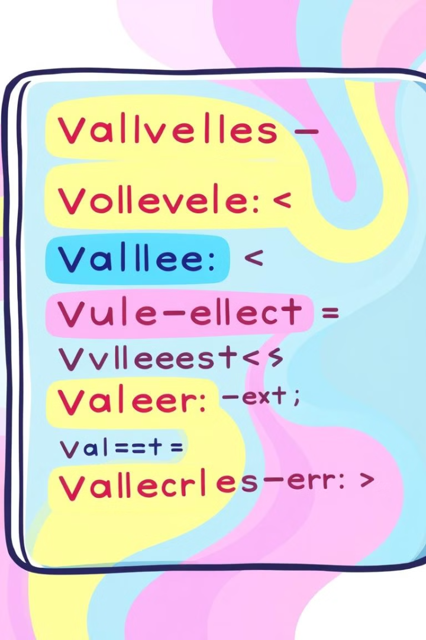
Starting with the Basics: Variables, Loops, and Conditional Statements
1
Variables
2
Loops
Variables are like containers that hold information. Imagine a box labeled "name" that stores the name of a character in your project.
Loops are used to repeat instructions multiple times. Think of a loop as a machine that keeps printing the same phrase until a certain condition is met.
3
Conditional Statements
Conditional statements allow the program to make decisions based on specific conditions. For instance, if a character hits an obstacle, the game might display a message.

Slide 4
Designing an Animated Story: Applying Coding Concepts
Storyboarding
1
Plan the story's flow using visual sketches, outlining the key events and character interactions.
Animation
2
Create simple animation sequences, making objects move and interact using coding principles.
Sound and Music
3
Add sound effects and background music to enhance the story's atmosphere and create a richer experience.

Slide 5



Building a Basic Game: Leveraging Coding Principles
Game Logic
1
Define the game's rules and how the character interacts with the environment.
Gameplay Mechanics
2
Implement movement controls, scoring systems, and level design to create an engaging experience.
User Interface
3
Design a user-friendly interface that allows players to interact with the game easily.

Slide 6
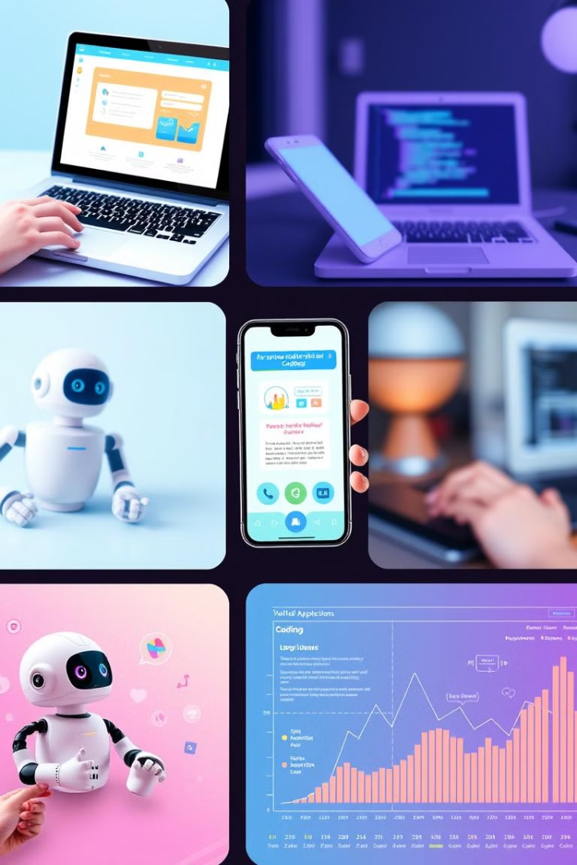



Linking Coding to Real-World Applications: Examples and Insights
Websites
Mobile Apps
Coding is essential for creating websites, enabling online businesses, communication, and information sharing.
Coding powers mobile apps, allowing people to access information, entertainment, and services on the go.
Robotics
Coding is used to program robots for automation, manufacturing, and exploration, driving innovation in various industries.

Slide 7




Debugging and Troubleshooting: Developing Problem-Solving Skills
Identify the Error
Find the exact line or code that is causing the issue by reviewing the code carefully.
Analyze the Cause
Determine why the error occurred, considering syntax errors, logical flaws, or missing information.
Implement a Solution
Fix the error by correcting the code or adding the necessary information to make it function correctly.

Slide 8

Conclusion: The Journey Continues, Empowering Yourself through Coding
Coding is a valuable skill that opens doors to countless possibilities. By embracing this journey, you empower yourself to create, innovate, and make a positive impact in the world.

