Slide 1
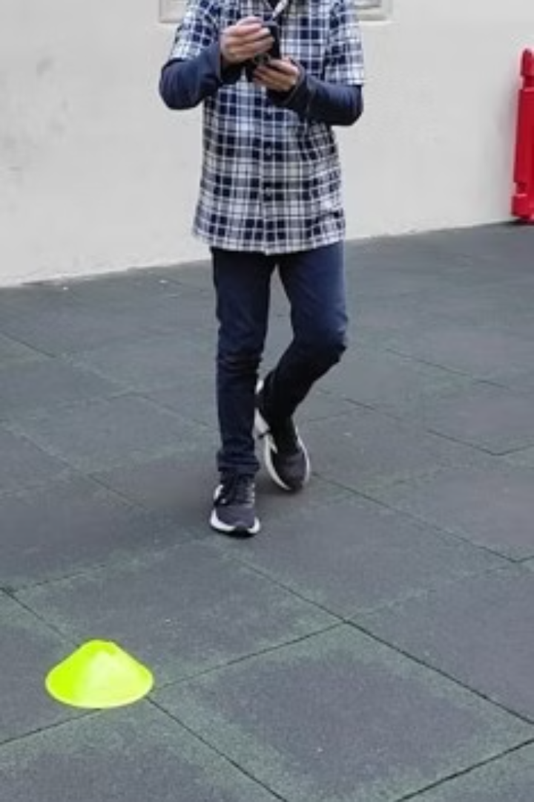
Creative Coding and the Sphero Bolt: A Case Study on Engaging Students with a Shapes Tutorial Demo.
by Gerard Vella
Newark School Malta

Slide 2
Introduction: The power of creative coding in the classroom
Empowering Creativity
Developing Critical Skills
Creative coding fosters innovation and empowers students to turn their ideas into reality, fostering an environment where exploration and experimentation are encouraged.
Coding teaches valuable skills like problem-solving, critical thinking, and computational thinking, preparing students for future success in a technology-driven world.

Slide 3

Drawing Shapes Example using Shero Bolt

Slide 4

Challenges in keeping students engaged: A common pain point
Passive Learning
Lack of Real-World Relevance
Traditional methods often rely on passive learning, which can lead to disengagement and a lack of motivation among students.
Students may struggle to see the practical application of concepts, leading to a disconnect between classroom learning and real-world applications.

Slide 5
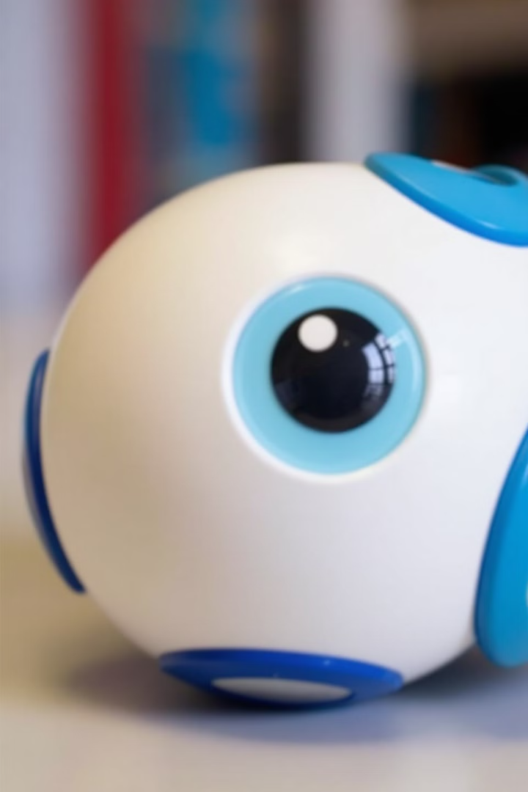



Introducing the Sphero Bolt: An interactive learning tool
Interactive Robotics
Engaging Activities
The Sphero Bolt is a programmable robot that allows students to control its movements and actions, bringing coding to life in a tangible and engaging way.
It offers a variety of activities and challenges that encourage creativity and problem-solving, making learning fun and interactive.
Coding Fundamentals
The Sphero Bolt provides an accessible platform for learning fundamental coding concepts, making it suitable for students of all skill levels.

Slide 6
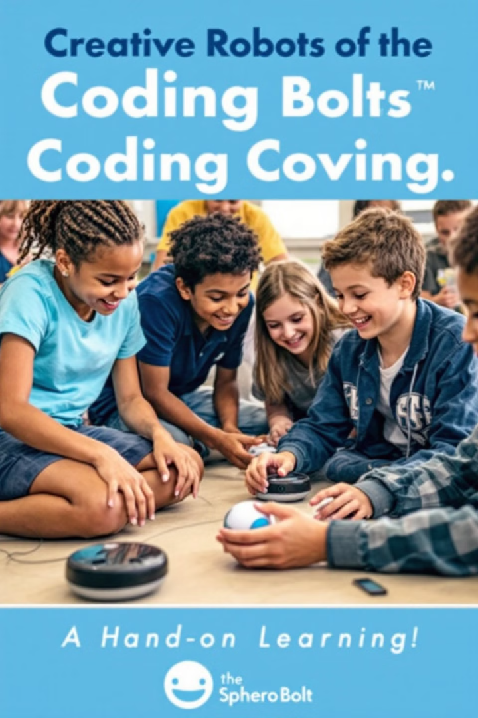
The Sphero Bolt in action: Sparking creativity and imagination
1
Coding Challenges
Students can create complex obstacle courses or design games for their Sphero Bolt, using their coding skills to bring their ideas to life.
2
Collaborative Projects
Groups can work together to build a robotic symphony, with each student programming their Sphero Bolt to play a specific note or melody.
3
Interactive Storytelling
Students can create interactive stories using the Sphero Bolt as a character, programming it to move and react to user input.

Slide 7



Integrating the Sphero Bolt into the curriculum: Lessons learned
Focus on Engagement
1
Prioritize interactive learning experiences that encourage student participation and foster a sense of accomplishment.
Adaptable Curriculum
2
Create flexible lesson plans that can be adapted to different learning styles and skill levels.
Practical Applications
3
Connect coding concepts to real-world applications, showing students how coding can be used to solve problems and create solutions.

Slide 8



Student reactions and feedback: Measuring the impact
Increased Engagement
Enhanced Collaboration
Confidence and Innovation
Students reported higher levels of engagement and enthusiasm for learning, showing a clear shift in their approach to coding.
Collaborative projects fostered teamwork, communication, and problem-solving skills, demonstrating the value of interactive learning.
Students displayed increased confidence in their coding abilities and showcased innovative ideas, showcasing the transformative potential of creative coding.

Slide 9
Real-world applications: Preparing students for the future
Robotics and Automation
1
The Sphero Bolt can be used to explore the field of robotics and automation, preparing students for careers in these growing industries.
Game Development
2
Students can learn basic game design principles and experiment with creating their own interactive games using the Sphero Bolt.
Internet of Things
3
The Sphero Bolt can be used to explore the concept of the Internet of Things, enabling students to create connected devices and systems.

Slide 10
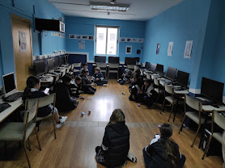
Overcoming obstacles: Strategies for successful implementation
1
2
Training
Resources
Provide teachers with adequate training on using the Sphero Bolt and integrating it into their curriculum.
Ensure access to sufficient Sphero Bolt robots and other resources to support classroom activities.
3
4
Curriculum Integration
Support
Develop engaging lesson plans and projects that align with existing curriculum standards.
Offer ongoing support to teachers and students to address any technical challenges or questions.

Slide 11


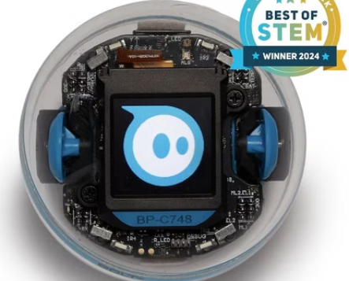
Conclusion: The transformative potential of creative coding

