Slide 1
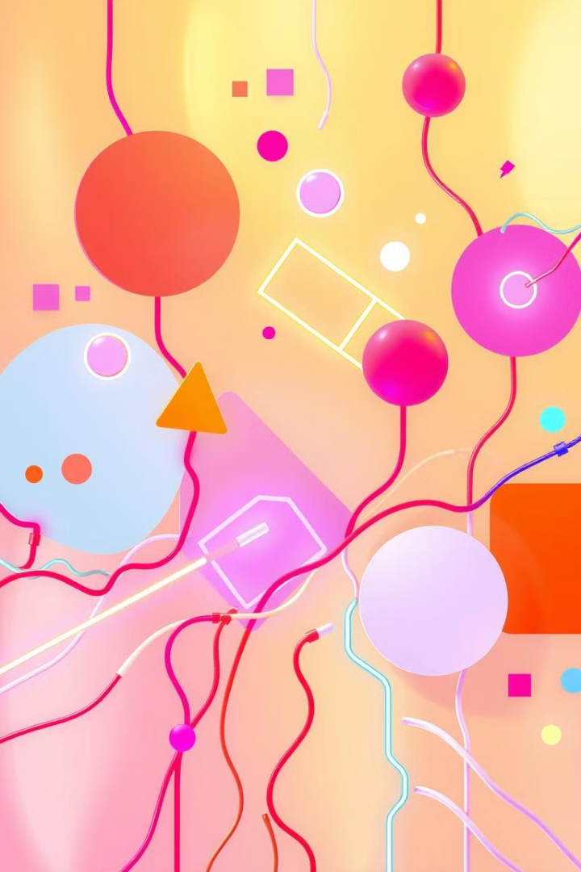
Introduction to Creative Coding Platforms
Welcome to the world of creative coding. This presentation will introduce you to the exciting realm of building interactive art, animations, games, and more using code.
by Gerard Vella
Newark School Malta.

Slide 2
What is Creative Coding?
Coding for Creativity
Beyond Traditional Programming
Creative coding is a blend of computer programming and artistic expression. It empowers you to bring your ideas to life using code.
It goes beyond writing code for practical tasks. Creative coding focuses on artistic outcomes and interactive experiences.

Slide 3

Benefits of Creative Coding
Problem-Solving
Computational Thinking
Coding encourages logical thinking and finding creative solutions to challenges.
It develops critical thinking skills by breaking down complex problems into smaller steps.
Creativity and Expression
Creative coding lets you explore artistic ideas and express yourself through code.

Slide 4
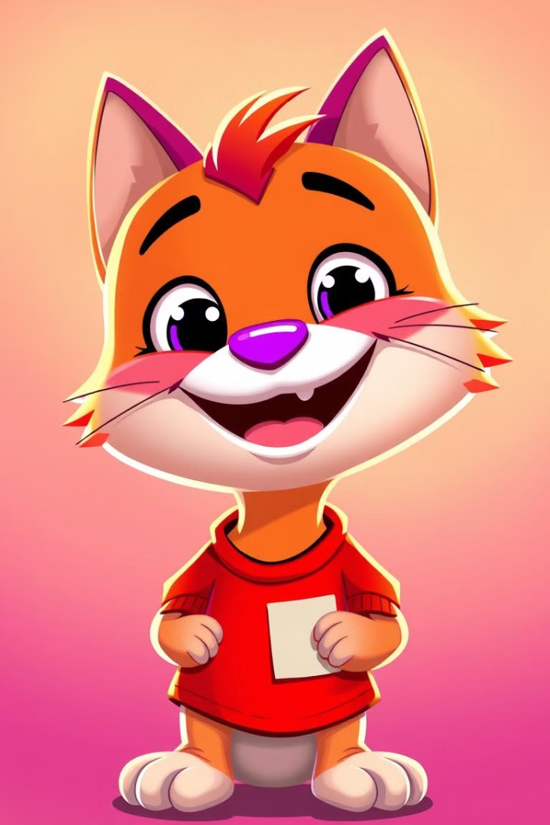
Overview of Scratch
Scratch is a visual programming language designed specifically for young learners and beginners. It features a block-based interface, making coding accessible and fun.

Slide 5
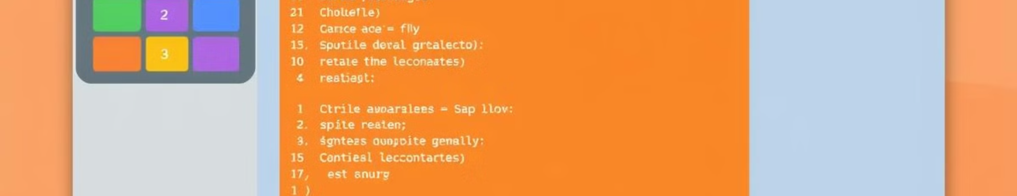



Scratch's Core Features
Block-Based Coding
Sprites and Stages
Sound and Music
Users drag and drop colorful blocks to create code without typing.
Scratch allows you to create animated characters and design backdrops.
Add sound effects, music, and voice recordings to your projects.

Slide 6

Getting Started with Scratch
Visit the Scratch website and click "Create." Explore the block library, create a sprite, and experiment with basic commands.

Slide 7
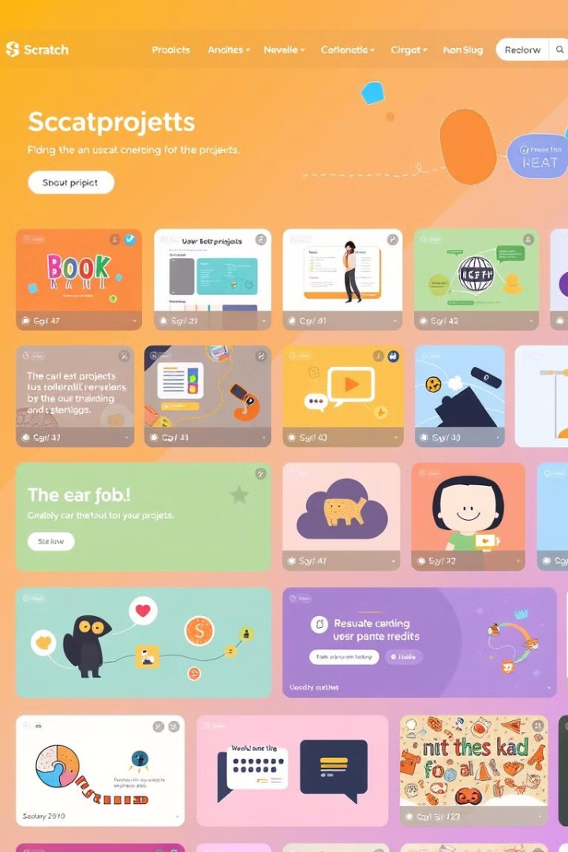
Scratch Projects and Community
Share your projects online and explore the vast collection of projects created by others. Join the Scratch community to learn, collaborate, and share your work.

Slide 8

Conclusion and Next Steps
Creative coding empowers you to express your ideas, build interactive experiences, and learn valuable computational thinking skills. Start your creative coding journey with Scratch and discover the endless possibilities!

