Slide 1


Enhancing Student Learning Through Creative Coding
Creative coding offers a powerful tool to engage students, foster critical thinking, and enhance their learning experience.
by Gerard Vella

Slide 2
Case Study 1: Coding Club Sparks Student Engagement
Challenge
Solution
A middle school struggled to engage students in STEM subjects. Many found traditional science and math classes uninspiring.
They established a coding club, where students learned programming basics and created interactive projects.

Slide 3

Integrating Coding into the Curriculum
Early Grades
Middle Grades
Interactive storytelling and game design introduce coding concepts through engaging activities.
Students learn basic programming languages and create projects using text-based code, developing critical thinking skills.
High School
Advanced coding projects challenge students to solve complex problems, prepare them for college and careers.

Slide 4
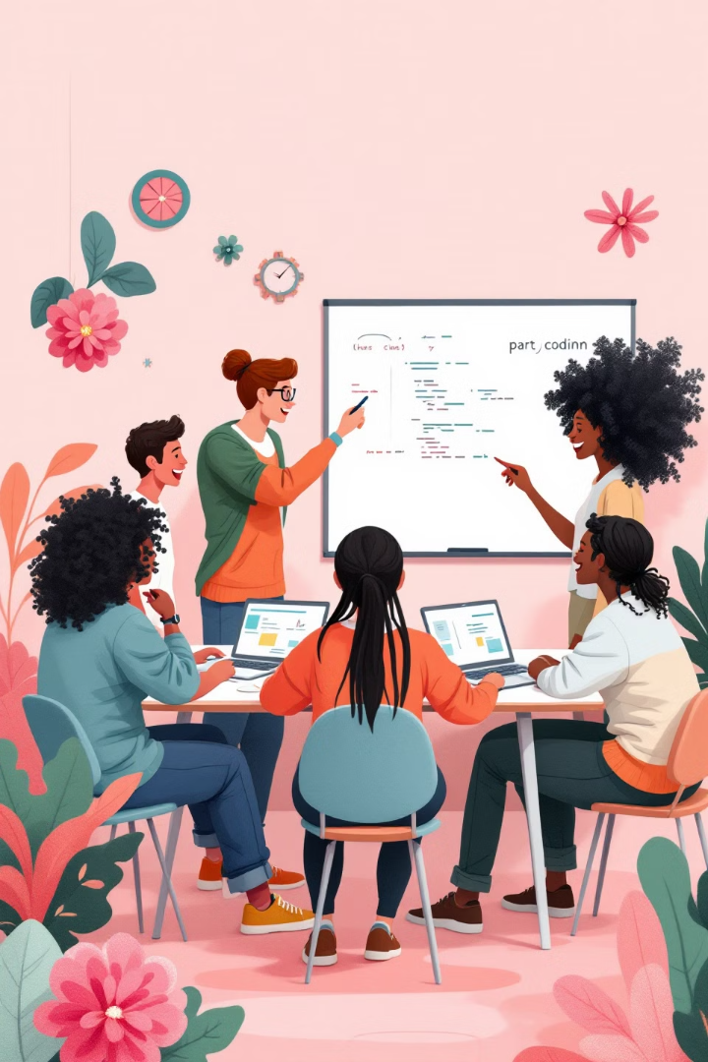


Fostering Collaboration and Problem-Solving
Teamwork
Coding projects require students to collaborate, share ideas, and solve problems as a team, building essential skills.
Critical Thinking
Students develop logical thinking, analyze problems, break them down, and devise creative solutions.

Slide 5


Showcasing Student Projects and Achievements
Animation
Game Design
Students demonstrate creativity and technical skills through animations and interactive storytelling.
Students learn game development principles, create games that test their coding skills and problem-solving abilities.

Slide 6



Case Study 2: Coding and the Arts Unlock Creativity
Visual Arts
1
Students explore digital painting, graphic design, and interactive art using programming languages.
Music
2
Coding empowers students to compose music, experiment with sound, and create interactive musical experiences.
Theater
3
Coding enhances stage design, lighting, sound effects, and even allows for interactive performances.

Slide 7



Blending Coding with Visual and Performing Arts
Digital Painting
Interactive Music
Students learn to code visual effects, create dynamic art, and explore artistic possibilities with digital tools.
Students create music that responds to user interaction, learn about algorithms, and understand the relationship between sound and code.

Slide 8
Empowering Students to Express Themselves
Creativity
1
Coding empowers students to express their unique ideas, solve problems creatively, and develop their artistic vision.
Confidence
2
Students gain confidence in their abilities, become more comfortable with technology, and embrace new learning experiences.

Slide 9
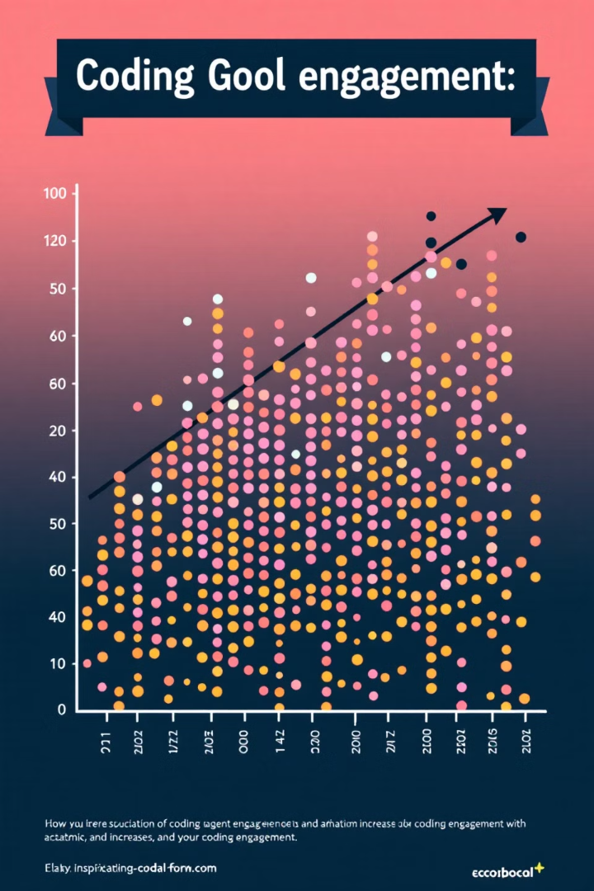
Measuring the Impact on Academic Performance
30%
Improved Grades
Studies have shown that coding can enhance academic performance, leading to significant improvements in grades.

Slide 10

Conclusion: The Power of Creative Coding in Education
Creative coding empowers students to learn, innovate, and express themselves in a way that is both engaging and impactful.

