Slide 1

Introduction to Sphero Robots
Welcome to the exciting world of Sphero Robots! This presentation will guide you through coding and tools for these versatile, spherical wonders.
We'll explore everything from basic concepts to advanced programming techniques. Get ready to roll into the future of robotics!
by Gerard Vella
Newark School Malta.

Slide 2

What are Sphero Robots?
Spherical Design
Programmable
Unique ball-shaped robots that can roll in any direction.
Can be coded to perform various tasks and movements.
Educational Tool
Versatile
Used to teach coding, robotics, and STEM concepts.
Suitable for beginners and advanced programmers alike.

Slide 3





Sphero Robot Applications
Education
Gaming
Teaching programming and robotics in schools.
Interactive, augmented reality games and challenges.
Robotics Research
Entertainment
Testing algorithms and AI in spherical robots.
Creating interactive light shows and performances.

Slide 4
Sphero Robot Hardware Overview
Outer Shell
Internal Components
Power Source
Durable polycarbonate sphere, waterproof and shockproof.
Motors, gyroscope, accelerometer, LED lights, and Bluetooth module.
Rechargeable battery with inductive charging capability.

Slide 5
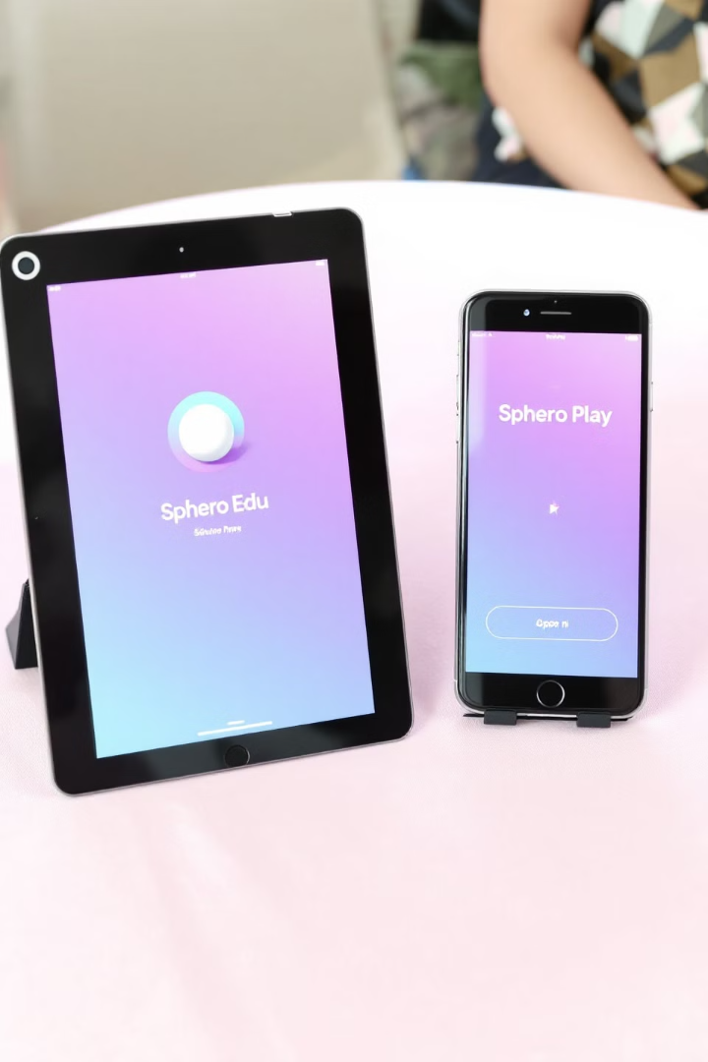
Sphero Robot Software
Sphero Edu App
Sphero Play
Main platform for programming Sphero robots, available on multiple devices.
App for casual users, featuring pre-programmed games and activities.
SDK
Software Development Kit for advanced users to create custom applications.

Slide 6

Coding Sphero Robots
1
Draw
Simple path drawing for beginners.
2
Blocks
Visual block-based programming for intermediate users.
3
Text
JavaScript coding for advanced programmers.

Slide 7





Sphero Robotics Scratch
Drag and Drop
Use pre-made code blocks to build programs.
Connect Blocks
Snap blocks together to create sequences.
Customize Parameters
Adjust values within blocks for precise control.
Run and Test
Execute your code and watch Sphero respond.

Slide 8





Sphero Robotics Iteration Algorithms
1
Define Task
2
Create Initial Solution
3
Test and Evaluate
4
Refine and Optimize
5
Repeat Until Satisfied
Iteration algorithms improve Sphero's performance through repeated refinement cycles.

Slide 9

Sphero Robotics Conditional Statements
If-Then
If-Then-Else
Execute code when a specific condition is met.
Choose between two actions based on a condition.
Switch-Case
Select from multiple code blocks based on variable value.

Slide 10




Sphero Robotics Looping Structures
For Loop
While Loop
Repeat a set number of times.
Repeat as long as a condition is true.
Do-While Loop
Execute at least once, then repeat if condition is true.

Slide 11
Sphero Robotics Event-driven Programming
Define Events
1
Identify triggers like collisions or gestures.
Create Event Handlers
2
Program responses to specific events.
Link Events to Actions
3
Connect triggers with corresponding behaviors.
Test and Refine
4
Ensure Sphero responds correctly to events.

Slide 12
Sphero Robotics Sensor Integration
Accelerometer
Gyroscope
Magnetometer
Detects speed and orientation changes.
Measures angular velocity and rotation.
Determines Sphero's heading relative to magnetic north.

Slide 13
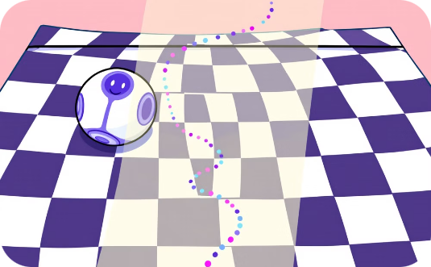


Sphero Robotics Data Visualization
Speed Graph
Path Heatmap
3D Orientation
Visualize velocity changes during movement.
Display frequently traversed areas.
Show robot's position in three-dimensional space.

Slide 14
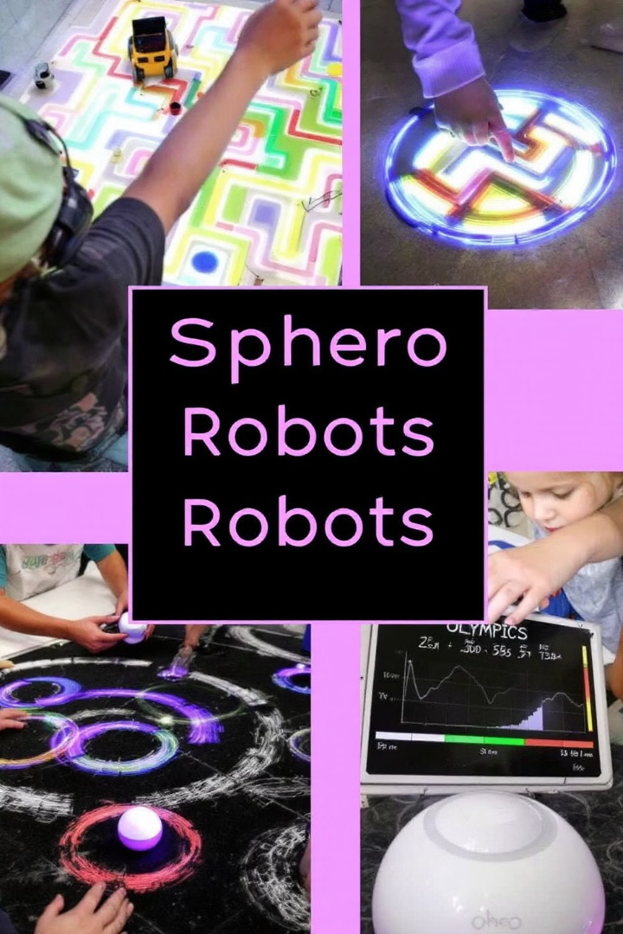
Sphero Robotics Project-based Learning
1
Maze Navigation
2
Light Painting
Program Sphero to autonomously navigate complex mazes.
Create art using Sphero's LED and long-exposure photography.
3
Sphero Olympics
4
Data Collection
Design competitive games testing speed, accuracy, and control.
Use Sphero as a mobile sensor to gather environmental data.

Slide 15

Conclusion and Key Takeaways
1
3
∞
Versatility
Coding Levels
Creativity
Sphero robots offer a wide range of applications and learning opportunities.
From beginners to experts, Sphero provides multiple coding interfaces.
The possibilities for Sphero projects and applications are limitless.
Sphero robots make coding fun, interactive, and accessible for all skill levels.

