Slide 1
Cybersecurity in Lunar Exploration: Protecting Humanity's Next Giant Leap
As lunar missions increase, cybersecurity becomes mission-critical. Vulnerabilities in interconnected systems can compromise entire operations. Securing lunar assets requires a multi-faceted, proactive approach.
by Bivash Kumar Nayak

Slide 2
The Expanding Lunar Infrastructure
Spacecraft
Ground Stations
Communication Networks
Orbiters, landers, rovers vulnerable to attack.
Data processing, mission control, communication hubs.
Deep Space Network, commercial providers.

Slide 3
Unique Challenges of Lunar Cybersecurity
1
Interconnected Systems
2
Communication Delays
Real-time response to cyber incidents is impossible.
Breaches can cascade across entire mission infrastructure.
3
Limited Resources
Power, bandwidth, and processing capabilities are constrained.

Slide 4
Threat Vectors in Lunar Missions
Malware Uploads
Signal Interception
Command Injection
Compromised software updates, infected USB drives.
Eavesdropping on Earth-lunar communications.
Unauthorized spacecraft/base control.

Slide 5
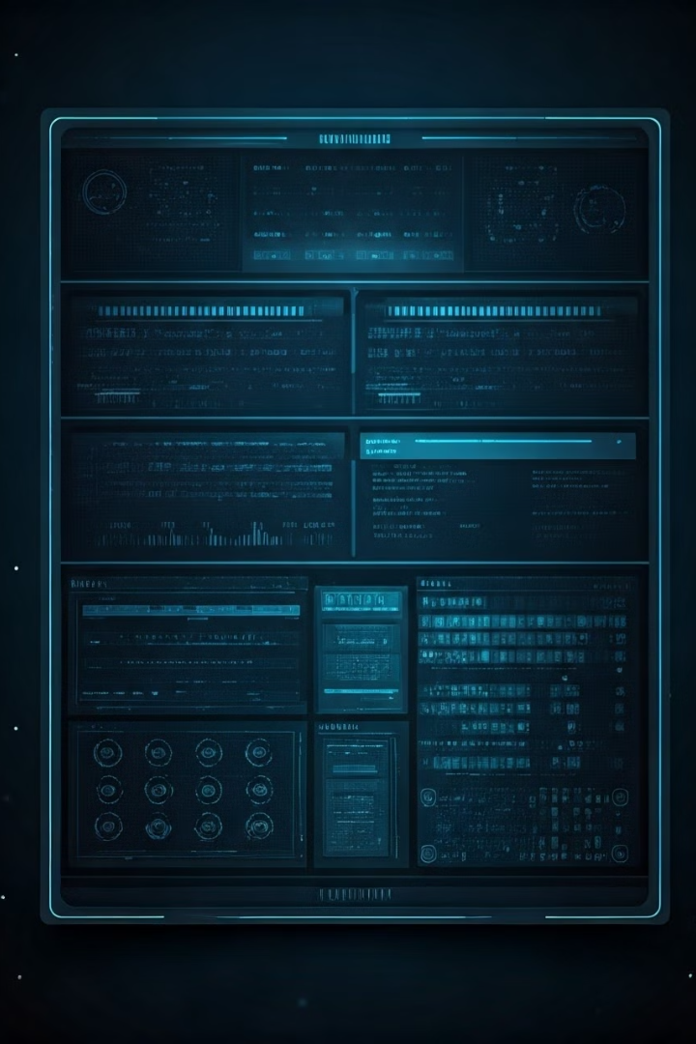
Securing Lunar Assets: Key Strategies
Encryption
Protecting data in transit and at rest.
Authentication
Verifying user/system identities.
Intrusion Detection
Monitoring for suspicious activity.
Incident Response
Planning for quick recovery.

Slide 6
AI and Automation in Lunar Cybersecurity
2
Automated Response
1
AI Threat Detection
Autonomous Systems
3

Slide 7
International Collaboration and Standards
1
Common Standards
2
Share Intel
3
Coordinate Response

Slide 8
Conclusion: A Secure Future for Lunar Exploration
Cybersecurity is key
Proactive Security
Fundamental enabler of lunar success.
Essential to protect lunar assets.
International Collaboration
Critical for a secure future.

