Slide 1


Cultural Connections: Enhancing EU Heritage,
Social Inclusion, and Digital Literacy through our
Pupils’ Hearts
Erasmus+ 2024-2-R001-KA210-SCH-000290935
Co-funded by European Union
04.03.2025-04.03.2027

Slide 2

Our motivation:
Our pupils, are at the of our mission. By our collaborative efforts we support each child to use the power of imagination and Divergent Thinking, raising their awareness of local and EU Cultural Heritage.
By creating educational activities that incorporate cultural heritage using Digital Games and Divergent Thinking, we will address students' needs from diverse backgrounds, including those with special educational needs (SEN) and Roma communities, to feel proud of their heritage, included, and valued.
This Photo by Unknown Author is licensed under CC BY-NC

Slide 3
Objectives:
O1: Enhance the professional skills of 24 teaching staff from four partner organizations in designing both formal and nonformal educational activities focused on cultural heritage. This will be achieved through the use of Digital Games and Divergent Thinking in an inclusive context, facilitated by participation in two joint staff training events during the project.
O 2: Boost social inclusion and empower 240 pupils from the four partner organizations by 20% through the implementation of integrated measures tailored to their needs over the course of the project.
O 3: Improve the academic achievements of 240 students aged 11-15 from the four partner organizations by 10%. This will be accomplished by reducing school absenteeism by 60% and actively involving students in the project’s activities

Slide 4


All together: Romania, Turkey, Lithuania and Spain, we will exchange ideas, reflect, and produce valuable results for peers and stakeholders, such as new methodologies, techniques, guides, integrated optional curricula, and training materials for teachers.
This evolution will benefit our educational institutions, teachers, pupils, and the local community.
This Photo by Unknown Author is licensed under CC BY-SA-NC
This Photo by Unknown Author is licensed under CC BY-SA

Slide 5

We addressed an interesting agenda for our K+ project, which includes:
- Transnational
Management
meetings in Turkey May, 2025
-Joint Staff Training
events in Lithuania October, 2025
and Romania April, 2026
-Short-Term Exchange
of pupils in Spain. November, 2026

Slide 6

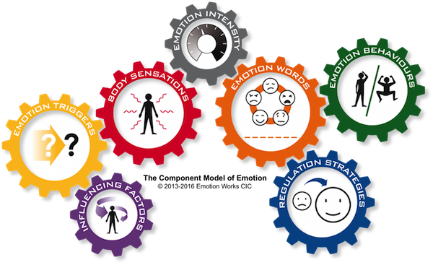
We have to keep in mind that before each activity, each coordinator will provide emotional support for the other participants.
He/ She will also prepare the all needed documents, the link to host coordinator, and 2 hours Q&A sessions.
In order to ensure the acquisition
by the participants of the knowledge
and the skills necessary into the daily work,
each coordinator will ensure:
10 hours of English using theme specialized terms
4 hours of cultural training with a History teacher
6 on-line activities for participants` preparation.
This Photo by Unknown Author is licensed under CC BY-ND

Slide 7

During the mobilities / activities, all the teams will have a leader to ensure good communication and cooperation and equal positions to each partner.
The host coordinator will provide contact info of the school, of the hotel and of the embassies of the participants` country and emergency protocols.
Before the mobilities, each participant will purchase the health insurance, will make sure that the travel papers are valid. Any updates or changes will be sent by email or messaging apps.
In case a teacher can no longer participate to a mobility for objective reasons, a reserve will be designed.

Slide 8

Turkey Activities: Kick-Off Management Meeting
Location: Bener Cordan Ortaokulu, Trabzon, Turkey
Duration: 5 days (11/05/2025 - 15/05/2025)
Activity: Management Meeting
Purpose: To manage and oversee the project’s progress.
Participants: 12 staff members (4 coordinators, 4 heads, 4 alternative coordinators)
Objectives
Build a solid foundation for project execution.
Align partner responsibilities and timelines.
Expected Results
Clear action plans and task distribution for all partners.
Enhanced collaboration and communication.
This Photo by Unknown Author is licensed under CC BY-SA

Slide 9
Turkey will be responsible for eTwinning – each partner will contribute.
Before coming to Trabzon, at least 3 teachers from each partner school must have an eTwinning account.
https://school-education.ec.europa.eu/en/etwinning/projects/cultural-connections-1
Digital Materials: Creating digital training materials for teachers.
Design: Designing project posters, brochures (2000 pieces), logos, roll-ups (1 piece), posters (1 piece), and school project boards, administrating
Events: Planning the Erasmus Days event.

Slide 10

Lithuania Activities: Scientific and Creative Thinking
Location: Ukmerges Uzupio pagrindine mokykla, Lithuania
Duration: 7 days (05/10/2025 - 11/10/2025)
Activity: Scientific and Creative Thinking Workshop
Purpose: To provide 12 teachers with new and modern learning-teaching approaches to science focusing on problem-solving through creative thinking.
Participants: 12 teachers (3 per country)
Objectives
Equip teachers with innovative methods for scientific and critical thinking.
Create inclusive activities that foster problem-solving and curiosity.
Expected Results
• Creation of 6 new learning activities and 2 lesson plans.
• Improved teaching proficiency and student engagement.
• Reduction in absenteeism through inclusive approaches.

Slide 11
Lithuania will create the YouTube channel – each partner will upload their materials.
https://youtube.com/@eu-hearts?si=VTuQtQqsIAqC41kD
Training material for teachers: Creating and publishing teachers training material on "Scientific and Creative Thinking”
Promotion: Producing 4 short video content for promotion and awareness.
Meetings: Organizing 4 online meetings for students.
Consultations: Conducting virtual information and consultation meetings.

Slide 12

Romania Activities: Use of Divergent Thinking in Education
Location: Şcoala Gimnazială nr. 2 Fundeni-Dobroeşti, Romania
Duration: 7 days (19/04/2026 - 25/04/2026)
Activity: Blended Short-Term Teachers Training
Purpose: To provide 12 staff with new learning and teaching methods on how to use in a creative and innovative way the Divergent Thinking approaches
by involving Digital Games too.
Participants: 24 teachers from partner organizations
Objectives
• Train teachers to apply divergent thinking techniques in teaching basic skills.
• Promote inclusion by tailoring activities for disadvantaged students and those with SEN.
Expected Results
• Enhance teaching proficiency of 24 teachers by 20%.
• Development of innovative lesson plans for classrooms.
• Improve student engagement and reduce absenteeism.

Slide 13
Romania will take care of the project website and will upload the materials provided by the partners to the Google Drive
https://drive.google.com/drive/folders/1ZDtUbaymEkZK9Or1Xfz-ixvAJ8yNI2yA?usp=sharing

Slide 14
Romania, as main coordinator:
Communication: Ensuring seamless communication among partners and preventing project deviations.
Curricula: Creating and publishing the integrated optional curricula with the same name of our Project
OER Guide: Creating and publishing Teacher’s Guide of 80 pages, A4 format, with an ISBN number (printed in 50 copies, and available online/e-Guide on websites for teachers, parents, experts in education, etc.)
Blended Short-term Teachers Training Event: Organizing and carrying it out- "Use of Divergent Thinking in Education of basic skills"
Planning: Designing the Management and Communication Plans.
Evaluation: Creating initial, intermediate, and final questionnaires to assess if the project meets its objectives.
Analysis: Analyzing results, reflecting, and writing reports.
Conclusion: Preparing the project conclusion article.
Platforms: Utilizing ESEP and E+ PRP platforms.
eTwinning: Co-founding the complementary eTwinning project.
Mobility: Managing preparation, follow-up, and evaluation activities related to mobility

Slide 15

Spain Activities: Games-Based Learning including imagination
Location: CEIP JOSÉ CALDERÓN, Málaga, Spain
Duration: 3 days (02/11/2026 - 04/11/2026)
Activity: Short-Term exchange of groups of pupils
Purpose: To develop basic skills in reading, writing, numeracy, and computer literacy, while also fostering an appreciation for cultural heritage.
Participants: 40 students and teachers (10 participants per country)
This Photo licensed CC BY-SA
Objectives
• Foster creativity and social inclusion through game-based learning.
• Enhance understanding and appreciation of EU cultural heritage.
Expected Results
• Creation of 4 e-educational games.
• Strengthened intercultural awareness among students.
• Boost in creativity and teamwork.

Slide 16
Spain will create the Facebook page – each partner will upload their own materials.
Lesson Content: Preparing 4 lesson contents and 4 non-formal learning activities adapted with the imaging technique based on peer education
Clubs: Establishing Thinking clubs.
Dissemination: Creating and using social media accounts and other dissemination channels.

Slide 17
Project results:
Enhance by 20% teaching proficiency for 24 teachers in Divergent Thinking
Promote social inclusion and reduce absenteeism by 60% for 240 students
Improvement by 20% of learning process
Increasing by 20% of creative skills and Critical Thinking
Increasing by 10% in basic skills and academic success
Integrated curricula
OER Guide with ISBN no. for staff
Website
Twin space
E+PRP

Slide 18

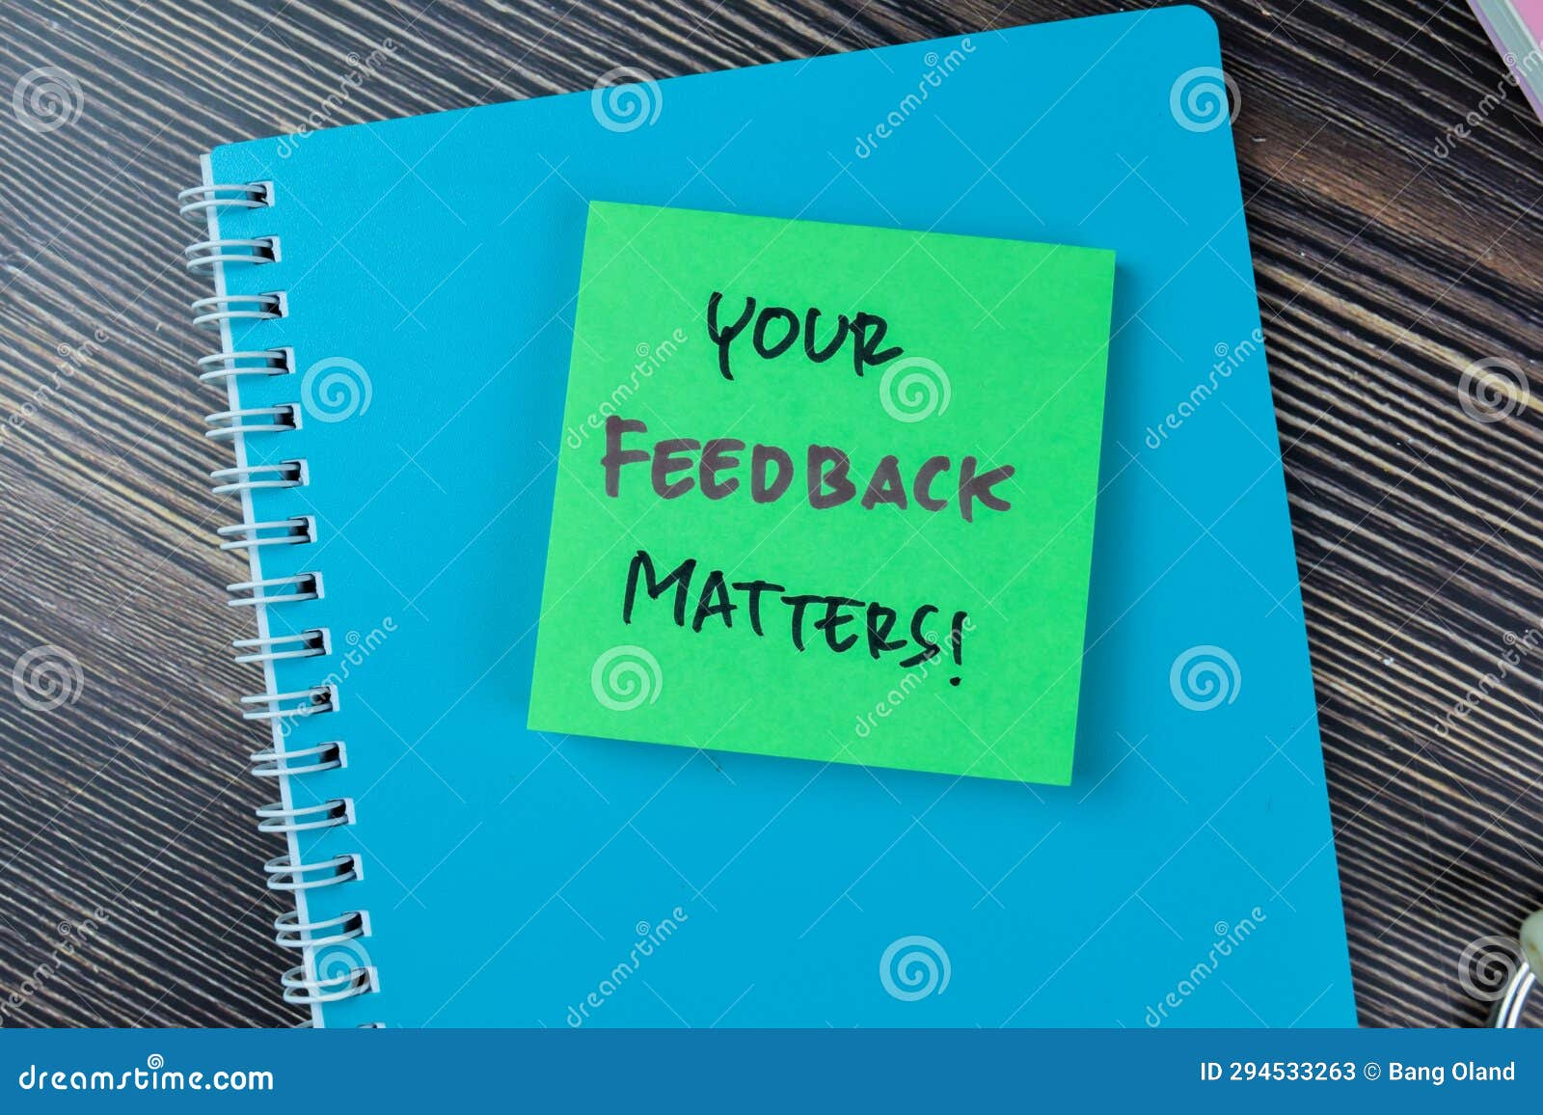



Last but not least.......
- Contract Agreements and GDPR rules will be signed by all partners.
- all the materials will be prepared in English
We will all need:
Meeting minutes, monitoring surveys, satisfaction questionnaires, feedback after each activity
Activities report, evaluation analysis
photos, videos, work results in Padlet
Europass Mobility Certificates, Attendance Certificates
-
English, please..

Slide 19
DISCLAIMER Funded by the European Union. The views and opinions expressed are those of the author(s) and do not necessarily reflect the views and opinions of the European Union or the European Education and Culture Executive Agency (EACEA). Neither the European Union nor the EACEA can be held responsible for them.

Slide 20

Thank you
For sustainability, digital tools will reduce the carbon footprint.
Digital signatures, e-folders, online surveys, etc. will also ensure efficient and eco-friendly project management

