Slide 1
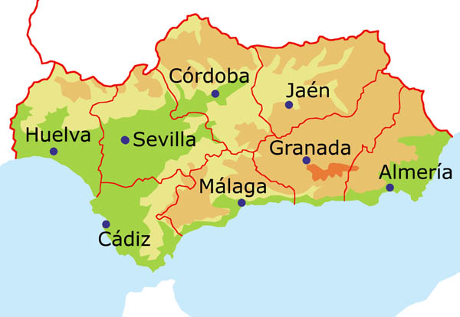
ANDALUCÍA
Andalusia is a large autonomous region of hills, rivers and farmland forming Spain’s southern coast. It was under Moorish rule from the 8th-15th centuries, a legacy that shows in its architecture, including such landmarks as the Alcázar castle in Seville, the capital city, as well as Córdoba’s Mezquita Mosque-Cathedral and Granada’s Alhambra palace and Malaga”s Alcazaba that the delegations will get to see in their convening.

Slide 2
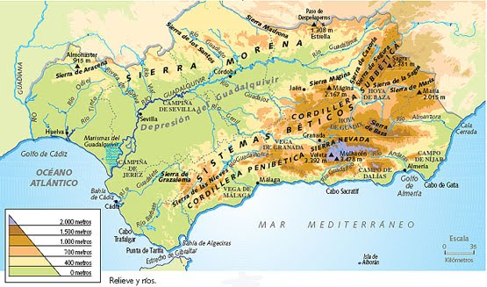
ANDALUSIAN TOPOGRAPHY
Andalucía, Spain's southernmost region, features incredibly diverse geography, featuring Europe's highest peaks (Sierra Nevada), the arid Tabernas Desert (Europe's only one), fertile river valleys (Guadalquivir), and extensive coasts on both the Atlantic and Mediterranean, separated by the Strait of Gibraltar from Africa. It's characterized by dramatic contrasts, from snowy mountains and olive groves to sun-drenched beaches, all shaped by its unique location where two oceans and two continents meet.

Slide 3
TRADITIONAL FOODS

Slide 4
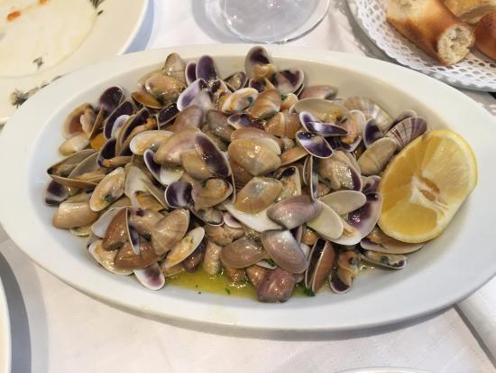
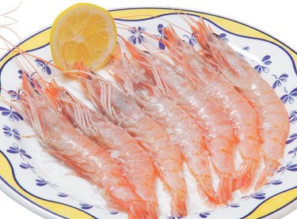
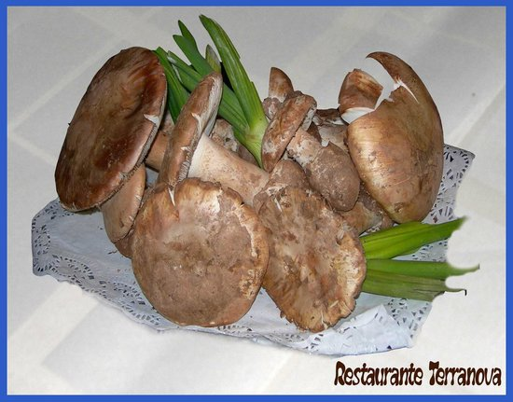
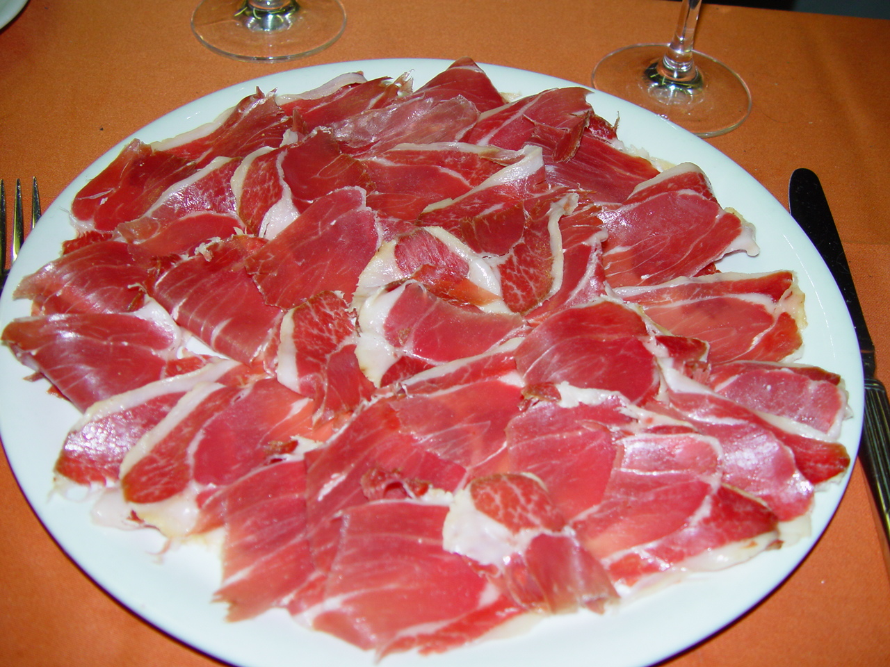
HUELVA CUISINE
Gambas de Huelva
Coquinas
Jamón Serrano
Setas

Slide 5
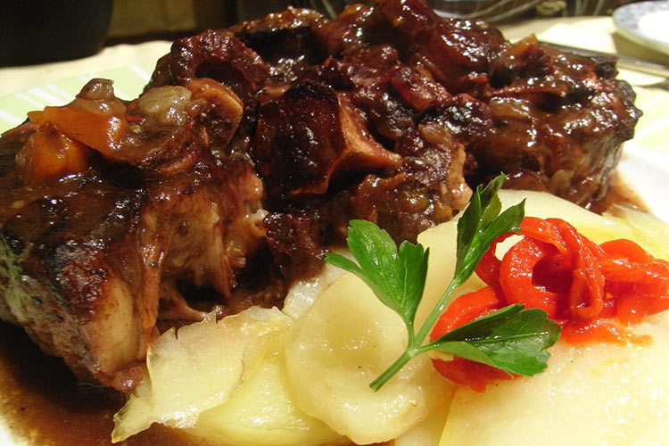
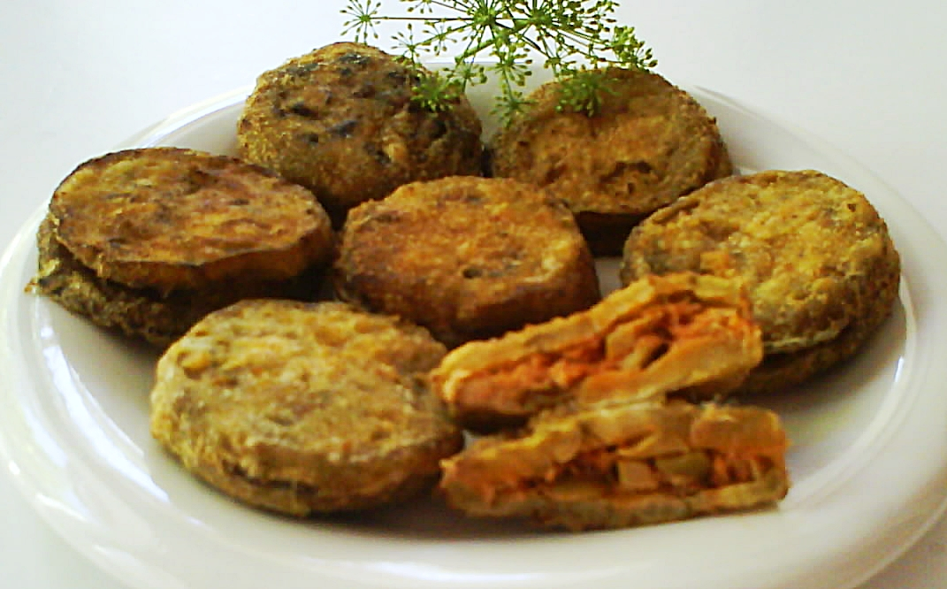
ALIMENTOS DE SEVILLA
Rabo de toro
Berenjena sevillana

Slide 6
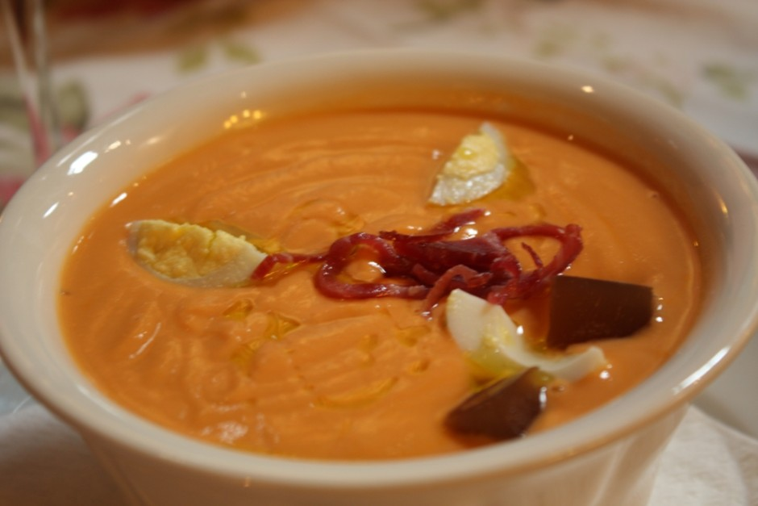
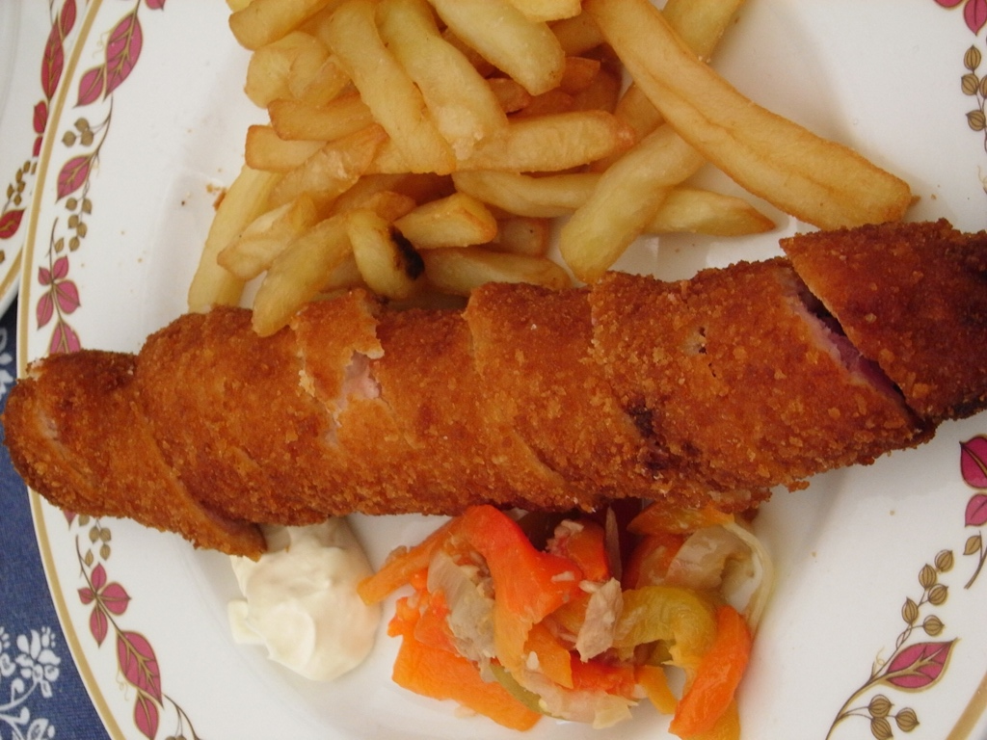
ALIMENTOS DE CÓRDOBA
Flamenquín
Salmorejo

Slide 7
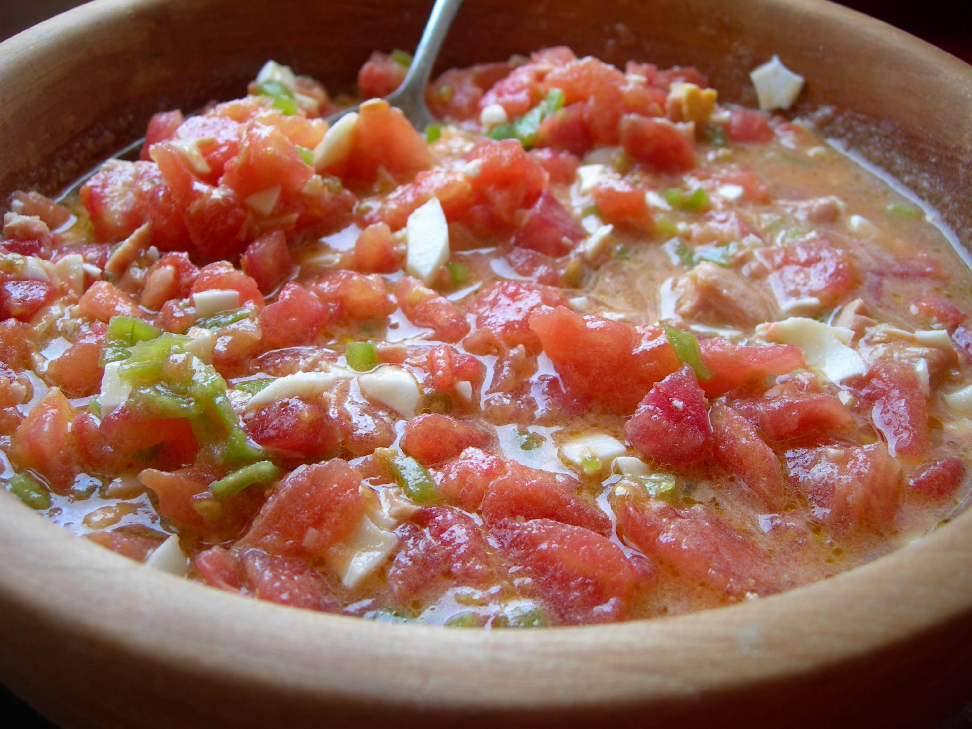
ALIMENTOS DE JAÉN
Pipirrana Jienense

Slide 8
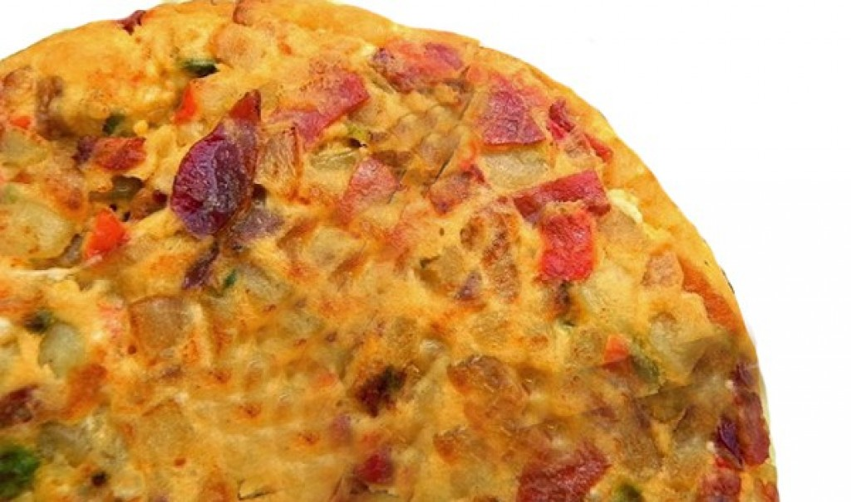
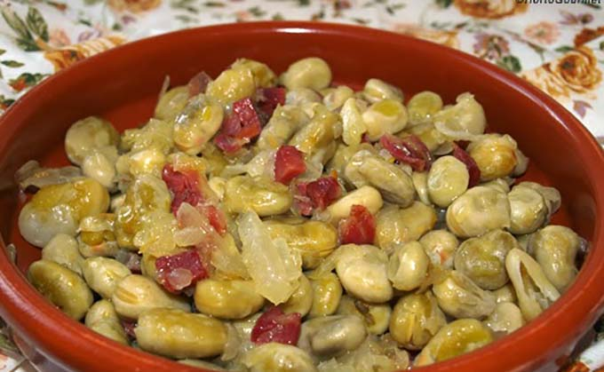
ALIMENTOS DE GRANADA
Habas con jamón
Tortilla sacromonte

Slide 9
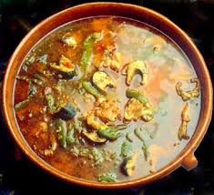
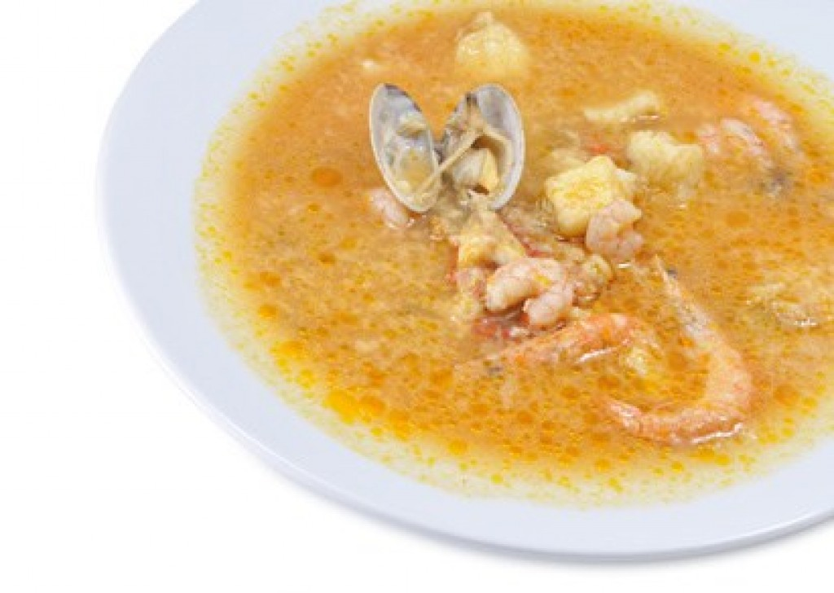
ALIMENTOS DE ALMERÍA
Sopa de Almería
Caldo quemao

Slide 10
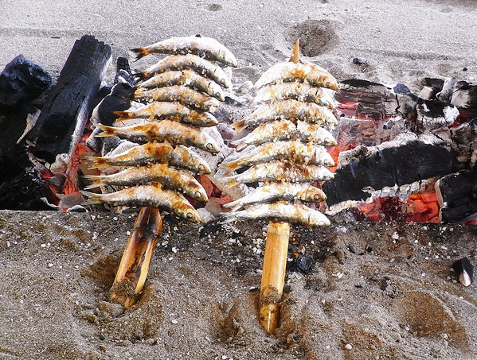
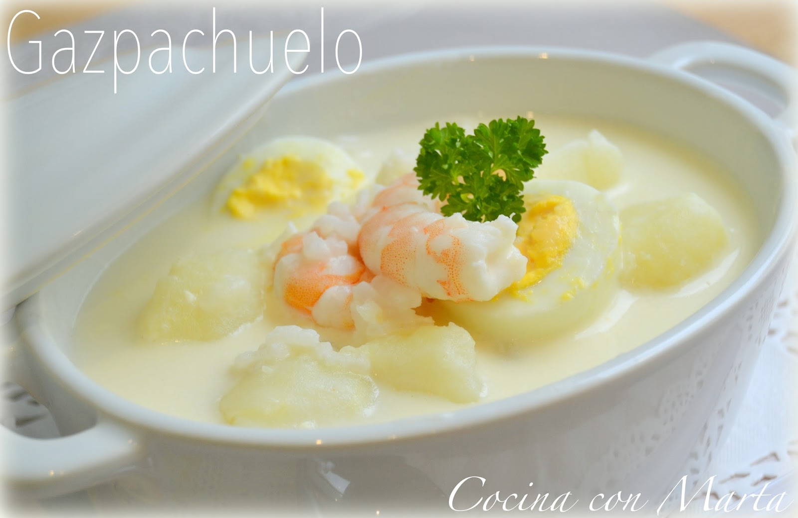
ALIMENTOS DE MALAGA
Espeto

Slide 11
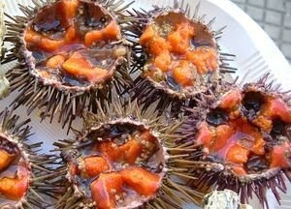
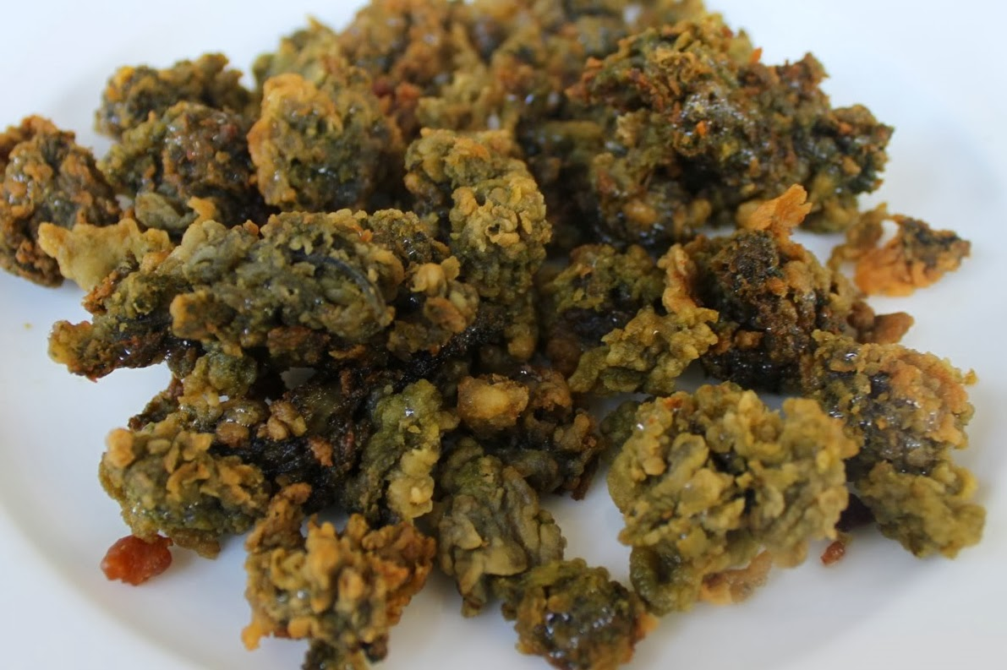
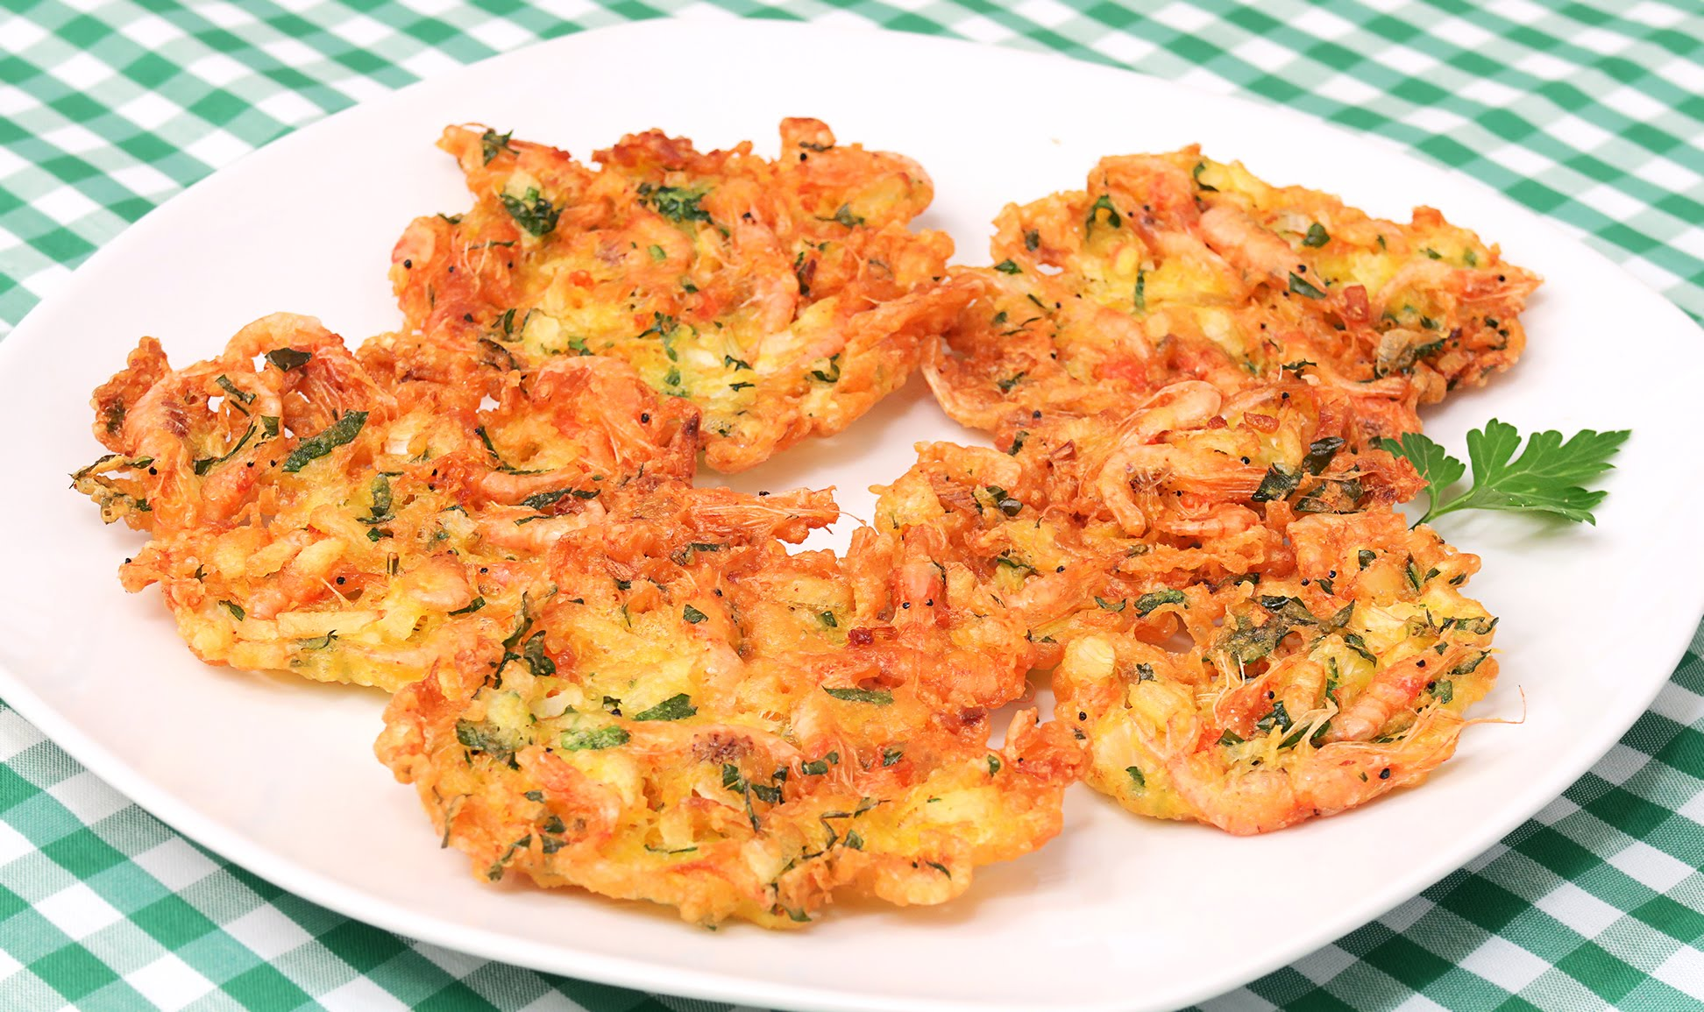
ALIMENTOS DE CADIZ
Erizos de mar
Ortiguillas de mar
Tortillita de camarones

Slide 12
MONUMENTS

Slide 13
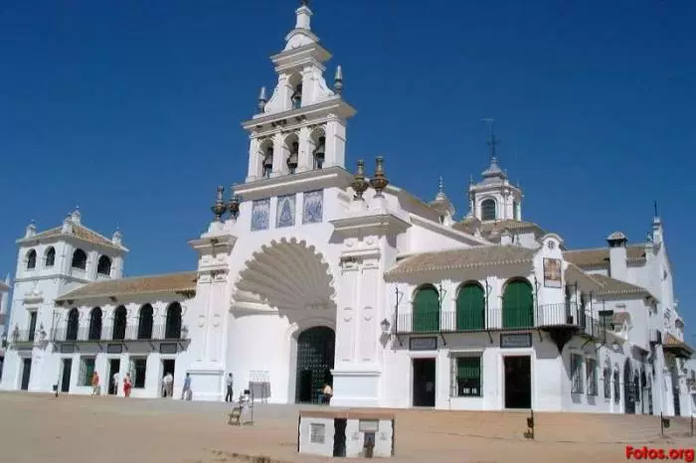
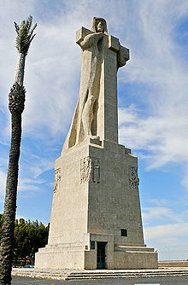
HUELVA
Monumento a Colón
El Rocío

Slide 14
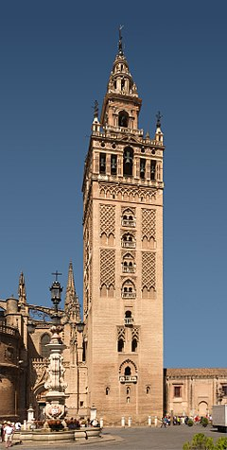
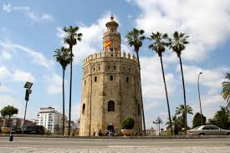
SEVILLA
Giralda
Torre del Oro

Slide 15
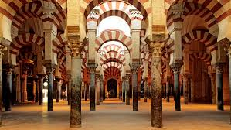
CÓRDOBA
Mezquita

Slide 16
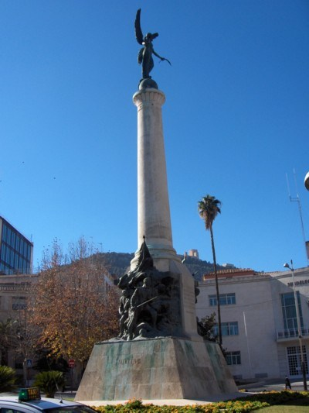
JAÉN
Monumento a las batallas de Jaén

Slide 17
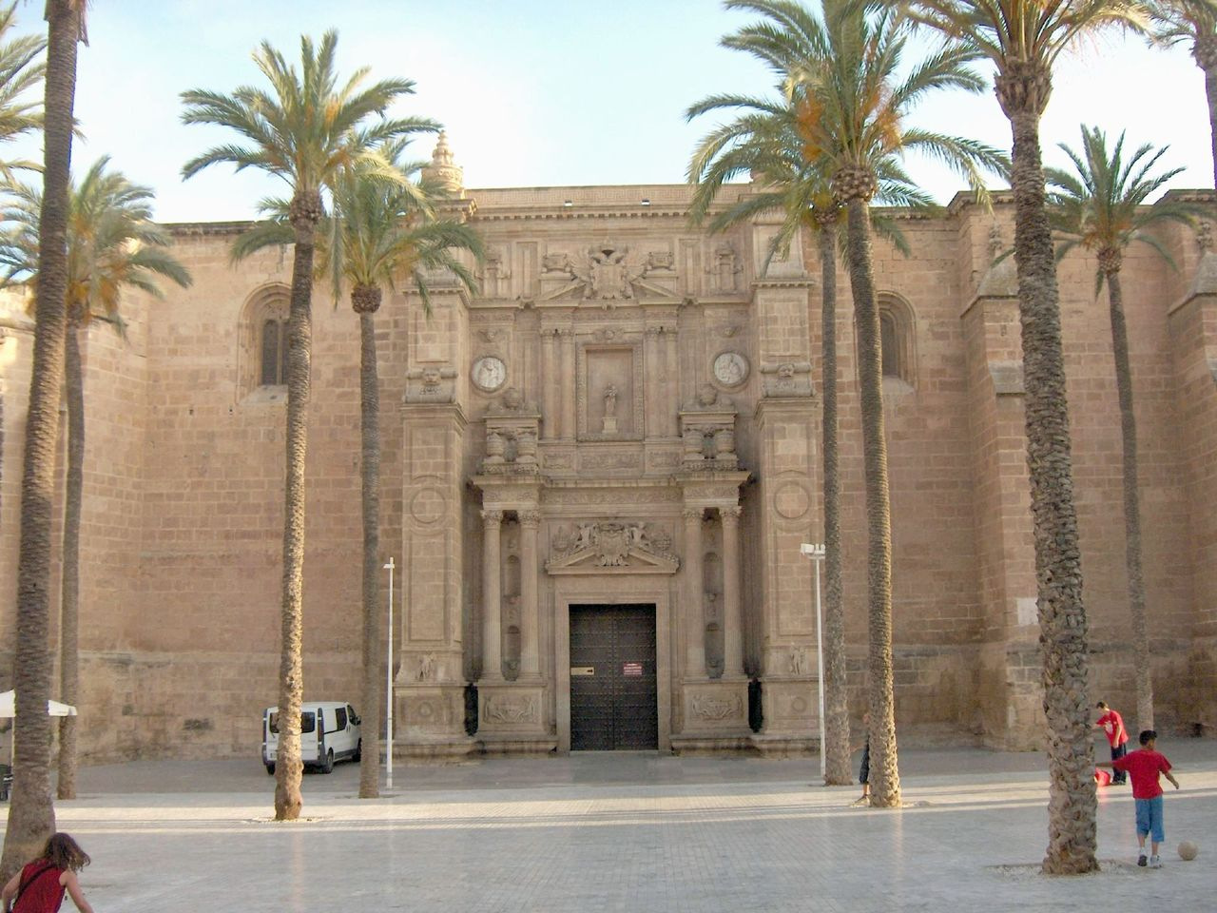
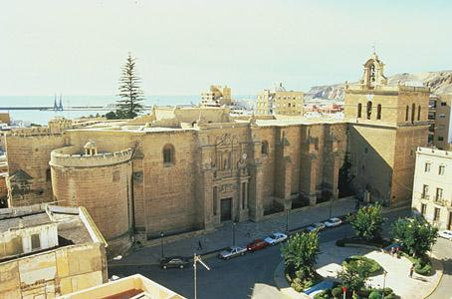
ALMERÍA
Catedral

Slide 18
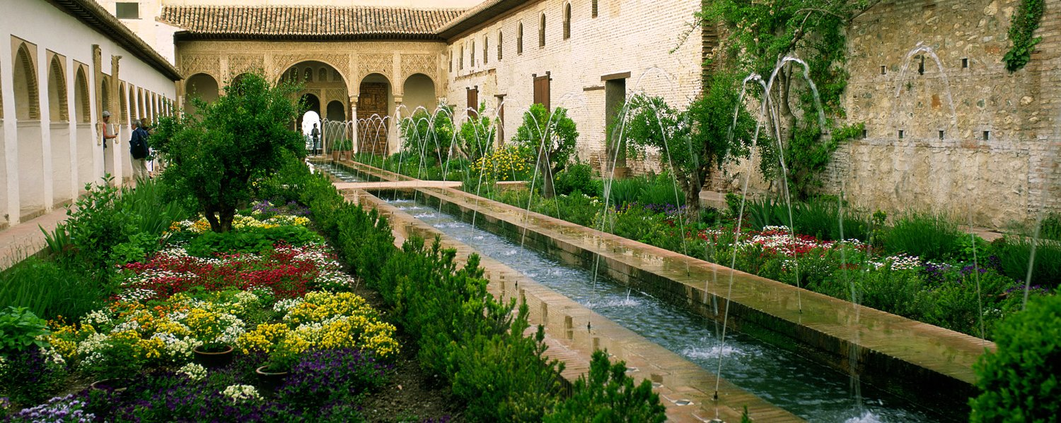
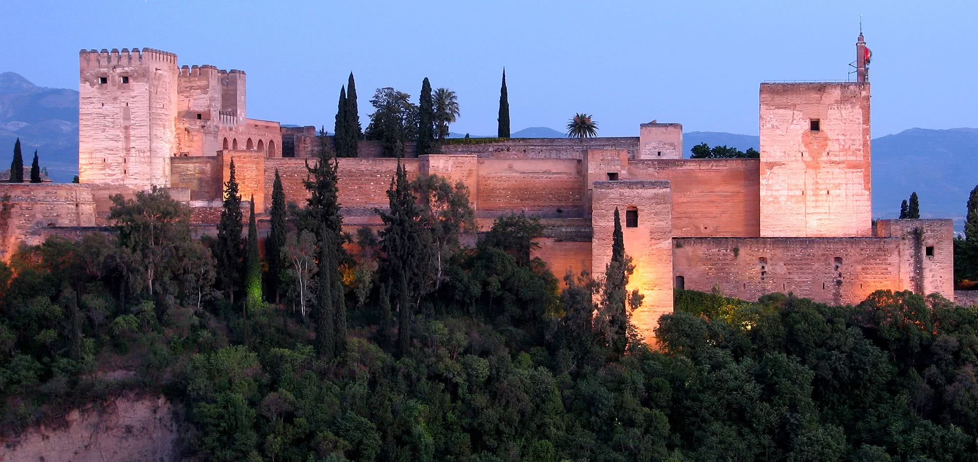
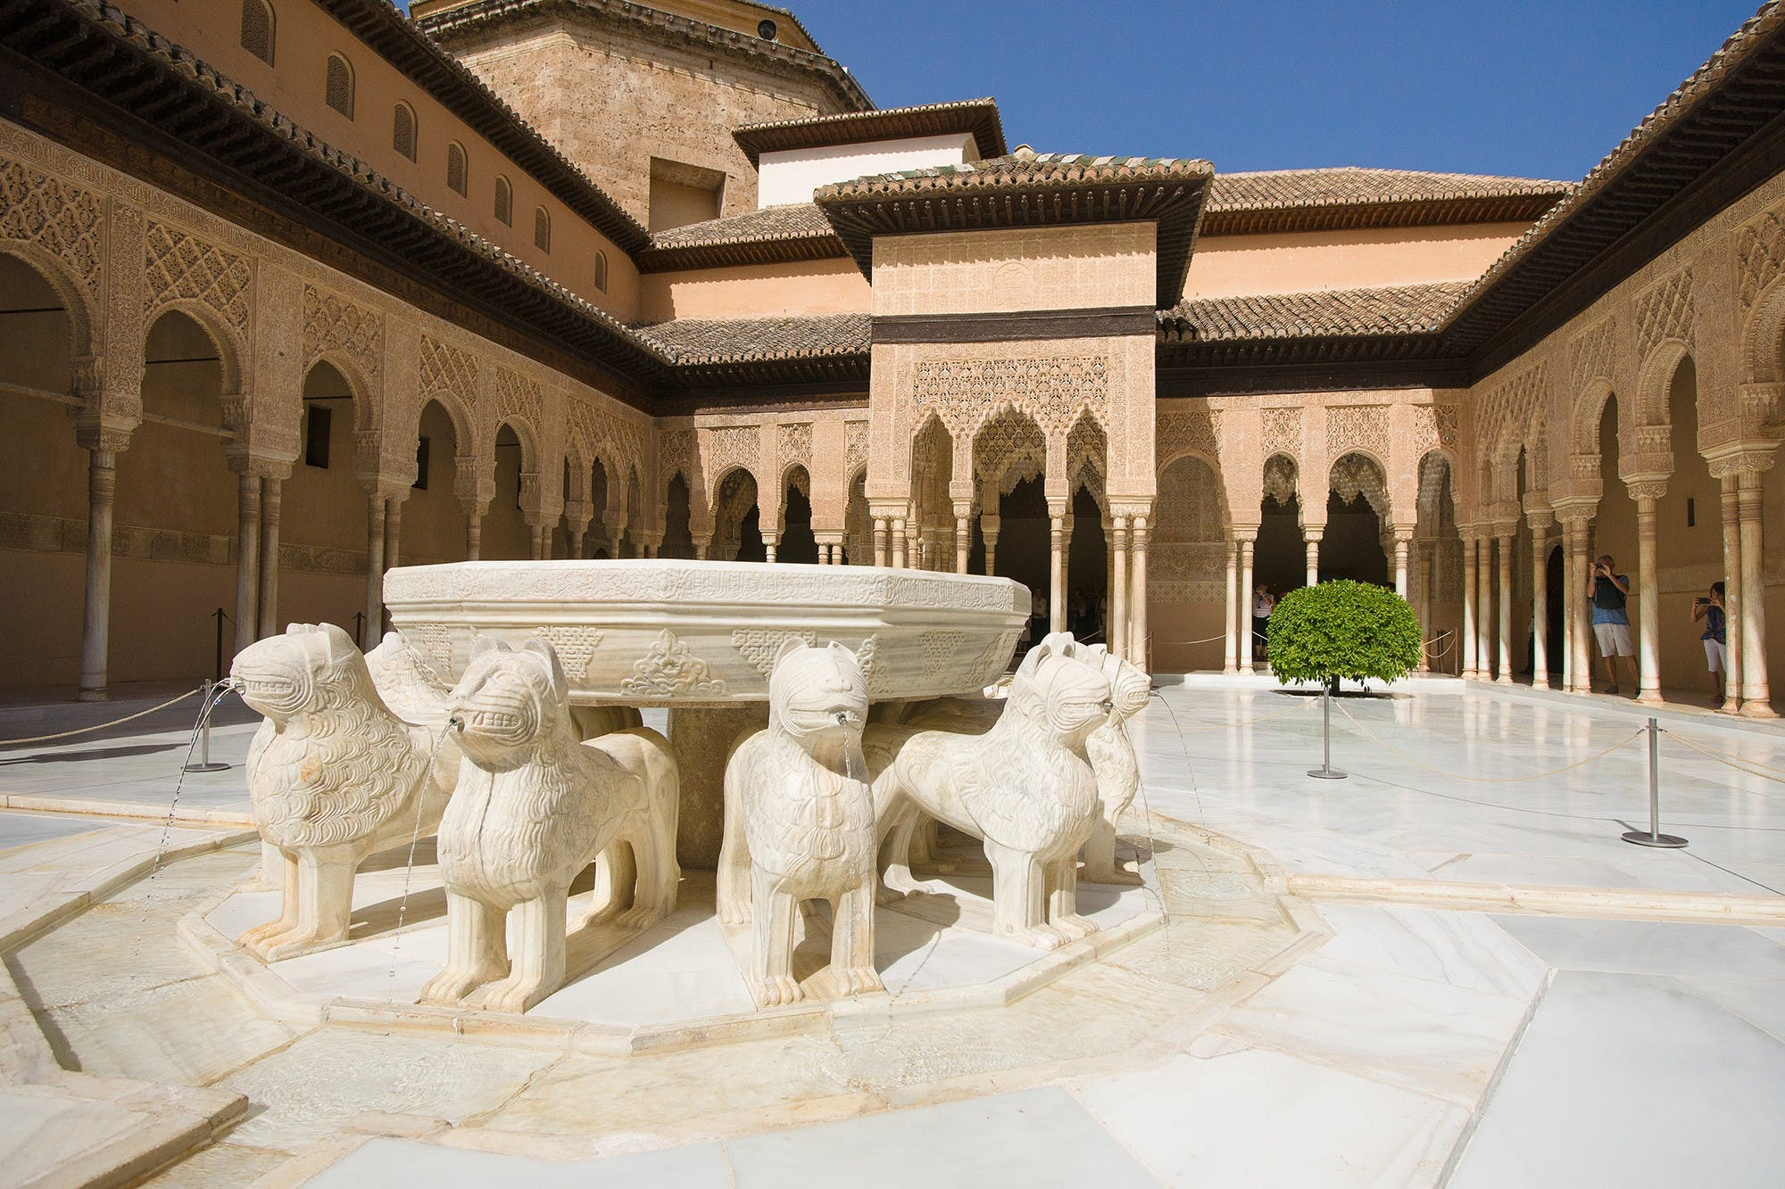
GRANADA
Alhambra

Slide 19
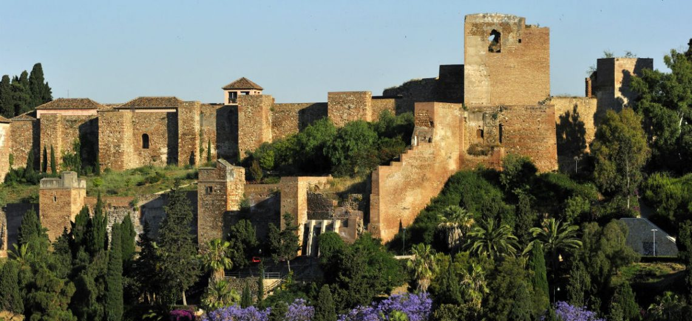
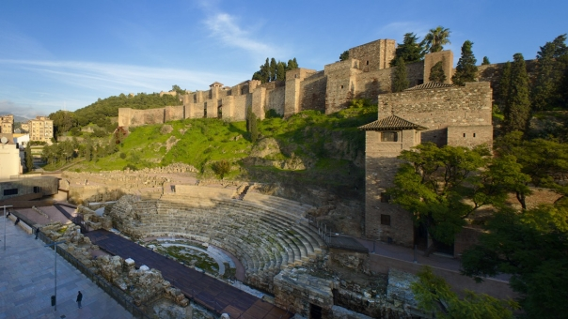
MÁLAGA
La Alcazaba

Slide 20
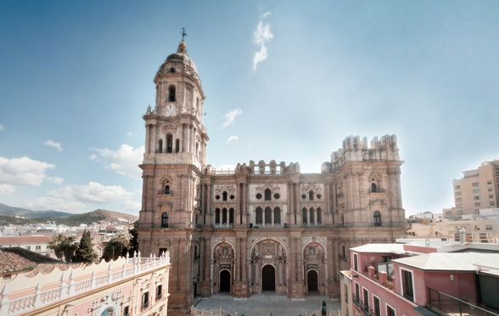
Catedral de Málaga
“La Manquita”

Slide 21
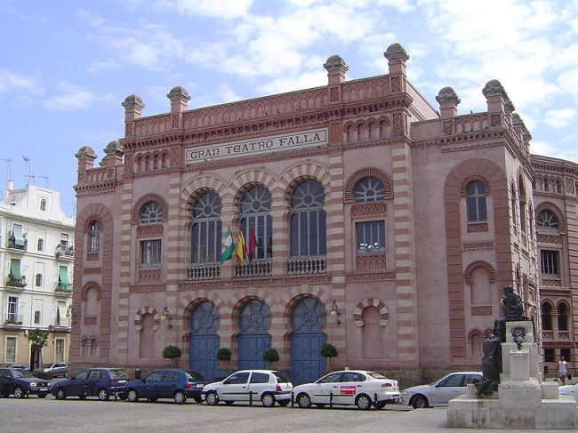
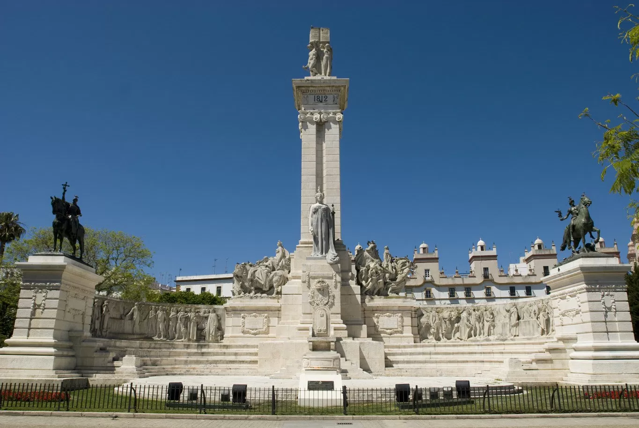
CÁDIZ
Monumento a la Constitución de 1.812
Teatro Falla

Slide 22
PROMINENT
FIGURES

Slide 23
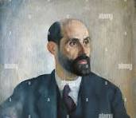
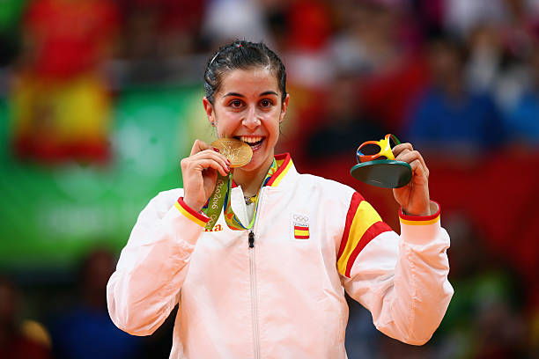
HUELVA
Carolina Marin
the first Spanish badminton player to win an Olympic gold medal
Juan Ramón Jiménez
Nobel Prize in Literature

Slide 24
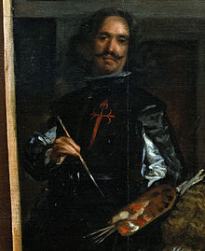
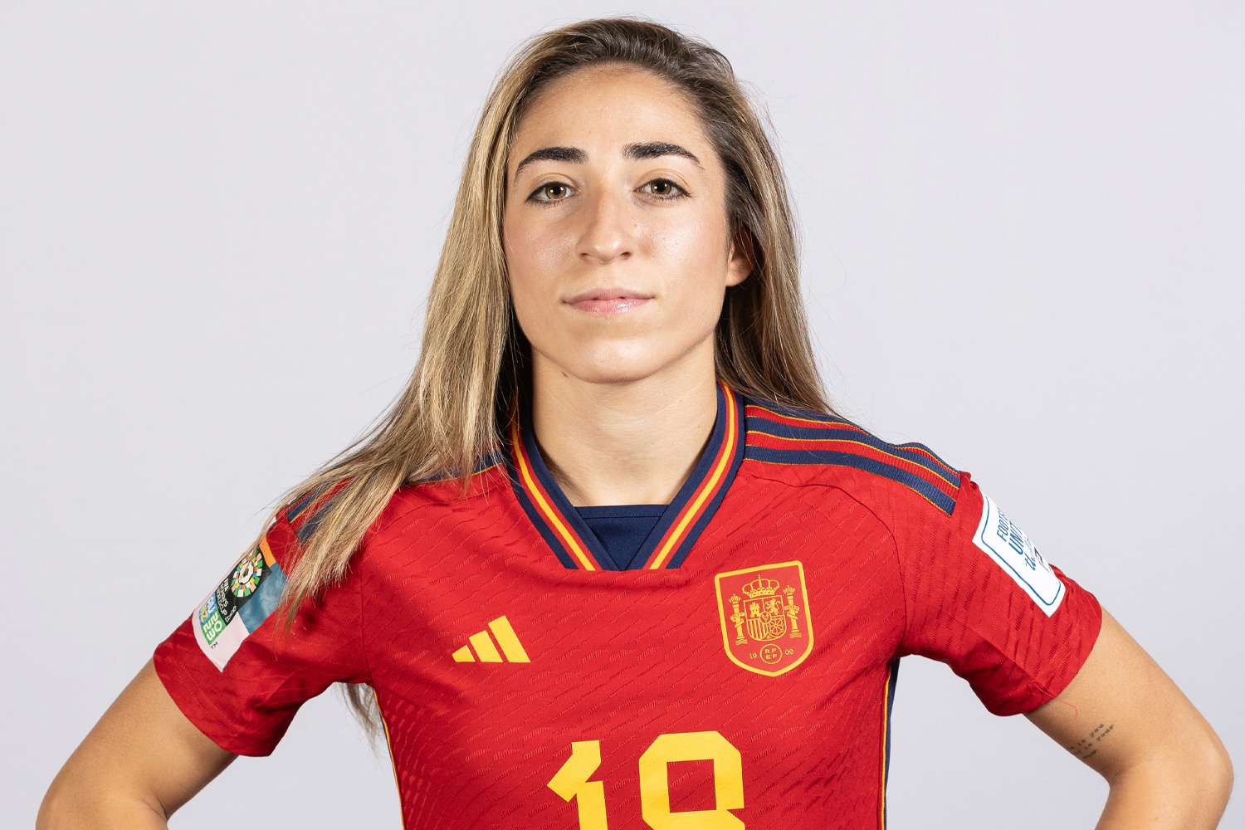
SEVILLA
Olga Carmona,
Soccer World Cup winner.
Velázquez. Painter of Las Meninas.

Slide 25
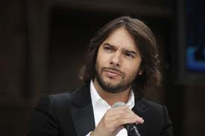
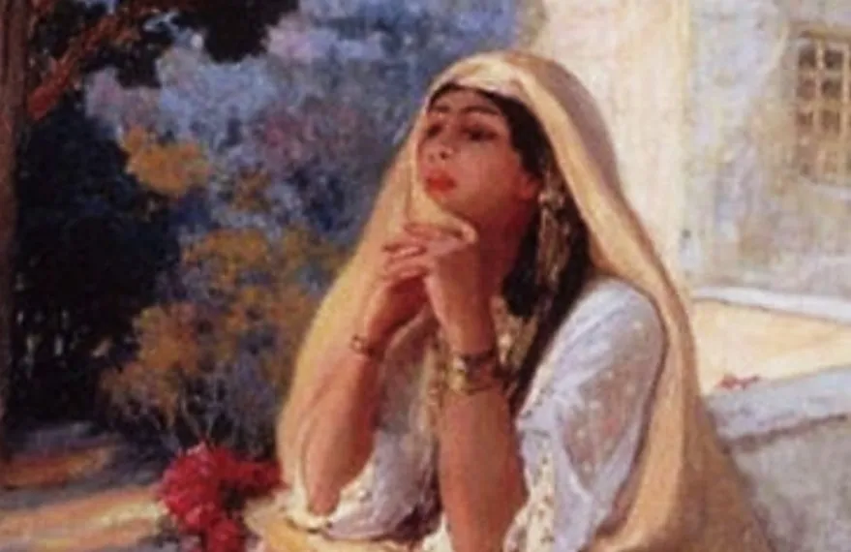
CÓRDOBA
Joaquín Cortés. Bailador internacional.
Zayda, muslim princess from Al Andalus.

Slide 26
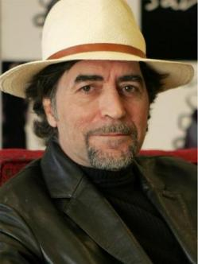
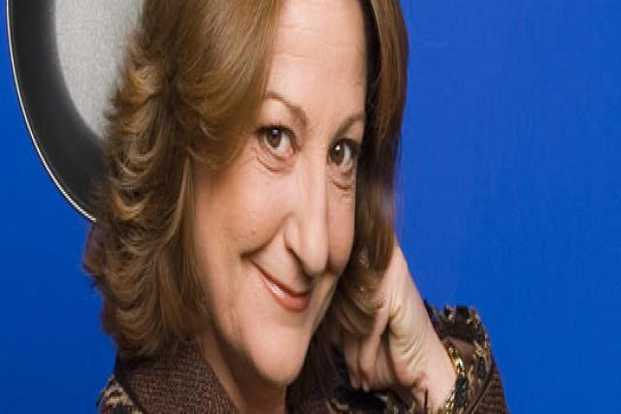
JAÉN
Rosario Pardo. Actress
Joaquín Sabina. Singer and composer.

Slide 27
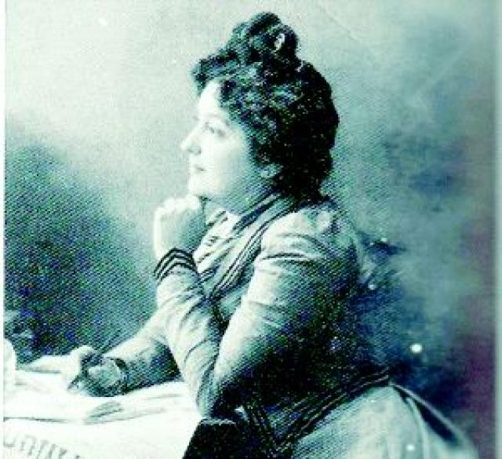

ALMERÍA
Carmen de Burgos. Journalist, writer, translator and suffragist who fought tirelessly for women’s rights.

Slide 28
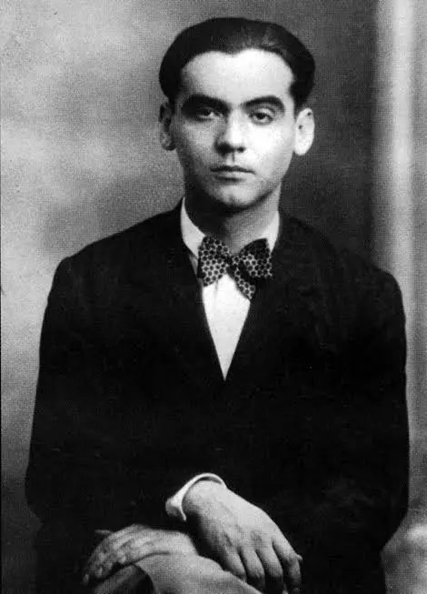
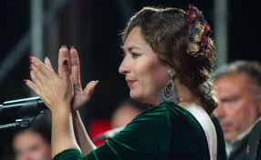
GRANADA
Estrella Morente. Spanish flamenco singer. https://www.youtube.com/watch?v=3PJiNOJsK8E&list=RD3PJiNOJsK8E&start_radio=1
Federico García Lorca. Poet, writer and theatre director.

Slide 29
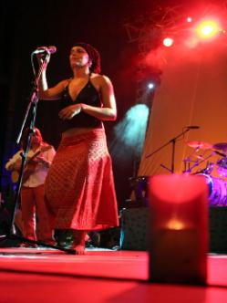
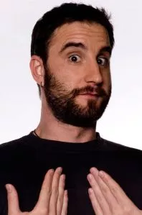

MÁLAGA
La Mari de Chambao. Flamenco singer and composer.
Antonio Banderas, The most Universal malagueño
Dani Rovira. Monologuista y actor.

Slide 30
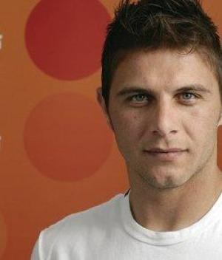

CÁDIZ
Sara Baras. Bailaora de flamenco.
Joaquín Sánchez . Famous footballer from Real Betis.

Slide 31
THE END

