Slide 1

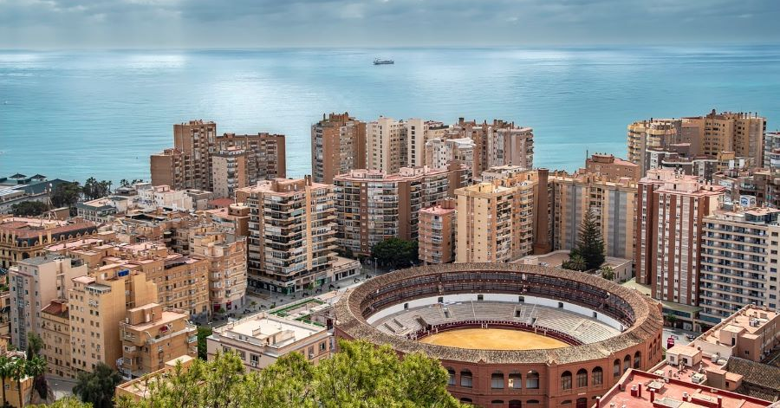
ERASMUS +
SPAIN MOBILITY PLAN
CEIP JOSÉ CALDERÓN
MÁLAGA, SPAIN

Slide 2
Dates and scheduling
, We have scheduled the following dates for the Spanish mobility plan:
Traveling dates, Monday, November 16th and Friday November 20 th.
Tuesday, November 17th, 2026
Wednesday, November 18th
Thursday, November 19th.

Slide 3
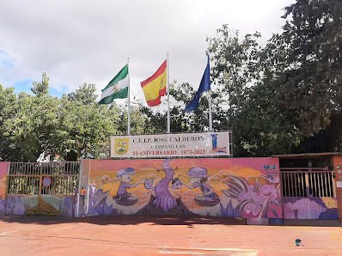
Tuesday, November 17th Agenda
Reception at CEIP José Calderón.
Brief introduction from principal Salvador welcoming all of the Erasmus students to our school in Málaga.
Following Salvador's message, students from our school will do a small presentation about Spain and Málaga for their Erasmus guests.

Slide 4
Tuesday, November 17th Agenda
We would like to propose that the Erasmus delegations from Lithuania, Romania and Turkey prepare a brief 8-10 minute introduction about their hometowns and countries of origin.
Breakfast break
After the break, we will have all students participate in a gymkhana (field day) based on popular, cooperative Spanish games.
Our lunch will take place at Camposol Restaurant with a fixed menu.

Slide 5
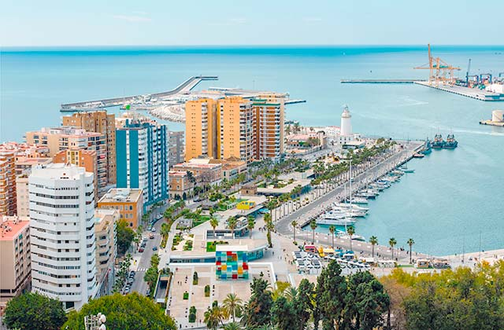
Tuesday, November 17th Agenda
In the evening, we’ll have all the delegations enjoying a beautiful stroll along Muelle Uno, the historical and touristic pier in Málaga Port, downtown.
We will take the opportunity to visit the Pompidou Museum, also located at the Muelle, and the Cathedral.
Finally, we will enjoy a delicious pizza at Pizzeria La Caprichosa.

Slide 6
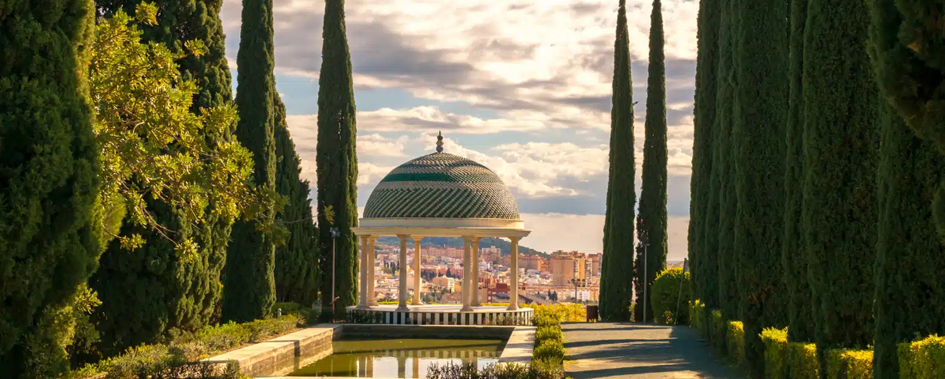
Wednesday, November 18th Agenda
Early in the morning, we will take the opportunity to visit the high school that enrolls a majority of our CEIP José Calderón students.
Our school’s alumni will be our ambassadors to Campanillas High School and they’ll give us a short tour of the campus.
The group will visit the La Concepción Botanical Gardens. All participants will be provided with a bag lunch, including a typical spanish bocadillo, drink, and fruit.

Slide 7
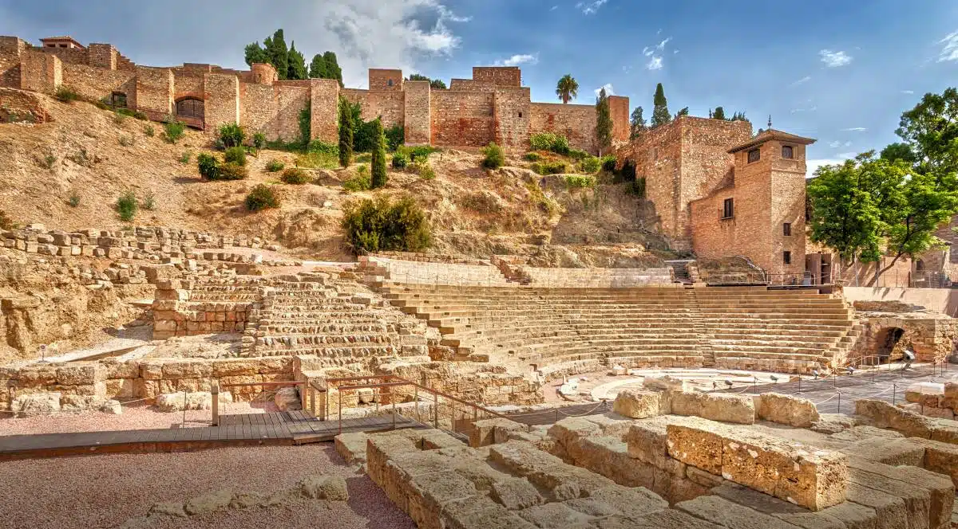
Wednesday, November 18th Agenda
We will finish the day admiring the beauty of La Alcazaba Muslim fortress that overlooks downtown Málaga and the sea, as well as the Roman Theater.

Slide 8
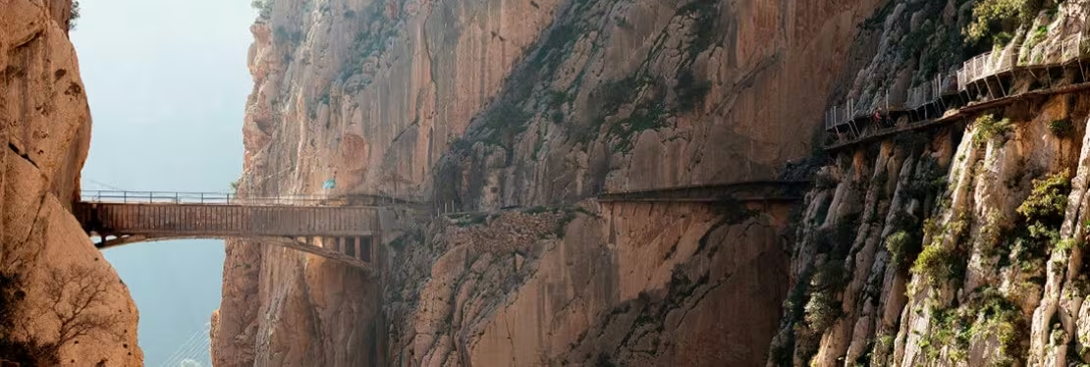
Thursday, November 19th Agenda
The group will take a field trip to El Caminito del Rey (the King’s Pathway) located next to the Conde de Guadalhorce Reservoir. This route takes 2-3 hours and is mildly physically challenging.
A picnic will be organized for lunch. Once again, Spanish-style bocadillos will be provided for the delegation.
In the early evening, we will visit the Museum of Imagination, where our expedition will let their creativity run wildly.
That evening we will host our final dinner and farewell.

Slide 9

¡¡¡ Gracias por su atención !!!

