Slide 1
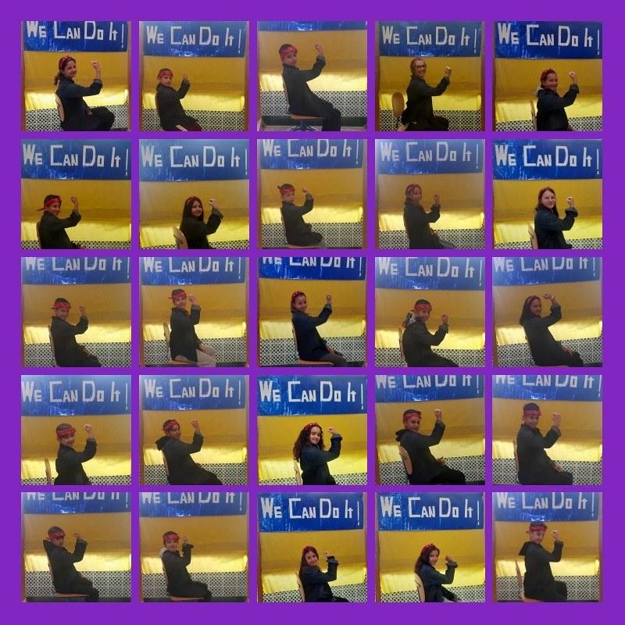
The Spanish Educational System
X de diciembre
Equipo de Málaga

Slide 2
Educational System & Structure

Slide 3
The foundations of the Spanish education system
The structure of the Spanish education system is complex, and comprises:
the education authorities, education professionals, and all other, public and private operators, which contribute to making the right to education a reality in Spain, as well as the beneficiaries of this right;
the set of relationships, structures, measures and actions being implemented to deliver the education system.
Ministerio de Educación: https://administracion.gob.es/pag_Home/Tu-espacio-europeo/derechos-obligaciones/ciudadanos/educacion/sistema-educativo/organizacion.html

Slide 4
The 1978 Spanish Constitution provides a decentralised model that shares the educational roles and competences across all administrative levels. It is a symmetrical model in which the educational roles and competences of the autonomous communities are basically the same.
The roles and competences in education are distributed among:
The General State Administration (Ministry of Education, Vocational Training and Sports).
The autonomous communities (regional ministries or departments of education) in the cities of Ceuta and Melilla, the MEFPD is in charge of educational roles and competences.
The local administrations, with a role in educational management through Education Councils or Municipal Education Institutes.
The education centres also have a part given their autonomy in terms of pedagogical autonomy (to develop their own educational projects) and financial autonomy to manage the resources.
Ministerio de Educación: https://administracion.gob.es/pag_Home/Tu-espacio-europeo/derechos-obligaciones/ciudadanos/educacion/sistema-educativo/organizacion.html

Slide 5
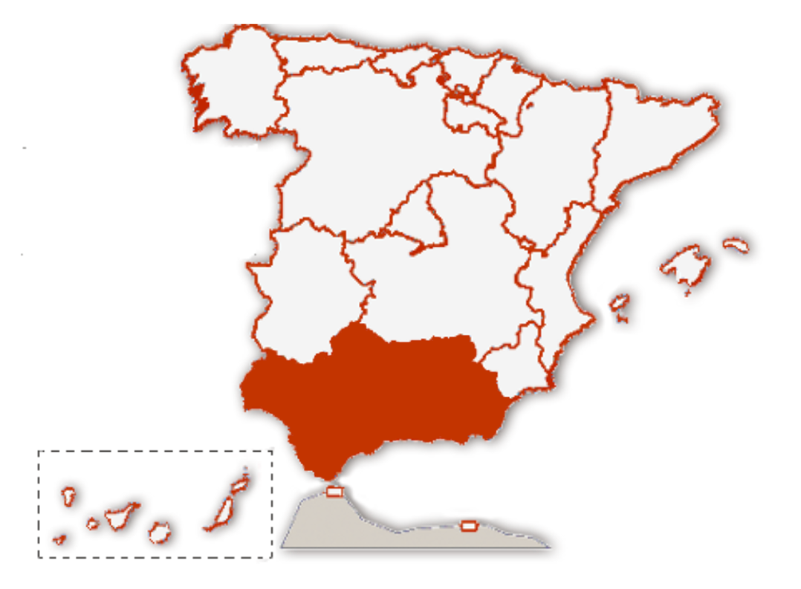
Comunidades Autónomas
The Organic Law 3/2020, approved December 29, 2020 (LOMLOE) and modifying the Organic Law of Education of 2006 (LOE), regulates the educational system and establishes the distribution of educative competencies and roles between the Central Government and the Autonomous Communities (states).
El Colegio José Calderón is located in the Autonomous Community of Andalucía.
Ministerio de Educación: https://administracion.gob.es/pag_Home/Tu-espacio-europeo/derechos-obligaciones/ciudadanos/educacion/sistema-educativo/organizacion.html

Slide 6
Main characteristics of the administration of the education system
Decentralisation: educational competences are shared between the General State Administration (Ministry of Education, Vocational Training and Sports) and the authorities of the autonomous communities (Departments for Education):
the central education administration executes the general guidelines of the Government on education policy and regulates the basic elements or aspects of the system;
regional education authorities develop the State regulations and have executive and administrative competencies for managing the education system in their own territory.
Schools have pedagogical, organisational and managerial autonomy for their resources.
Participation of the education community in the schools’ organisation, governance, running and evaluation.
Eurodice: https://eurydice.eacea.ec.europa.eu/eurypedia/spain/overview

Slide 7
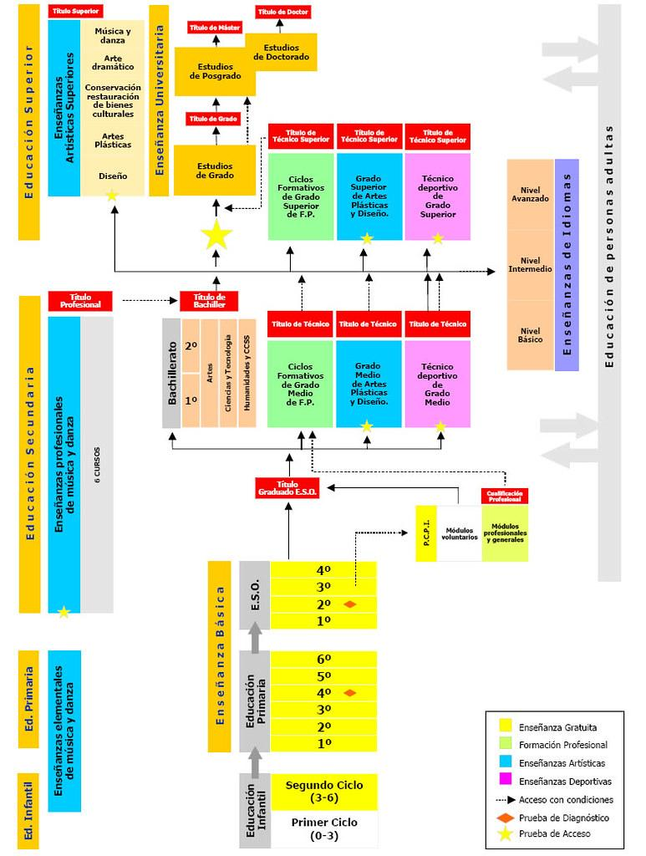
Structure and organisation of the Spanish education system
The Spanish education system consists of the following stages:
Early childhood education.
Primary education.
Compulsory secondary education [ESO].
Upper secondary education [Bachillerato].
Vocational Training [FP].
Adult education.
University education.
The Spanish system also offers education in languages, artistic pursuits and sports, which is regarded as specialised education.
Ministerio de Educación:
https://www.educacionfpydeportes.gob.es/contenidos/in/sistema-educativo.html
https://administracion.gob.es/pag_Home/Tu-espacio-europeo/derechos-obligaciones/ciudadanos/educacion/sistema-educativo/organizacion.html

Slide 8
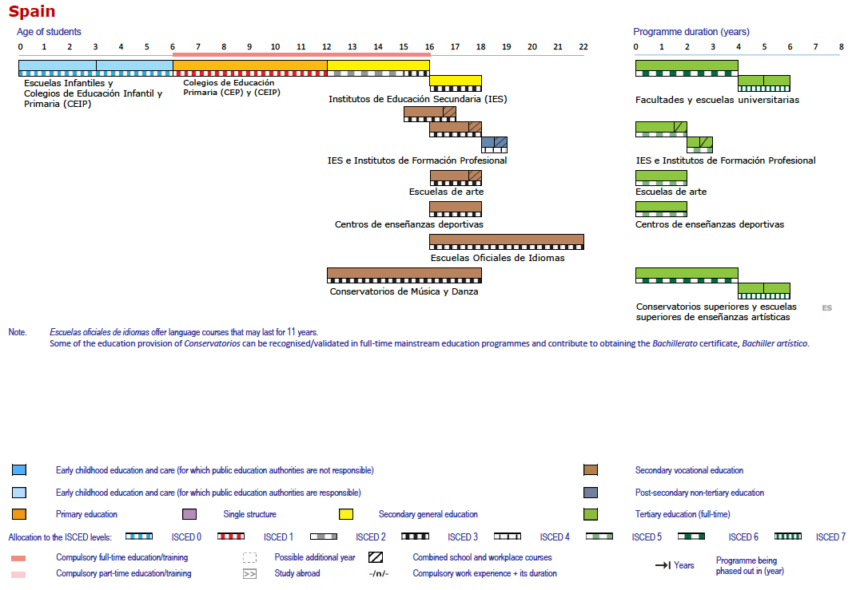
Eurydice The structure of the European education systems 2023/2024: schematic diagrams: https://eurydice.eacea.ec.europa.eu/publications/structure-european-education-systems-20232024-schematic-diagrams

Slide 9
Early Childhood Education
Early childhood education is a stage of education with its own identity, catering for girls and boys from birth to six years old. The purpose of early childhood education is to contribute to the integral, harmonious development of pupils in all areas – physical, emotional, sexual, emotional, social, cognitive and artistic – as well as to provide education on civic values to promote coexistence.
Early childhood education is organised into two educational phases:
The first programme is for children up to 3 years old.
The second programme, which is free of charge, is for children aged 3 to 6.
Although voluntary, the uptake for the second phase of early childhood education and care has become widespread throughout Spain; almost all boys and girls aged 3 to 6 years old are now in school, having reached a percentage of more than 97% for all ages according to the 2022 Panorama of Education report. With regard to the first phase, the enrolment rate has increased by 26 percentage points since 2005, reaching 41.1 %. This uptake is expected to continue to gradually increase through a sufficient number of places being made available and the extension of free-of-charge provision.
Junta de Andalucía: https://administracion.gob.es/pag_Home/en/Tu-espacio-europeo/derechos-obligaciones/ciudadanos/educacion/sistema-educativo/infantil.html

Slide 10
Primary education
Primary education is compulsory and free.
This stage of education is divided into six academic years, generally for those aged between 6 and 12. Pupils generally start the first year of primary education in the calendar year in which they reach the age of 6.
The aim of primary education is for pupils to develop in the following areas: verbal expression and comprehension, reading, writing, mathematics, basic cultural awareness, and skills for coexistence, study and work, artistic awareness, creativity and emotional development, thus guaranteeing a comprehensive education so as to contribute to the full development of the pupils’ personalities, and prepare them for going to compulsory secondary education.
At this stage, educational activities seek to integrate learning with pupils’ different experiences, and they can be adapted to varying work rates.
Ministry of Education: https://administracion.gob.es/pag_Home/en/Tu-espacio-europeo/derechos-obligaciones/ciudadanos/educacion/sistema-educativo/primaria.html

Slide 11
Ministerio de Educación: https://www.educacionfpydeportes.gob.es/contenidos/in/sistema-educativo.html

Slide 12
Secondary and post-secondary education
Compulsory secondary education is the final compulsory stage of basic education that is free of charge.
Compulsory secondary education is organised according to the principles of common education and attention to diversity, and places particular emphasis on the educational and professional guidance of students.
This includes:
four academic years, and students are generally aged between 12 and 16 years old
In the final year, guidance is also provided both on post-compulsory studies and entering working life
On successful completion of compulsory secondary education, a Secondary Education Diploma is awarded and this gives access without distinction to any post-compulsory education provided for by law.( Article 3.4 of Organic Law 2/2006 of 3 May ).
Ministry of Education: https://administracion.gob.es/pag_Home/en/Tu-espacio-europeo/derechos-obligaciones/ciudadanos/educacion/sistema-educativo/secundaria.html

Slide 13
Bachillerato (post-16/upper secondary)
Upper secondary education is post-compulsory secondary education and is therefore voluntary. It comprises two academic years, and students are generally aged between 16 and 18.
Its purpose is to:
provide students with the education, intellectual and social maturity, knowledge and skills to develop on a personal level and to participate in working life as a responsible and competent employee;
This stage enables students to acquire and achieve the skills needed for future training and working life.
prepare students for accessing higher education.
It is structured around different fields of study and is flexibly arranged so as to offer different pathways as necessary. It can provide specialist training adapted to student expectations and educational interests, or to enable students to transition into working life at the end of their education.
The fields of study in upper secondary education which the educational authorities and/or the education centres can offer are as follows:
Arts and humanities.
Science and technology.
General.
Ministry of Education: https://administracion.gob.es/pag_Home/en/Tu-espacio-europeo/derechos-obligaciones/ciudadanos/educacion/sistema-educativo/secundaria.html

Slide 14
Basic Level Vocational Education
Basic Level Vocational Education is a component of compulsory general education and is free. It corresponds to level 1 competence standards of the National Catalogue of Standards of Professional Competences. It consists of two academic years and is aimed at students with the best potential for learning and achieving compulsory secondary education competences in a work-related environment.
In general, there are two requirements for admission to Basic Level Vocational Education, which are as follows:
be aged 15 (or be 15 by the end of the calendar year concerned).
to have completed the third year of compulsory secondary education or, exceptionally, to have completed the second year; and
to have been proposed by the teaching team to the parents, legal guardians or guardians and to the student.
On successful completion of all the subjects included in Basic Level Vocational Education, students are awarded a Compulsory Secondary Education Diploma and a Basic Technician’s Diploma in the corresponding speciality. These diplomas give access to Intermediate Level Vocational Education, as well as to other education routes.
Ministry of Education: https://administracion.gob.es/pag_Home/en/Tu-espacio-europeo/derechos-obligaciones/ciudadanos/educacion/sistema-educativo/secundaria.html

Slide 15
Ministerio de Educación: https://www.educacionfpydeportes.gob.es/contenidos/in/sistema-educativo.html

Slide 16
Performance Indicators

Slide 17
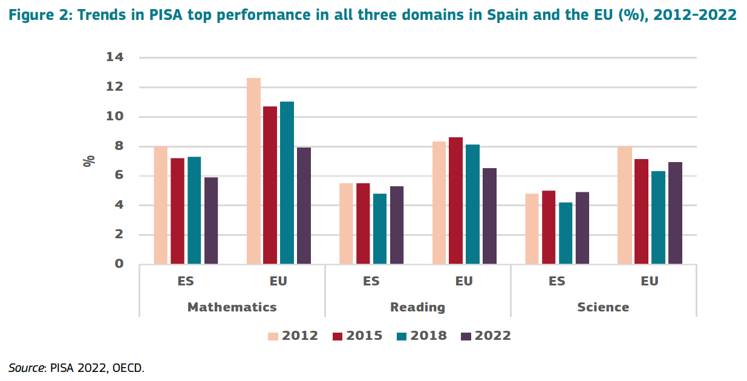
European Commision Education and Training Monitor 2025: https://op.europa.eu/en/publication-detail/-/publication/3b55834e-bf89-11f0-a612-01aa75ed71a1/language-en

Slide 18
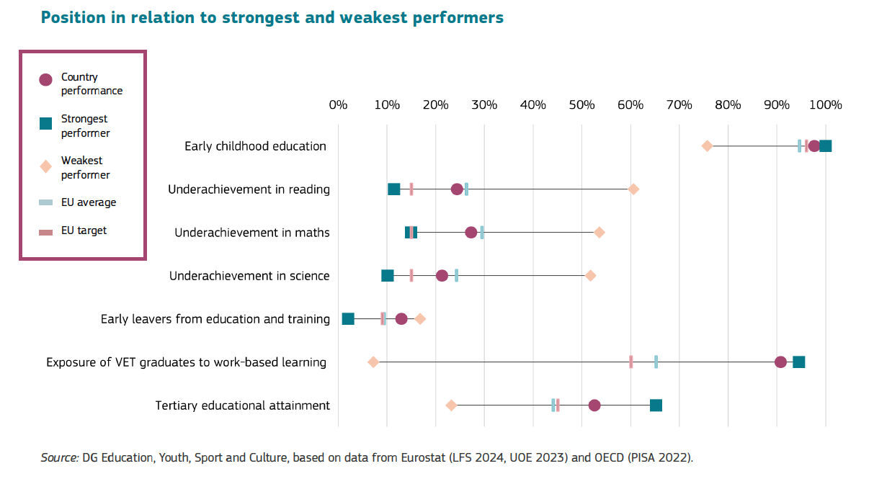
European Commision Education and Training Monitor 2025: https://op.europa.eu/en/publication-detail/-/publication/3b55834e-bf89-11f0-a612-01aa75ed71a1/language-en

Slide 19
The End!

