Slide 1

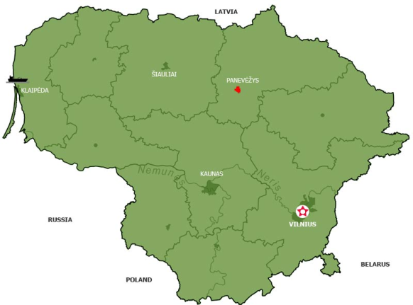
LITHUANIA

Slide 2
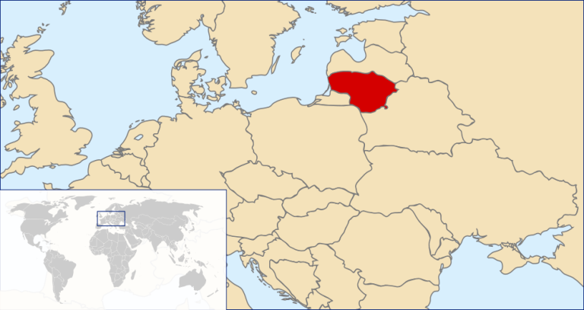
GEOGRAPHICAL SITUATION
The State is in Europe, on the shore of the Baltic Sea in the south- east.

Slide 3


THE FLAG AND THE COAT OF ARMS

Slide 4
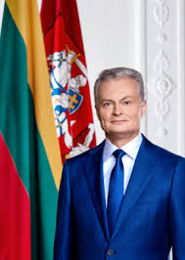
THE PRESIDENT OF LITHUANIAN REPUBLIC
Gitanas Nausėda

Slide 5
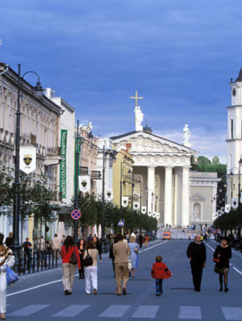
THE CAPITAL
Vilnius is the capital of Lithuania and the biggest city of the country.
The old town of Vilnius is one of the biggest one in the Eastern Europe.
In 1994 it is writen into UNESCO, world heritage list.

Slide 6
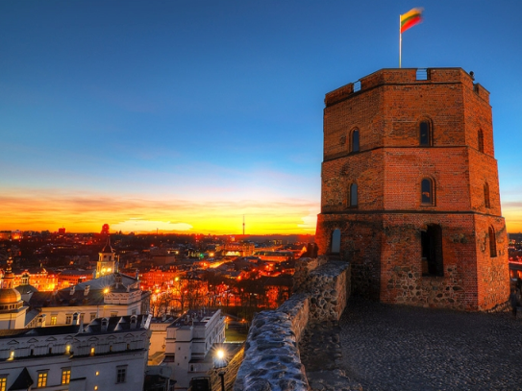
THE MONUMENTS OF ARCHITECTURE
GEDIMINAS CASTLE

Slide 7
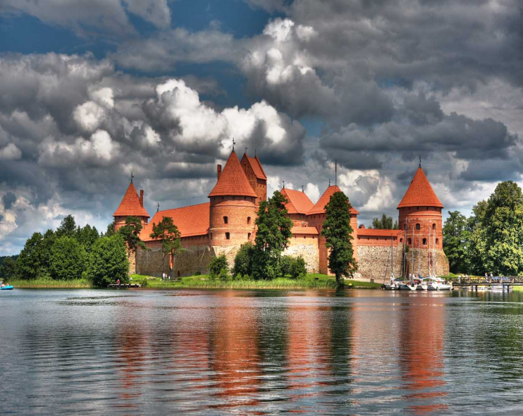
TRAKAI CASTLE

Slide 8
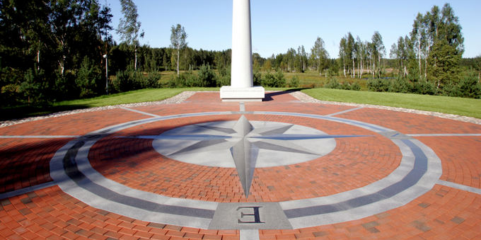
THE CENTRE OF EUROPE
In 1989 the scientists of French national geographic institute established the place of geographical centre of European continent.

Slide 9
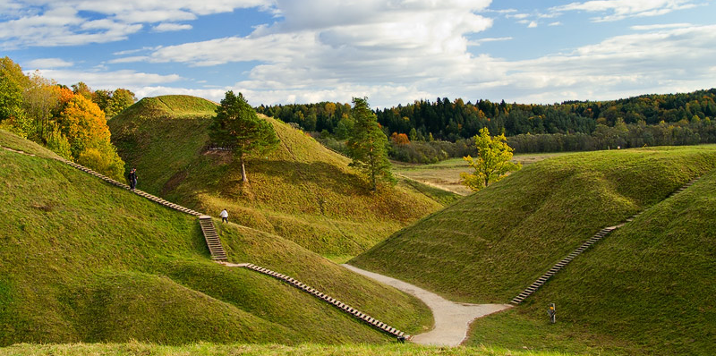
KERNAVĖ
This town is the first capital of Lithuania. It is famous having a lot of wonderful mounds.

Slide 11

Coat of arms

Slide 12
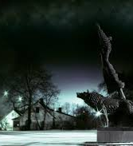
Ukmerge’s legend
According to local legend, Vilkmergė was a girl raised by wolves, who bridged the divide between animals and humans, in the same way as Rudyard Kipling's Mowgli.

Slide 13
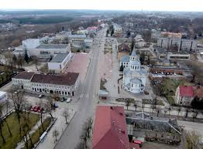
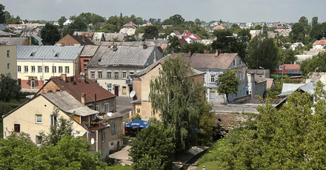
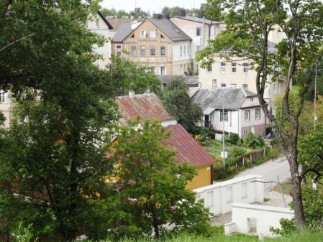
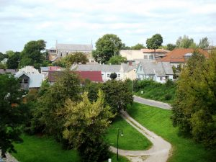
Our town

Slide 14
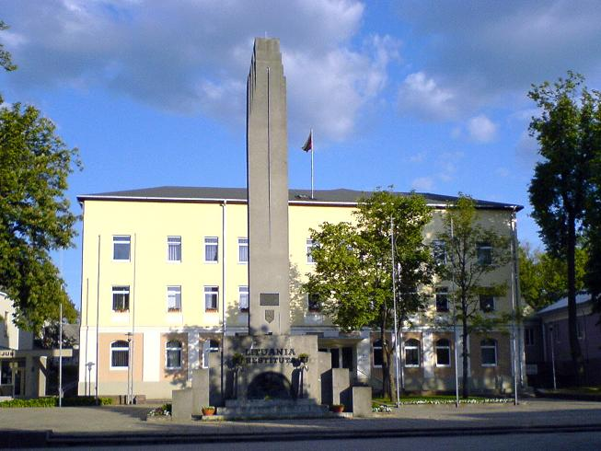
Freedom monument „Lituania Restituta“

Slide 15
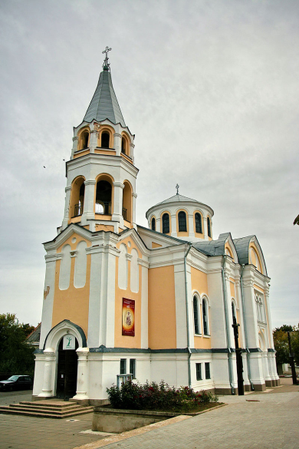
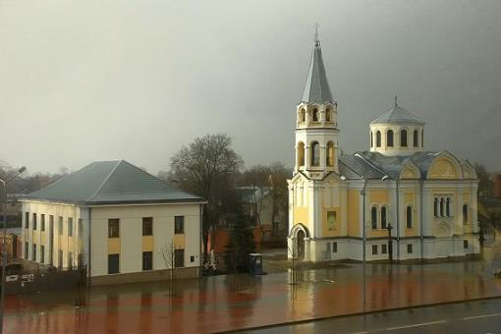
Holy Trinity Church

Slide 16
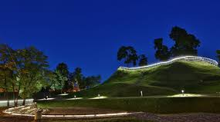
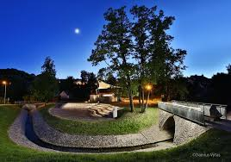
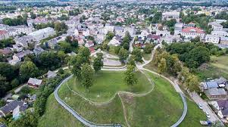
The mound
The mound is located near the holy river and stream Ukmergėlės the confluence of the city center.

Slide 17
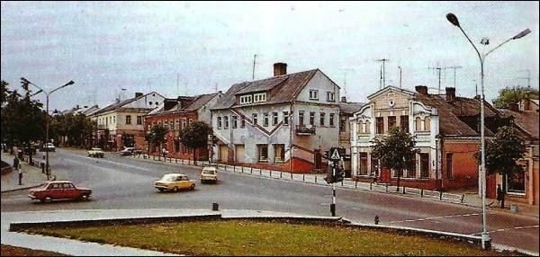
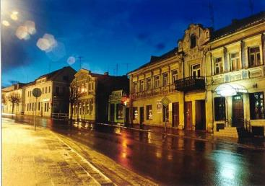
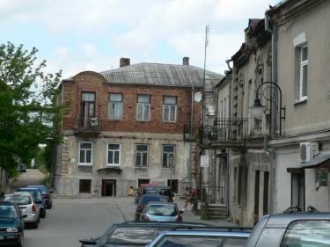
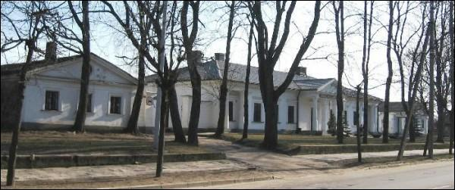
Old town

Slide 18
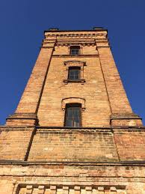
Old fire tower
This is the 19th century the end of the building, whose height - 18 m.
Top of the tower - observation deck offers excellent panorama of the city.

Slide 19
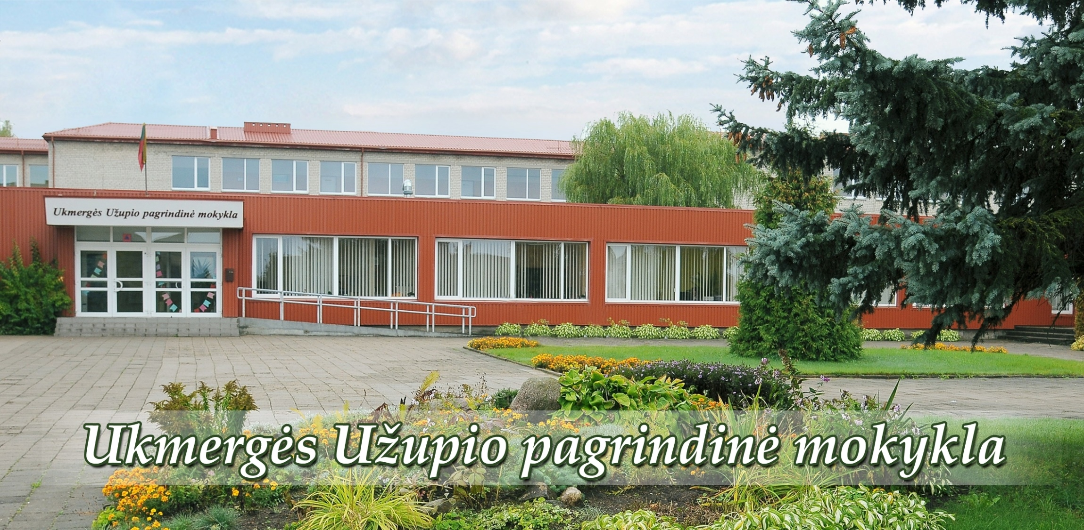
Ukmergės Užupio pagrindinė mokykla

Slide 20


Slide 21
Vision: Students graduating from Užupis Basic School will be self-confident, eager to learn and develop, and able to plan their careers, successfully creating their own future and Lithuania's well-being.
Mission: To develop pupils' interest in science, the ability to explore, creativity, leadership competences of pupils and teachers, personal, social, national and civic self-awareness through the provision of quality primary and basic education, taking into account the individual needs and abilities of pupils.
Values: Learning, respect for self and others, personal responsibility, development, cooperation, creativity.

Slide 22
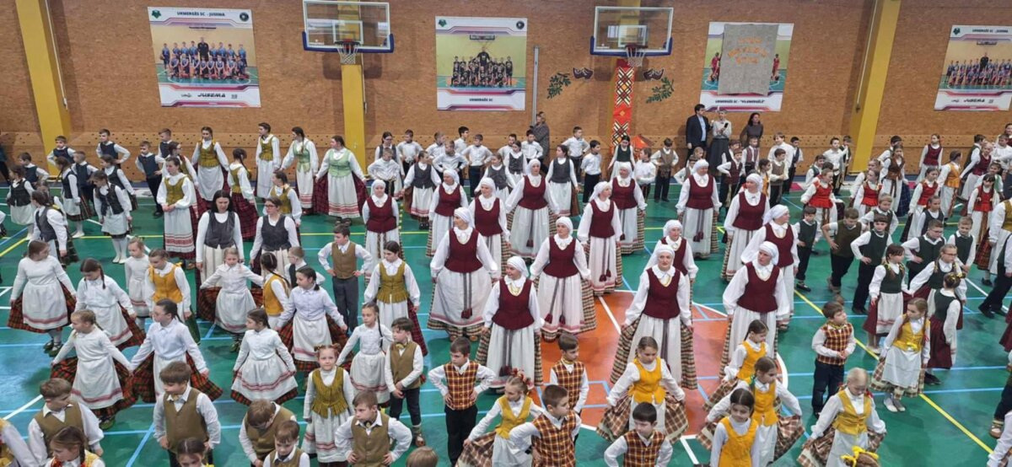
TRADITIONAL EVENTS AT SCHOOL

Slide 23
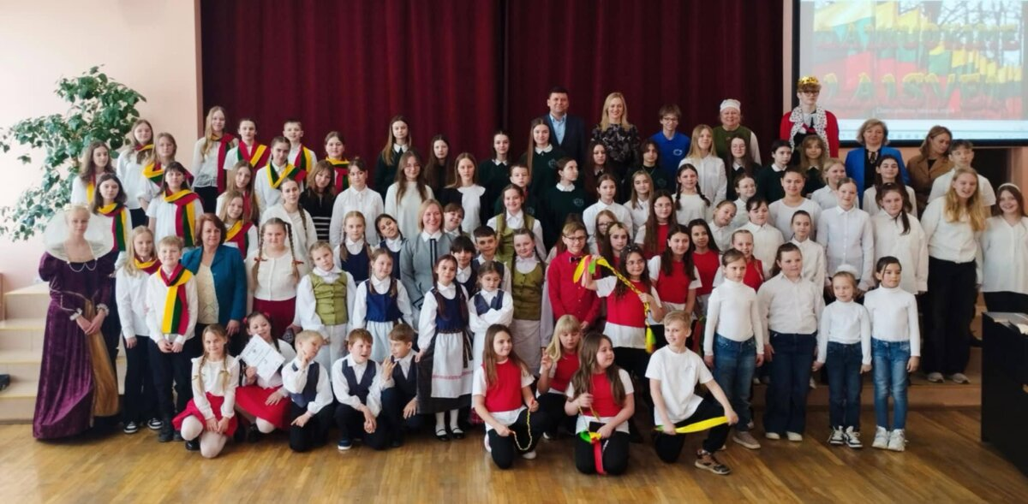

Slide 24
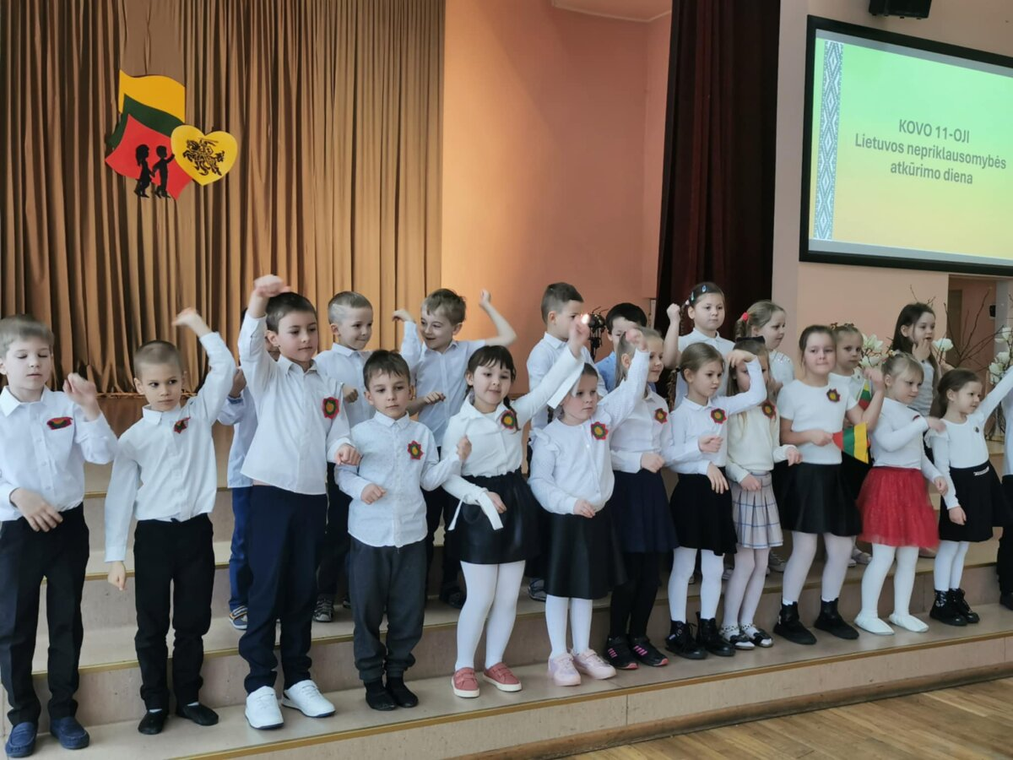

Slide 25
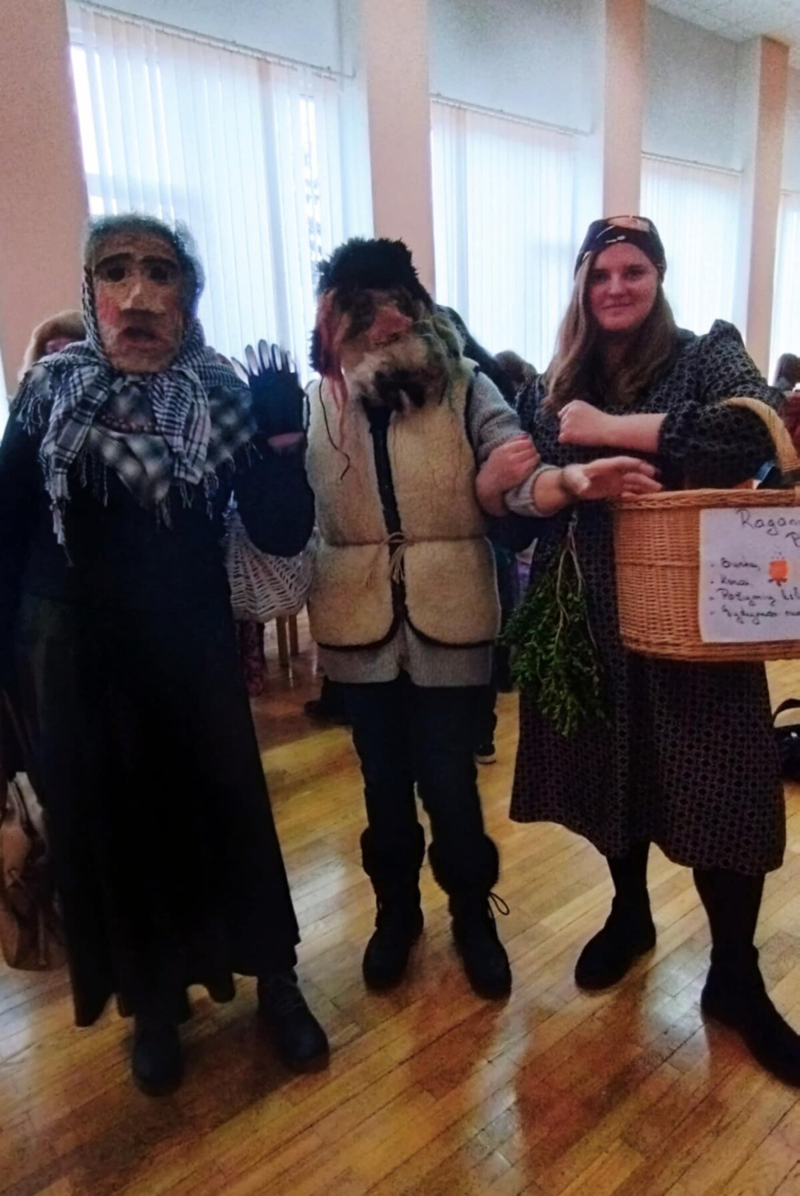
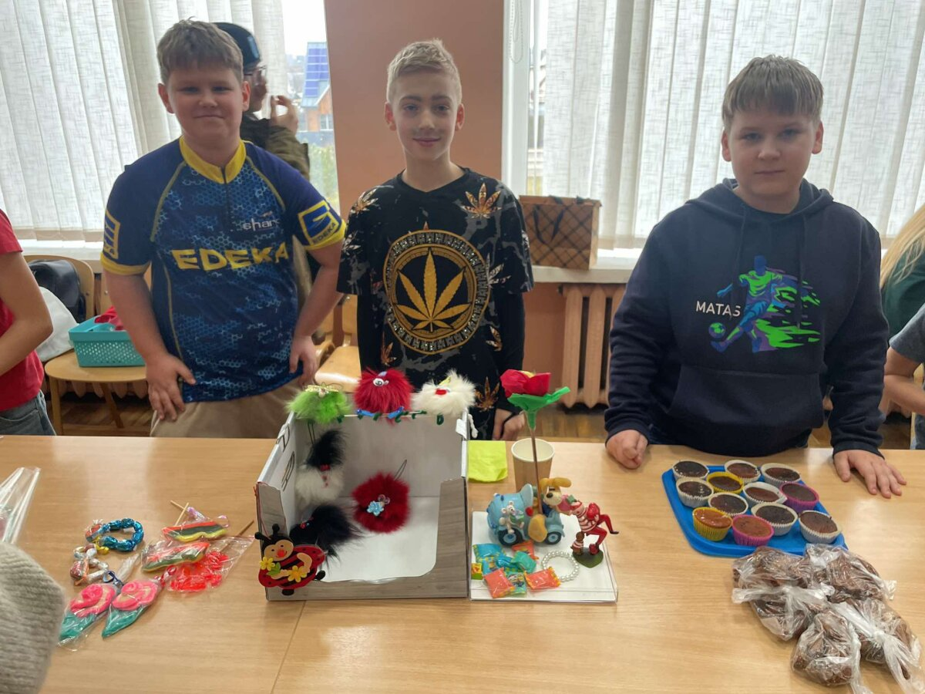

Slide 26

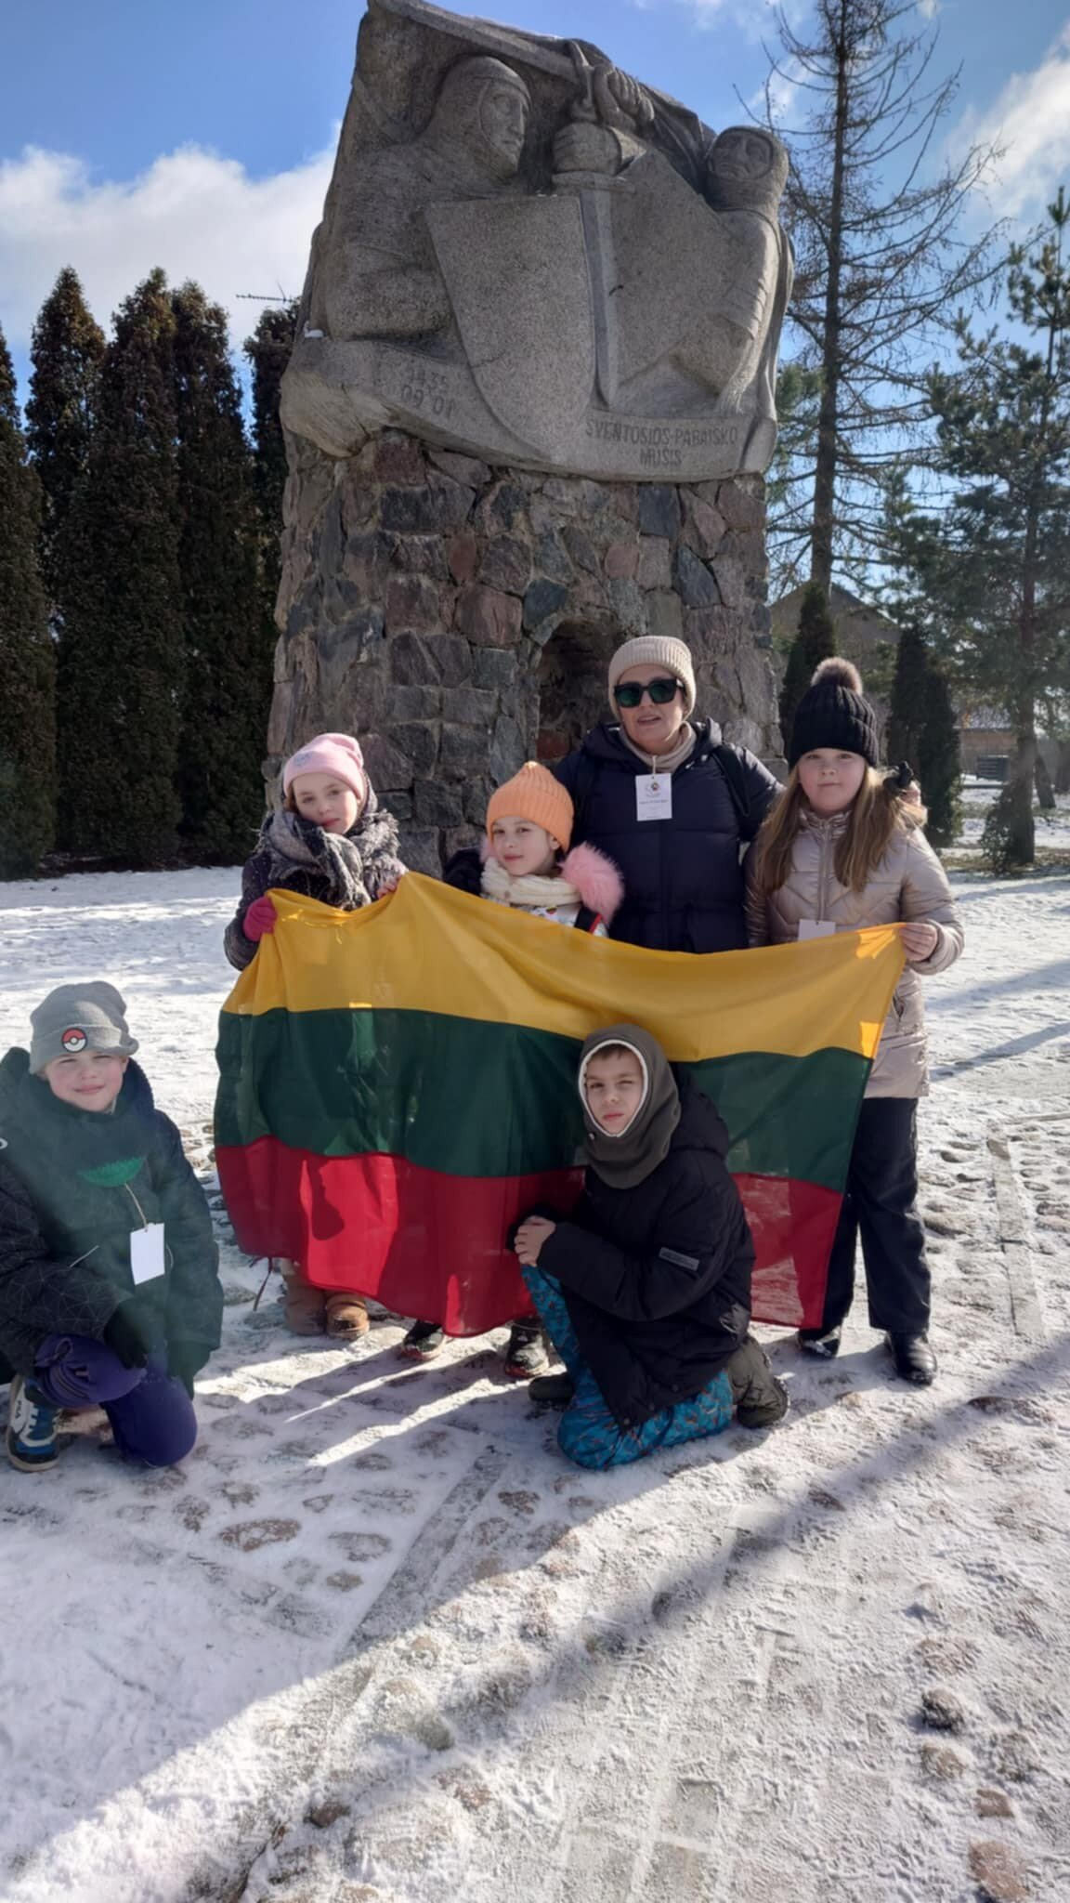
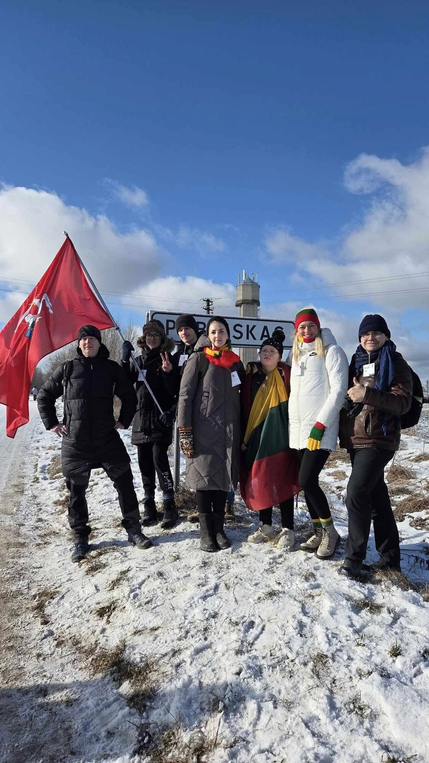

Slide 27
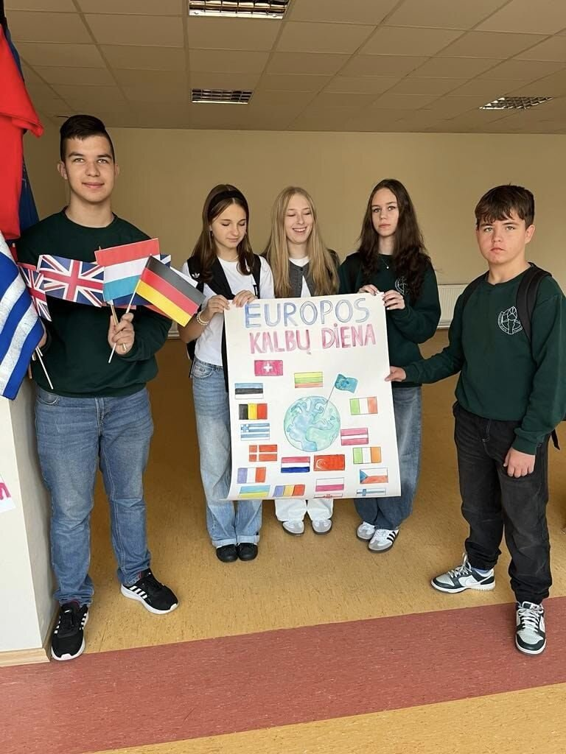
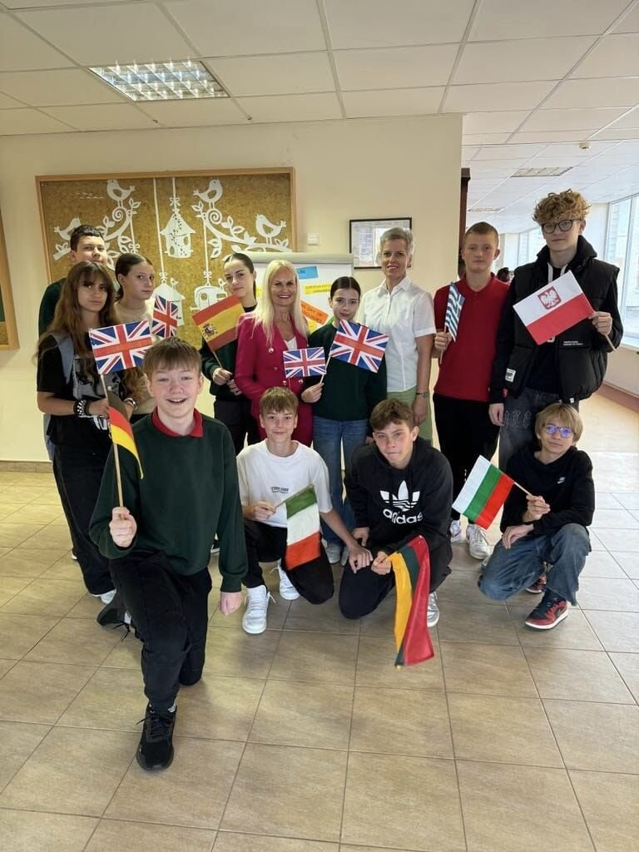

Slide 28
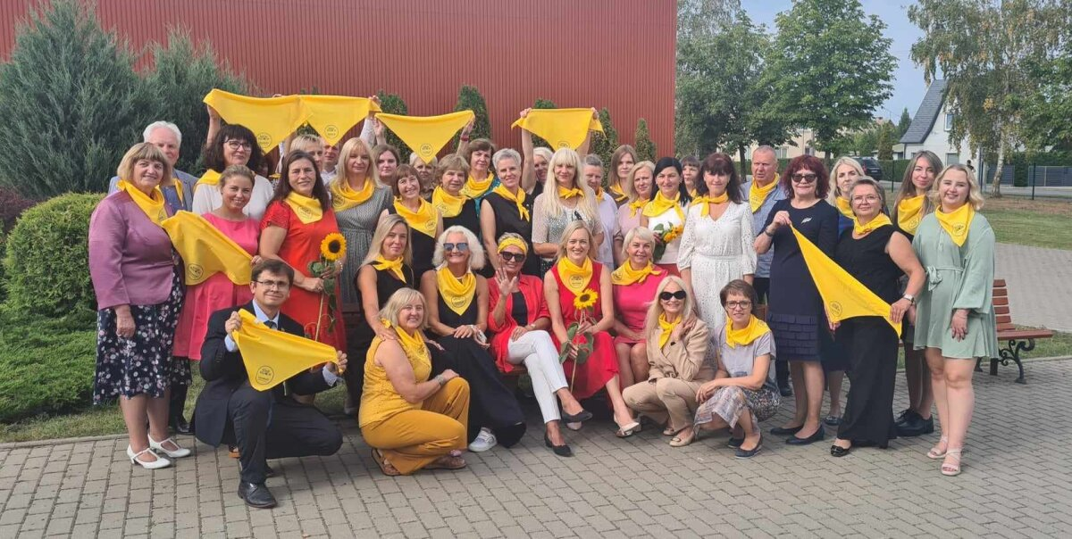

Slide 29
Thank you!

