Slide 1
About Lithuania
Test your knowledge of this Baltic republic. (If you know very little about the country, it's worth doing some research first). Good luck and have fun!

Slide 2
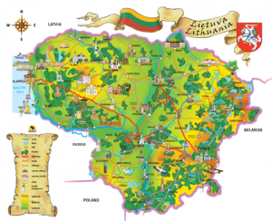
Which of these countries does Lithuania *not* share a border with?
Latvia
Poland
Belarus
Estonia

Slide 3
Lithuanian is the most southerly of the the three Baltic republics. Latvia lies immediately to the north. Lithuania also borders on Belarus, Poland and the Kaliningrad district of Russia, which is not contiguous with the main body of Russia.

Slide 4
In the south-west, Lithuania borders on the Kaliningrad district of Russia.
True
False

Slide 5
The Kaliningrad district is an exclave of Russia, that is, it has no common border with the rest of Russia. The district consists of the northern third of what was formerly East Prussia. The southern two-thirds of East Prussia have been part of Poland since 1945.

Slide 6
What is the capital of Lithuania?
Vilnius
Tallinn
Riga
Kaunas

Slide 7
Riga is the capital of Latvia, Tallinn the capital of Estonia. Kaunas is Lithuania's second largest city and was the capital from 1920-40, as Vilnius was annexed by Poland in 1921.

Slide 8
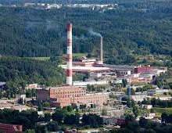
Which of the following is *not* an important Lithuanian industry?
Electric motors
Furniture
Automobiles
Agricultural machinery

Slide 9
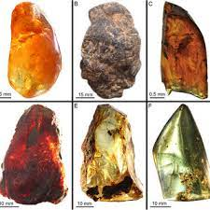
Another industry of some significance is the processing of amber.

Slide 10
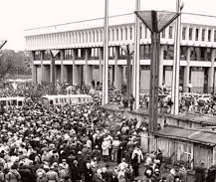
In which year did Lithuania gain actual independence from the Soviet Union?
1993
1989
1991
1987

Slide 11
Lithuania declared itself independent in 1990, but didn't gain effective independence till the following year. The last Russian troops left in 1993.

Slide 12
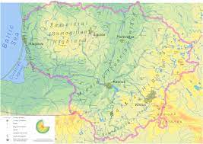
What is the approximate area of Lithuania?
18,400 sq miles
25,200 sq miles
44,700 sq miles
9,900 sq miles

Slide 13
25,200 sq miles
It is slightly bigger than Latvia and is the largest of the three Baltic republics.

Slide 14
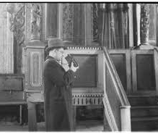
Which of these was the not an ethnic minority of any significant size in Lithuania?
Poles
Belorussians
Jews
Russians

Slide 15
Jews
Until Lithuania was invaded by the Nazis in 1941 the country had a substantial Jewish population, and Vilnius was a flourishing Jewish cultural center of international standing.
The other three groups all accounted for at least 4% of the population. (There is some disagreement about the exact size of these three groups).

Slide 16
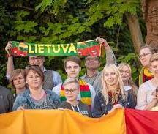
What is the approximate population of Lithuania?
7.2 million
5.2 million
2.8 million
1.9 million

Slide 17
2.8 million
It is the most populous of the Baltic republics, but its population has been falling since about 2000.

Slide 18
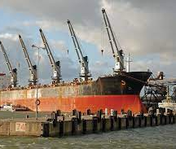
What is the country's main port?
Klaipeda
Gdansk
Kaliningrad
Liepaja

Slide 19
Klaipėda
Kaliningrad is in Russia, Gdansk in Poland and Liepaja is in Latvia. Klaipeda was formerly the German port of Memel.

Slide 20
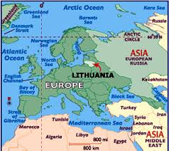
From 1795-1917 most of the present territory of Lithuania was part of the Russian Empire. Apart from Russian influence, what was predominant foreign cultural influence in the period c.1600-1800?
Polish
Ukrainian
German
Swedish

Slide 21
Polish
In this respect, Lithuania differs considerably from Latvia and Estonia, where German and Swedish influence was very significant.
The main religious denomination is Roman Catholic, like in Poland - and unlike in the other two Baltic republics, which are predominantly Lutheran.
For over two centuries prior to 1795, Poland and Lithuania were in effect one country, and most of the present territory of Lithuania was annexed by Russia in the course of the third partition of Poland (1795).

Slide 22
Thanks

