Slide 1
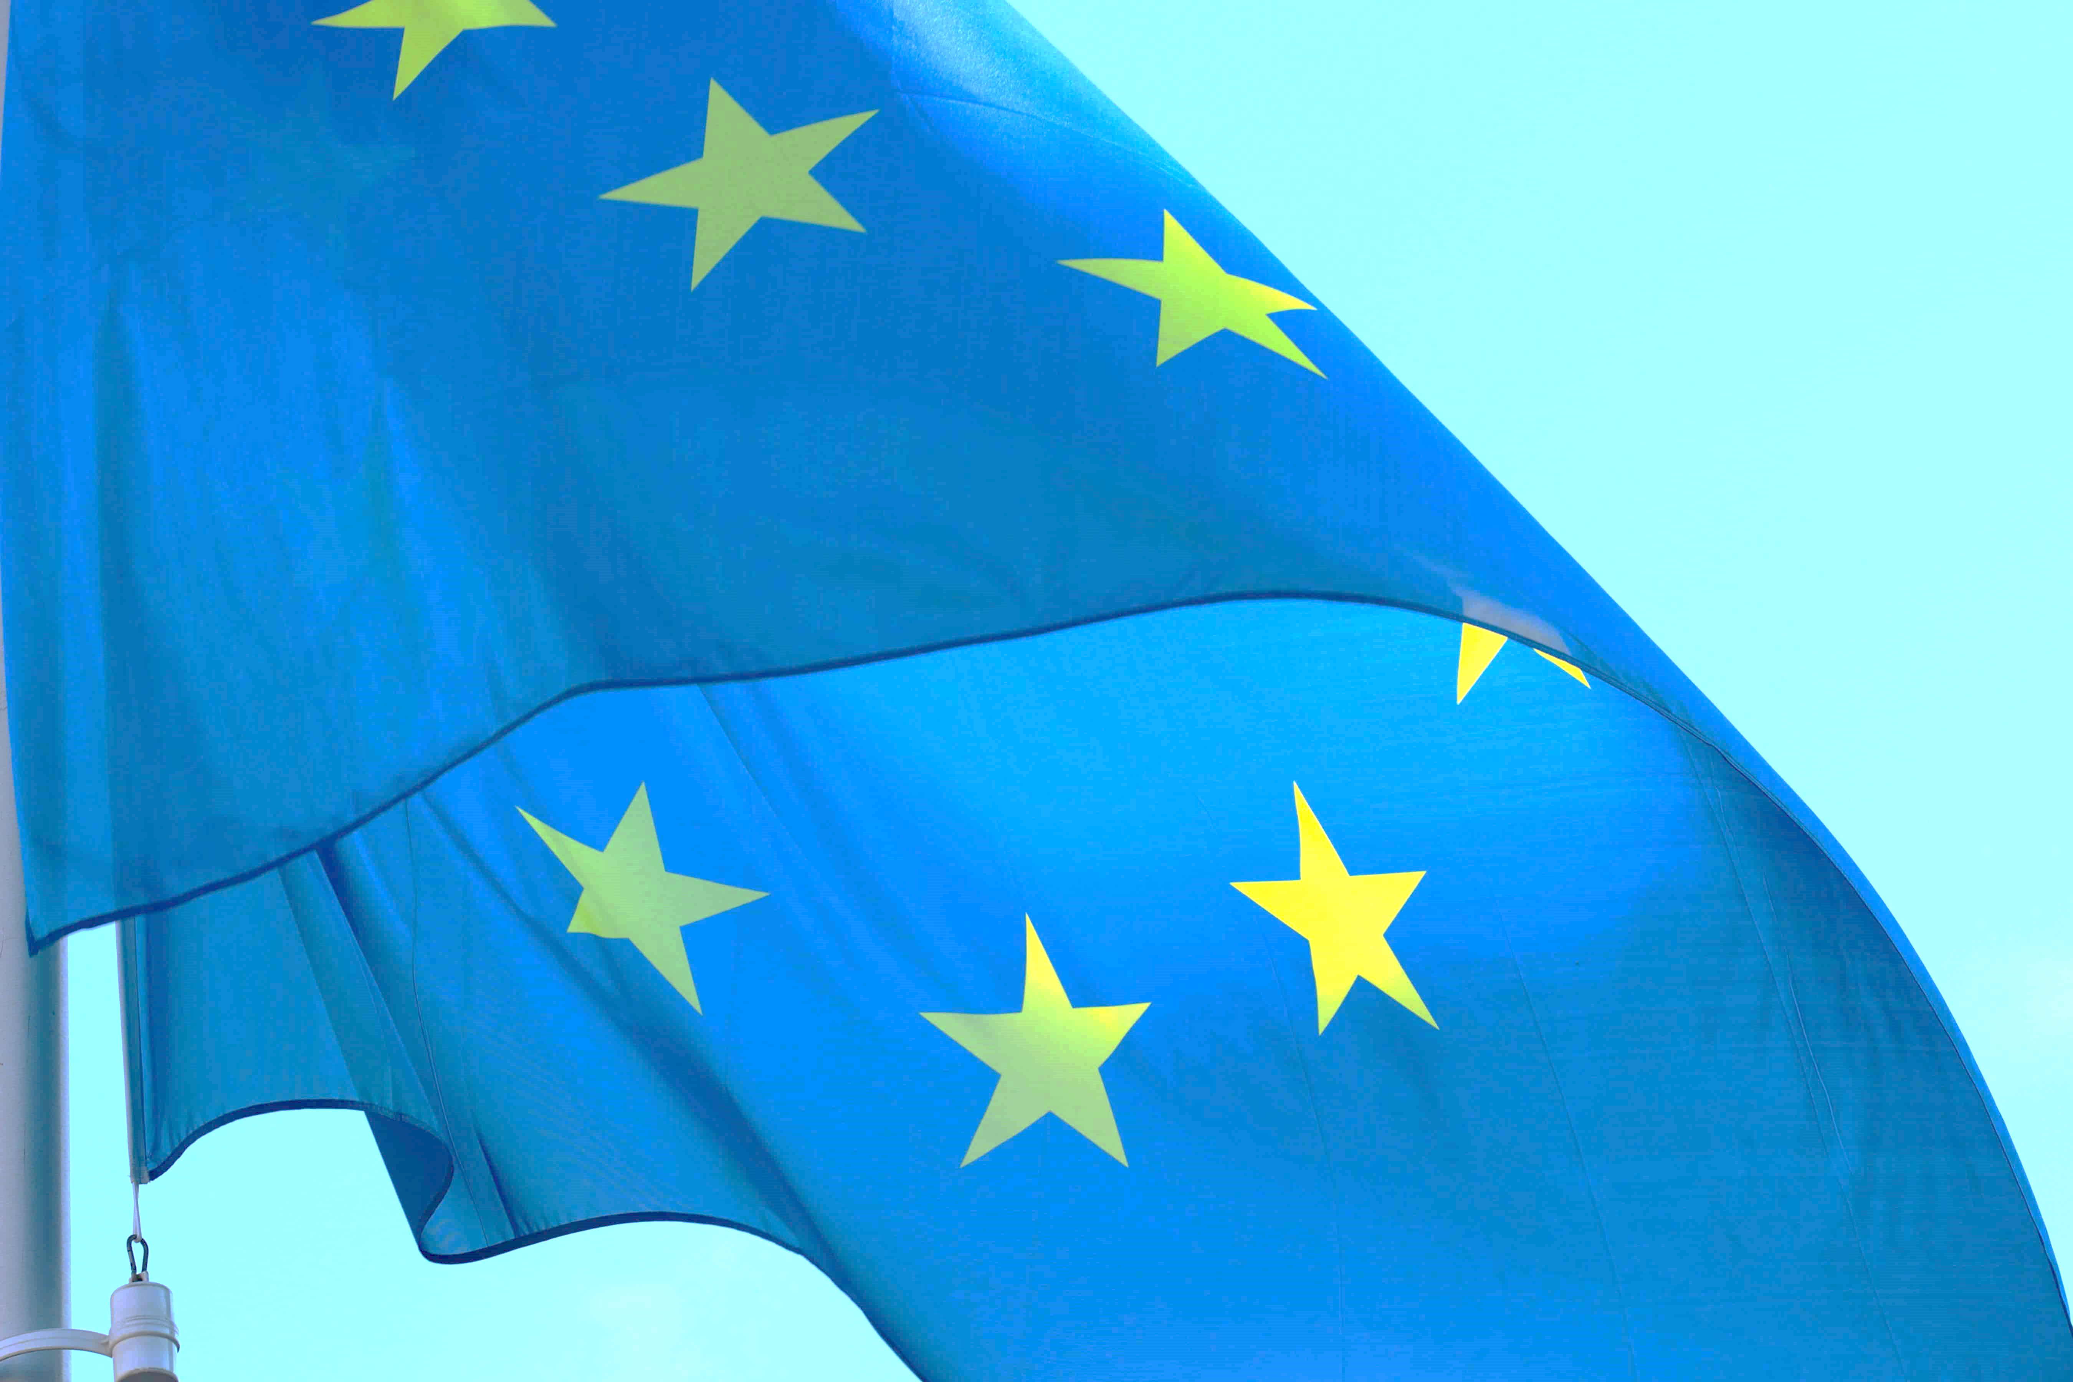
ERASMUS + PROJECTS
Undertaken by Secondary School no. 2 Fundeni

Slide 2
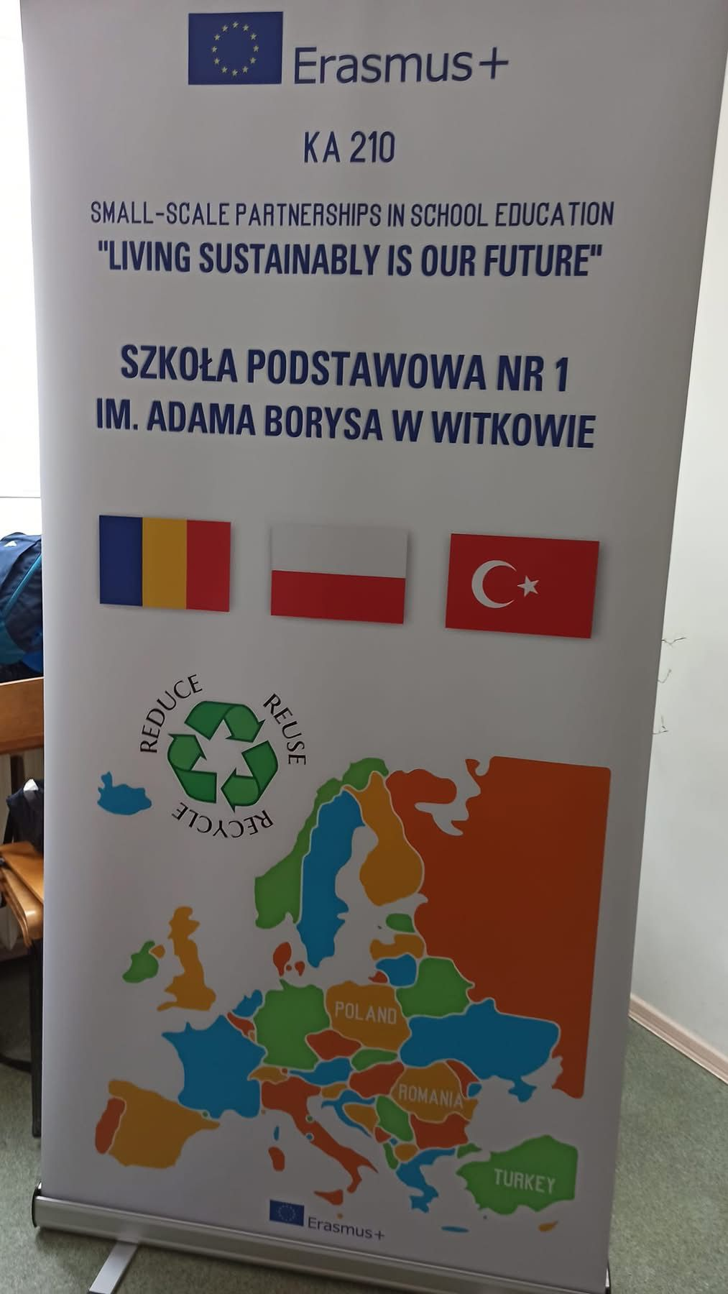
Project 1: “Living sustainably is our future”
Secondary School No. 2 Fundeni together with Szkola Podstawowa no. 1 im. Adama Borysa from Poland and Necip Fazıl Kısakürek Ortaokulu from Turkey established an Erasmus+KA210-SCH - Small-scale partnerships called ”Living sustainably is our future” in school education:
This environmental partnership raised awareness and produced positive changes in student attitudes through a series of activities that required active engagement and citizenship.
The main goal of the project is to educate students in the spirit of protecting the environment and promoting a sustainable way of life. With the support of this Erasmus+ project, today's students will become tomorrow's responsible adults, citizens who will tackle the problem of waste management and acquire knowledge about real-life concepts in environmental management.

Slide 3
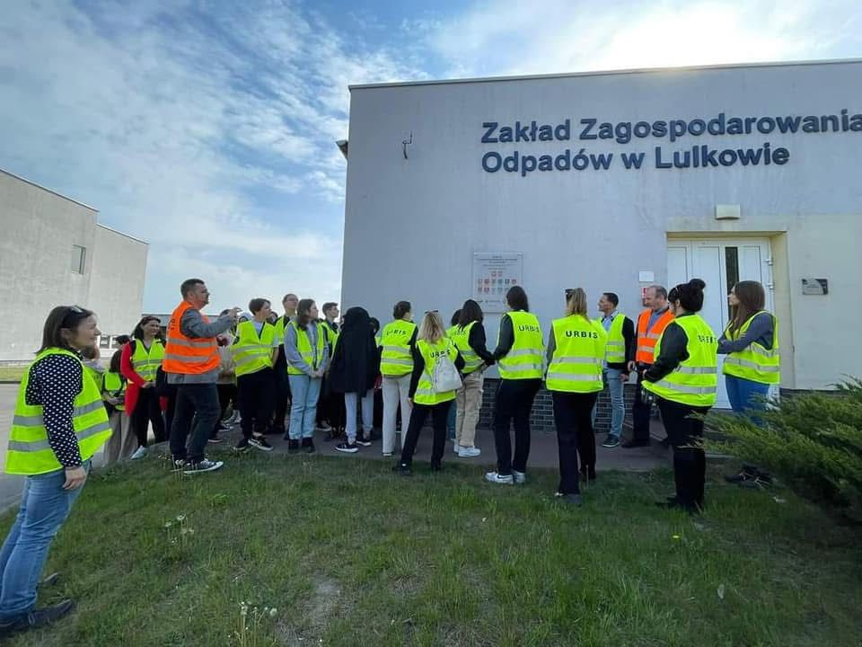
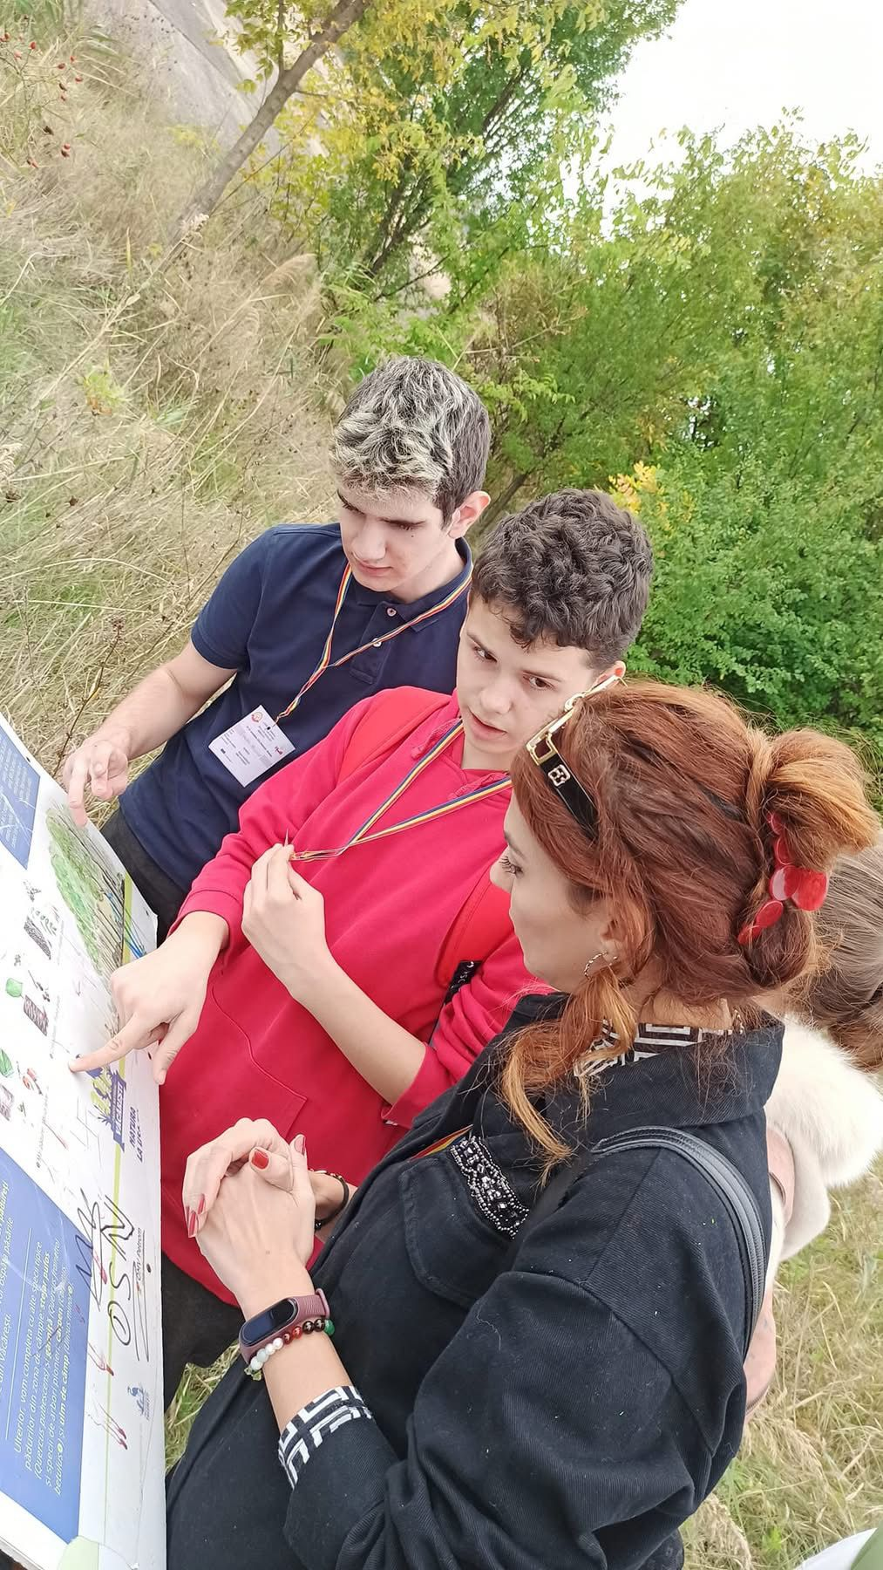
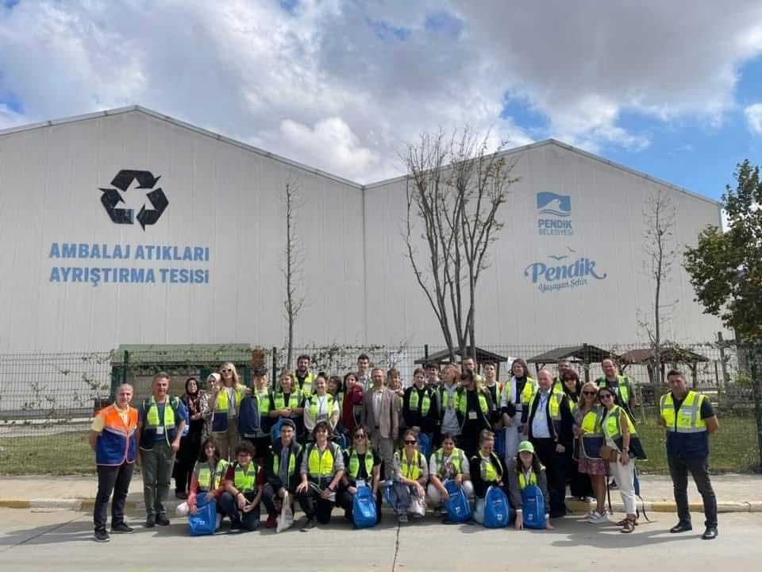
Planned activities were carried out, implemented at the local and international level, which will positively influence the beneficiaries to reflect critically on environmental problems, to inspire them to identify practical solutions that they can further transfer to the family, school and community.

Slide 4
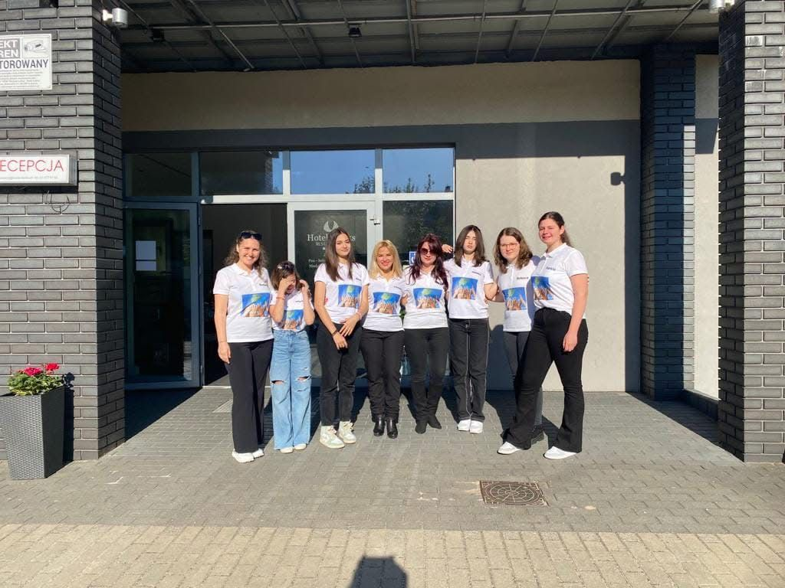
The project also brought benefits for all partners schools involved, teachers, students and management teams likewise.
The human resources will increase their international project management and organization capacity, expand their contact network which will set the pillars for further cooperation opportunities and development of European dimension in education.
They will be part of an inspiring working team where they will acquire lifelong skills and competences.
Due to the project, the students and teachers’ international mobility within partner schools will be increased, which will result in exchange of ideas and pedagogical practices, good practice examples to transfer in their own schools. Their interest in international exchange projects will be enhanced as they will all acknowledge the significantly positive impact on their professional and personal level beyond the life of the project.

Slide 5
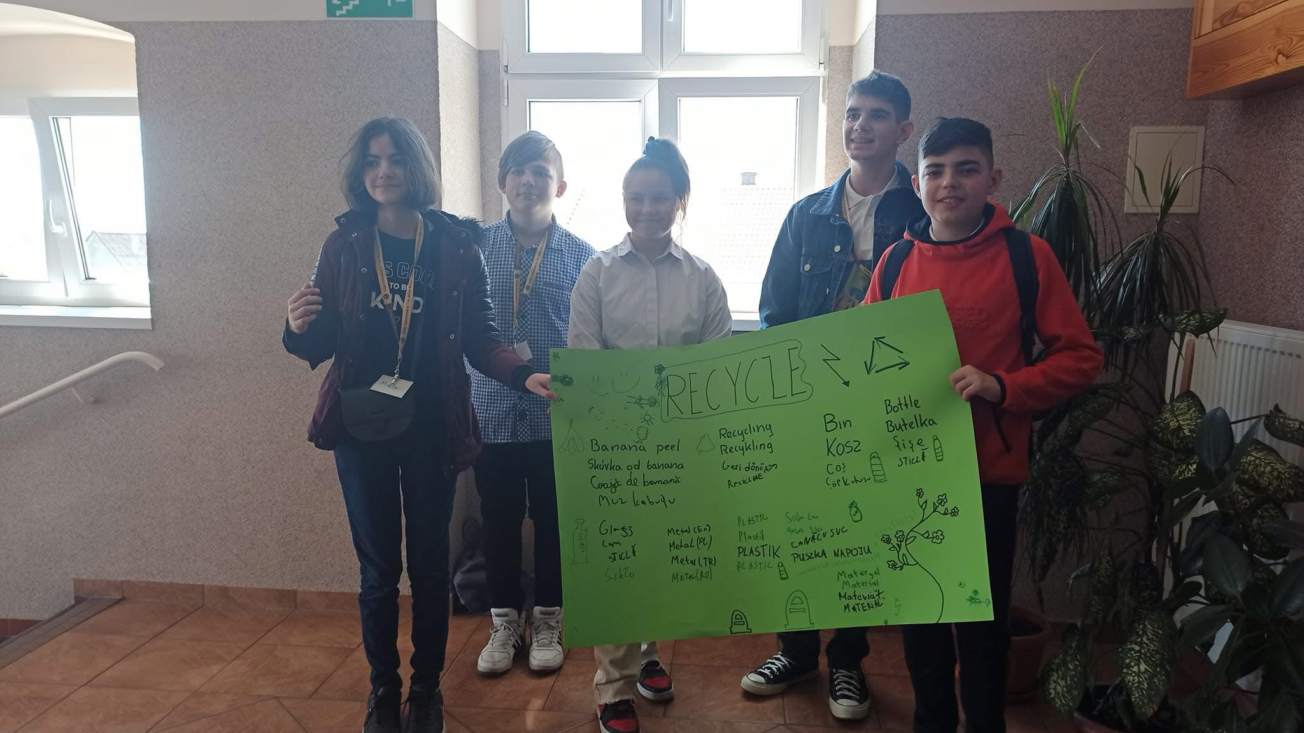
Living sustainably is our future

Slide 6
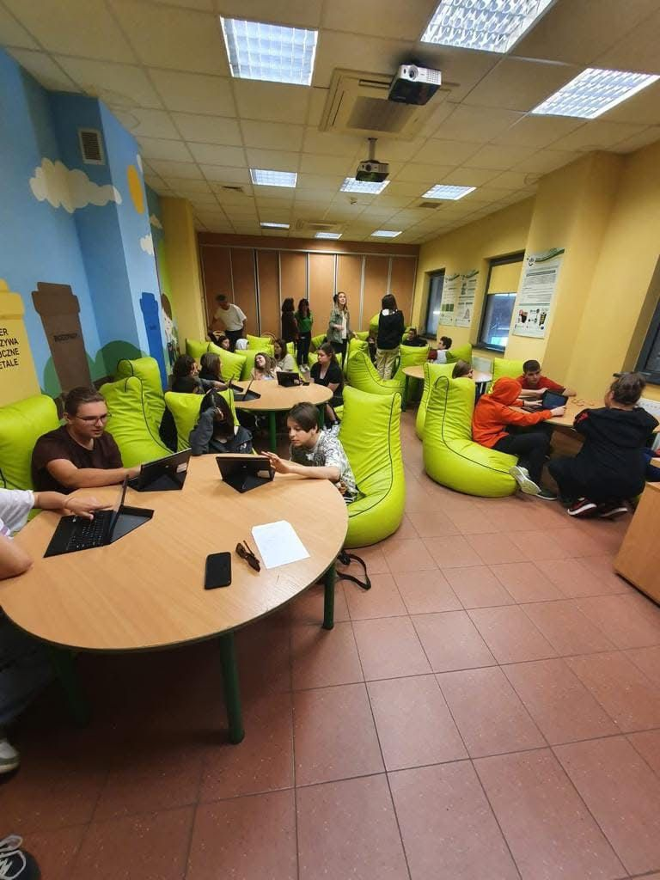
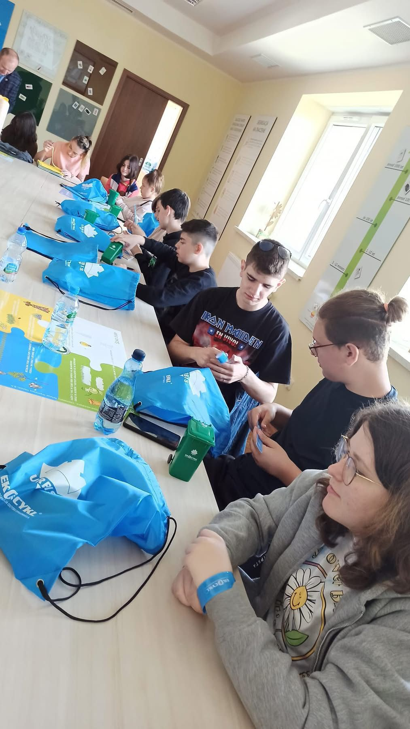
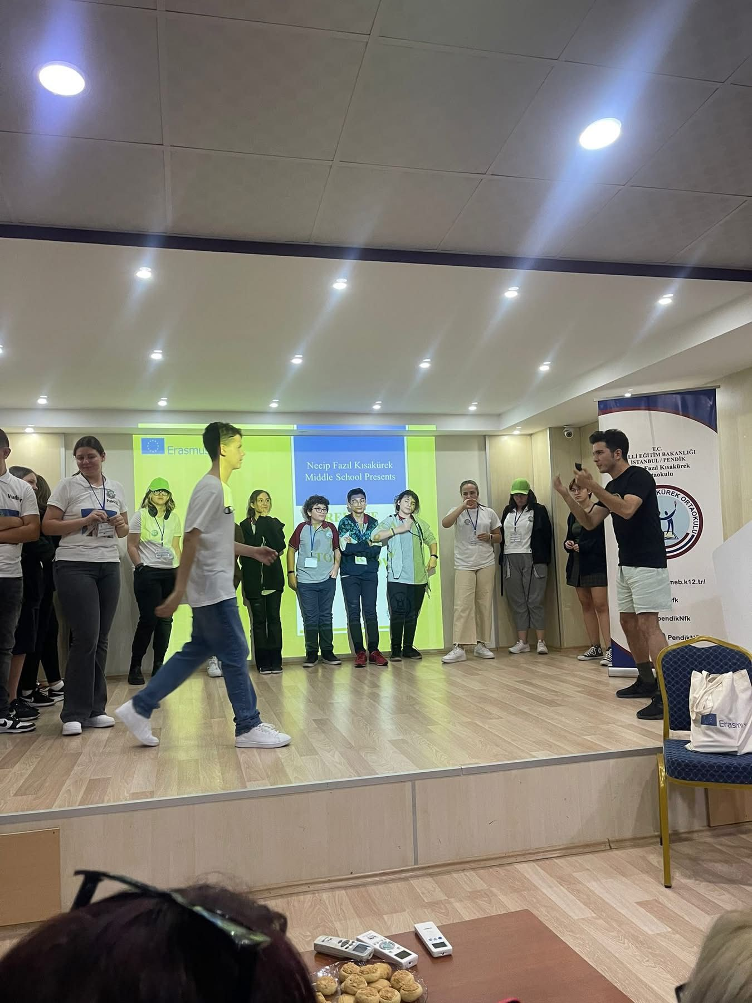
Living sustainably is our future

Slide 7
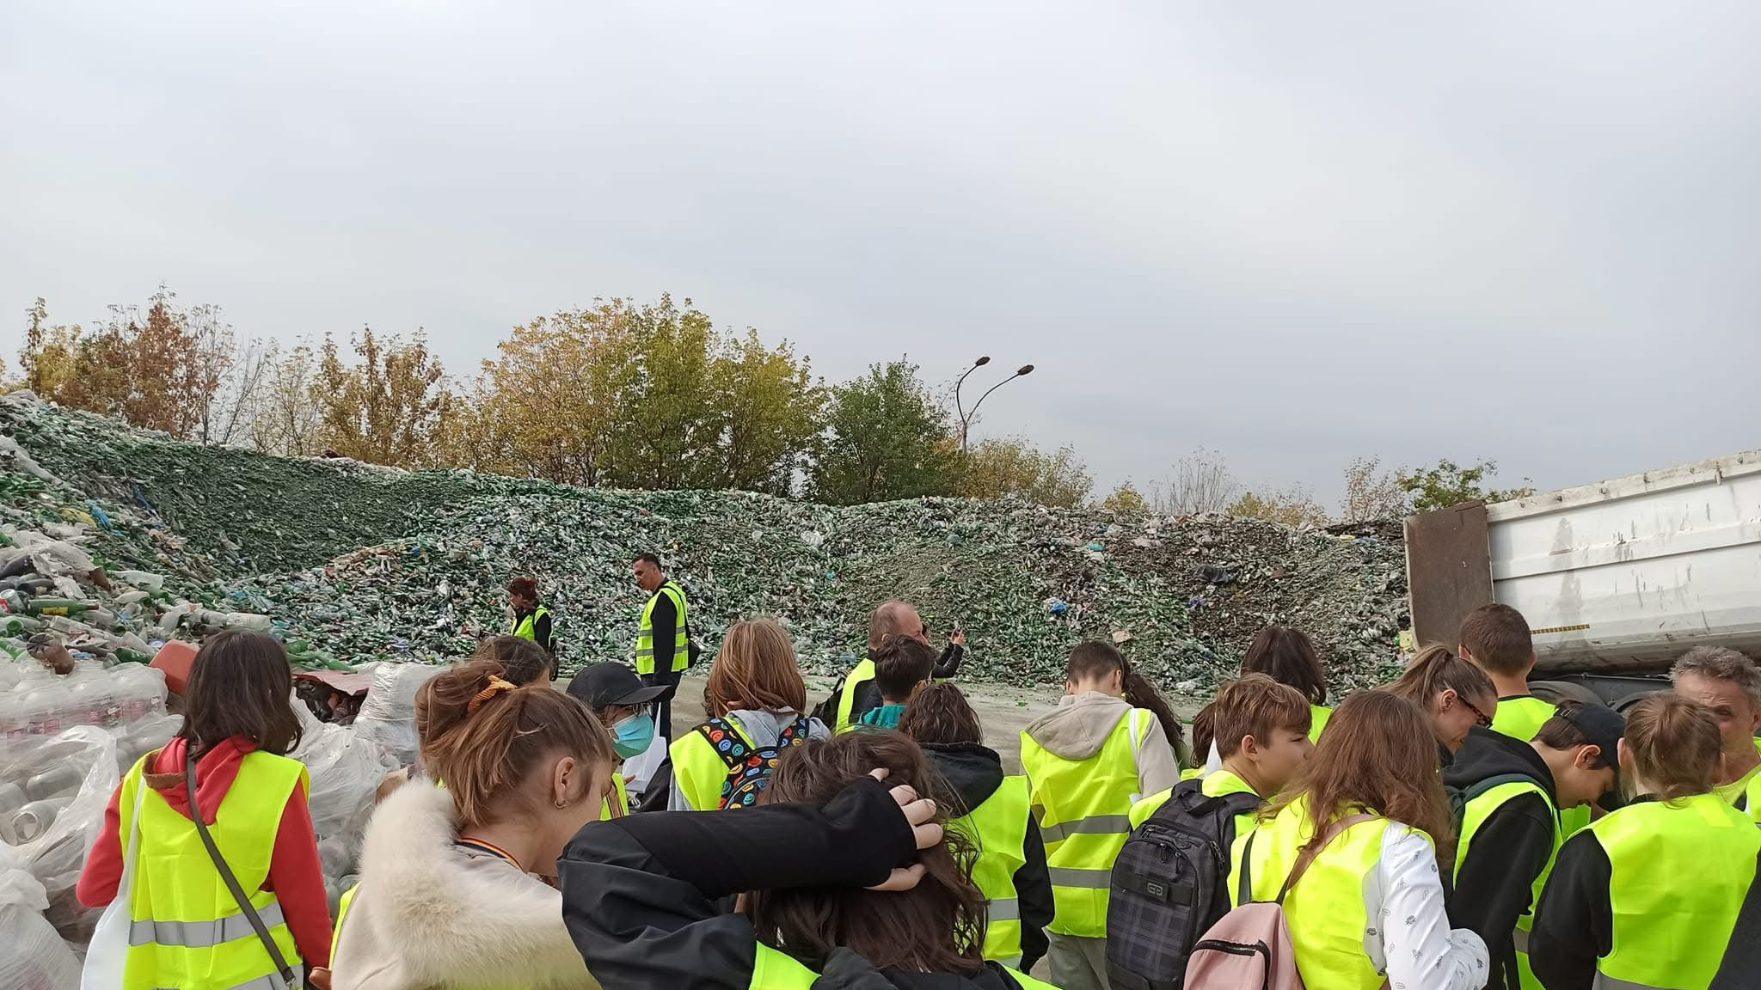
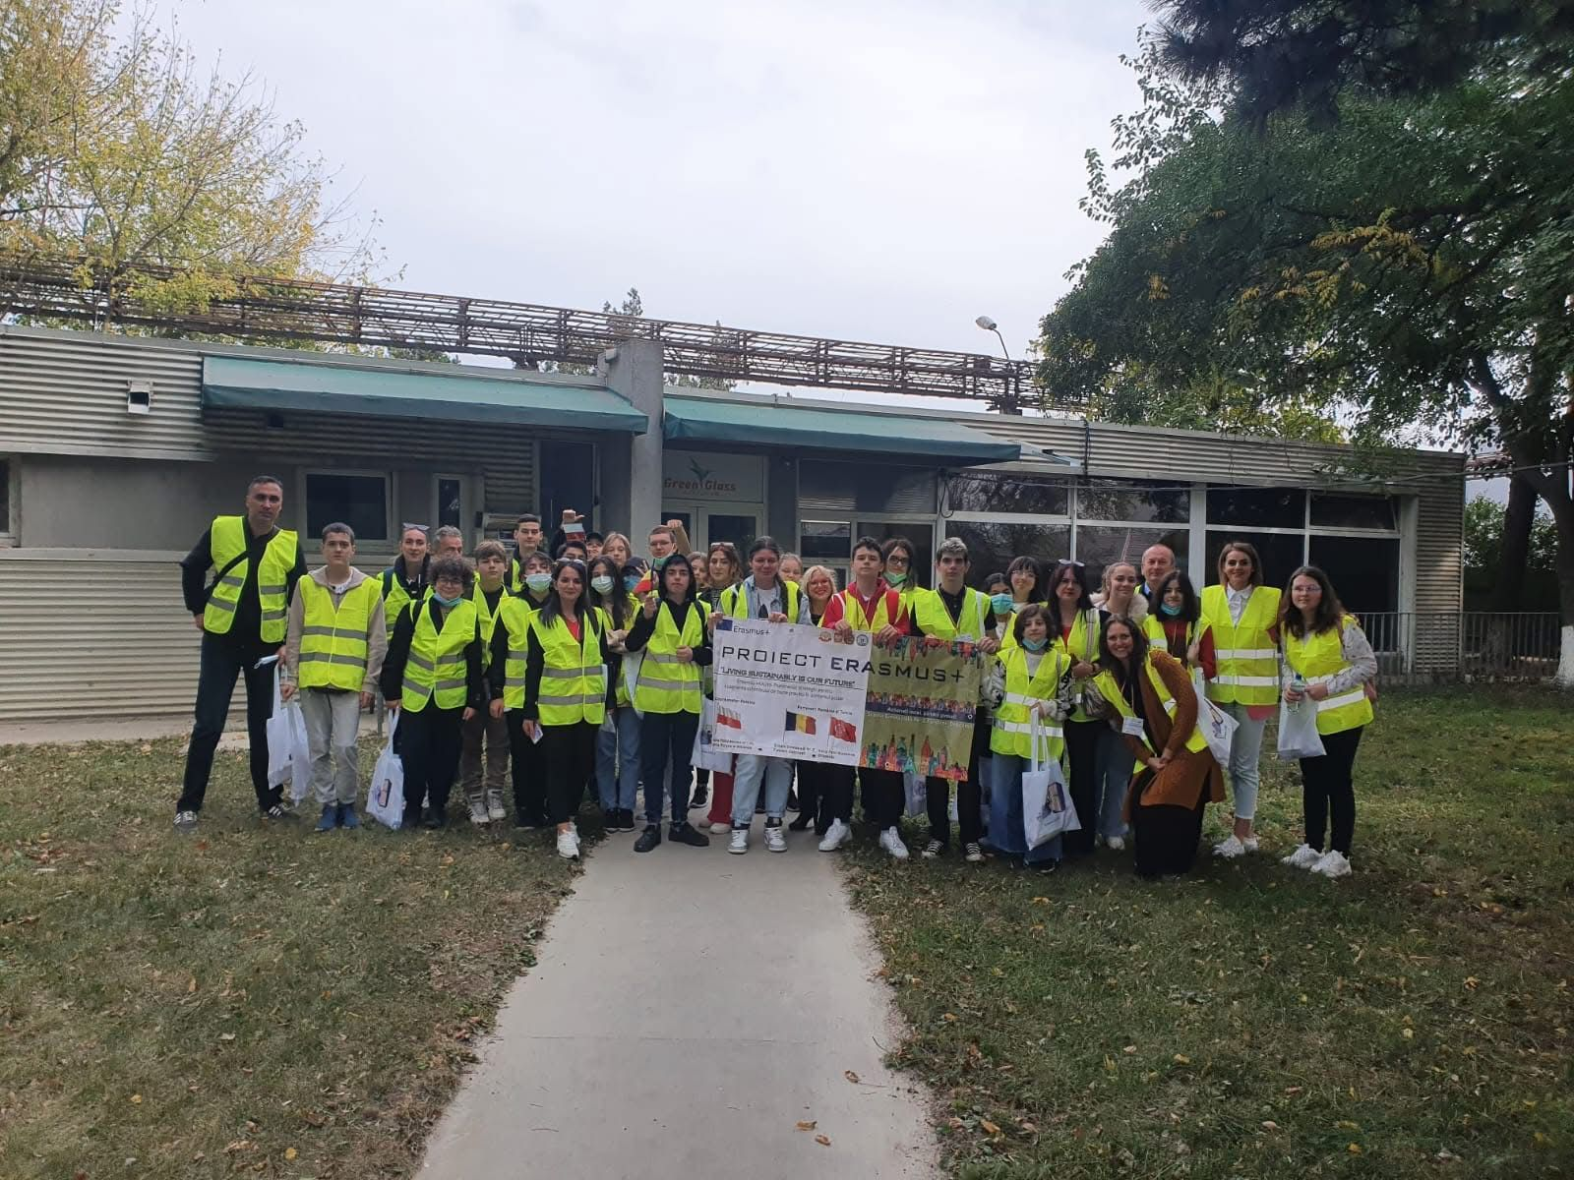
Through the topic we tackle in the project, our schools will become more environmentally friendly, highlighting the need of environmental education and focusing on concrete meaningful ways to improve waste management process.
The number of environmental activities and lessons will escalate and consequently, they will trigger changes in students’ attitudes towards environment and sustainability in medium and long term.
Thus, schools will reconfirm their key mission in the educating future generations of responsible adults. Schools will develop the cooperation strategy with local authorities, active NGOs in the field and economic agents to to set up further projects and cooperation activities.
The project product and results will continue to be multiplied in the following academic years with other generations of students. The waste management schemes will continue to be implemented in our schools and inspire teachers and students. Schools will increase visibility in their local and as well as in the wider community.

Slide 8
This partnership was structured around 3 key points:
1. Analysis report of waste management policies and the situation in each partner country. In this way, both similarities and differences were identified and project activities were planned accordingly.
2. Local and international activities whose main protagonists will be students. These activities promoted concrete solutions for reducing the amount of waste, reusing objects to avoid excessive consumption and recycling different materials to change their use.
3. Creating a comprehensive waste management guide to be applied at home and in schools. Therefore, the aim of the guide is to design a safe home and school-based waste management system.

Slide 9
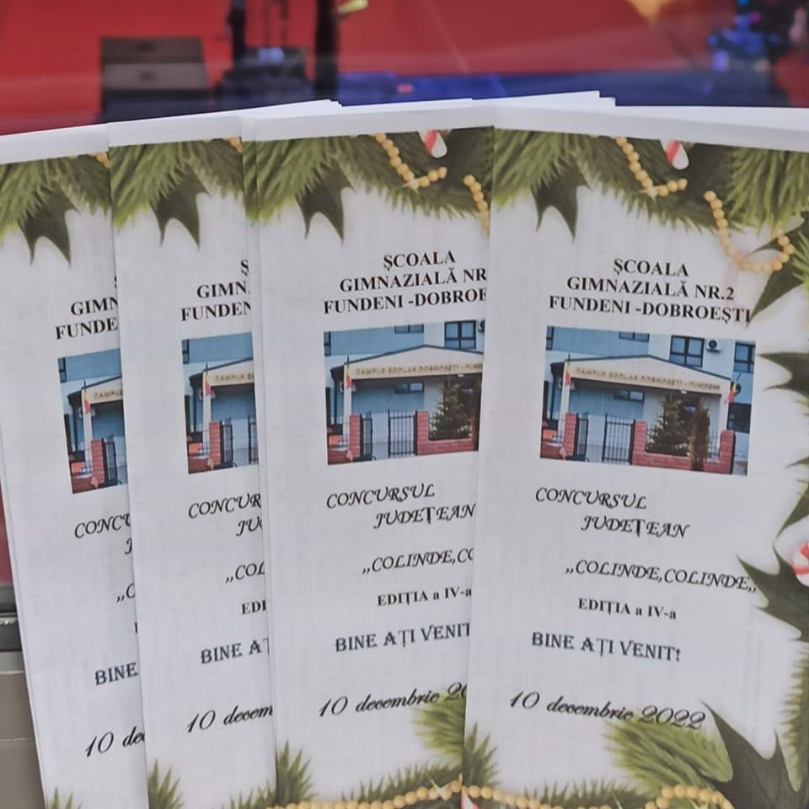
Among the projects that had a great impact in the community, we mention the project - competition ”Carols, carols”, a competition that aims to promote the Romanian culture and traditions. Our school was the main organizer, having as partner schools and kindergartens from Ilfov county.

Slide 10
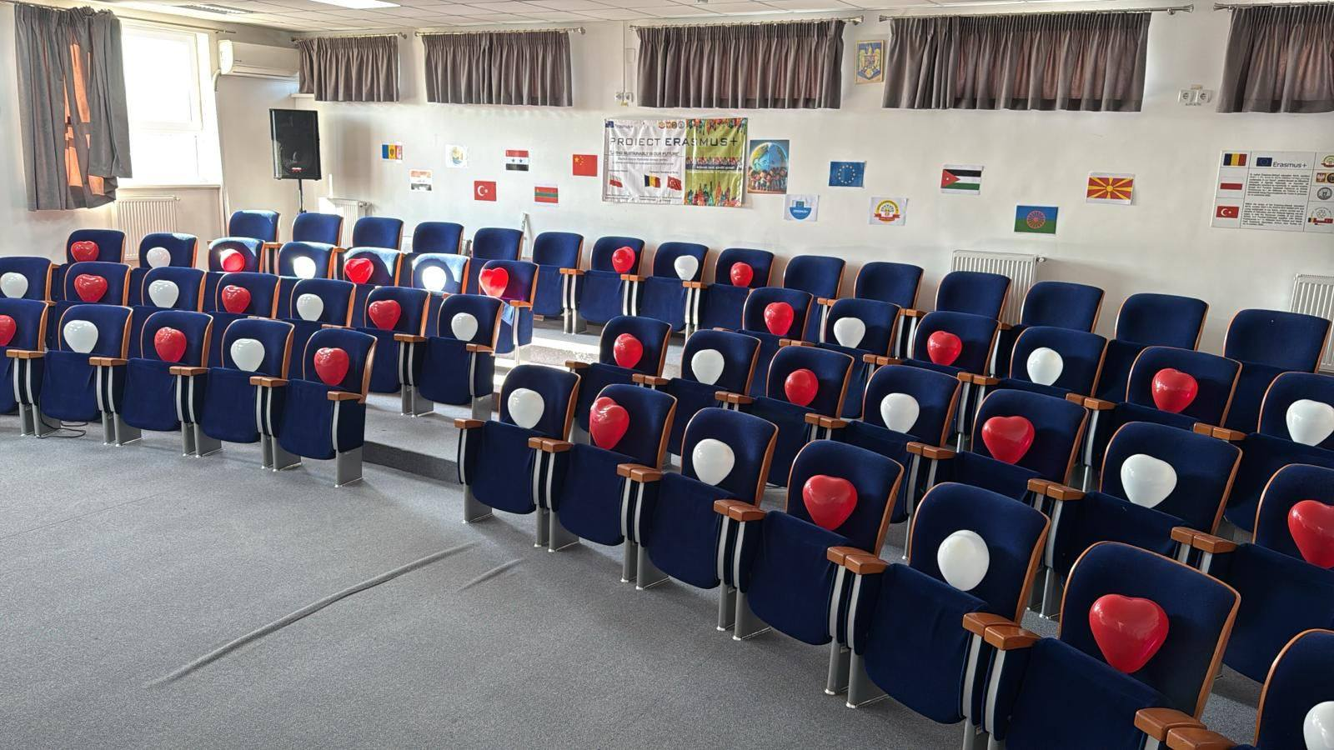
Another project carried out by our school is ”Let's bring spring into their souls!”, a project that has become a tradition in the school and in our community. The project consists of creating an artistic program at the school level, on the occasion of March 8th.

Slide 11
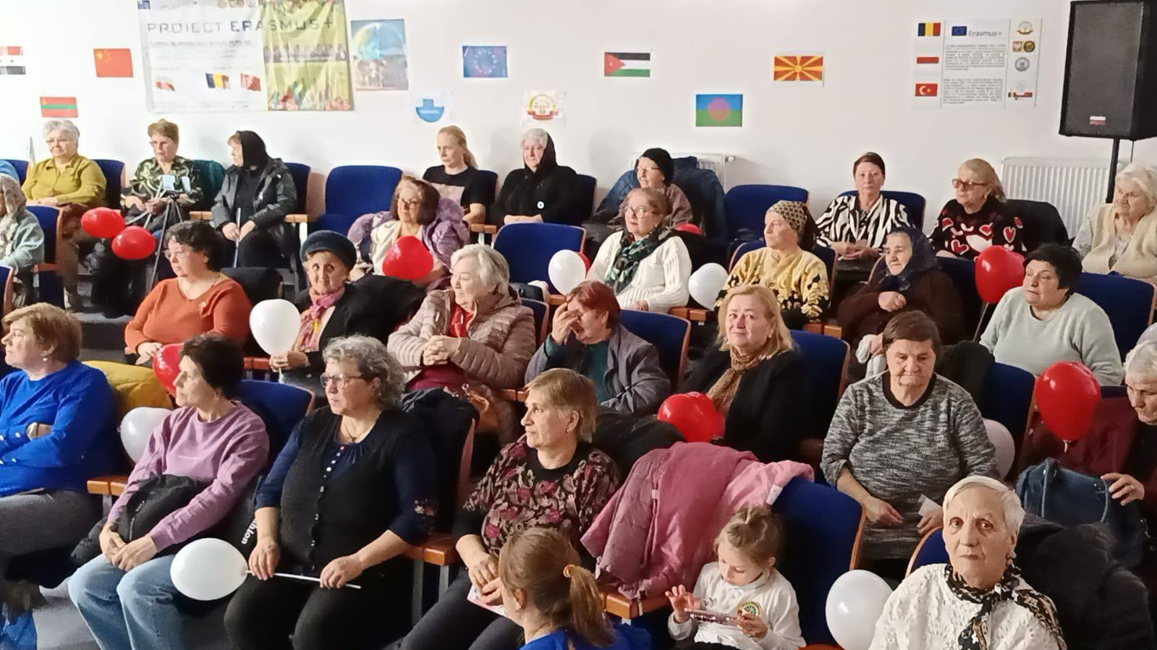

Slide 12
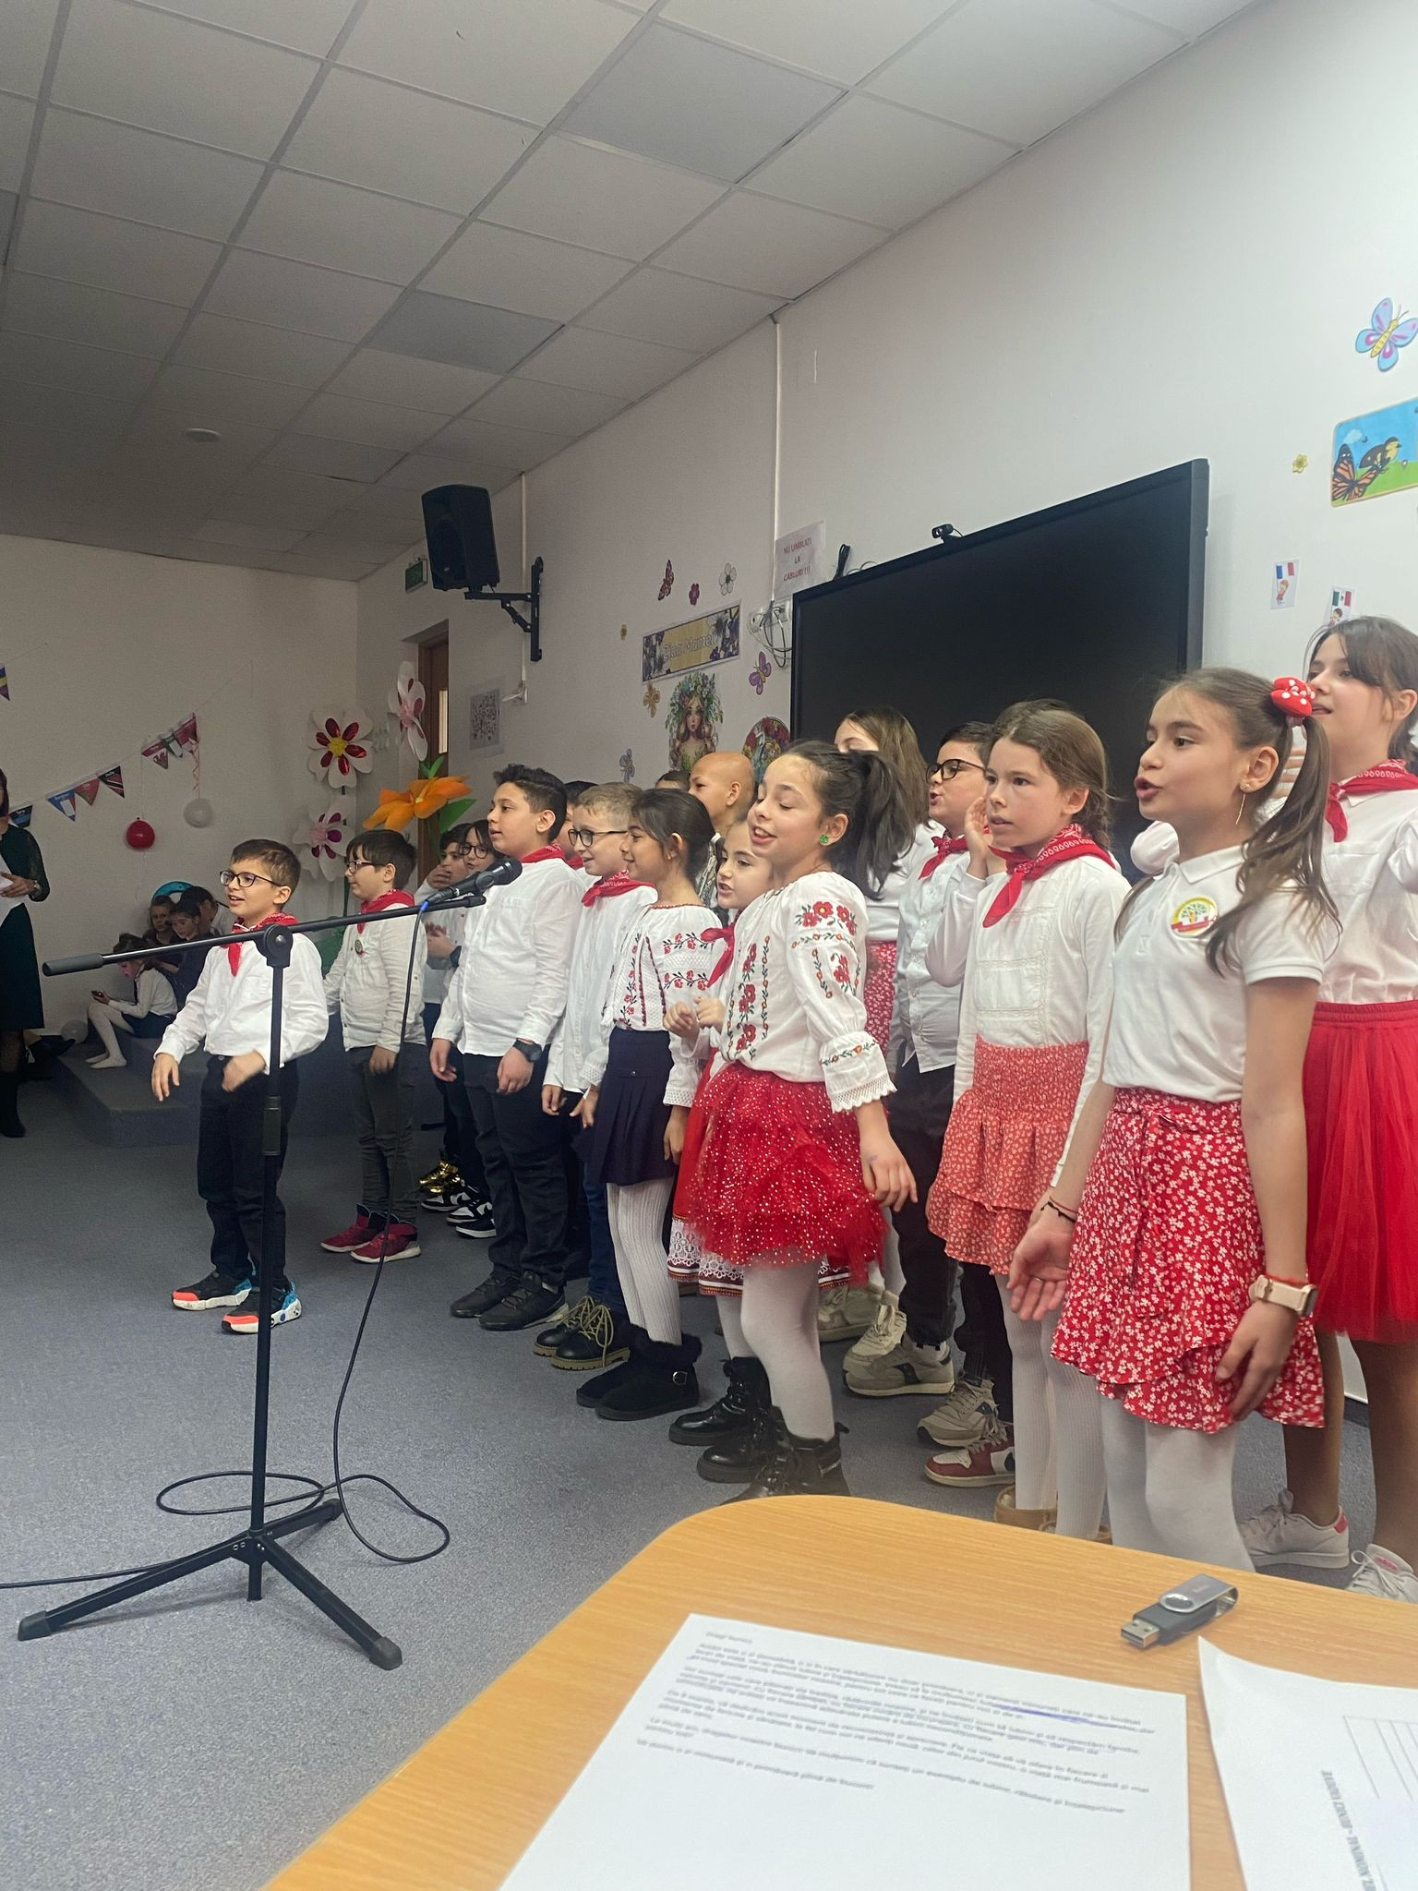
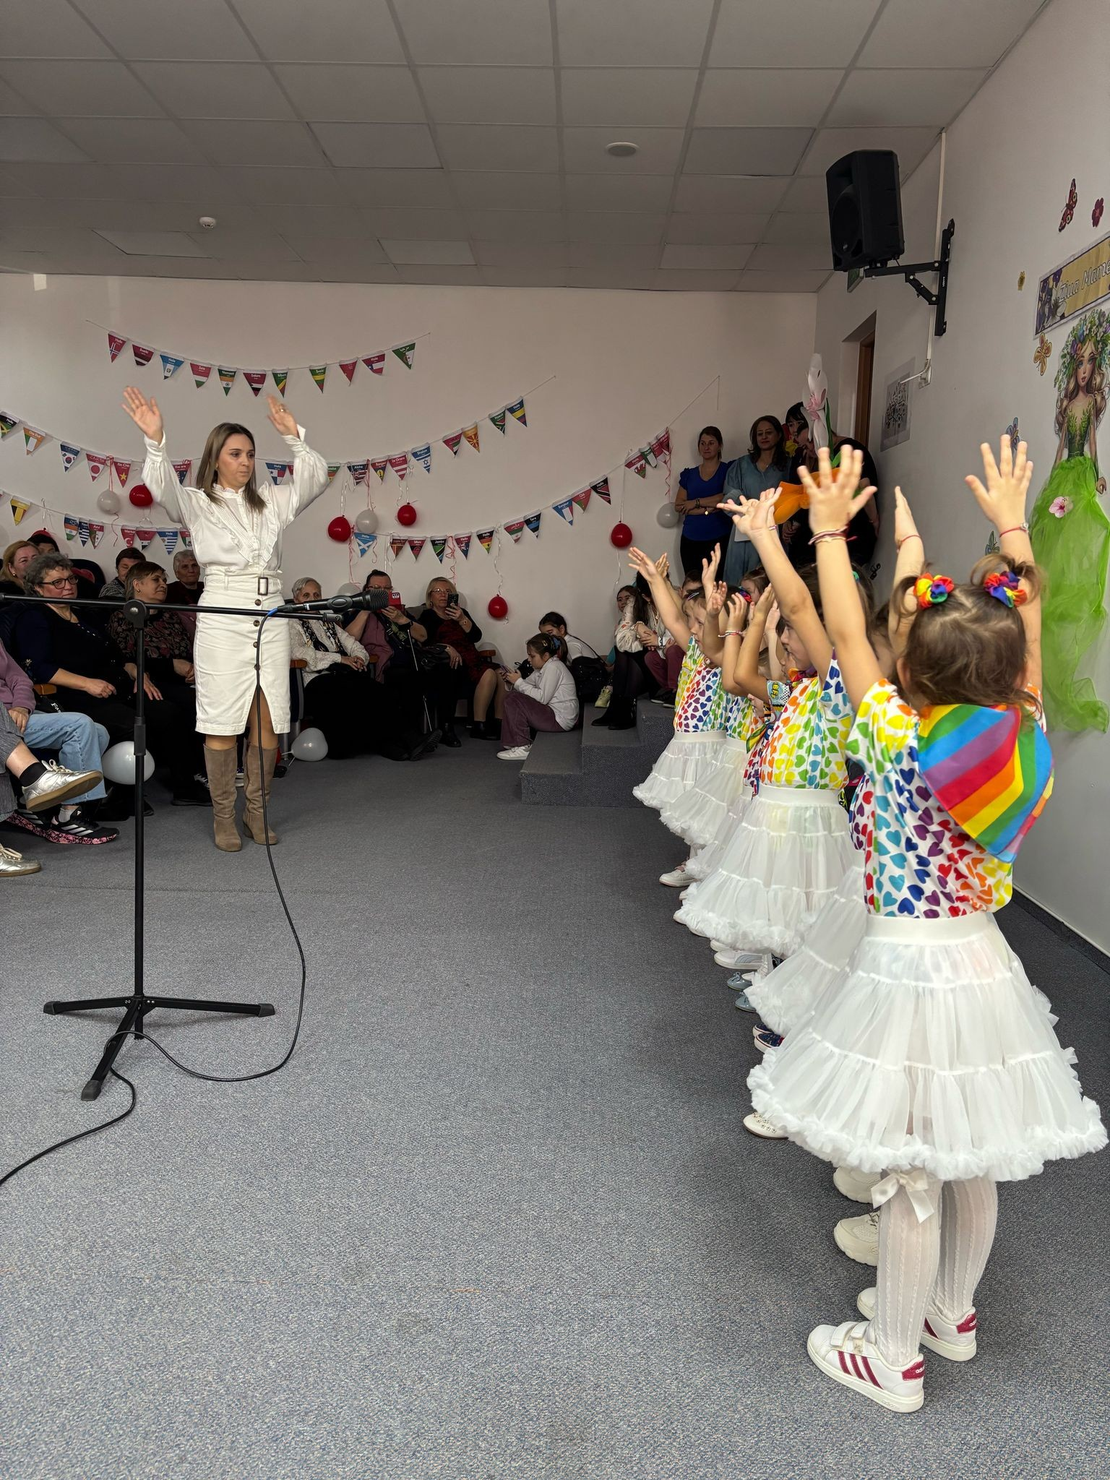
”Let's bring spring into their souls!”

Slide 13
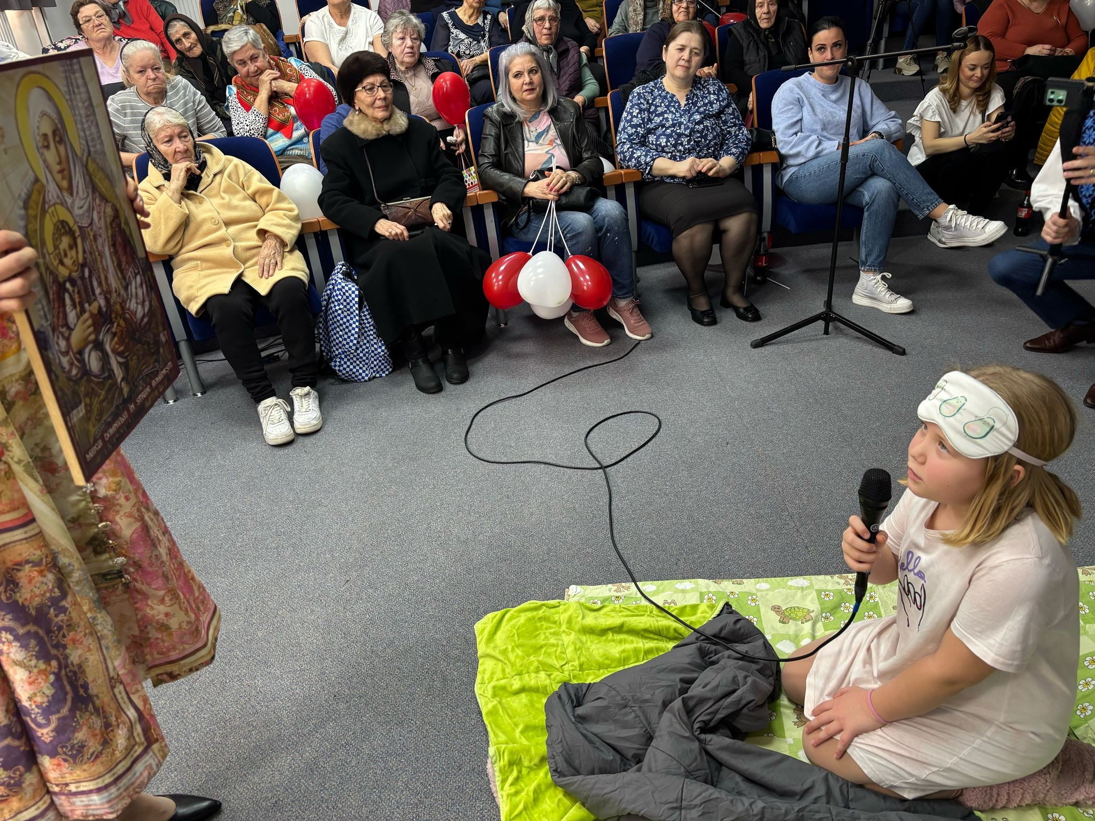
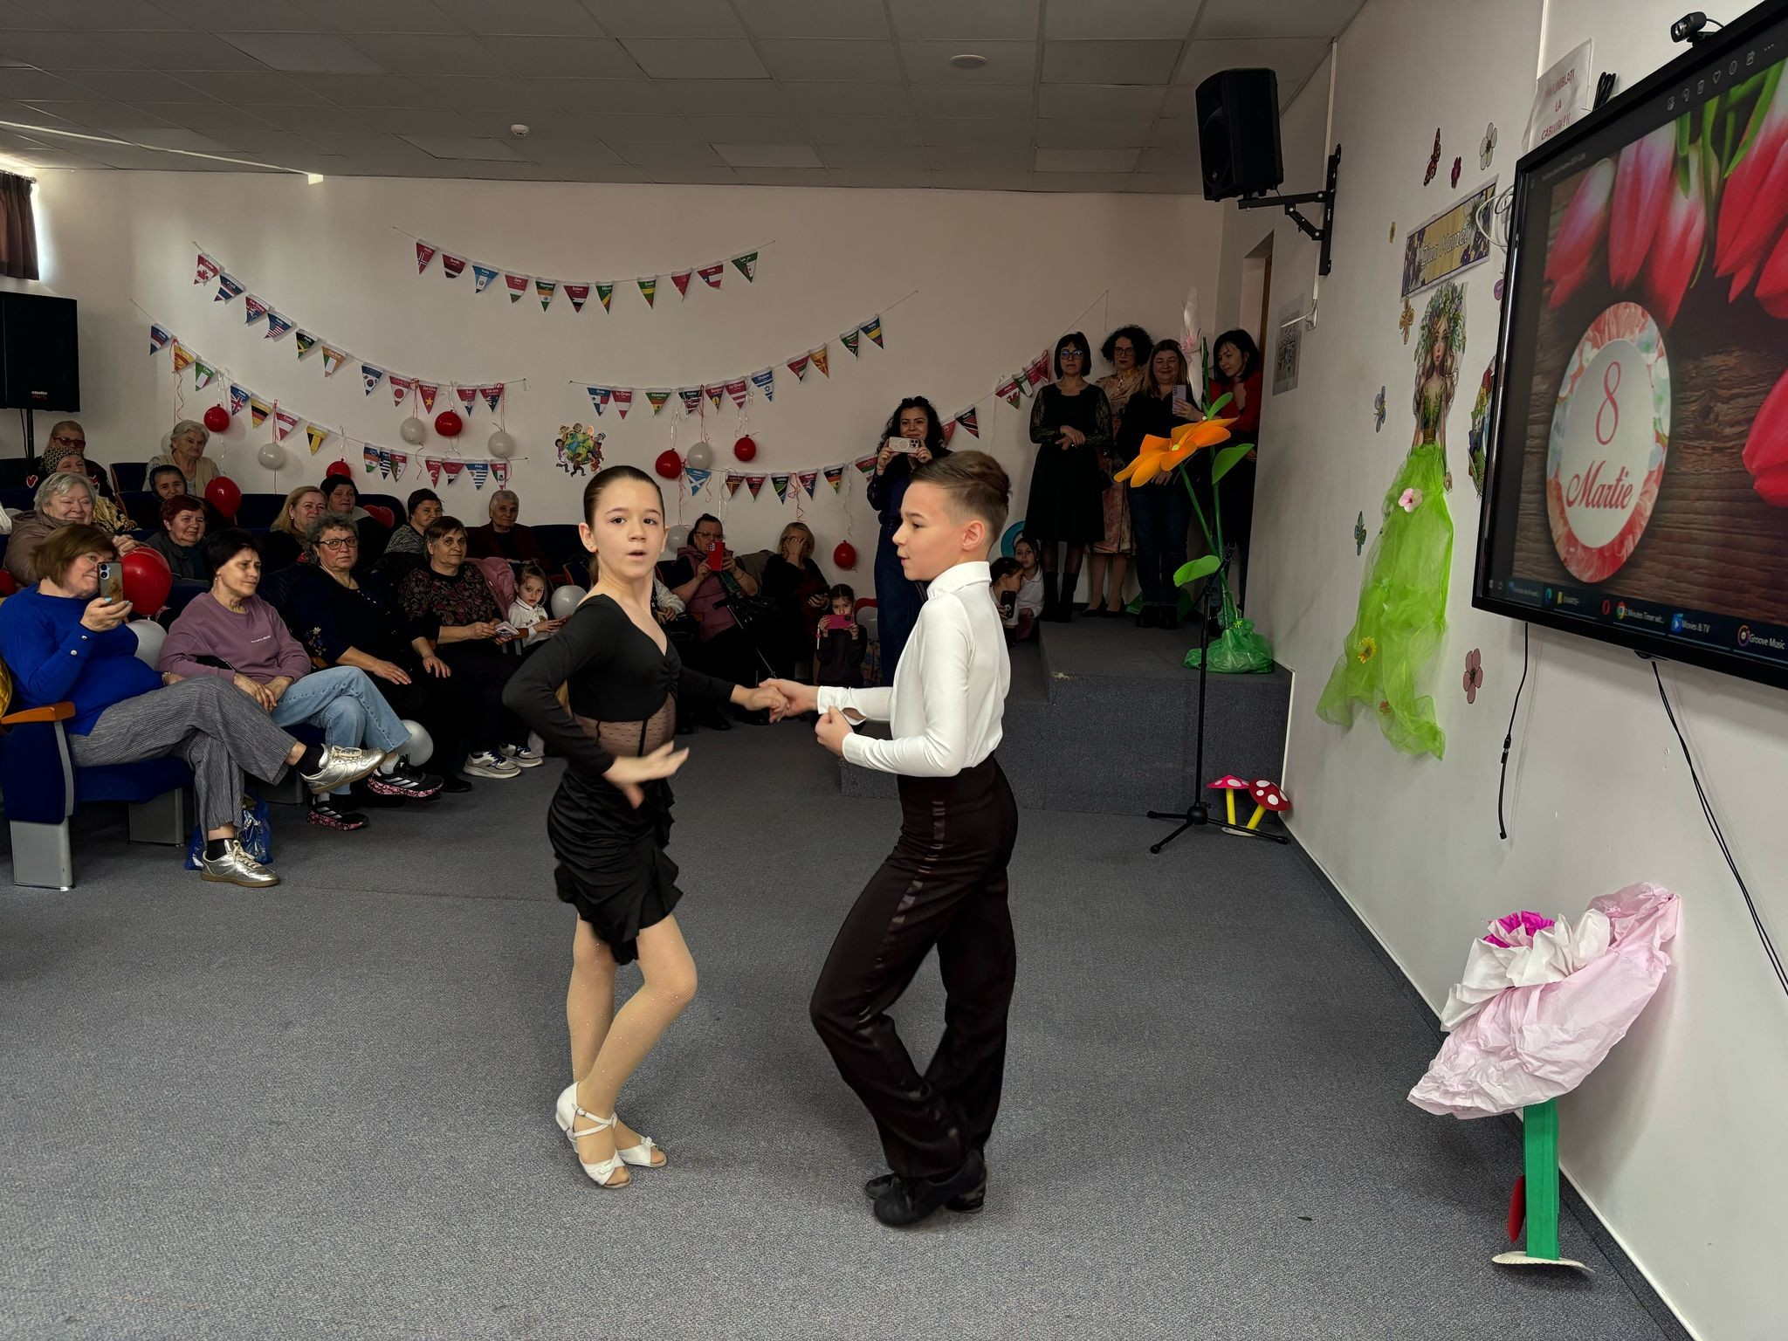
”Let's bring spring into their souls!”

Slide 14
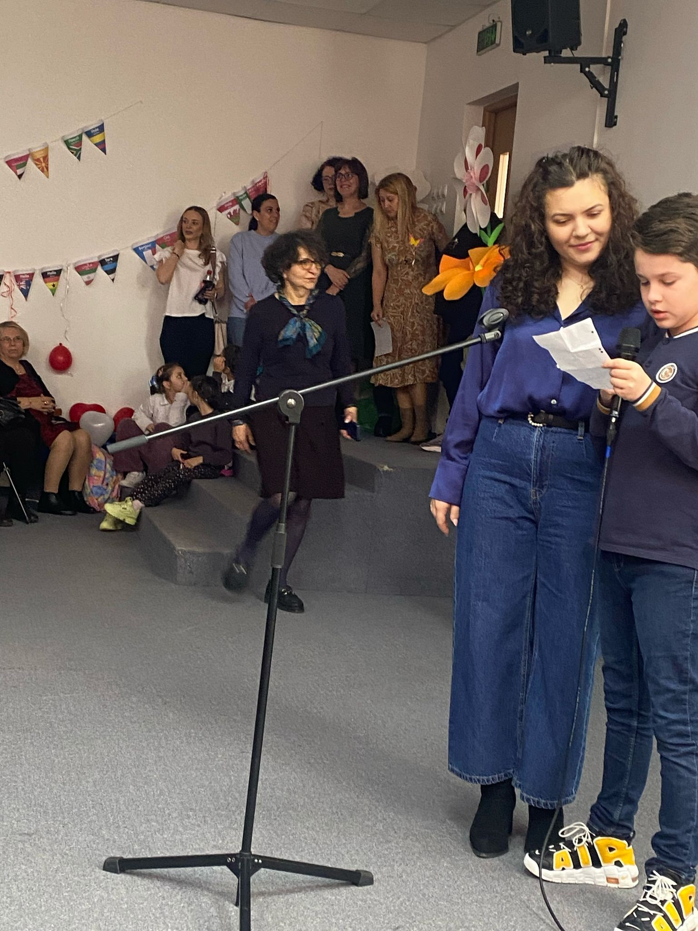
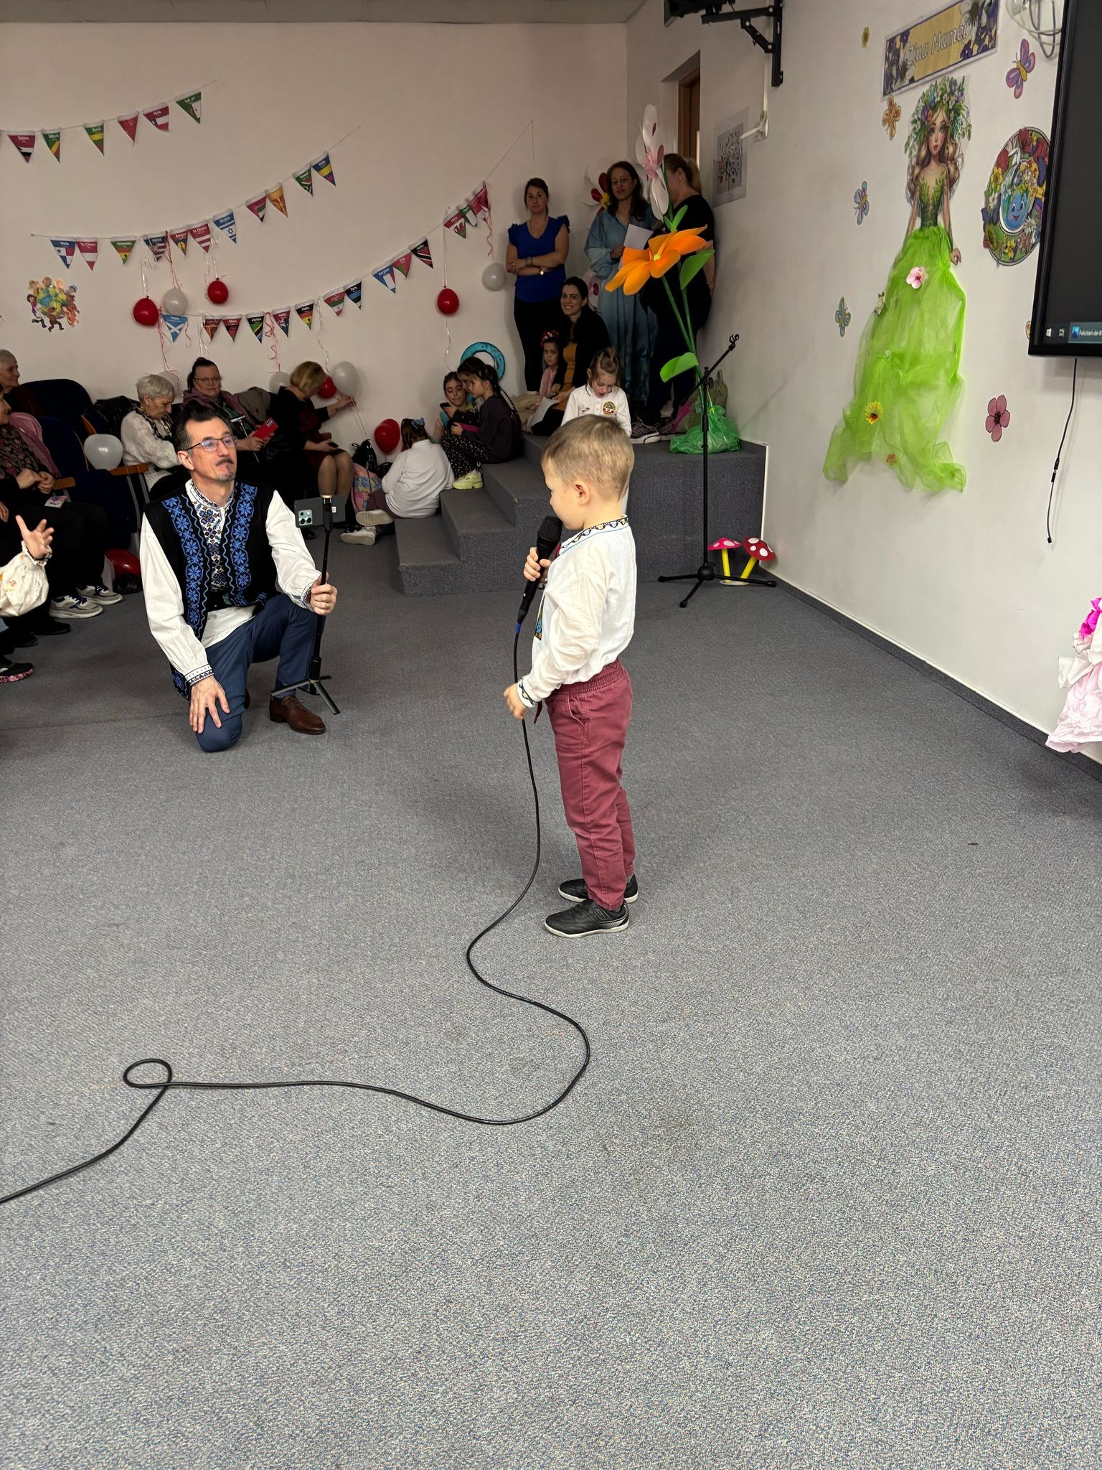
”Let's bring spring into their souls!”

Slide 15
“Caravana Primaverii” project aims to capitalize the traditions, contributes to the formation of the aesthetic and social side of the human personality, to the development of the taste for beauty and it addresses both children and staff.
“We support the Performance” is another educational program started in our institution, which respects the age of students with the aim of orienting them towards performance.
“Summer School” project is, first of all, a method of offering children an alternative activity for spending summer holiday. The idea of this project was born from the desire to help children, to help them learn to save their time, to spend time in a good way, to teach them to relate to teachers in a different way than the scholar one.

Slide 16
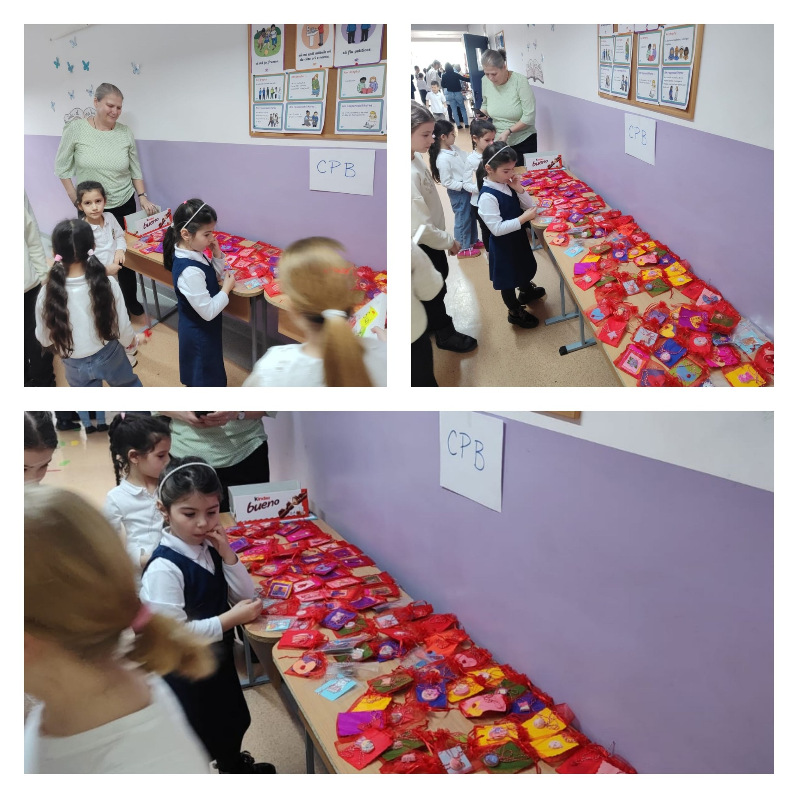
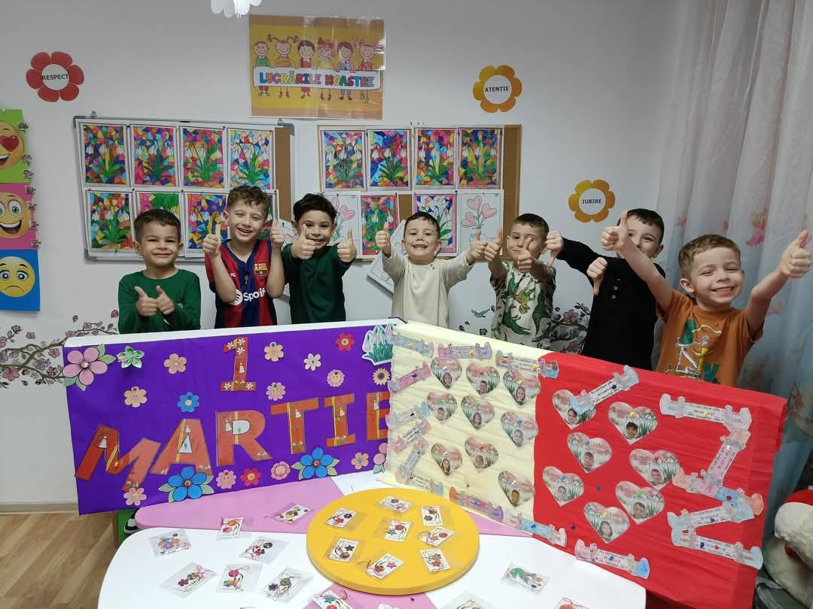

Slide 17
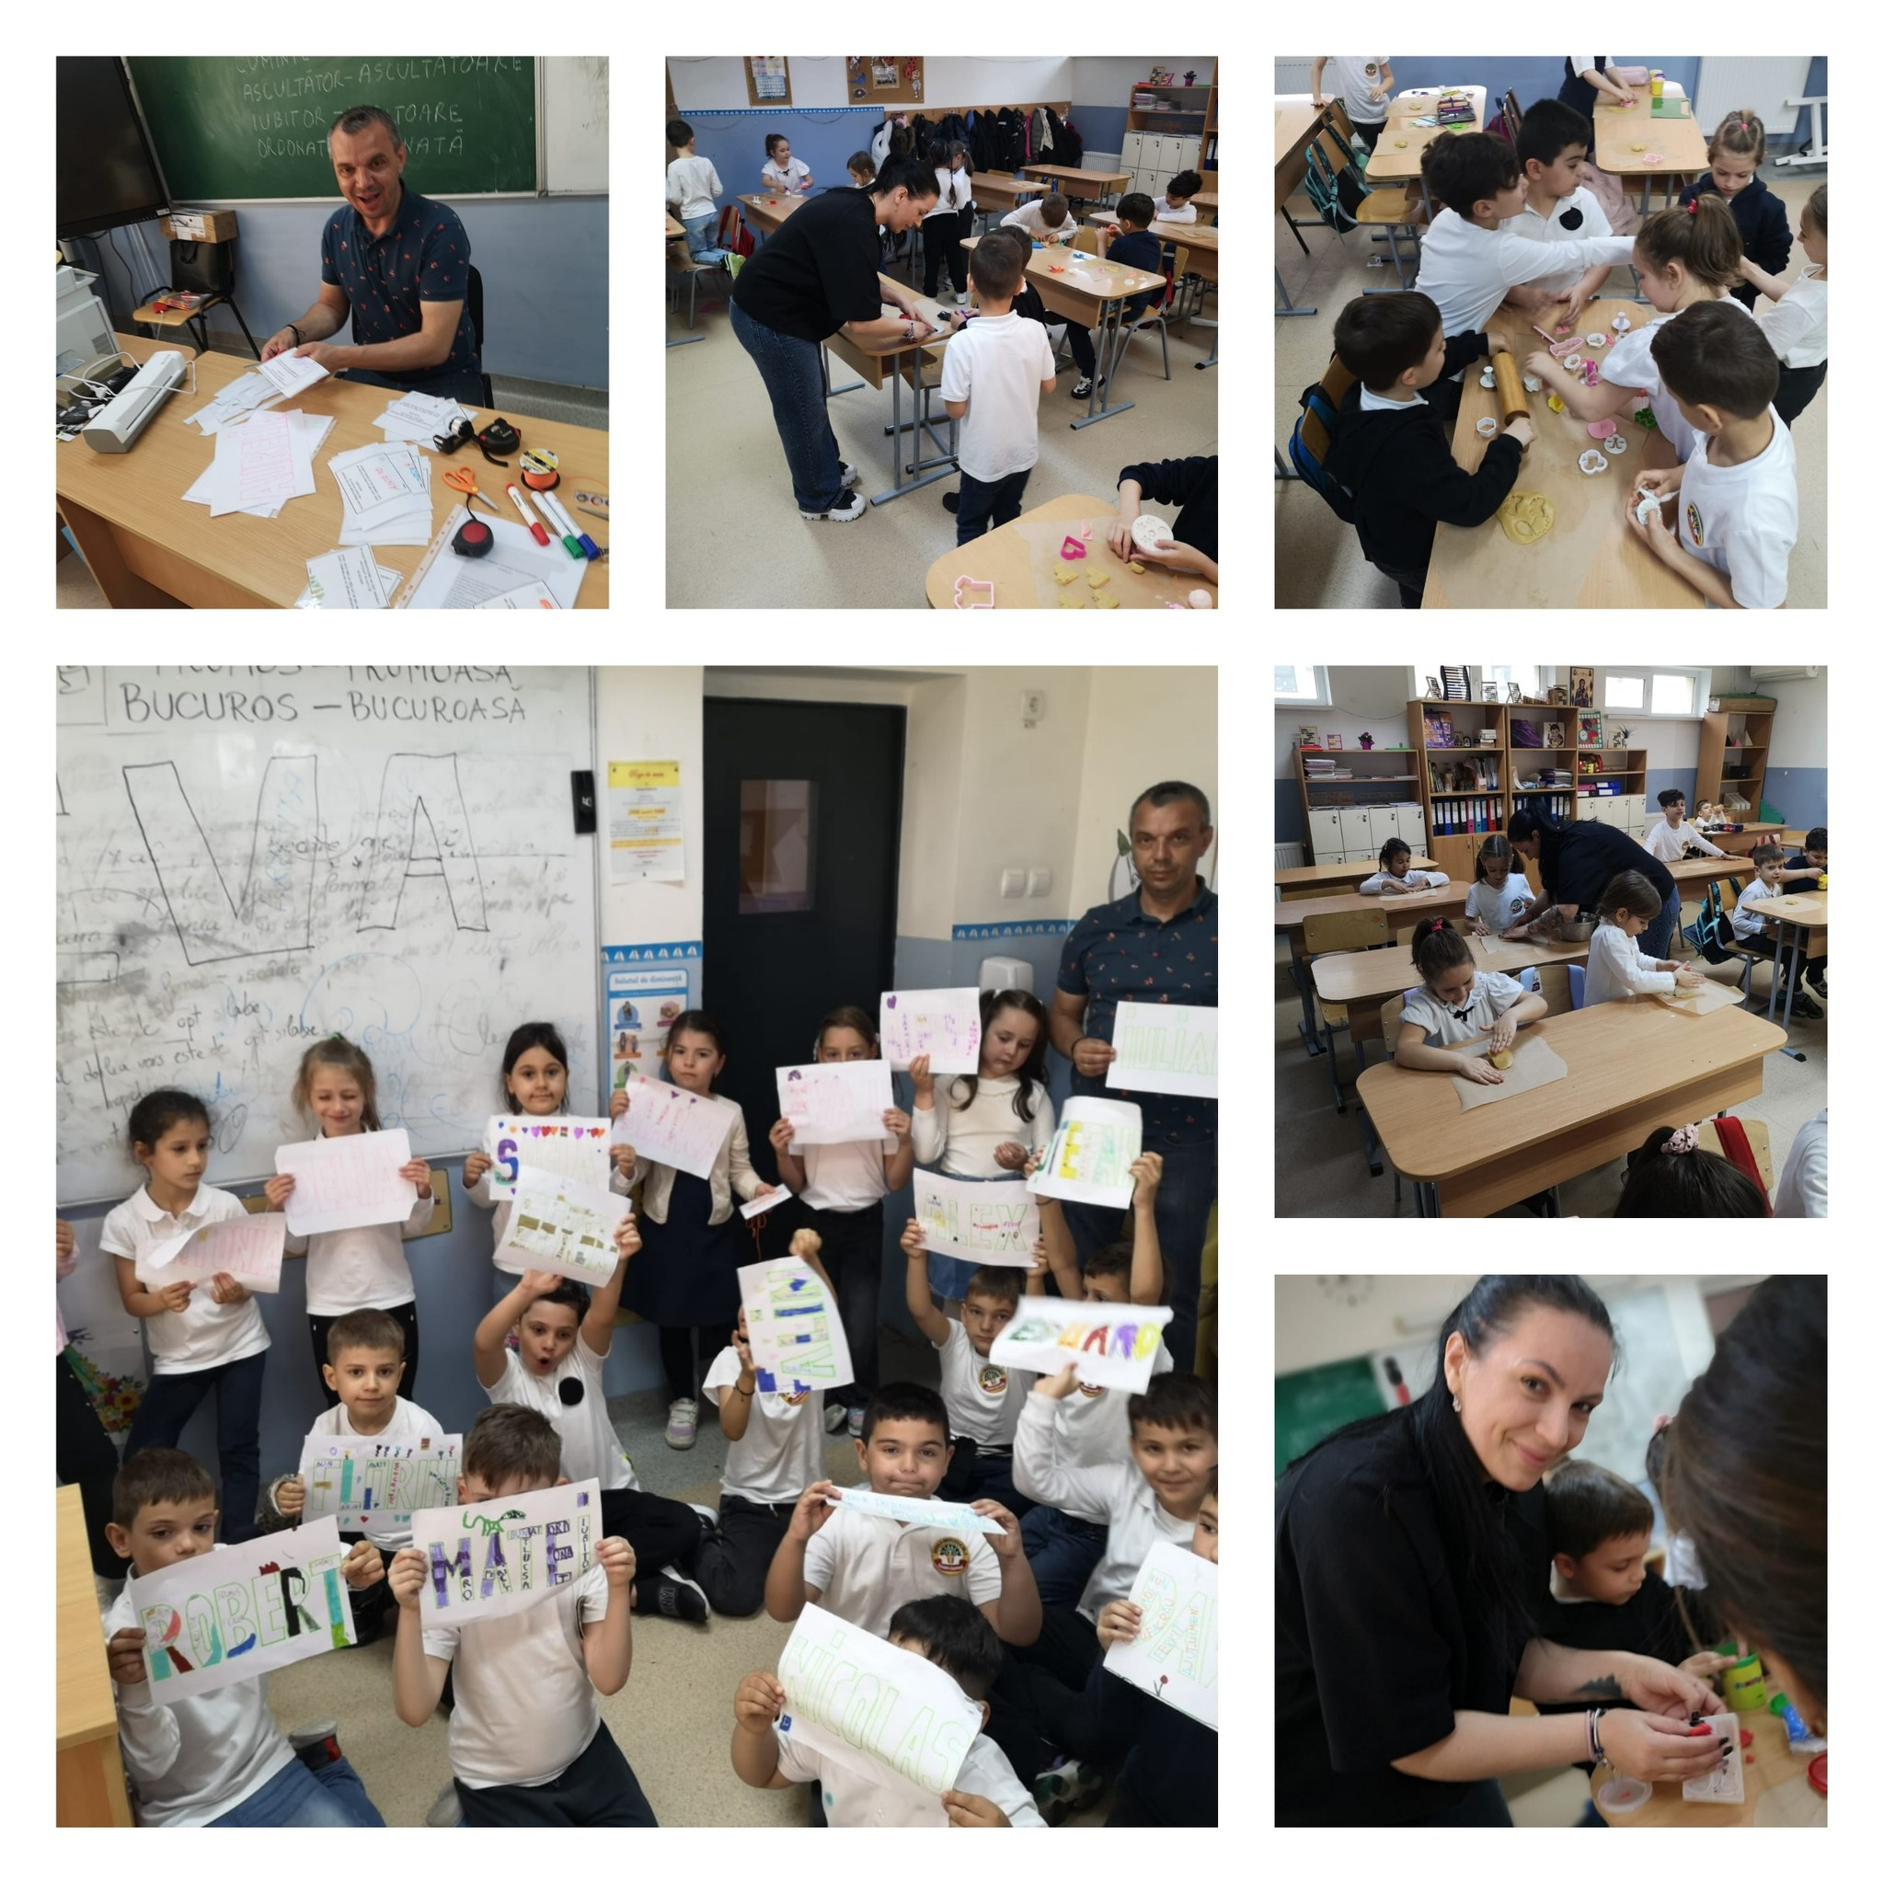
In order to improve the relationship between the family and the school, this year a national project was implemented. Developed in partnership with the local and the county institutions, this project would support the parents and the children, too. The title of the project is the ”Parents' School” and it lasts for a period of 4 months with the possibility of extension. It pursues an effective communication and relationship between school and family and helps parents to get to know their children better and ways to adapt them to school. The people who will provide training activities will be educators, teachers, professors, psychologists and school counselors.

Slide 18
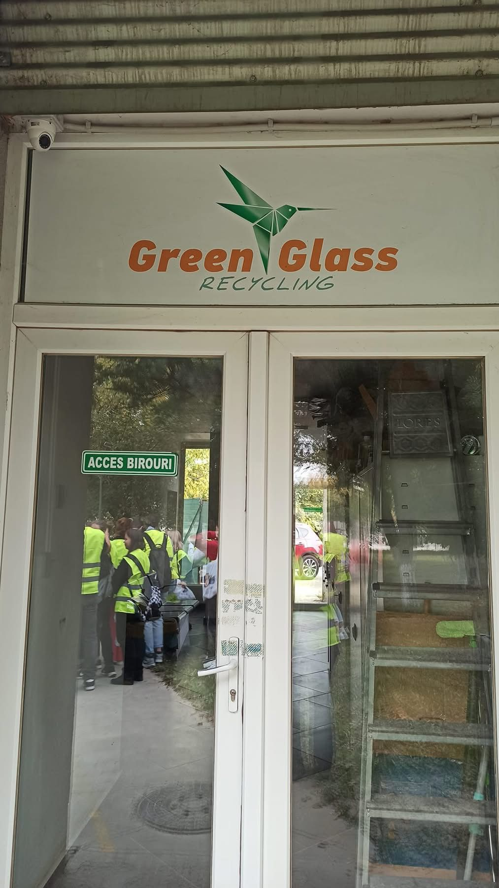
Our school has not benefited from any Erasmus project, but we are eager to participate in such a project. We believe it will be an useful and a constructive experience that will add value to our professional training.
We have experience in implementing local and county projects, which have been successful and have contributed to promote the image of our school in the community.

Slide 21
We will strive for this international project to be a success: we will promote the project so that the school teachers, students, parents and local authorities know the specifics of the project and its benefits, we will permanently discuss the project results at school and the community level, we will create in the school a database with information and examples of good practice obtained within the project, resources to which all teachers of the school and the 2 kindergartens will have access.
After each project activity, the teachers involved will meet with their colleagues and share their good practice models, we will also keep a journal of the project and we will realize informative materials about the project such as brochures, leaflets, informative panels with data and representative photos.

Slide 22
The key people in charge of running the project in the school will be:
Stupineanu Claudia – School principal
Piclisan Teodora – School Vice-principal
Ciupercă Alina – English teacher
Roxana Marinescu – Primary teacher
Magda Costache – Primary teacher
We want to be part of this project because we want to improve the pedagogical skills of our teachers and students. The participation of our teachers in this experience will increase the quality of the instructive-educational process, will create a support network between our teachers and the teachers from the partner schools.

Slide 23
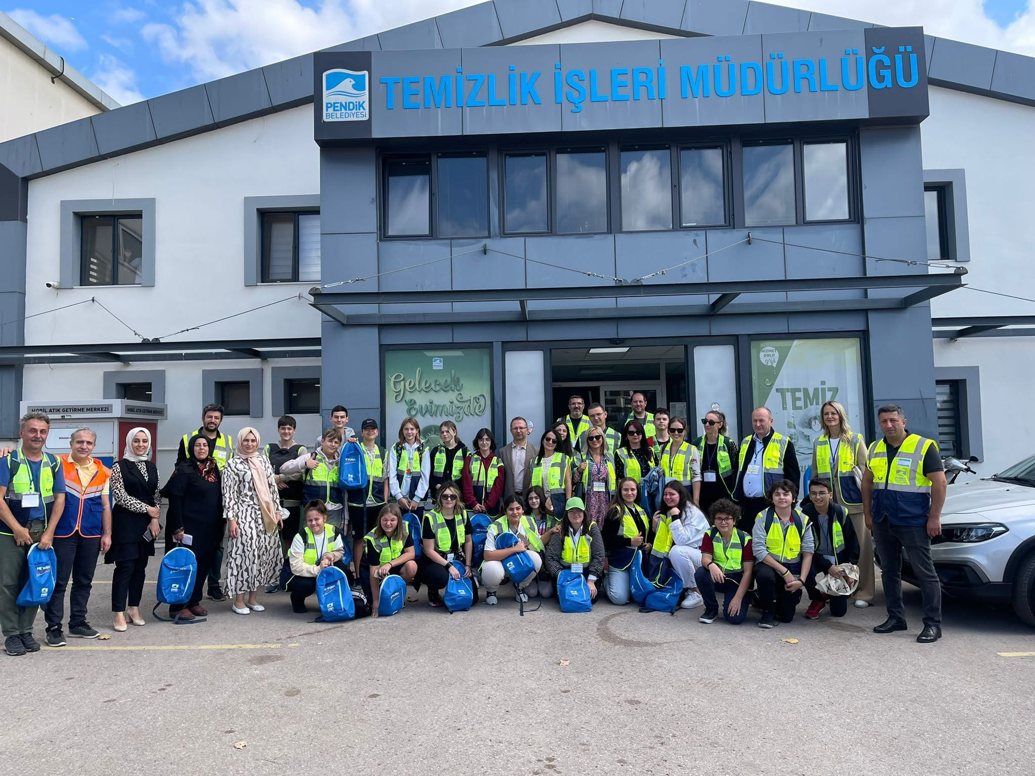
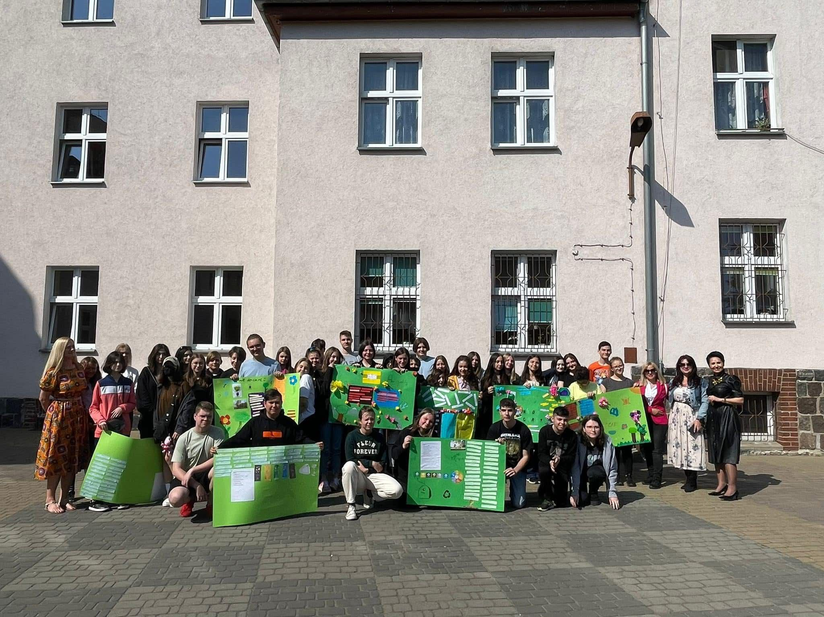

Slide 24
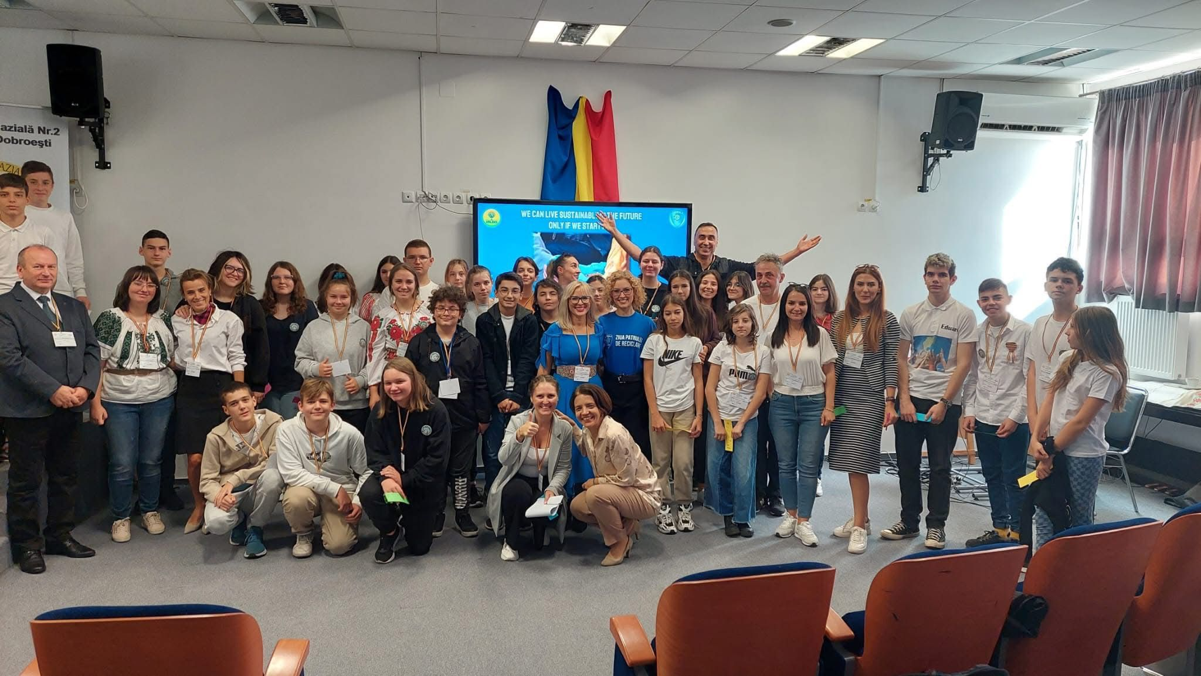

Slide 25
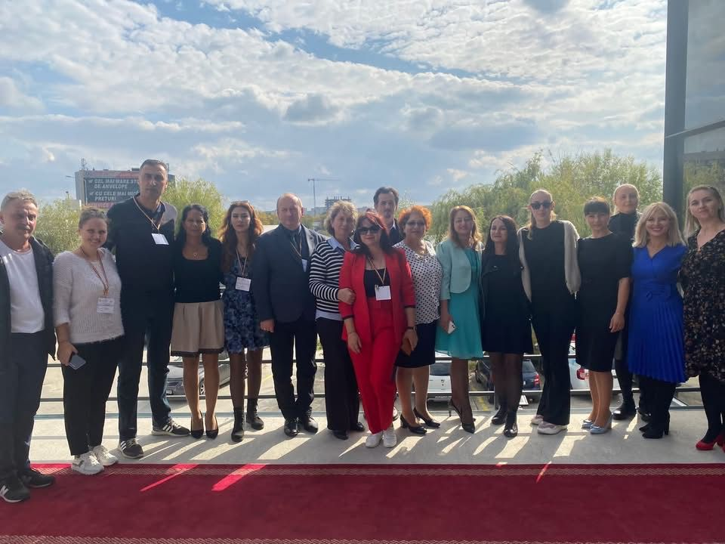

Slide 26
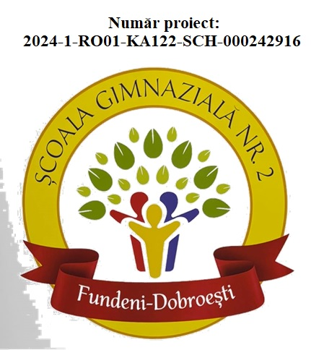
2. PROJECT “Europe and Its Values Through the Eyes of a Child”
The Erasmus+ project “Europe and Its Values Through the Eyes of a Child” is an educational initiative developed by Școala Gimnazială Nr. 2 Fundeni, aimed at promoting the inclusion of students from disadvantaged backgrounds through educational exchanges and intercultural experiences involving both teachers and students.

Slide 27
Within the project, teachers will participate in three types of international mobilities:
* *Job shadowing in Malta*, to observe effective strategies for inclusion and anti-bullying in European schools;
* *Structured courses in Finland*, focused on innovative teaching methods, emotional support, and overall well-being in the school environment;
* *A mobility with students to Lecce, Italy*, where joint activities with international peers will promote cultural exchange, cooperation, and European values.

Slide 28
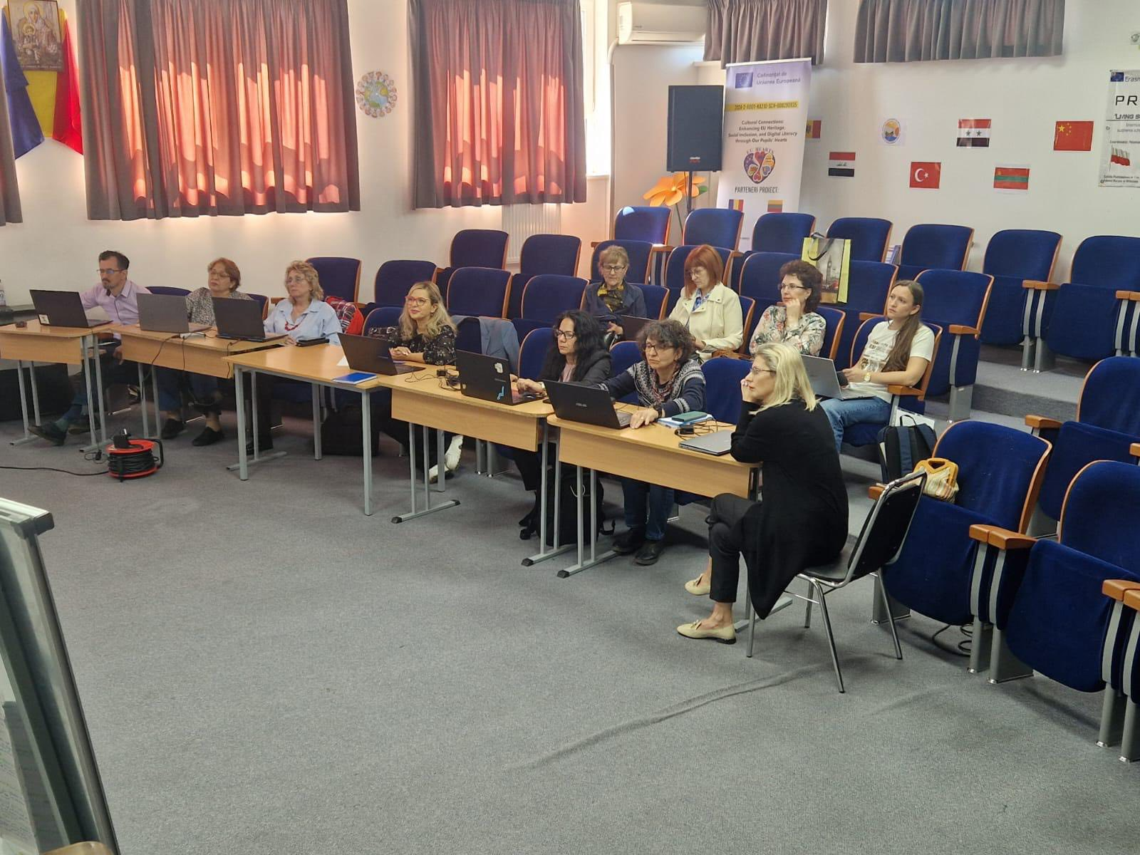
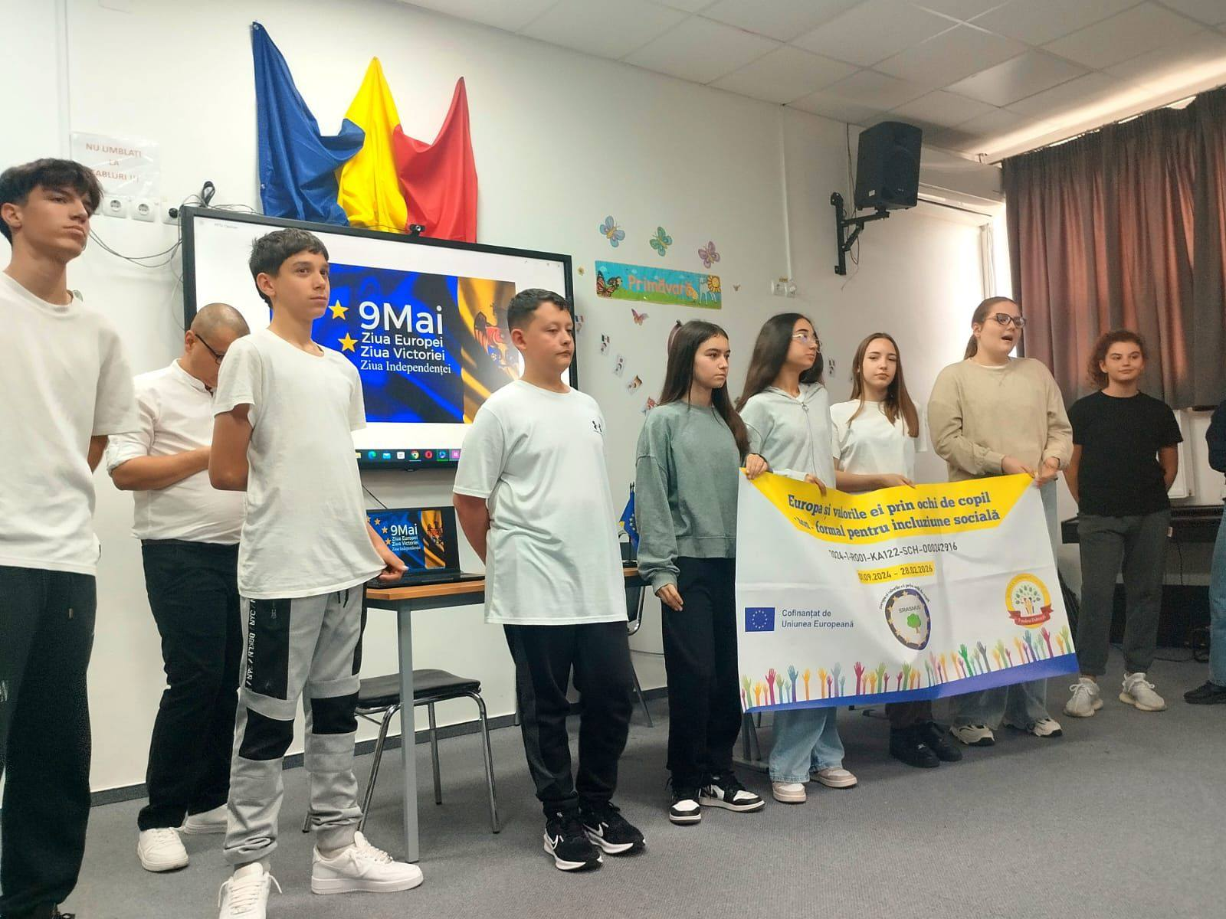

Slide 29
“Europe and Its Values Through the Eyes of a Child”
The project aims to:
* Improve the well-being of students and teachers in school;
* Identify and implement effective strategies for school inclusion and bullying prevention;
* Encourage active student participation in school life and in the community, regardless of socio-economic status;
* Develop responsible, empathetic, and open-minded European citizens.

Slide 30
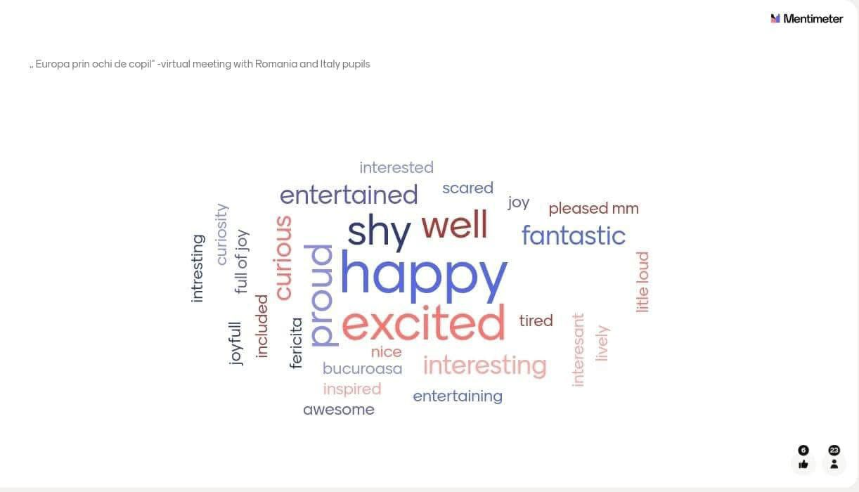
“Europe and Its Values Through the Eyes of a Child”
Through international experiences and collaborative activities, this project contributes to shaping an inclusive and modern school, grounded in European values such as respect, tolerance, cooperation, and solidarity.

Slide 31
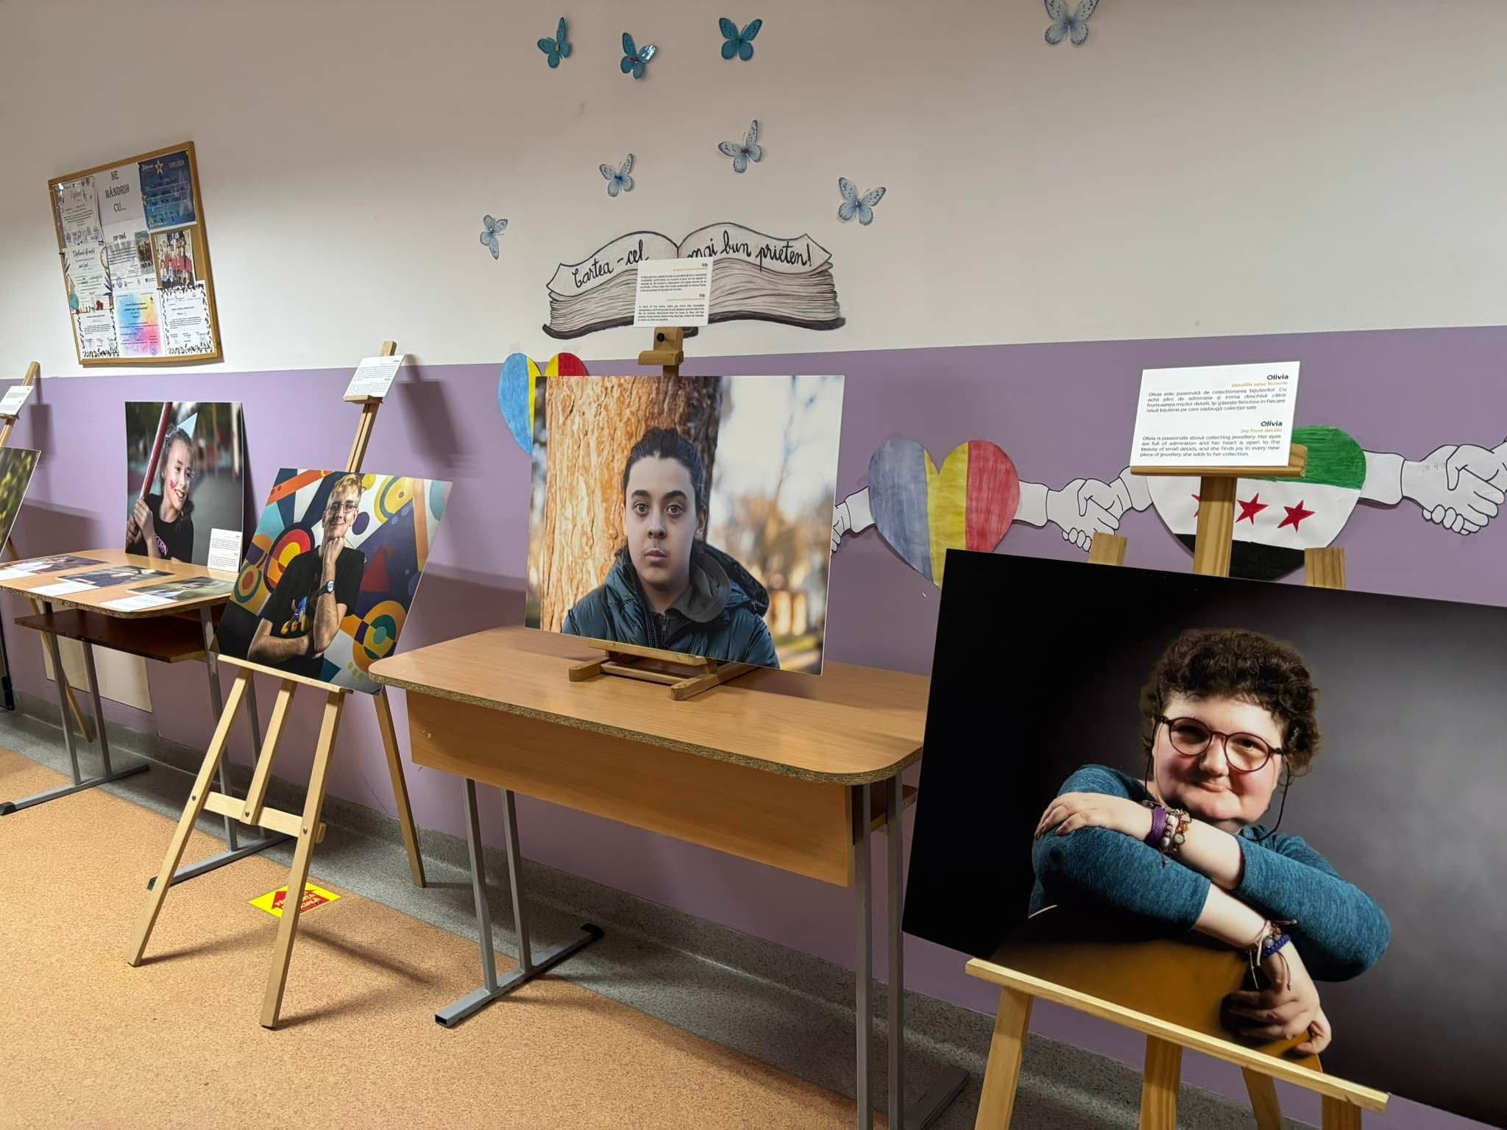

Slide 32
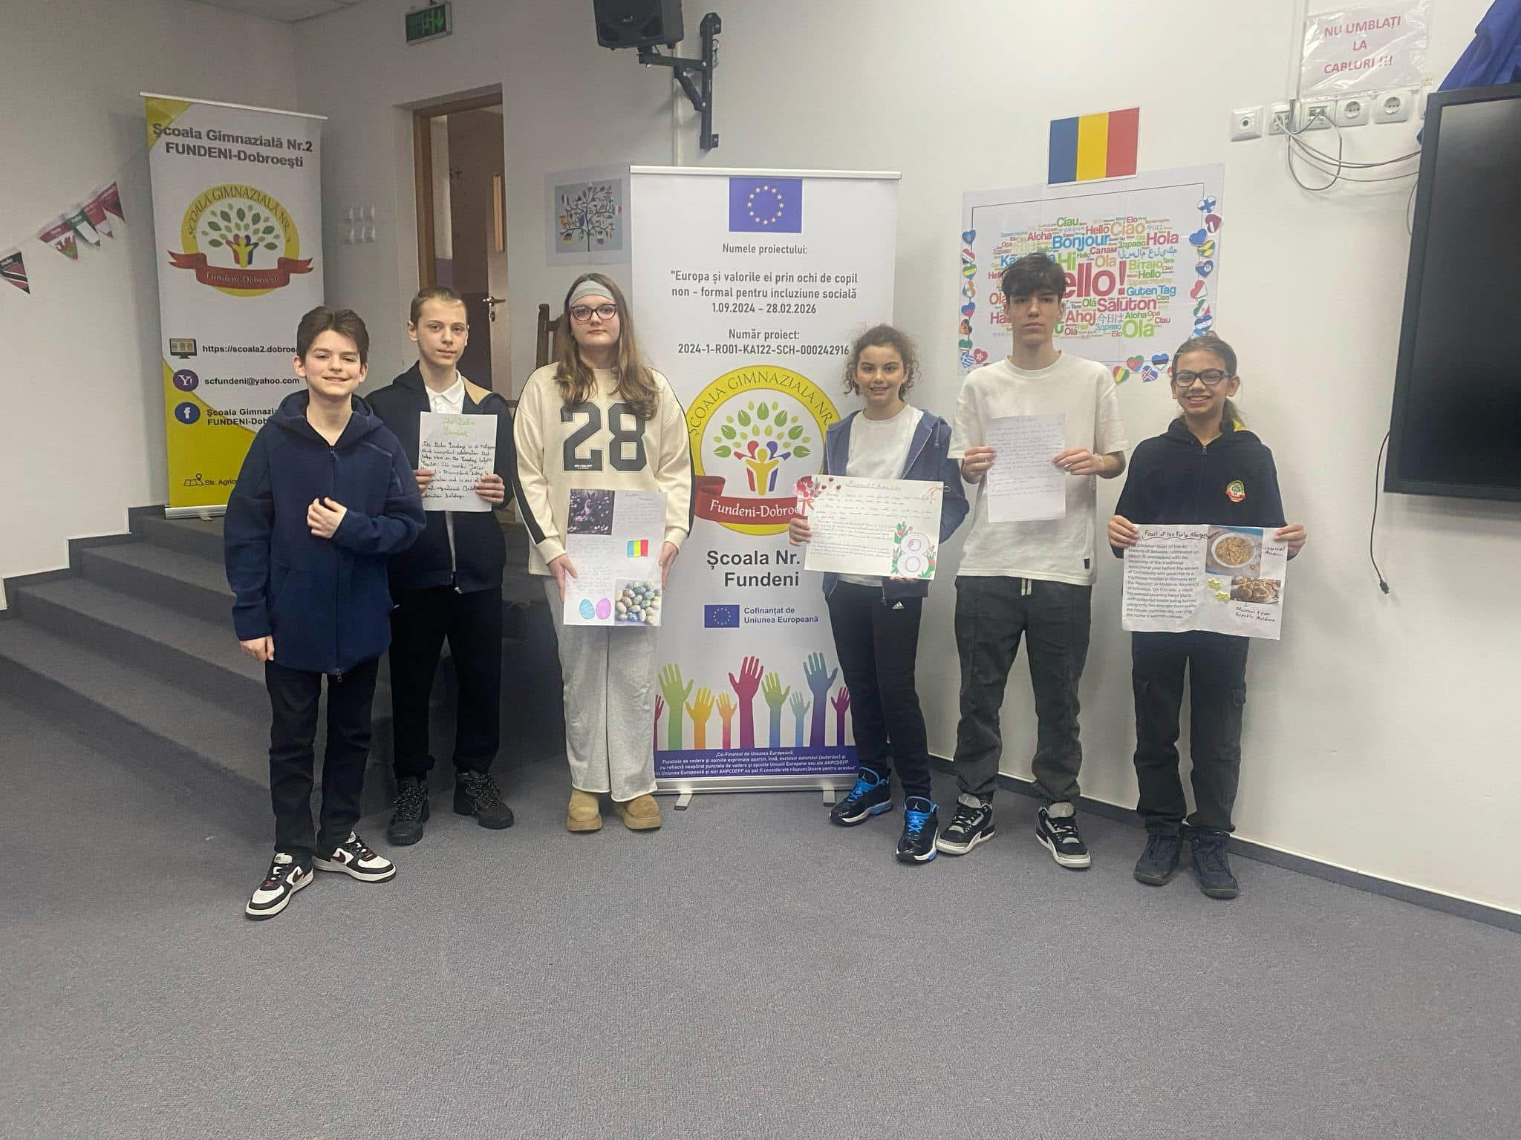

Slide 33
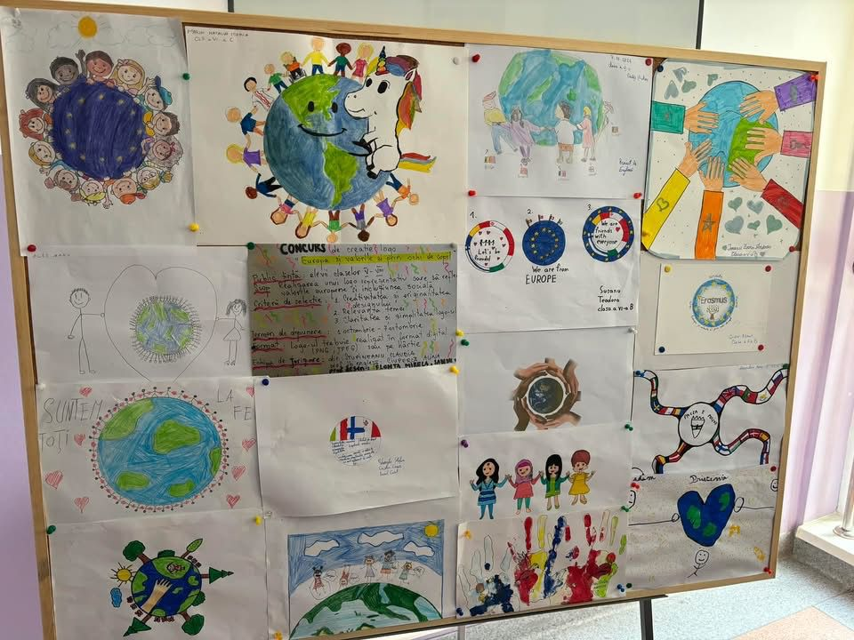
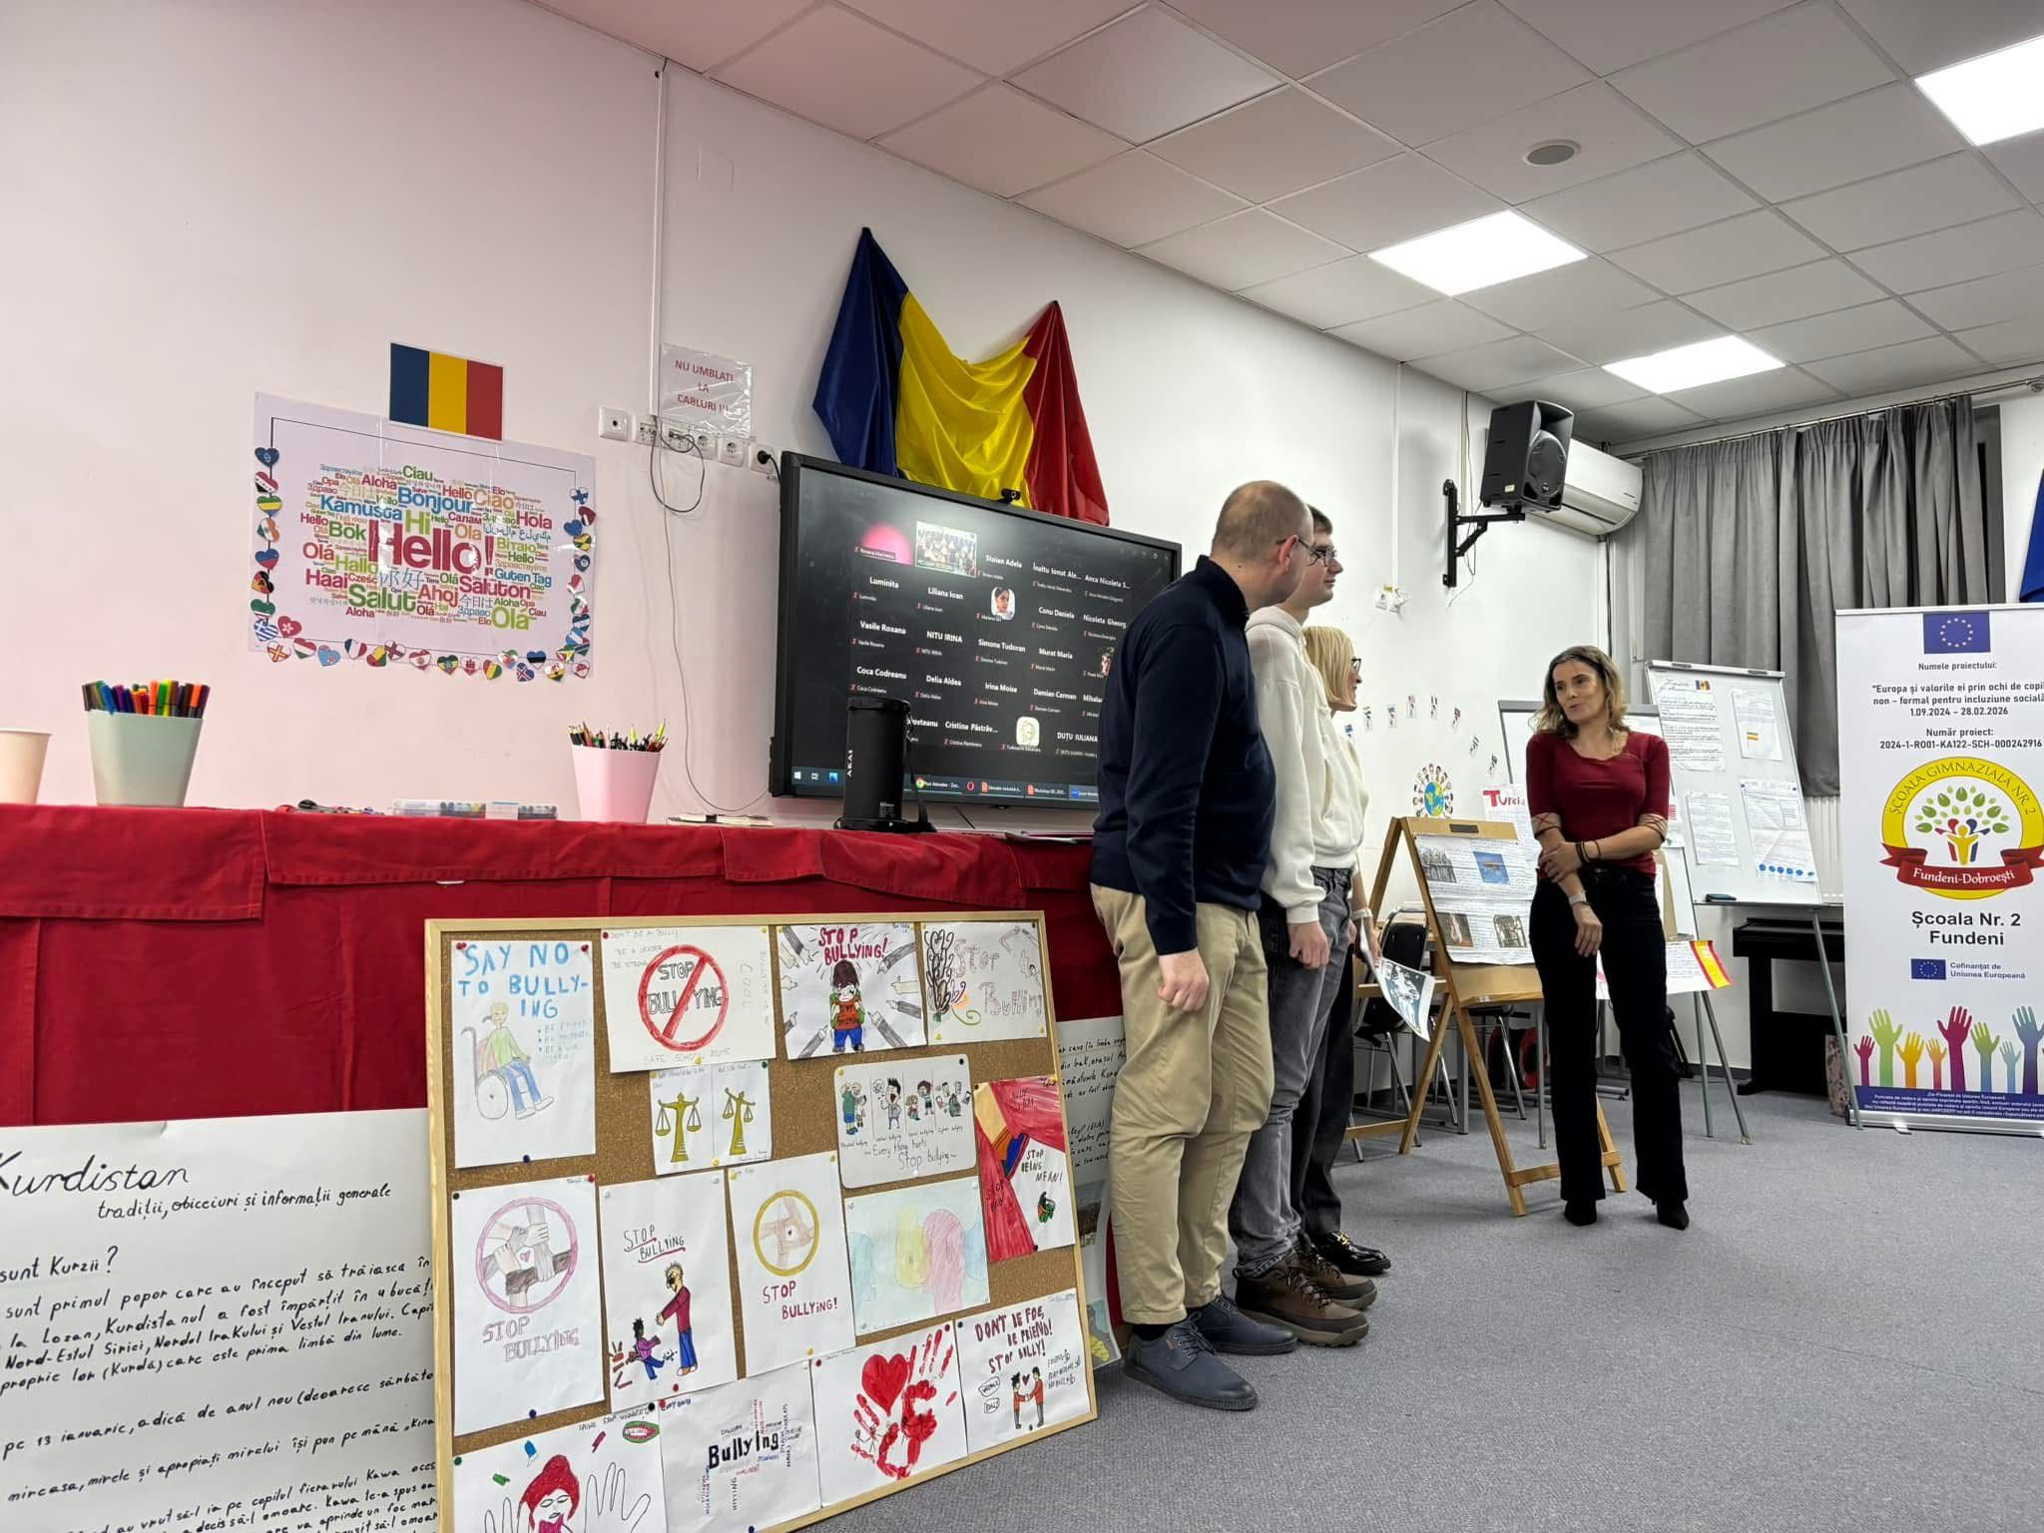

Slide 34
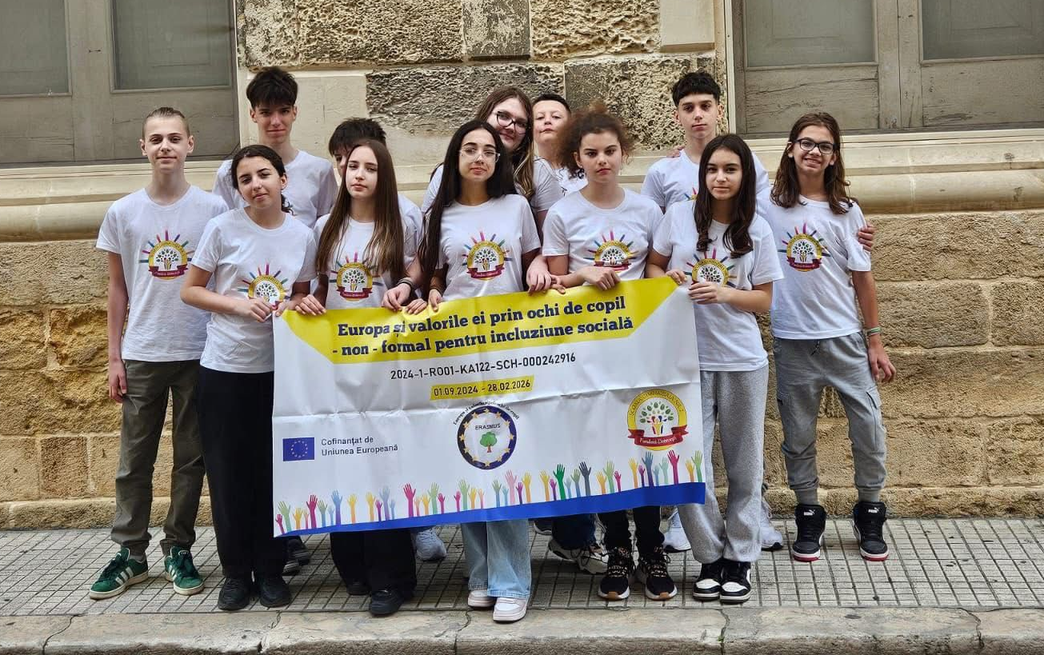

Slide 35
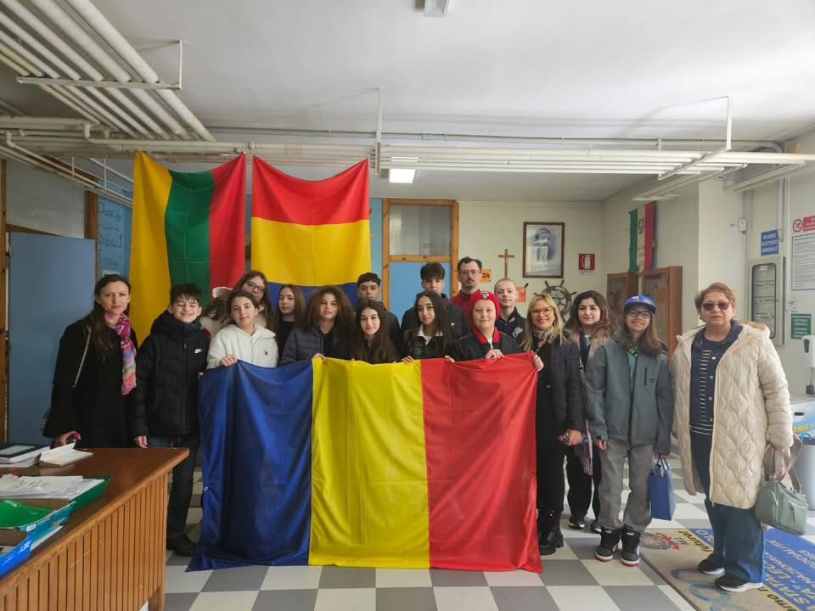
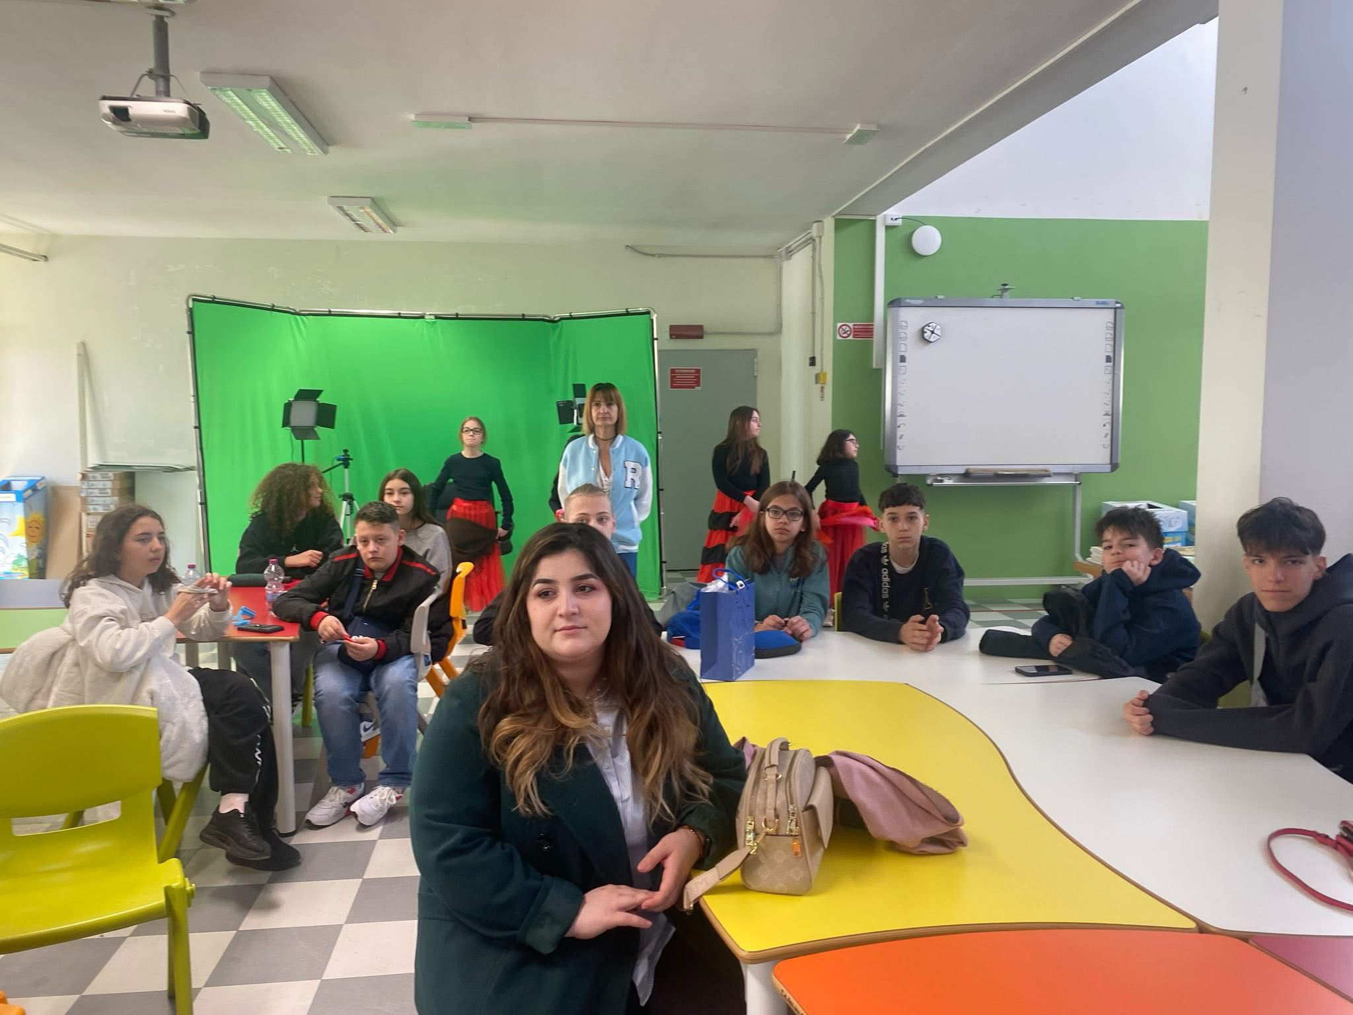

Slide 36

Project 3: Enhancing EU Heritage, Social Inclusion, and Digital Literacy through Our Pupils’ Hearts"
The Erasmus+ project "Cultural Connections: Enhancing EU Heritage, Social Inclusion, and Digital Literacy through Our Pupils’ Hearts" is a European educational initiative that brings together four schools from Romania, Lithuania, Spain, and Turkey.
The project is coordinated by Școala Gimnazială nr. 2 Fundeni-Dobroești (Romania) and is dedicated to both teachers and students aged 11 to 15, particularly those from disadvantaged backgrounds or at risk of social exclusion.

Slide 37
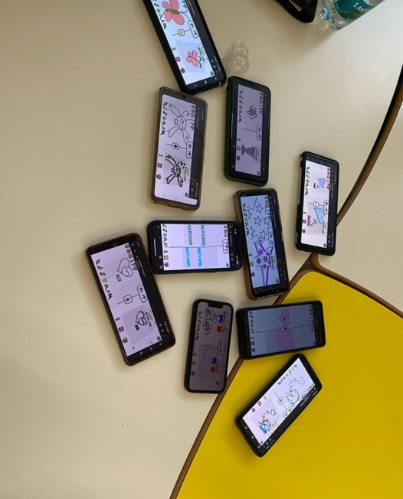
Project 3: Enhancing EU Heritage, Social Inclusion, and Digital Literacy through Our Pupils’ Hearts"
The central goal of the project is to *create an innovative, inclusive, and motivating educational framework* aimed at developing teachers’ professional skills, increasing student participation and academic performance, and promoting European cultural values in an accessible, creative, and digital way.

Slide 38

*Specific Objectives of the Project:*
1. *Professional development of 24 teachers* from the 4 partner organizations, by learning and applying methods based on divergent thinking, creativity, and digital games in both formal and non-formal teaching contexts.
2. *Fostering social inclusion for 240 students, through engaging, student-centered educational activities adapted to their individual needs, using an integrated approach to reduce marginalization and increase participation. A **20% increase in student engagement* is expected.
3. *Improving academic performance and reducing school dropout, by actively involving students in project activities. The goal is to **reduce absenteeism by 60%* and achieve an *annual 5% increase in students’ basic skills* (reading, writing, math, and digital literacy).

Slide 39
Expected Results:
Increased social inclusion, through students’ active participation in collaborative and intercultural educational activities.
Strengthened intercultural awareness and appreciation of European cultural diversity.
60% reduction in school absenteeism, using engaging teaching methods and motivational learning strategies.
At least a 5% annual improvement in students’ key competences in core learning areas.
Development of an 80-page Open Educational Resources (OER) Guide for teachers and educators, including:
teaching methods based on play and divergent thinking,
training materials for educators,
examples of best practices,
educational digital games adapted to students’ age and level.

Slide 40
Main Activities:
1. Project management and coordination meetings among partners to monitor progress and plan implementation stages.
2. Teacher training workshops, focused on using creativity and digital technologies in education, with an emphasis on game-based, imaginative, and collaborative learning.
3. Student exchange and experiential learning activities, including:
creative workshops centered on European cultural heritage,
educational games,
interactive digital activities,
presentations of local traditions and intercultural exchanges.
4. Design of an integrated curriculum and Open Educational Resources (OER), accessible to any educator interested in innovative and inclusive teaching strategies.

Slide 41
Partner Organizations:
Școala Gimnazială nr. 2 Fundeni-Dobroești (Romania) – Coordinator
Ukmergės Užupio pagrindinė mokykla (Lithuania)
CEIP José Calderón (Spain)
Bener Cordan Ortaokulu (Turkey)

Slide 42
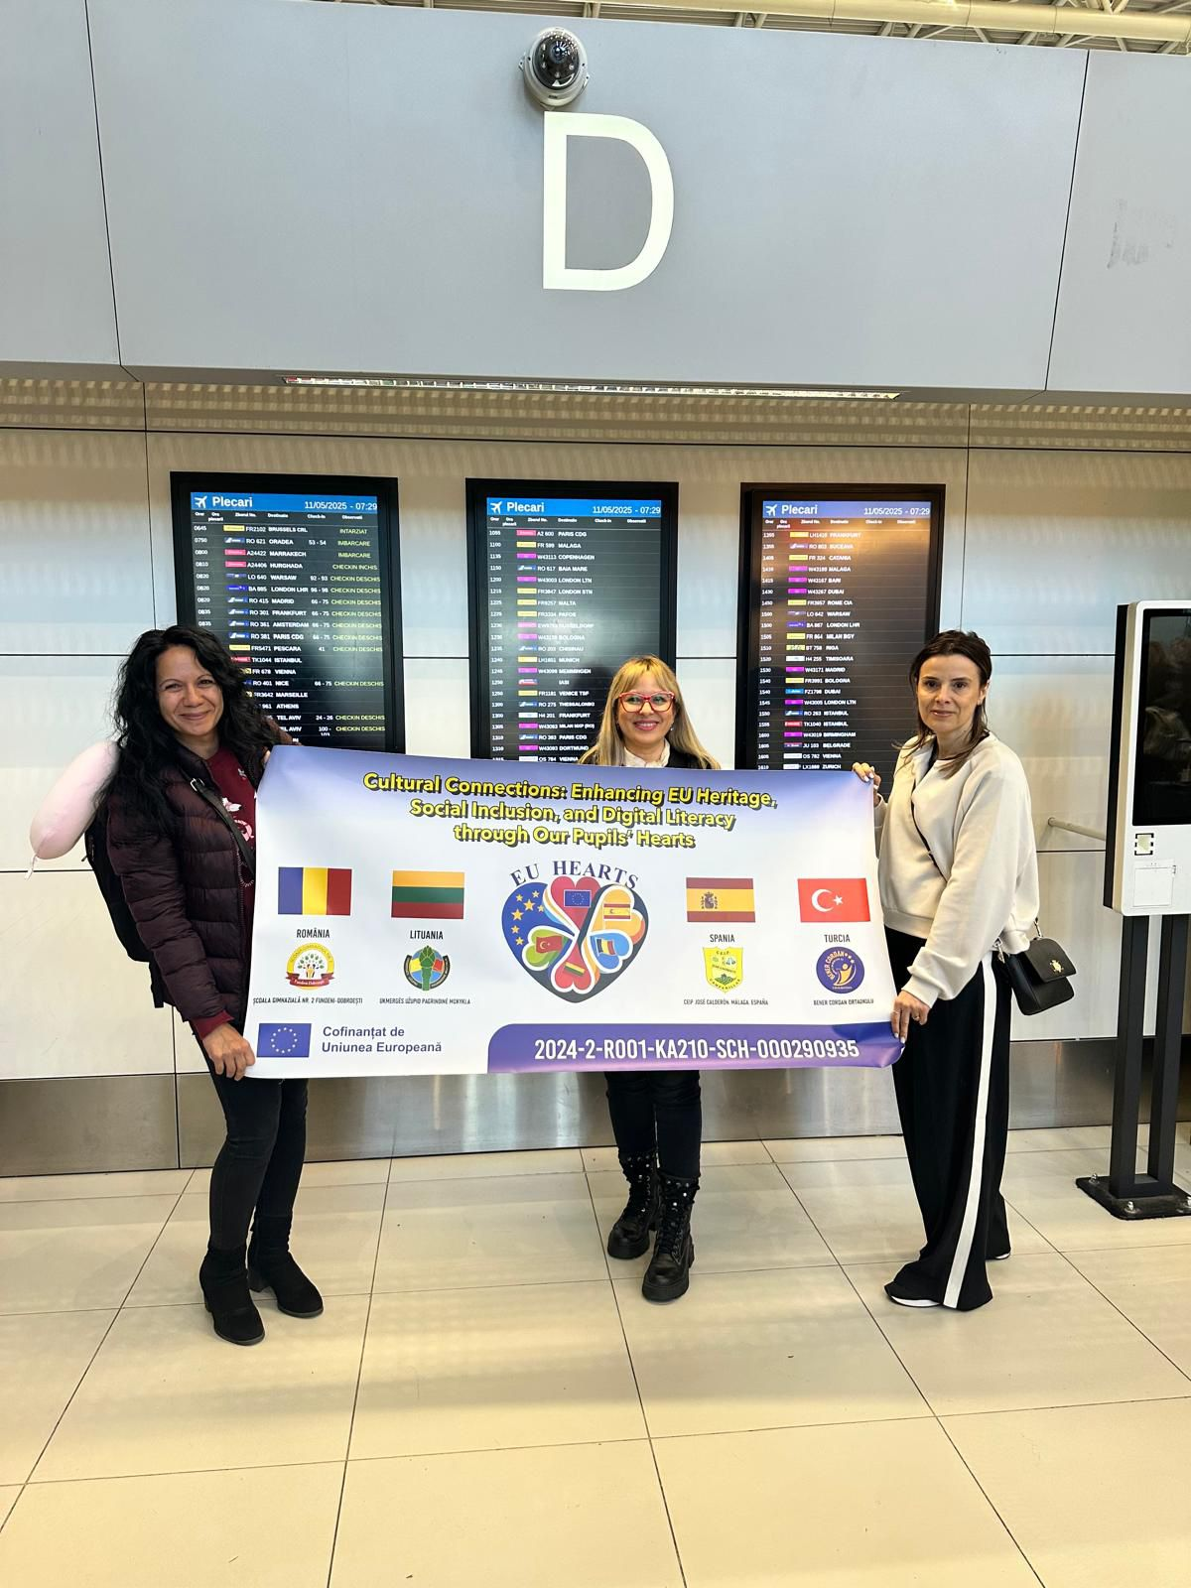
Added Value of the Project:
The "Cultural Connections" project promotes a learner-centered educational approach adapted to contemporary realities, integrating *innovation, digitalization, and interculturality.
By actively involving teachers and students from disadvantaged backgrounds, the project contributes to reducing inequalities, developing key life competences, and shaping an open and tolerant European identity.

