Slide 1
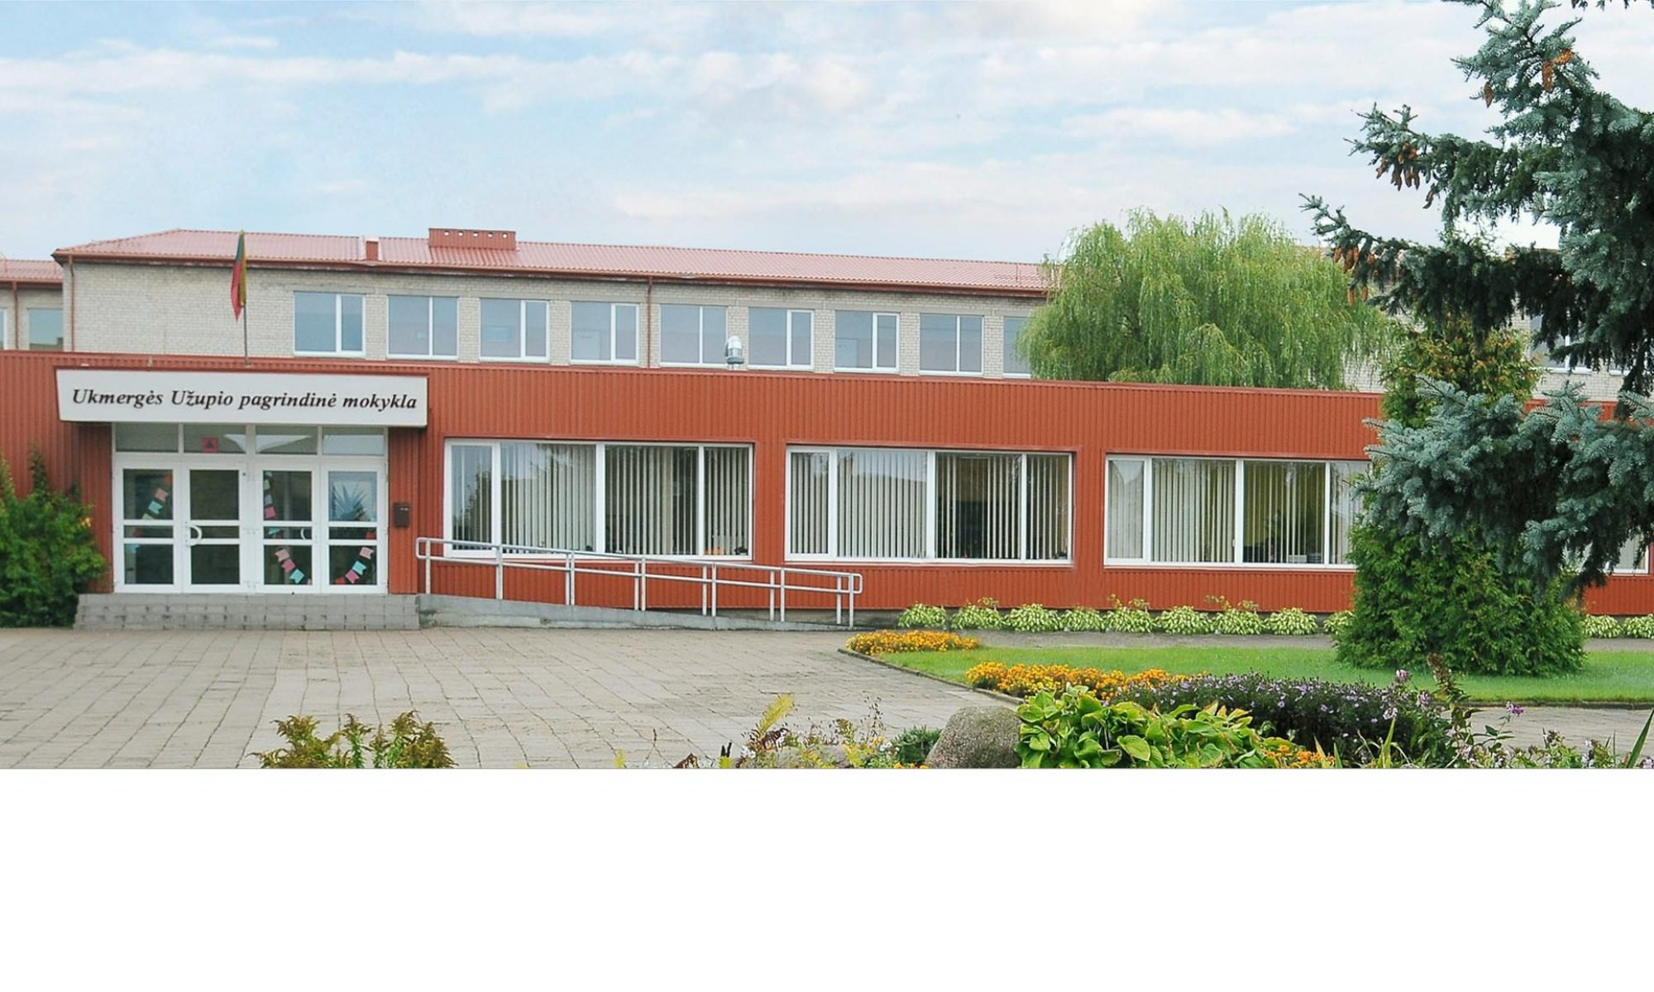
Erasmus project
2025
May
Erasmus – about us

Slide 2
INTRODUCTION
Since 2016 our school has been taking part in some of Erasmus+ projects with the partners from Lithuania, Poland, Latvia, Turkey, Romania, Italy, Greece, Macedonia and Bulgaria.
These projects are about educational systems and encourage communication between students, teachers and society.
During the projects‘ time the students and teachers try to share the innovation of their educational systems and develop intercultural communication.

Slide 3
Project themes
Practice makes Perfect
News from a Greener Europe
Secure Internet, Real Freedom
Treasure: Storytelling across Europe
We must use technology correctly

Slide 4
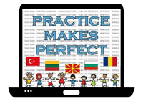
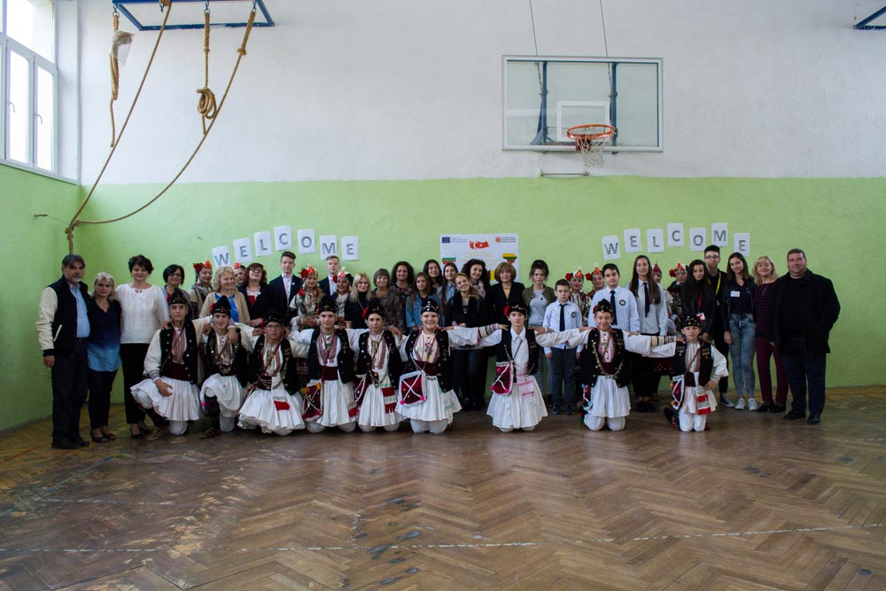
Practice makes Perfect
Goal: educate students‘ practical skills and strengthen learning effectiveness through experiential learning.
Participants: teachers and students from Turkey, Romania, Bulgaria, Macedonia and Lithuania.

Slide 5

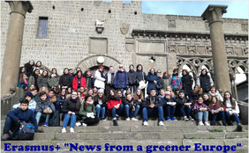
News from a Greener Europe
Goal: promote ecological awareness and the principles of sustainability between students and society.
Themes: climate change, waste reduction, environmental innovation.

Slide 6

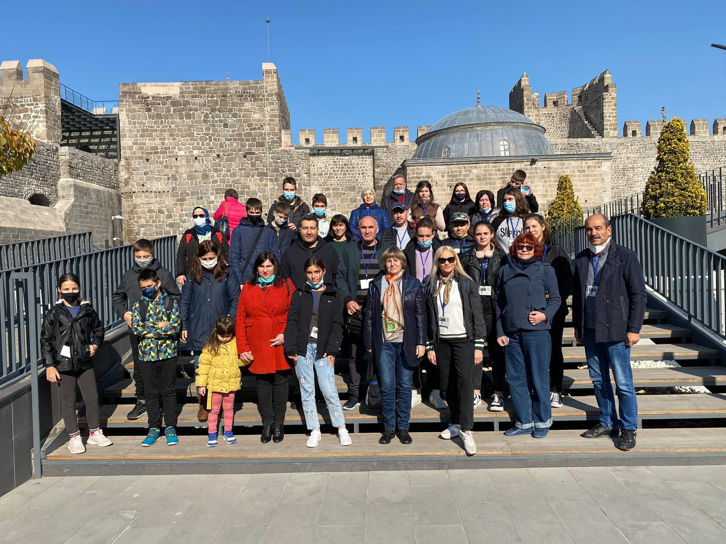
Secure Internet, Real Freedom
Goal: promote responsible and safe technology use.
Activities: discussions, seminars about digital threats and internet safety.

Slide 7

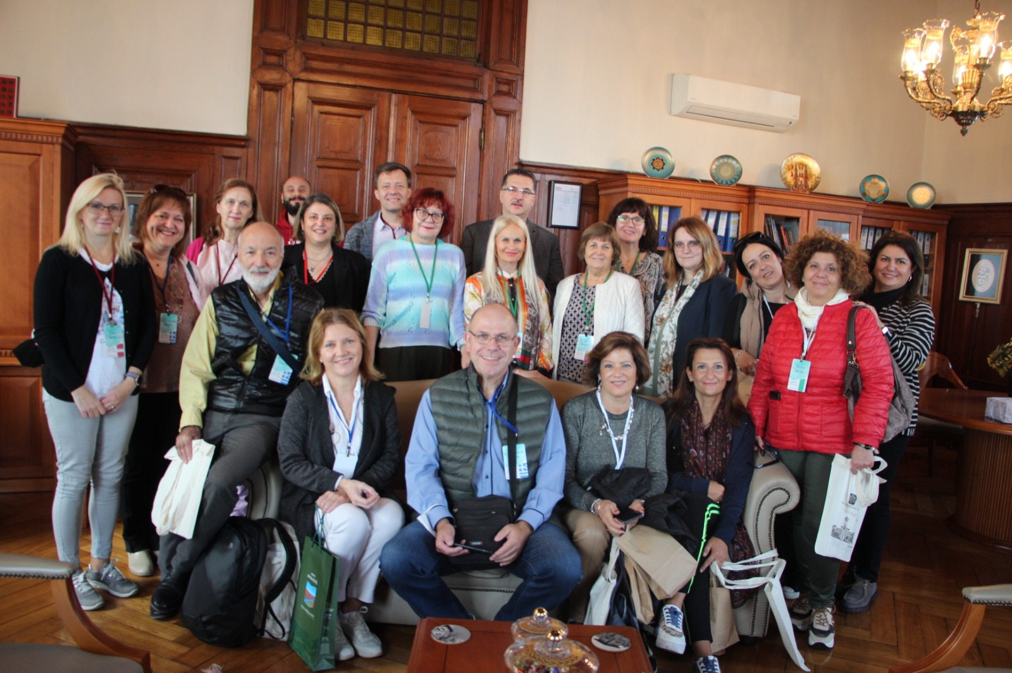
Treasure: Storytelling across Europe
Themes: cultural myths, stories, acting elements.
Goal: encourage creativity and cultural diversity through storytelling and share this among European schools.

Slide 8
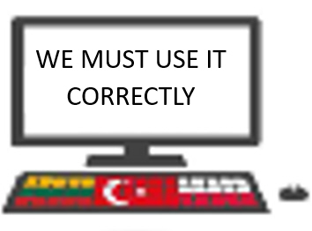
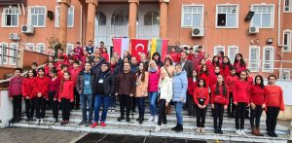
We must use technology correctly
Goal: learn to use technologies in the teaching process and promote technological awareness
Themes: how to apply technologies in the teaching process, artificial intelligence. digital literacy.

Slide 9
Projects‘ benefits
Intercultural communication: participiants from different countries had an opportunity to familiarise with cultural traditions of other countries and develop intercultural understanding.
Language learning: during the projects‘ participants improved foreign language skills which are important for fluent communication and academical success.
Innovations in educational system: projects‘ participiants tried out new teaching methods such as experiential education, creative workshops and digital technologies.

Slide 10
Difficulties
Different educational systems: due to different eduacational systems it was challenging to plan project activities and goals.
Language barrie: despite the language learning opportunities, sometimes it was difficult to effectively communicate to each other.

Slide 11
Benefit
For teachers
Professional development: opportunity to share innovative pedagogical methods among the teachers from different countries.
New ideas make teaching process more interesting: gain more experience in using digital technologies and other innovatove teaching methods.
For students
Intercultural communication: students broadened their mind about other countries and their cultures.
Skills of using technologies: encourage students to use technologies responsibly in the lessons and in everyday life.
For parents
Children participation in international projects: parents saw how their children grow during Erasmus projects, gain more experience and skills.
Society
Cultural exchange: events involved the society and created opportunities to know other countries traditions.

Slide 12
Strength
International partnership: strong communication among partners help to exchange knowledge and good experience.
Diverse education: encourage academic skills, emotional intelligence, social and cultural abilities.
Weaknesses
Language barrie: different languages and cultural differences sometimes cause problems to communicate fluently.

Slide 13
Conclution
During 9 years Erasmus+ projects gave students and teachers great opportunities to deepen knowledge and create valuable communication with other countries.
Projects broadened mind to the local societies by increasing intercultural understanding and encouraging to use educational innovations.

Slide 14
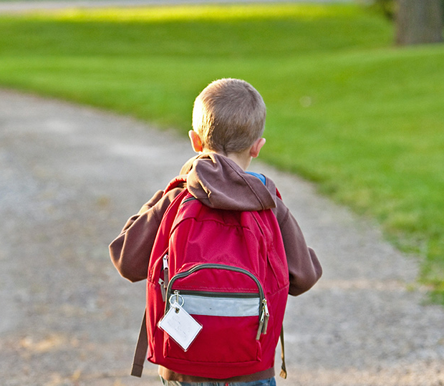
Thank you !

