Slide 1

WAYS OF MOTIVATION IN LITHUANIA AND IN UKMERGĖ UŽUPIS BASIC SCHOOL
2023

Slide 2
TYPES OF MOTIVATION OF LEARNING
EXTERNAL
INTERNAL
Learning to get ahead of others or to show better skills
Achieving better results
Seeking social recognition
Achieving better material wealth
Analyzing situations in order to choose the best occupation in life
Learning is based on interest and curiosity
The joy of learning

Slide 3
MOTIVATION OF STUDENTS OF DIFFERENT AGES
Students' motivation in grades 5-12 is constantly changing:
In grade 5 motivation to learn is higher than in grade 6 and in grade 7.
Motivation is statistically higher in 7th grade than in the 6th and 8th grades.
From grade 8 to 11, students' motivation remains more or less the same.
In 12th grade motivation increases and reaches the level of 5th grade pupils.

Slide 4
LEARNING MOTIVATION FACTORS
Family
Teacher
Learning motivation factors
Classroom microclimate
The school atmosphere
Future career plans

Slide 5
STRATEGIES FOR MOTYVATION
Arousing curiosity
Encouraging the joy of learning
Intrinsic motivation strengths
Encouraging the experience of winning and achieving expectations

Slide 6
COMMON WAYS FOR STUDENTS TO STAY MOTIVATED IN LITHUANIA
♦ Praise. Honored students are praised publicly, with a certificate of appreciation, diploma, etc. Students create a feeling of pride and achievement.
♦ Waiting for success. Simple, easy-to-do tasks that show students' knowledge. Presenting simple tasks that are easy to understand, relevant to students' knowledge and require the students to complete them by the end.
♦ Feedback and reinforcement. Feedback involves providing learners with information about their responces. It helps students feel confident, which helps them to do a better work.

Slide 7
♦ Capturing pupils' good practice (both oral and written). This encourages pupils to be active, confident and self-esteem.
♦ Results of tests, quizzes, and grades. The results of the tests and feedback on the completion of the tasks show whether the student is making progress.
♦ Involving students in an activity which they can choose it themselves. Assignment of several similar tasks, when students are allowed to choose one, increases interest and give satisfaction what is being done.
♦Organising a wide range of learning activities. Opportunities to draw, create music, sing, make crosswords, puzzles, riddles, adapt body movements and various other forms of expression.

Slide 8
♦ Specifying the purpose of classroom and home tasks.
♦ Use of non-traditional teaching methods and techniques.
♦ Unexpected action by a teacher. Sometimes it is useful to do something unconventional. The unconventional approach grabs the student's attention and engages them in the activity.
♦ Use of known material.
♦ Use of unusual, unexpected contexts.
♦ The right attitude in the family, parents and teachers cooperation. It‘s really important that parents‘ and teachers‘ attitudes would be similar. The right attitude increases students motivation.

Slide 9

WAYS TO INCREASE MOTIVATION IN UKMERGĖS UŽUPIO BASIC SCHOOL
In our school, we try to use every possible way to motivate our students.
Every teacher is creative and uses not only common but also his/her own methods of motivation and encouragement.
We will introduce them in the following slides

Slide 10
Virtual exhibitions of pupils' work are organised, which can be viewed by the pupils themselves, their parents and teachers.
Some links to students' work:
Greetings to Mum
Bookworm videos
Personal exhibitions of work

Slide 11

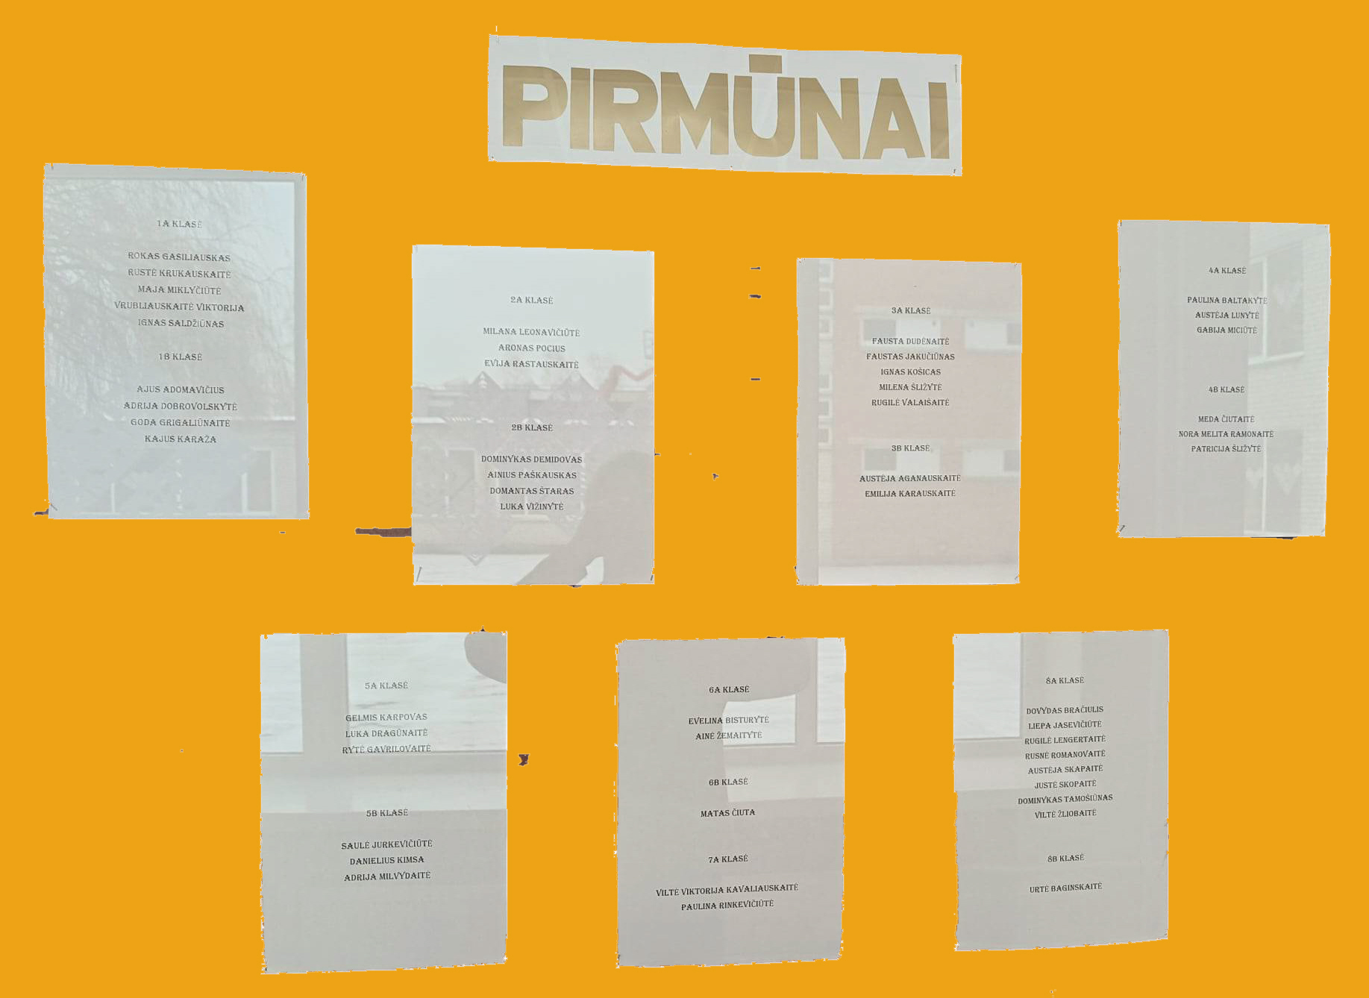
The names of (photos) honor students are displayed on the honor roll.

Slide 12
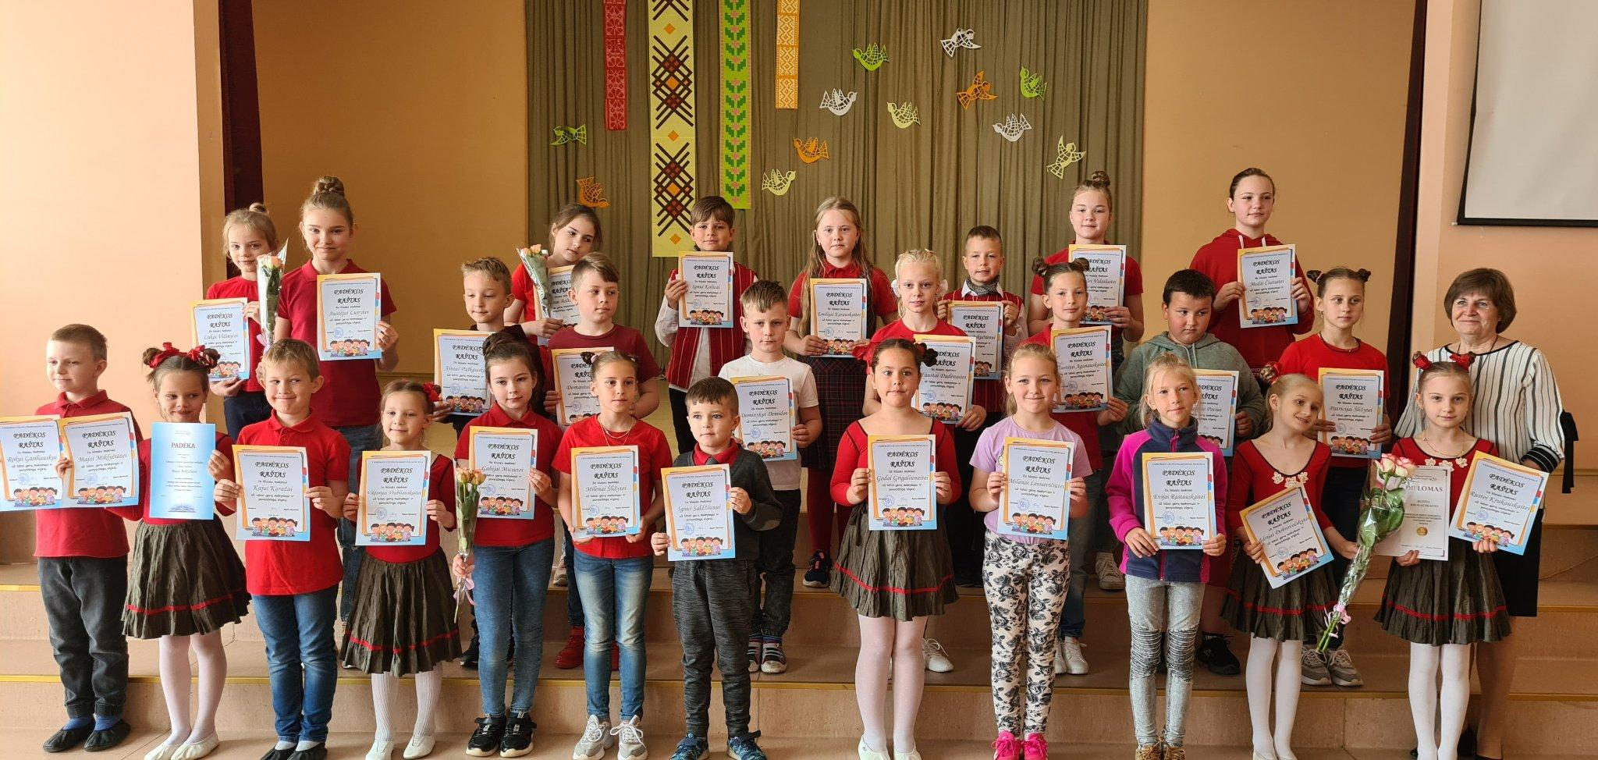
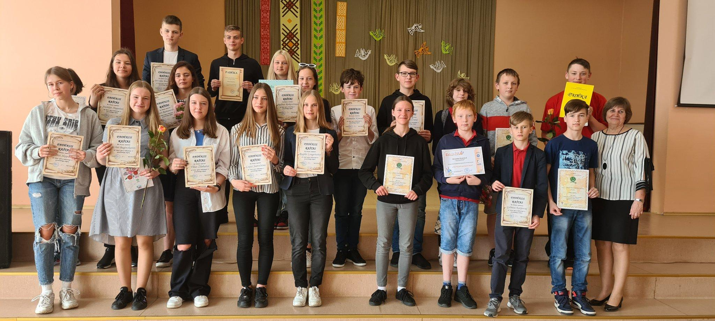
At the end of each school year, there is Honor‘s Day to reward the best learners and winners of competitions

Slide 13
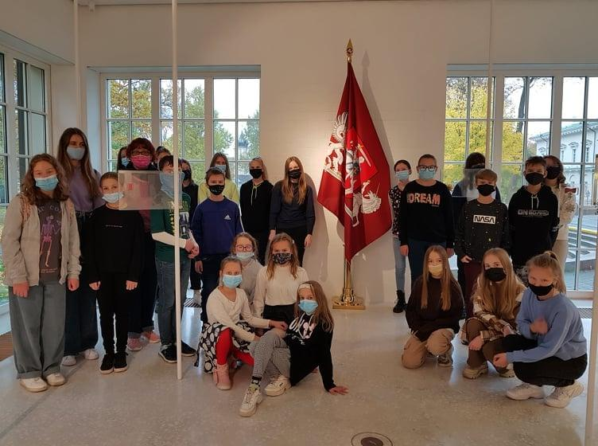
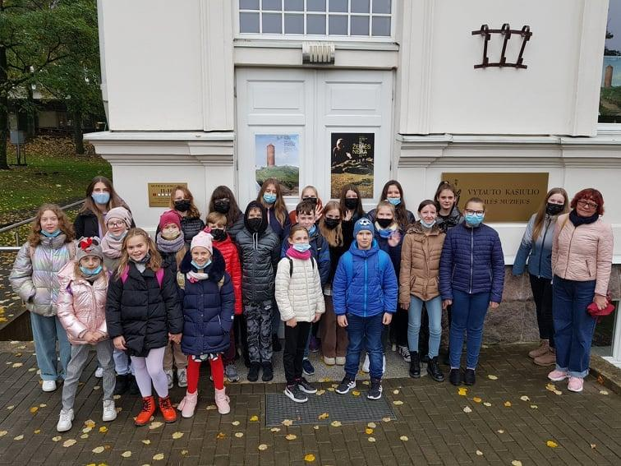
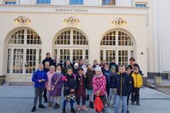
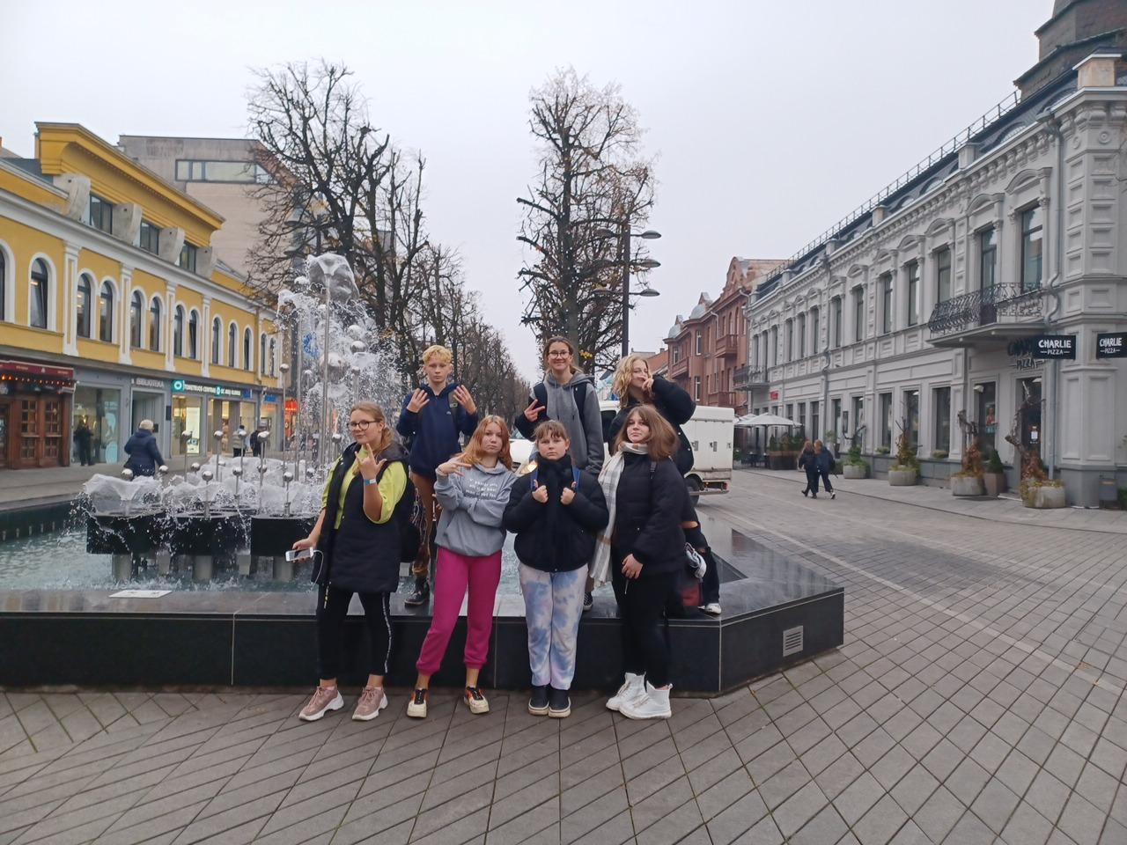
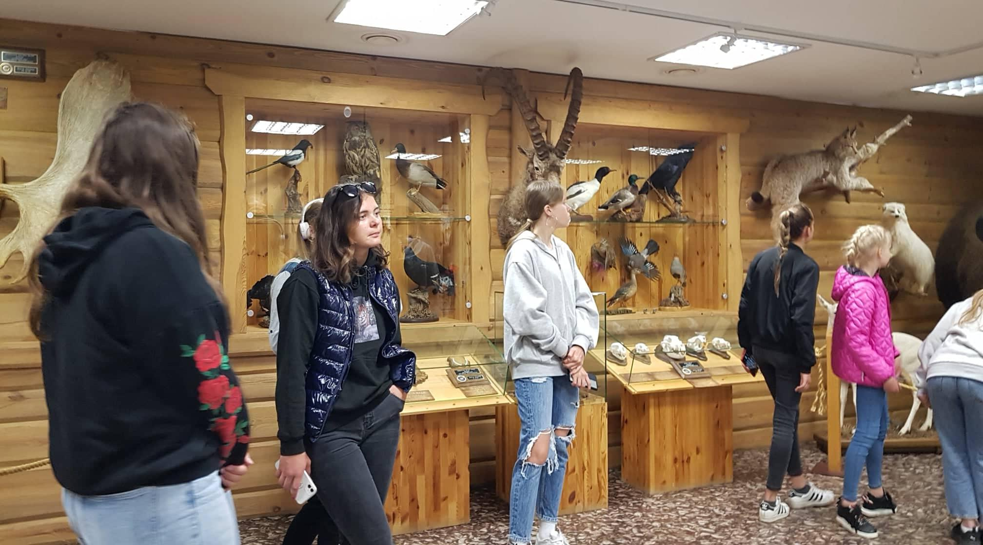
Twice a year, educational excursions to the theatre, museums, Presidential Palace, Ethnocosmological Centre etc. are organised to the best motivated and most active students.

Slide 14
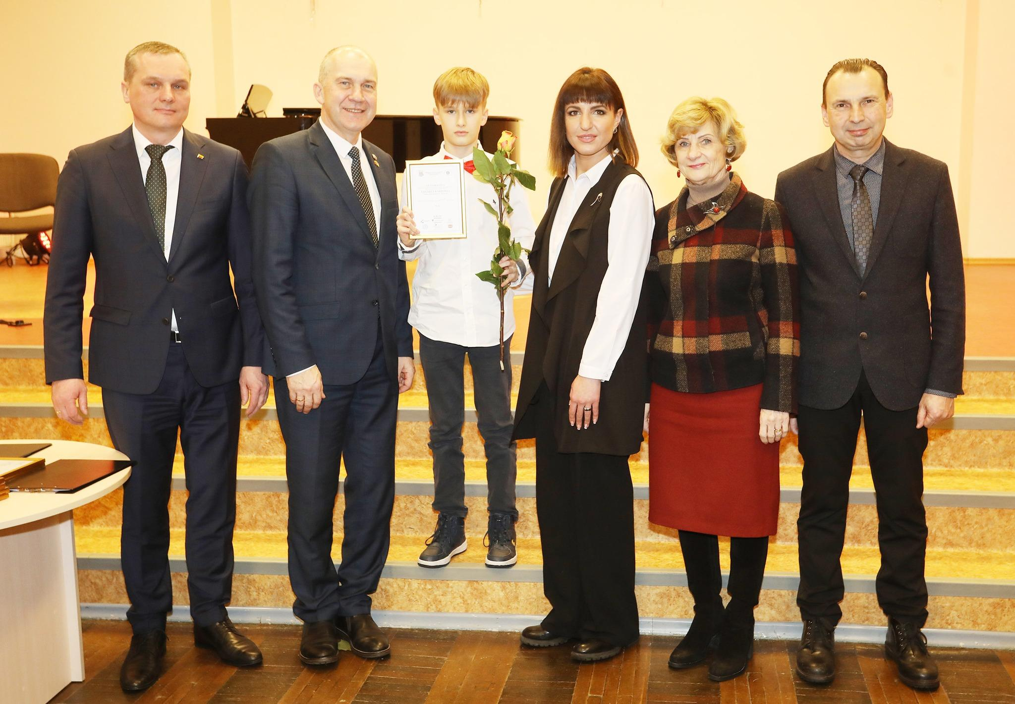
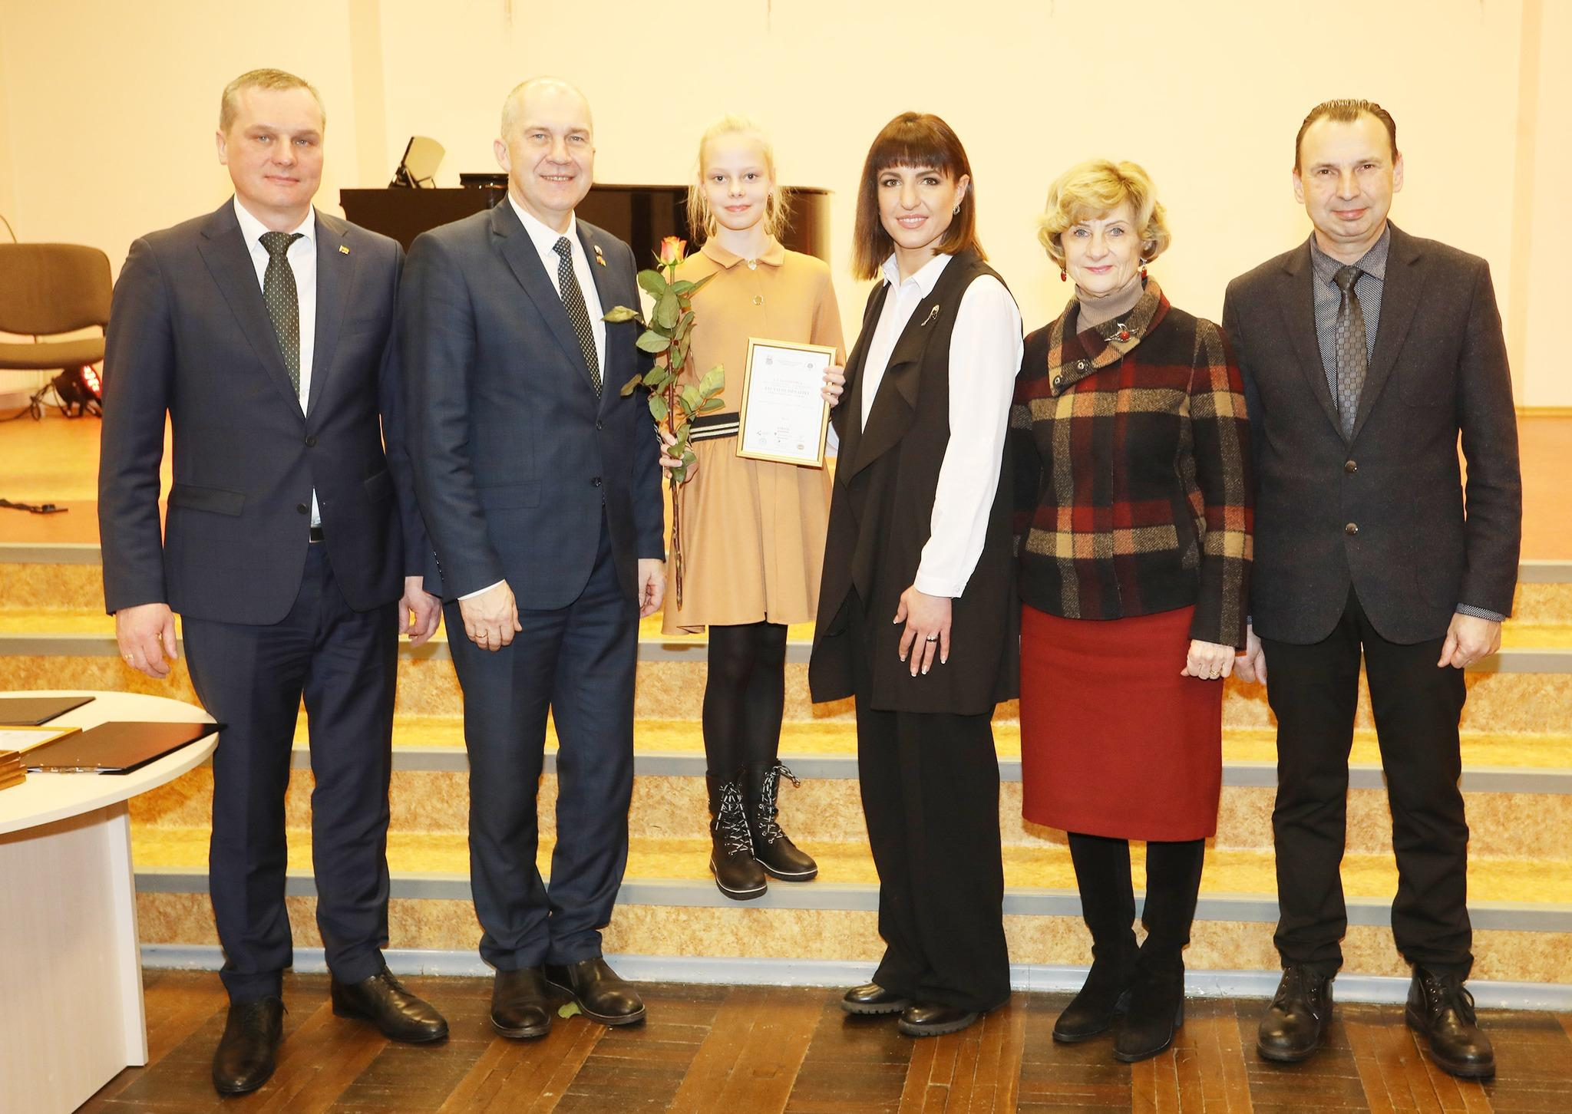
Winners of 1st - 3rd places in national competitions are awarded cash prizes twice a year by the District Sports and Education Department

Slide 15
Motivating students with learning difficulties
For pupils with learning difficulties, extra guidance is provided to overcome learning gaps;
They are given personalised assignments.
In primary classes, these pupils are taught not only by a teacher but also by a teaching assistant.

Slide 16


Thank you for your attention

