Slide 1
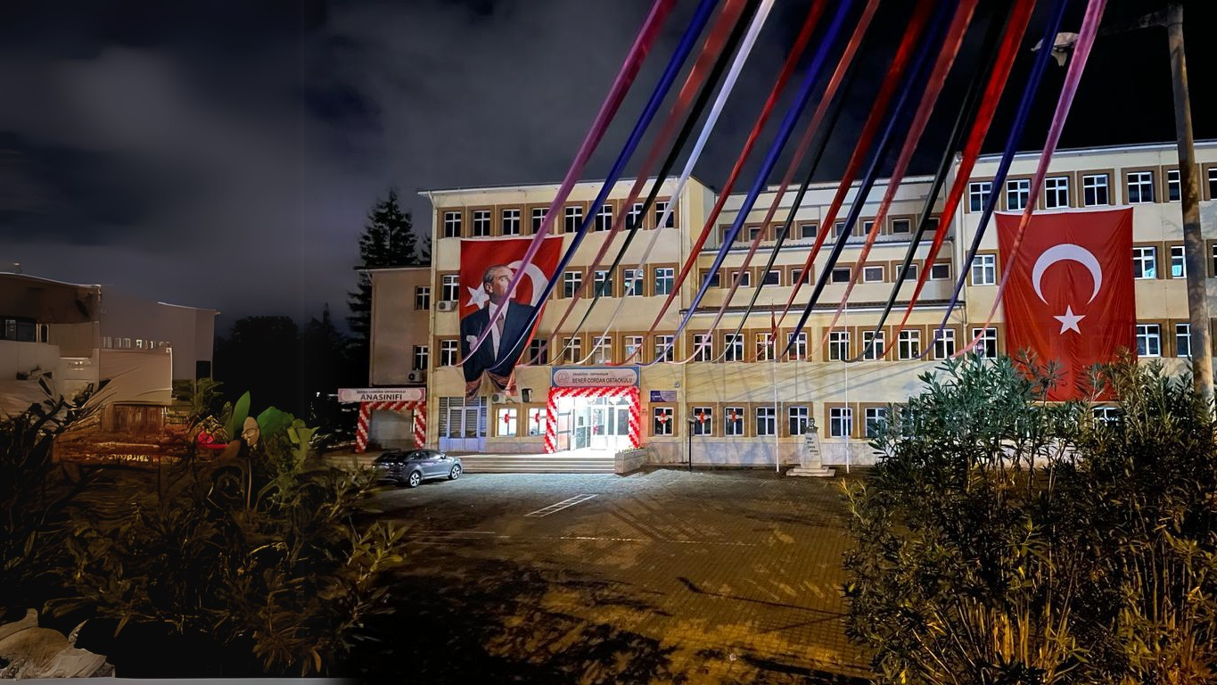




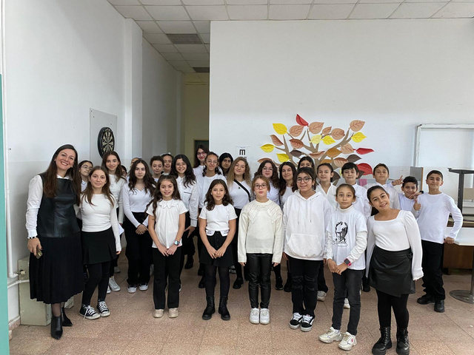
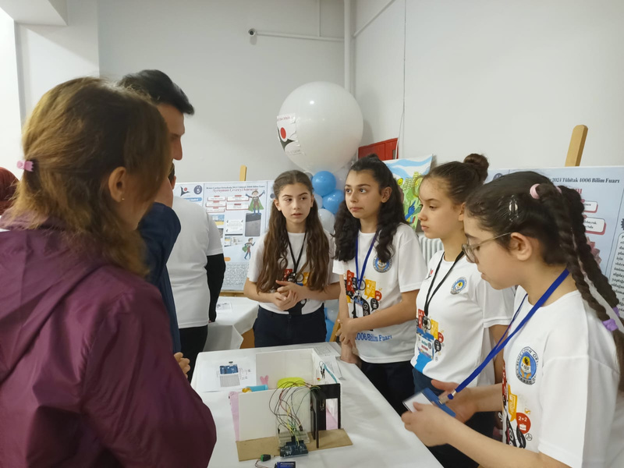


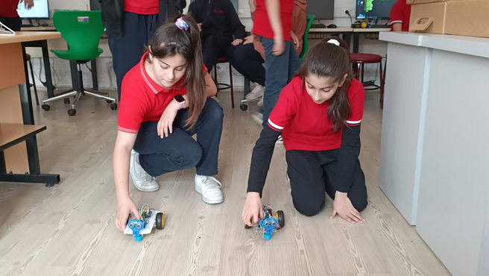
Education System in
Türkiye

Slide 2

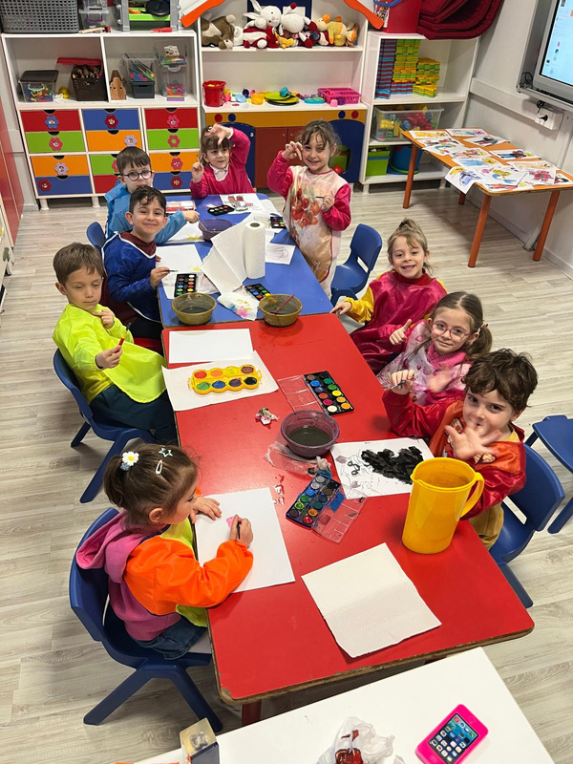

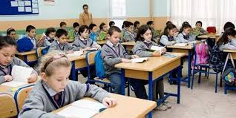
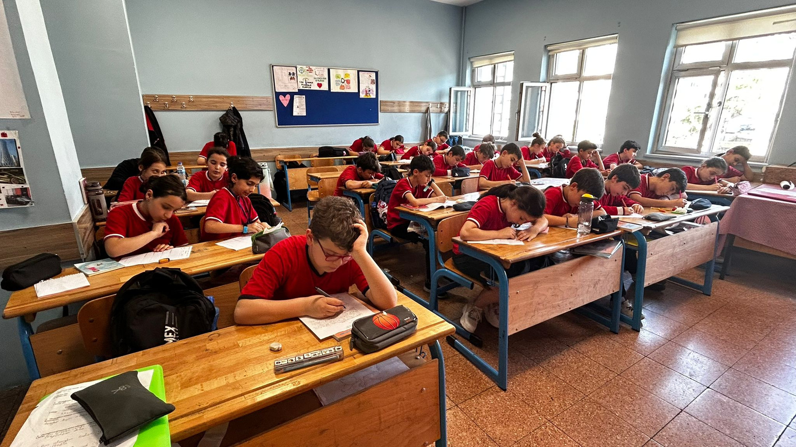
Compulsory education is 13 years.
Kindergarten Education- 1 year
Primary school - 4 years
Secondary school- 4 years
High school- 4 years

Slide 3

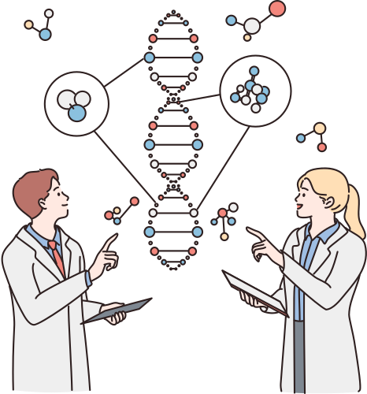





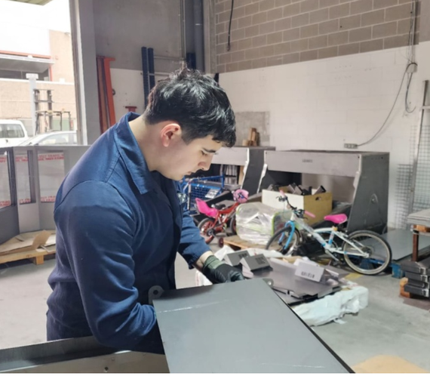

There are different types of high
schools in Türkiye.
Science high schools
Anatolian high schools
Vocational high schools

Slide 4
  Our school provides 4 years of education as a secondary school.
  Students are approximately 10-13 years old.
  7 lessons in a day
  Each lesson is 40 minutes
  Total 35 lessons per a week

Slide 5
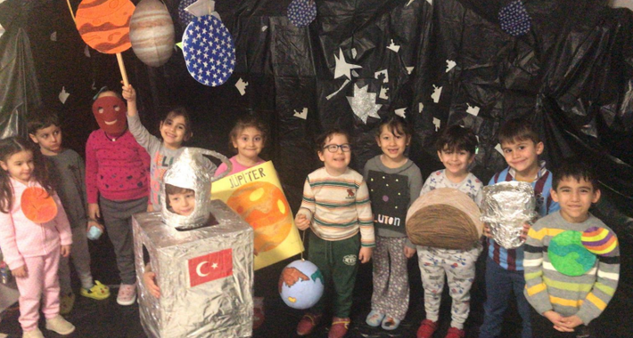


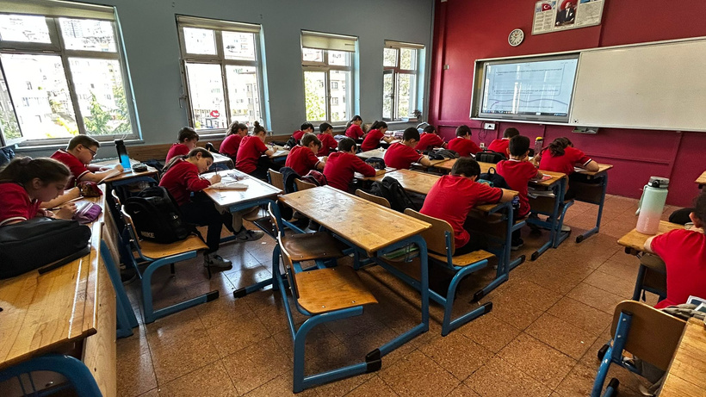


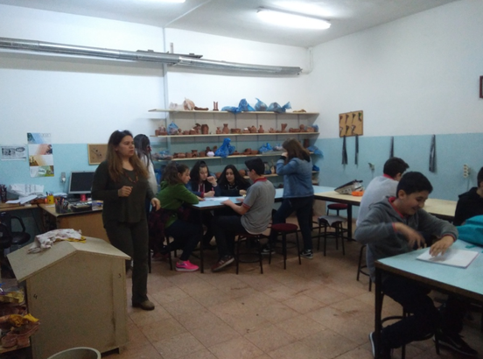

5 administrators and 85 teachers
84 kindergarten students and 1422 secondary school students
3 kindergarten classrooms
38 secondary school classrooms and workshop classrooms
Average of 35-40 students in each class

Slide 6
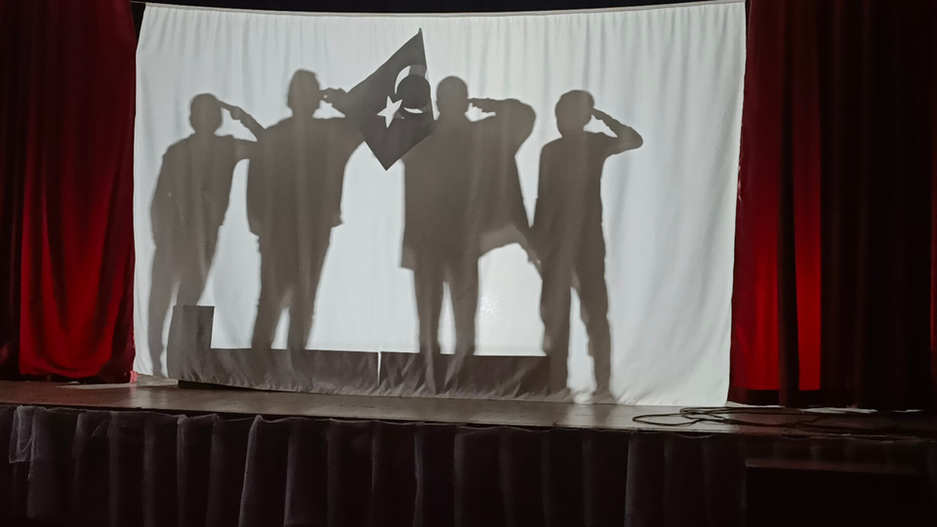
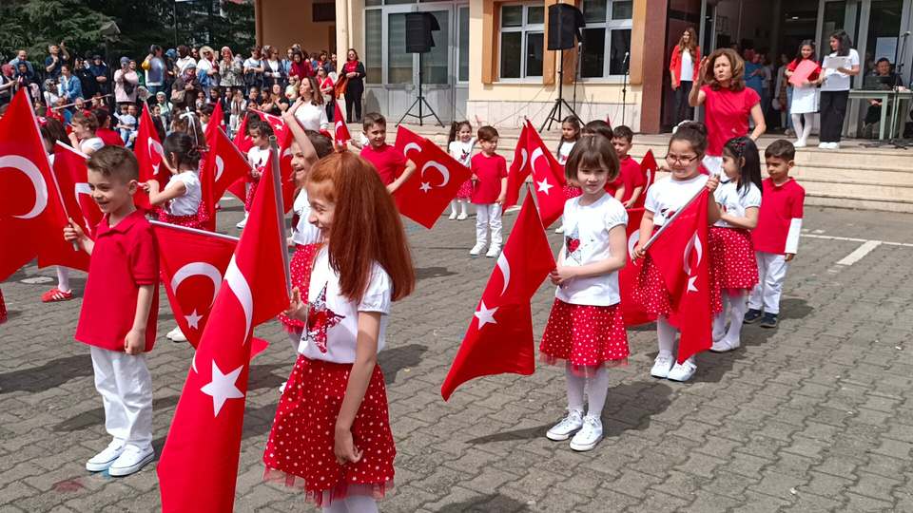
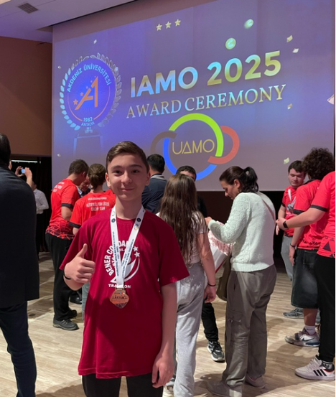
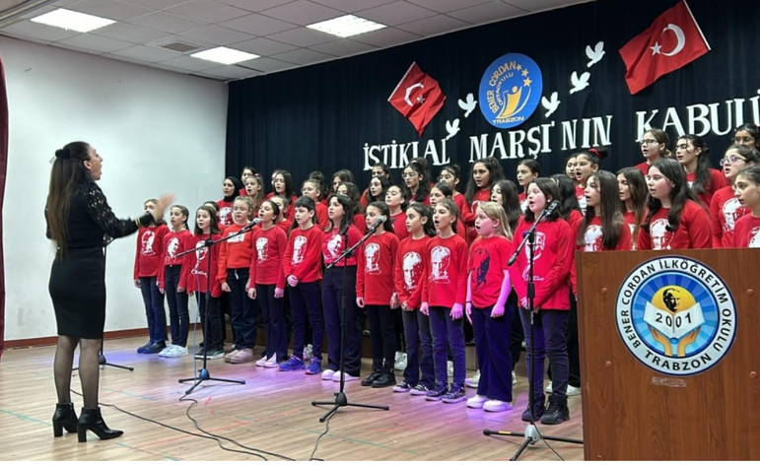
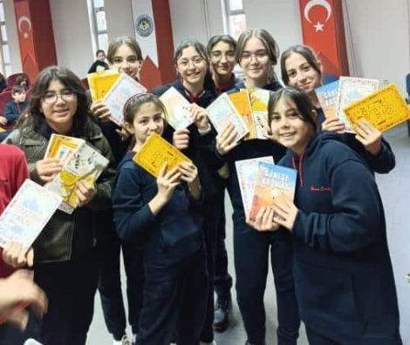
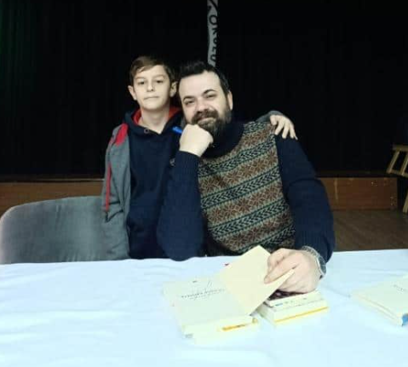
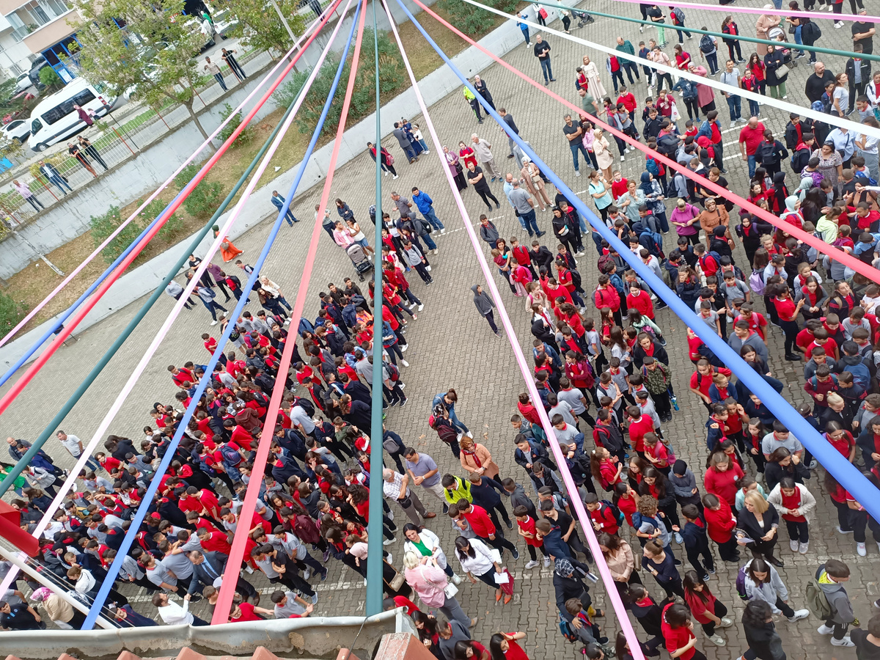
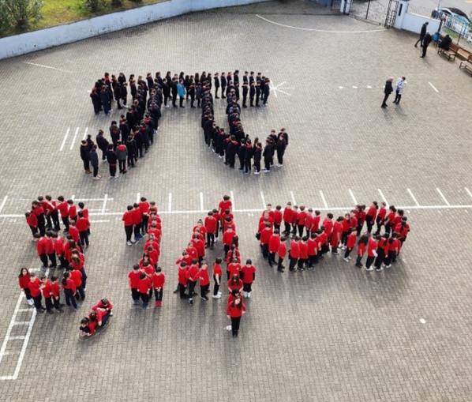
Every year, events and shows are organized on special days and National Holidays.
Many children's book authors visit our school and talk to students.

Slide 7
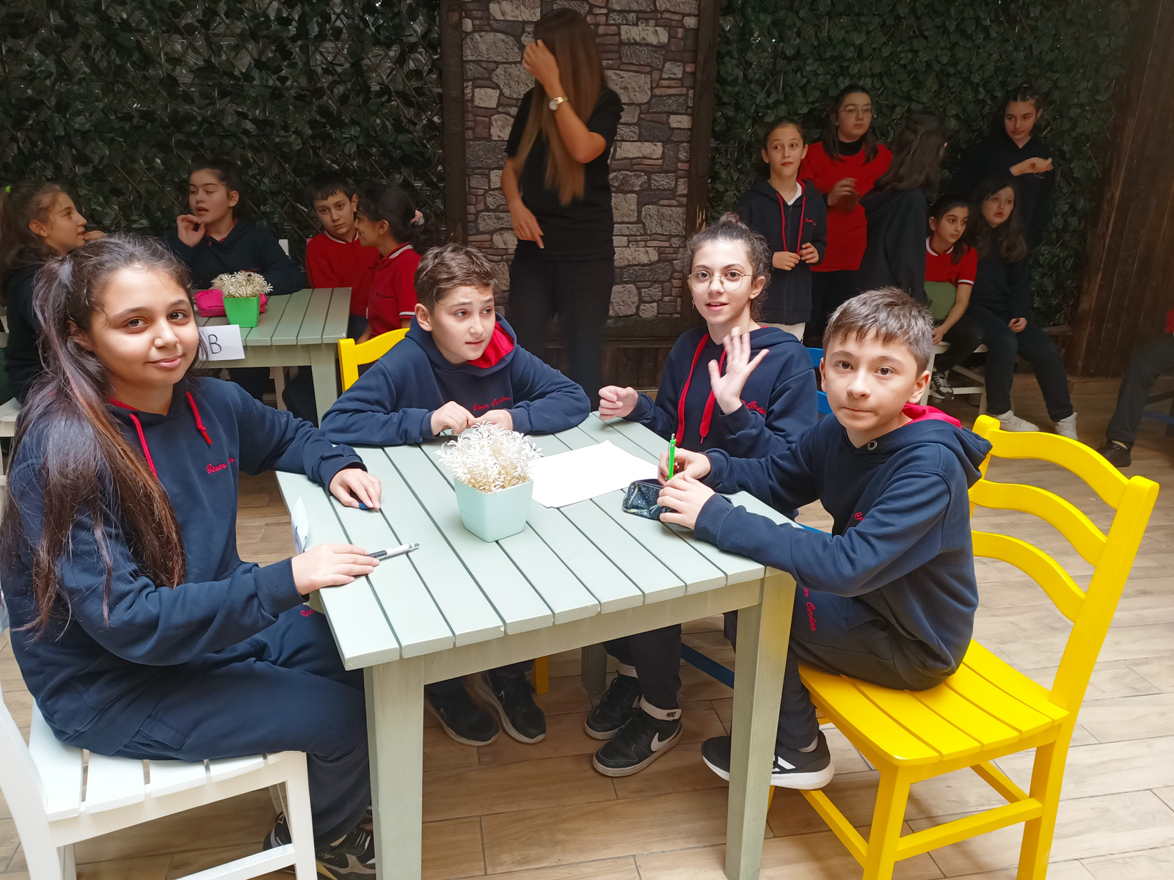
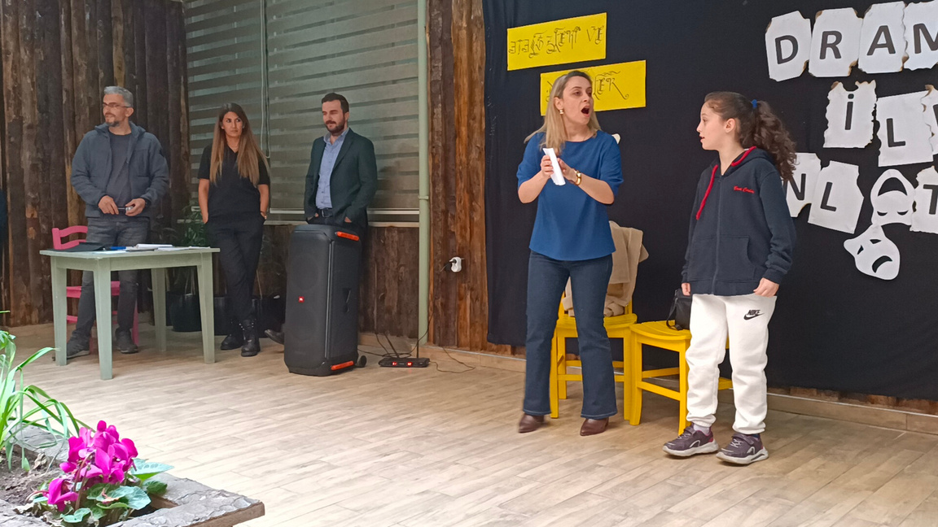
Local Projects
“Richness of Our Language”

Slide 8
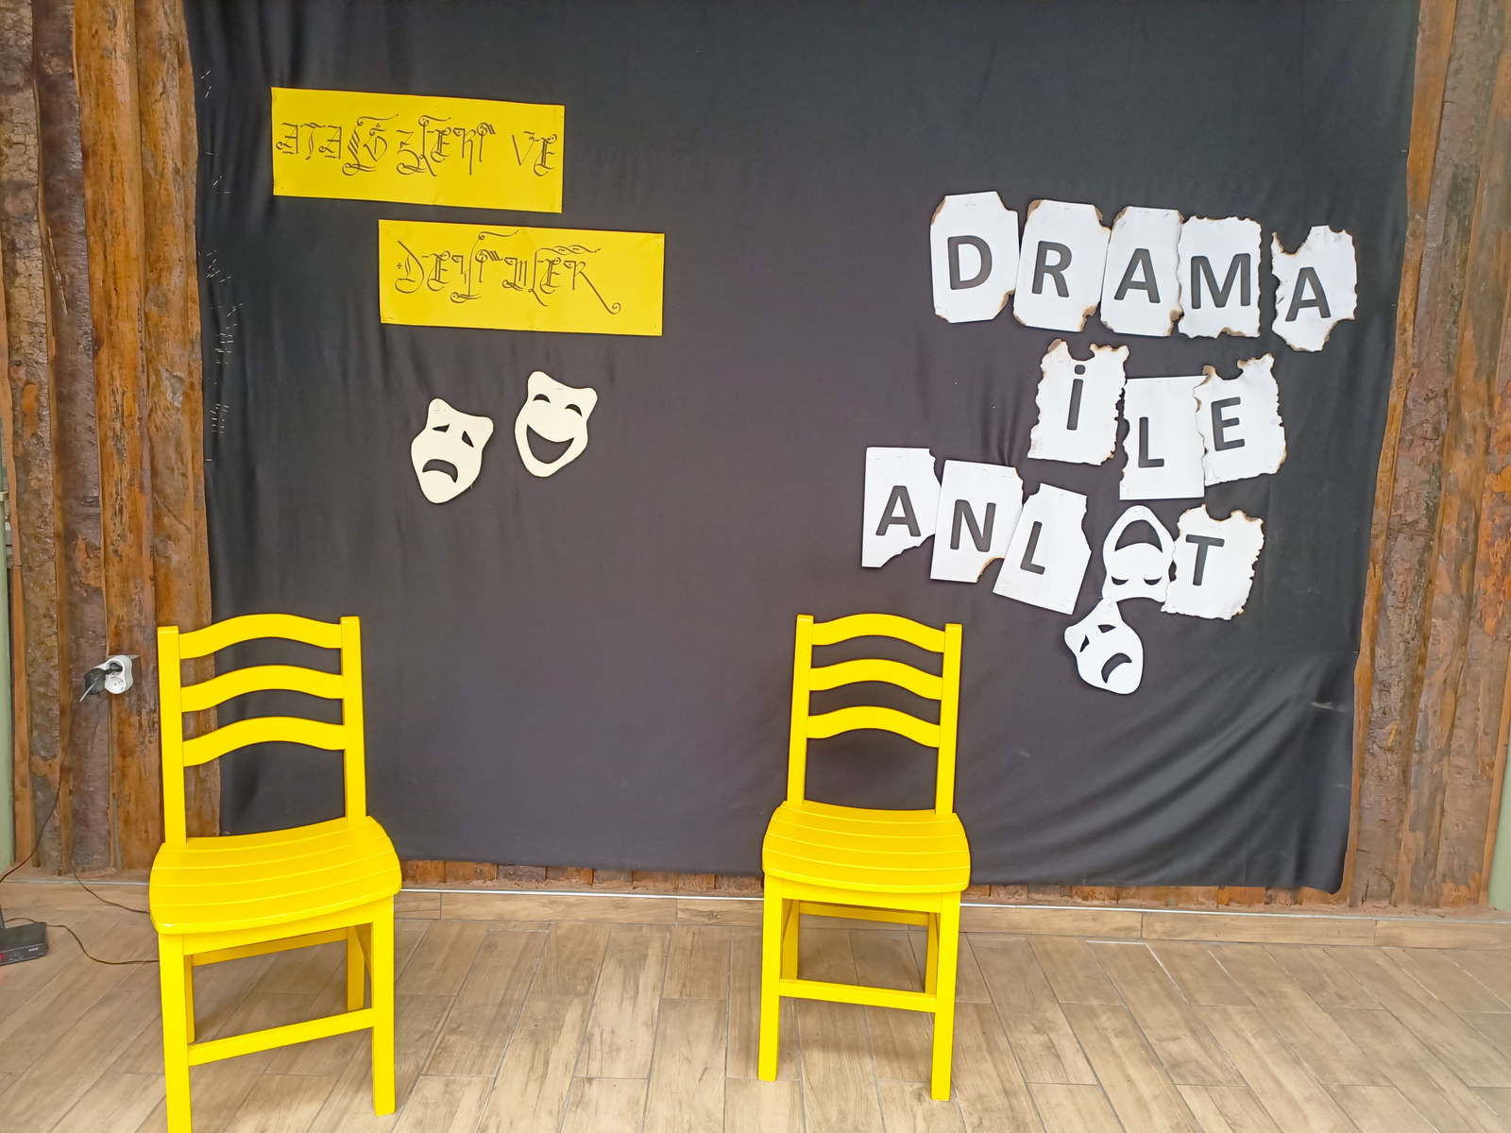
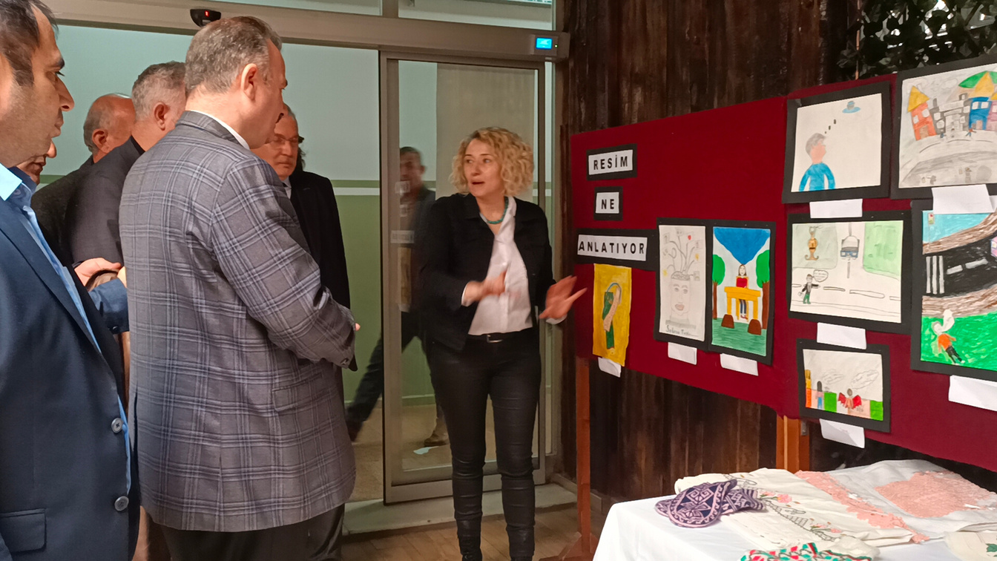
Idioms Exhibition
Drama

Slide 9
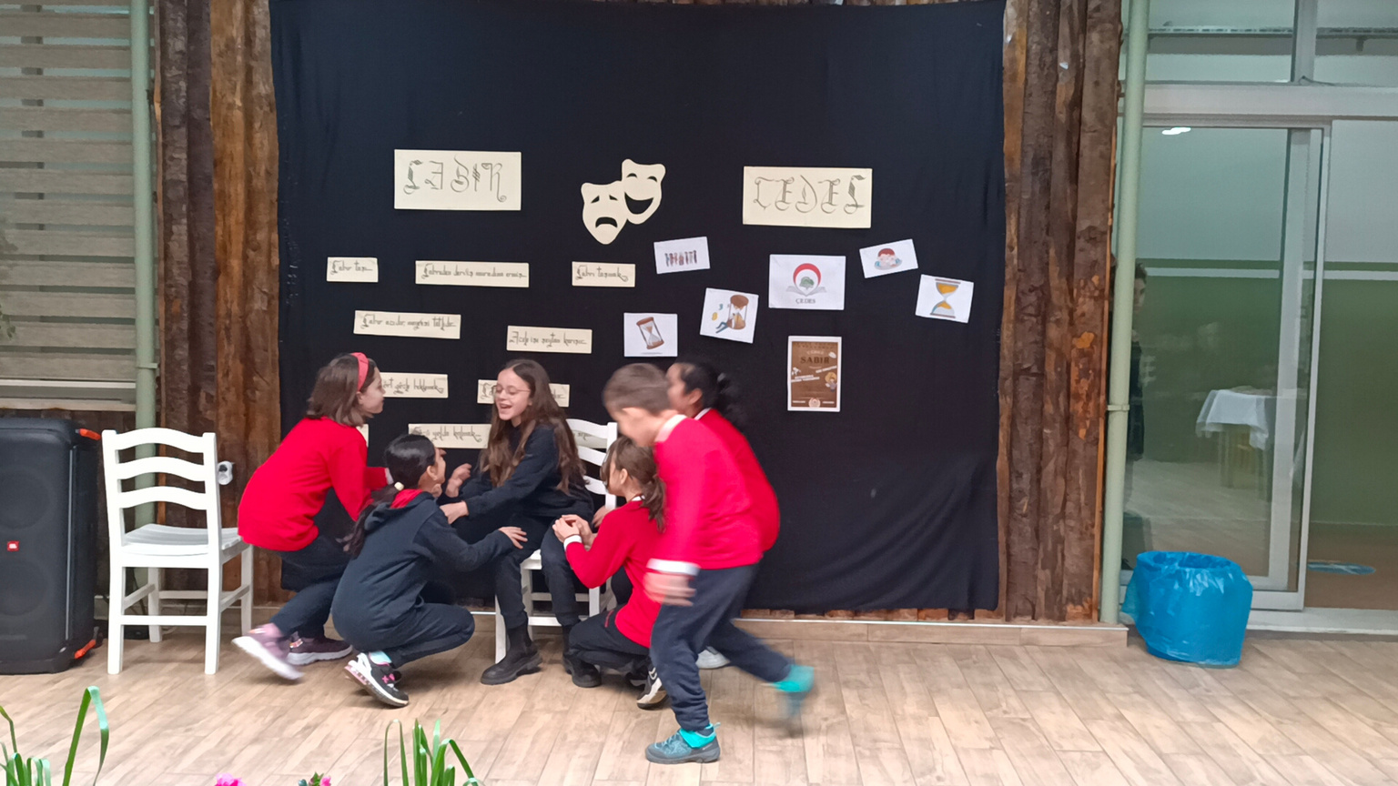
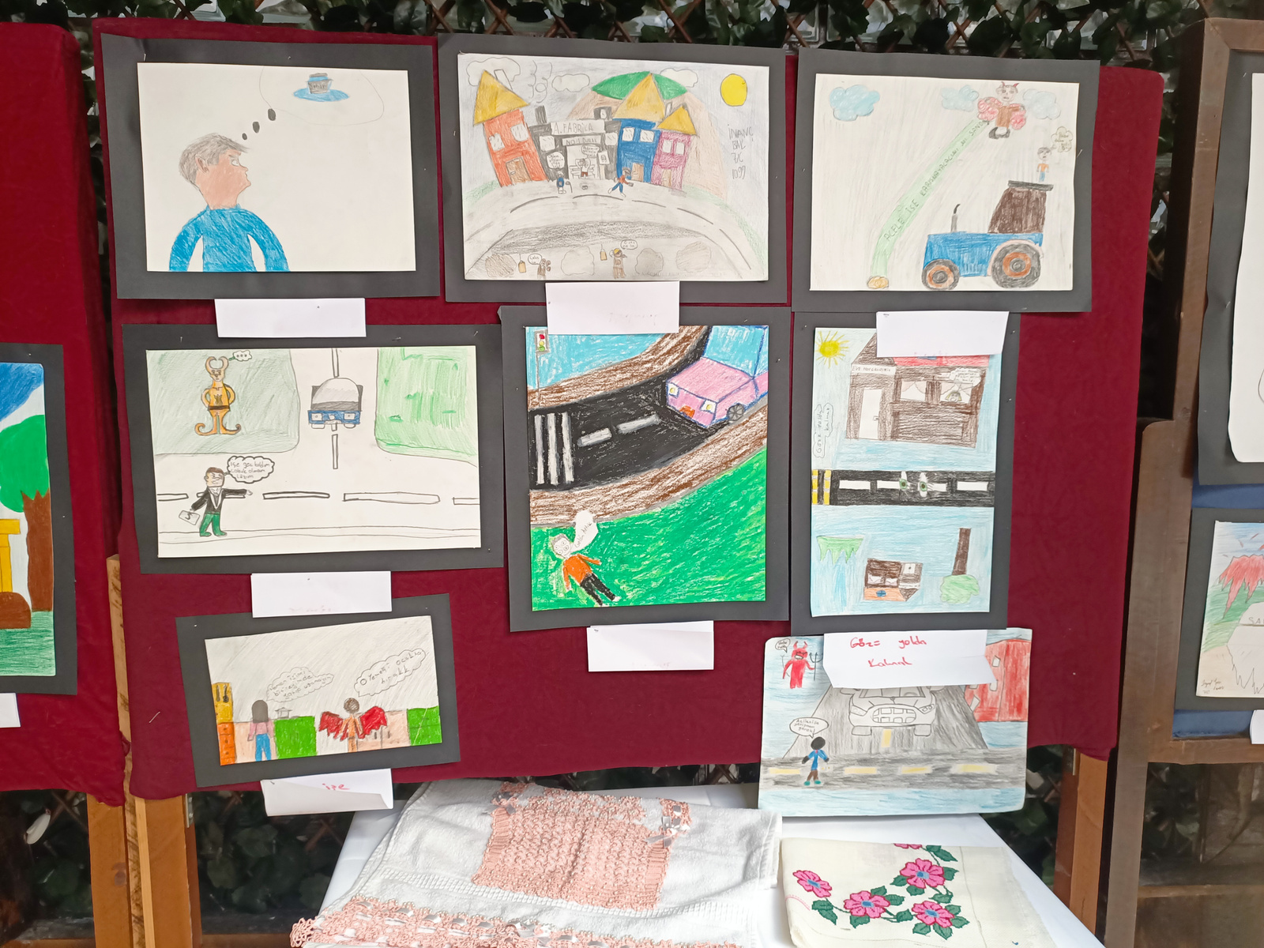
Exhibition
Drama

Slide 10
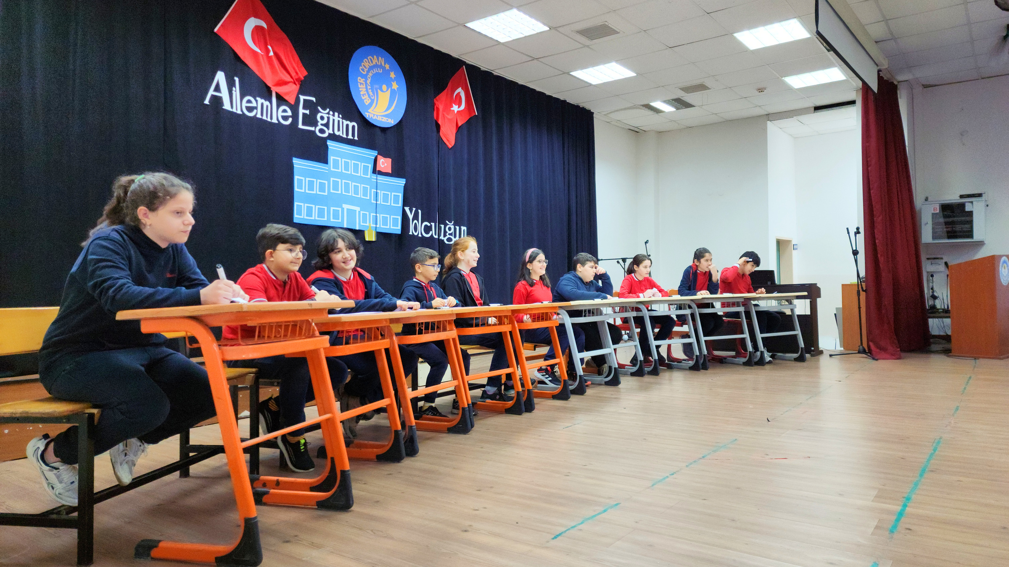
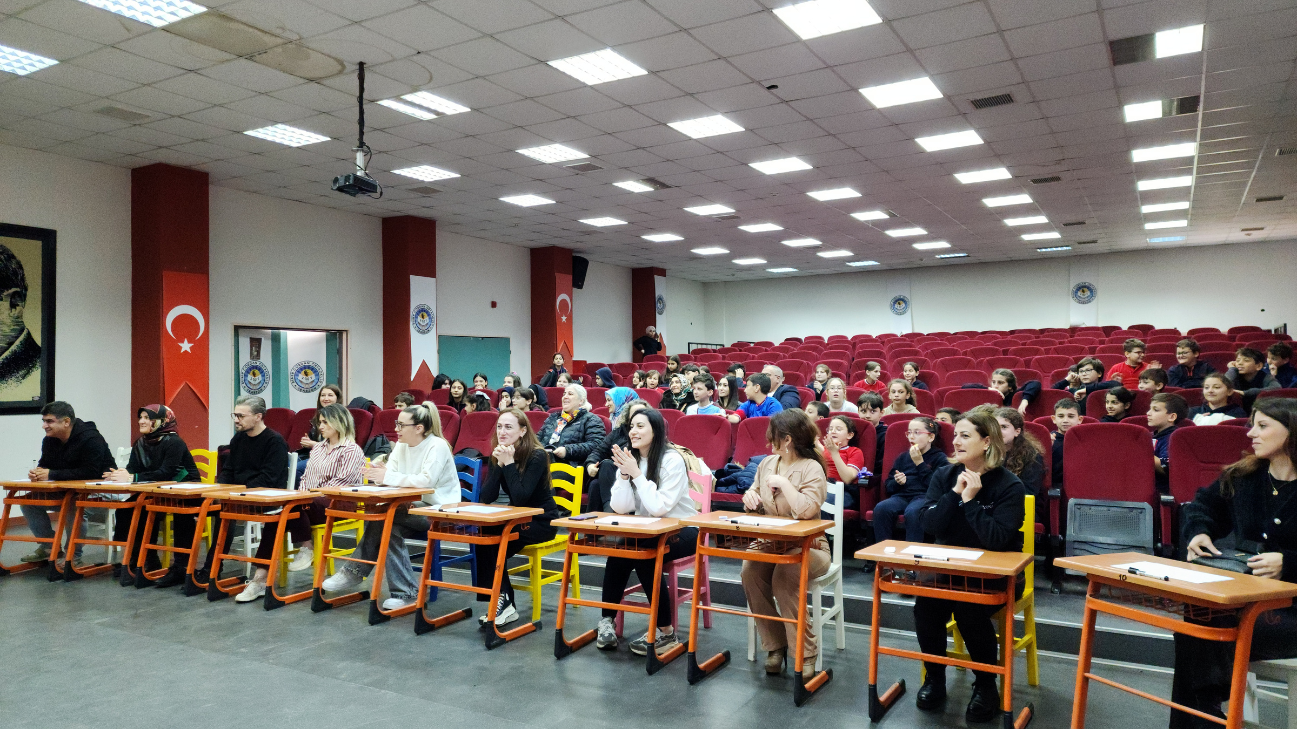
“Education Journey with My Family”.

Slide 11
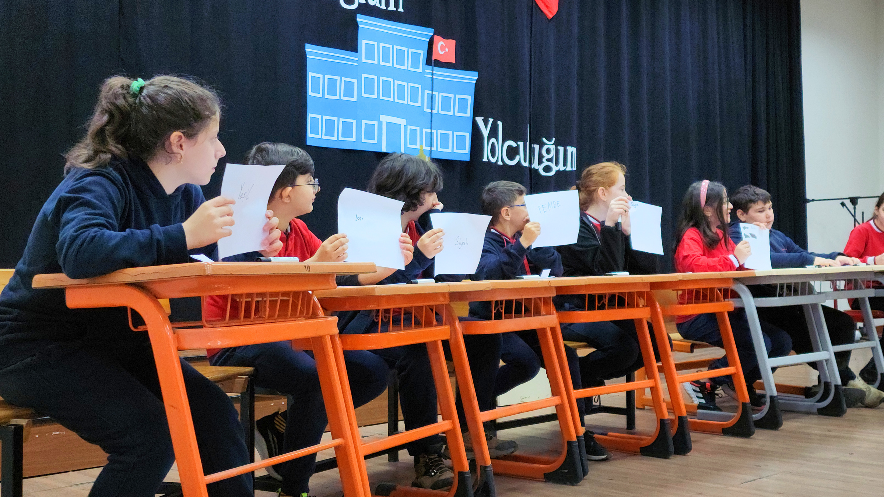
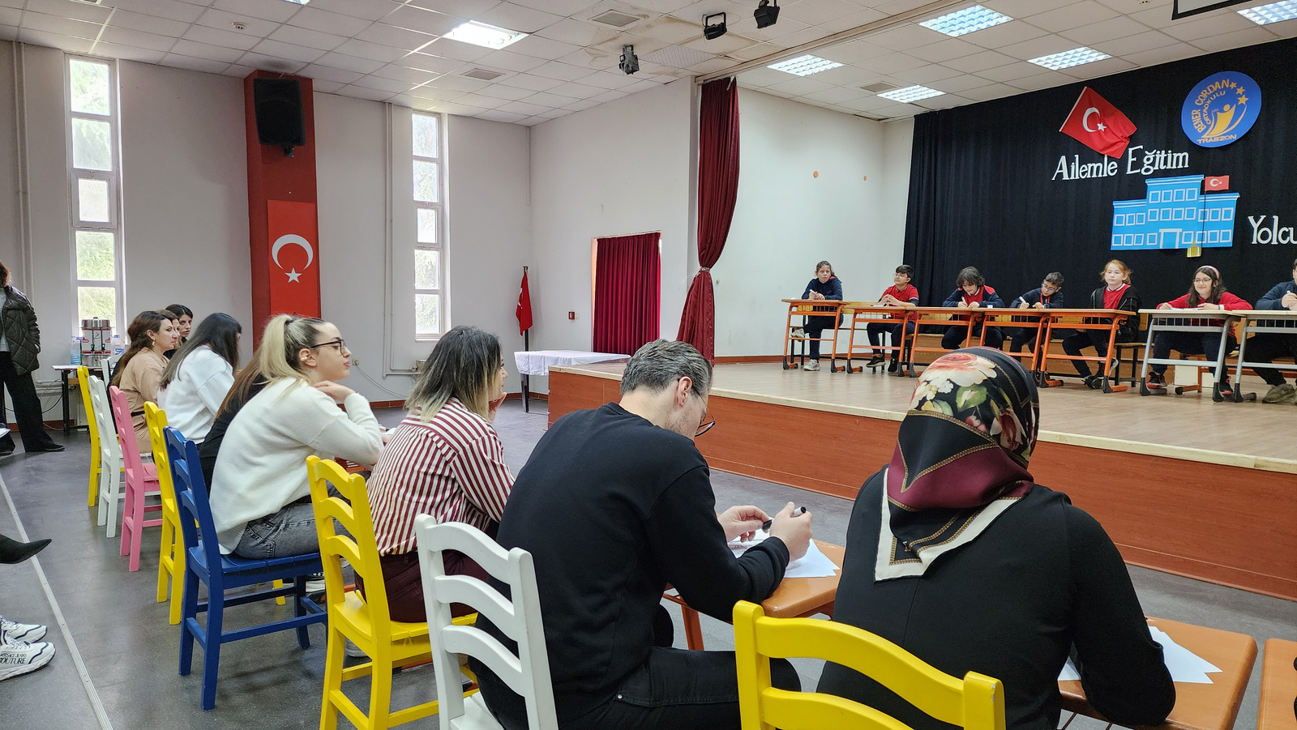

Slide 12
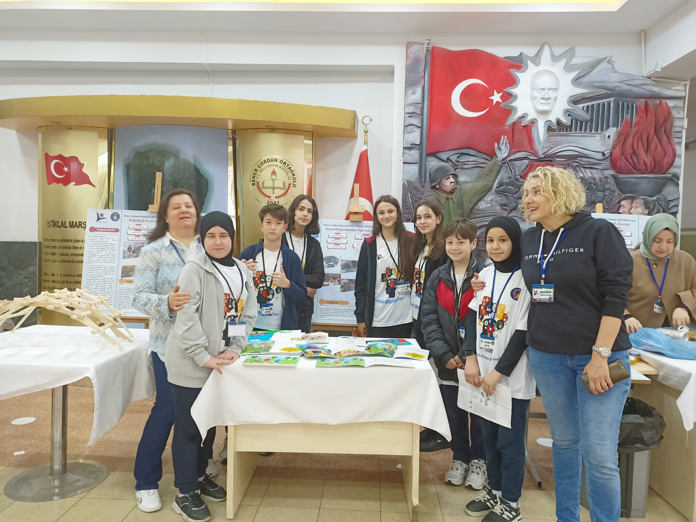
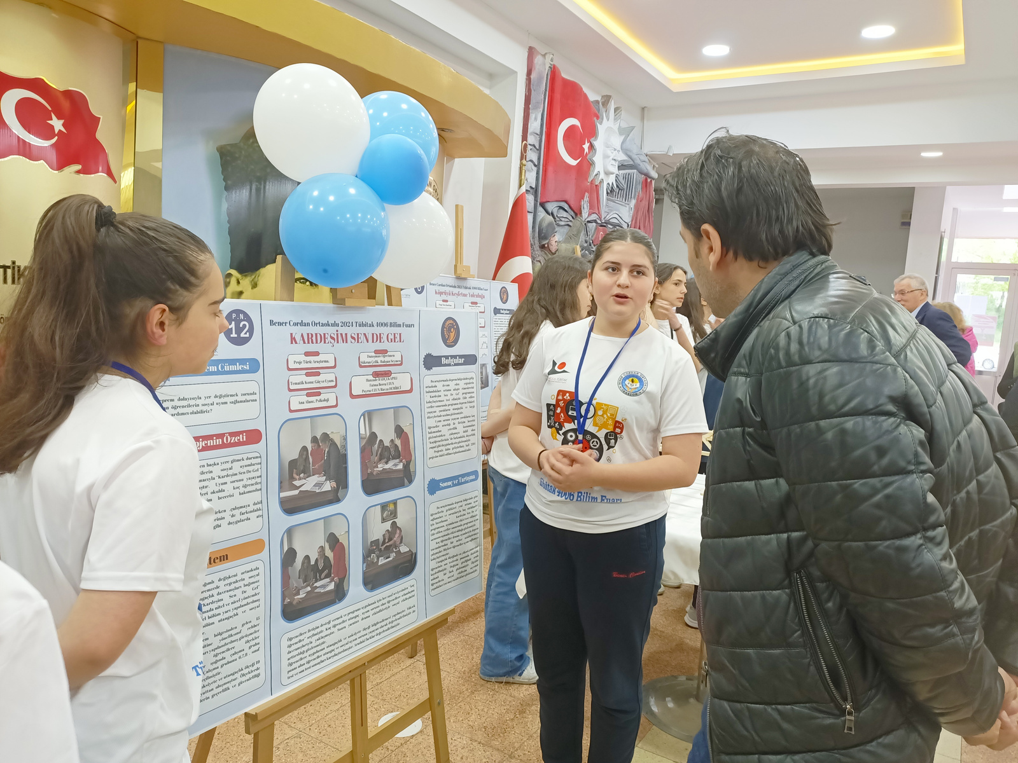
Project Exhibitions

Slide 13
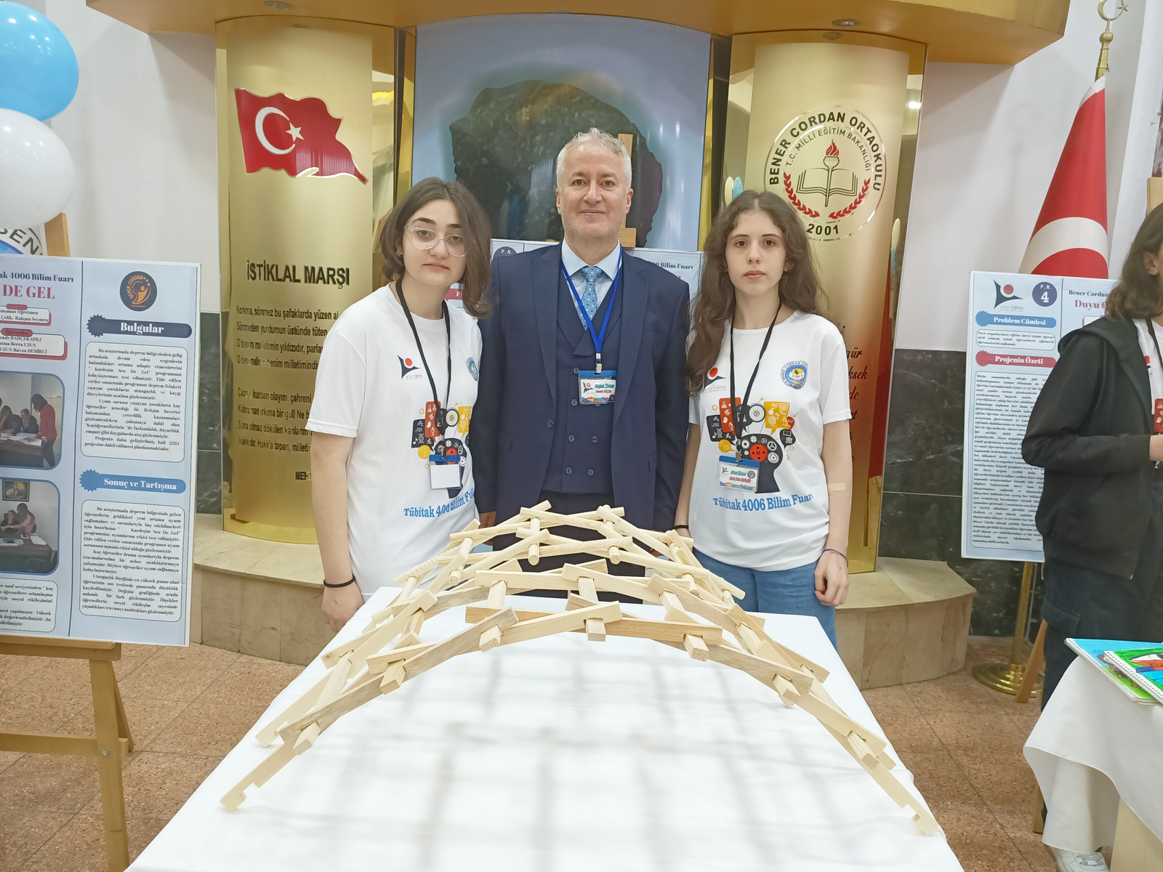
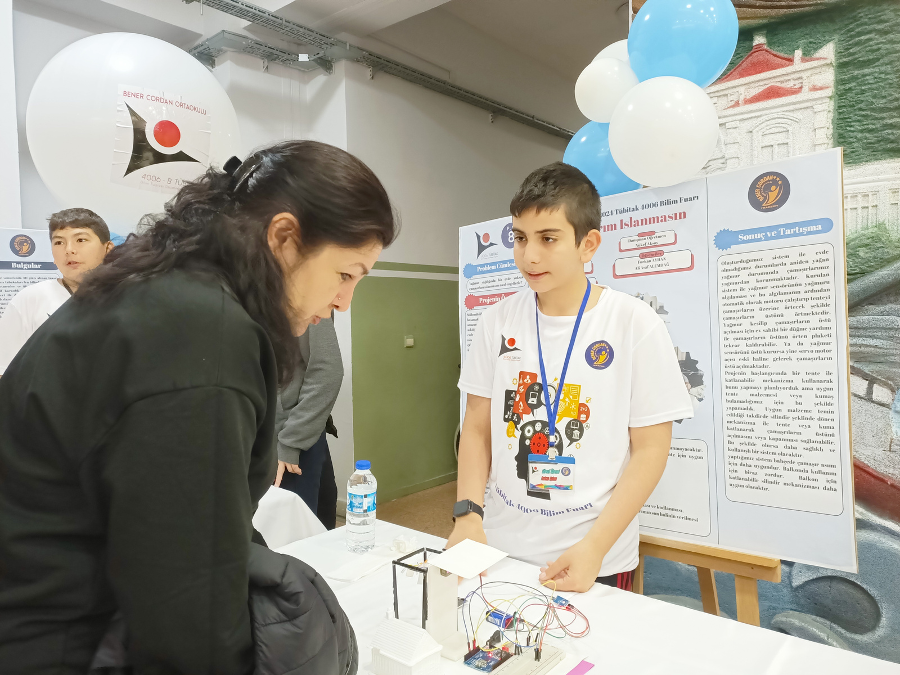

Slide 14
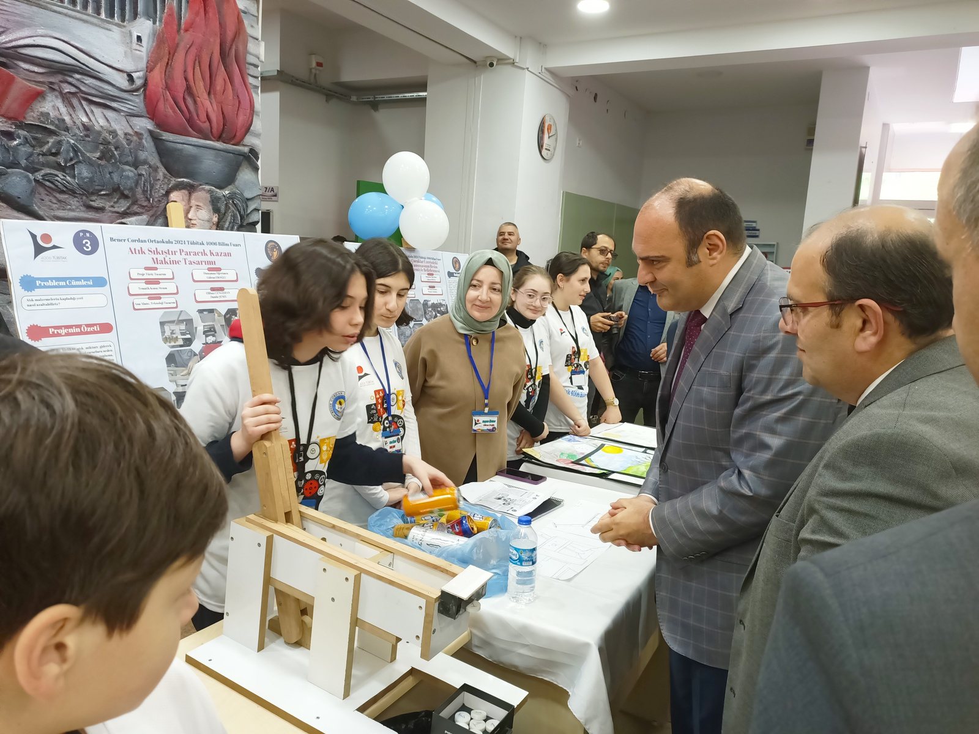
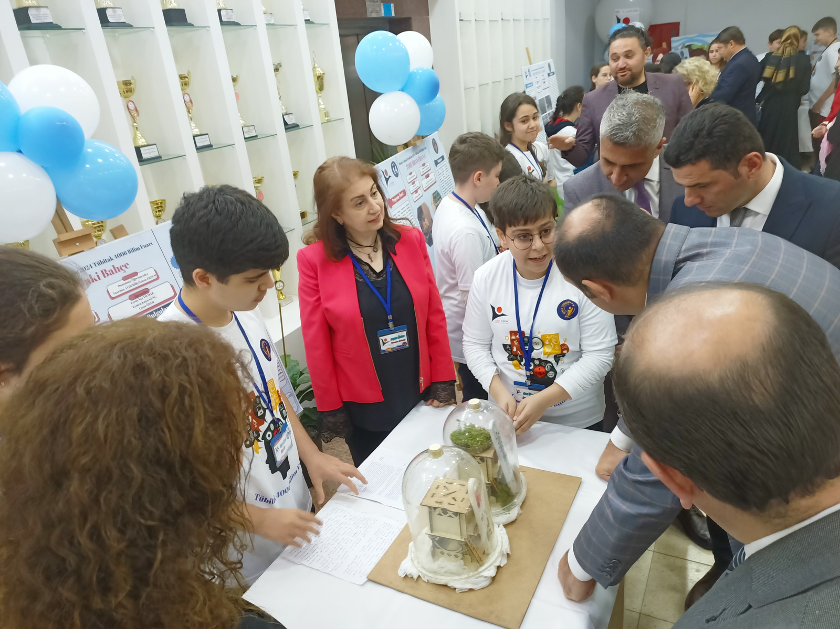

Slide 15

ERASMUS +
In addition, we have taken part in 3 Erasmus + projects in the past years.
2013- Computer Based Training
2019-2022 “Taking A Learning Journey On The Steam Train”
2024- Trabzon Erasmus + Accreditation Partnership

Slide 16
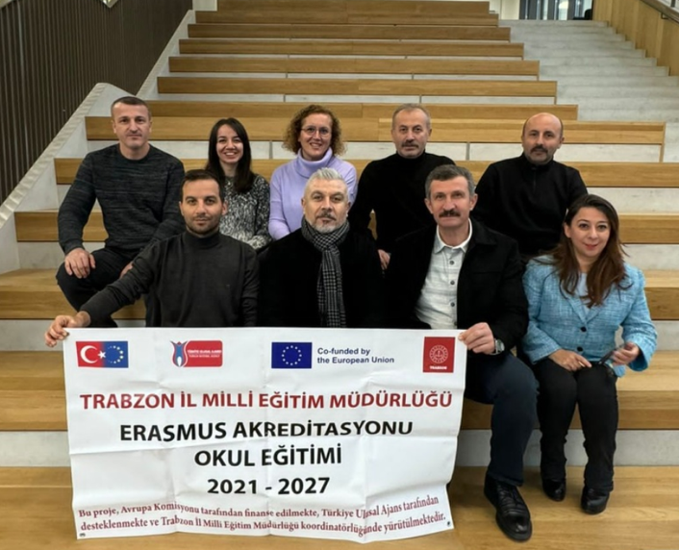
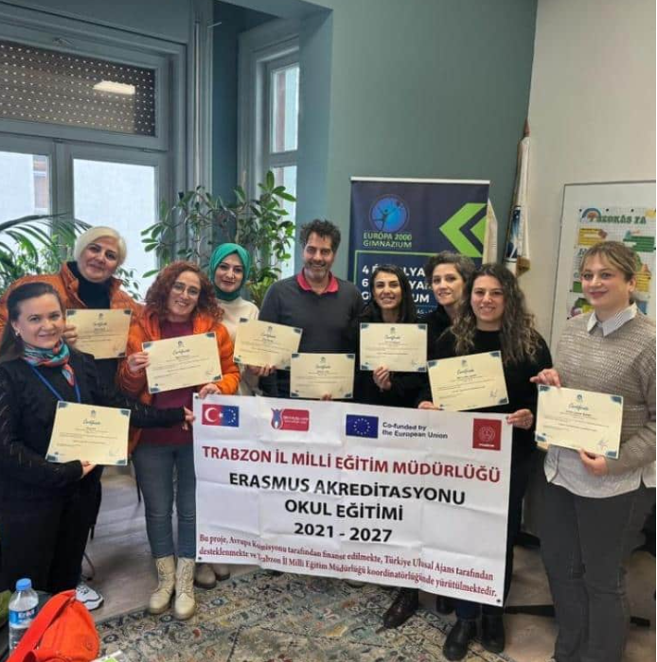

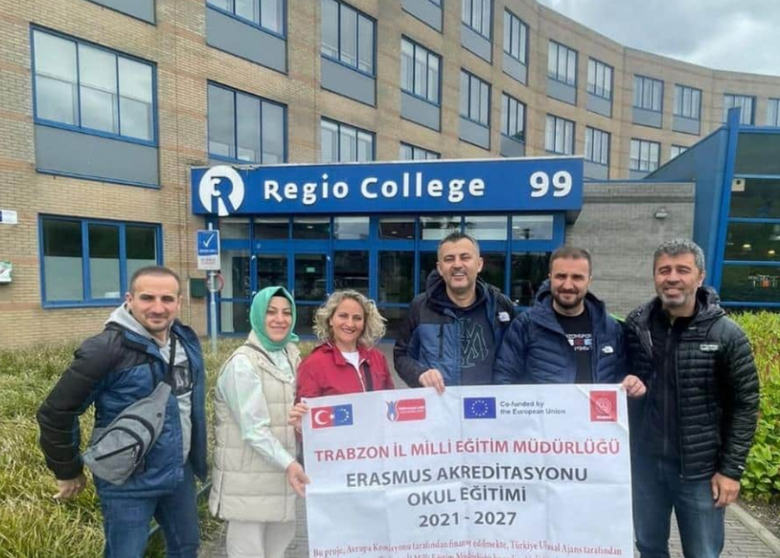
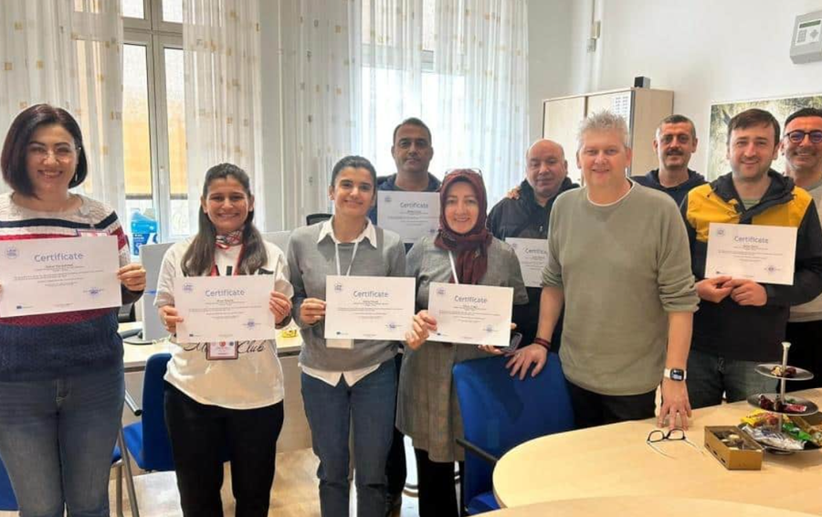
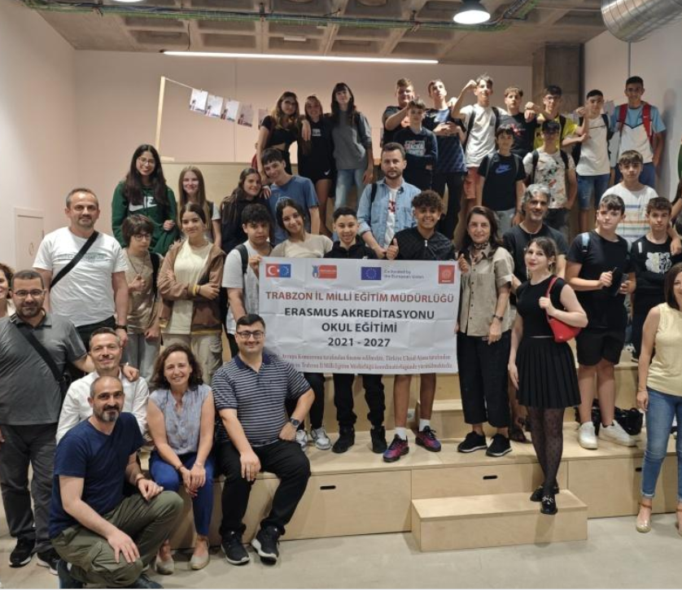
2024- Trabzon Erasmus + Accreditation Partnership
In 2024, we took part in the Erasmus project of the Trabzon Provincial Directorate of National Education as an accreditation partner.

Slide 17
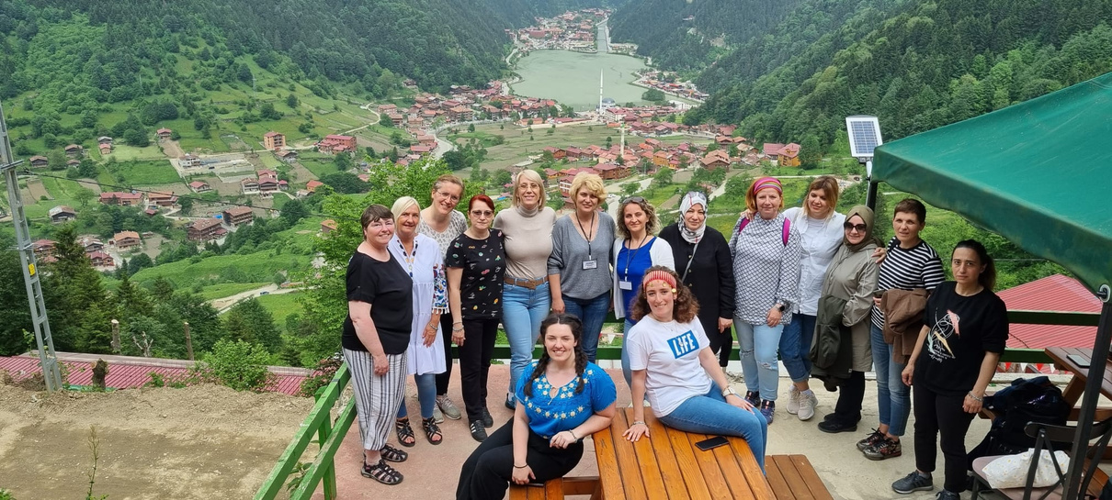

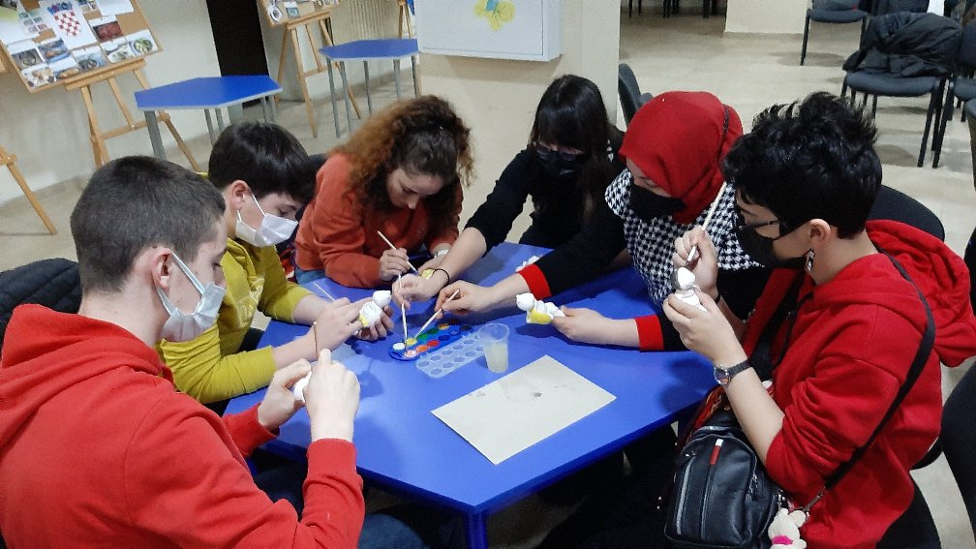
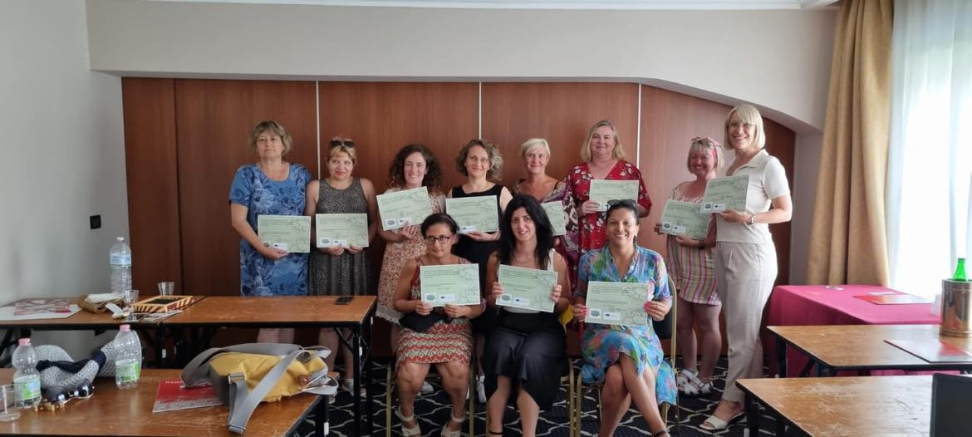
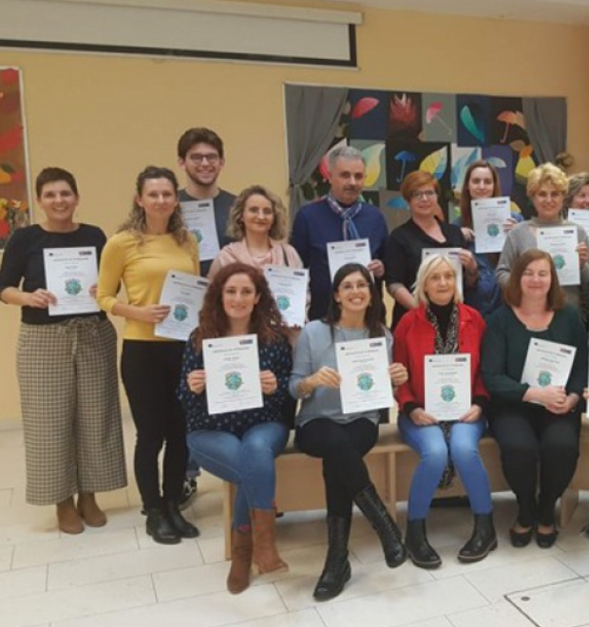
2019-2022 “Taking A Learning Journey On The Steam Train”
In 2024, we took part in the Erasmus project of the Trabzon Provincial Directorate of National Education as an accreditation partner.

Slide 18

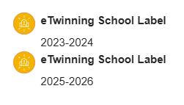



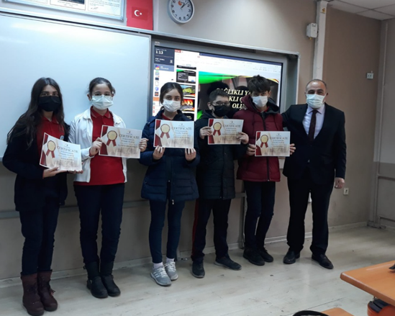

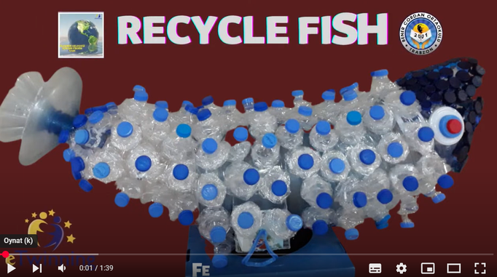


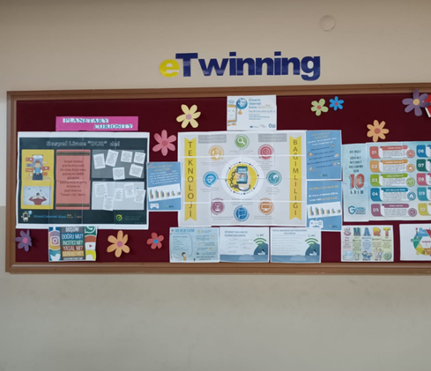
eTwinning
eTwinning Projects
  For the last 5 years.
  Many national and international eTwinning quality labels
  eTwinning school label 2 times

Slide 19
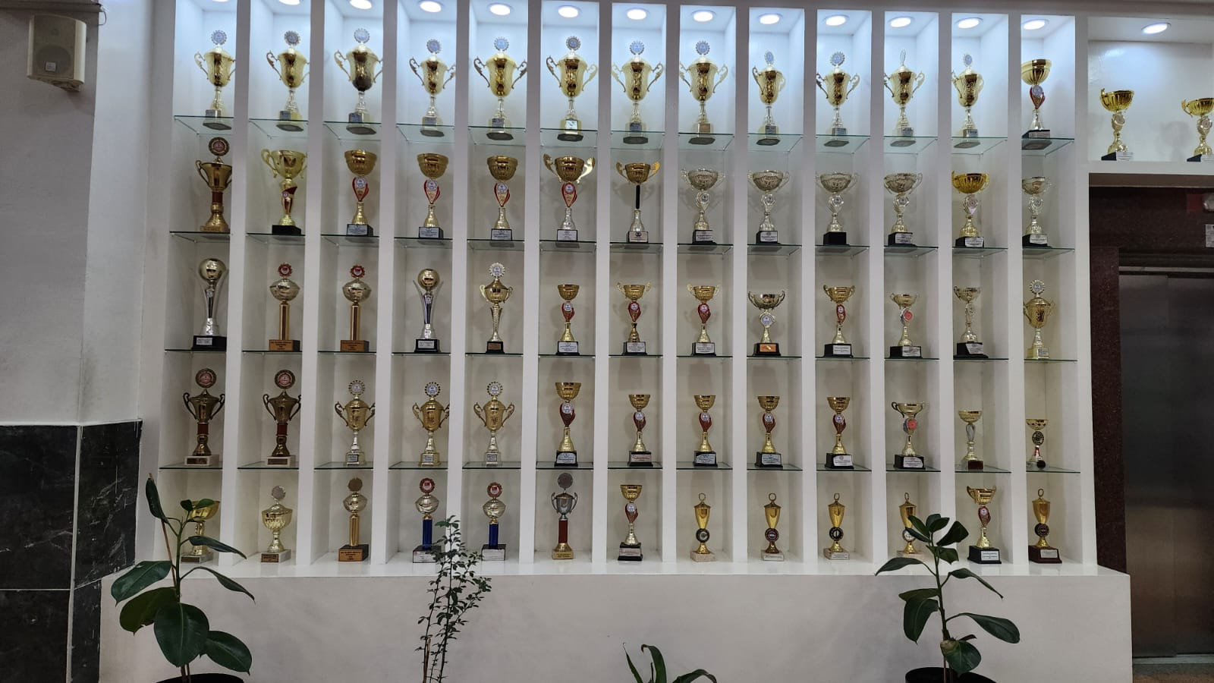





School managers and teachers support the social success of our students as well as their academic success.

Slide 20


Erasmus + KA210
eTwinning Projects
  Announcement to
our school teachers,
students and stakeholders.
  News on our school website

Slide 21

Banner

Slide 22


Slide 23


Slide 24

Dissemination Product

Slide 25
Thank You

