Slide 1

EDUCATION SYSTEM OF LITHUANIA
Ukmerge, 2025

Slide 2
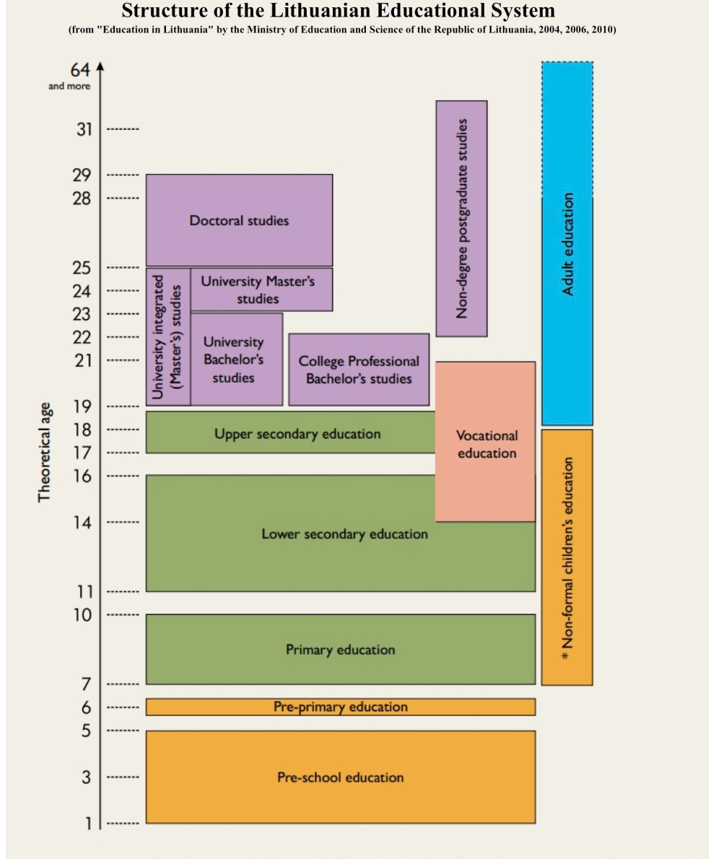

Slide 3
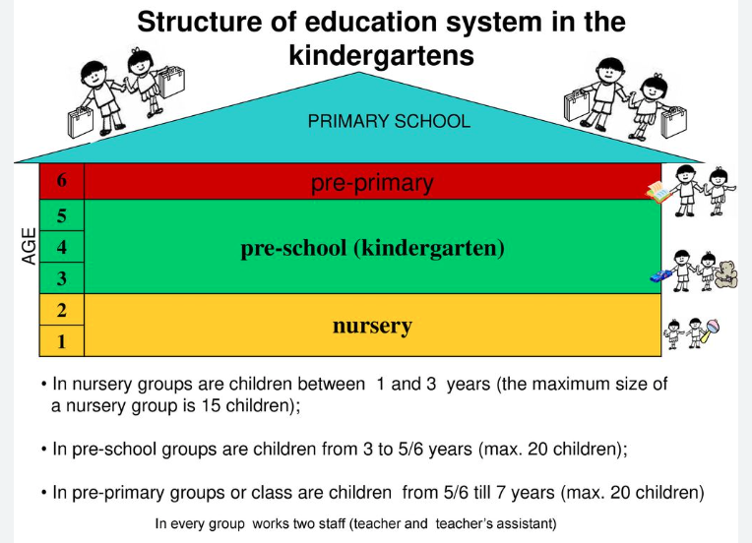
Pre-school education

Slide 4
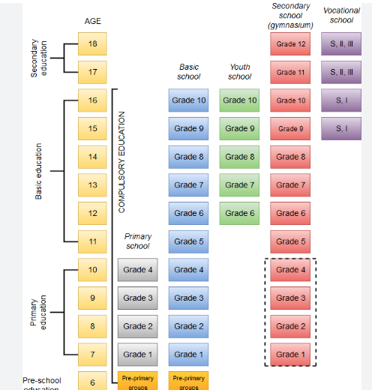
Secondary education

Slide 5

Adult education
Vocational education
College Professional Bachelor’s studies
University Bachelor’s studies
Master’s studies
Doctoral studies

Slide 6
Education system in Lithuania
Lithuania’s educational system is continually evolving – to empower each learner for the challenges of a changing world.

