Slide 1




Sport și wellbeing
incluziune socială printr-un sport nobil: golful
Nr. de ref.
2024-2-RO01-KA182-SPO-000272991
Job- shadowing in Netherlands
07th -11th February 2025
BENEFICIARY JOURNAL
ALBATROSS GOLF CLUB
SADU, SIBIU, ROM\NIA
DISCLAIMER
Finanțat de Uniunea Europeană. Punctele de vedere și opiniile exprimate aparțin, însă, exclusiv autorului (autorilor) și nu reflectă neapărat punctele de vedere și opiniile Uniunii Europene sau ale Agenției Executive Europene pentru Educație și Cultură (EACEA). Nici Uniunea Europeană și nici EACEA nu pot fi considerate răspunzătoare pentru acestea.
by SCOTT JOSEPH MOLZOF, DAVID LOUIS FOSTER & DAVID MORELLI

Slide 2
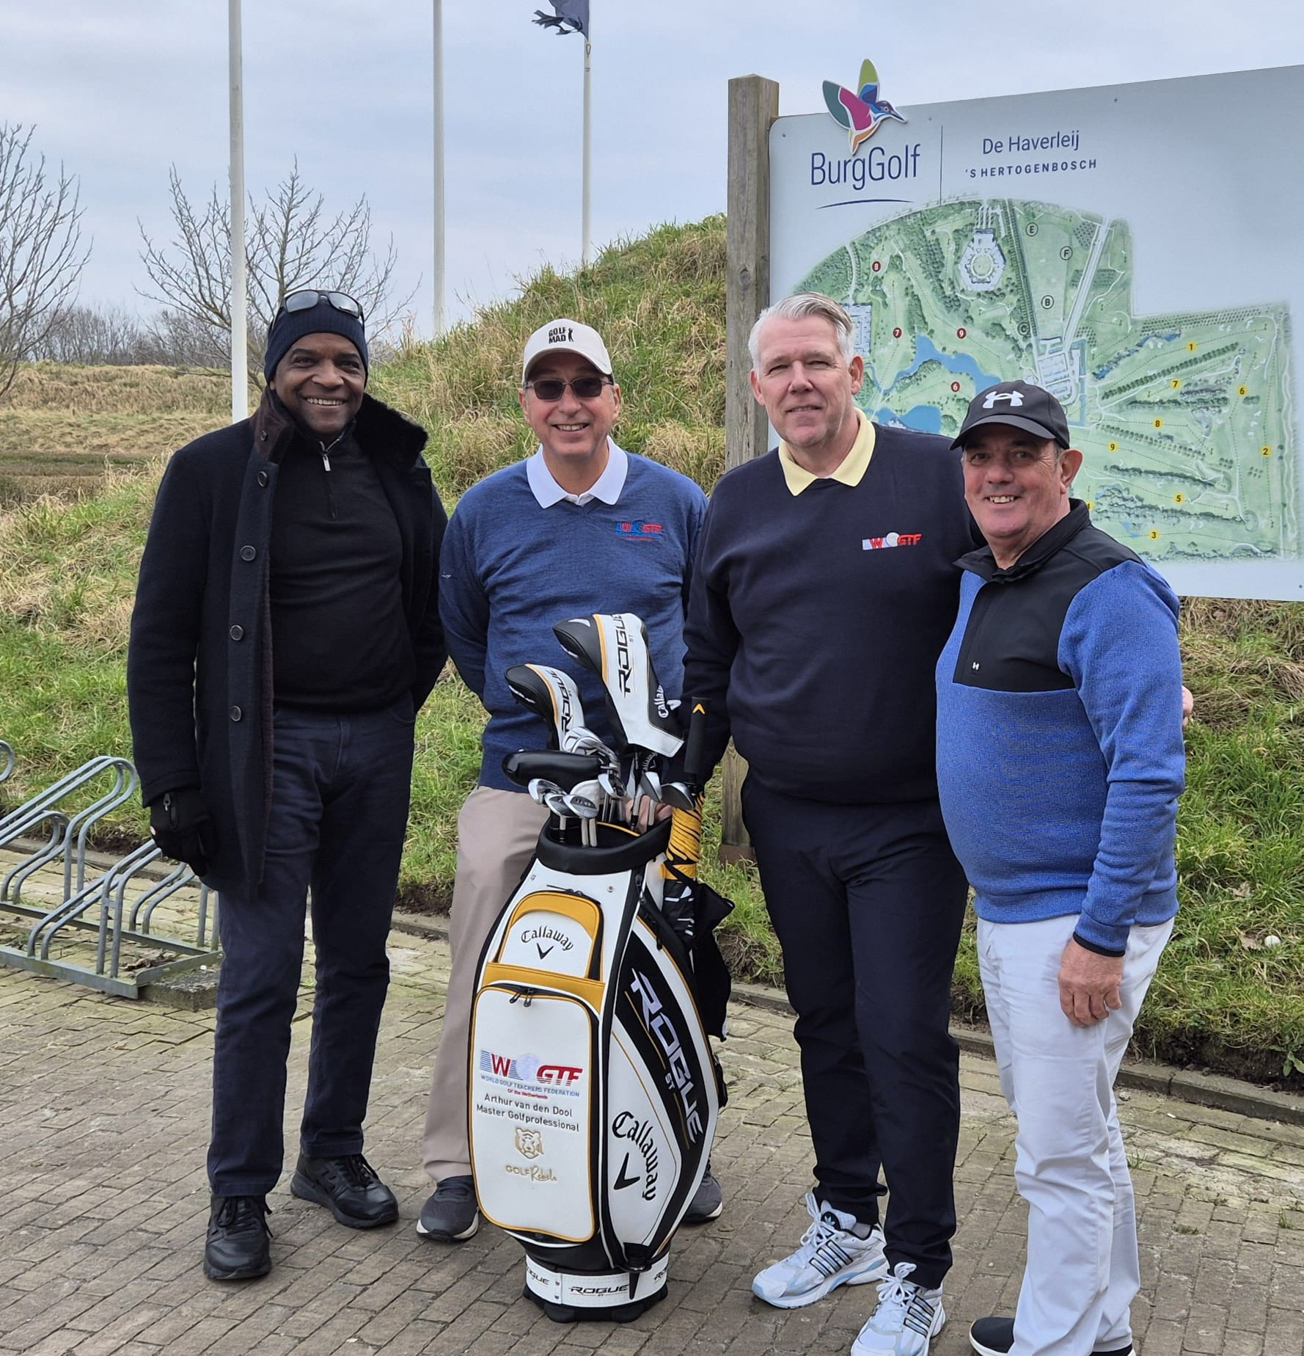
Mindful Golf: Enhancing Performance Through Mental Well-being
Welcome to our presentation on the transformative five-day job-shadowing program focused on mindfulness in golf. This innovative approach combines the precision of golf with the centering practices of mindfulness to create a powerful framework for both personal and athletic development.
Our program, hosted in the Netherlands and led by professional coach Arthur Van Den Doon, guided participants through a journey of mental technique development alongside physical golf skills. The following slides detail our activities, insights gained, and the remarkable progress participants made throughout this unique experience.

Slide 3
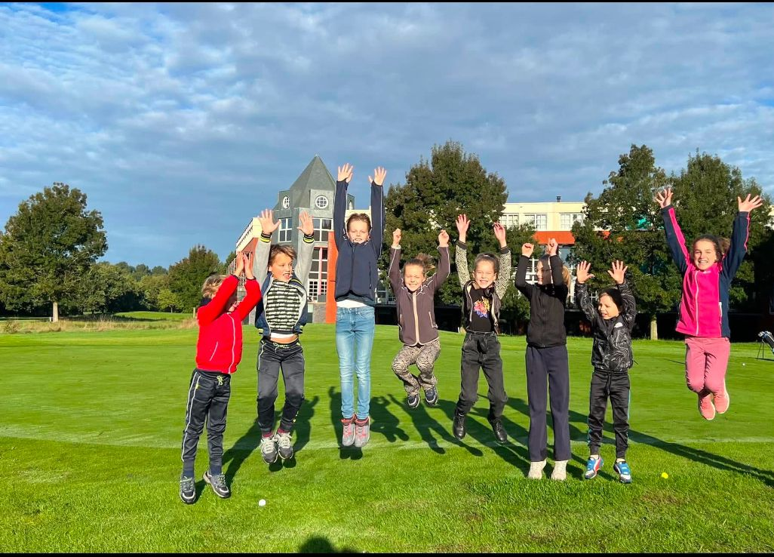




Program Introduction & Facility Tour
Welcome Session
Introduction to program objectives and expected outcomes
Mindful Golf Concept
Overview of core principles and scientific benefits
Facility Tour
Exploration of practice areas, mindfulness spaces, and course layout
Networking
Building connections through interactive introduction activities
Day one established the foundation for our program, introducing participants to the sinergy of mindfulness and golf. The initial workshop demonstrated how focused awareness techniques directly translate to improved performance on the course, setting the stage for hands-on practice in subsequent days.

Slide 4

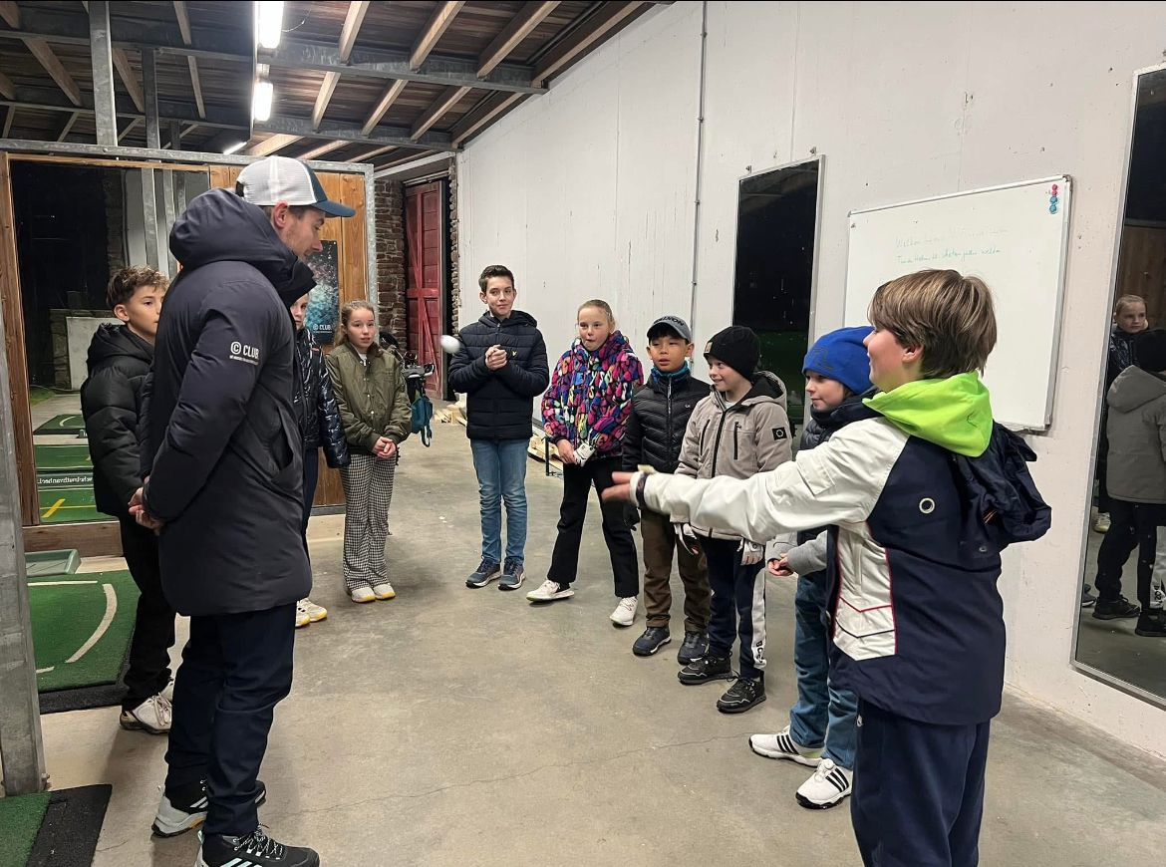



Breathing & Concentration Techniques
Centering Breath
Two-minute breathing ritual before addressing the ball
Focused Attention
Single-point concentration practice during pre-shot routine
Release Tension
Progressive muscle relaxation for optimal swing mechanics
Present Awareness
Grounding techniques between shots to maintain flow state
Under the expert guidance of Coach Arthur Van Den Doon, participants learned to integrate specific breathing patterns with their golf mechanics. This day's sessions revealed how proper breath control directly influences swing tempo and balance. The afternoon practice round allowed immediate application, with many participants reporting enhanced focus and reduced anxiety during challenging shots.

Slide 5
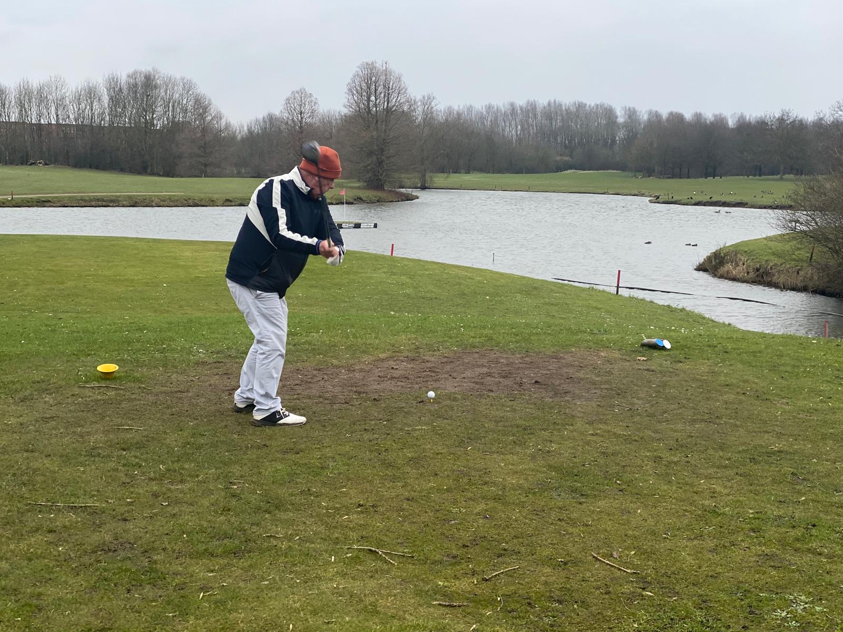
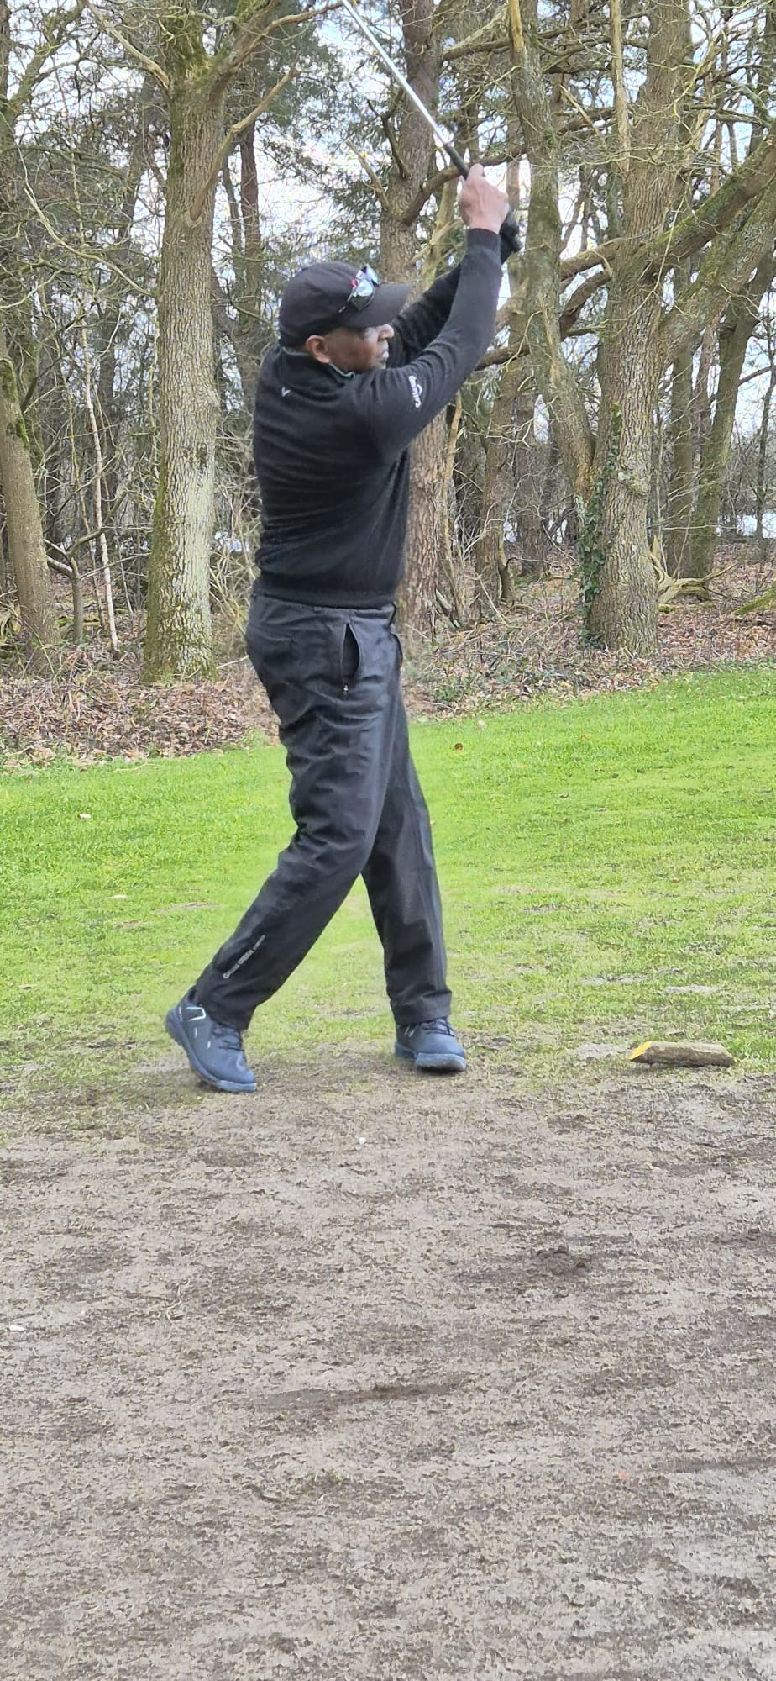
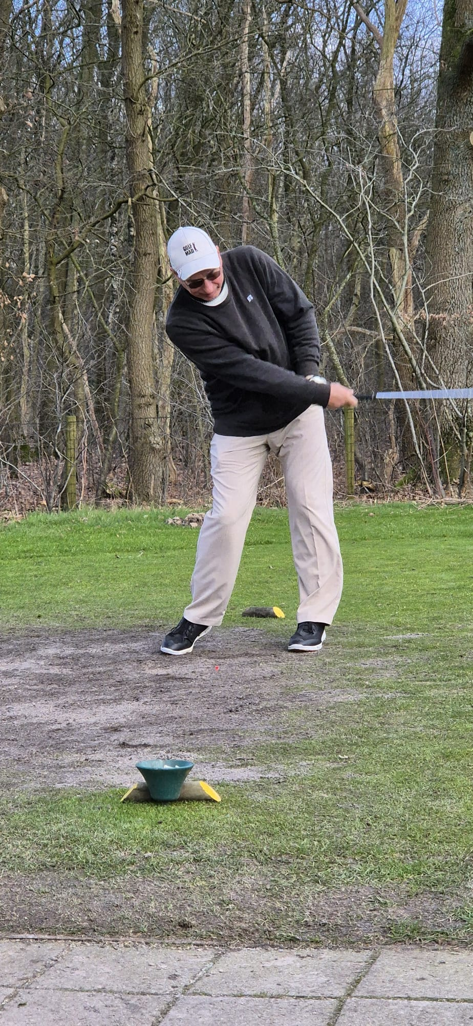
Skill Development Through Mindfulness
Balance Integration
Participants practiced one-legged stances while mindfully attending to weight distribution, dramatically improving swing stability and ground connection.
Coordination Enhancement
Special exercises combining rhythmic breathing with progressive swing components developed smoother transitions between backswing, downswing, and follow-through.
Friendly Competition
A low-pressure tournament format created opportunities to apply mindfulness techniques under mild performance conditions, building confidence through direct experience.
Team Building
Collaborative mindfulness activities fostered group cohesion and mutual support, enhancing the learning environment through shared experiences.
Day three expanded upon previous lessons by focusing on physical skill development through mindfulness principles. The integration of balance and coordination exercises specifically designed for golf mechanics produced notable improvements in participants' technique and consistency.

Slide 6








Advanced Performance Techniques
Peak Performance State
Accessing flow state through targeted mental cues
Strategic Awareness
Mindful course management and decision-making
Recovery Skills
Techniques for mental resilience after poor shots
Personalized Routines
Custom pre-shot rituals for consistent performance
Day four elevated the program with individualized coaching that addressed each participant's specific mental and technical challenges. Advanced mindfulness techniques focused on achieving optimal performance states, with participants learning to recognize and replicate their best mental conditions.
The inclusion of Paralympic practitioners provided profound insights into adaptability and mental resilience, inspiring all participants to overcome their perceived limitations through focused awareness and positive mindset techniques.

Slide 7
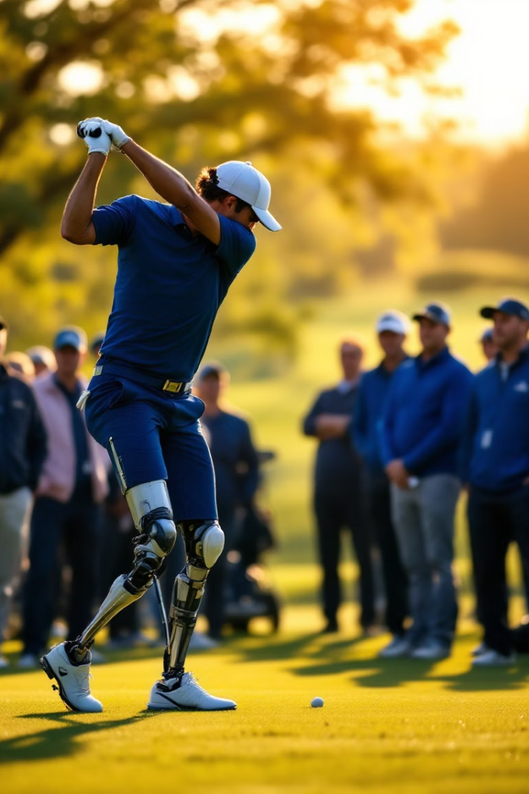



Paralympic Golf Practitioners
Adaptive Equipment
Mental Resilience
Creative Problem-Solving
Specialized clubs and mobility devices enabling superior performance despite physical challenges, demonstrating how mindfulness enhances adaptability.
Paralympic athletes shared powerful techniques for maintaining focus despite additional challenges, providing perspective on overcoming mental barriers.
Innovative approaches to traditional technique demonstrated how mindfulness promotes adaptability and personalized solutions to technical challenges.
The Paralympic practitioners session proved to be among the most impactful components of our program. Participants witnessed firsthand how mindfulness techniques help adaptive golfers achieve remarkable performance through enhanced body awareness and mental clarity. These demonstrations challenged conventional limitations and inspired new perspectives on what's possible through disciplined mental practice.

Slide 8
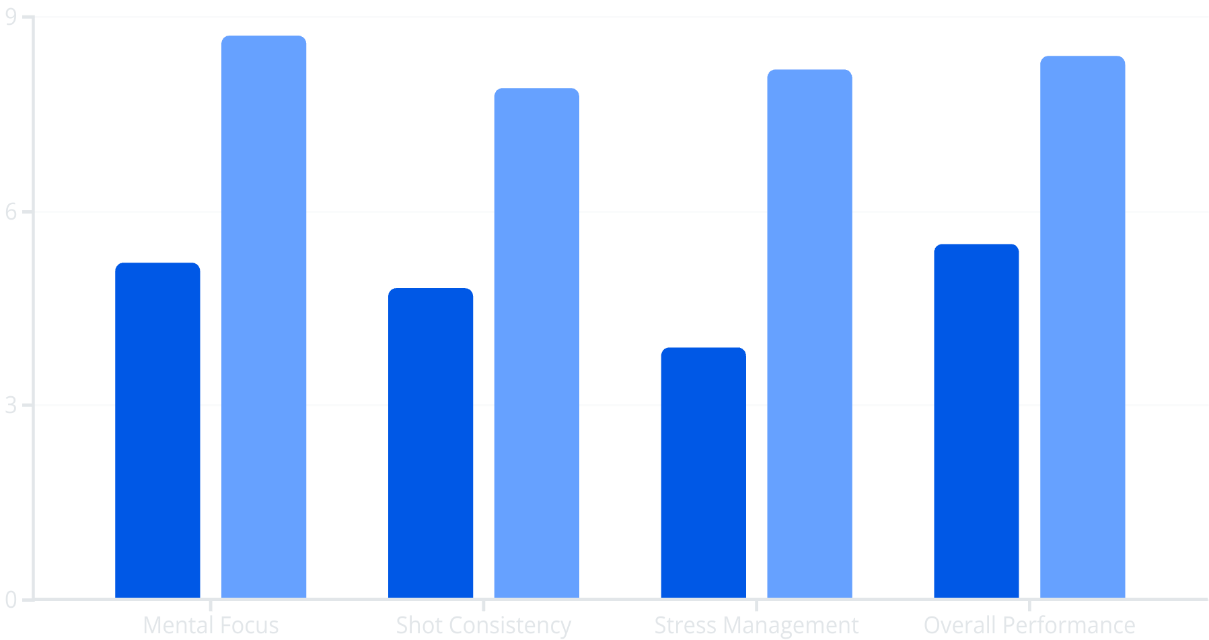
Participant Progress & Outcomes
Before Program
After Program
The final day's evaluation revealed significant improvements across all measured performance metrics. Participants demonstrated measurable progress in mental focus, shot consistency, and especially stress management during challenging situations on the course.
Group reflection sessions highlighted how mindfulness techniques had become integrated into participants' natural golf routines, suggesting lasting behavioral change. The Europass Mobility and Participation Certificates ceremony formally recognized these achievements while encouraging continued practice of the mindfulness principles learned.

Slide 9




Key Takeaways & Future Applications
Foundational Awareness
Mindfulness as the basis for all skill development
Integration Practice
Regular application during both practice and play
Performance Enhancement
Measurable improvement in technical and mental aspects
Life Application
Transferring skills to professional and personal contexts
This pioneering program demonstrated that mindfulness techniques provide a powerful framework for enhancing golf performance. Participants now possess a comprehensive toolkit of mental skills applicable not only to golf but to other aspects of life requiring focus, resilience, and presence.
Future programs will expand upon this foundation with longer-term tracking of participant progress and additional focus on specialized applications for competitive players. The integration of mindfulness into traditional golf instruction represents an exciting frontier with tremendous potential for holistic player development.

Slide 10
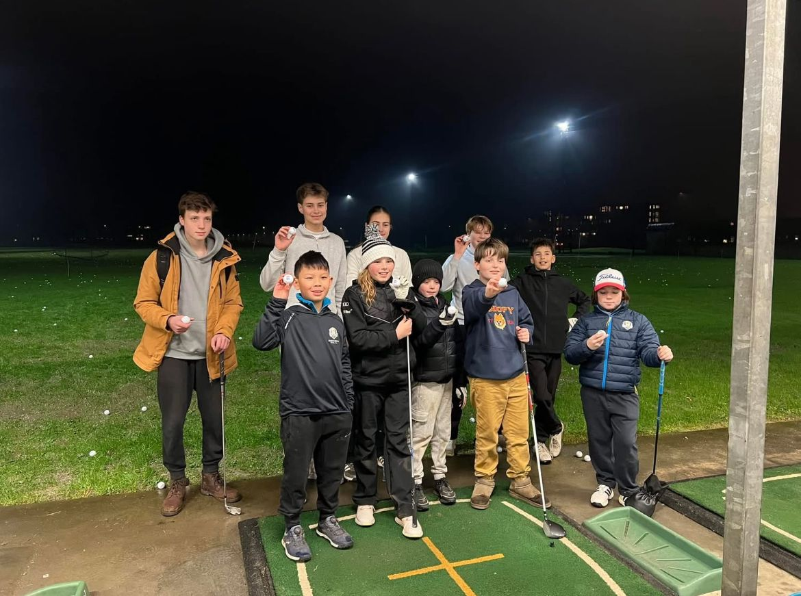
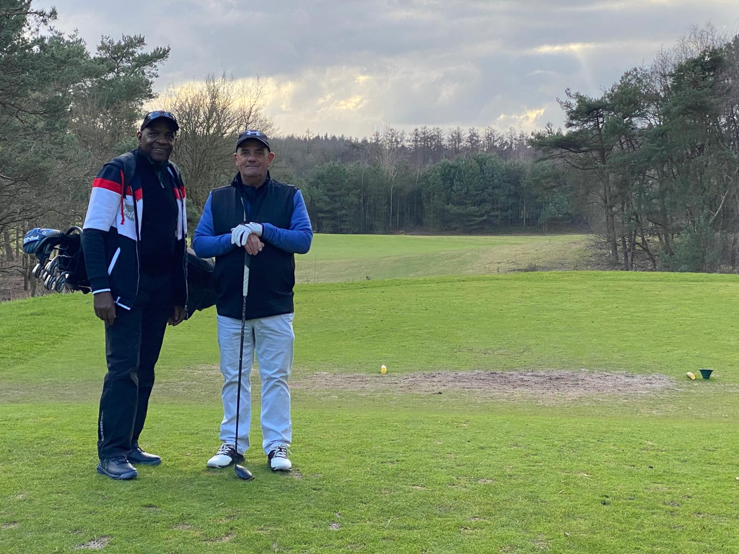

Slide 11
