Slide 1

Sport and Wellbeing: Social Inclusion Through Golf
Our vision is to create a golf club accessible to all. We found that, although golf became an Olympic sport again in 2009, in Romania there is no inclusive approach to facilitate the access of children from disadvantaged backgrounds, potential future champions.
By Scott Joseph Molzof
ALBATROSS GOLF CLUB, SIBIU COUNTY, ROMANIA
DISCLAIMER: Funded by the European Union. Views and opinions expressed are however those of the author(s) only and do not necessarily reflect those of the European Union or the European Education and Culture Executive Agency (EACEA). Neither the European Union nor EACEA can be held responsible for them.

Slide 2

Project Goals:
Inclusion and Wellbeing
Fostering Inclusion
Increasing Professional Skills& European dimension
Transforming our golf club into a more inclusive and accessible environment for children, women and all members by implementing
Improving the professional skills of our staff
Creating a vibrant international network

Slide 3
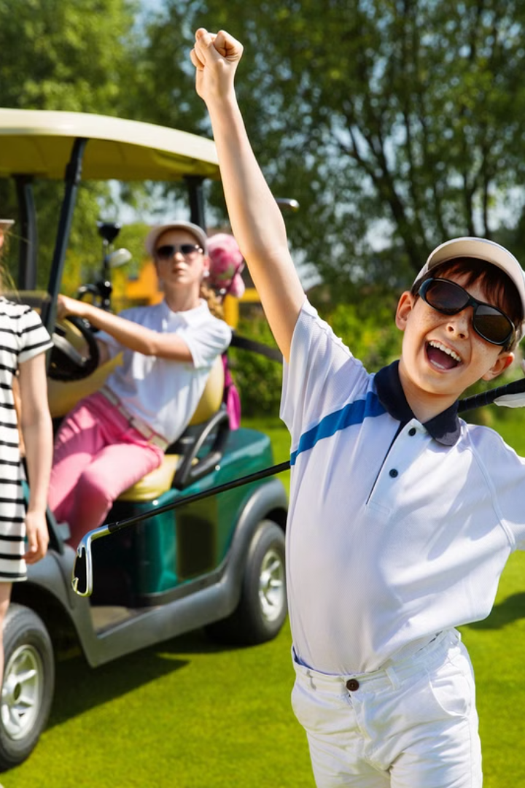
Reaching Underserved Communities
1
Target Populations
Individuals facing socioeconomic disadvantages and limited access to sports (kids, youth, and ladies).
2
Addressing Barriers
Overcome financial constraints, transportation challenges, and lack of awareness. Provide inclusive and accessible programs.

Slide 4
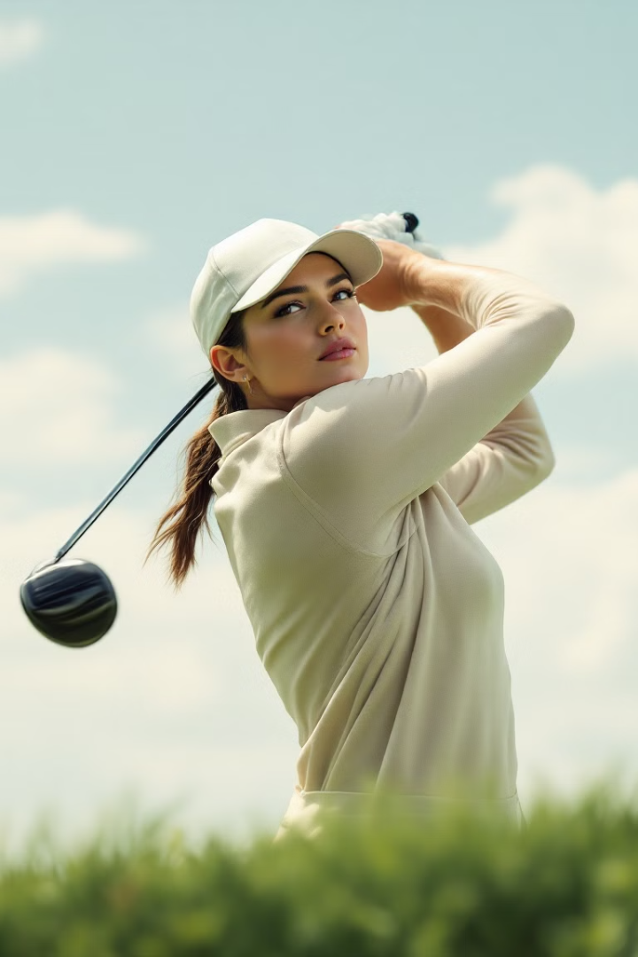



Golf: A Tool for Transformation
Physical Benefits
Mental Benefits
Social Benefits
Improve cardiovascular health, strength, and flexibility. Encourage an active lifestyle and combat sedentary behavior.
Reduce stress, improve focus, and boost self-esteem. Promote mindfulness and cognitive function through golf.
Foster social interaction, build friendships, and create a sense of community. Promote teamwork, communication, and sportsmanship.

Slide 5
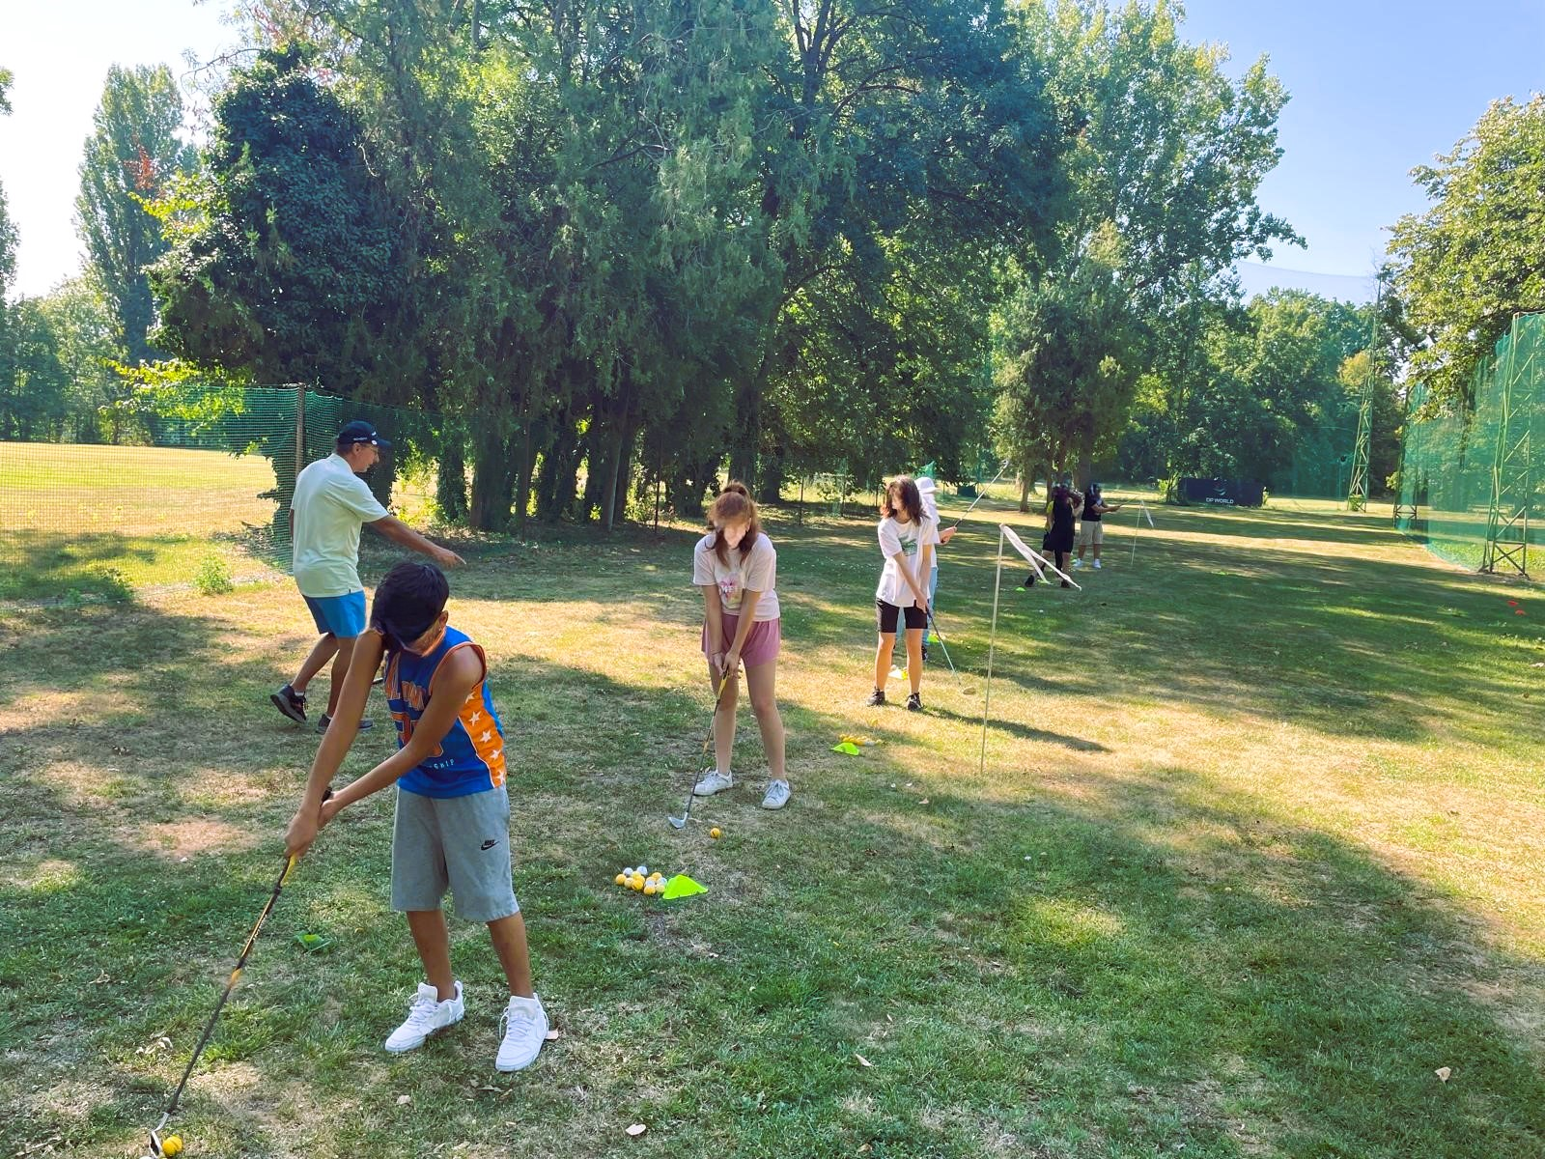
Project Activities: Engaging the Community
1
Workshops
Educational sessions on golf techniques, rules, and etiquette. Promote skill development and knowledge acquisition.
2
Training Sessions&Job-shadowing
Hands-on coaching and practice opportunities with experienced instructors. Develop practical skills and build confidence on the course. Mobility in NDL and BG.
3
Community Events
Organize golf tournaments, social gatherings, and family-friendly activities. Celebrate achievements and foster a sense of belonging.

Slide 6
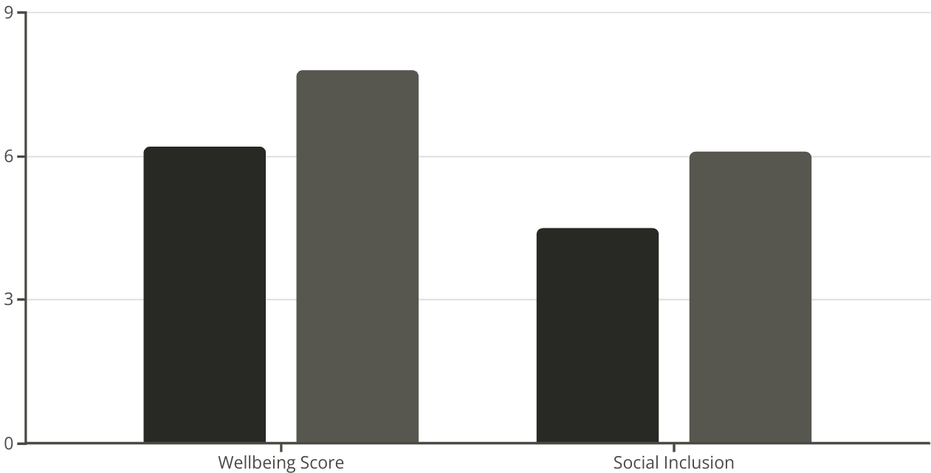
Measuring the Positive Effects by Check-points every 3 months.
Baseline
Post-Project
Assess the impact of the project. Collect data on participants' wellbeing, social inclusion, and golf skills. Use surveys, interviews, and performance metrics. See the above example.

Slide 7
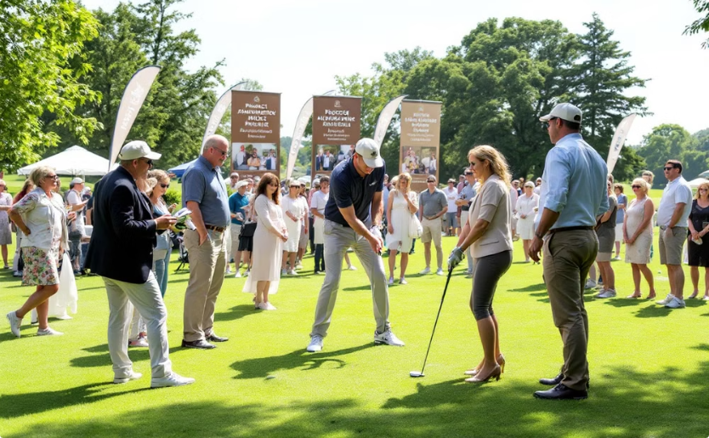
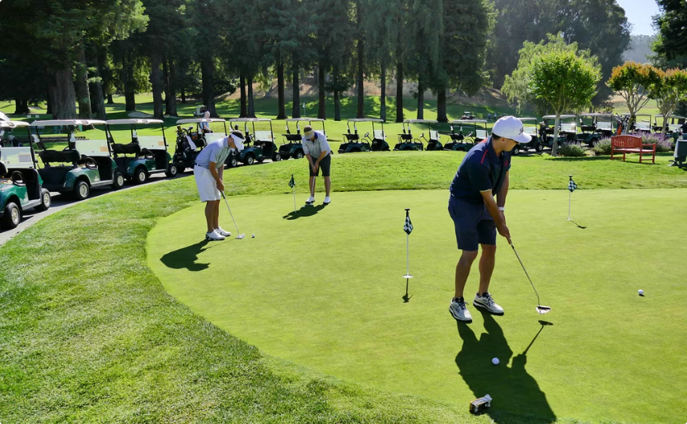
Celebrating Success: Transformations and Impact
Community Impact
Kit for Trainers, practitioners, and public
Demonstrate the positive effects on the broader community. Showcase increased social cohesion, participation in sports, and overall wellbeing.
A unique and innovative OER best practice kit in Romania that promotes the benefits of golf for physical and mental health

Slide 8


Future Directions: Expanding the Reach
Sustainability
Establish partnerships with local organizations, golf courses, golf clubs for Erasmus+ partnerships in Sport, and sponsors. Secure long-term funding and resources to sustain the project's impact.
Scaling the Program
Replicate the project model in other communities and regions. Adapt the program to meet the specific needs and contexts of different populations.

