Slide 1






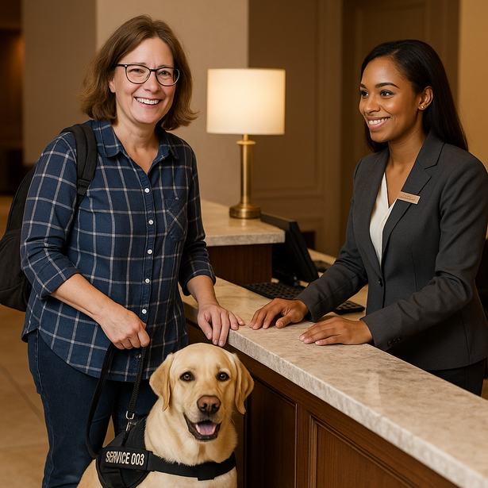


Thynk Unlimited
Welcoming All Guests
Disability Awareness and Service Excellence
Presented By:
Julie Taylor Soltes
www.jts-hrconsulting.com

Slide 2





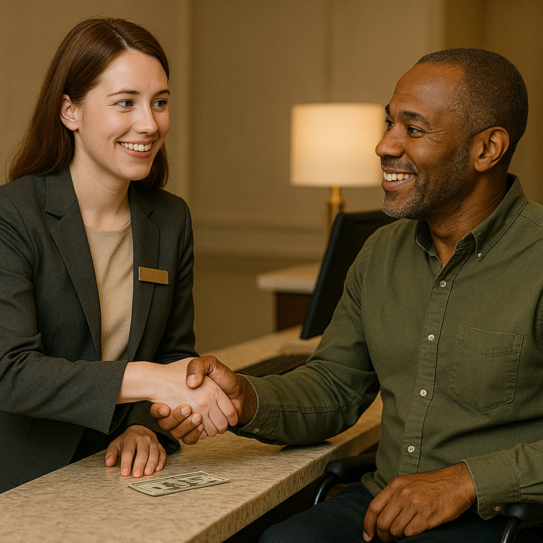


Why This Training Matters
It’s The Law: ADA Title III requires equal access for all guests.
It’s Good For Business: Guests with disabilities represent a loyal and growing market.
It’s Hospitality!
True service excellence wecomes everyone.

Slide 3

Understanding Disabilities
Not All Disabilities Are Visible - Avoid Assumptions
Examples of Visible Disabilities
Invisible Disabilities
  Wheelchair
  Crutches, canes or walkers
  Prosthetic limbs
  Service animal
  Impaired movement
  Down’s Syndrome
  Other
  Hearing impairment
  Vision impairment
  Autism
  PTSD
  Diabetes
  Seizure Disorder
  Other

Slide 4
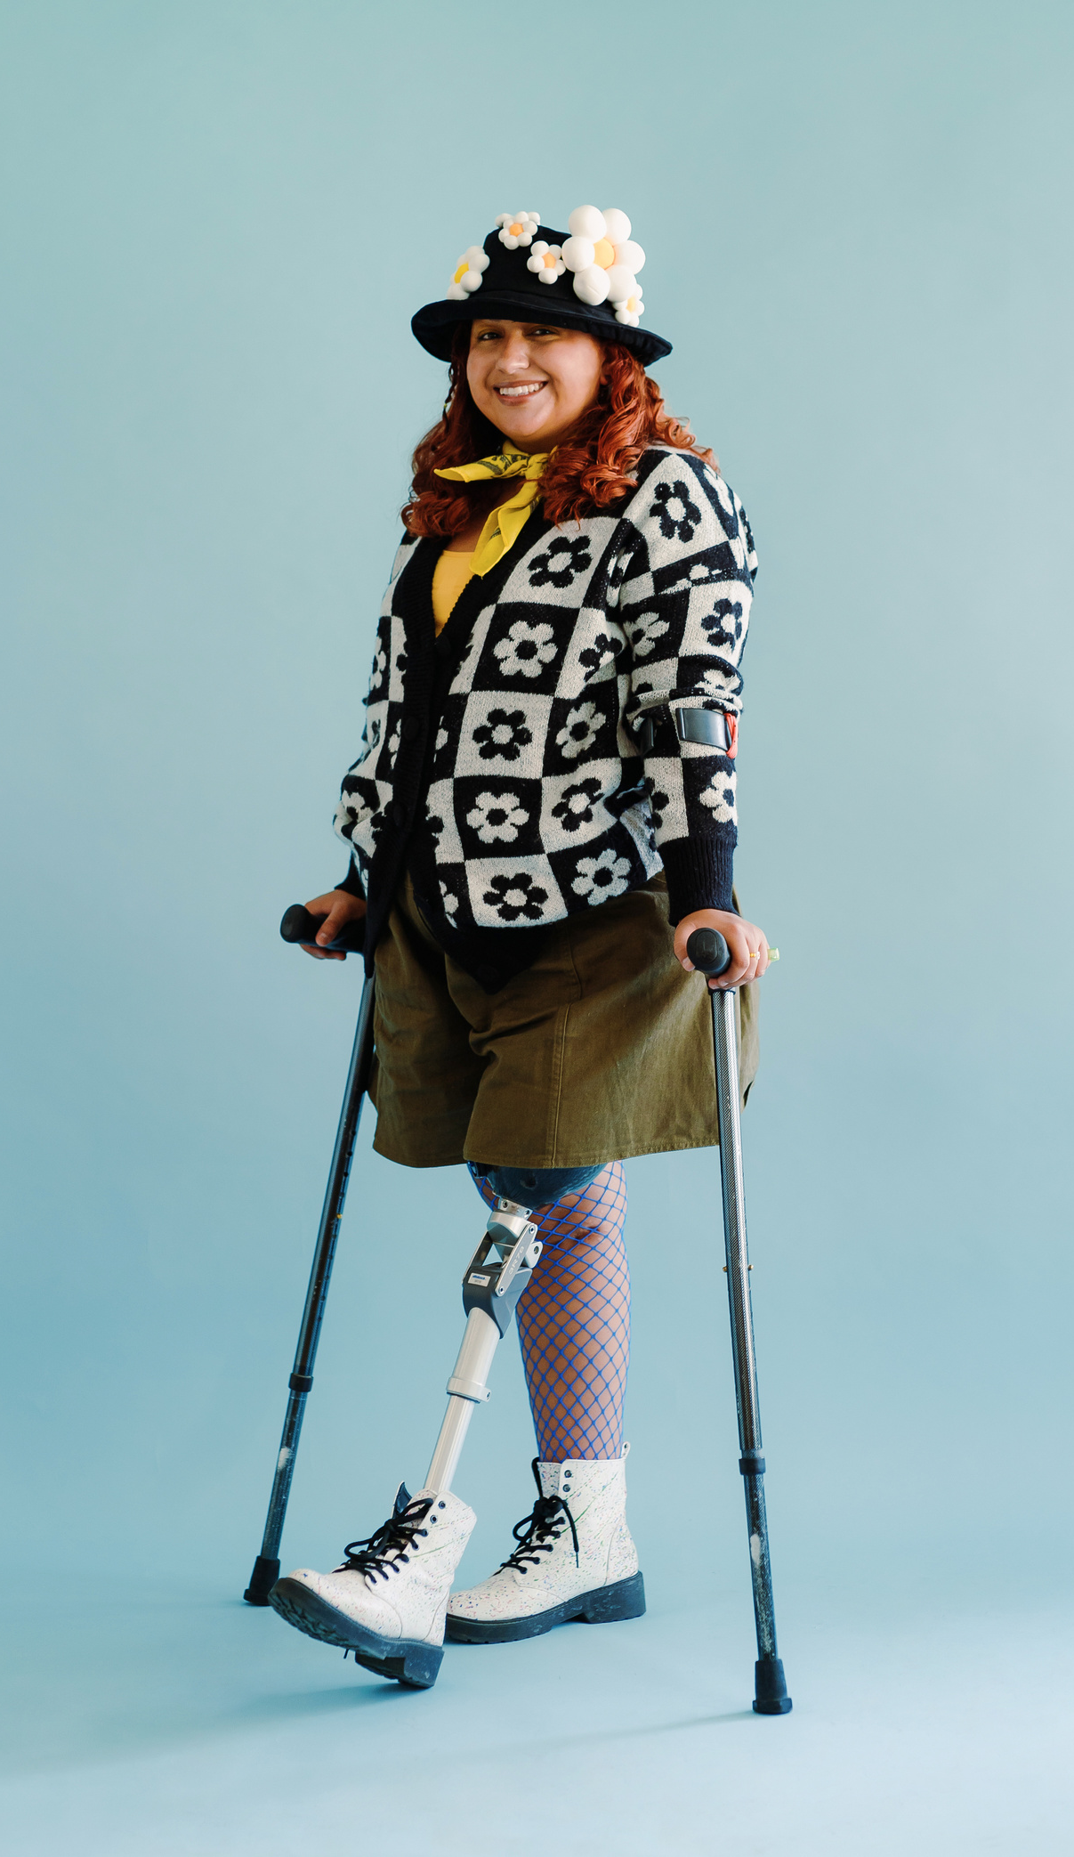


Empathy Builds Trust
Use person-first language
By prioritizing empathy, you create meaningful connections that build trust and reflect the true spirit of hospitality. Empathetic communication is the foundation of exceptional guest service. When interacting with guests who have disabilities, it’s important to approach each conversation with genuine respect and an open mind.
Ask before helping
Speak directly to the guest, not their companion
Be patient

Slide 5




Contact Me For Full Presentation
Thank you for viewing the demo.
www.jts-hrconsulting.com
julie.soltes@jtshrconsulting.com

