Slide 1


THE WEEKLY MONDAY BOOST 3 WAYS TO IGNITE THOSE MONDAY BLUES
By Owain Walsh

Slide 2
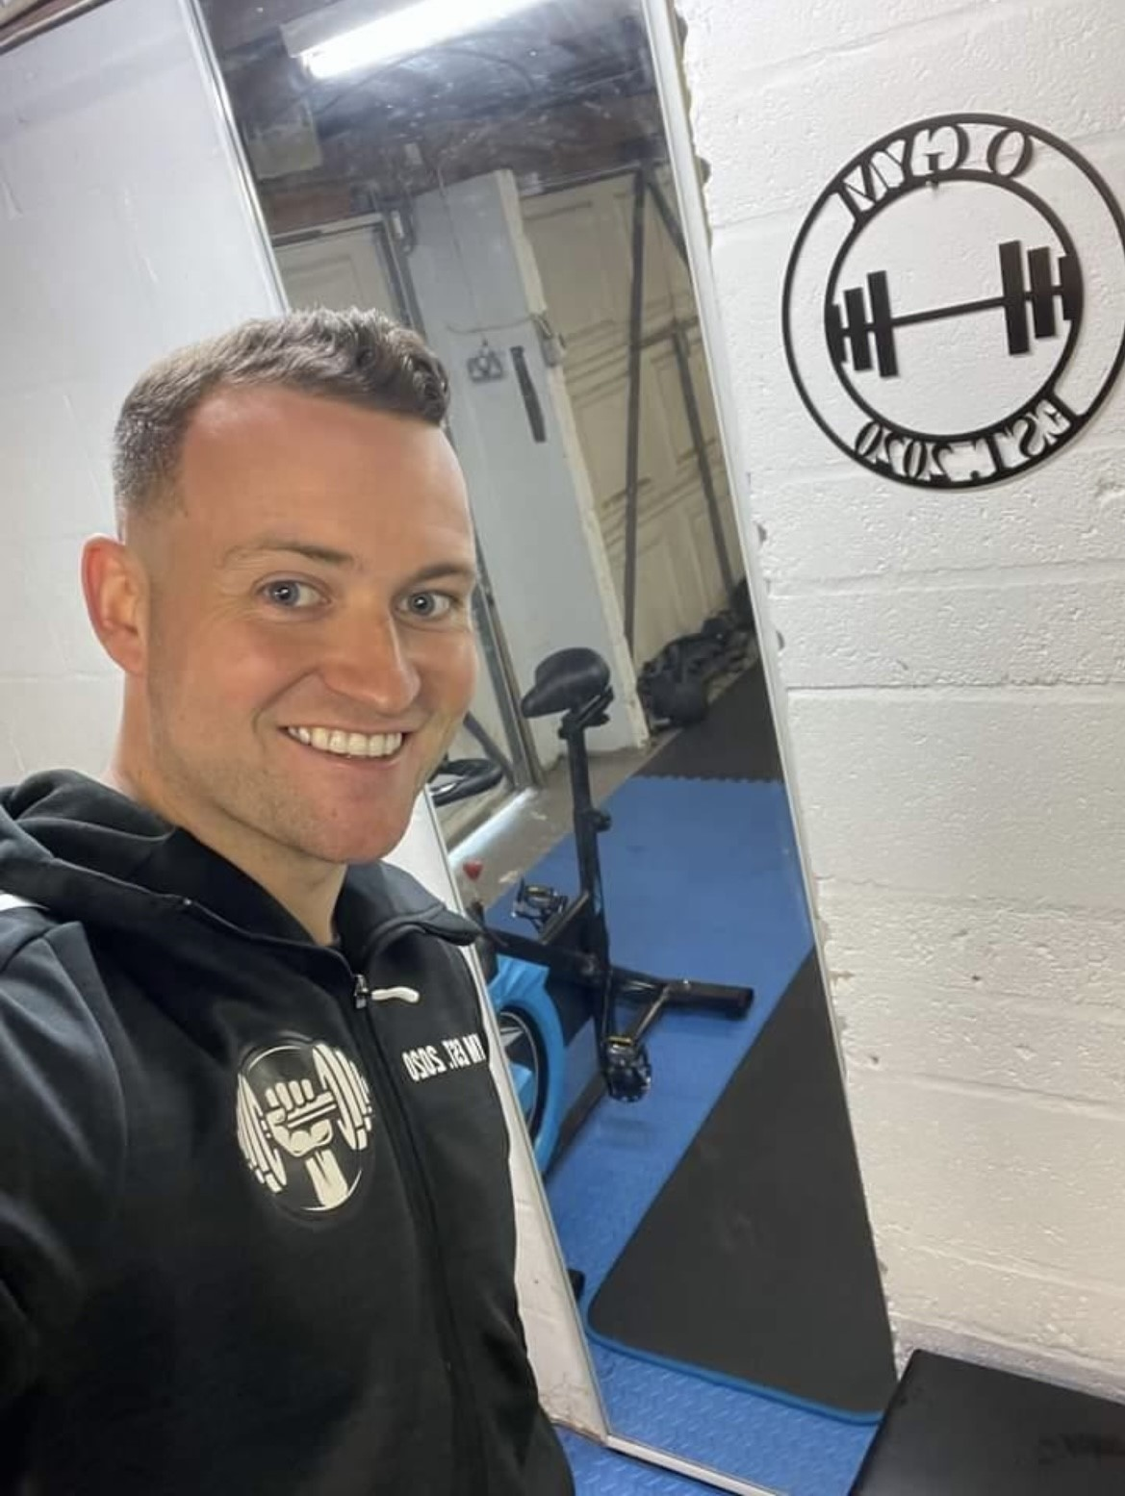
happy Monday
Many people dread the start of the week, it could be going back to work, or getting back into the gym. There are a few reasons for this…
Social media, comparing to other people or simply just a poor image of oneself and the steps you have taken (big or small) in improving your quality of life can all contribute to not appreciating just how far you have come.
So again, here are 3 things to help start your week the right way with a positive mindset!

Slide 3

There are only 2 more Mondays until Christmas
The countdown continues, there are now only 2 more Mondays until Christmas!
We are also over a week into December with plenty of party's, catch ups, good food, festive films and general happiness to experience at this time of year.
This is a great time for people who struggle during the colder and darker months to feel some relief and positivity by spending more time with friends and family, and generally interact with more people.
Christmas and New Year for most people increase social connections, and this very important for our overall well-being.
When we interact with friends, family, our partner or are introduced to new people our brain releases happy chemicals, these social connections keep us healthy, so we should connect regularly and not just during the festive period for long term health.

Slide 4
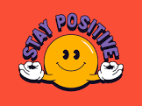
Keep up the social connections after Christmas
As mentioned, its no coincidence people feel happy and mentally healthy during the festive period.
It’s a time of year where we speak and interact with more people than any other time of the year.
That may mean catching up with certain friends and family members who you wouldn't usually see and speak to.
This feels great because it releases those happy chemicals, decreases loneliness and allows us to share laughter and valued time with the people who's company we enjoy.
These social connections are without a doubt extremely important, studies have even linked them to improved health and reduced risk of early death.
Christmas and New Year amplify social connections, we see and speak to so many people so its no wonder we feel great.
What tends to happen in January though, is that we lose touch and stop seeing and speaking to the people around us as much, and as a result our mood shifts.
In January, keep up the social connections to stay happy and healthy all year round!

Slide 5
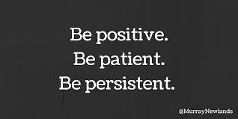
The 3 p’s
As always be positive, patient & persistent.
If its trying a new diet, a new exercise plan, a new job, new business, new project, moving to a new location or just trying something outside of your comfort zone then always remember the 3 P’s.
If something does’t work, don’t get frustrated or upset . That’s just feedback that something needs altering, which isn't a bad thing. (you learn from this)
It can take a while to adjust to something new, but if you attack it with a positive mindset, be patient with the results and be persistent with your efforts then you will get your reward.
Use Monday as a new opportunity to improve your life.
This way, you will never dread it again! You will actually look forward to it.

Slide 6
Your weekly exercise fact
The World Health Organisation released a report on Social Connections.
Its global report revealed that 1 in 6 people worldwide are affected by loneliness, with significant impacts on health and well-being.
Loneliness is linked to an estimated 100 deaths every hour, more than 871,000 deaths annually. Strong social connections can lead to better health and a longer life.
This outlines the importance of staying in touch with friends and family members past the festive time of year.

Slide 7
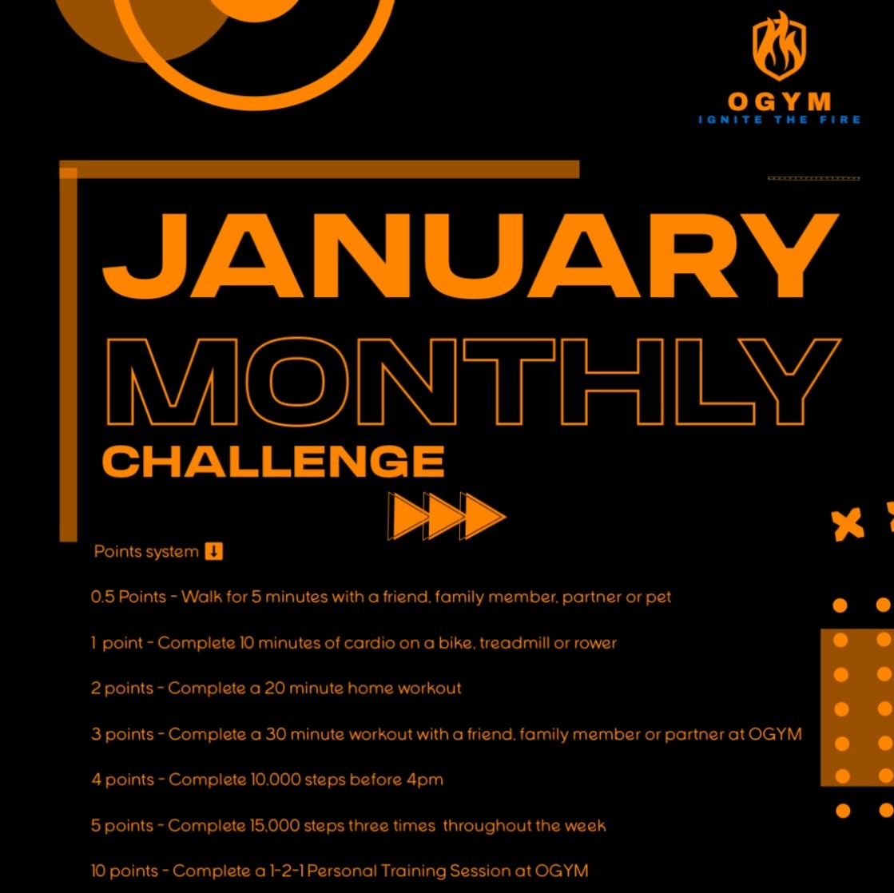
The January monthly challenge
There are only 24 days until the start of the January Monthly Challenge.
A chance to get healthier, take part in something positive and win big if you perform well..

Slide 8
I hope this boosted your Monday! Any Questions feel free to drop me a message.

