Slide 1


The ogym monthly newsletter BY OWAIN WASH
March 2026

Slide 2
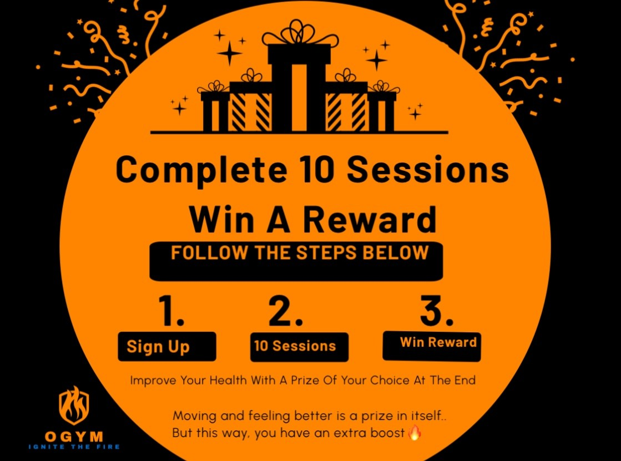
THE BLOCK Challenge
Do you like winning prizes? Of course you do!
Sign up to any block 10, 20 or 30 and complete the entire block with ZERO cancellations.
If you can complete this challenge, you will win ANY prize of your choice worth up to £60.

Slide 3

WHATS OUR NEXT PLANNED ADDITION?
At OGYM our main goal is to make exercise as enjoyable as possible, to do that we need to make sure we are upgrading our space and improving the experience.
We have something exciting planned for this year.. it will be our best addition yet!

Slide 4

Client spotlights!
Client Spotlight this month is on Jen Titcombe.
Jen has completed 5 out of 10 weekly challenges, these are sent to Jen every week to give her some extra activity, outside of our Thursday sessions together.
Jen is doing incredibly well to keep up her weekly exercise, and also shows up to each session with a great attitude to work hard for a full hour on Thursdays.
Jen has also been very sensible following guidance to help recover her ankle, due to following advice, its already feeling a lot better from a combination of home exercises, exercises at OGYM, and balanced walking.

Slide 5
Welcome to the monthly newsletter
The OGYM Monthly Newsletter will be sent out on the 10th of every month.
The purpose of the newsletter is to give you tips around everything relating to fitness in a digestible format.
There will be a different monthly focus on each edition to ensure the newsletter hits a variety of topics so that it can help people in different ways and support different goals:
Weight Loss
Muscle Gain
Nutritional Knowledge
Staying Consistent & General Support/Wellbeing
This months topic….

Slide 6

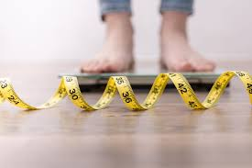
Weight loss (Simplified))
Weight loss throughout the years seems to be getting increasingly overcomplicated!
All this talk about too much sugar, foods spiking your blood sugar, your body type, and these crazy fat burning workouts on social media can make weight loss seem quite scary.
This can make getting in shape seem really complicated, when it really isn’t.
In truth, it’s the boring things we need to address. Like eating a healthier diet, getting more steps and exercise in, controlling stress and making sure your getting in a decent nights sleep.
In terms of exercise, you don’t need to use all the fancy equipment and crazy workout routines, you need to learn the basic moves as a beginner and slowly progress in these week by week, or slowly increase the amount and duration of whatever exercise you choose to do weekly.
This will help in your daily movement, keeping you strong and fit for your day to day life and also help with weight loss.
When you do these things, everything else will fall into place and you’ll become a much healthier and happier person.
Let’s take a closer look at all of these basic things to get right from the start..

Slide 7
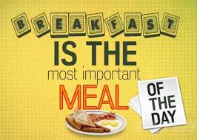

Eating a healthier diet
I always recommend the 80/20 approach, eating healthy, whole, nutrient dense foods 80% of the time and then make allowances for what you love 20% of the time.
Lean meats, Fish, Wholemeal, Wholegrain, Fruit & Veg should make up 80% of your diet.
This does not mean you need to eat chicken and rice three times a day seven days a week, it just means that when you do have a meal, you should have some protein and veg or fruit to go with it.
A great example of this is the three plate, two snack rule.
Three meals throughout the day that all fit on a plate, the plate should contain some protein and also some fruit and veg.
Then two snacks in between these three meals throughout the day, the only rule is the snacks have to fit in your hand.
Examples of these could be a banana, apple. nuts, yoghurt or even a chocolate bar or biscuit to satisfy your cravings.
The goal from the three plate and two snack rule is smarter choices and portion control…without starving yourself!

Slide 8

Breaking this down further
The healthy foods we eat contain protein, carbohydrates, fats and fiber.
Protein will help keep you full and build muscle, Carbohydrates help fuel your performance and give you the energy to exercise regularly, and fats also help keep you full and give your food flavor (when you combine healthy fats, protein & fiber in a meal this is really effective in helping to keep you full)
Don’t miss out on Fiber - Most adults are only consuming 20g of fiber a day. Try to get up to 30g. Fiber keeps our heart healthy, protects our digestive system and can help prevent bowel cancer. It can also help in keeping us full to assist those trying to lose weight!
Plenty of Water - Being well hydrated helps prevent cramps and cravings, it also helps in carrying oxygen and nutrients to our muscles to fuel our performance when exercising!
Sometimes its challenging to address every single one of these when trying to clean up your diet, a good recommendation to make it more manageable is to take it one step at a time.
This means adding more protein and drinking more water in week one, adding carbohydrates to fuel your exercise the week after, week three adding more fiber in your diet, and week four adding healthy fats to your diet.
After a month, you should have all these implemented as part of a healthy diet.
A good and balanced combination of these will help with weight loss goals.

Slide 9


mORE steps & exercise
Throughout the years you have probably head countless times that you need to hit 10,000 Steps every single day to lose weight.. not quite true.
Taking a better look at your diet first is more important, but a high step count helps!
To give you an idea on the ranges for weight loss:
0 - 3,000 steps a day is generally quite low.
3,000 - 5,000 steps a day is a step up from this! (much better range to hit daily)
5,000 - 10,000 is a fantastic range for fat loss.
10,000 to 15,000 is an extremely impressive amount (if hitting daily and not losing weight its likely your diet)
Getting straight up to 10,000 a day can be hard, try starting on at least 3,000, set a challenge of adding 100 steps every week and build up to higher over time.
If your doing another form of exercise at least 2 times a week e.g. cardio, HIIT, weightlifting or sport then this will be extremely helpful in helping to boost your weight loss goals!

Slide 10

That being said..don't do too much!
Now training hard is great and will be worth the long term results.
However taking an hour to relax every day could help your recovery in the gym as well as your overall mental health.
There’s different types of fatigue that we accumulate throughout the day.
One is physiological fatigue during exercise, your bones micro fracture when you lift heavy, muscles get damaged and your tendons and connective tissues take a beating.
A perfect example is after a tough leg day at the gym where you can barely walk down the stairs.
However there’s another fatigue which can stack on top of this which is psychological fatigue.
Psychological fatigue can come from other aspects of your day that don’t involve exercise or being on your feet all day.
It can be the stress from work, or other stressors around your personal life.
This means we need to keep our stress in check, the next slide will explain why this is important for weight loss.

Slide 11
control your stress
Prolonged stress can cause your body to hold on to more water weight, it can also cause your muscles to inflame causing discomfort.
Stress eating also comes into play, if your stressed and comfort eating with foods high in salt and carbs then this will make your body retain onto more water due to higher sodium levels in the body.
Remember if you ever stress eat and get frustrated that the scale is showing you weigh a few pounds more, this is a water retention and NOT a body fat increase.
Just get back to your regular diet the next day and watch your weight return back to normal.
If however you are consistently stress eating then this can definitely cause to you gain actual body fat over time.
To control stress, make sure to take at least an hour or more for yourself every day.
Read a book, go for a walk, play video games, watch a series/film, anything that chills you out.
Follow the session-rest-session approach to allow your body to recover.

Slide 12

Getting sleep right
Sleep is so important for our fitness, general health & weight loss goals.
When we don’t get enough sleep, its been scientifically proven to mess up our hunger hormones. Potentially causing us to consume too many calories over the next day or so.
The goal is to schedule your day to fit in 7-8 hours of sleep along with time for physical activity, to balance the effects of both. Getting the 8-hour recommendation (or more) into your routine may help you feel more energized, work out harder and generally move more day to day.
If you can combine all these mentioned throughout, improving your diet, getting more steps and exercise in, controlling your stress and improving your sleep then weight loss will come naturally to you.
If one of these is out of control then it may be harder, not impossible but harder.
Take control of these in your life and you will get the results you deserve, you will feel better and move better!

Slide 13
Get a weekly/monthly average for more accuracy
Getting an average weight for the week/month is far more accurate, as our weight fluctuates on a daily basis.
When we understand that our weight fluctuates on a daily basis, daily weighing actually becomes a better idea.
It allows us to get a average weight for the week/month to give us the most accurate reading of our current weight. Rather than stepping on the scales one day of the week where weight may have fluctuated, this can then make you frustrated as you may be under the impression that you haven't made any progress.
For males a great practice is to weigh every day of the week, add all of these weights up at the end of the week and divide by 7 for the average. You can then compare these week to week for decreases. For females a better idea can be to get a monthly average, taking into account fluctuations during the menstrual cycle.
Our weight can fluctuate on a day to day basis due to stress, a higher intake of carbohydrates or salt, or even a lack of sleep.

