Slide 1
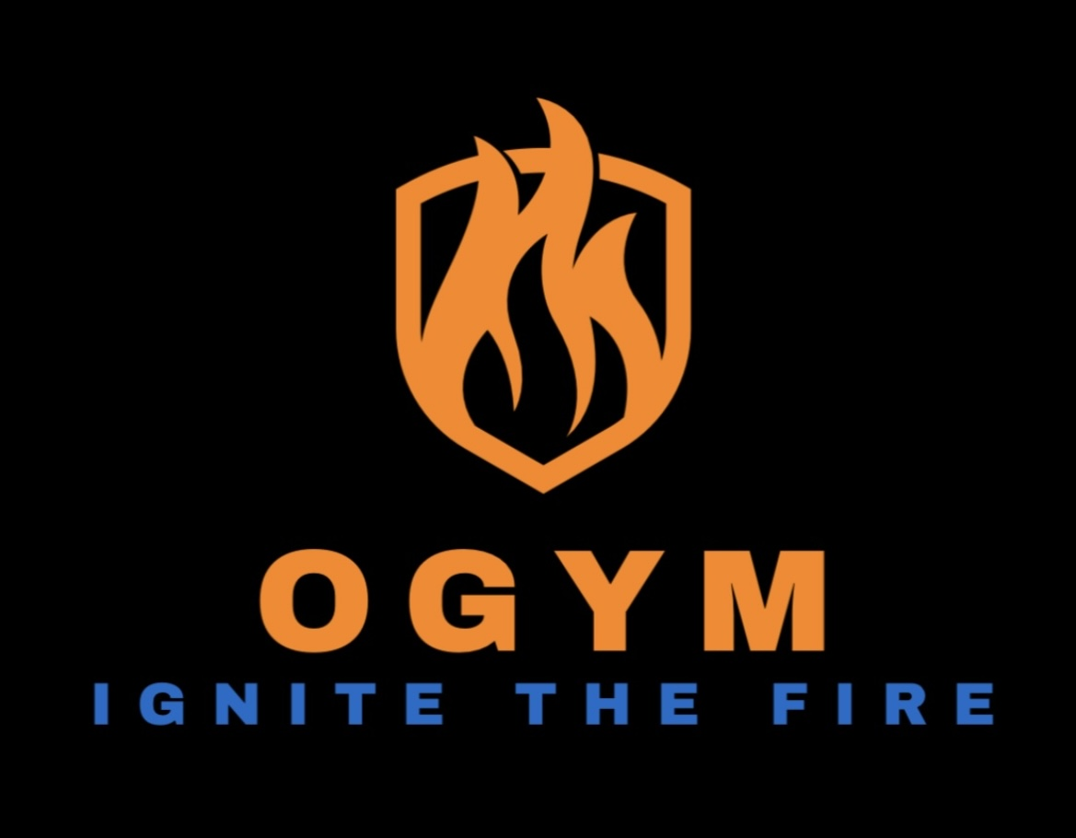
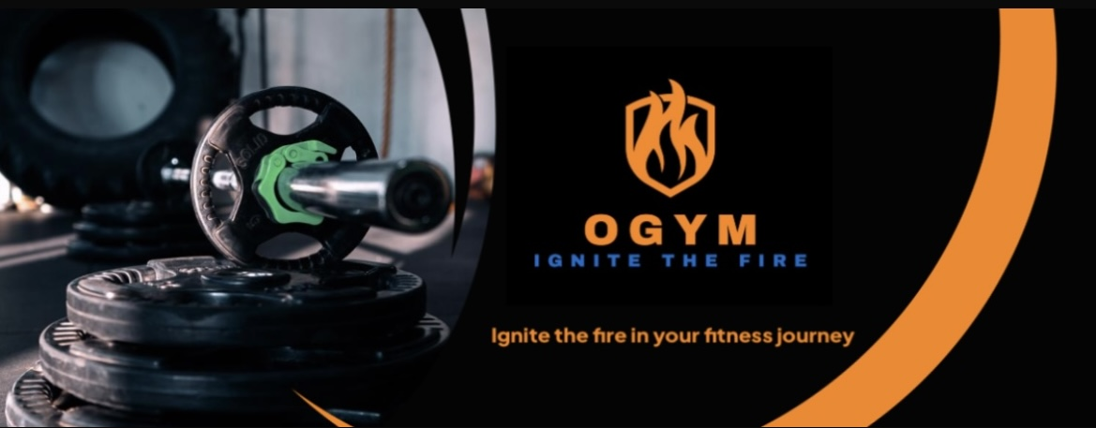
The ogym monthly newsletter BY OWAIN WASH
April 2026

Slide 2
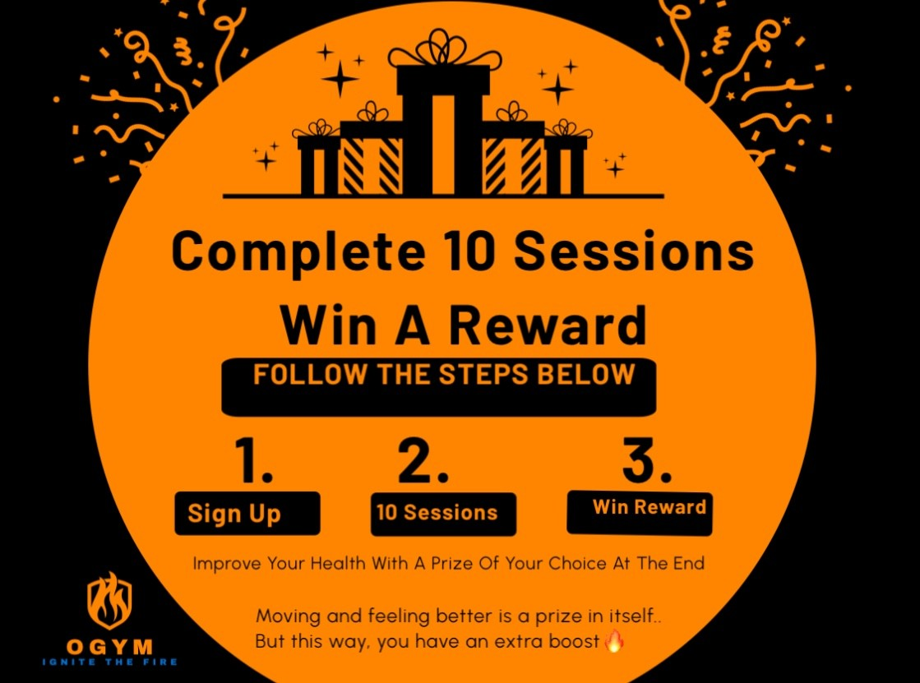
THE BLOCK Challenge
Do you like winning prizes? Of course you do!
Sign up to any block 10, 20 or 30 and complete the entire block with ZERO cancellations.
If you can complete this challenge, you will win ANY prize of your choice worth up to £60.

Slide 3

Client spotlights!
Client Spotlight this month is on Sarah Powell.
Sarah has made an absolutely incredible start to her journey of becoming healthier.
For the last 4 weeks, she has been consistently training twice a week on a Tuesday & Friday.
Sarah is achieving things she always doubted herself on, once we introduced the exercises at a pace she was comfortable with, we were then able to progress these in intensity every session going forward.
Sarah is doing full body sessions twice week, and I couldn't be prouder of her.

Slide 4
Welcome to the monthly newsletter
The OGYM Monthly Newsletter will be sent out on the 10th of every month.
The purpose of the newsletter is to give you tips around everything relating to fitness in a digestible format.
There will be a different monthly focus on each edition to ensure the newsletter hits a variety of topics so that it can help people in different ways and support different goals:
Weight Loss
Muscle Gain
Nutritional Knowledge
Staying Consistent & General Support/Wellbeing
This months topic….

Slide 5
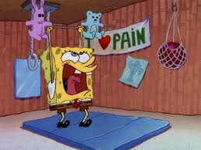
Gaining muscle
Gaining muscle, how important is it?
Often times gaining muscle can be viewed as an ego game, people seem to get this impression that people who like to grow muscle just want to look at themselves in the mirror all the time!
Now I wont lie, when I'm in the privacy of my own room, I may hit a bicep flex to see if they have grown more (you caught me)
But gaining muscle is a lot more than the look it gives your body, and it can actually make life changing differences to your future, confidence and overall health.
Lets take a look at the benefits of actually having muscle.

Slide 6
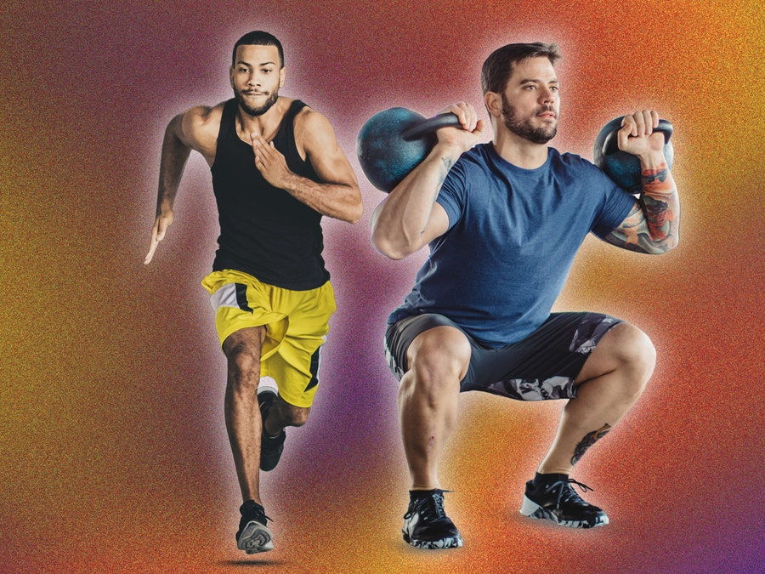
Better Joint, connective tissue & Bone Health
A H
When you strength train, your not just training to grow muscle.
Your also training for the healthy future of your joints, tendons, ligaments and bones.
Preventing bone diseases like osteoporosis is really important to avoid fractures from weak bones. Growing muscle helps you decrease that risk.
Muscles grow faster than tendons, tendons faster than ligaments, and ligaments faster than bone.
While the first thing you may notice as a result of growing muscle is how much better it makes your body look, long term you will also notice how much better you move.
Things like standing up, sitting down, going up the stairs, walking up the drive, carrying the shopping, your walking pace and other day to day activities will feel so much easier.
So you can see the benefit of growing muscle goes beyond looking better, its moving better too!

Slide 7
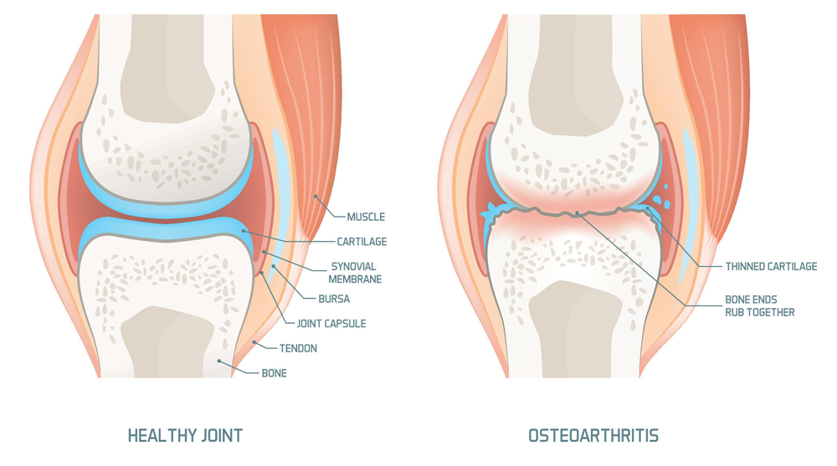
Improved joint cartilage (Less Pain)
Ever wonder why your joints hurt?
You have something in your joints called cartilage, its there to act as a cushion and shock absorber for your everyday movements. Think of it as a protective layer in your joints.
It covers the end of bones where they meet, preventing them from rubbing against each other.
To keep healthy cartilage, you need to move your joints regularly as well as challenge them sufficiently under load (weight training)
Strength training and muscle building improves joint cartilage, instead of breaking it down. Unlike cardio, strength training is an effective tool for helping muscles groups to become stronger so you move better, and have healthy cartilage.
A reduced amount of cartilage due to a lack of movement and poor joint health can reduce this protective cushion, causing pain, inflammation and stiff joints.

Slide 8
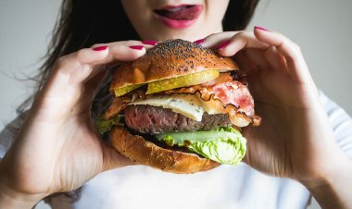
We can eat more and get away with it
When your physically active, you burn more calories on a daily basis, that means you can enjoy more food and still maintain your current weight, it even makes losing weight easier, compared to someone who does little to no exercise.
The building muscle aspect of it plays a huge role in this too, muscle is more metabolically active than fat, meaning that its better to have muscle on your body compared to more fat as this helps your body burn more calories daily.
Growing muscle also increases your muscle glycogen stores (your muscle can store up to 400-500g of glycogen) This is great as it means glucose in the blood will go to your muscles and get converted to glycogen for when you need energy, rather than the glucose getting sent to the fat cells.
When the muscle & liver cant take in anymore glucose, the only place glucose circulating in the blood can go is the fat cells. But when we weight train we use that glycogen in the muscle for energy, freeing up space for more to come in. Once we have finished a weight training session and the muscle gets bigger, it means our little gas tank for glycogen storage has also got bigger.

Slide 9
Improved mobility, balance & protection
Stronger muscles contribute to better balance and coordination, reducing the risk of falls and fractures, as well as improving overall mobility for daily life.
Muscle tissue also acts as a natural armor, protecting bones and organs from damage during falls or impacts.
So with all this in mind, you can see that muscle building is much more than how you look.
Muscle building is an essential part of staying strong and fit for life.

