Slide 1







Ova Boost
OVA BALANCE
EMPOWERING WOMEN WITH PCOS
Presented By :
Pristine Health
www.pristinehealth.com
123-456-7890

Slide 2


Ova Boost
www.reallygreatsite.com
123-456-7890
PCOS IN MIDDLE AGED WOMEN
▪️Polycystic Ovary Syndrome (PCOS) affects up to 1 in 10 women globally
▪️Symptoms worsen with age, including insulin resistance, weight gain, and hormonal imbalance
▪️Middle aged women are underserved in the PCOS supplement market
▪️There is a critical need for targeted, effective, and safe solutions.

Slide 3





Ova Boost
www.ovabalance.co.za
123-456-7890
OUR SOLUTION : OVA BALANCE SUPPLEMENT
  Introducing Ova balance : a science-backed supplement designed to alleviate PCOS symptoms in women aged 35-55
  Key Ingredients
  Inositol: Improves insulin sensitivity
  Berberine: Supports metabolic health
  Omega 3s: Reduces inflammation
  Vitamin D & Magnesium: Hormonal balance

Slide 4



www.ovabalance.co.za
123-456-7890
MARKET OPPORTUNITY
•PCOS affects over 116 million women globally (WHO)
•Supplement market for women's health projected to reach $75B by 2028.
•Target demographic: 35-55 year old women, health conscious, underserved by current products.

Slide 5

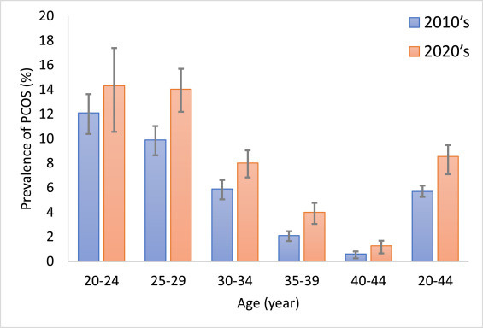
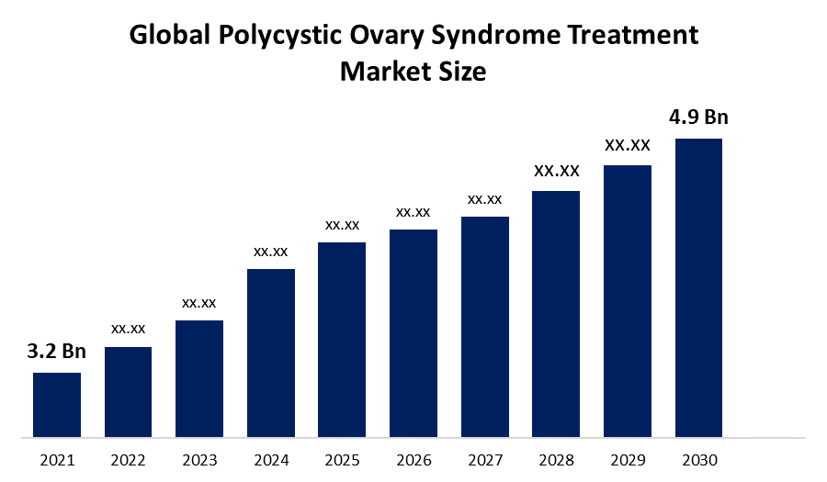
www.ovabalance.co.za
123-456-7890
PCOS PREVALENCE OVER TIME
Reference : science direct.com

Slide 6


www.ovabalance.co.za
123-456-7890
COMPETITIVE LANDSCAPE
  Current PCOS supplements in the market
  Generic multivitamins sometimes used as an alternative
  Fertility focused products masking the solution to the fundamental problems
  Lack of age specific solutions
OVA BALANCE ADVANTAGE
  OvaBalance Advantage:
  Tailored for middle-aged women
  Comprehensive symptom coverage
  Backed by clinical research

Slide 7

www.ovabalance.co.za
123-456-7890
BUSINESS MODEL
Pricing: $39.99/month subscription
Distribution: DTC via e-commerce, Amazon, health retailers
Revenue Streams:
Monthly subscriptions
One time purchases
Affiliate partnerships

Slide 8

www.ovabalance.co.za
123-456-7890
MARKET STRATEGY
Marketing Channels:
• Influencer campaigns
• SEO & content marketing
• Webinars with health experts
•Partnerships:
• Gynecologists & endocrinologists
• Women's health clinics

Slide 9

www.ovabalance.co.za
123-456-7890
FINANCIAL PROJECTIONS
Year 1: $250K
•Year 2: $1.2M
•Year 3: $3.5M
•Year 4: $6.8M
•Year 5: $10M
•Break even: Year 2, Q3
•Gross Margin: 65%

Slide 10

www.ovabalance.co.za
123-456-7890
IMPACT & SCALABILITY
Health Outcomes:
• Improved metabolic and hormonal health
• Enhanced quality of life
Social Benefits:
•Empowering underserved demographic
•Reducing healthcare burden
Scalability:
  Global Expansion potential

Slide 11
www.ovabalance.co.za
123-456-7890
CASE STUDIES: REAL WOMEN, REAL RESULTS
Case Study 1:
'Angela', 42
- Struggled with insulin resistance and fatigue
- After 3 months on OvaBalance: improved fasting glucose, more energy
Case Study 2:
'Linda', 50
- Experienced chronic inflammation and weight gain
- After 4 months: reduced CRP levels, lost 8 lbs, improved mood

Slide 12


www.ovabalance.co.za
123-456-7890
Join us in transforming PCOS care for middle aged women
Fund Requirements: Seeking $300K seed funding to launch and scale
Goal : To empower women with science backed wellness
Contact:
invest@ovabalance.com

Slide 13
THANK YOU
Presented By :
Pristine Health
www.pristinehealth.com
123-456-7890

