Slide 1
علم التشريح للتمريض
(0201161)
كلية الصيدلة / جامعة الزيتونة االردنية
Al-Zaytoonah University of Jordan
د. محمد الكفاوين
Dr-Mohammad Al-Kafaween

Slide 2
The Human Body: An Orientation
Anatomy and Physiology are closely related.
Anatomy:
Tomy- “to cut”
Ana- “apart”

Slide 3
Levels of Organization
Atoms → molecules -→ organelles → cells → tissues → organs → organ systems → organism
Groups of cells that perform a function are tissues
Groups of tissues that perform a function are organs
Groups of organs that perform a function are organ systems.

Slide 4
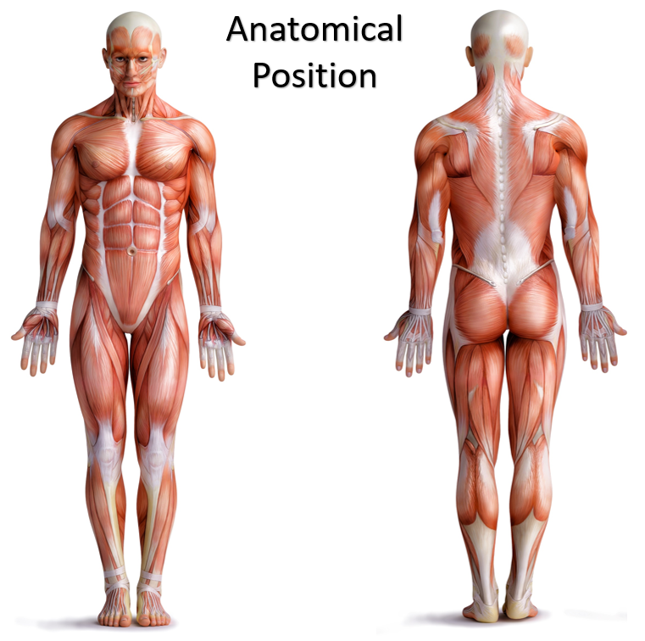
The Language of Anatomy
Special terminology is used to prevent misunderstanding
Anatomical Position:
Body upright
Feet flat & parallel
Arms at sides
Palms forward
Thumbs point away from the body

Slide 5
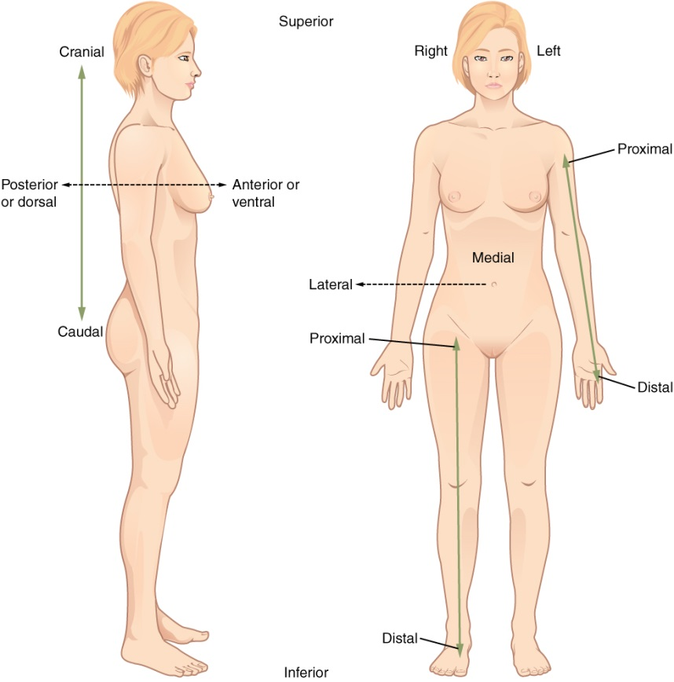
Orientation and Directional Terms
Directional Terms are used to explain where a body part is in relation to another.
The terms “right” and “left” refer to those sides of the person or the cadaver being viewed (not those of the observer).

Slide 6
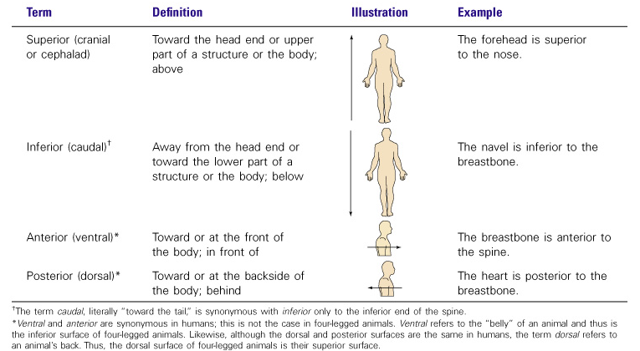
Orientation and Directional Terms

Slide 7
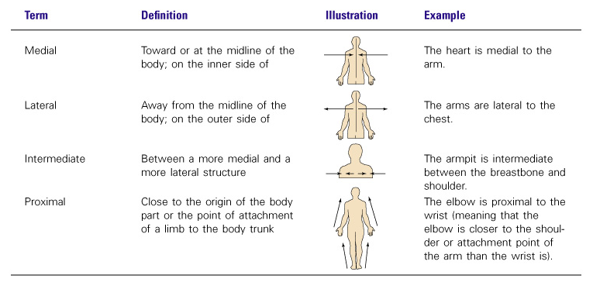
Orientation and Directional Terms

Slide 8
Orientation and Directional Terms

Slide 9
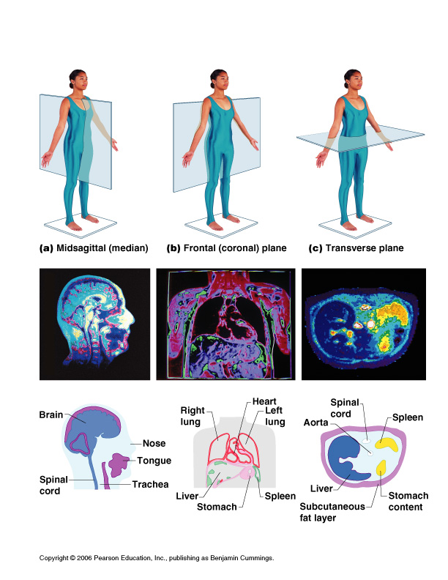
Body Planes
3 major planes of section (each results in a different view):
Sagittal- right & left halves (median/midsagittal)
Frontal – anterior & posterior (coronal)
Transverse- superior & inferior (horizontal/cross section)
17

Slide 10
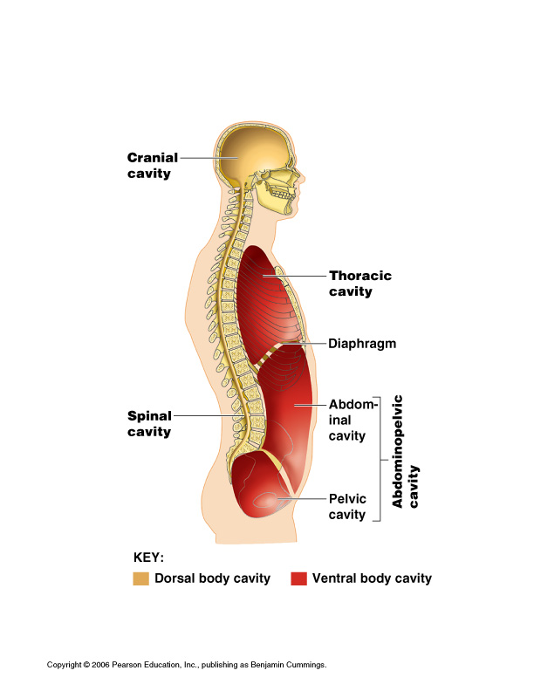
Major body cavities
Body cavities:
are closed to the outside
Provide protection to
the organs contained
within them.

Slide 11
Major body cavities
Dorsal- on posterior
Cranial- brain
Spinal (vertebral) - spinal cord
Ventral- on anterior
Thoracic- lungs, heart, thymus, trachea, esophagus
Abdominal- viscera
Pelvic- internal reproductive organs, urinary bladder, rectum

Slide 12
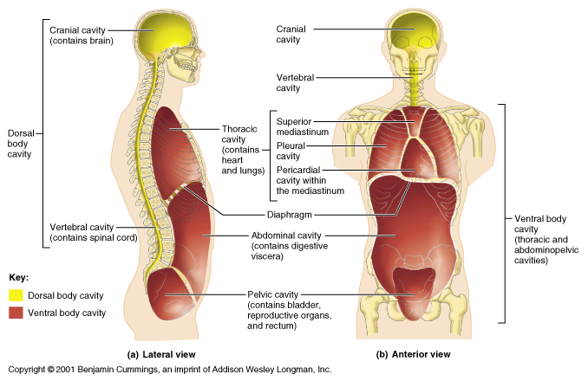
Major body cavities
Thoracic cavity is subdivided into:
Pleural cavities (lungs)
Mediastinum- a central region, separates the lungs; contains heart (pericardial cavity), thymus, trachea, esophagus (superior mediastinum).
Diaphragm muscle separates thoracic and abdominal cavities.

Slide 13
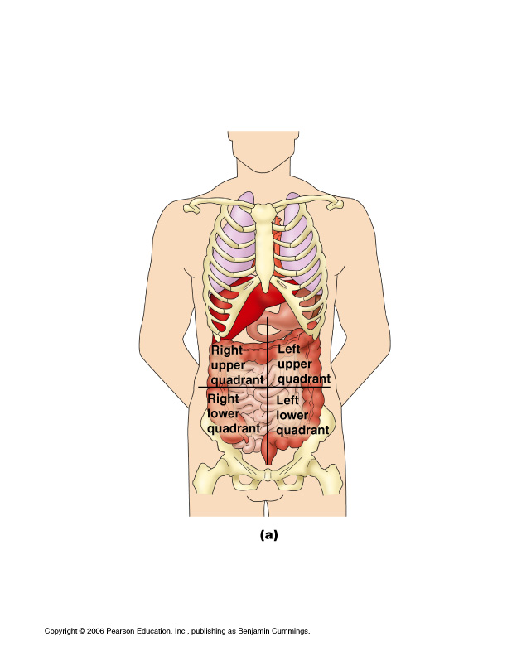
Abdominopelvic Quadrants
Notes:
Because the abdominopelvic cavity is quite large and contains many organs, it helps to divide it up into smaller areas for study. A scheme commonly
used by medical personnel divides the abdominopelvic cavity into four more or less equal regions called quadrants. The quadrants are then simply named according to their relative positions— that is, right upper quadrant (RUQ), right lower quadrant (RLQ), left upper quadrant (LUQ), and left lower quadrant (LLQ)

Slide 14
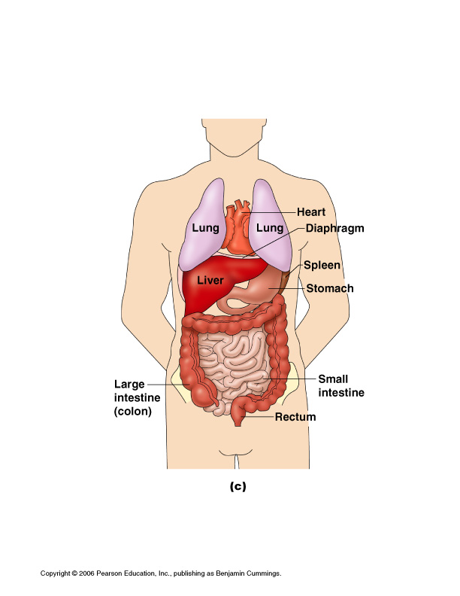
Abdominopelvic Regions / Major Organs
Notes:
Another system, used mainly by anatomists, divides the abdominopelvic cavity into nine separate regions by four planes. The umbilical region is the centermost region,
deep to and surrounding the umbilicus (navel). The epigastric (ep″ı˘-gas′trik) region is located superior to the umbilical region (epi = upon, above; gastric = stomach). The hypogastric (pubic) region is inferior to the umbilical region (hypo = below). The right and left iliac, or inguinal, regions are lateral to the hypogastric region (iliac = superior part of the hip bone). The right and left lumbar regions lie lateral to the umbilical region (lumbus = loin). The right and left hypochondriac (hi″pokon′dre-ak) regions flank the epigastric region and contain the lower ribs (chondro =cartilage).

Slide 15
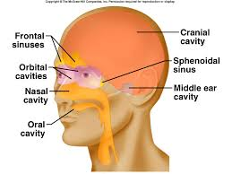
Minor body cavities
Nasal cavity
Orbital cavity
Oral cavity
Middle ear cavity
Notes:
In addition to the large closed body cavities, there are several smaller body cavities. Most of these are in the head and open to the body exterior. (With
the exception of the middle ear cavities, the body regions that house these cavities are all shown in Figure 1.5.).
Oral and digestive cavities. The oral cavity, commonly called the mouth, contains the teeth and tongue. This cavity is part of and continuous with the cavity of the digestive organs, which opens to the exterior at the anus. Nasal cavity. Located within and posterior to the nose, the nasal cavity is part of the respiratory system passageways.
Orbital cavities. The orbital cavities (orbits) in the skull house the eyes and present them in an anterior position.
Middle ear cavities. The middle ear cavities carved into the skull lie just medial to the eardrums. These cavities contain tiny bones that transmit sound vibrations to the hearing receptors in the inner ears.

Slide 16
Classification of Body Membranes
Epithelial Membranes include the:
Cutaneous membrane (skin).
Mucus membranes.
Serous membranes.
Connective tissue membranes: Synovial membranes

Slide 17
Epithelial membranes

Slide 18
Epithelial membranes: Mucous Membranes
Mucous membranes (or mucosa)
Composed of epithelium (the type varies from site to site) resting on a loose connective tissue membrane called a lamina propria.
Lines all the cavities that open to the exterior such as respiratory, digestive, urinary, and reproductive tracts.
Always moist because they are continually bathed in secretions.
Secretion of mucus and absorption of materials.
Moist due to mucus secretion (urine) and cilia to move materials

Slide 19
Epithelial membranes: Serous Membranes
The serous membrane (or serosa) is a smooth tissue membrane of mesothelium lining the contents and inner walls of body cavities.
Line the body cavities that are closed to the exterior (except for the dorsal body cavities and joint cavities).
Occur in pairs – parietal layer lines a specific portion of the wall of the ventral body cavity (around cavity).

Slide 20
Epithelial membranes: Serous Membranes
The serous layers are separated by a clear fluid called serous fluid.
Important to decrease friction by moving organs (heart, stomach)
Some serous membranes
Peritoneum – abdominal cavity
Pleura – around the lungs
Pericardium – around the heart

Slide 21
Connective tissue membranes: Synovial membranes
Synovial membranes are composed of connective tissue and contain no epithelial cells at all.
Line the fibrous capsules surrounding joints where they provide a smooth surface and secrete a lubricating fluid.
cushion organs moving against each other during muscle activity.
Notes:
Contain small sacs of connective tissue called bursae and tubelike tendon sheaths – both cushion organs moving against each other during muscle activity.

Slide 22
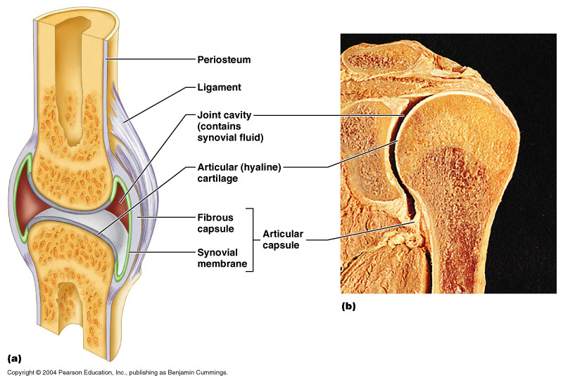
Synovial Joint

Slide 23
Integumentary System
Skin (cutaneous membrane)
Skin derivatives
Sweat glands
Oil glands
Hair
Nails
Notes:
Also called the integument (in-teg′u-ment), which simply means “covering,” the skin multitasks.

Slide 24
Skin Functions
Protection and cushioning
insulates and regulates body heat (sweat glands, blood in
capillary beds)
is waterproof (prevents unnecessary water loss).
Protects from chemicals and pathogens (like bacteria)
Protection from UV light (Melanin offers protection)
Sensory receptors such as pain receptors
Modified cholesterol molecules in skin are converted to Vitamin D by sunlight.
Notes:
touch, pressure, temperature, and pain receptors.
Melanin produced by melanocytes offers protection from UV damage.
Desiccation (drying out): contains a water-resisting glycolipid and keratin.

Slide 25
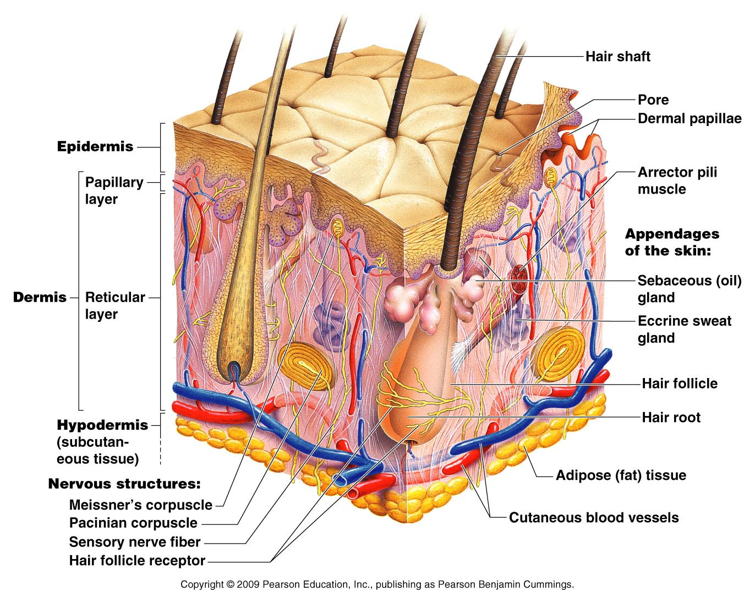
Skin Structure
Epidermis—outer layer
Dermis

Slide 26
Skin Structure
Subcutaneous tissue (hypodermis) is deep to dermis
Not part of the skin
Anchors skin to underlying organs
Composed mostly of adipose tissue
Notes:
Fat storage
Subcutaneous tissue serves as a shock absorber and insulates the deeper tissues from extreme temperature changes occurring outside the body.

Slide 27
Epidermis
consists of four distinct cell types and four or five layers.
Cell types include: keratinocytes, melanocytes, Merkel cells, and Langerhans’ cells.

Slide 28
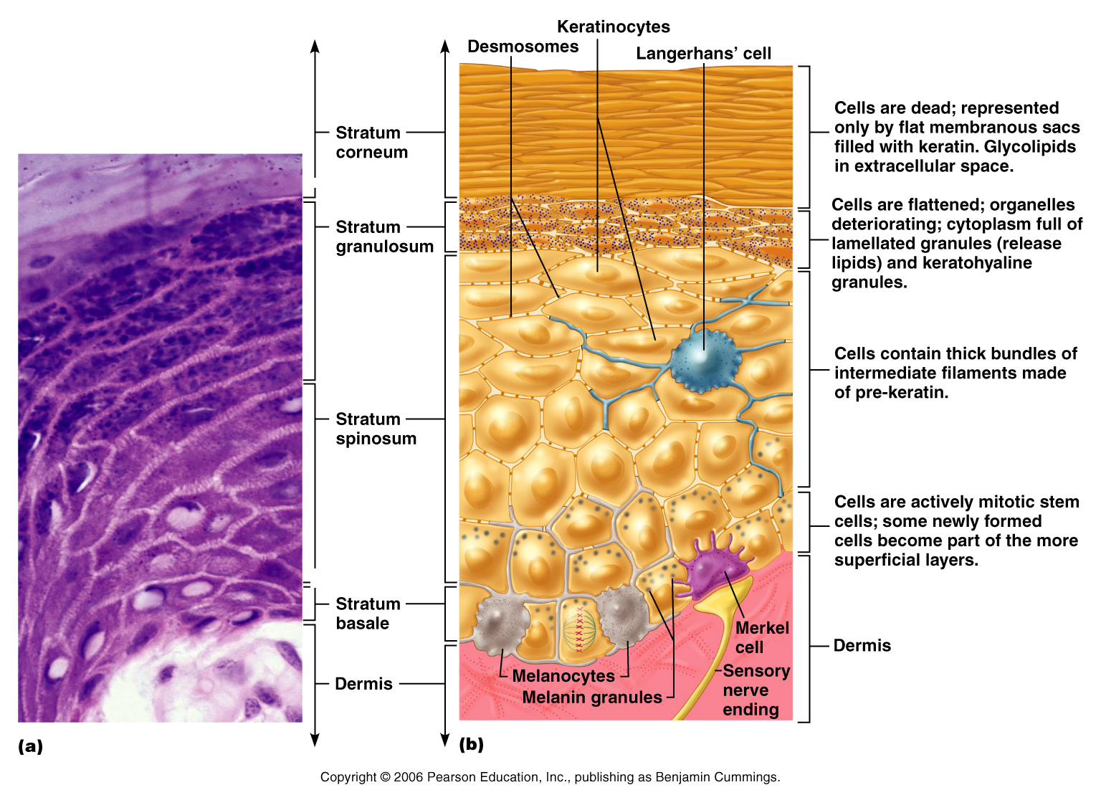
Cells of the Epidermis
Keratinocytes (keratin cells) – produce the fibrous protein keratin. Most cells of the epidermis are keratinocytes.
Melanocytes – produce the dark pigment melanin.
Merkel cells – function as touch receptors in association with sensory nerve endings.
Langerhans’ cells – epidermal macrophages that help activate the immune system.
Notes:
Most cells of the epidermis are keratinocytes
Melanin (mel′ah-nin), a pigment that ranges in color from yellow to brown to black, is produced by special spider-shaped cells called
melanocytes (mel′ah-no-s￣ıtz), found chiefly in the stratum basale.

Slide 29
Layers of the Epidermis: Stratum Basale (Basal Layer)
Deepest epidermal layer firmly attached to the dermis.
Consists of a single row of the youngest keratinocytes.
Cells undergo rapid division, hence its alternate name, stratum germinativum

Slide 30
Layers of the Epidermis: Stratum Spinosum (Prickly Layer)
Cells contains bundles of intermediate filaments (protein) called tonofilaments.
The spinyness (irregularity in shape) does not exist in living tissue; its an artifact that arises from tissue preparation.

Slide 31
Layers of the Epidermis: Stratum Granulosum (Granular Layer) Layers of flattened keratinocytes producing keratin.
Layers of the Epidermis: Stratum Lucidum (Clear Layer)
Thin, transparent band superficial to the stratum granulosum.
Consists of a few rows of flat, dead keratinocytes.
Present only in thick skin like palms and soles.
Notes:
Granules containing keratin

Slide 32
Layers of the Epidermis: Stratum Corneum (Horny Layer)
Outermost layer of keratinized cells
it accounts for about three-quarters of the epidermal thickness
dead cells
Many layers thick
Functions include:
Waterproofing
Protection from abrasion and penetration
Rendering the body relatively insensitive to biological, chemical, and physical assaults
Notes:
The outermost layer, the stratum corneum (kor′ne-um), is 20 to 30 cell layers thick but it accounts for about three-quarters of the epidermal thickness.
The shinglelike dead cell remnants, completely filled with keratin, are referred to as cornified or horny cells (cornu = horn).
Keratin is an exceptionally tough protein. Its abundance in the stratum corneum allows that layer to provide a durable “overcoat” for the body, which protects
deeper cells from the hostile external environment (air) and from water loss and helps the body resist biological, chemical, and physical assaults. The stratum corneum rubs and flakes off slowly and steadily as the dandruff familiar to everyone. This layer is replaced by cells produced by the division of the deeper stratum basale cells. Indeed, we
have a totally “new” epidermis every 25 to 45 days.

Slide 33
Dermis
Second skin region containing strong, flexible connective tissue.
Cell types include fibroblasts, macrophages, and occasionally mast cells and white blood cells.
Rich supply of nerves and blood vessels.
Critical role in temperature regulation (the blood vessels).
Composed of two layers:
Papillary
Reticular
Notes:
Nerve supply

Slide 34
Layers of the Dermis: Papillary Layer
Papillary layer
Its superior surface contains projections called dermal papillae.
Layers of the Dermis: Reticular Layer
Reticular layer
Accounts for approximately 80% of the thickness of the skin
Collagen fibers in this layer add strength to the skin
Elastin fibers provide stretch- recoil properties

Slide 35
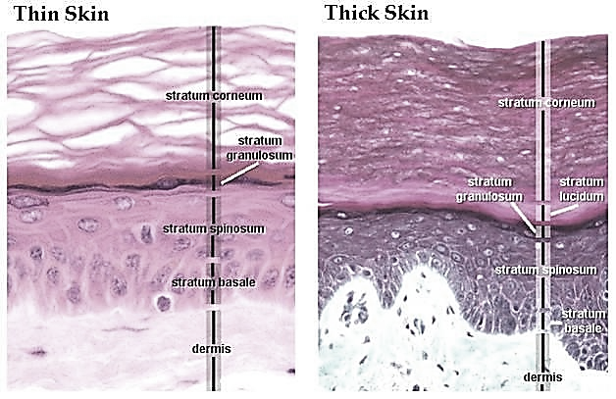
Thick skin: Prominent stratum corneum, stratum lucidum, No hair and sebaceous glands.
Thin skin: less Prominent stratum corneum, No stratum lucidum, hair and sebaceous glands.
Notes:
Thinner dermis
Thicker dermis

Slide 36
Hypodermis
Hypodermis (Greek)= below the skin
Subcutaneous (Latin)= below the skin
Composed of adipose tissue (fat storage) and areolar connective tissue (anchors the skin).
Notes:
Also called “superficial fascia”
Fascia (Latin)= band; in anatomy it means a sheet of connective tissue

Slide 37
Skin Color
Different pigments contribute to skin color like:
1. Melanin
Yellow, brown, or black pigments (most important)
Melanin is sythesized in melanocytes and passed in granules to keratinocytes in stratum basale.
Melanocytes number is the same in all races.
Variations in color come from different kind and amount of melanin made and retained (lysosomes).
Protection from UV light
2. Carotene
Orange-yellow pigment from some vegetables.
most obvious in the palms and soles of the feet.
3. Hemoglobin (the pink of light skin)
Red coloring from blood cells in dermal capillaries.
Notes:
The amount of melanin produced is affected by genetics and environmental factors.
When the skin is exposed to sunlight, which stimulates the melanocytes to produce more of the melanin pigment, tanning occurs. As the melanocytes produce melanin, it accumulates within them in membrane-bound granules called melanosomes. These granules then move to the ends of the melanocytes’ spidery arms, where they are taken up by nearby keratinocytes. Inside the keratinocytes, the melanin forms a pigment umbrella over the superficial, or “sunny,” side of their nuclei and shields their genetic material (DNA) from the damaging effects of ultraviolet radiation in sunlight. Freckles and moles are seen where melanin is concentrated in one spot.
Despite melanin’s protective effects, excessive sunexposure eventually damages the skin, leading to leathery skin. Overexposure to the sun can also alter the DNA of
skin cells, leading to skin cancer. Black people seldom have skin cancer, attesting to melanin’s amazing effectiveness as a natural sunscreen

Slide 38
Skin Appendages
Derived from epidermis but extend into dermis
Sebaceous glands (oil glands).
Sweat glands (sudoriferous).
Cutaneous glands are all exocrine glands
Hair and hair follicles
Nails
Notes:
As these glands are formed by the cells of the stratum basale, they push into the deeper skin regions and ultimately reside almost entirely in the dermis.

Slide 39
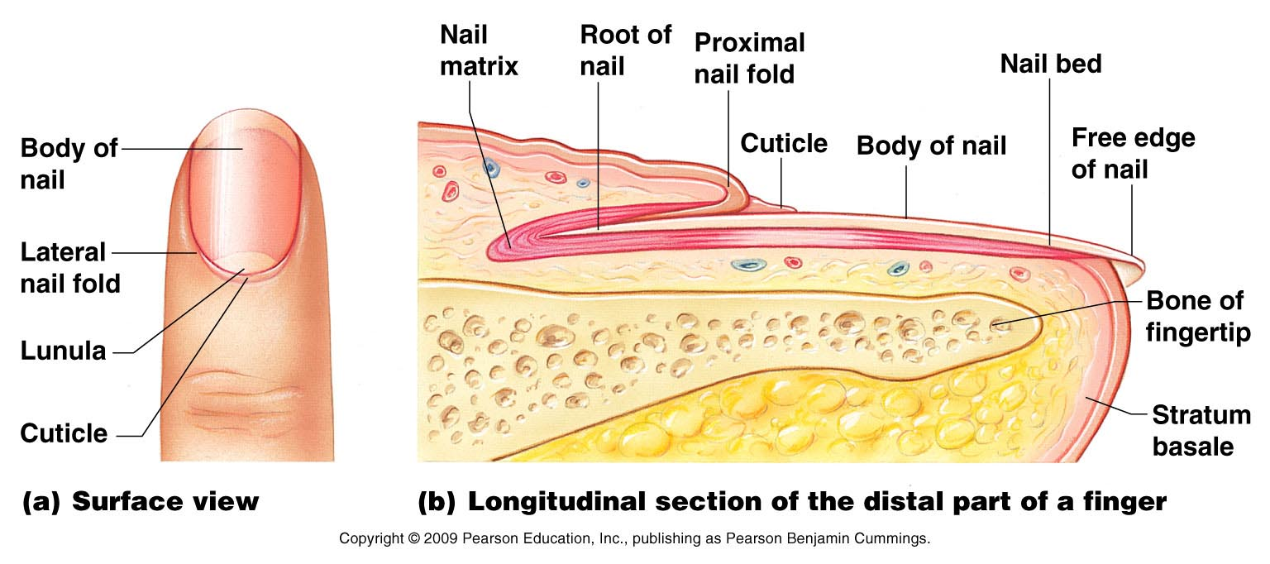
Nails
are composed of hard keratin
Grows from nail matrix
Notes:
The stratum basale of the epidermis extends beneath the nail as the nail bed. Its thickened proximal area, called the nail matrix, is responsible for nail growth.
Nails consist of stratified squamous epithelial cells overlying the nail bed. As the nail cells are produced by the matrix, they become heavily keratinized
and die. Thus, nails, like hairs, are mostly nonliving material.
Nails are transparent and nearly colorless, but they look pink because of the rich blood supply in the underlying dermis.
As new cells are produced, older ones are pushed outward and become keratinized.

Slide 40
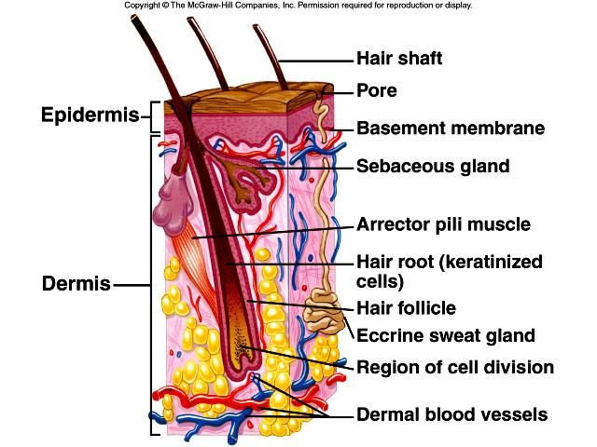
Hair and Hair follicles
Derived from epidermis and dermis
Everywhere but palms of the hand, soles of the foot, nipples, parts of the genitalia
A bundle of smooth muscle cells, called the arrector pili muscle, attaches to each hair follicle.
Notes:
That part of the hair enclosed in the follicle is called the root. The part projecting from the surface of the scalp or skin is called the Shaft.
Thus the bulk of the hair shaft, like the bulk of the epidermis, is dead material and almost entirely protein.
Hair pigment is made by melanocytes in the hair bulb, and varying amounts of different types of melanin (yellow, rust, brown, and black) combine to produce all varieties
of hair color from pale blond to pitch black.
This action helps keep animals warm in winter by adding a layer of insulating air to the fur.

Slide 41
Sebaceous (oil) glands
Entire body except palms of the hand and soles of the feet
Produce sebum
Oils and lubricates
Notes:
Their ducts usually empty into a hair follicle (see Figure 4.3 and Figure 4.7, on p. 120), but some open directly onto the skin surface.
The product of the sebaceous glands, sebum (se′bum; seb = grease), is a mixture of oily substances and fragmented cells.
Sebum is a lubricant that keeps the skin soft and moist and prevents the hair from becoming brittle. Sebum also contains chemicals that kill bacteria, so it is important in
preventing the bacteria present on the skin surface from invading the deeper skin regions. The sebaceous glands become very active when male sex hormones are produced in increased amounts (in both sexes) during adolescence. Thus, the skin tends to become oilier during this period of life.

Slide 42
Sweat glands
Entire skin surface except nipples and part of the external genitalia
Prevent overheating
Notes:
Sweat Glands
Each gland consists of a tiny tube that originates as a ball shaped coil lined with sweat secreting epithelial cells.
Cells respond to body temperature and stress
Modified Sweat Glands
Modified sweat glands, called secrete wax in the ear canal.
Mammary glands, another modified type of sweat glands, secrete milk.

Slide 43
Types of sweat glands
Eccrine or merocrine
most numerous, found all over the body
true sweat: 99% water, some salts, traces of waste
ducts open through pores
Apocrine
Axillary, anal and genital areas only
ducts open into hair follicles
the organic molecules when decomposed by bacteria cause an unpleasant odor.
Modified apocrine glands
ceruminous- secrete earwax
mammary- secrete milk
Notes:
Sweat is acidic (pH from 4 to 6), a characteristic that inhibits the growth of certain bacteria, which are always present on the skin surface.
Apocrine glands begin to function during puberty under the influence of androgens (male sex hormones). Although their secretion is produced almost continuously, apocrine glands play a minimal role in thermoregulation. Their precise function is not yet known, but they are activated by nerve fibers during pain and stress and during
sexual foreplay.

Slide 44
The Skeletal System
Divided into two divisions
Axial skeleton
Appendicular skeleton
Parts of the skeletal system
Bones (skeleton)
Joints
Cartilage
Ligaments (bone to bone)
Tendon (bone to muscle)

Slide 45
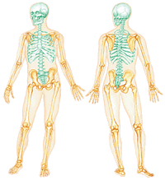
The Skeletal System
Axial skeleton
(highlighted in blue) Skull, Bony thorax, Vertebrae, Hyoid bone
Appendicular skeleton (highlighted in yellow)
Upper and lower limbs,
Pectoral and Pelvic girdle
The skeleton has 206 bones

Slide 46
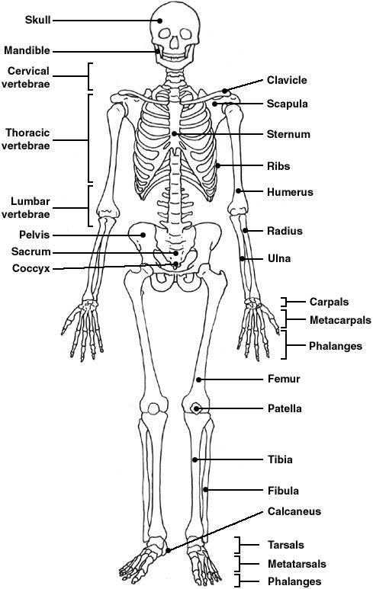
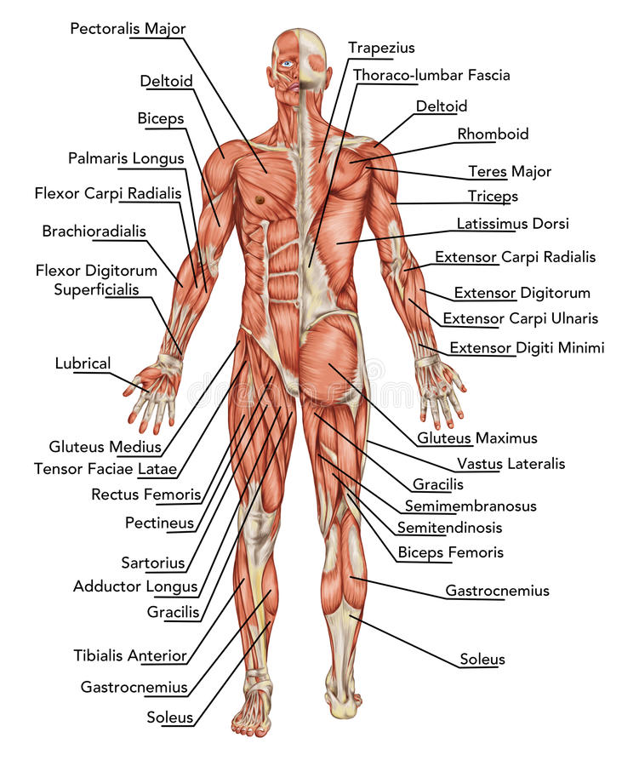

Slide 47
Functions of the Bones
Support of the body
Protection of soft organs
Movement due to attached skeletal muscles
Storage of minerals and fats
Blood cell formation

Slide 48
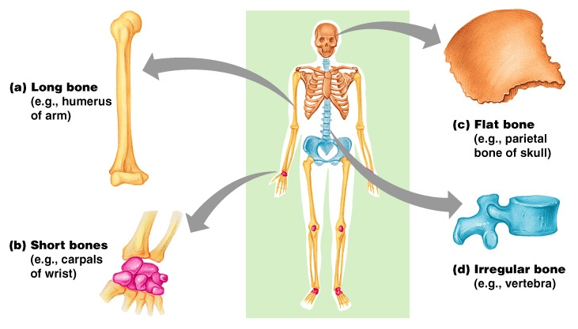
Classification of Bones on the Basis of Shape

Slide 49
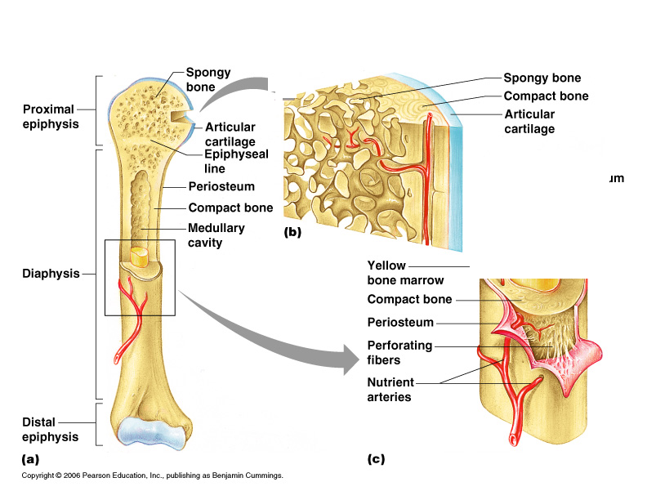
Classification of Bones
The adult skeleton has 206 bones
Two basic types of osseous tissue
Compact bone
Is dense and looks smooth
Homogenous
Spongy bone
Small needle-like pieces of bone
Many open spaces

Slide 50
Types of Bone Cells
Osteocytes
Mature bone cells
Osteoblasts
Bone-forming cells
Osteoclasts
Bone-destroying cells
Break down bone matrix for remodeling and release of calcium
Bone remodeling is a process controlled by both osteoblasts and osteoclasts

Slide 51
Supporting Connective Tissue: Cartilage
Cartilage
Structure
Firm ground substance
Chondroblasts produce the matrix and lie at the surface of the tissue
Chondrocytes – mature cartilage cells that are located in lacunae
Enclosed in perichondrium (capsule)
Lacks direct blood supply, nerve fibers and lymphatic vessels; supplied by diffusion
3 Types:
Hyaline cartilage; Elastic cartilage ; Fibrocartilage

Slide 52
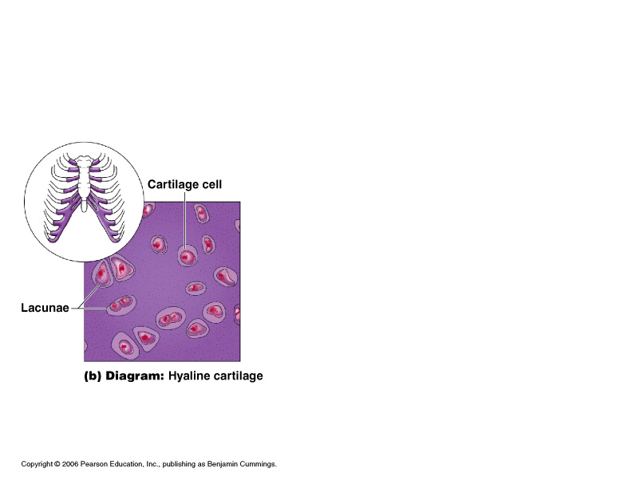
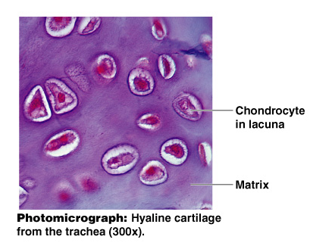
Supporting Connective Tissue: Cartilage
Hyaline cartilage
(Most common cartilage); bluish-white translucent
Structure
collagen and elastic fibers
Rubbery matrix
Function
Bone Development (growth of long bones)
Support (able to tolerate weight)

Slide 53
Supporting Connective Tissue: Cartilage
Hyaline cartilage
Location
Tracheal and bronchial cartilage
Nasal septum
Forms supporting structure of larynx (voicebox)
Attaches ribs to breastbone (costal catilage)
Covers ends of long bones (joint cavities)
Composes most of the fetal/ embryonic skeleton

Slide 54
Supporting Connective Tissue: Cartilage
Elastic cartilage
Structure
Dark in color
Contains both elastic and collagen fibers but more Elastic fibers
Function
Provides elasticity and flexibility
Location
Entrance of larynx (Epiglottis)
External ear (ear pinna)

Slide 55
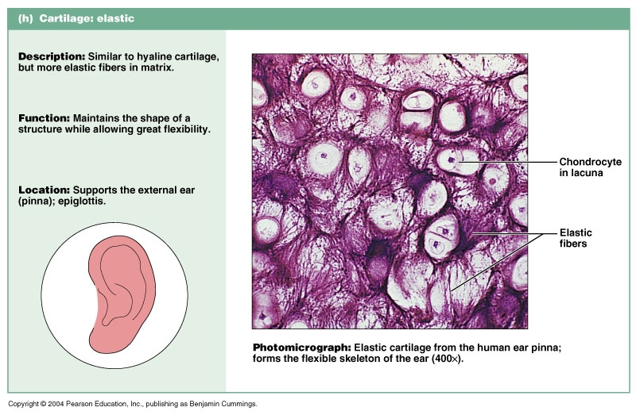

Slide 56
Supporting Connective Tissue: Cartilage
Fibrocartilage
Structure
mainly collagen fibers
very little matrix
No perichondrium (no capsule)
Highly compressible (tough)
Function
Shock absorber
Location
Intervertebral disks
Cushions the knee joint
Pubic symphysis

Slide 57
The Axial Skeleton
Divided into four parts:
Skull
Bony thorax
Vertebral column
Hyoid bone

Slide 58
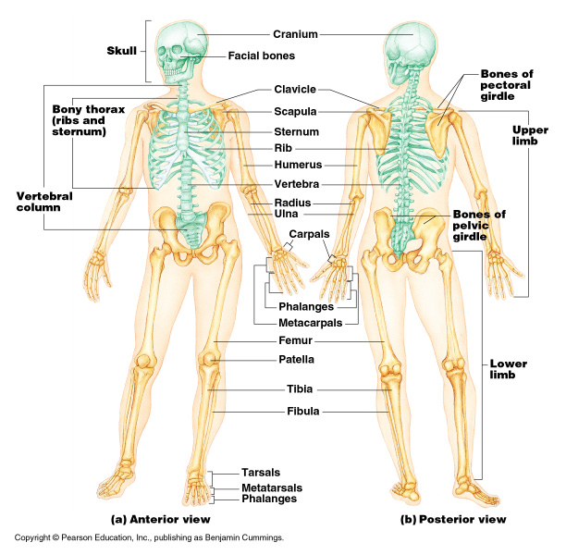
The Axial Skeleton

Slide 59
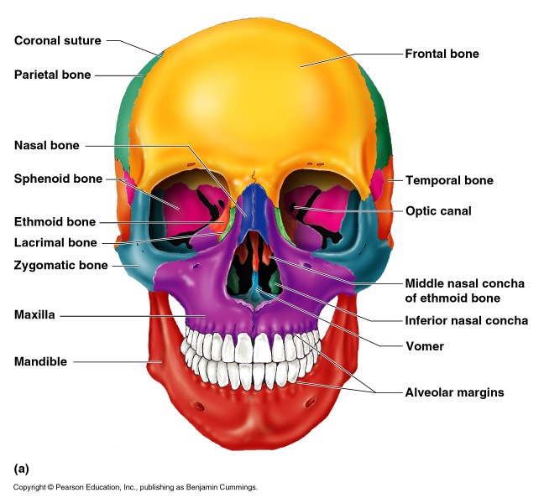
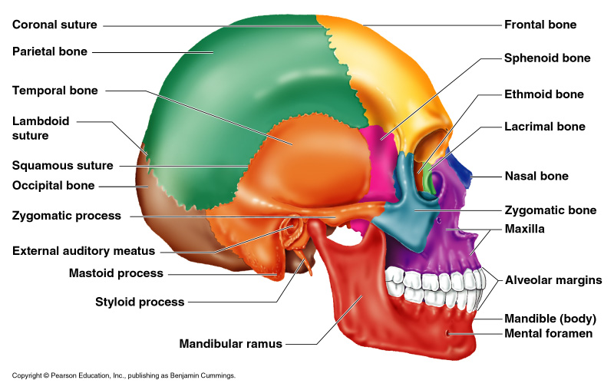
Bones of the Skull
Skull (divided into Two sets of bones: Cranial and Facial bones).
Bones are joined by sutures

Slide 60
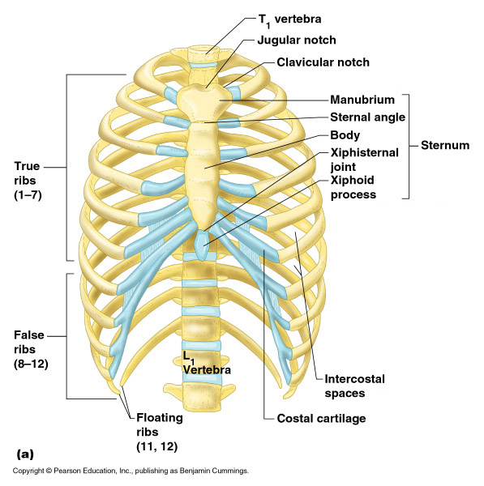
The Bony Thorax
Forms a rib cage to protect major organs (like heart, lungs)
Support pectoral girdle and arm
1. 12 pairs of ribs
2. 12 thoracic vertebrae
3. Sternum

Slide 61
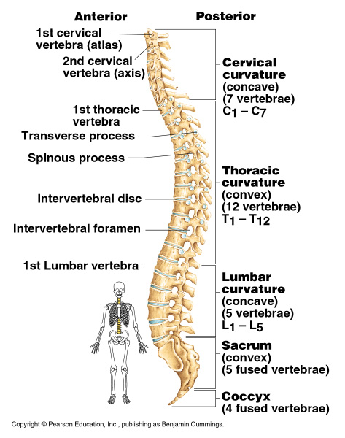
The Vertebral Column
33 vertebrae
24 individual vertebrae
9 fused vertebrae
Irregular bones
Vertebrae separated by intervertebral discs (fibrocartilage)
Each vertebrae is given a name according to its location: cervical, thoracic, lumbar, sacral (sacrum), coccygeal (coccyx).

Slide 62
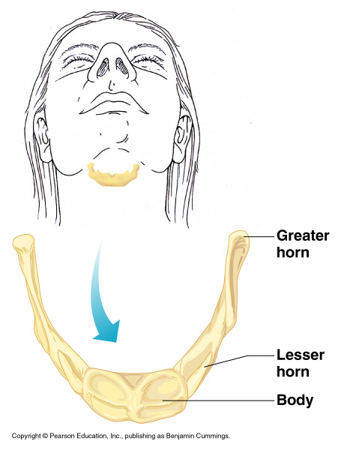
The Hyoid Bone
C-shaped bone
The only bone that does not articulate with another bone
Serves as a moveable base for the tongue
The hyoid bone also helps to keep the larynx (voice box) open at all times
Suspended by styloid ligament to styloid process of the temporal bone

Slide 63
The Appendicular Skeleton
Upper and lower limbs (appendages)
Pectoral girdle (shoulder girdle)
Pelvic girdle

Slide 64
The Appendicular Skeleton

Slide 65
The Muscular System
Muscles are responsible for all types of body movement – they contract or shorten and are the machine of the body
Three basic muscle types are found in the body
Skeletal muscle
Cardiac muscle
Smooth muscle

Slide 66
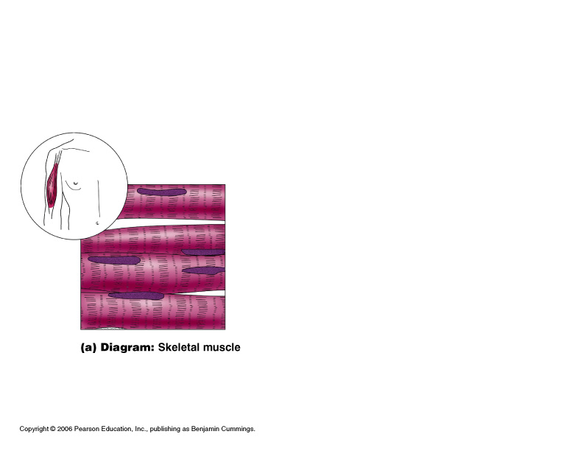
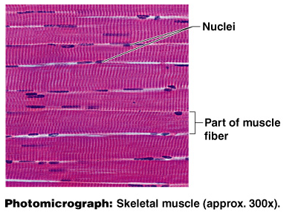
Muscle Tissue Types
Skeletal muscle/ striated muscle
Structure:
Muscle Fiber – long, cylindrical cell
Many nuclei in each cell, peripheral
Cells are striated – alternating light & dark pattern
unbranched
Function:
Voluntary movement
body movement
facial expression
Location:
Attached to bones

Slide 67
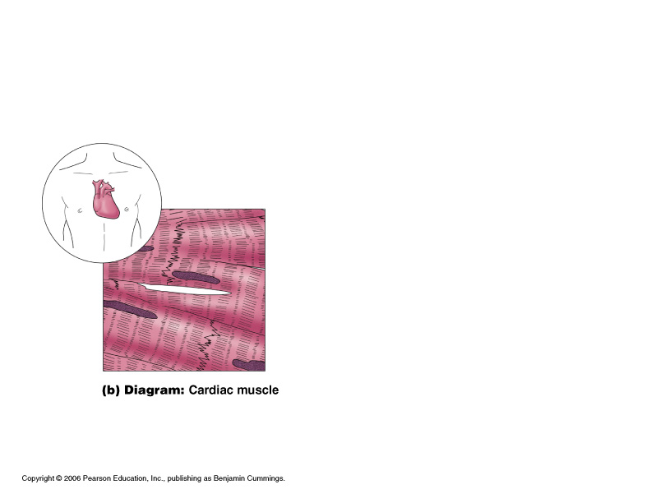
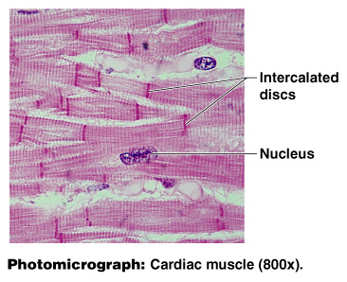
Muscle Tissue Types
Cardiac muscle
Structure:
Cells are striated
Cells are branched
One nucleus per cell (central)
Cells joined end-to-end with intercalated disk in-between.
Function:
Involuntary heart movement
Pumping blood
Location:
Heart wall

Slide 68
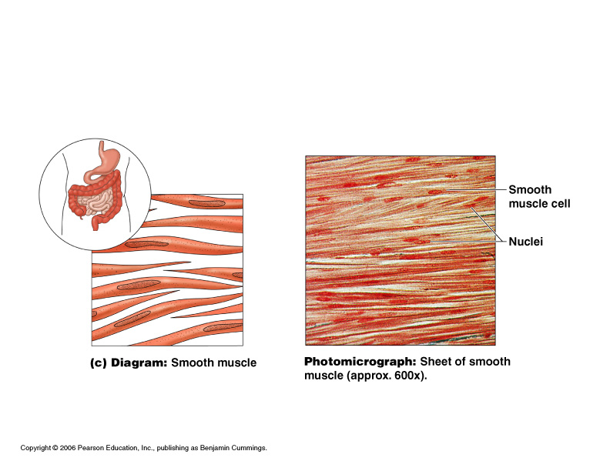
Muscle Tissue Types
Smooth muscle
Structure
Fusiform (spindle shaped) cells
unbranched
One nucleus per cell
No visible striations
Function
Involuntary movement
wave-like movement pushes food through digestive system
Location
Walls of hollow internal organs
Ex: wall of internal viscera Stomach, Intestines, Bladder, Uterus, Blood vessels

Slide 69
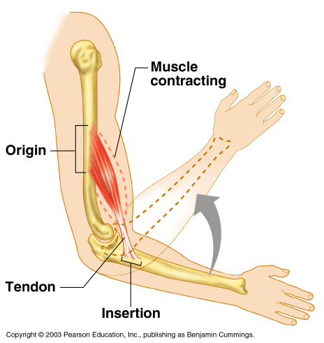
Muscles and Body Movements
Muscles are attached to at least two points
Origin
Insertion
Notes:
Origin – attachment to a moveable bone
Insertion – attachment to an immovable bone

Slide 70
Muscles and Body Movements
The action (movement) of a muscle is directed from insertion (has a tendon) towards origin.
Notes:
Origin: the attachment of the muscle to the bone that remains stationary
Insertion: the attachment of the muscle to the bone that moves
Belly: the fleshy part of the muscle between the tendons of origin and/or insertion

Slide 71
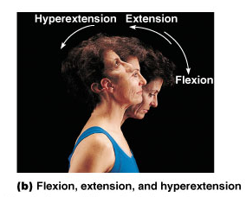
Types of Ordinary Body Movements
Flexion – decreases angle of joint and brings two bones closer together
Extension- opposite of flexion
When a muscle contracts it shortens
When a muscle extends it lengthens

Slide 72
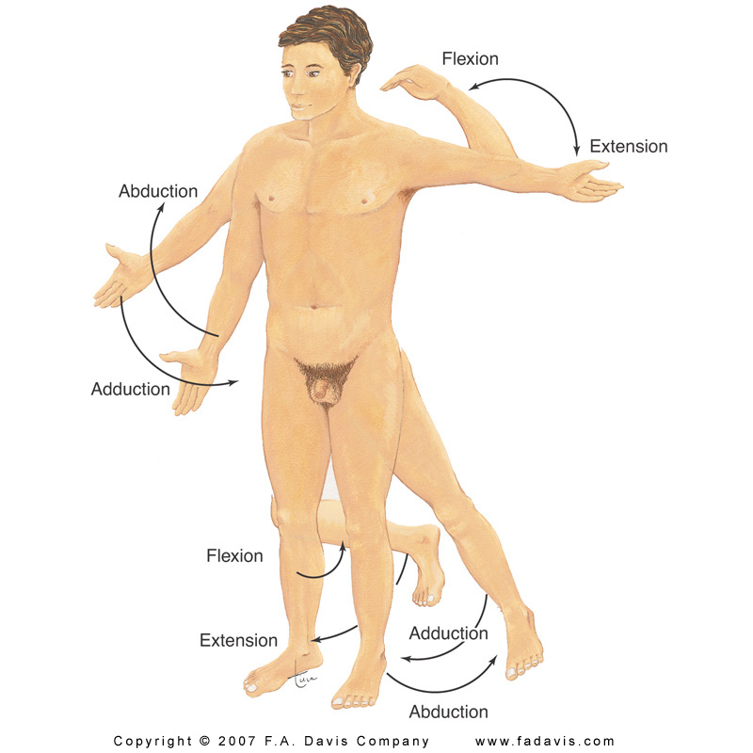
Types of Ordinary Body Movements
Abduction – moving the limb away from the midline
Adduction- moving the limb toward the midline

Slide 73
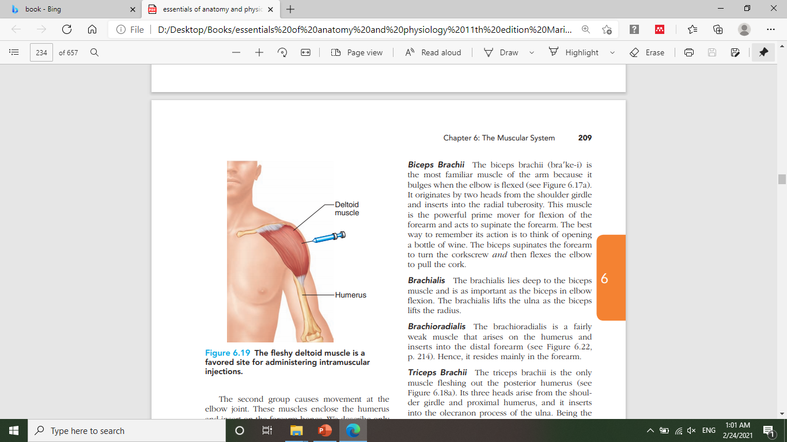
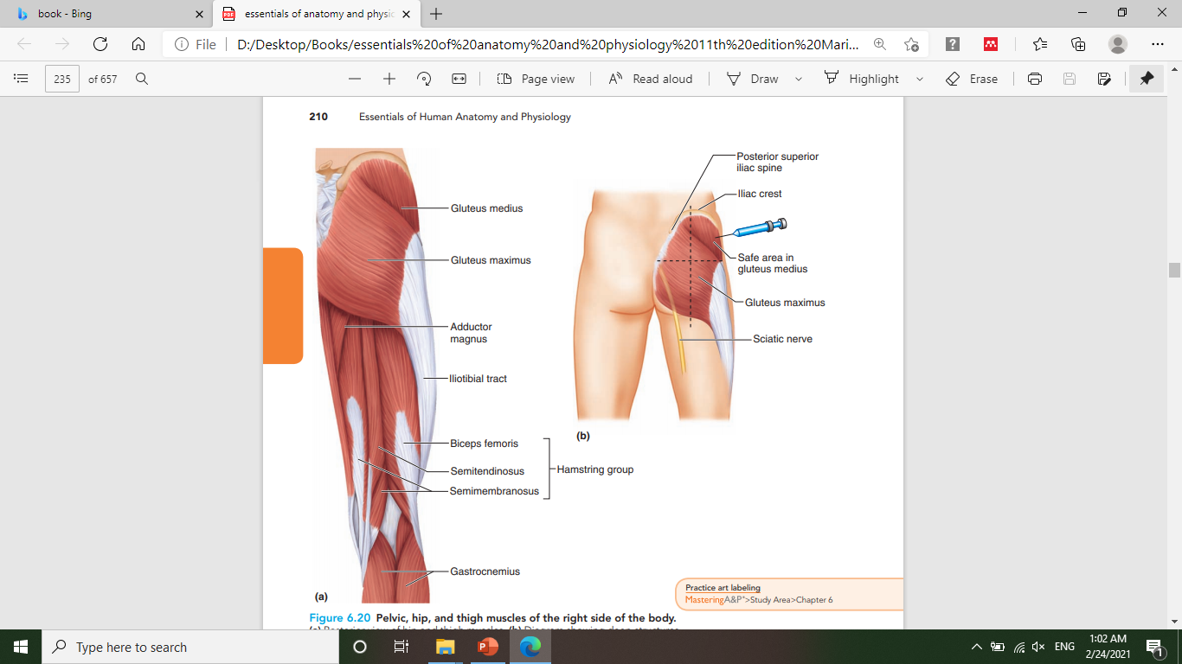

Slide 74
The Nervous System

Slide 75
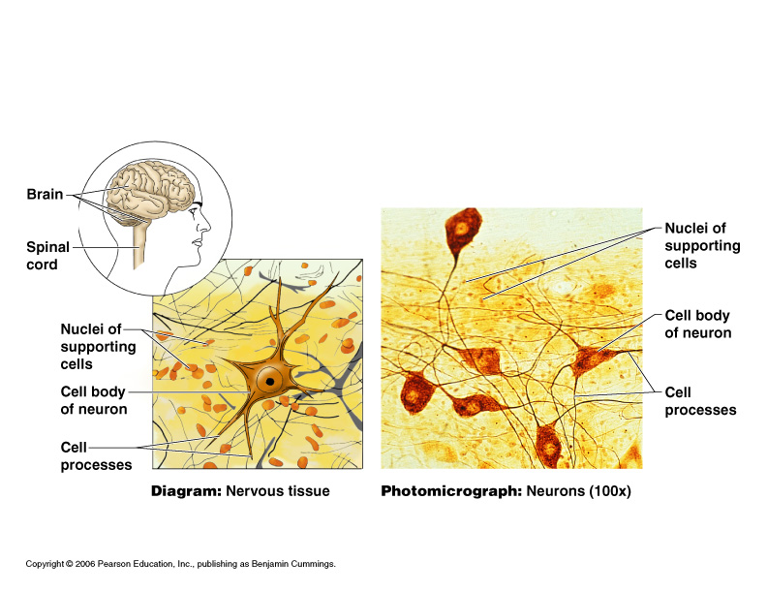
Nervous Tissue
Structure:
Neurons (cells)
Neuroglial cells /glial cells- support neurons
Function of neurons:
Sense changes in the environment
Respond by transmitting impulses

Slide 76
Glial cells
Oligodendrocytes and Schwann cells- formation of myelin.
Astrocytes- help to regulate the external environment of neurons.
Ependymal cells- formation of Cerebrospinal fluid (CSF).
Microglia- act as macrophages.

Slide 77
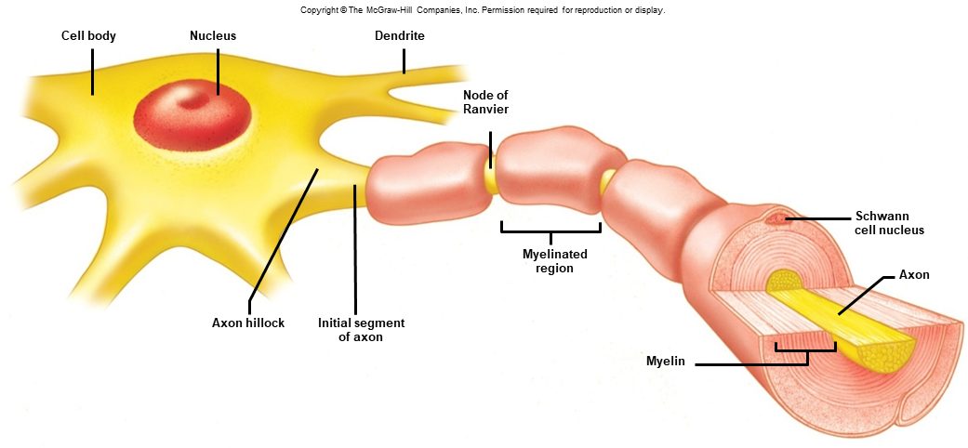
General structure of neurons
Neurons vary in size and shape, but they all have:
A cell body that contains the nucleus, Nissl bodies, and other organelles.
Dendrites: receive impulses and conducts an impulse toward the cell body.
Axon: conducts action potentials away from the cell body
Axons vary in length from a few millimeters to a meter
Some axons are covered in myelin with open spots called nodes of Ranvier.
79

Slide 78
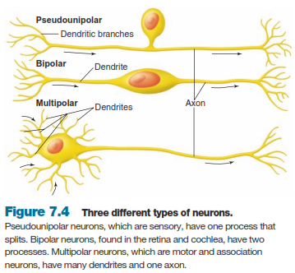
Structural classification of Neurons
Structural classification (based on the number of processes that extend from the cell body)
Unipolar neurons: single short process that branches like a T (one axon). (sensory neurons)
Bipolar neurons: two processes, one at either end (one axon and dendrite).
(retina of the eye, cochlea of the ear)
Multipolar neurons: many processes, several dendrites and one axon extending from the cell body.
(most common type of neurons:
motor neurons, Interneurons)

Slide 79
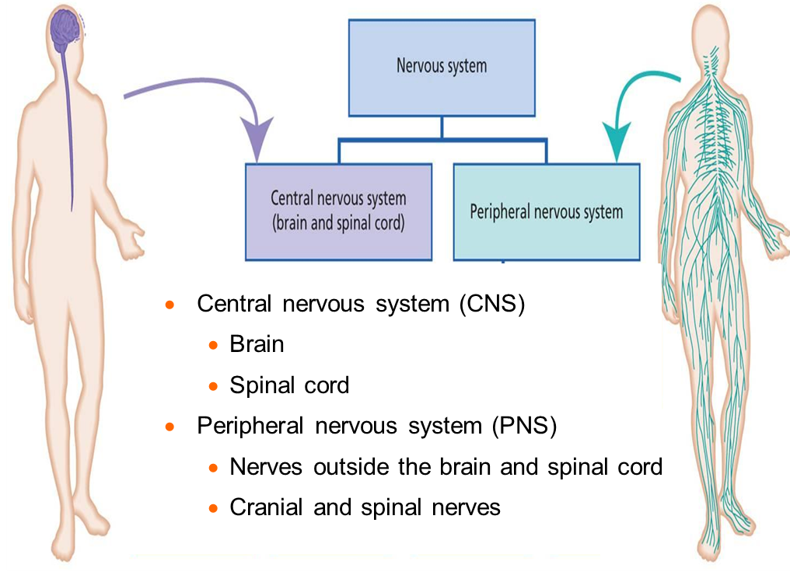
Structural Classification of the Nervous System

Slide 80
Functional classification of Neurons
Functional classification of neurons – based on direction impulses are conducted
Sensory neurons: conduct impulses from sensory receptors to the CNS
Motor neurons: conduct impulses from the CNS to target organs (muscles or glands)
Association/interneurons: located completely within the CNS and integrate functions of the nervous system

Slide 81
Motor Neurons
Somatic motor neurons: responsible for reflexes and voluntary control of skeletal muscles
Autonomic motor neurons: innervate involuntary targets such as smooth muscle, cardiac muscle, and glands
Sympathetic
Parasympathetic

Slide 82
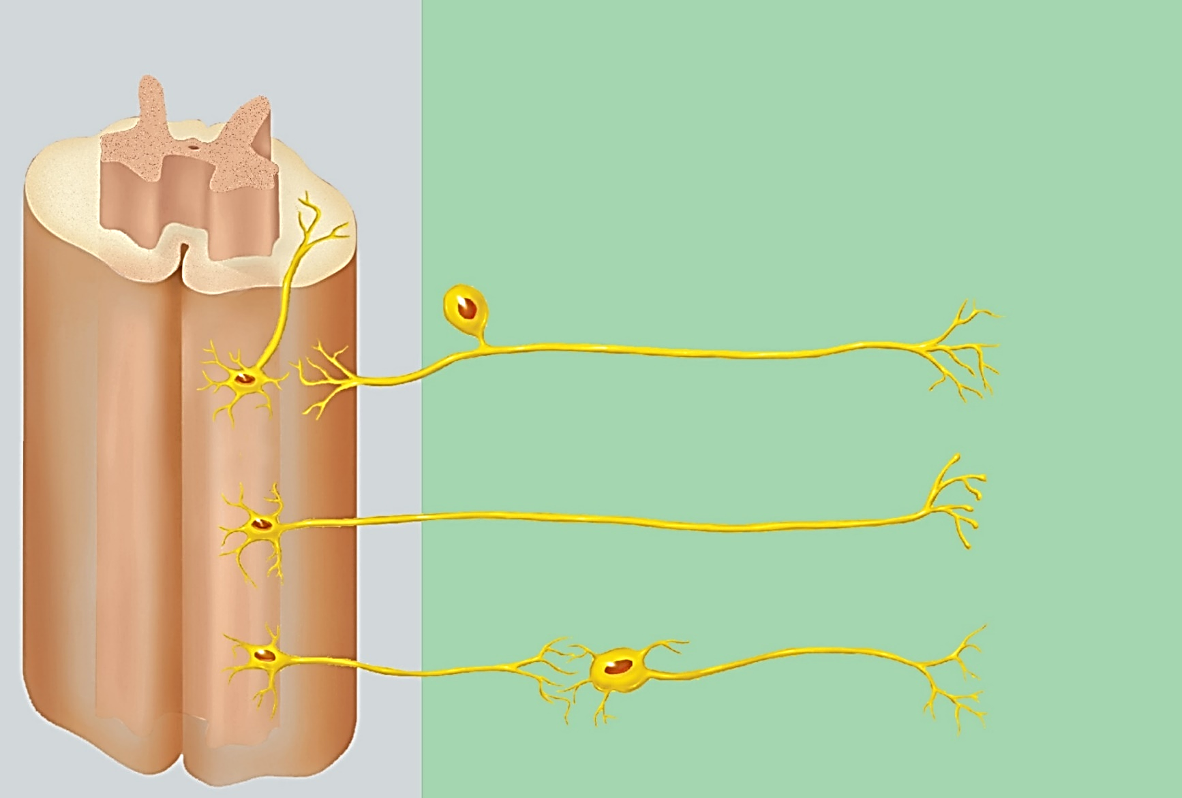
Functional Categories of Neurons
Central Nervous System (CNS)
Peripheral Nervous System (PNS)
Copyright © The McGraw-Hill Companies, Inc. Permission required for reproduction or display.
Association neuron (interneuron)
Sensory neuron
Receptors
Somatic motor neuron
Skeletal
muscles
Autonomic motor neurons
Smooth muscle
Cardiac muscle
Glands
Autonomic ganglion

Slide 83
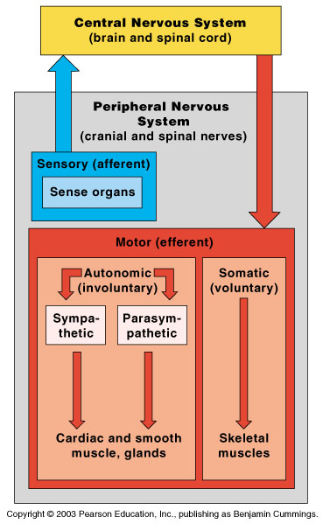
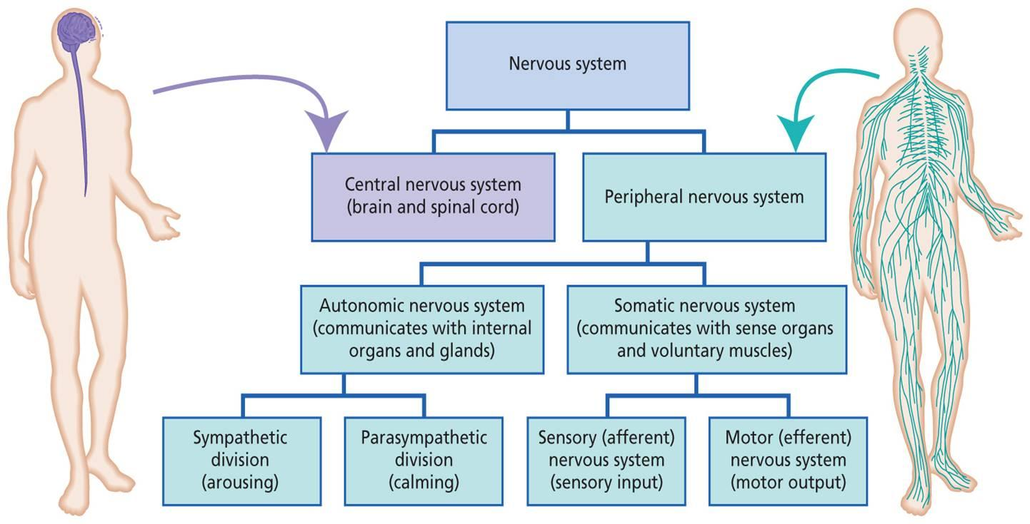
Organization of the Nervous System

Slide 84
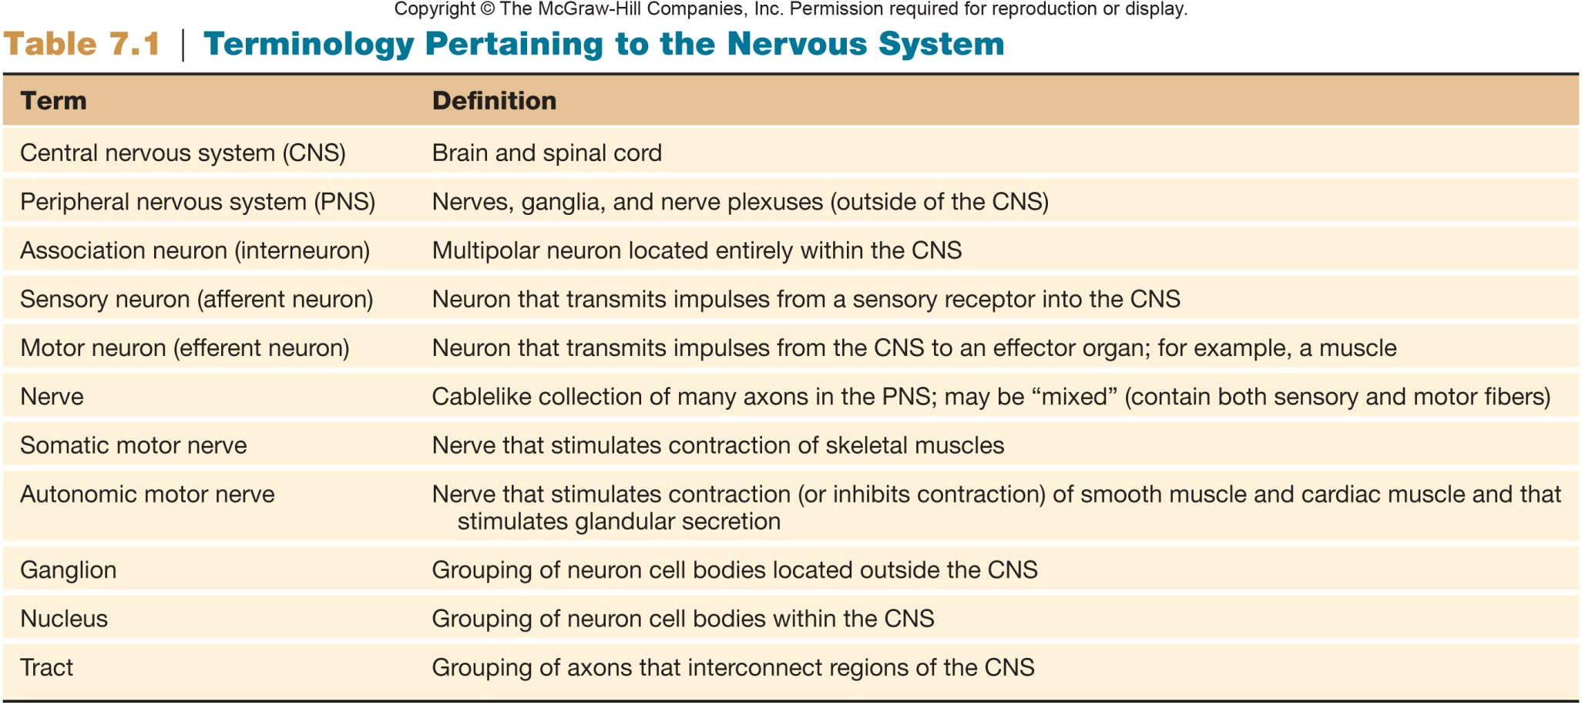
+Fiber

Slide 85
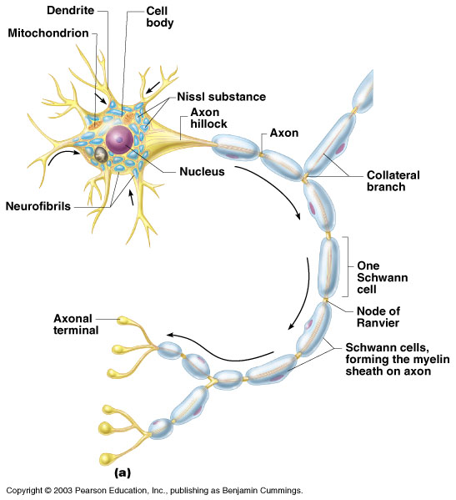
Neuron Anatomy
Cell body
Nucleus
Extensions outside the cell body
Dendrites – conduct impulses toward the cell body
Axons – conduct impulses away from the cell body (only 1!)

Slide 86
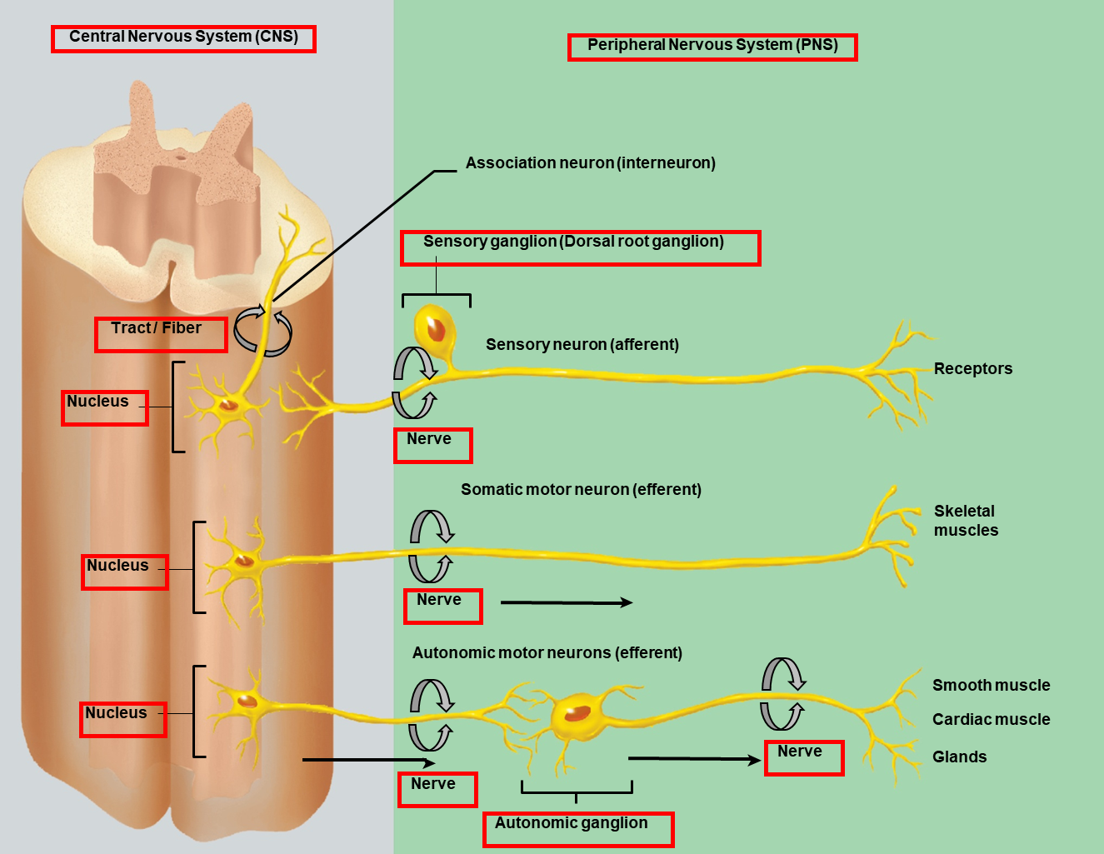

Slide 87
The central nervous system
Central nervous system (CNS)
Brain
Spinal cord

Slide 88

Regions of the Brain
Cerebrum (cerebral hemispheres)
Diencephalon
Brain stem
Cerebellum

Slide 89


Cerebral Hemispheres (Cerebrum)
The largest part of the brain
Voluntary movements
Emotion
Memory
Speech
Paired (left and right) superior parts of the brain

Slide 90


Cerebral Hemispheres (Cerebrum)
Left and right hemispheres are connected together by the nerve fibers (corpus callosum)

Slide 91
Cerebral Hemispheres (Cerebrum)
The surface is made of elevations (gyri) and grooves (sulci)

Slide 92
Lobes of the Cerebrum
Fissures (deep grooves) divide the cerebrum into lobes
Surface lobes of the cerebrum
Frontal lobe
Parietal lobe
Occipital lobe
Temporal lobe

Slide 93


Lobes of the Cerebrum
Insula

Slide 94

Neuron Cell Body Location
Nuclei – clusters of cell bodies within the central nervous system (CNS).
Ganglia – clusters of cell bodies outside the central nervous system (in the PNS).
Gray matter– cell bodies and unmylenated fibers.
White matter- myelinated fibers or tracts.

Slide 95
Cerebral Histology: Layers of the Cerebrum
Outer layer which is called the cortex (sulci and gyri) is composed of gray matter (composed mostly of neuron cell bodies).
Internal clusters of gray matter are also present in the cerebrum.
The functional units of the nervous system are the cell bodies of neurons.

Slide 96
Cerebral Histology: Layers of the Cerebrum
White matter
Fiber tracts (axons of neurons).
Example: the corpus callosum which connects the two cerebral hemispheres

Slide 97
Brain Stem
Attaches to the spinal cord
Parts of the brain stem
Midbrain
Pons
Medulla oblongata

Slide 98

Brain Stem

Slide 99
Cerebellum
Two hemispheres with convoluted surfaces

Slide 100
Diencephalon
Sits on top of the brain stem
Enclosed by the cerebral hemispheres
Made of three parts
Thalamus
Hypothalamus
Epithalamus
Pituitary gland

Slide 101
Diencephalon
The Thalamus surrounds the third ventricle.
The Hypothalamus is located below the thalamus.
The Epithalamus forms the roof of the third ventricle. It houses the pineal gland (an endocrine gland) and includes the choroid plexus which forms the cerebrospinal fluid.
Pituitary gland

Slide 102

Spinal Cord Anatomy
The spinal cord extends from the medulla oblongata (foramen magnum of the skull) to the region of L1 or L2 (First or second lumbar vertebra).
Meninges cover the spinal cord and do not end at the second lumbar vertebra level but extend well beyond the end of the spinal cord.

Slide 103
Spinal Cord Anatomy
31 pairs of nerves arise from the spinal cord and exit form the vertebral column to serve the body areas close by
8 cervical, 12 thoracic, 5 lumbar, 5 sacral, 1 coccygeal.
The collection of spinal nerves at the inferior end of the vertebral canal is called the cauda equina.

Slide 104

Spinal Cord Anatomy
Exterior white mater – tracts
Internal gray matter - mostly cell bodies (looks like the letter “H” in a cross or transverse section).
Dorsal (posterior) horns
Anterior (ventral) horns
Central canal filled with cerebrospinal fluid

Slide 105

Protection of the Central Nervous System (brain and spinal cord)
Scalp (skin, hair and fatty tissue)
Bone (Skull and vertebral column)
Cerebrospinal fluid (in ventricles, subarachnoid space and central canal)
Meninges
Blood brain barrier (continuous capillaries).

Slide 106
Meninges
1. Dura mater
Double-layered external covering (first covering)
It forms a hard cover between the skull bone and the CNS.
Under the dura mater is a space called subdural space (it does NOT contain CSF)

Slide 107
Meninges
2. Arachnoid mater
Middle layer, Web-like or net-like cover
Delicate, transparent
Under the Arachnoid mater is space which contains CSF
3. Pia mater
Internal layer
Thin and highly vascular layer
Tightly attached to the surface of the brain

Slide 108
Cerebrospinal Fluid
A clear colorless liquid; similar to blood plasma composition.
Formed continuously by the choroid plexuses of lateral, 3rd and 4th ventricles.
Forms a watery cushion to protect the brain (fills the subarachnoid space).
Circulates in the subarachnoid space, the ventricles of the brain, and the central canal of the spinal cord.

Slide 109
Functions of the Cerebrospinal Fluid (CSF)
Delivers nutrients from blood to the brain and spinal cord.
Protect the brain and spinal cord (Shock absorber that reduces trauma).
Removes wastes from the brain and spinal cord
Notes:
trauma
صدمة

Slide 110

Ventricles of the Brain

Slide 111
Peripheral Nervous System
Nerves and ganglia outside the central nervous system
Nerve = bundle of neuron fibers
Neuron axons are bundled by connective tissue
Composed of 12 pairs of cranial nerves
31 pairs of spinal nerves

Slide 112

Structure of a Nerve
Nerve – cordlike organ of the PNS consisting of peripheral axons enclosed by connective tissue

Slide 113
Classification of Nerves
Mixed nerves – both sensory and motor fibers
Afferent (sensory) nerves – carry impulses toward the CNS
Efferent (motor) nerves – carry impulses away from the CNS

Slide 114

Cranial Nerves
12 pairs of nerves that mostly serve the head and neck
Numbered in order, front to back.
Most are mixed nerves, but three are sensory only (I, II and VIII).

Slide 115
Cranial Nerves
Number and Name | Composition | Function
I , Olfactory | Sensory | Olfaction
II, Optic | Sensory | Vision
III, Oculomotor | Sensory, Motor | Proprioception and motor impulse to muscles of the eyeball
IV, Trochlear | Sensory, Motor | Proprioception and motor impulse to muscles of the eyeball
V, Trigeminal | Sensory, Motor | Sensory from several parts of the face like the scalp, nasal mucosa, skin of nose and cheek Motor to muscles of mastication (chewing)
VI, Abducens | Sensory, Motor | Proprioception and motor impulse to muscles of the eyeball
VII, Facial | Sensory, Motor | Motor to muscles of facial expression Motor: Secretion of tears and salivation Proprioception from muscles involved in facial expression and sensation from taste buds of the tongue.
VIII, Vestibulocochlear | Sensory | Hearing, Equilibrium (Balance)
IX, Glossopharyngeal | Sensory, Motor | Motor: muscles of pharynx (swallowing), salivation Sensory: taste buds of tongue, Proprioception from muscles of the pharynx
X, Vagus | Sensory, Motor | Motor: pharynx and larynx, regulation of many visceral functions (heart, lung, stomach, intestine,…) Sensory: Proprioception from visceral organs
XI, Accessory | Sensory, Motor | Motor: larynx, muscles of the head, neck and shoulder Sensory: Proprioception from muscles of the head, neck and shoulder
XII, Hypoglossal | Sensory, Motor | Proprioception and motor impulse to muscles of the tongue

Slide 116

Spinal Nerves
They are named for the region of the spinal cord from which they arise.
31 pairs

Slide 117
Autonomic Nervous System
The involuntary branch of the nervous system.
Consists of only motor nerves.
The effectors are the cardiac muscles (Heart), the smooth muscles and glands.
Divided into two divisions
Sympathetic division
Parasympathetic division

Slide 118

Central Nervous System (CNS)
Peripheral Nervous System (PNS)
Copyright © The McGraw-Hill Companies, Inc. Permission required for reproduction or display.
Association neuron (interneuron)
Sensory neuron
Receptors
Somatic motor neuron
Skeletal
muscles
Autonomic motor neurons
Smooth muscle
Cardiac muscle
Glands
Autonomic ganglion

Slide 119

Anatomical components of the Autonomic nervous system
Preganglionic neuron:
The cell body is in the CNS.
The axon exits from the CNS.
The axon extends to the autonomic ganglion.
Postganglionic neuron:
The entire neuron lies outside the CNS.
The axon terminates in the visceral effector (the effector organ).

Slide 120
Origin of Preganglionic neurons of the Sympathetic
and Parasympathetic nerves
Preganglionic neurons origin of the sympathetic division:
The cell bodies lie in the gray matter of the 12 thoracic segments and the first two lumbar segments of the spinal cord.
Also called the Thoracolumbar division.
Preganglionic neurons origin of the parasympathetic division:
The cell bodies lie the nuclei of four cranial nerves (III, VII, IX, X) and the gray matter of the second, third and fourth sacral segments (S2,S3,S4) of the spinal cord.
Also called the Craniosacral division.

Slide 121


Slide 122
The Cardiovascular System
A closed system of the heart and blood vessels
The heart pumps blood
Blood vessels allow blood to circulate to all parts of the body
The main function of the cardiovascular system is to deliver oxygen and nutrients and to remove carbon dioxide and other waste products

Slide 123
The Heart
Size, location and Orientation
In the thoracic cavity between the lungs (enclosed within the inferior mediastinum).
Between the 2nd rib and 5th intercostal space.
Turned on its longitudinal axis to the left and rests on the diaphragm.
Cone-shaped; has a narrow mobile lower part (apex) and a wide fixed upper part (base).

Slide 124

The Heart

Slide 125

The Heart coverings
The heart is enclosed by a double-walled sac called the Pericardium – connective tissue (protection and anchoring to surrounding structures).
Outer superficial layer is the Fibrous pericardium.
Inner layer is the Serous pericardium which is composed of two layers.
Parietal layer: lines the interior of the fibrous pericardium.
Visceral layer (Epicardium): lines the outer surface of the heart (this layer is actually part of the heart wall).
Serous pericardial fluid fills the space between the layers of pericardium (provides a frictionless environment).
Notes:
Surrounding structures as the diaphragm and sternum.

Slide 126
The Heart Wall
Three layers
1. Epicardium
Outer layer of thin connective tissue.
This layer is the visceral pericardium.
2. Myocardium
Middle layer
Thick bundles of cardiac muscles.
Reinforced internally by a dense fibrous connective tissue called the skeleton of the heart.
Generating and conducting nerve impulses, regulated by ANS (autonomic nervous system).
3. Endocardium
Inner layer
Simple squamous epithelium (Endothelium).
Continuous with the lining of the blood vessels leaving and entering the heart.

Slide 128

External Heart Anatomy
At the top of each of the atria there is a flap like an appendage called auricle. The function of the auricle is unknown.

Slide 129
The Heart chambers
Right and left side act as separate parts.
Four chambers
Atria
Receiving chambers
Right atrium
Left atrium
Ventricles
Discharging chambers
Right ventricle
Left ventricle

Slide 130

Internal Heart Anatomy

Slide 131

Blood Circulation

Slide 132
The Heart: associated Great Vessels
Aorta
Leaves left ventricle
Pulmonary trunk which splits into the right and left pulmonary arteries).
Leave right ventricle
Superior vena cava and Inferior vena cava
Enters right atrium
Pulmonary veins (four)
Enter left atrium

Slide 133
The Heart: associated Great Vessels
The left ventricle is the systemic pump that pumps blood over a much longer pathway through the body, its walls are substantially thicker than those of the right ventricle and it is a much more powerful pump.

Slide 134
The Heart Valves
Allow blood to flow in only one direction (they prevent backflow of blood).
Four valves
Atrioventricular valves between atria and ventricles.
Bicuspid valve (mitral valve): (left) (2 flaps/cusps).
Tricuspid valve: (right) (3 flaps/cusps).
Semilunar valves between ventricles and arteries.
Pulmonary semilunar valve
Aortic semilunar valve

Slide 135


The Heart: Valves

Slide 136
The Heart Valves
Valves open as blood is pumped through.
Valves close to prevent backflow.
The atrioventricular valves are held in place by chordae tendineae (“heart strings”).
Chordae tendineae are connected to papillary muscles.

Slide 137
Coronary Circulation
Blood in the heart chambers does not nourish the myocardium.
The heart has its own nourishing circulatory system.
Coronary arteries (arise from ascending aorta)
Cardiac veins empty into an enlarged vessel on the posterior of the heart called the coronary sinus.
Blood empties into the right atrium via the coronary sinus.

Slide 138
External Heart Anatomy

Slide 139
Blood Vessels: The Vascular System
Taking blood to the tissues and back
Large Arteries (Elastic arteries)
Medium Arteries (Muscular arteries)
Arterioles (small arteries)
Capillaries
Venules (small veins)
Medium-sized Veins
Veins

Slide 140

The Vascular System

Slide 141
Blood Vessels: Anatomy
Except for the microscopic capillaries, the walls of blood vessels have three layers (tunics).
Tunica interna (Tunica intima)
Endothelium (simple squamous epithelium on a basement membrane) and elastic fibers
Tunica media
Smooth muscle and elastic fibers.
Tunica externa (Tunica adventitia)
Mostly connective tissue.

Slide 142
Arteries
Arteries carry blood away from the heart. The walls of arteries are usually much thicker than those of veins.
Large Arteries (Elastic arteries): such as the aorta
closer to the heart; allow stretch as blood is pumped into them and recoil when ventricles relax.
The wall consists of:
Tunica interna (intima): endothelial cells, basement membrane of loose connective tissue.
Tunica media: mainly elastic fibers with few muscle fibers. Some larger arteries have elastic laminae (sheets of elastic tissue) in addition to the scattered elastic fibers
Tunica externa (adventitia): connective tissue which contains many blood vessels (vasa vasorum); small blood vessels that supply the wall of the large blood vessels such as large arteries and the largest veins (vena cavae).

Slide 143
Arteries
Medium-sized Arteries (Muscular arteries):
smaller lumina, most common type of arteries, farther from the heart.
Walls are similar to large arteries EXCEPT that the Tunica Media is contains mainly more smooth muscle in proportion to diameter with few elastic fibers.
Small Ateries (Arterioles):
smaller diameter, provide the greatest resistance
wall is similar to medium-sized arteries but thinner.
control blood flow through the capillaries.

Slide 144
Capillaries
Smallest blood vessels.
Form networks called capillary beds.
Single layer of simple squamous epithelium tissue in wall (one layer of endothelial cells which rests on a basal lamina)
The site where gases and nutrients are exchanged between the blood and tissues.

Slide 145

Capillary Beds
Capillary beds consist of two types of vessels
Vascular shunt – directly connects an arteriole to a venule
True capillaries – exchange vessels
Oxygen and nutrients cross to cells
Carbon dioxide and metabolic waste products cross into blood

Slide 146
Types of Capillaries
1. Continuous capillaries: Endothelial cells are closely joined together by tight junctions. These types of capillaries are found in muscles, adipose tissue and the central nervous system (blood-brain barrier).
2. Fenestrated capillaries: have pores in vessel wall (intercellular spaces and pores in the endothelial cells called fenestrae); found in the kidney, intestine and endocrine glands.
3. Sinusoids (Discontinuous capillary): almost no basal lamina (no basement membrane), have gaps (wide pores) between endothelial cells and fenestrated pores in endothelial cells; found in liver, spleen and bone marrow. Allow the passage of proteins.

Slide 147

Types of Capillaries

Slide 148
Veins
Most veins are relatively large vessels (large lumen in comparison to the corresponding arteries).
They carry deoxygenated blood from the body to the heart.
One EXCEPTION: the four pulmonary veins which carry oxygenated blood from the lungs to the left atrium.
Walls contain same three layers like arteries BUT:
Tunica media is much thinner (Thinner walls than arteries).
Less elastic, collagenous, and smooth muscle tissue.
The thickest layer is tunica adventitia (externa)
Larger veins inner sides contain valves that prevent backflow of blood.

Slide 149

Movement of blood through Veins
Veins need help to return blood to the heart:
Skeletal muscle pumps: the action of muscles surrounding the veins help pump or move blood.
Venous valves: Ensure one-directional flow of blood.
Breathing: Flattening of the diaphragm at inhalation increases abdominal cavity pressure in relation to thoracic pressure and moves blood toward heart.

Slide 150
The Respiratory System
Provides oxygen to all body tissues:
Gas exchange (oxygen and carbon dioxide) between the blood and external environment
Smell
Sound production

Slide 151

Function of the Respiratory System
(External Respiration and Internal Respiration
Respiration has two types:
1. Alveoli and capillaries (external respiration).
This exchange of gas takes place within the lungs in the alveoli (only site of gas exchange, other structures of the respiratory system are only passageways.
Passageways to the lungs purify, warm, and humidify the incoming air
Shares responsibility with cardiovascular system
2. Capillaries and cells (internal respiration).
responsibility of the cardiovascular system

Slide 152

Organs of the Respiratory system
Nose and nasal cavity
Pharynx
Larynx
Trachea
Bronchi
Lungs – bronchioles and alveoli

Slide 153

Anatomy of the Nose and Nasal cavity
The only external part of respiratory system
Contains the nostrils (nares).
Supported by nasal bone.
Interior of the nose contains the nasal cavity which in divided by the nasal septum (Vomer bone inferiorly and perpendicular plate of the ethmoid bone superiorly).

Slide 154

Anatomy of the Nasal Cavity
Olfactory receptors are located in the mucosa on the superior surface
The rest of the cavity is lined with respiratory mucosa.
Moistens and warms air.
Traps incoming foreign particles.
Contains cilia which move contaminated mucus posteriorly towards the pharynx where it is swallowed and digested by stomach juices.
Notes:
respiratory mucosa, rests on a rich network of thin-walled veins that warms the air as it flows past. (Because of the superficial location
of these blood vessels, nosebleeds are common and often profuse.
The ciliated cells of the nasal mucosa create a gentle current that moves the sheet of contaminated mucus posteriorly toward
the throat (pharynx), where it is swallowed and digested by stomach juices.

Slide 155

Anatomy of the Nasal Cavity
Lateral walls have projections called conchae.
Increase surface area.
Increase air turbulence within the nasal cavity.
The nasal cavity is separated from the oral cavity below by the palate
Anterior hard palate (bone).
Posterior soft palate (muscle).

Slide 156

Sphenoid bone
Sphenoid bone
Greater wings
Lesser wings
Depression called
Sella turcica (pituitary gland)

Slide 157


Slide 158

Paranasal Sinuses
Cavities within bones surrounding the nasal cavity
Frontal bone
Sphenoid bone
Ethmoid bone
Maxillary bone
Function of the sinuses
Lighten the skull
Act as resonance chambers for speech
Produce mucus that drains into the nasal cavity

Slide 159

Pharynx (Throat)
passage from nasal cavity to larynx
Three regions of the pharynx
Nasopharynx – superior region behind nasal cavity.
Oropharynx – middle region behind mouth.
Laryngopharynx – inferior region attached to larynx.
The oropharynx and laryngopharynx are common passageways for air and food.

Slide 160

Structures of the Pharynx
Auditory tubes coming from the middle ear enter the nasopharynx.
Tonsils of the pharynx
Pharyngeal tonsil (adenoids) in the nasopharynx.
Palatine tonsils in the oropharynx.
Lingual tonsils at the base of the tongue.
Notes:
The pharyngotympanic tubes, which drain the middle ear, open into the nasopharynx.

Slide 161
Larynx (Voice Box)
Routes air and food into proper channels.
Plays a role in speech.
Made of eight rigid hyaline cartilages and a spoon-shaped flap of elastic cartilage which is called the epiglottis.

Slide 162
Structures of the Larynx
Thyroid cartilage
Largest hyaline cartilage
Protrudes anteriorly (Adam’s apple)
Vocal cords (vocal folds)
Vibrate with expelled air to create sound (speech)
Epiglottis
Superior opening of the larynx
Routes food to the esophagus and air toward the larynx.

Slide 163


Slide 164
Trachea (Windpipe)
Connects larynx with bronchi.
Lined by the nasal mucosa which is composed of Pseudostratified ciliated columnar epithelium.
Cilia beat continuously in the opposite direction of incoming air.
Expel mucus loaded with dust and other debris away from lungs to the throat (pharynx), where it can be swallowed or spat out.
Walls are reinforced with C-shaped hyaline cartilage.
Notes:
The trachea is fairly rigid because its walls are reinforced with C-shaped rings of hyaline cartilage. These rings serve a double purpose.
The open parts of the rings abut the esophagus and allow it to expand anteriorly when we swallow a large piece of food. The solid portions
support the trachea walls and keep it patent, or open, in spite of the pressure changes that occur during breathing. The trachealis muscle abuts the esophagus and completes the wall of the trachea posteriorly.

Slide 165

Trachea (Windpipe)

Slide 166
Primary Bronchi
Formed by division of the trachea
Right primary bronchus is wider, shorter, and straighter than left.
Right primary bronchus divides into 3 secondary (lobar) bronchi.
Left primary bronchus divides into 2 secondary (lobar) bronchi.

Slide 167
Respiratory Tree Divisions
Bronchi subdivide into smaller and smaller branches.
Primary bronchi
Secondary bronchi
Tertiary bronchi
Bronchioles

Slide 168

Bronchioles
All but the smallest branches (Bronchioles) have reinforcing cartilage

Slide 169
Alveoli
Terminal bronchioles end in alveoli (Site of gas exchange).
Alveoli are the respiratory part of the respiratory system (functional unit).
Simple squamous epithelialum.
Alveolar Macrophages.
Pulmonary capillaries cover external surfaces of alveoli.

Slide 170

Respiratory Membrane (Air-Blood Barrier)
Thin squamous epithelial layer lining alveolar walls
Pulmonary capillaries cover external surfaces of alveoli

Slide 171

Lungs
Each lung is divided into lobes by fissures
Left lung – two lobes (separated by one fissure).
Right lung – three lobes (separated by two fissures).
Notes:
Occupy most of the thoracic cavity
Apex is near the clavicle (superior portion)
Base rests on the diaphragm (inferior portion)

Slide 172

Coverings of the Lungs (Pleura)
Visceral pleura covers the lung surface
Parietal pleura lines the walls of the thoracic cavity
Pleural fluid fills the area between layers of pleura to allow gliding

