Slide 1


Diabetes Mellitus
Dr. Maha Subih

Slide 2
DIABETES MELLITUS
DM is a metabolic disorder characterized by hyperglycemia and results from defective insulin production, secretion, or utilization.
disturbances of carbohydrate, fat and protein metabolism .
Types of D.M
1. Etiology of Insulin Dependant DM—viral, autoimmune, and environmental theories are under review.
2. Etiology of Non Insulin Dependant DM —heredity/genetics and obesity play a major role
3. Gestational DM: develops only during pregnancy
4. DM associated with other illnesses(secondary DM): pancreatitis, Cushing syndrome

Slide 3
Type 1 diabetes
Was previously called insulin-dependent diabetes mellitus (IDDM) or juvenile-onset diabetes.
Type 1 diabetes develops when the body’s immune system destroys pancreatic beta cells,
strikes children and young adults, although disease onset can occur at any age.
Risk factors for type 1 diabetes may include autoimmune, genetic, and environmental factors.

Slide 4
Type 2 diabetes
Was previously called non-insulin-dependent diabetes mellitus (NIDDM) or adult-onset diabetes.
It usually begins as insulin resistance, a disorder in which the cells do not use insulin properly. As the need for insulin rises, the pancreas gradually loses its ability to produce insulin.
Type 2 diabetes is associated with older age, obesity, family history of diabetes, history of gestational diabetes, impaired glucose metabolism, physical inactivity, and race/ethnicity.

Slide 5
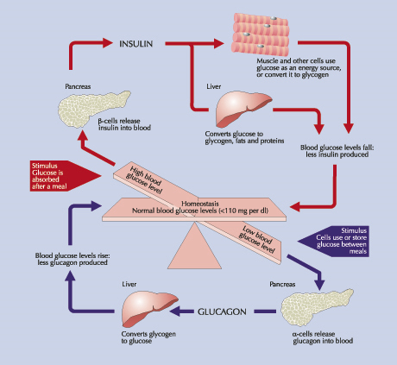

Slide 6
Clinical Manifestations Type I
A. Hyperglycemia
1. Weight loss, fatigue
2. Polyuria, polydipsia, polyphagia
3. Blurred vision
B. Altered Tissue Response
1. Poor wound healing
2. Recurrent infections, particularly of the skin

Slide 7
Clinical Manifestations Type II
Decreased sensitivity of tissues to insulin or mild decrease in insulin secretion
Hyperglycemia
Hyperosmolar Nonketotic Syndrome
Manifestations:
  Fatigue
  Irritability
  Polyurea
  Poor wound healing
  Vaginal infection
  Visual changes
  Polydepsia
  weight gain

Slide 8
Etiology
Genetic factors
Immunologic factors (auto immune response)
Environmental factors (viruses or toxins)
Diagnostic evaluation:
FBS: >140mg/dl
Random: >200mg/dl
Glucose Tolerance test: >200mg/dl
HbA1c more than 6.7%.

Slide 9
Diabetes Long-term Effects
The long–term effects of DM include progressive development of the specific complications of
retinopathy with potential blindness,
nephropathy that may lead to renal failure,
and/or neuropathy with risk of foot ulcers, amputation, and sexual dysfunction.
People with diabetes are at increased risk of cardiovascular, peripheral vascular and cerebrovascular disease.

Slide 10
Secondary DM
Secondary causes of Diabetes mellitus include:
Acromegaly,
Cushing syndrome,
Thyrotoxicosis,
Pheochromocytoma
Chronic pancreatitis,
Cancer
Drug induced hyperglycemia:
  Atypical Antipsychotics –Beta blockers –Calcium Channel Blockers -Corticosteroids -Thiazide Diuretics

Slide 11
Prediabetes: Impaired glucose tolerance and impaired fasting glucose
Prediabetes is a term used to distinguish people who are at increased risk of developing diabetes. People with prediabetes have impaired fasting glucose (IFG) or impaired glucose tolerance (IGT).
IFG the fasting blood sugar (100 to 125 mg/dL) after an overnight fast but is not high enough to be classified as diabetes.
IGT the blood sugar (140 to 199 mg/dL after a 2-hour oral glucose tolerance test), but is not high enough to be classified as diabetes.
HbA1c 5.7-6.4%.

Slide 12
Prediabetes (cont.)
Progression to diabetes among those with prediabetes is not inevitable. Studies suggest that weight loss and increased physical activity among people with prediabetes prevent or delay diabetes and may return blood glucose levels to normal.
People with prediabetes are already at increased risk for other adverse health outcomes such as heart disease and stroke.

Slide 13
Prevention or delay of diabetes:
Life style modification
Research studies have found that lifestyle changes can prevent or delay the onset of type 2 diabetes among high-risk adults.
Lifestyle interventions included diet and moderate-intensity physical activity (such as walking for 2 1/2 hours each week).

Slide 14
Prevention or delay of diabetes: Medications
Studies have shown that medications have been successful in preventing diabetes in some population groups.
treated with the drug metformin reduced their risk of developing diabetes by 31% over 3 years.
Treatment with metformin was most effective among younger, heavier people (those 25-40 years of age who were 20 to 32 kgm overweight) and less effective among older people and people who were not as overweight.

Slide 15
Management of DM
The major components of the treatment of diabetes are:
A
Diet and Exercise
B
Oral hypoglycaemic therapy
C
Insulin Therapy

Slide 16
A. Diet
Diet is a basic part of management in every case. Treatment cannot be effective unless adequate attention is given to ensuring appropriate nutrition.
Dietary treatment should aim at:
  ensuring weight control
  providing nutritional requirements
  allowing good glycaemic control with blood glucose levels as close to normal as possible
  correcting any associated blood lipid abnormalities

Slide 17
Exercise
Physical activity promotes weight reduction and improves insulin sensitivity, thus lowering blood glucose levels.
People should, however, be educated about the potential risk of hypoglycaemia and how to avoid it.

Slide 18
B.1 Oral Agent Monotherapy
If glycaemic control is not achieved (HbA1c > 6.5%) with lifestyle modification within 1 –3 months, ORAL ANTI-DIABETIC AGENT should be initiated.
In the presence of marked hyperglycaemia in newly diagnosed symptomatic type 2 diabetes (HbA1c > 8%), oral anti-diabetic agents can be considered at the outset together with lifestyle modification.

Slide 19
B.2 Combination Oral Agents
Combination oral agents is indicated in:
Newly diagnosed symptomatic patients with HbA1c >10
Patients who are not reaching targets after 3 months on monotherapy

Slide 20
B.3 Combination Oral Agents and Insulin
If targets have not been reached after optimal dose of combination therapy for 3 months, consider adding intermediate-acting/long-acting insulin.
Insulin dose can be increased until target FPG is achieved.

Slide 21
Insulin regimens
The majority of patients will require more than one daily injection if good glycaemic control is to be achieved. However, a once-daily injection of an intermediate acting preparation may be effectively used in some patients.
Twice-daily mixtures of short- and intermediate-acting insulin is a commonly used regimen the morning.
Further doses of short-acting insulin are given before lunch and the evening meal and an evening dose of intermediate-acting insulin is given at bedtime.

Slide 22
Comparison | Short acting | Intermediate | Long acting
Onset | 0.5-2hrs | 3-4hrs | 6-8hrs
Peak | 2-6hrs | 8-12hrs | 14-20hrs
Duration | 6-12hrs | 20-40hrs | >32hrs
Appearance | Clear | Whit milky | Vary
Administration | 20-30min after meals | 0.5 hr before meal | At any time

Slide 23
Complications of DM
Acute
  Hypoglycemia
  DKA
  HHS
Chronic
  Micro and macro vascular changes
  Retinopathy
  Nephropathy
  Neuropathy

Slide 24
Hypoglycemia
abnormally low blood glucose, is an acute complication of several diabetes treatments.
C/M: agitated, sweaty, and have many symptoms of sympathetic activation of the autonomic nervous system resulting in feelings akin to dread and immobilized panic.
Consciousness can be altered or even lost in extreme cases, leading to coma, seizures, or even brain damage and death.
In patients with diabetes, this may be caused by several factors, such as too much or incorrectly timed insulin, too much or incorrectly timed exercise (exercise decreases insulin requirements) or not enough food (specifically glucose containing carbohydrates).
Hypoglycemia is treated with sugary drinks or food. In severe cases, an injection of glucagon is used or an intravenous infusion of dextrose is used for treatment, but usually only if the person is unconscious.

Slide 25
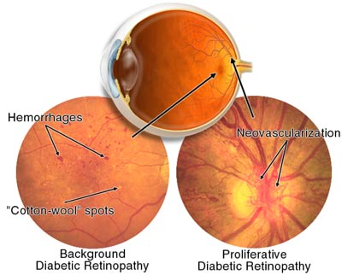
Diabetic retinopathy
Growth of friable and poor-quality new blood vessels in the retina as well as macular edema (swelling of the macula), which can lead to severe vision loss or blindness.

Slide 26
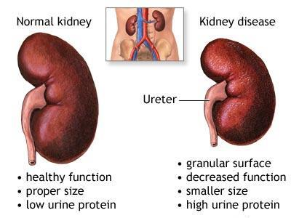
Diabetic Nephropathy
Damage to the kidney which can lead to chronic renal failure, eventually requiring dialysis.

Slide 27
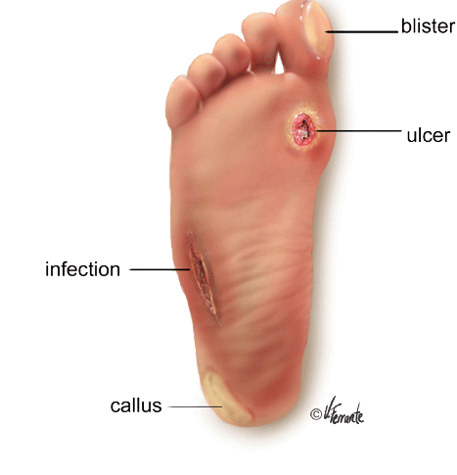
Diabetic Neuropathy
Abnormal and decreased sensation, starting with the feet but potentially in other nerves, later often fingers and hands. When combined with damaged blood vessels this can lead to diabetic foot

Slide 28
Diabetes Mellitus
Nursing Management
Nursing Diagnoses
Ineffective therapeutic regimen management
Fatigue
Risk for infection

Slide 29
Diabetes Mellitus
Nursing Management: Planning
Overall goals:
  Active patient participation
  No episodes of acute hyperglycemic emergencies or hypoglycemia
  Maintain normal blood glucose levels
  Prevent chronic complications
  Lifestyle adjustment with minimal stress

Slide 30
Diabetes Mellitus
Nursing Management
Nursing Implementation
Health Promotion
  Identify those at risk
  Routine screening for overweight adults over age 45
  Diabetes prevention (weight control)

