Slide 1
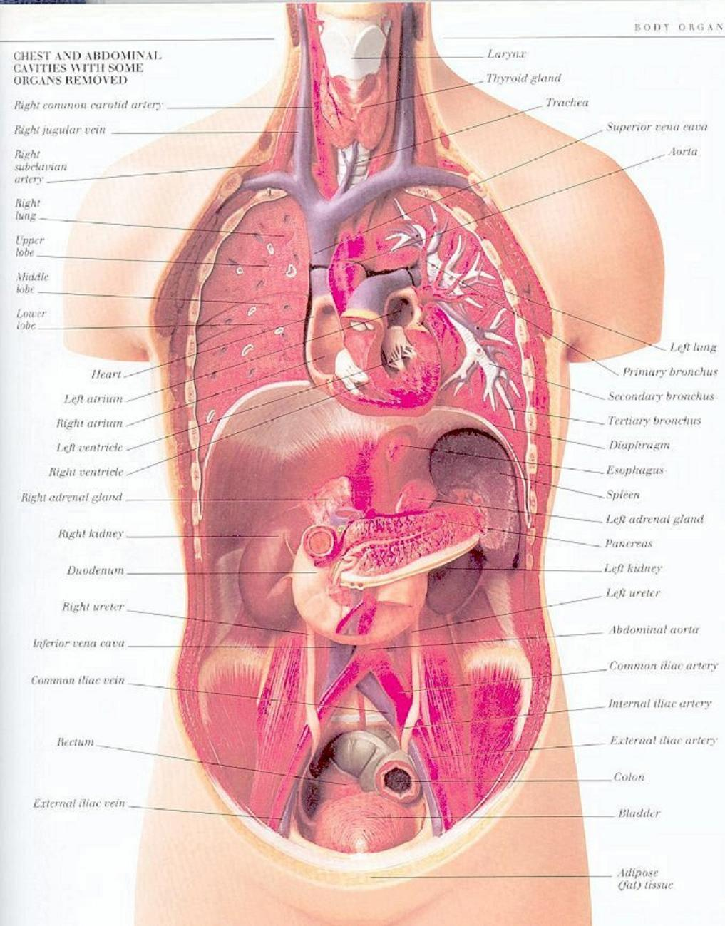

Management of patients with intestinal and rectal disorders
Dr
Loai Abu Sharour
Revised by: Dr Maha Subih

Slide 2
1.constipation
an abnormal infrequency or irregularly of defecation. And abnormal hardening of stools that makes the passage difficult and sometimes painful.
Causes :
Medication ( iron, anticholinergic , antacid )
rectal or anal disorder ( hemorrhoid, fissure)
obstruction ( cancer )
metabolic, neurological, neuromuscular . endocrine
lead poisoning , connective tissue (SLE).
Weakness and immobility
Pathophysiology :
Its interfere with one of the three functions of colon ;
Mucosal transport : mucosal secretion facilitate the movement of colon contents
Myoelectric activity : mixing of the rectal mass and propulsive actions

Slide 3
Continue…
3) Process of defection
The urge to defecate is stimulated normally by rectal distention which initiate a series of four action :
stimulation of inhibitory rectoanal reflex.
relaxation of the internal sphincter
relaxation of external sphincter muscle
relaxation of pelvic region
if defecation is ignored rectal mucosa become insensitive to presence of fecal mass
Clinical manifestation :
Abdominal distention
Borborygmus ( gurgling or rumbling sound caused by gas through the intestine
Pain and pressure
Sensation of incomplete emptying
Straining at stool
Elimination of small –volume , hard, dry stool .

Slide 4
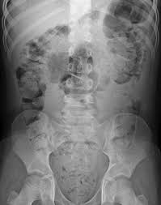

Continue…
Complications:
Hypertension
Fecal impaction
Hemorrhoid and fissure and megacolon
Decrease cardiac output .
Management :
Treatment of underlying causes
Bowel habit training
Increased fiber diet
Increased fluid intake
Laxative ( avoid abuse )
Routine exercise
Lubricant

Slide 5
2. Diarrhea
Is increased frequency of bowel movements ( more than three time / day ), increased amount of stool ( more than 200 mg) and altered in consistency (looseness)
Causes :
any condition that increased intestinal secretion, decreased mucosal absorption, or altered motility .
Irritable bowel syndrome ( IBS)
inflammatory bowel disorders ( IBD) and
lactose intolerance???? .
Pathophysiology :
Types of diarrhea include secretory . osmotic, and mixed.
Secretory : high volume diarrhea and caused by production and secretion of water and electrolytes by the intestinal mucosa into intestinal lumen .
Osmotic : water is pulled into the intestine by the osmotic pressure .
Mixed : combination of both .

Slide 6
Continue…
Clinical manifestation :
Increase frequency and fluid content of stool
Abdominal cramps
Distention
Anorexia
Thirst
Dehydration and electrolyte imbalance
Watery stool : presence of mucous ( inflammatory ) . oily (pancreatic insufficiency )
Assessment and diagnosis
CBC, chemistry profile, urine analysis , stool examination Endoscopic examination and barium enema .
Complication :
cardiac dysrhythmias ( electrolyte imbalance )
urinary output less than 30 ml/ hour for 2-3 hours
hypotension weakness
Management :
controlling symptom and prevent complications

Slide 7
3. Irritable Bowel syndrome :
It’s the most common GI problems , occurs mostly in women than in men .
Associated with heredity , psychological stress, depression and anxiety, high fat diet , alcohol. Smoking
Pathophysiology :
Its result from abnormal function of GI motility . the alter caused by neurological , infection, irritation, or vascular or metabolic disturbance.
Clinical manifestation : primary : constipation, diarrhea, or combination of both, abdominal pain and distention
Assessment and diagnosis : stool studies , contrast x-ray . Protoscopy
Management :
Reduce anxiety
Antidiarrheal agent and antidepressant agent

Slide 8
Inflammatory bowel disease
Comparison | Crohn’s disease | Ulcerative colitis
Definition | Is an inflammatory disease of the GIT affecting usually the small intestine | Is a recurrent ulcerative and inflammatory disease of the mucosal and submucosal layer of the colon and rectum
Manifestations | Diarrhea, Anorexia, weight loss, fever, abdominal distension, colicky abdominal pain | Diarrhea (bloody), Anemia, Dehydration, Anorexia, weight loss, Skin lesions, joint abnormalities
Incidence | Occurs in adolescent and young adults | Caucasians and Jewish heritage

Slide 9
TREATMENT
Diet and Fluid intake
Oral fluids, low-residue diets; supplemental vitamin therapy; and iron replacement
IV Therapy
Smoking Cessation
Avoiding foods that exacerbate symptoms, such as milk and cold foods
Parental Nutrition (PN) may be provided as indicated

Slide 10
Pharmacologic therapy
Sedative, antidiarrheal, and antiperistaltic medications to ↓ GI motility
Aminosalicylate such as Sulfasalazine (Azulfidine), which are effective for mild or moderate inflammation. Given with a glass of water to prevent stone precipitation
Antibiotics for secondary infections
Adrenocortico tropic hormone (ACTH) and corticosteroids (↓ bleeding and inflammation)
Immunomodulator agent (eg. IMURAN)
Histamimic and vitamins to correct iron deficiency and promote healing

Slide 11
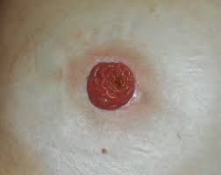
Surgical management
Total colectomy with ileostomy
An opening into the ileum or small intestine (usually by means of an ileal stoma on the abdominal wall) is commonly performed after a total colectomy (i.e. Excision of the entire colon)

Slide 12
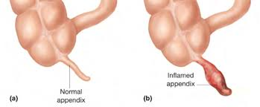
Appendicitis
Appendix is a small . finger like structure about 10 cm , its fill of the food and empties frequently in cecum
appendicitis : inflammation of appendix
Pathophysiology : when it become kinked or obstructed by a fecalith ( hardened mass of stool ) tumor, foreign body , inflammation increase intraluminal pressure causes upper abdominal pain and localized in RLQ .
Clinical manifestation : vague abdominal pain , low grade fever, vomiting, loss of appetite is common . rebound tenderness . constipation ,Rovsing sign (palpitation of lt abd cause pain in Rt)
- Assessment and Diagnosis :
complete physical examination
x-ray and laboratory result
ultrasound and CT scan
Complication
Perforation of the appendix ( peritonitis and abscess )
Management : surgery ( Appendectomy ) .

Slide 13
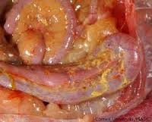
Peritonitis
- Its inflammation of the peritoneum , the serous membrane lining the abdominal cavity and covering the viscera .
result from bacterial infection ( original source GI in men and reproductive in women ). External source ( injury )
- the most common bacteria is : E. coli, Klebsiella , proteus, Pseudomonas.
- Pathophysiology :
* caused by leakage of abdominal content into the abdominal cavity ,usually as a result of inflammation , infection, ischemia, trauma , or tumor perforation this lead to edematous of issue, and exudation of fluid with increasing amount of protein and WBC, cellular debris .
clinical manifestation :
pain , localized
abdominal tender and distended
rebound tender
nausea and vomiting
fever

Slide 14
Continue…
Assessment and Diagnosis :
CBC ( leukocytosis ) ,
Abdominal x-ray ( fluid collection )
Complication
generalized sepsis
shock
intestinal obstruction
Management :
fluid replacement
Antibiotics
Analgesia
intestinal intubation ( NGT)
Oxygen therapy by nasal cannula or mask
surgical removal of fluid collection ( Drainage )

Slide 15
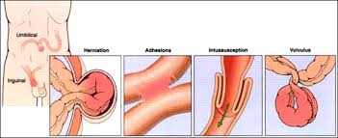
Intestinal Obstruction
Its blockage that prevents the normal flow of intestinal contents through the intestinal tract.
Two types of process
Mechanical : intraluminal obstruction or a mural obstruction from pressure on the intestinal walls, ( tumor, stenosis, hernias , abscess )
Functional : intestinal musculature cannot propel the contents along the bowel , ( amyloidosis, endocrine ( D.M ) Parkinson , lockage is temporary .
Pathophysiology :
intestinal contents, fluid, and gas accumulate above the intestinal obstruction
the abdominal distention and retention of fluid reduce the absorption of fluid and stimulate more gastric secretion

Slide 16
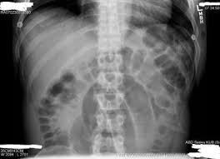
Continue…
clinical manifestation ;
cramp pain ( wavelike) . pass blood or mucous (but no fecal )
vomiting ( stomach content, bile-stained contents)
generalized weakness , aching.
Assessment and diagnosis
X-ray
Physical examination and history taking
Laboratory studies
Management
Decompression (NGT)
Surgical : resection . or pressure removal

Slide 17
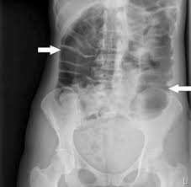
Large bowel Obstruction
Pathophysiology
result from accumulation of intestinal contents, fluid, and gas accumulate above the intestinal obstruction.
lead to severe perforation and distention and intestinal strangulation and necrosis
Clinical manifestation :
if sigmoid or rectum obstruction : constipation , abdomen distention, loops of large bowel become visible outlined through
Assessment and Diagnostic finding ;
x-ray ( flat and upright )
Barium enema
Management
colonoscopy
cecostomy
resection

Slide 18
Comparison | Small bowel | Large bowel
Incidence | 85% of the cases | 15% of the cases
Causes | Main cause is adhesions | Causes may be carcinoma, benign tumors and inflammatory bowel disorders.
pain | Pain in upper and middle abdomen | Pain in lower abdomen
Vomiting | Nausea and vomiting | Minimal or no vomiting
Fluid/Electroytes | Severe F/E imbalance(low K) | No major F/E imbalance
Acid base balance | Metabolic alkalosis | Metabolic acidosis

Slide 19
Diagnostic evaluation | *Abdominal x-ray may show large amount of gas and fluid in the bowel *Lab studies: CBC and electrolytes, dehydration, loss of plasma volume and possibly infection | *Diagnostic evaluation; abdominal x-ray shows distended colon *Barium studies contra indicated

Slide 20
Management | *Decompression: NGT *Surgical intervention If complete obstruction. This depend on the cause (hernia; repair) *Removal of affected bowel & anastomosis performed | *Medical and surgical management *Colonoscopy to untwist and decompress the bowel *Cecostomy: surgical opening into the secum to relief obstruction *Rectal tube: decompress the lower area in the bowel

Slide 21
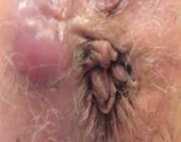
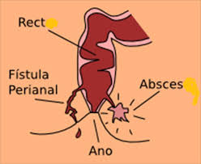
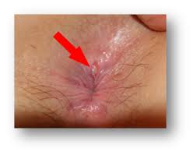
Diseases of the Anorectum
1. Anorectum Abscess :
caused by obstruction of an anal gland , resulting in retrograde infection.
its containing foul – smell pus and its painful .
redness , superficial , swelling, and tenderness.
Therapy : sitz path and analgesia , and surgical incision to remove dead tissue and pus drainage .
2. Anal fistula
it’s a tiny , tubular , fibrous tract that extends into the anal canal from the opening located beside the anus .
its may result from infection, trauma, fissure, enteritis,
surgical treatment must be recommended.
3. Anal fissure
is a longitudinal tear or ulceration in the lining of the anal canal .
its caused by trauma, pass of firm large ,dry stool.

Slide 22
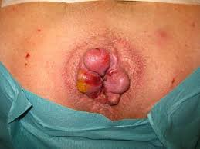
Continue…
4. Hemorrhoids
are dilated portions of veins in the anal canal . they are very common ( by age 50)
Pathophysiology/Etiology
1. Predisposing factors include:
a. Pregnancy, prolonged sitting/standing
b. Straining at stool, chronic constipation/diarrhea
c. Anal infection, rectal surgery or episiotomy
d. Hereditary factor, alcoholism
e. Portal hypertension (cirrhosis)
f. Coughing; sneezing; vomiting
g. Loss of muscle tone due to old age
h. Anal intercourse
2. Increased intraabdominal pressure causes engorgement in the vascular tissue lining the anal canal.
3. Loosening of vessels from surrounding connective tissue occurs with protrusion or prolapse into anal canal.

Slide 23
Continue…
Clinical Manifestations
1. Sensation of incomplete fecal evacuation
2. Visible (if external) and palpable mass
3. Constipation, anal itching
4. Bleeding during defecation, bright red blood on stool due to injury of mucosa covering hemorrhoid
5. Infection or ulceration, mucus discharge
6. Pain noted more in external hemorrhoids
7. Sudden rectal pain due to thrombosis in external hemorrhoids
Diagnostic Evaluation
1. History and visualization by external examination and the use of an anoscope or proctoscope
2. Barium enema or sigmoidoscopy, to rule out more serious colonic lesions causing rectal bleeding
Complications
1. Hemorrhage, anemia
2. Incontinence
3. Prolapse and strangulation

Slide 24
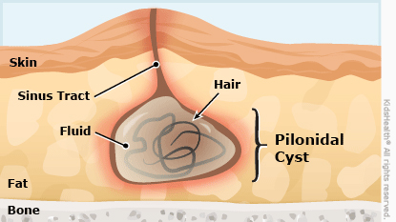
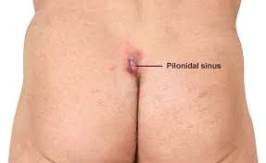
Continue…
5. Pilonidal Sinus or cyst ( PNS)
its found in the intergluteral cleft on the posterior surface of the lower sacrum .
its result from local trauma that causes the penetrating of hairs into the epithelium and subcutaneous tissue . its also be congenital
in early stage : antibiotic therapy
in late stage ( abscess) surgical and pus drainage

