Slide 1
Musculoskeletal care modalities
By
Dr. Mohammad Alnaeem

Slide 2
Learning Objectives
On completion of this lecture, the students will be able to:
1. Use the nursing process as a framework for care of the patient with a cast.
2 Use the nursing process as a framework for care of the patient in traction.
3. Use the nursing process as a framework for care of the patient undergoing orthopedic surgery.

Slide 3
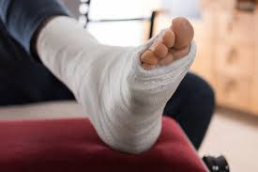
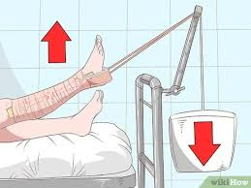
Introduction
The management of musculoskeletal problems frequently includes the use of casts, traction, artificial joint replacement, and/or surgery.
Patient education is essential for optimal outcomes.
The nurse prepares the patient for immobilization with casts or traction, for surgery, and for joint replacement when indicated.

Slide 4
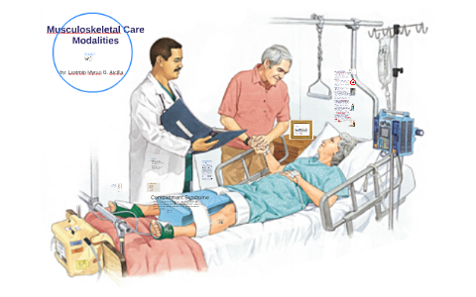
Introduction
Nursing care is planned to maximize the effectiveness of these treatment modalities and to prevent potential complications associated with each of the interventions.
The patient is taught to manage his or her care at home and how to safely resume activities.

Slide 5
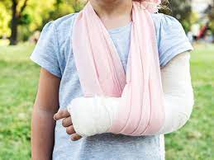
Managing Care of the Patient in a Cast
A cast is a rigid external immobilizing device that is molded to the contours of the body.
The purposes of a cast are:
Immobilize a body part in a specific position
Apply uniform pressure on encased soft tissue.
Immobilize a reduced fracture
Correct a deformity
Support and stabilize weakened joints.

Slide 6
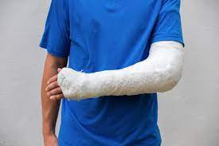
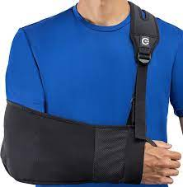
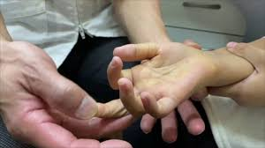
ARM CASTS
Nursing Interventions
To control swelling, the nurse elevates the immobilized arm.
A sling may be used when the patient ambulates. To prevent pressure on the cervical spinal nerves.
Circulatory disturbances in hand may become apparent with signs of cyanosis, swelling, and an inability to move the fingers.
The nurse makes frequent neurovascular checks.

Slide 7
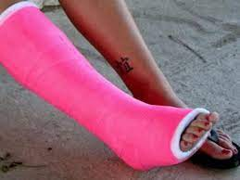
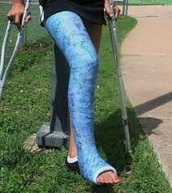
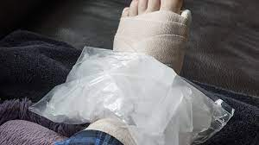
LEG CASTS
The cast may be a short leg cast extending to the knee, or a long leg cast, extending to the groin.
The nurse supports the patient’s leg on pillows to heart level to control swelling and applies ice packs as prescribed over the fracture site for 1 or 2 days.
The patient is taught to elevate the casted leg when seated.
The nurse assesses circulation by observing the color, temperature, and capillary refill of the exposed toes.
Nerve function is assessed by observing the patient’s ability to move the toes and by asking about the sensations in the foot.

Slide 8
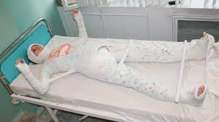
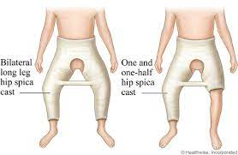
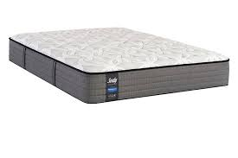
BODY/SPICA CAST
Casts that encase the trunk (body cast) and portions of one or two extremities (spica cast) require special nursing strategies.
Nursing responsibilities include preparing and positioning the patient, assisting with skincare and hygiene.
Supporting the patient on a firm mattress and with flexible, waterproof pillows until the cast dries.
The nurse turns the patient as a unit toward the uninjured side every 2 hours to relieve pressure and to allow the cast to dry.
The nurse inspects the skin around the edges of the cast frequently for signs of irritation.

Slide 9
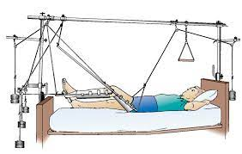
Managing the Patient in Traction
Traction is the application of a pulling force to a part of the body.
Traction is used to minimize muscle spasms; reduce, align, and immobilize fractures; to reduce deformity; and increase space between opposing surfaces.
At times, traction needs to be applied in more than one direction to achieve the desired line of pull.

Slide 10
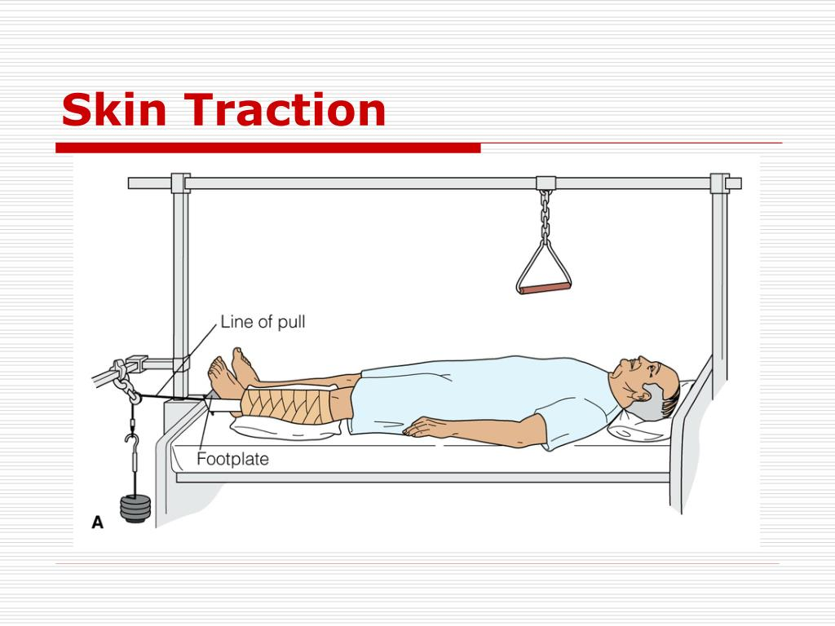
Skin traction is used to control muscle spasms and to immobilize an area before surgery. Skin traction is accomplished by using a weight to pull on traction tape or on a foam boot attached to the skin.
Buck’s extension traction (unilateral or bilateral) is skin traction to the lower leg. The pull is exerted in one plane when partial or temporary immobilization is desired. It is used to provide immobility after fractures of the proximal femur before surgical fixation.

Slide 11
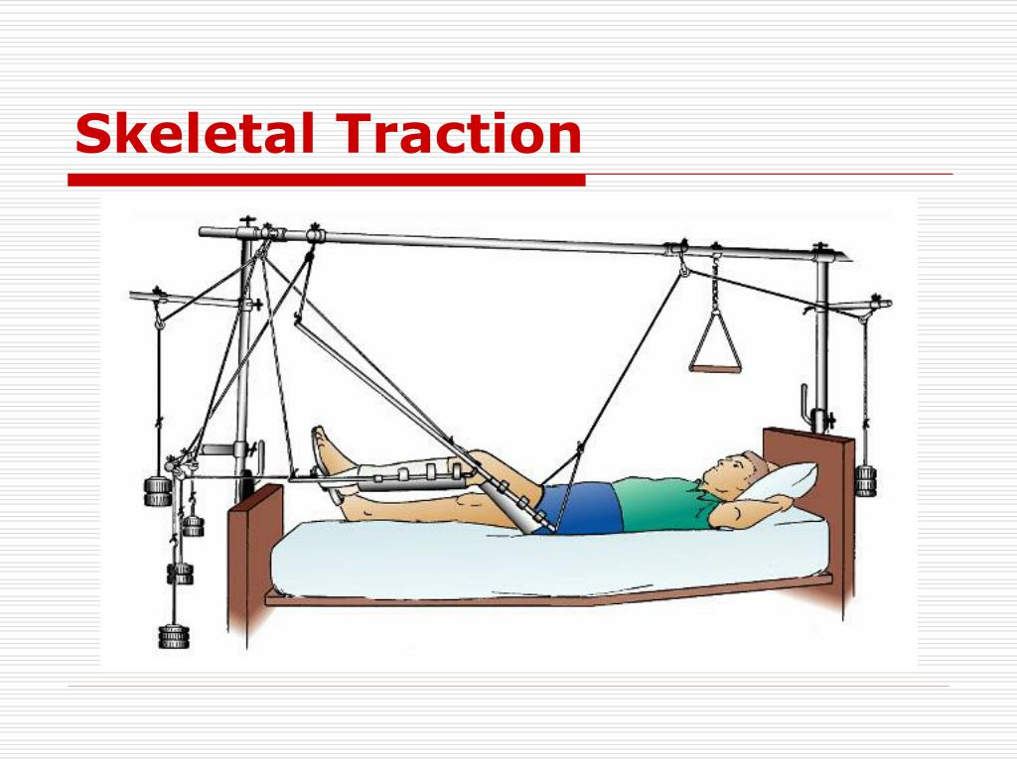
SKELETAL TRACTION
Skeletal traction is applied directly to the bone.
This method of traction is used occasionally to treat fractures of the femur, the tibia, and the cervical spine.
The traction is applied directly to the bone by use of a metal pin or wire that is inserted through the bone distal to the fracture, avoiding nerves, blood vessels, muscles, tendons, and joints.

Slide 12
Nursing Interventions
ENSURING EFFECTIVE TRACTION:
It is important to avoid wrinkling and slipping of the traction bandage.
Proper positioning must be maintained to keep the leg in a neutral position.
The patient should not turn from side to side; however, the patient may shift position slightly with assistance.

Slide 13
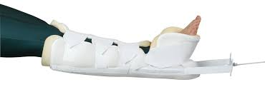
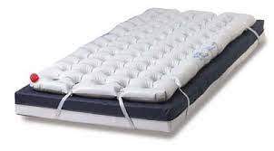
MONITORING POTENTIAL COMPLICATIONS
1- Skin Breakdown:
Removes the foam boots to inspect the skin and skin care.
Palpates the area of the traction tapes daily to detect underlying tenderness.
Provides back care at least every 2 hours to prevent pressure ulcers.
Uses special mattress overlays (e.g., air-filled, high-density foam) to minimize the development of skin ulcers.

Slide 14
MONITORING AND MANAGING POTENTIAL COMPLICATIONS
2- Nerve Pressure:
Regularly assess sensation and motion.
Immediately investigate any complaint of a burning sensation under the traction bandage or boot.
Promptly report altered sensation or motor function.

Slide 15
MONITORING AND MANAGING POTENTIAL COMPLICATIONS
3- Circulatory Impairment:
Circulatory assessment consists of the following:
Peripheral pulses, color, capillary refill, and temperature of the fingers or toes
Indicators of DVT include calf tenderness, and swelling.
Active foot exercises every hour when awake.

Slide 16
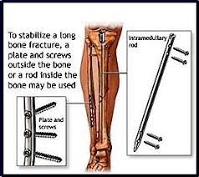
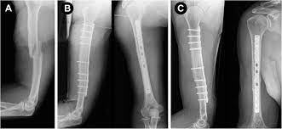
Managing the Patient Undergoing Orthopedic Surgery
Many patients with musculoskeletal dysfunction undergo surgery to correct the problem. Problems that may be corrected by surgery include unstabilized fracture, deformity, joint disease, necrotic or infected tissue, and tumors. Frequent surgical procedures include 1- open reduction with internal fixation (ORIF), and 2- joint replacement for joint.

Slide 17
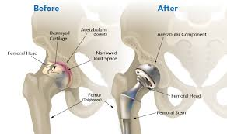
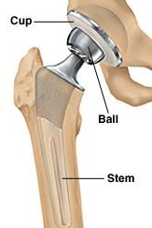
JOINT REPLACEMENT
Joints frequently replaced include the hip and the knee.
Most joint replacements consist of metal and high-density polyethylene components.
With joint replacement, excellent pain relief is obtained in most patients.
Return of motion and function depends on preoperative soft tissue condition, soft tissue reactions, and general muscle strength.

Slide 18
TOTAL HIP REPLACEMENT
Total hip replacement is the replacement of a severely damaged hip with an artificial joint.
The use of an abduction splint
The patient’s hip is never flexed more than 90 degrees
Avoid internal and external rotation, hyperextension, and acute flexion.
Fluid and blood accumulating at the surgical site are usually drained with a portable suction device
Perform ankle and foot exercises hourly while awake, and use elastic stockings.
Prophylactic antibiotics are prescribed to prevent infection

Slide 19
TOTAL KNEE REPLACEMENT
the knee is dressed with a compression bandage.
Ice may be applied to control edema and bleeding.
The Nurse assesses the neurovascular status of the leg.
Frequently, a continuous passive motion (CPM) device is used.
Elevated knee when the patient sits in a chair.
Progressive ambulation.

Slide 20
Joint replacement/ Nursing Interventions
Preoperatively, it is important to evaluate cardiovascular, respiratory, renal, & hepatic functions.
Age, obesity, preoperative leg edema, history of DVT, & varicose veins increase the risk of postoperative DVT & pulmonary embolism. These are the most common causes of postoperative mortality for patients older than 60 years of age undergoing total hip replacement.
Postoperative assessment data are compared with preoperative
assessment data to identify changes and deficits.
Nerve palsy could occur as a result of surgery.

Slide 21
Joint replacement/ Nursing Interventions
Preventing infection:
Preoperative assessment of the patient for infections is necessary because of the risk of postoperative infection.
Any infection 2 to 4 weeks before planned surgery may result in the postponement of surgery.
Preoperative skin preparation frequently begins 1 or 2 days before the surgery.
Prophylactic antibiotics are administered perioperatively as a single preoperative or short perioperative course.
Culture of the joint during surgery, before intraoperative antibiotic therapy is begun.
Patients with total joint replacement begin ambulation with a walker or crutches within a day after surgery.

