Slide 1
Neurologic system Assessment
By
Dr. Suhair Al-Ghabeesh
Revised by Dr Mohammad Alnaeem
1

Slide 2
Learning objectives
On completion of this lecture, the students will be able to:
Describe the structures and functions of the central & peripheral nervous systems.
Describe the significance of physical assessment to the diagnosis of neurologic dysfunction.
Describe diagnostic tests used for assessment of suspected
neurologic disorders and the related nursing implications.
2

Slide 3
The Nervous System Anatomy and physiology
The nervous system is divided into:
The central nervous system, consisting of the brain and spinal cord.
The peripheral nervous system, which consists of the cranial nerves and spinal nerves.
The peripheral nervous system can be further divided into the somatic, or voluntary, nervous system, and the autonomic, or involuntary, nervous system.
3

Slide 4
Anatomy and physiology
The autonomic nervous system, consists of sympathetic and Para-sympathetic systems.
The basic functional unit of the brain is the neuron. It is composed of a cell body, a dendrite, and an axon.
The function of the nervous system is to control all motor, sensory, autonomic, cognitive, and behavioral activities.
4

Slide 5
The Brain Hemispheres
The right side receives information from and controls the left side of the body. Specializes in perception of physical environment, art, music, nonverbal communication, spiritual aspects.
The left receives information from and controls the right side of the body. Specializes in analysis, calculation, problem solving, verbal communication, interpretation, language, reading, and writing.
Peripheral Nervous System: Cranial Nerves
5

Slide 6
Assessment: HEALTH HISTORY
The onset, character, severity, location, duration, and frequency of signs and symptoms.
Family history of genetic diseases
Review of the medical history
History of trauma or falls
Use of alcohol and medications.

Slide 7
Assessment: CLINICAL MANIFESTATIONS
Pain: associated with spinal disc disease, trigeminal neuralgia, or other neuropathic pathology.
Seizures: Seizures are the result of abnormal paroxysmal discharges in the cerebral cortex, which then manifest as an alteration in sensation, behavior, movement, perception, or consciousness
Dizziness: is an abnormal sensation of imbalance or movement.
Visual Disturbances: can range from the decreased visual acuity to sudden blindness.
Weakness: muscle weakness, is a common manifestation of neurologic disease.
Abnormal Sensation: Numbness, abnormal sensation, or loss of sensation

Slide 8
PHYSICAL EXAMINATION: Assessing Cerebral Function
MENTAL STATUS: (observing the patient’s appearance and behavior, noting dress, grooming, and personal hygiene.
INTELLECTUAL FUNCTION: (repeat seven digits without faltering and recite five digits backward.
THOUGHT CONTENT: (patient’s thought content). Are the patient’s thoughts spontaneous, natural, clear, relevant, and coherent? Does the patient have any fixed ideas, illusions, or preoccupations?
PERCEPTION: Agnosia is the inability to interpret or recognize objects seen through the special senses.

Slide 9
Assessing Cerebral Function
MOTOR ABILITY: Assessment of cortical motor integration is carried out by asking the patient to perform a skilled act (throw a ball, or move a chair).
LANGUAGE ABILITY: The person with normal neurologic function can understand and communicate in spoken and written language.

Slide 10
Motor Examination
MUSCLE STRENGTH Assessing the patient’s ability to flex or extend the extremities against resistance tests muscle strength.
BALANCE AND COORDINATION: Cerebellar influence on the motor system is reflected in balance control and coordination. Coordination

Slide 11
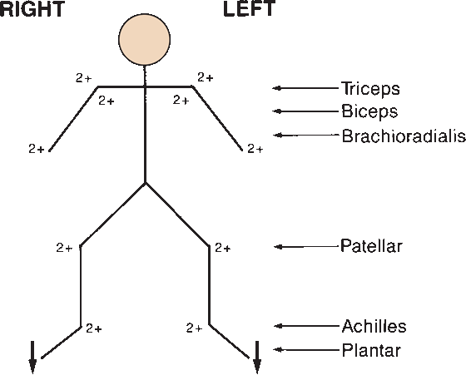
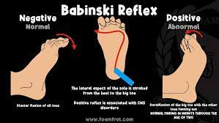
Examining the Reflexes
The motor reflexes are involuntary contractions of muscles in response to abrupt stretching near the site of the muscle’s insertion
Common reflexes that may be tested include the deep tendon reflexes (biceps, brachioradialis, triceps, patellar, and ankle reflexes) and superficial or cutaneous reflexes (abdominal reflexes and plantar or Babinski response

Slide 12
Examining the Reflexes
Deep tendon reflex responses are often graded on a scale of 0 to 4+.
A 4+ indicates a hyperactive reflex, often indicating pathology;
3+ indicates a response that is more brisk than average but may be normal or indicative of disease
2+ indicates an average or normal response
1+ indicates a hypoactive or diminished response
0 indicates no response.

Slide 13
Sensory Examination
Temperature Regulation and Pain Perception
Taste and Smell Alterations
Tactile and Visual Alterations

Slide 14
Diagnostic Tests
CT scan
MRI
Cerebral Angiography. Cerebral angiography is an x- ray study of the cerebral circulation with a contrast agent injected into a selected artery. Cerebral angiography is a valuable tool to investigate vascular disease, aneurysms, and arteriovenous malformations.
Lumbar puncture (LP). between the third and fourth or fourth and fifth lumbar vertebrae to obtain CSF for examination The postpuncture headache is usually managed by bed rest, analgesic agents, and hydration

Slide 15
Diagnostic Tests
Electroencephalogram (EEG). The EEG is a useful test for diagnosing and evaluating seizure disorders, coma, or organic brain syndrome.
Electromyogram (EMG). An EMG is useful in determining the presence of a neuromuscular disorder and myopathies.
Myelogram: A myelogram is an x-ray of the spinal subarachnoid space taken after the injection of a contrast agent into the spinal subarachnoid space through a lumbar puncture.

Slide 16
Management of Patients With Neurologic Dysfunction

Slide 17
Learning objectives
On completion of this lecture, the students will be able to:
Identify the various types and causes of seizures.
Use the nursing process to develop a plan of care for the patient
experiencing seizures.

Slide 18
Seizure Disorders
1- Seizures: are episodes of abnormal motor, sensory, autonomic, or psychic activity (or a combination of these) resulting from sudden excessive discharge from cerebral neurons.
The international classification of seizures differentiates between two main types: partial seizures that begin in one part of the brain, and generalized seizures that involve electrical discharges in the whole brain.
Most seizures are sudden and transient.
Epilepsy: Is a group of syndromes characterized by unprovoked, recurring seizures.

Slide 19
Types
1. Partial seizure
Depend on the region
may develop to a generalized tonic-clonic seizure.
Divided into
Simple and Complex partial seizure
Simple partial seizures:
1- no loss of consciousness 2- last less than 1 minute.
a finger or hand shake
mouth jerk uncontrollably.
Talk unintelligibly
Dizzy
unpleasant sights, sounds, odors, or tastes,

Slide 20
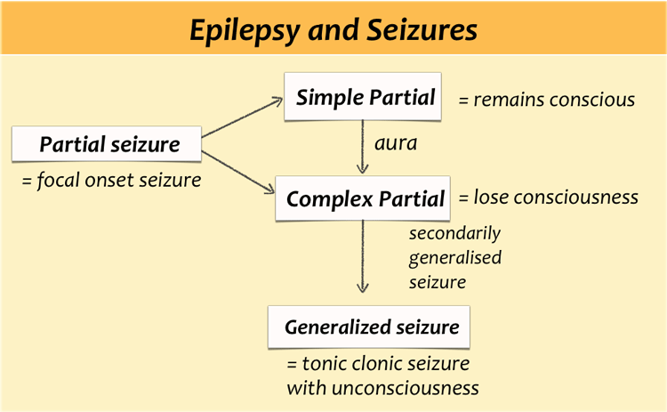

Slide 21
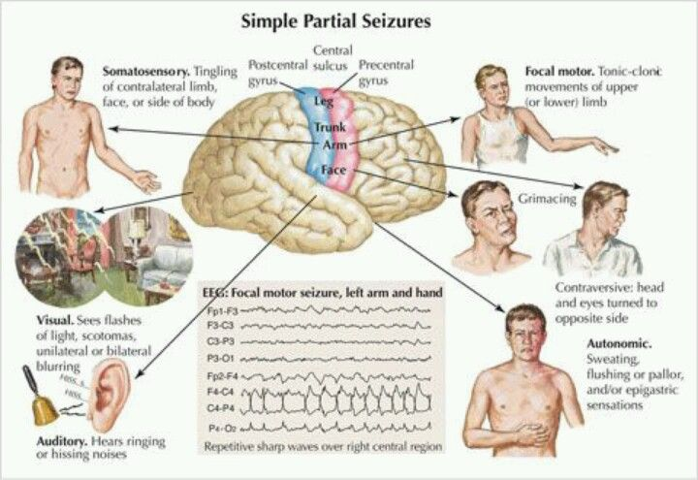

Slide 22
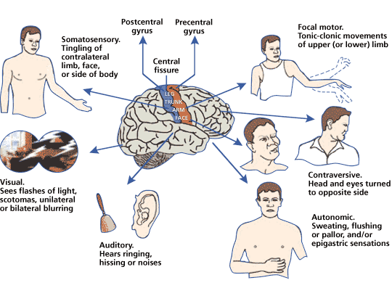
Complex partial seizure:
usually evolve temporal lobe
Some alteration in LOC, rarely complete LOC
Remains motionless or moves automatically but inappropriately for time and place
may experience excessive emotions of fear, anger, elation, or irritability.
the person does not remember the episode

Slide 23
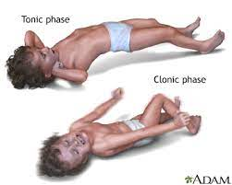
Generalized: Bilateral synchronous epileptic discharge in the brain from the onset of the seizure.
Entire brain is affected
there is no warning.
loses consciousness
tonic-clonic, or grand mal.
falling followed by stiffening of the body (tonic phase) for 10 to 20 seconds.
jerking of the extremities (clonic phase) for another 30 to 40 seconds

Slide 24
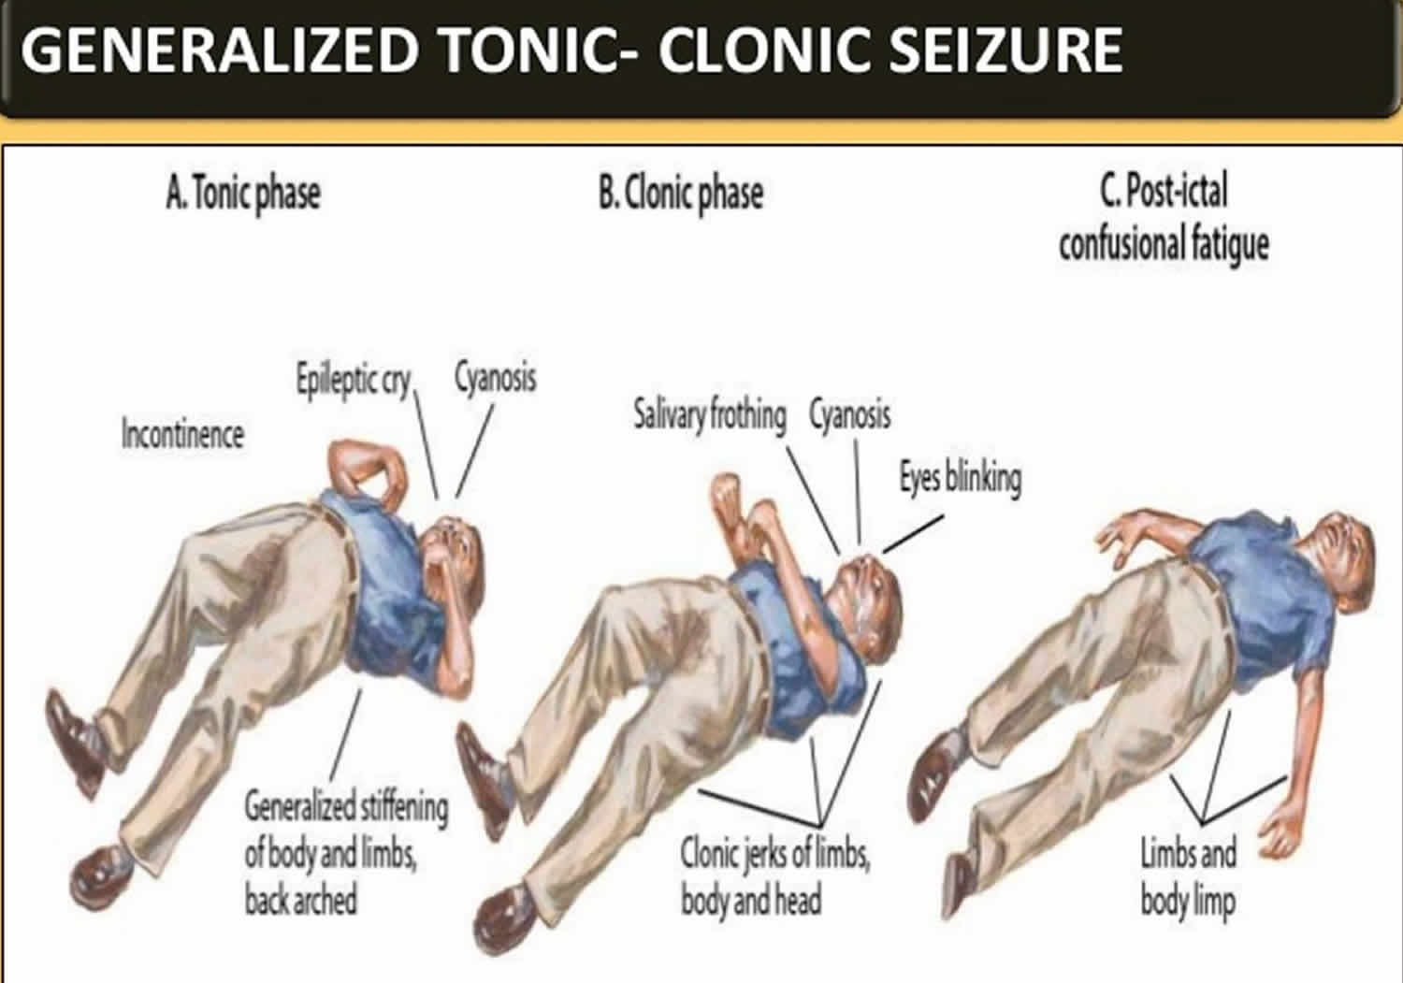

Slide 25
Generalized seizures (grand mal) involve both hemispheres of the brain. Generalized tonic-clonic contraction
Epileptic cry.
The tongue is often chewed, and incontinent of urine and feces.
After 1 or 2 minutes, the convulsive subside; the patient relaxes and lies in deep coma, breathing noisily.
after the seizure: confused and hard to arouse and may sleep for hours.
headache, sore muscles, fatigue, and depression

Slide 26
Epilepsy
Epilepsy: Is a group of syndromes characterized by unprovoked, recurring seizures.
Epilepsy can be:
primary (idiopathic)
secondary (when the cause is known and the epilepsy is a symptom of another underlying condition, such as a brain tumor).

Slide 27
Causes of Epilepsy
During first 6 months of life are: birth injury, Congenital defects involving the CNS, Infections, errors of metabolism.
Causes in 2 and 20 years: infection, trauma, and genetic factors.
In 20 and 30 years of age: trauma, brain tumors, or vascular disease.
After 50 years of age: stroke and brain tumors

Slide 28
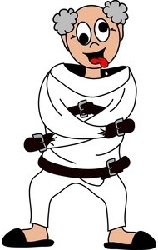

Facts about epilepsy
Injuries to the brain may be the cause of seizures but by to all of the victims.
People with epilepsy are not intellectually retarded.
People with epilepsy are not violent or crazy.
People with epilepsy are not mentally ill.
Seizures do not cause brain damage.
Epilepsy is not necessarily inherited.
Epilepsy is not a life-long disorder.
About 60 % have epilepsy that can be easily controlled. However, about 25 % will require lifelong treatment.
Epilepsy is not a curse: Epilepsy has nothing to do with curses, possession, or punishment.

Slide 29
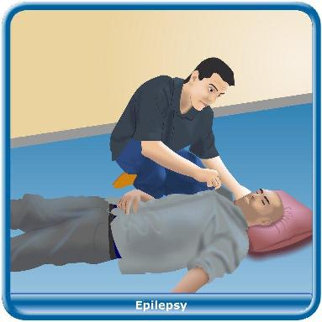
First aid: During the seizure
Remain calm
Provide privacy and protect the patient from curious onlookers. (if the patient who has an aura seek a safe, private place.)
Ease the patient to the ﬂoor, if possible.
Protect the head with a pad to prevent injury (from striking a hard surface).
Push aside any furniture that may injure the patient during the seizure

Slide 30
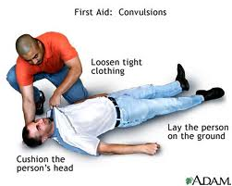
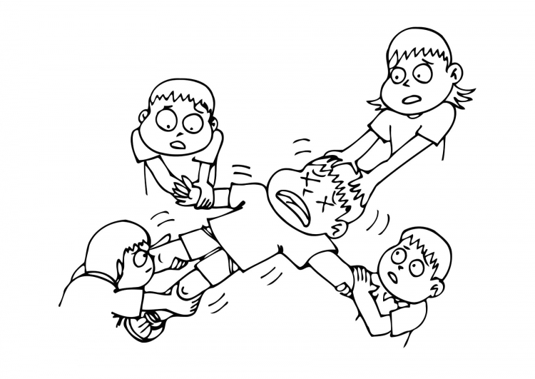
First aid: During the seizure
During the seizure
Monitor breathing
Loosen constrictive clothing.
Pay attention to the length of the seizure
Do NOT try to restrain the person, you cannot stop the seizure
Do not force anything into the persons mouth or give them anything to eat or drink
If the seizure continues for longer than five minutes, call 199

Slide 31
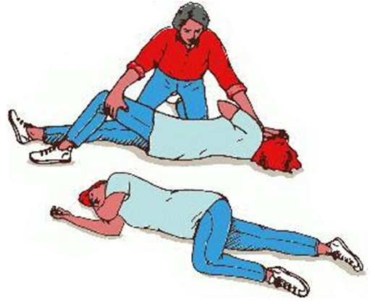
After the seizure
If the patient is in bed, remove pillows and raise side rails.
Do not open jaws that are clenched
Place the patient on one side with head ﬂexed forward, which allows the tongue to fall forward and facilitates drainage of saliva and mucus.
If suction is available, use it if necessary to
clear secretions.
If the patient is in bed, remove
pillows and raise side rails.

Slide 32
After the seizure
6. Do not open jaws that are clenched
7. Place the patient on one side with head ﬂexed forward, which allows the tongue to fall forward and facilitates drainage of saliva and mucus. If suction is available, use it if necessary to clear secretions.
8. The person will probably feel confused and disoriented.
9. They will also be very tired, let them sleep but stay with them until they are fully awake.
10. Do not give him anything to eat or drink until they have fully recovered

Slide 33
Nursing Management
Do not attempt to pry open jaws that are clenched in a spasm to insert anything.
No attempt should be made to restrain the patient during the seizure.
If possible, place the patient on one side with head flexed forward.
Post a seizure
Keep the patient on one side to prevent aspiration. Make sure the airway is patent.
There is usually a period of confusion after a grand mal seizure.
The patient, on awakening, should be reoriented to the environment.

Slide 34
After the partial seizures
When to call 911?
If this is a first time
If the seizure lasts more than 5 minutes
If the person has one seizure after another
If the person is pregnant, injured, or diabetic
If the seizure stops, but the person does not regain consciousness within 10-15 minutes.
If the person is not breathing correctly within one minute after the seizure.
Ask questions to determine if the victim knows his orientation X3.
Let the victim know what happened during a seizure and allow him to talk about it.
help the victim to meet his needs; may ask for a washcloth or tissue to wipe away any saliva. Some persons may need to go to the bathroom. Others may want to lie down

Slide 35
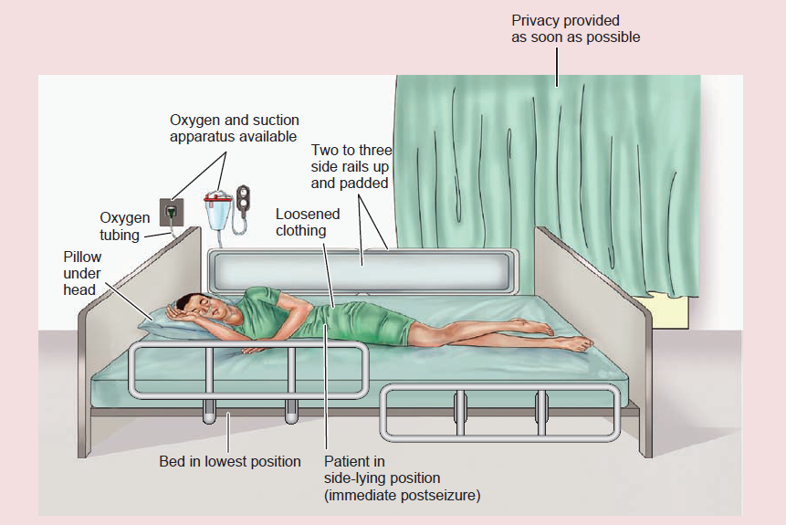

Slide 36
Diagnostic assessment
To determine the type of seizures, frequency, severity, and precipitating factors.
A developmental history
lab. Tests
MRI - lesions, Cerebrovascular abnormalities, & cerebral degenerative changes
EEG
SPECT: A single-photon emission CT for identifying the area in the brain giving rise to seizures can be removed surgically.

Slide 37
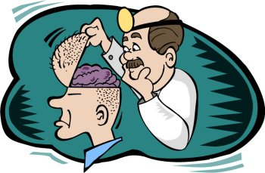
Medical Management
individualized (some forms arise from brain damage and others from altered brain chemistry)
Pharmacologic Therapy
the exact mechanisms of action are unknown.
The objective: to achieve seizure control with minimal side effects.
Does not cure seizures.
Selected on the basis of the type of seizure and the effectiveness and safety of the medications. Table 61-4 lists the medications.
Surgical Management
indicated in intracranial tumors, abscesses, cysts, or vascular anomalies.
Intractable seizure (do not respond to drugs): the removal of the area generating the seizures.

Slide 38
Nursing Diagnoses
Risk for injury related to seizure activity
Fear related to the possibility of seizures
Ineffective individual coping related to stresses imposed by epilepsy
Deﬁcient knowledge related to epilepsy and its control

Slide 39

Nursing Interventions
Preventing Injury is a priority. pads applied to the side rails…
Reducing Fear of Seizures:
adherence to the prescribed treatment
trust relationship.
anti-seizure medication must be taken on a continuing basis, no drug addiction.
Avoid emotional disturbances, environmental stressors, onset of menstruation in female patients, or fever.

Slide 40
Nursing Interventions
Encourage to follow a regular routine lifestyle, diet (avoiding excessive stimulants), exercise, and rest (sleep deprivation may lower the seizure threshold).
Moderate activity is therapeutic,
Ketogenic diet (high-protein, low-carbohydrate, high-fat diet)
Photic stimulation precipitate seizures( wear dark glasses
stress management
No alcohol intake

Slide 41
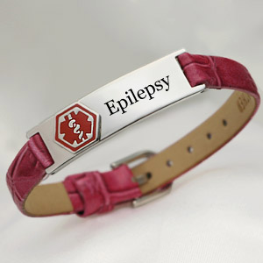
Nursing Interventions
Improving Coping Mechanisms
feelings of stigmatization, separation, depression, and uncertainty. not being able to drive, and feeling different from other people, unemployment, concerns about relationships and child bearing. Family reactions
Counseling
Patient and Family Education
carry an emergency medical identiﬁcation card or wear a medical information bracelet.
Educate about medications as well as care during a seizure.
Monitoring and Managing Potential Complications: Status epilepticus, toxicity of medications - serum drug levels assessed at regularly. drug interactions - potentiate or inhibit the effectiveness of the medications.

Slide 42
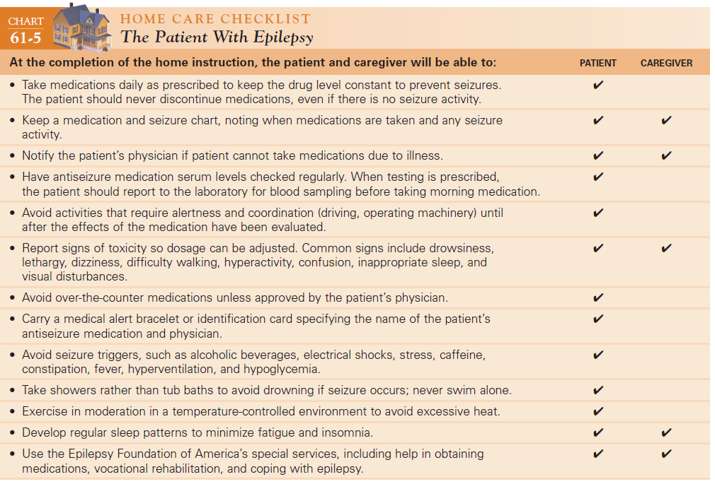
66

Slide 43
Status Epilepticus
Acute prolonged seizure activity= is a series of generalized seizures that occur without full recovery of consciousness between attacks.
lasting at least 30 minutes, even without impairment of consciousness.
a medical emergency: may cause respiratory arrest (venous congestion and hypoxia of the brain).
fatal brain damage.
Precipitating factors: withdrawal of antiseizure medication, fever, and infection.

Slide 44
Status Epilepticus: Medical Management
The goals : to stop the seizures quickly as possible
to ensure adequate cerebral oxygenation
Maintain a seizure free state.
Establish airway and adequate oxygenation
Endotracheal tube is inserted.
IV diazepam (Valium), phenytoin, phenobarbital) to maintain a seizure-free state.
Ongoing assessment and monitoring + Vital signs and neurologic signs are monitored

Slide 45
Status Epilepticus: Medical Management
Dextrose IV infusion is administered if the seizure is caused by hypoglycemia.
general anesthesia with a short-acting barbiturate
side-lying position
Suctioning
The IV line is closely monitored,
Care of the patient during seizure

Slide 46
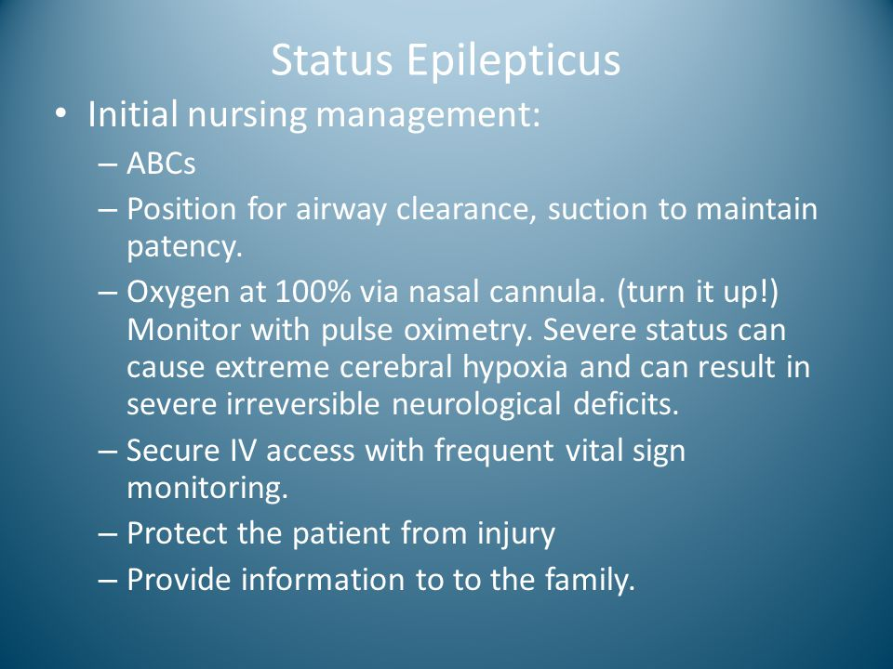

Slide 47
2- The epilepsies
Epilepsy: is a group of syndromes characterized by recurring seizures.
In most cases of epilepsy, the cause is unknown (idiopathic).
Epilepsy can follow head injuries, some infectious diseases (bacterial, viral), toxicity (carbon monoxide), circulatory problems, fever, metabolic and nutritional disorders, & drug or alcohol intoxication.
It is also associated with brain tumors, abscesses, & congenital malformations.

Slide 48
Clinical Manifestations
In simple partial seizures, only a finger or hand may shake, or the mouth may jerk uncontrollably. The person may talk unintelligibly, may be dizzy, and may experience unusual or unpleasant sights, sounds, odors, or tastes, but without loss of consciousness.
In complex partial seizures, the person either remains motionless or moves automatically but inappropriately for time & place, or may experience excessive emotions of fear, anger, elation, or irritability.
Whatever the manifestations, the person does not remember the episode when it is over.

Slide 49
Clinical Manifestations
There may be intense rigidity of the entire body followed by alternating muscle relaxation and contraction (generalized tonic–clonic contraction).
The simultaneous contractions of the diaphragm and chest muscles may produce a characteristic epileptic cry. The tongue is often chewed, and the patient is incontinent of urine and stool.
After 1 or 2 minutes, the convulsive movements begin to subside; the patient relaxes and lies in deep coma, breathing noisily. After the seizure, the patient is often confused & hard to arouse & may sleep for hours.

Slide 50
Assessment and Diagnostic Findings
The patient is questioned about illnesses or head injuries that may have affected the brain.
Biochemical, hematologic, and serologic studies.
MRI is used to detect lesions in the brain, focal abnormalities, and Cerebrovascular abnormalities.
The electroencephalogram (EEG)

Slide 51
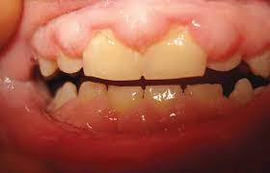
Medical Management
Pharmacologic therapy:
Medication therapy controls rather than cures seizures.
Gingival hyperplasia (swollen & tender gums) can be associated with long-term use of phenytoin (Dilantin).
Periodic physical & dental examinations & laboratory tests are performed.
Surgical management
Surgery is indicated for patients whose epilepsy results from intracranial tumors, abscess, cysts, or vascular anomalies.

Slide 52
Nursing process:
the patient with epilepsy
Assessment:
The patient is asked about the factors that may precipitate the seizures.
Alcohol intake is documented.
The nurse determines if the patient has an aura (warning sensation) before an epileptic seizure, which may indicate the origin of the seizure (e.g. seeing a flashing light may indicate the seizure originated in the occipital lobe).

Slide 53
Nursing process:
the patient with epilepsy
Diagnosis
Risk for injury related to seizure activity
Fear related to the possibility of seizures
Ineffective individual coping related to stresses
Deficient knowledge related to epilepsy and its control
Potential complications
The major potential complication of patients with epilepsy is
Status epilepticus

Slide 54
Nursing process:
the patient with epilepsy
Nursing Interventions:
1- Preventing injury:
the patient should be placed on the floor and any obstructive
items should be removed.
The patient should never be forced into a position, nor should anyone attempt to insert anything into the patient’s mouth once a seizure has begun.
Patients on seizure precautions should have pads applied to side rails while in bed.

Slide 55
Nursing process:
the patient with epilepsy
Nursing Interventions:
2- Reducing fear of seizures
It should be emphasized that the prescribed antiseizure medication must be taken on a continuing basis without fear of drug dependence or addiction.
Moderate activity is therapeutic, but excessive exercise should be avoided.
Photic stimulation (bright lights, television viewing) may precipitate seizures; wearing dark glasses may be preventive.

Slide 56
Nursing process:
the patient with epilepsy
Nursing Interventions:
Tension states (anxiety) induce seizures in some patients.
Alcoholic beverages should be avoided. 3- Improving coping mechanisms:
Social and recreational opportunities are necessary for good mental health.
Educate patients with epilepsy and their families about symptoms and their management

Slide 57
Nursing process:
the patient with epilepsy
Nursing Interventions:
4- Monitoring and managing potential complications:
The patient and family are instructed about side effects and are given specific guidelines to assess and report signs and symptoms indicating medication overdose.
5- Promoting home and community-based care
Teaching Patients Self-Care
Continuing Care

Slide 58
The End

