Slide 1
Management of Patients With Musculoskeletal Disorders
By
Dr. Suhair Al-Ghabeesh
Revised by Dr. Mohammad Alnaeem

Slide 2
Learning objectives
On completion of this lecture, the students will be able to:
Use the nursing process as a framework for care of the patient with low back pain.
Describe the rehabilitation and health education needs of the patient with low back pain.
Describe the medication therapy program for the patient with Paget’s disease.
Use the nursing process as a framework for care of the patient with osteomyelitis and
osteoarthritis.
Use the nursing process as a framework for care of the patient with a bone tumor.
Specify the clinical manifestations of a fracture and the emergency management of the patient with a fracture.
Describe the principles and methods of fracture reduction, fracture immobilization,
and management of open fractures.
Use the nursing process as a framework for care of the patient with a simple fracture.
Describe the prevention and management of immediate and delayed complications of fractures.
2

Slide 3
Common Musculoskeletal Problems
Low back pain

Slide 4
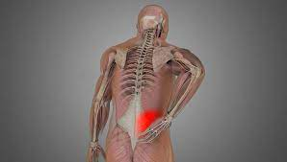
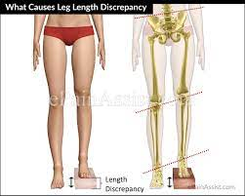
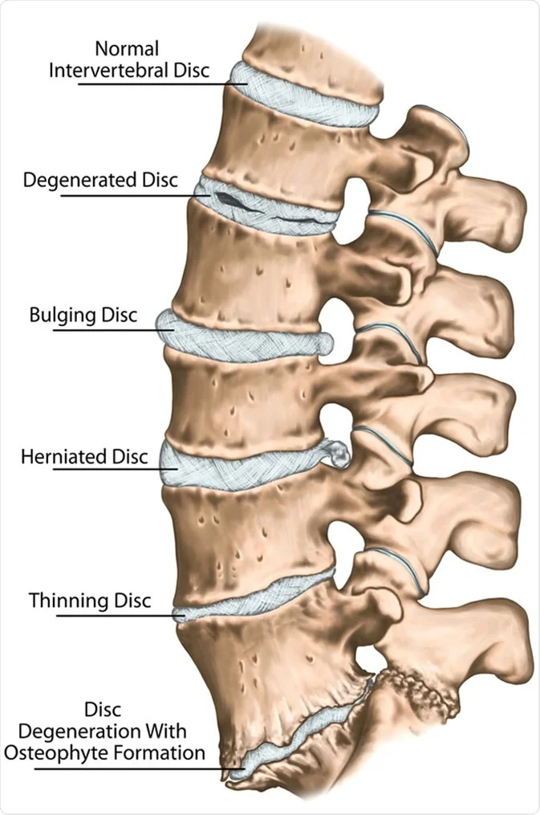
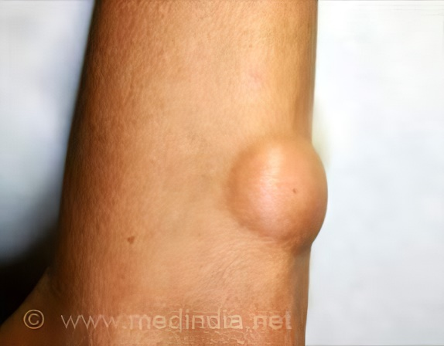
Low back pain/ Causes
Acute lumbosacral strain or unstable lumbosacral ligament and weak muscles
Intervertebral disc problems
Inequality of leg length
Kidney disorders
Retroperitonial tumors

Slide 5
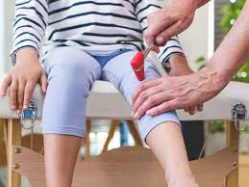
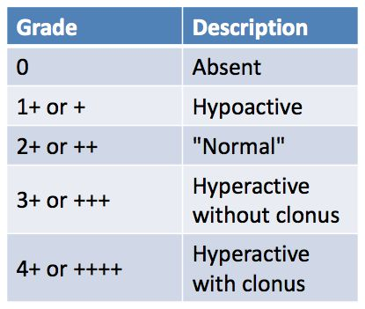
Clinical manifestations
Acute or chronic back pain.
Fatigue.
Pain radiating down the leg, which suggests nerve root involvement.
Altered patient’s gait, reflexes (0, +1, +2,+3, +4), leg length, leg motor strength, and sensory perception.

Slide 6
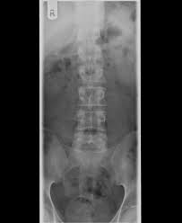
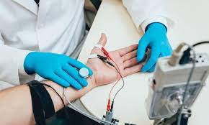
Diagnostic findings
A focused history and physical examination, including:
Back examination
Neurologic testing (reflexes, sensory, and motor impairment).
X-ray spine
Computed tomography: soft tissue lesions
MRI: spinal pathology
EMG: evaluate the spinal nerve root

Slide 7
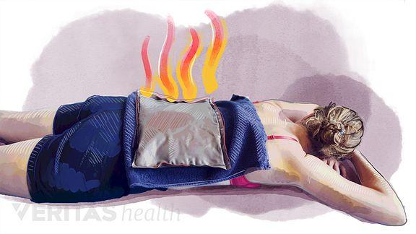
Management
Most back pain is self-limited and resolves within 4 weeks
Management focuses on:
Relief of pain and discomfort (NSAIDs).
Sometimes muscle relaxants or opioids.
Heat or cold therapy frequently provides temporary relief of symptoms.

Slide 8
Nursing diagnosis
Acute pain related to musculoskeletal problems
Impaired physical mobility related to pain, muscle spasms, and decreased flexibility
Deficient knowledge related to back- conserving techniques of body mechanics
Imbalanced nutrition: more than body requirements related to obesity

Slide 9
Patient education
Modify activity patterns:
Twisting, bending, lifting, and reaching, all of which stress the back, are avoided.
The patient is taught to change position frequently.
Bed rest is recommended.
Weight management for obese persons

Slide 10
Nursing process Assessment
Describe the pain.
Observe for patient’s posture, and gait.
On physical examination, the nurse assesses the spinal curve, any leg length discrepancy
The nurse palpates the paraspinal muscles and notes spasm and tenderness
The nurse evaluates nerve involvement by assessing deep tendon reflexes, sensations and muscle strength.

Slide 11
Implementation/RELIEVING PAIN:
To relieve pain, the nurse encourages the patient to reduce stress on the back muscles and to change position frequently.
If medication is prescribed, the nurse assesses the patient’s response to each medication
Self-applied intermittent heat or cold may reduce the pain.

Slide 12
Implementation/ IMPROVING PHYSICAL MOBILITY
Position changes should be made slowly and carried out with assistance as required.
Twisting and jarring motions are avoided.
Advises the patient to avoid sitting, standing, or walking for long periods
As the patient achieves comfort, activities are gradually resumed, and an exercise program is initiated.

Slide 13
Implementation/ USING PROPER BODY MECHANICS
The patient must be taught how to stand, sit, lie, and lift properly
The patient who wears high heels is encouraged to change to low heels.
The patient should sleep on the side with knees and hips flexed.
The nurse instructs the patient in the safe and correct way to lift objects

Slide 14
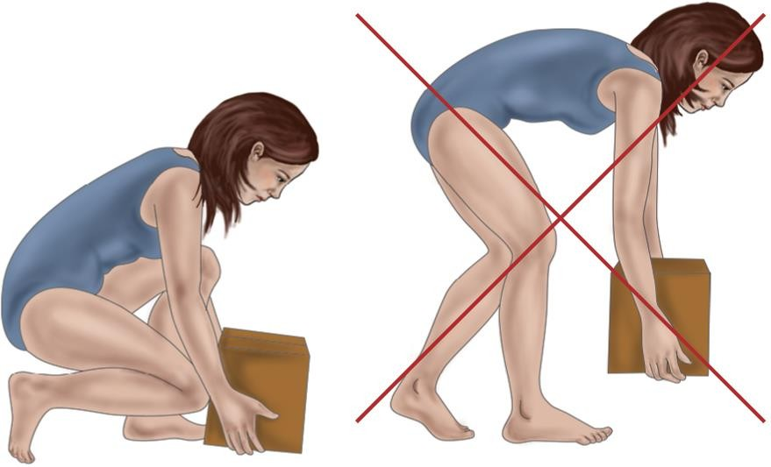

Slide 15
Metabolic Bone Disorders
OSTEOPOROSIS OSTEOMALACIA

Slide 16
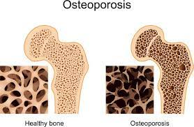
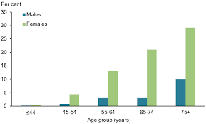
What is Osteoporosis?
Loss in total mineralized bone
is a condition characterized by a decrease in the density of bone, decreasing its strength and resulting in fragile bones (Loss in total mineralized bone).
Over 50% of women and 30-45% of men over age 50 have osteopenia/osteoporosis.

Slide 17
Assessment and Diagnostic Findings
Ultrasonography
CT scan
Dual Energy X-ray Absorptiometry (DEXA)
”gold standard”
Heel and forearm: easy but less reliable
Hip site: best correlation with future risk hip fracture
Vertebral spine: best predict vertebral fractures

Slide 18
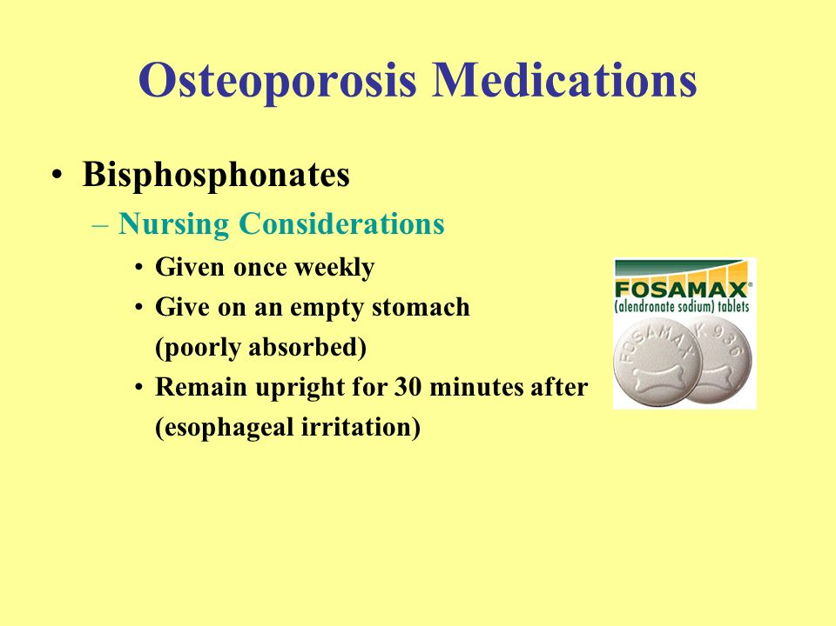
Medical management
Biphosphonates
– Alendronate: Fosamax
Calcitonin
adequate amounts of calcium and vitamin D
Fracture management

Slide 19
*Biphosphonates (Fosamax ) are administered on arising in the morning with a full glass of water on an empty stomach and remain upright for 30 minutes after taking it.
*Prevent ulcers in the mouth and esophagus: The patient must stay upright for 30–60 minutes after taking Fosamax.

Slide 20
Nursing management
Nursing diagnosis:
Deficient knowledge about the osteoporotic process and treatment regimen
Acute pain related to fracture and muscle spasm
Risk for constipation related to immobility or development of ileus (intestinal obstruction)
Risk for injury: additional fractures related to osteoporosis

Slide 21
Interventions
Knowledge: Promoting understanding of osteoporosis and the treatment regimen
Control pain.
Promote appropriate bowel habits
Prevent injury (initiate fall precautions)
Monitor for fat embolism.
Promote nutrition
– Increasing calcium intake and supplementation as appropriate

Slide 22
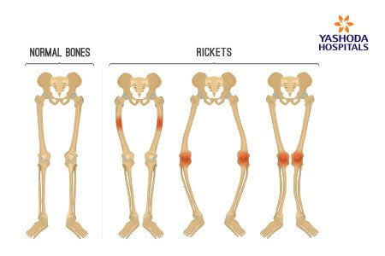
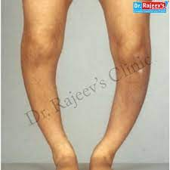
Osteomalacia
A metabolic bone disease characterized by inadequate bone mineralization
Is the softening of the bones caused by impaired bone metabolism primarily due to inadequate levels of available Phosphate, calcium, and vitamin D . الكساح

Slide 23
Symptoms
Bone pain and muscle weakness most commonly affects the lower back, pelvis, hips, legs and ribs.
The pain might be worse at night, and rarely relieved completely by rest.
A waddling gait and walking slower and more difficult.

Slide 24
Causes
Gastrointestinal disorders or surgeries (A damaged intestinal lining doesn't absorb nutrients well, and can lead to vitamin D and calcium deficiency).
Renal insufficiency (activating vitamin D). Deficiency of activated vitamin D causes lack of bone mineralization and low extracellular calcium and phosphate.
Hyperparathyroidism
Dietary deficiency

Slide 25
Diagnostic findings
Low levels of calcium or a significant drop in phosphate levels .
X-ray
Bone biopsy

Slide 26
Treatment of Osteomalacia
Correct underlying cause
Increased doses of vitamin D and calcium are usually recommended
Handle patient gently; patient is at high risk for fractures
Address pain and discomfort

Slide 27
Nursing Management
Nursing diagnoses
Acute pain related to weakness and possible fracture.
Knowledge Deficit: about the disease process and treatment procedures.
Disturbance of self-concept related to swelling in the legs, and spinal deformity.

Slide 28
Nursing interventions
Give Vitamin D supplementation
Check the patient’s skin daily for redness
Monitor the patient’s pain level and give analgesics.
Explain all treatments, tests, and procedure to
the patient
Provide emotional support for clients and the family.

Slide 29
Musculoskeletal Infections
Osteomyelitis:
Osteomyelitis is an infection of the bone. The bone becomes infected by one of three modes:
1- Extension of soft tissue infection (e.g. infected ulcer)
2- Direct bone contamination from bone surgery, or open fracture
3- Hematogenous (blood-borne) spread from other sites of infection (e.g. infected tonsils, infected teeth, upper respiratory infections).

Slide 30
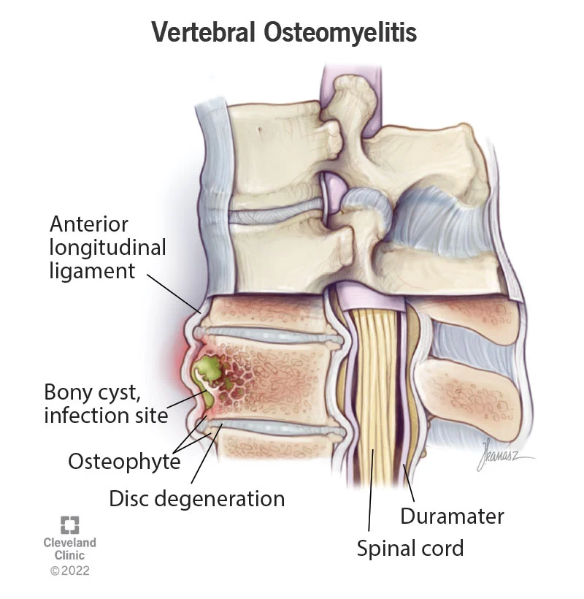
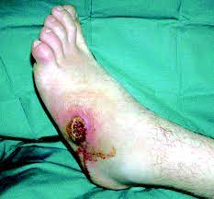
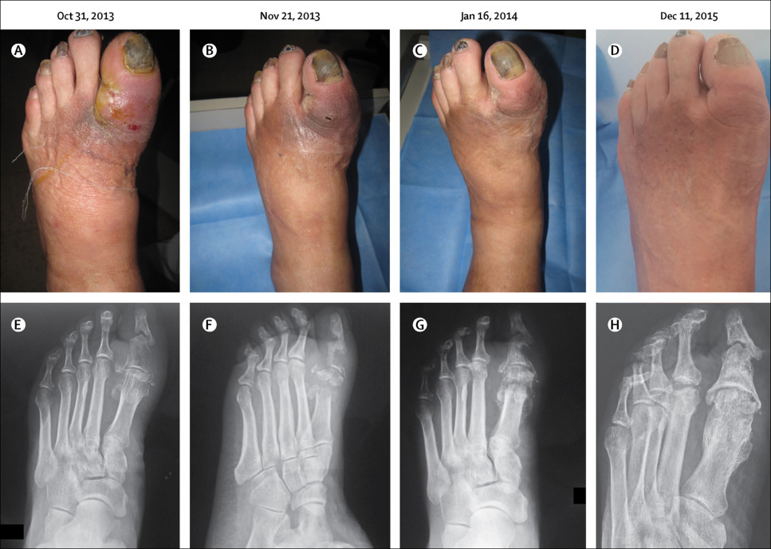
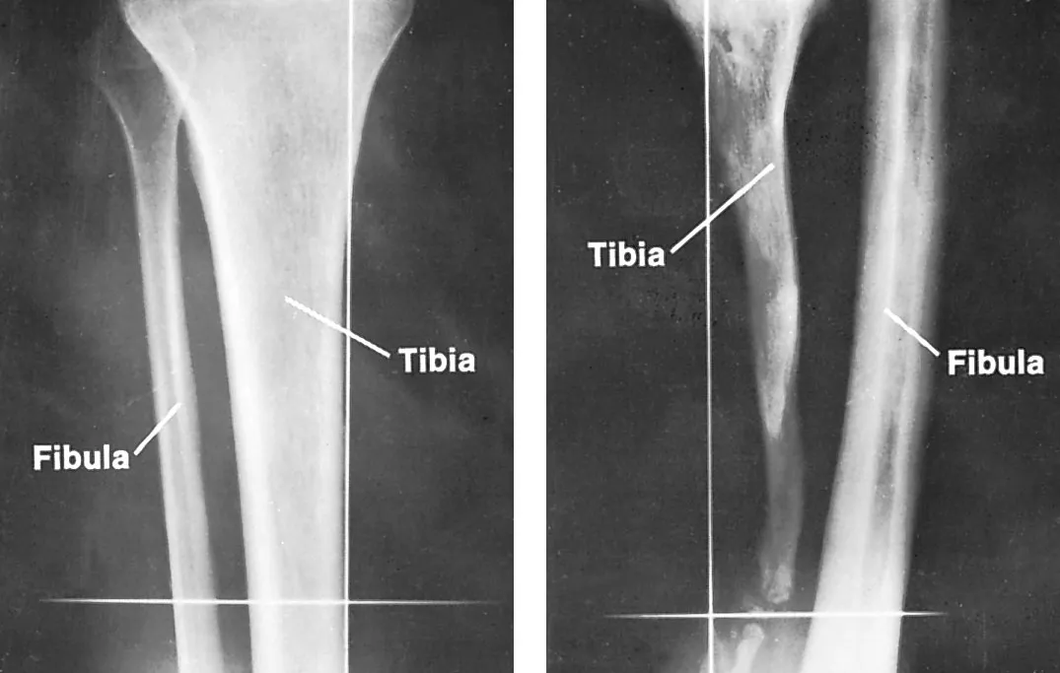

Slide 31
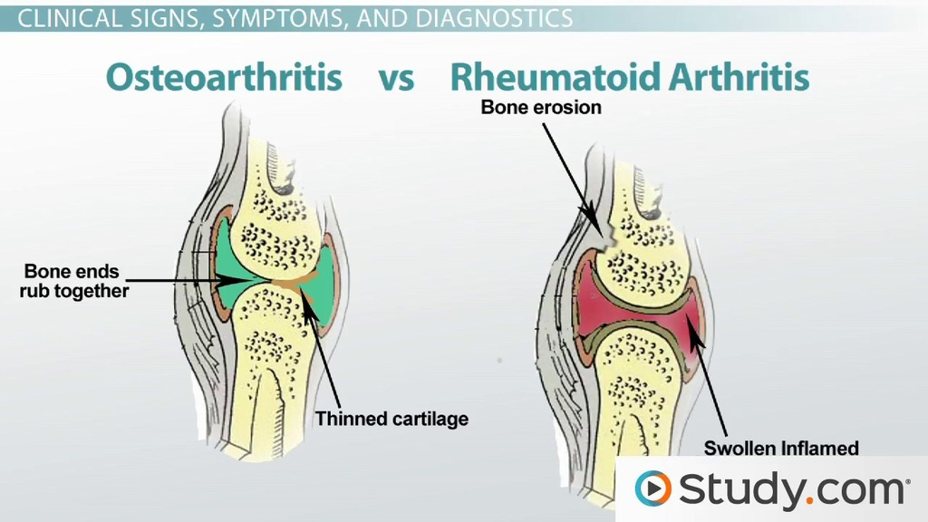
Osteomyelitis
Risk factors:
Poorly nourished
Elderly.
Patients with impaired immune systems,
Chronic illness (e.g. diabetes, rheumatoid arthritis),
Orthopedic postoperative surgical wound.

Slide 32
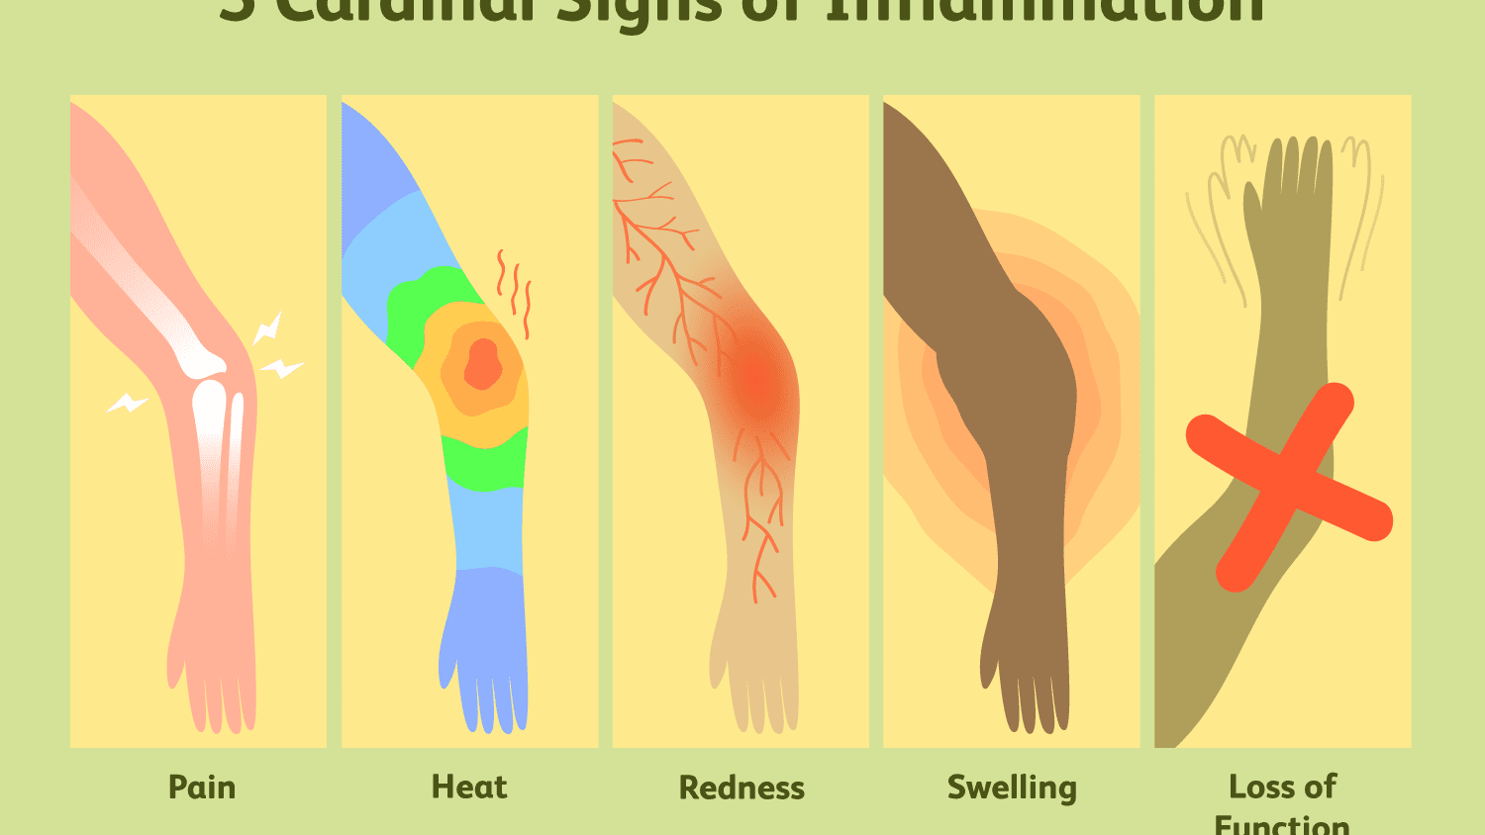
Pathophysiology
Staphylococcus aureus causes 70% to 80% of bone infections.
Other pathogenic organisms frequently found in osteomyelitis include Proteus and Pseudomonas species and Escherichia coli.
The initial response to infection is: 1- Inflammation 2- Increased vascularity 3- Edema.

Slide 33
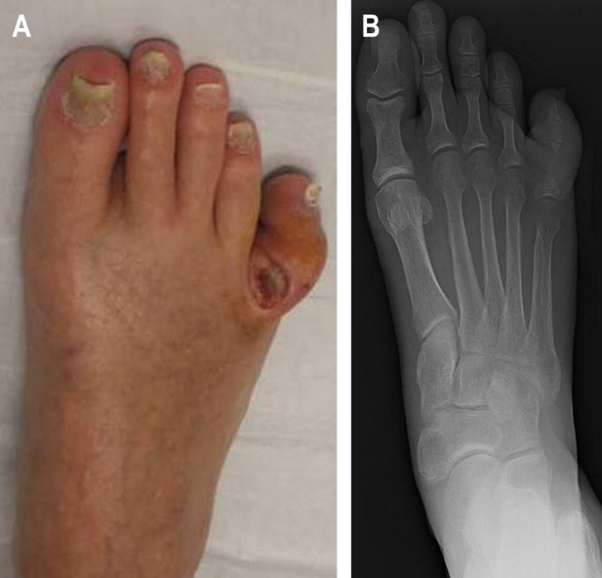
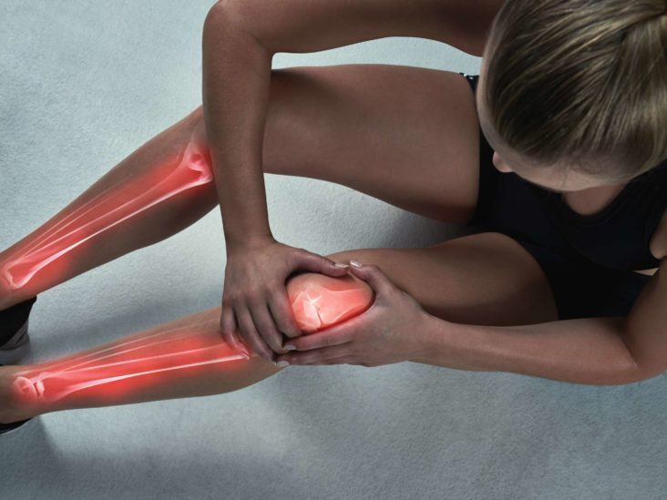
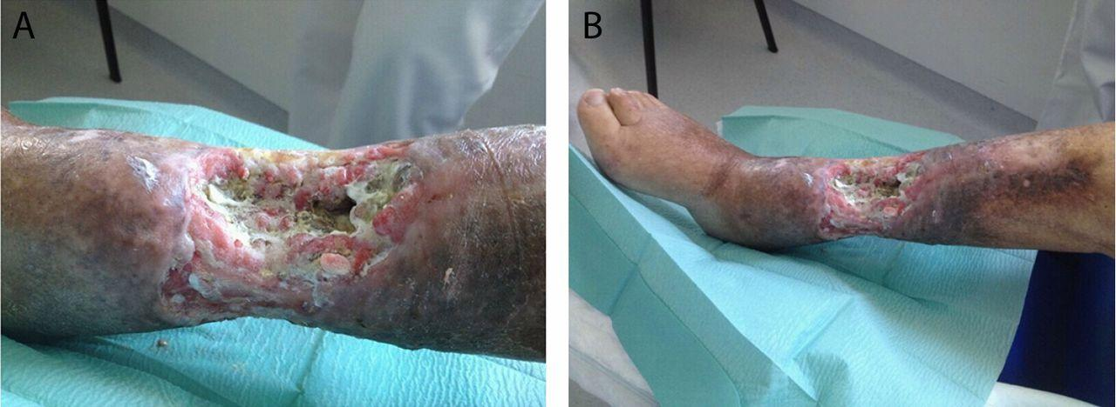
Clinical Manifestations
When the infection is blood-borne, the onset is usually sudden, occurring often with the clinical manifestations of septicemia (e.g., chills, high fever, rapid pulse, general malaise).
The infected area becomes painful, swollen, and extremely tender to the touch.
The patient with chronic osteomyelitis presents with a continuously draining sinus or experiences recurrent periods of pain, inflammation, and swelling.

Slide 34
Assessment and Diagnostic Findings
Early x-ray findings demonstrate soft tissue swelling.
Radioisotope bone scans…. nuclear imaging
Magnetic resonance imaging (MRI) helps with early diagnosis.
Blood studies reveal elevated leukocyte levels and an elevated sedimentation rate.
Wound and blood culture studies are performed to identify appropriate antibiotic therapy.

Slide 35
Prevention
Elective orthopedic surgery should be postponed if the patient has a current infection.
Careful attention is paid to the OR.
Prophylactic antibiotics.
Urinary catheters and drains are removed as soon as possible
Aseptic postoperative wound care reduces the incidence of osteomyelitis

Slide 36
Medical Management
Antibiotic therapy depends on cultures.
General supportive measures (e.g. hydration, diet high in protein) should be instituted.
The area affected is immobilized.
Warm wet soaks may be prescribed to increase circulation
Surgical management:
The infected bone is surgically exposed, the purulent and necrotic material is removed, and the area is irrigated with sterile saline solution.

Slide 37
Nursing process:
The patient with osteomyelitis
Assessment
Signs and symptoms (e.g. localized pain, swelling, Erythema, fever) or recurrent drainage of an infected sinus with associated pain, swelling, and low-grade fever.
The nurse assesses the patient for risk factors (e.g. older age, diabetes) and for a history of previous injury, infection, or orthopedic surgery.
Purulent drainage may be noted. The patient has an elevated temperature

Slide 38
Nursing process:
The patient with osteomyelitis
Nursing Diagnoses
Nursing diagnoses for the patient with osteomyelitis:
Acute pain related to inflammation and swelling
Impaired physical mobility related to pain, use of immobilization devices, and weight-bearing limitations
Risk for extension of infection: bone abscess formation
Deficient knowledge related to the treatment regimen

Slide 39
Nursing process/nursing intervention
Nursing Interventions
1- Relieving pain
The affected part may be immobilized.
The extremity must be handled with great care and gentleness.
Elevation reduces swelling and associated discomfort.
Pain is controlled with prescribed analgesics and other pain reducing techniques.

Slide 40
Nursing process:
The patient with osteomyelitis
2- Improving physical mobility
Restrict activity and avoidance of stress on the bone.
The nurse encourages full participation in to promote general well-being.
3- Controlling the infectious process
The nurse monitors the patient’s response to antibiotic therapy.
4- Promoting home and community-based care

Slide 41
Bone Tumors
Neoplasms of the musculoskeletal system are of various types..
They may be primary tumors or metastatic tumors from primary cancers elsewhere in the body (e.g. breast, lung, prostate, kidney).
Metastatic bone tumors are more common than primary bone tumors.

Slide 42
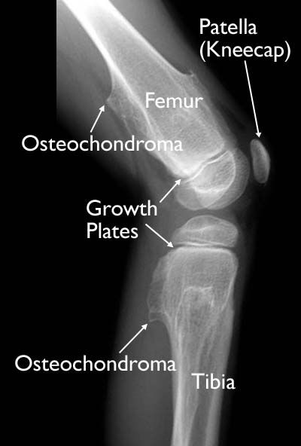
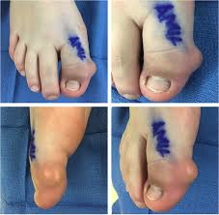
Bone tumors
Benign tumors of the bone & soft tissue are more common than malignant primary bone tumors.
Benign primary neoplasms of the musculoskeletal system include osteochondroma, and bone cyst.

Slide 43
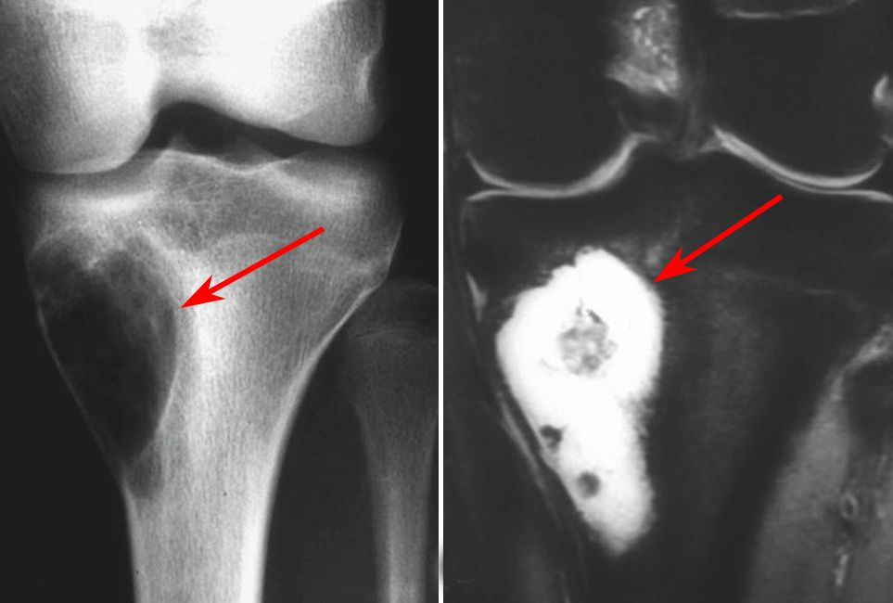
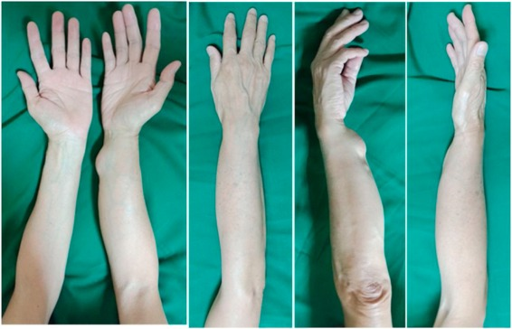
Bone tumors
Malignant primary musculoskeletal tumors include osteosarcoma.
Soft tissue sarcomas include liposarcoma, and rhabdomyosarcoma.

Slide 44
Clinical manifestations
Pain,
Swelling,
Limited motion,
Weight loss.
The bony mass may be:
Palpable,
Tender, and Fixed,
Increase in skin temperature over the mass & venous distention.

Slide 45
Medical Management
The goal of primary bone tumor treatment is to remove the tumor. This may be accomplished by:
Surgical excision
Radiation therapy
Chemotherapy (preoperative, intraoperative, & postoperative).

Slide 46
Medical Management
Rehabilitation to restore function and reduce the risk for complications.
Chemotherapy to prevent metastasis.
Chemotherapy is started before and continued after surgery.
Soft tissue sarcomas are treated with radiation & chemotherapy.

Slide 47
Nursing process:
The patient with a bone tumor
Assessment
The nurse asks the patient about the onset & course of symptoms.
On physical examination, the nurse gently palpates the mass & notes its size & tenderness.
Assessment of the neurovascular status & range of motion of the extremity.
The nurse evaluates the patient’s mobility & ability to perform ADLs.

Slide 48
Nursing process:
The patient with a bone tumor
Diagnosis
Deficient knowledge related to the disease process & the therapeutic regimen
Acute & chronic pain related to pathologic process & surgery
Risk for injury: pathologic fracture related to tumor & metastasis
Ineffective coping related to fear of the unknown, perception of disease process, & inadequate support system
Risk for situational low self-esteem related to loss of body part or alteration in role performance

Slide 49
Nursing process:
The patient with a bone tumor
Nursing Interventions
Promoting understanding of the disease process and treatment regimen
Relieving pain
Preventing pathologic fracture
Promoting coping skills
Promoting self-esteem
Monitoring and managing potential complications

Slide 50



Slide 51
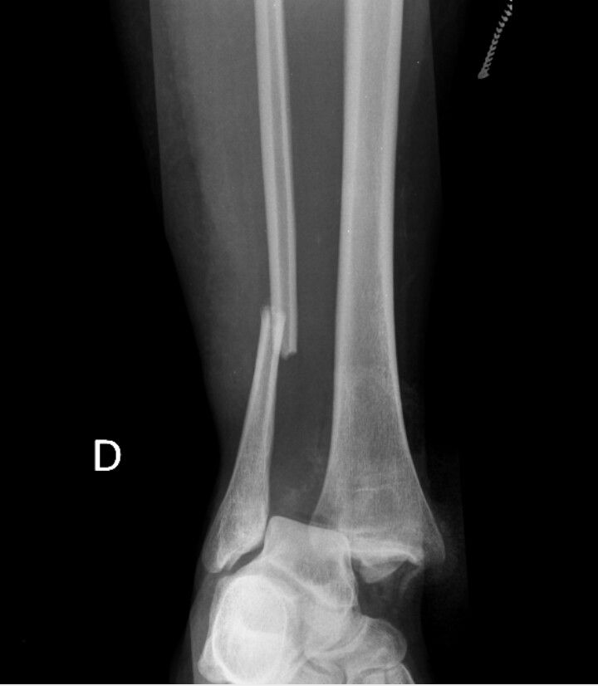
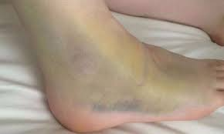
Fractures
A fracture: is a break in the continuity of bone & is defined according to its type and extent.
Fractures occur when the bone is subjected to stress greater than it can absorb.
Fractures are caused by direct blows, crushing forces, sudden twisting motions, and even extreme muscle contractions.

Slide 52
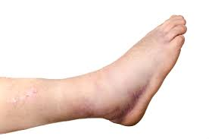
When the bone is broken, adjacent structures are also affected, resulting in soft tissue edema, hemorrhage into the muscles & joints, joint dislocations, ruptured tendons, severed nerves, & damaged blood vessels.

Slide 53
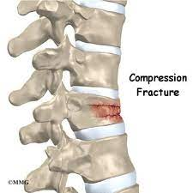
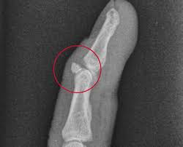
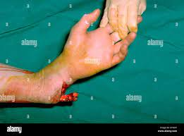
Types of Fractures
Avulsion: a fracture in which a fragment of bone has been pulled away by a ligament or tendon and its attachment
Comminuted: a fracture in which bone has splintered into several fragments
Compound: a fracture in which damage also involves the skin or mucous membranes; also called an open fracture
Compression: a fracture in which bone has been compressed (seen in vertebral fractures)

Slide 54
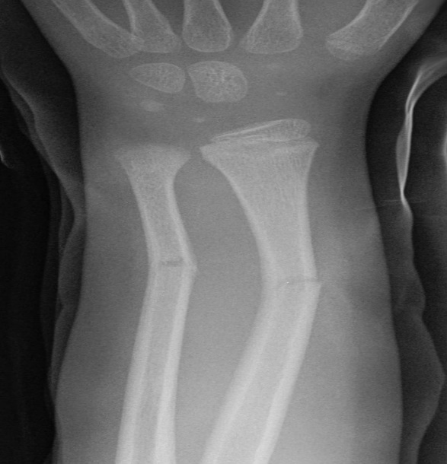
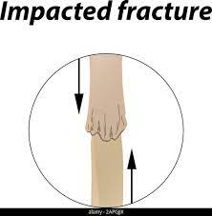
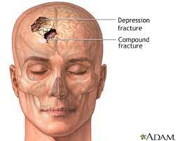
Depressed: a fracture in which fragments are driven inward (seen frequently in fractures of skull and facial bones)
Greenstick: a fracture in which one side of a bone is broken & the other side is bent
Impacted: a fracture in which a bone fragment is driven into another bone fragment

Slide 55
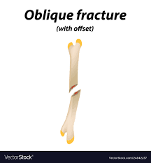
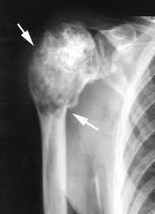
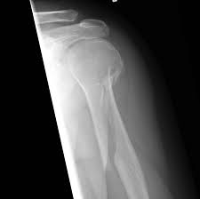
Types of Fractures
Oblique: a fracture occurring at an angle across the bone
Pathologic: a fracture that occurs through an area of diseased bone (e.g. osteoporosis, bone cyst, Paget’s disease, tumor); can occur without trauma or a fall
Simple: a fracture that remains contained; does not break the skin
Spiral: a fracture that twists around the shaft of the bone

Slide 56
Types of Fractures
Transverse: a fracture that is straight across the bone.
Open fractures are graded according to the following criteria:
Grade I is a clean wound less than 1 cm long.
Grade II is a larger wound without extensive soft tissue damage.
Grade III is highly contaminated, has extensive soft tissue damage, and is the most severe.

Slide 57
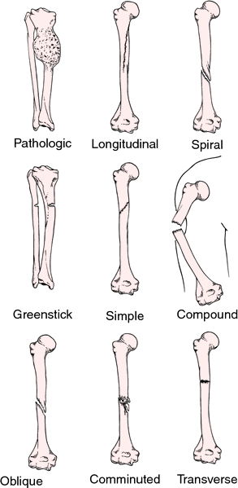
Types of Fractures

Slide 58
Clinical Manifestations
The clinical manifestations of a fracture are:
Pain (The pain is continuous and increases in severity until the bone fragments are immobilized),
Loss of function,
Deformity,
Shortening of the extremity.
Crepitus (caused by the rubbing of the bone fragments against each other),
Local swelling and discoloration.

Slide 59
Emergency Management of Fractures
It is important to immobilize the body part before the patient is moved.
Adequate splinting for joints adjacent to the fracture
Assessed adequacy of peripheral tissue perfusion and nerve function.
With an open fracture, the wound is covered with a clean (sterile) dressing to prevent contamination of deeper tissues.
No attempt is made to reduce the fracture.

Slide 60
Medical Management of Fractures
Closed Reduction: is accomplished by bringing the bone fragments into apposition through manipulation and manual traction.
X-rays are obtained to verify that the bone fragments are correctly aligned.
Traction (skin or skeletal) may be used to effect fracture reduction & immobilization.
Open Reduction: Some fractures require open reduction through
a surgical approach, the fracture fragments are reduced.
Internal fixation devices (metallic pins, wires, screws, plates, nails, or rods) may be used to hold the bone fragments in position.

Slide 61
Nursing Management
Patients with closed fractures
Encourages patients to return to their usual activities as rapidly as possible.
Teaches patients how to control swelling & pain associated with the fracture.
It is important to teach exercises to maintain the health of unaffected muscles and to increase the strength of muscles needed for transferring.
Patient teaching includes self-care, medication information, monitoring for potential complications

Slide 62
Nursing Management
Patients with open fractures
The nurse administers tetanus prophylaxis if indicated.
Irrigation and debridement.
Intravenous antibiotics are prescribed to prevent or treat infection.
The wound is cultured..
With open fractures heavily contaminated wounds are left unsutured.
After it has been determined that infection is not present, the wound is closed or by grafting of skin or a flap.

Slide 63
Fracture Healing and Complications
Factors that enhance fracture healing:
Immobilization of fracture fragments
Maximum bone fragment contact
Sufficient blood supply
Proper nutrition
Exercise: weight bearing for long bones
Hormones: growth hormone, calcitonin.

Slide 64
Fracture Healing and Complications
Factors That Inhibit Fracture Healing
Extensive local trauma
Inadequate immobilization
Space or tissue between bone fragments
Metabolic bone disease (eg, Paget’s disease)
Avascular necrosis
Age (elderly persons heal more slowly)
Infection

Slide 65
Fracture Healing and Complications (Early and Delayed)
Complications of fractures fall into two categories—early and delayed.
Early complications include shock, fat embolism, compartment syndrome, deep vein thrombosis, thromboembolism(pulmonary embolism), disseminated intravascular coagulopathy, & infection.
Delayed complications include delayed union and nonunion, a vascular necrosis of bone, reaction to internal fixation devices, complex regional pain syndrome and heterotrophic ossification.

Slide 66
Fat embolism syndrome
After fracture of long bones or pelvis fat emboli may develop.
The fat emboli occlude the small blood vessels that supply the lungs, brain, kidneys, and other organs.
The onset of symptoms is rapid, occurring within 72 hours.
The respiratory distress response includes tachypnea, dyspnea, chest pain, cough, and tachycardia.
Arterial blood gas show PaO2 to be less than 60 mmHg,.
Acute pulmonary edema, and heart failure develop.
Cerebral disturbances: headache, and confusion and coma

Slide 67
Management
Respiratory support is provided with oxygen given in high concentrations.
Mechanical ventilation.
Corticosteroids: to treat the inflammatory lung.
Vasoactive medications to support cardiovascular function and to prevent hypotension, and shock.
Accurate fluid intake and output records facilitate adequate fluid replacement therapy.

Slide 68
Compartment syndrome
Compartment syndrome is a complication that develops when tissue perfusion in the muscles is reduced.
The patient complains of deep, throbbing, unrelenting pain, which is not controlled by opioids.
This pain can be caused by:
The muscle fascia is too tight, or the cast is constrictive.
Edema or hemorrhage at the site.
The forearm and leg muscle compartments are involved most frequently.

Slide 69
Assessment and Diagnostic Findings
Frequent assessment of neurovascular function. Sensory deficits include paresthesia.
Motion is evaluated by asking the patient to move fingers or toes distal to the potential problem.
No movement (paralysis) suggests nerve damage.
Peripheral circulation is evaluated by assessing color, temperature, capillary refill time, swelling, and pulses.
Cyanotic (blue-tinged) nail beds suggest venous congestion.
Edema may obscure the presence of arterial pulsation

Slide 70
Medical Management
Compartment syndrome is managed by elevation of the extremity, release of restrictive devices (dressings or cast), a fasciotomy may be needed to relieve the constrictive muscle fascia.
After fasciotomy, the wound is not sutured but instead is left open to permit the muscle tissues to expand; it is covered with moist, sterile saline dressings.
The limb is splinted in a functional position and elevated, & passive ROM exercises are usually performed,
when the swelling has resolved, and tissue perfusion has been restored, the wound is débrided and closed.

Slide 71
Other complications
Deep vein thrombosis (DVT)
Surgical internal fixation of fractures carries a risk for infection.
The delayed union may be associated with distraction (pulling apart) of bone fragments, systemic or local infection, or poor nutrition.
Vascular necrosis occurs when the bone loses its blood supply and dies

Slide 72



