Slide 1
Management of Patients With Cerebrovascular Disorders
By
Dr. Mohammad Alnaeem

Slide 2
Learning objectives
On completion of this lecture, the students will be able to:
Describe the incidence and social impact of CVA disorders.
Identify the risk factors for CVA and related measures for prevention.
Compare the various types of CVA : their causes, clinical manifestations, and medical management.
Relate the principles of nursing management to the care of a patient in the acute stage of an ischemic stroke.
Use the nursing process as a framework for care of a patient recovering from an ischemic stroke.
7. Identify essential elements for family teaching and preparation for
home care of the stroke patient.

Slide 3
Ischemic Stroke
An ischemic stroke, Cerebrovascular accident (CVA), or what is now being termed “brain attack” is a sudden loss of function resulting from disruption of the blood supply to a part of the brain.
This event is usually the result of long-standing Cerebrovascular disease.
Only 8% of ischemic strokes result in death within 30 days

Slide 4
Stroke ch. 67
An acute neulogic deficit persisting for more than 24 hours and caused by interruption of blood flow to the brain. Consequently, O2 supply is decreased and causing brain cell death (infarction).
Other names:
Cerebrovascular accident
Brain attack

Slide 5
Risk Factors of Stroke
Stroke is the primary cerebrovascular disorder.
Non-modifiable risk factors
Age (over 55), male gender, race
Modifiable risk factors
Hypertension is the primary risk factor
Cardiovascular disease
Elevated cholesterol or elevated hematocrit
Obesity
Diabetes
Oral contraceptive use
Smoking and drug and alcohol abuse

Slide 6
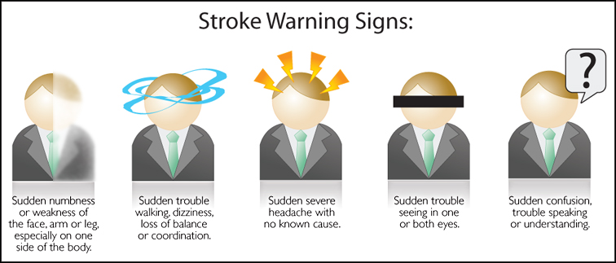
Stroke Warning Signs
If blood flow to brain is totally interrupted
Neurologic metabolism is altered in 30 seconds
Metabolism stops in 2 minutes
Cellular death occurs in 5 minutes
If adequate blood flow restored early (<3 hours) → less brain damage and less neurologic function lost.
According to the American Stroke Association the warning signs of stroke are sudden:

Slide 7
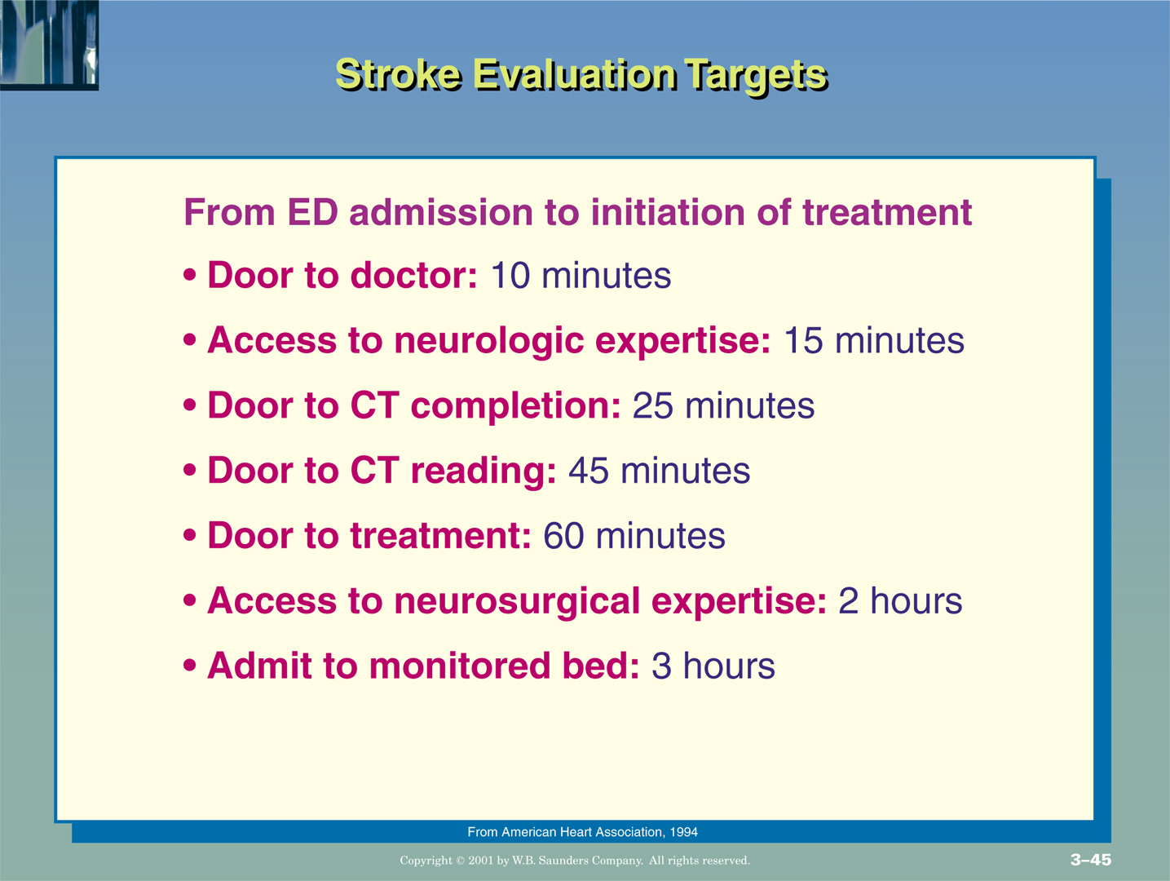
Computed tomography (CT) of the brain without contrast is the most important initial diagnostic study.
Tissue plasminogen activator (tPA) is used to reestablish blood flow through a blocked artery in patients with acute onset of ischemic stroke symptoms

Slide 8
Major types of stroke & their causes
Classification
Ischemic
Causes
Large or small artery
thrombosis
Cryptogenic (no known cause)
Intracerebral hemorrhage
Subarachnoid hemorrhage
Cerebral aneurysm
Hemorrhagic

Slide 9
Types of Stroke
Ischemic strokes Disruption of the blood supply due to an obstruction, usually a thrombus or embolism, that causes infarction of brain tissue
85% of all strokes are ischemic strokes
Types
Large artery thrombosis
Small penetrating artery thrombosis
Cardiogenic embolism
Cryptogenic: No specific cause
Other

Slide 10
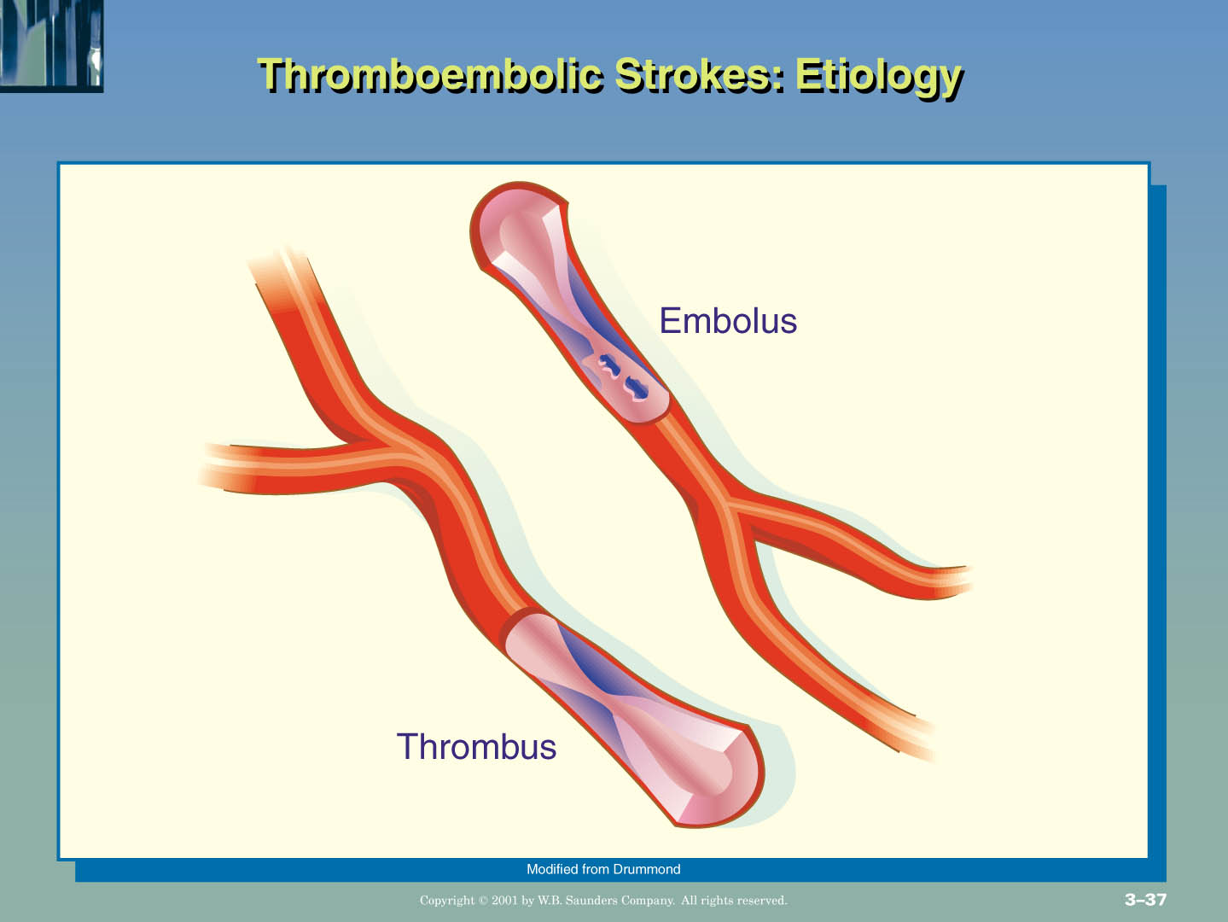
B
Menu
F

Slide 11
Clinical Manifestations
Numbness or weakness of the face, arm, or leg, especially on one side of the body
Confusion or change in mental status
Trouble speaking or understanding speech
Visual disturbances
Difficulty walking, dizziness, or loss of balance or coordination
Sudden severe headache

Slide 12
Comparison of Left and Right Hemispheric Strokes
Left hemispheric stroke Right hemispheric stroke
Paralysis or weakness on
right side of body
Right visual field deficit
Aphasia (expressive,
receptive, or global)
Altered intellectual ability
Slow, cautious behavior
Paralysis or weakness on
left side of body
Left visual field deficit
Increased distractibility
Poor judgment
Lack of awareness

Slide 13
Assessment and Diagnostic Findings
A careful history and a complete physical and neurologic examination.
Initial assessment will focus on airway patency, which may be compromised by loss of gag or cough reflexes and altered respiratory pattern;
Cardiovascular status (including blood pressure, cardiac rhythm, and rate, carotid bruit), and gross neurologic losses.

Slide 14
Assessment and Diagnostic Findings
The initial diagnostic test is CT scan.
A 12-lead electrocardiogram and a carotid ultrasound are standard tests.
Other studies may include cerebral angiography and magnetic resonance imaging of the brain and/or neck.

Slide 15
Prevention
Treating hypertension & hyperglycemia & stopping smoking, will reduce stroke risk.
Many health promotion efforts involve encouraging a healthy lifestyle, including eating a low-fat, low-cholesterol diet and increasing exercise.
Recent evidence suggests that eating fish two or more times per week reduces the risk of thrombotic stroke for women.
In patients with atrial fibrillation, which increases the risk of emboli, administration of Warfarin, an anticoagulant that inhibits clot formation.

Slide 16
Medical Management
Thrombolytic therapy
Anticoagulant administration to maintain cerebral perfusion.
Osmotic diuretic (e.g. mannitol) to reduce increased intracranial
pressure (ICP)
Intubation to establish a patent airway, if necessary
Continuous hemodynamic monitoring.
Neurologic assessment to determine whether bleeding from anticoagulation occurred.
Surgical intervention : The main surgical procedure is carotid endarterectomy, it is the removal of an atherosclerotic plaque or thrombus from the carotid artery.

Slide 17
Transient Ischemic Attack (TIA)
Temporary neurologic deficit resulting from a temporary impairment of blood flow
“Warning of an impending stroke”
Diagnostic workup is required to treat and prevent irreversible deficits

Slide 18
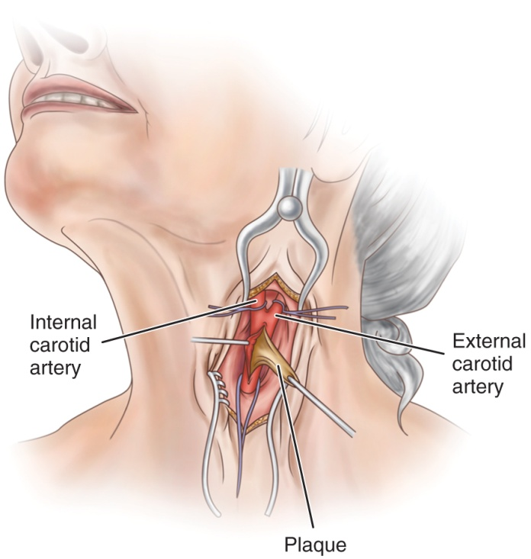
Preventive Treatment
Health maintenance measures: healthy diet, exercise, and treatment of underlying disease
Carotid endarterectomy
Anticoagulant therapy
Antiplatelet therapy: aspirin, Ticlid)
Antihypertensive medications

Slide 19
Hemorrhagic Stroke
Hemorrhagic strokes account for 15% of Cerebrovascular disorders & are primarily caused by an intracranial or subarachnoid hemorrhage.
Hemorrhagic strokes are caused by bleeding into the brain tissue, the ventricles, or the subarachnoid space.
Primary Intracerebral hemorrhage from a spontaneous rupture of small vessels accounts for approximately 80% of hemorrhagic strokes and is primarily caused by uncontrolled hypertension.
Secondary Intracerebral hemorrhage is associated with arteriovenous malformations (AVMs), intracranial aneurysms, or certain medications (eg, anticoagulants and amphetamines)

Slide 20
Hemorrhagic Stroke
Caused by bleeding into brain tissue, the ventricles, or subarachnoid space.
Spontaneous rupture of small vessels related to hypertension
subarachnoid hemorrhage due to a ruptured aneurysm
intracerebral hemorrhage related to amyloid angiopathy (deposition of fibrous protein), arterial venous malformations , aneurysms, or medications such as anticoagulants.
ICP increases.
injury to brain tissue.

Slide 21
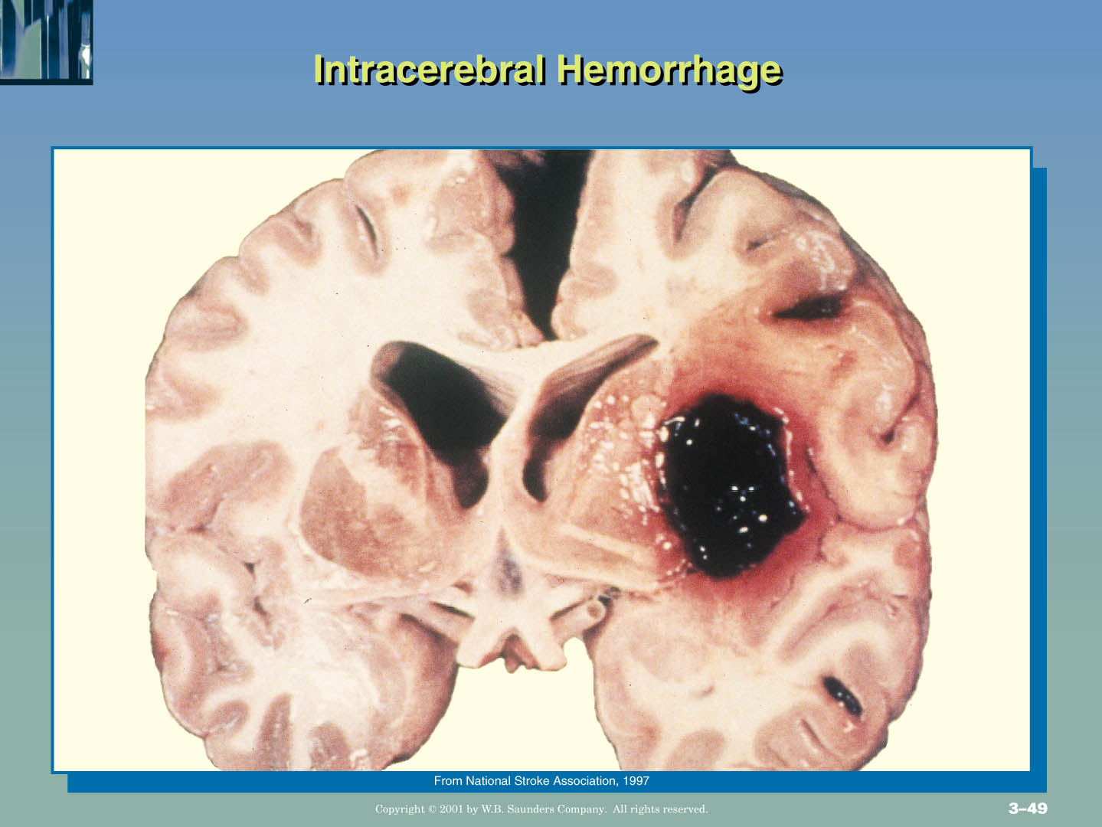
B
Menu
F

Slide 22
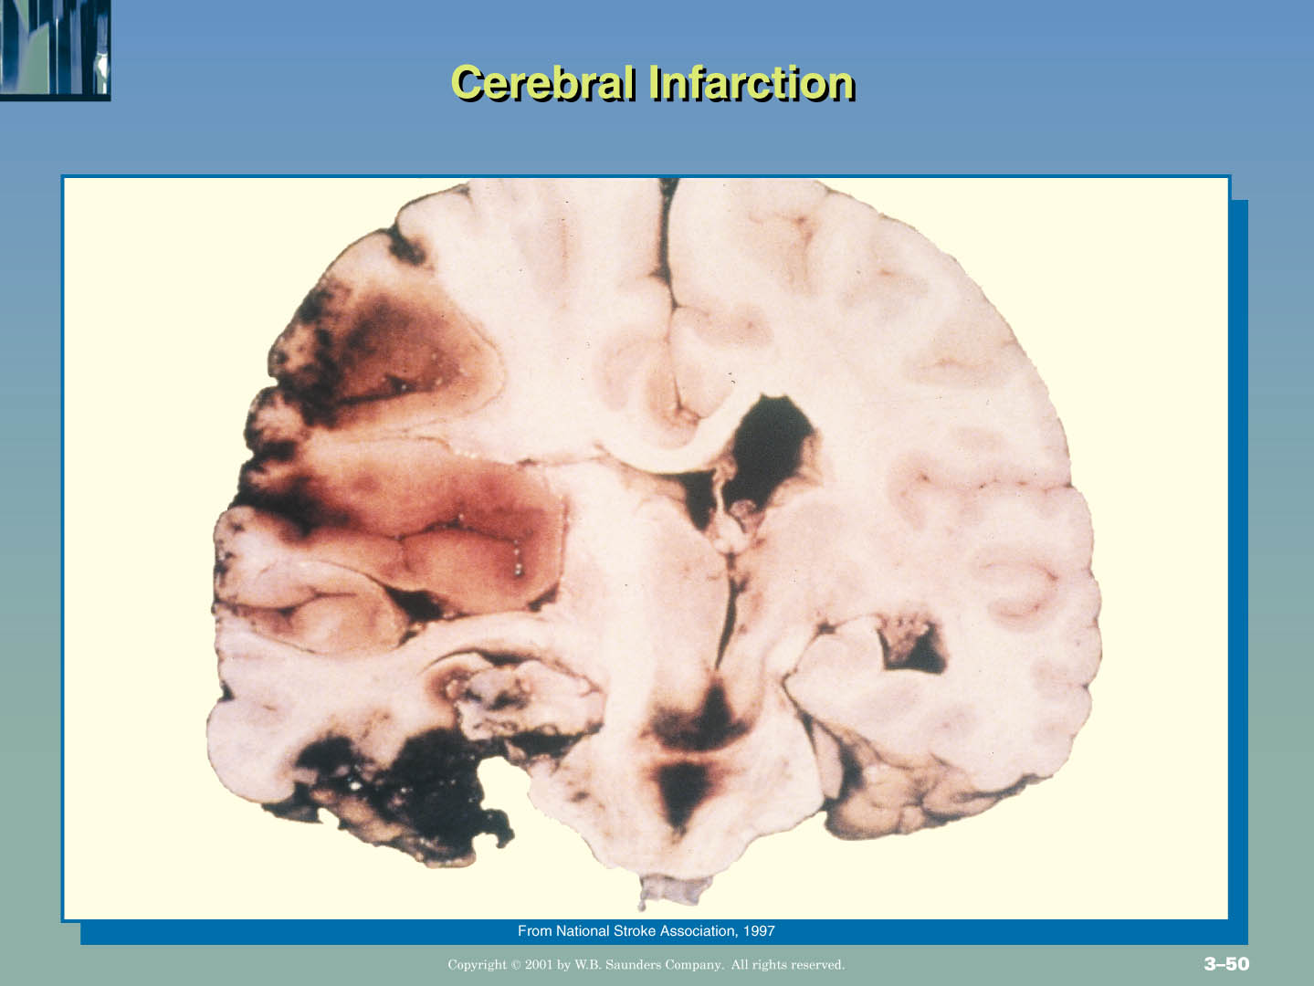
B
Menu
F

Slide 23
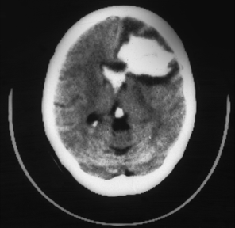
Intracerebral hemorrhage
(White areas indicate
hyperdensity = blood)
Large left frontal
intracerebral hemorrhage.
Intraventricular bleeding
is also present
No fibrinolytics!
Right
Left
Notes:
Scan B shows a large left frontal intracerebral hemorrhage. Intrav- entricular hemorrhage is present. This patient is not a candidate for fibrinolytics.

Slide 24
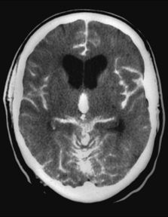
Subarachnoid hemorrhage
Acute subarachnoid hemorrhage
Diffuse areas of white (hyperdense) images
Blood visible in ventricles
and multiple areas on surface of brain
Notes:
Scan C shows diffuse areas of white (hyperdense) images consistent with an acute subarachnoid hemorrhage. The hemorrhage is visible in several areas on the surface of the brain.
A patient such as this is not a candidate for fibrinolytic therapy. CT findings may be more subtle than these.

Slide 25
Clinical Manifestations
neurologic deficits
Unusually severe headache and often loss of consciousness for a variable period.
Pain and rigidity of the back of the neck and spine
Visual disturbances (visual loss, diplopia, ptosis)
Tinnitus, dizziness, and hemiparesis
coma and death

Slide 26
Assessment and Diagnostic Findings
CT scanning to determine the size and location of the hematoma
Lumbar puncture is performed if there is no evidence of
increased ICP.
Prevention:
Control of hypertension, especially in individuals over 55 years
of age, clearly reduces the risk for hemorrhagic stroke.
Additional factors are similar to the risks for ischemic stroke and include smoking, excessive alcohol intake, and high cholesterol

Slide 27
Medical Management
Management consists of bed rest with sedation to prevent agitation and stress, management of vasospasm, and surgical or medical treatment to prevent rebleeding.
Analgesics (codeine, acetaminophen) may be prescribed for head and neck pain.
The patient is fitted with elastic compression stockings to prevent deep vein thrombosis, a threat to any patient on bed rest.

Slide 28
Clinical Manifestations of stroke
Affects many body functions
Motor activity
Communication
Affect
Intellectual function
Spatial-perceptual alterations
Elimination
Personality
Sensation

Slide 29
Clinical Manifestations Motor Function
Most obvious effect of stroke: Hemiplegia (paralysis) or Hemiparesis (weakness)
Include impairment of
In the early stage : flaccid paralysis and loss of or decrease in the DTR reappear (usually by 48 hours)
spasticity (abnormal increase in muscle tone) of the extremities on the affected side.

Slide 30
Clinical Manifestations Motor Function
Characteristic motor deficits
- Akinesia = Loss of skilled voluntary movement
- Impairment of integration of movements
Alterations in muscle tone
Alterations in reflexes = hyporeflexia, hyperreflexia
An initial period of flaccidity for days to weeks related to nerve damage
Spasticity of the muscles related to interruption of upper motor neuron influence

Slide 31
Clinical Manifestations Communication
Lt. dominant hemisphere is dominant for language skills which involves expression and comprehension.
Stroke damage Lt. hemisphere:
Aphasia is a total loss of comprehension and use of language
Global Aphasia: lost communication + lost receptive function
Receptive Aphasia: sound and speech not understood (stroke affecting Wernicke's area)
Expressive Aphasia= difficulty in speaking/writing (Bracas’ area)

Slide 32
Clinical Manifestations Communication
Dysphasia: difficulty related to the comprehension or use of language due to partial disruption
Dysarthria: Disturbance in muscular control of speech may involve pronunciation, verbalization, and phonation
Apraxia =inability to perform a previously learned action

Slide 33
Clinical Manifestations Affect
Difficulty controlling emotions
Emotional responses may be exaggerated or unpredictable
Depression
Frustrated by mobility and communication problems
Intellectual Function
Both memory and judgment may be impaired
A left-brain stroke is more likely to result in memory problems related to language.

Slide 34
Clinical Manifestations Spatial-Perceptual Alterations
Most commonly on right sided stroke, however, may occur with left-brain stroke
may be divided into four categories
Incorrect perception of self and illness
Wrong perception of self in space
Inability to recognize an object by sight, touch, or hearing
Inability to carry out learned sequential movements on command

Slide 35
Clinical Manifestations Elimination
Most problems with urinary and bowel elimination occur initially and are temporary
When a stroke affects one hemisphere of the brain, the prognosis for normal bladder function is resumed.

Slide 36
Nursing process
Assessment:
During the acute phase, a neurologic flow sheet is maintained to provide data about the following important measures of the patient’s clinical status:
Change in the level of consciousness or responsiveness as evidenced by movement, resistance to changes of position,& response to stimulation; orientation to time, place, and person
Presence or absence of voluntary or involuntary movements of the extremities; muscle tone; body posture; and position of the head
Stiffness or flaccidity of the neck

Slide 37
Nursing process
Eye opening, comparative size of pupils & pupillary reactions to light, and ocular position
Color of the face and extremities; temperature and moisture of the
skin
Quality and rates of pulse and respiration; arterial blood gas values as indicated, body temperature, and arterial pressure
Ability to speak
Volume of fluids ingested or administered; volume of urine excreted each 24 hours
Presence of bleeding
Maintenance of blood pressure within the desired parameters

Slide 38
Nursing process
Diagnosis
Based on the assessment data, the major nursing diagnoses may include:
Impaired physical mobility related to hemiparesis, loss of balance and coordination, spasticity, and brain injury
Acute pain (painful shoulder) related to hemiplegia and disuse
Self-care deficits (hygiene, toileting, grooming, and feeding) related to stroke sequelae
Disturbed sensory perception related to altered sensory reception, transmission, and/or integration
Impaired swallowing

Slide 39
Nursing process
Incontinence related to flaccid bladder, detrusor instability, confusion, or difficulty in communicating
Disturbed thought processes related to brain damage, confusion,
or inability to follow instructions
Impaired verbal communication related to brain damage
Risk for impaired skin integrity related to hemiparesis/
hemiplegia, or decreased mobility
Interrupted family processes related to catastrophic illness and caregiving burdens
Sexual dysfunction related to neurologic deficits or fear of failure

Slide 40
Nursing process
Nursing Interventions
improving mobility and preventing joint deformities
Preventing shoulder pain
Enhancing self-care, promoting home and community-based care
Managing sensory-perceptual difficulties
Managing dysphasia
Attaining bowel and bladder control
Improving thought processes
Improving communication
Maintaining skin integrity,
Improving family coping

Slide 41
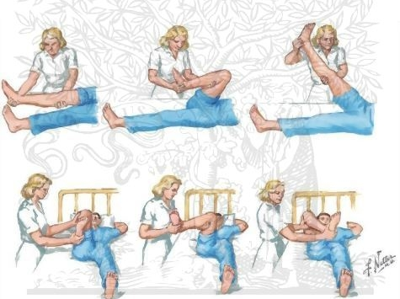
Improving Mobility and Preventing Joint Deformities
Turn and position in correct alignment every 2 hours
Use of splints
Passive or active ROM 4–5 times day
Prevention of flexion contractures
Figure 5: Quadriceps setting. While sitting in a chair, straighten your leg and hold. Repeat 5 to 10 times. Do the exercises with both knees, up to 3 times each day.

Slide 42
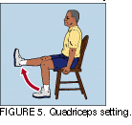
Improving Mobility and Preventing Joint Deformities
Prevent and treat shoulder pain; Prevent shoulder abduction
Do not lift by flaccid shoulder
Establish regular exercise routine; Encourage patient to exercise unaffected side
Quadriceps setting
Ambulation training: move slowly, Assist patient out of bed as soon as possible- assess to achieve balance.
Figure 5: Quadriceps setting. While sitting in a chair, straighten your leg and hold. Repeat 5 to 10 times. Do the exercises with both knees, up to 3 times each day.

Slide 43
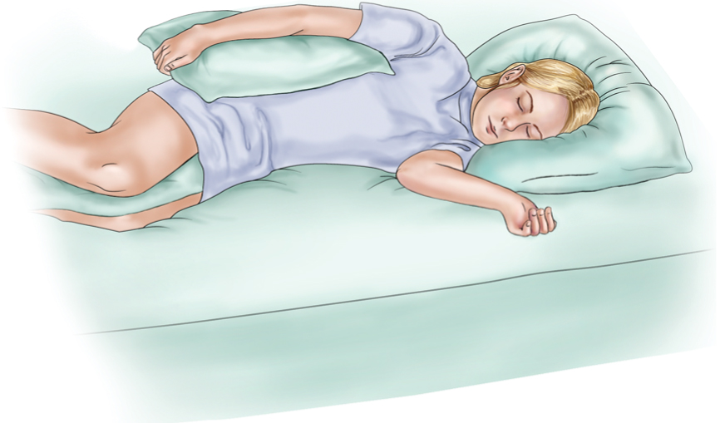
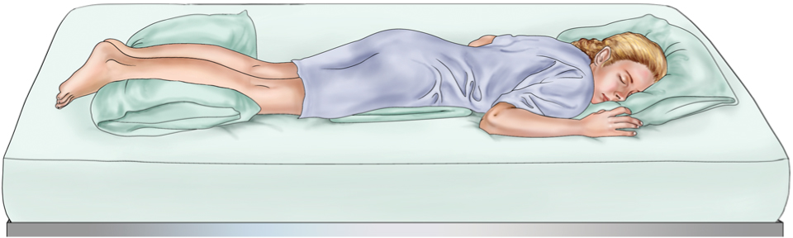
Positioning to Prevent Shoulder Abduction
Prone Positioning to Help Prevent Hip Flexion

Slide 44
Interventions
Enhancing self-care
Set realistic goals with the patient
Encourage personal hygiene
Assure that patient does not neglect the affected side
Use of assistive devices and modification of clothing
Support and encouragement
Strategies to enhance communication
Encourage patient to turn head, look to side with visual field loss

Slide 45
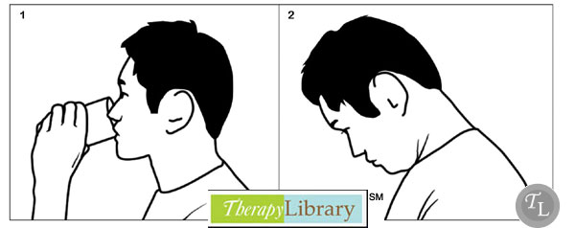
Nutrition
Consult with speech therapy or nutritional services
Have patient sit upright to eat
Chin tuck or swallowing method
Use of thickened liquids or smashed diet
Bowel and bladder control
Assessment of voiding and scheduled voiding
Measures to prevent constipation—fiber, fluid, toileting schedule
Bowel and bladder retraining

Slide 46
Aneurysm Precautions
Absolute bed rest
Elevate head of the bed 30° to promote venous drainage or flat to increase cerebral perfusion
Avoid all activity that may increase ICP or BP; Valsalva maneuver, acute flexion or rotation of neck or head
Exhale through mouth when voiding or defecating to decrease strain
Nonstimulating, nonstressful environment; dim lighting, no reading, no TV, no radio
Prevent constipation
Visitors are restricted

Slide 47
Home Care and Teaching for the Patient Recovering from a Stroke
Prevent subsequent strokes, health promotion, and follow-up care, Prevent complications
Medication teaching
Safety measures
Adaptive strategies and use of assistive devices for ADLs
Nutrition—diet, swallowing techniques, tube feeding administration
Elimination—bowel and bladder programs, catheter use
Exercise and activities, recreation and diversion
Socialization, support groups, and community resources
Complications/Ischemic
Decreased cerebral blood flow
Inadequate oxygen delivery to brain
Pneumonia
Vasospasm
Hemorrhagic
Seizures
Rebleeding
Hyponatremia

