Slide 1
Diabetic Ketoacidosis and Hyperglycemic Hyperosmolar Nonketotic Syndrome
https://www.youtube.com/watch?v=Ms6kLLWDc74

Slide 2
Definition
Diabetic ketoacidosis (DKA) is a life-threatening emergency caused by a relative or absolute deficiency of insulin.
This deficiency in available insulin results in disorders in the metabolism of carbohydrate, fat, and protein.
Hyperglycemic Hyperosmolar Nonketotic Syndrome (HHNS) is a condition characterized by the presence of hyperglycemia, hyperosmolarity, and dehydration.
There is enough production of insulin to reduce ketosis but not to control hyperglycemia.

Slide 3
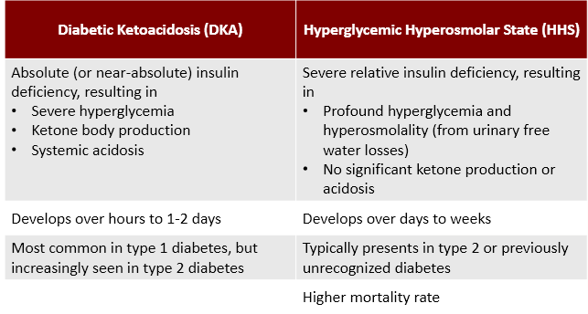

Slide 4
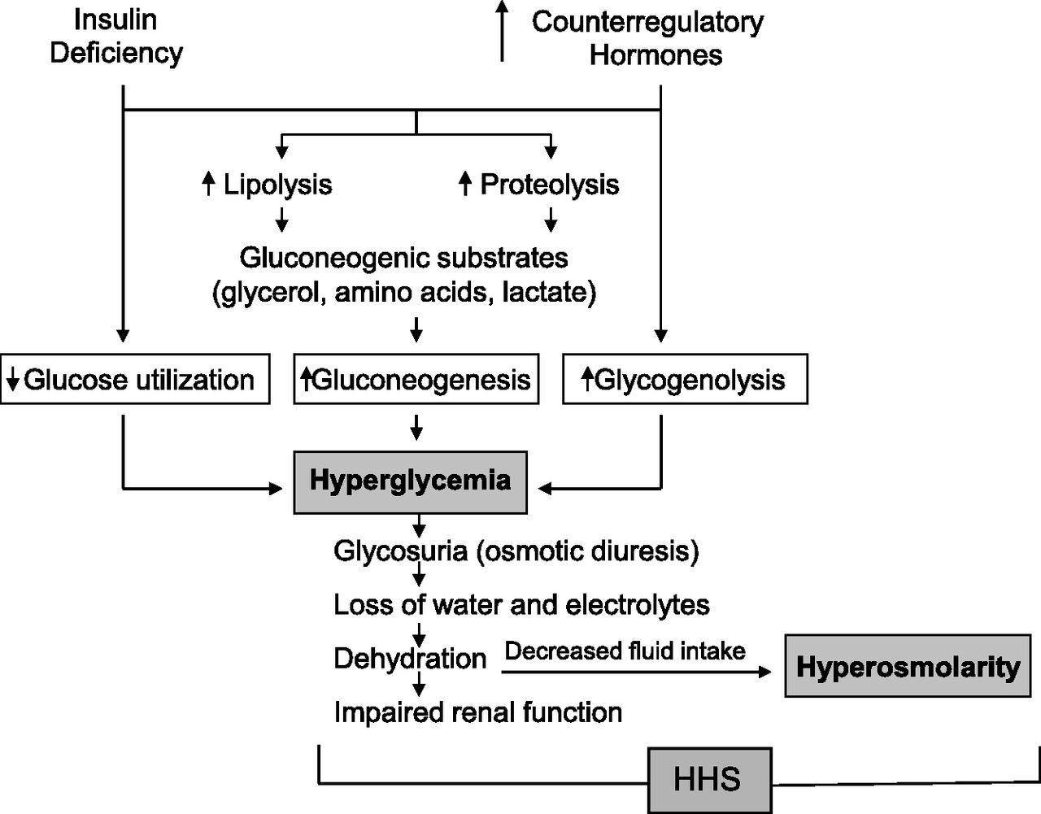
HHNS pathophysiology

Slide 5
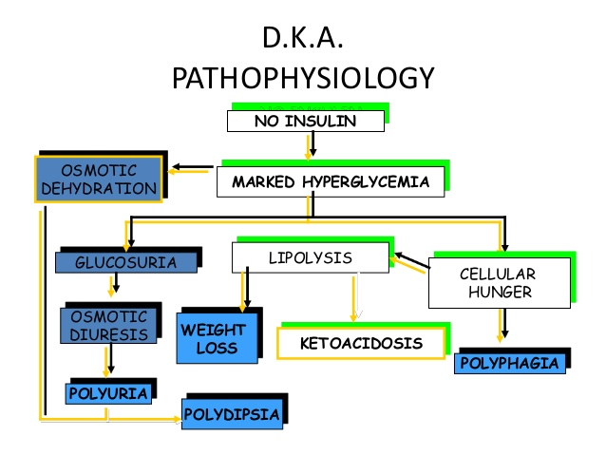

Slide 6
clinical features
DKA:
earliest symptoms of marked hyperglycemia are polyuria, polydipsia, polyphagia and weight loss.
As the degree or duration of hyperglycemia progresses, neurologic symptoms, including lethargy, focal signs, and obtundation, which can progress to coma in later stages, can be seen.
Neurological symptoms are most common in HHS, while hyperventilation and abdominal pain are primarily limited to patients with DKA
HHNS:
persistent hyperglycemia causes osmotic diuresis, which results in the fluid and electrolyte imbalances.
The clients with HHNS may present with symptoms of hypotension, tachycardia, marked dehydration, Excessive thirst, Dry mouth, Increased urination, Warm, dry skin Fever
neurological manifestation such as seizures, hemiparesis, and alterations in the sensorium), Drowsiness, confusion, Hallucinations, Vision loss, Convulsions, Coma

Slide 7
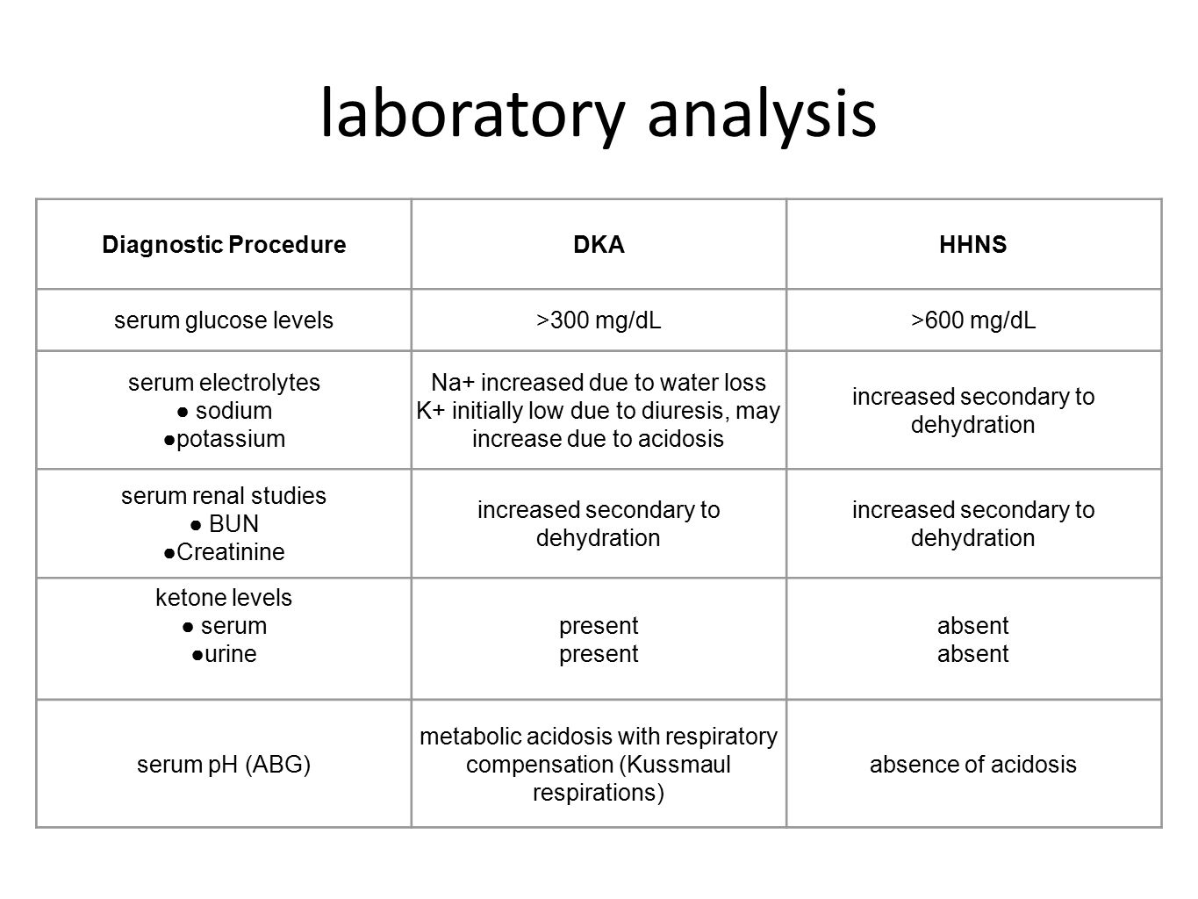

Slide 8
Medical management
Treatment Goals:
The goals of treatment are to provide frequent patient monitoring, to treat the underlying cause and to gradually and safely
Prevention of complication: Arterial or venous thrombosis , cerebral edema
Normalise Osmolality

Slide 9
Fluid Management: The fluid of choice is 0.9% sodium chloride with potassium added as required.
Insulin Therapy
Electrolyte Replacement – Potassium , Phosphate
Antibiotic Therapy
Anticoagulation

Slide 10
Nursing Care Plans
Risk For Fluid Volume Deficit
Risk For Infection
Deficient Knowledge
Imbalanced Nutrition: Less Than Body Requirements

Slide 11
Risk For Fluid Volume Deficit
nursing interventions:
Assess skin turgor, mucous membranes, and thirst.
Monitor hourly intake and output.
Monitor BP especially for orthostatic hypotension.
Monitor respirations, e.g., acetone breath, Kussmaul’s respirations.
Assess neurological status every two (2) hours.
Weigh client daily.

Slide 12
Risk For Infection
nursing interventions:
Assess for signs of infection and inflammation.
Observe client’s feet for ulcers, infected toenails, or other medical problems.
Observe aseptic technique during IV insertion and medication administration.
Provide skin care
Encourage adequate oral fluid intake (2-3 liters a day unless contraindicated)
Obtain sample for culture and sensitivity as indicated.
Administer antibiotics as indicated.

Slide 13
Imbalanced Nutrition: Less Than Body Requirements
Determine client’s dietary program and usual pattern.
Monitor weight daily or as indicated.
auscultation bowel sounds, note the presence of abdominal pain/abdominal bloating, nausea or vomiting. Maintain on NPO status, as indicated.
Recognize signs of hypoglycemia.
Monitor laboratory studies (Serum glucose, pH, HCO₃, acetone).

Slide 14
Diabetes Insipidus DI

Slide 15
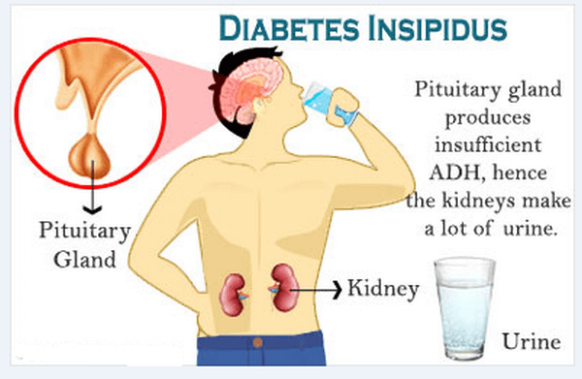
Description
Diabetes insipidus is hyposecretion of ADH caused by strokes, trauma, or idiopathic causes.
Kidney tubules fail to reabsorb water.

Slide 16
Assessment
Polyuria of 4 to 24 L per day
Polydipsia
Dehydration
Decreased skin turgor, dry mucous membranes
Inability to concentrate urine
A low urinary specific gravity: 1.006 or less
Fatigue
Muscle pain and weakness
Headache
Postural hypotension that may progress to vascular collapse without rehydration
Tachycardia

Slide 17
Diagnosis
If the clinical presentation suggests DI, laboratory tests must be performed to confirm the diagnosis, as follows:
A 24-hour urine collection for determination of urine volume
Serum electrolyte concentrations and glucose level
Urinary specific gravity
Simultaneous plasma and urinary osmolality
Plasma ADH level
Pituitary studies, including magnetic resonance imaging (MRI) and measurement of circulating pituitary hormones other than ADH
Water deprivation (Miller-Moses) test to ensure adequate dehydration and maximal stimulation of ADH for diagnosis

Slide 18
Medical Management
Objectives of therapy are:
to ensure adequate fluid replacement,
to replace vasopressin,
and to search for and correct the underlying intracranial pathology.

Slide 19
Nursing Interventions
Monitor vital signs and neurological and cardiovascular status.
Provide a safe environment, particularly for the client with a change in level of consciousness or mental status.
Monitor electrolyte values and for signs of dehydration.
Monitor intake and output, weight, and specific gravity of urine.
Maintain the intake of adequate fluids, and monitor for signs of dehydration.
Instruct the client to avoid foods or liquids that produce diuresis.

Slide 20
Administer vasopressin as prescribed; these are used when the ADH deficiency is severe or chronic.
Instruct the client in the administration of medications as prescribed (demopressin (DDAVP) may be administered by injection, intranasally, or orally).
Instruct the client to wear a Medic-Alert bracelet.

Slide 21
Acute Pancreatitis

Slide 22
Definition
inflammation of the pancreas, ranging from mild edema to extensive hemorrhage, resulting from various insults to the pancreas.
defined by a discrete episode of abdominal pain and serum enzymes elevations
function and structure usually return to normal after an acute attack

Slide 23
Risk Factors
Alcoholism
Cholecystitis
Surgery involving or near the pancreas
Viral hepatitis, mumps, peptic ulcer disease, periarteritis
Hyperlipidemia,hypercalcemia, anorexia nervosa, shock with ischemia
Trauma to the pancreas
Medications

Slide 24
Pathophysiology and Etiology
excessive alcohol consumption
biliary tract disease such as cholelithiasis, acute and chronic cholecystitis
mortality is high because of shock, anoxia, hypotension or multiple organ dysfunction
autodigestion of all or part of the pancreas is involved

Slide 25
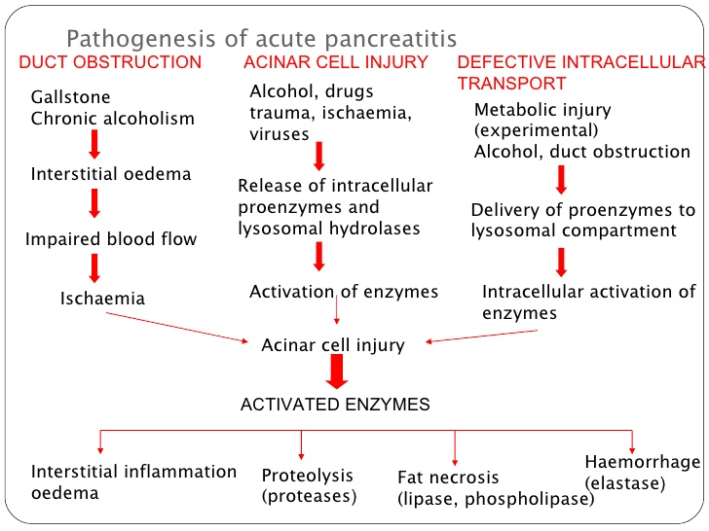

Slide 26
Assessment/Clinical Manifestations/Signs and Symptoms
abdominal pain, usually constant, midepigastric or periumbilical, radiating to the back or flank
nausea and vomiting
fever
involuntary abdominal guarding, epigastric tenderness
dry mucous membranes, hypotension, cold clammy skin, cyanosis or tenderness, tachycardia and mild to moderate dehydration
shock with respiratory distress and acute renal failure
purplish discoloration of the flanks (Turner’s sign) or of the periumbilical area (Cullen’s sign)

Slide 27
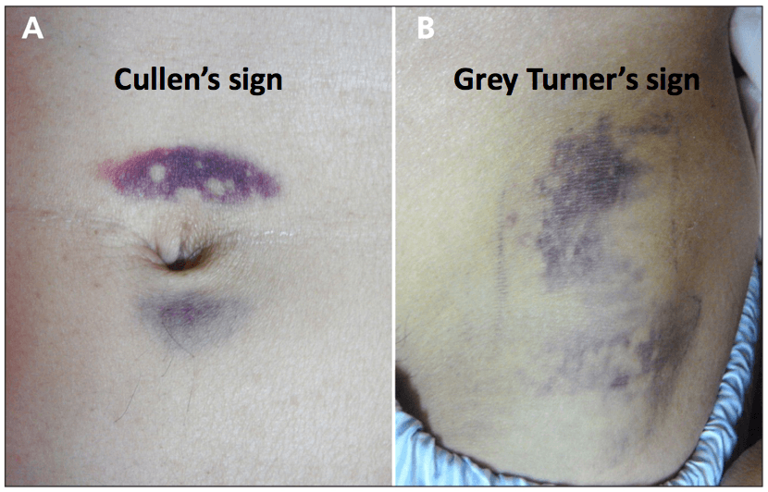

Slide 28
Diagnostic Evaluation
serum amylase, lipase, glucose, bilirubin, alkaline phosphatase, lactate dehydrogenase, aspartate transaminase (AST) and alanine transaminase (ALT), potassium and cholesterol may be elevated
Serum albumin, calcium, sodium, magnesium and potassium may be low due to dehydration
CT scan is the most definitive study
Chest x-ray for detection of pulmonary complications

Slide 29
Medical Management
During the acute phase, management is symptomatic and directed toward preventing or treating complications.
Oral intake is withheld to inhibit pancreatic stimulation and secretion of pancreatic enzymes.
Parenteral nutrition is administered to the debilitated patient.
Nasogastric suction is used to relieve nausea and vomiting, decrease painful abdominal distention and paralytic ileus and remove hydrochloric acid so that it does not stimulate the pancreas.
Cimetidine (Tagamet) is given to decrease hydrochloric acid secretion.

Slide 30
Adequate pain medication is administered; morphine and morphine derivatives are avoided because they cause spasm of the sphincter of Oddi.
Correction of fluid, blood loss, and low albumin levels is necessary.
Antibiotics are administered if infection is present.
Insulin is necessary if significant hyperglycemia occurs.
Aggressive respiratory care is provided for pulmonary infiltrates, effusion and atelactasis.
Biliary drainage (drains and stents) results in decreased pain and increased weight gain.
Surgical intervention may be performed for diagnosis, drainage, resection or debridement

Slide 31
Complications
Pancreatic ascites, abscess or pseudocyst
Pulmonary infiltrates, pleural effusion, acute respiratory distress syndrome
Hemorrhage with hypovolemic shock
Acute renal failure
Sepsis and multi-oran dysfunction syndrome

Slide 32
Nursing Management
The client should avoid oral intake to inhibit pancreatic stimulation and secretion of pancreatic enzymes:
Total parenteral nutrition is administered to assist with metabolic stress.
Maintain fluid and electrolyte balance:
Assess fluid and electrolyte status (e.g. skin turgor, mucous membranes, intake and output); and provide replacement therapy as indicated.
Promote adequate nutrition:
Assess nutritional status; monitor glucose levels; monitor IV therapy, provide a high-carbohydrate, low-protein, low-fat diet when tolerate; and instruct the client to avoid spicy foods.

Slide 33
Maintain optimal respiratory status:
Place the client in semi-Fowler’s position to decrease pressure on the diaphragm.
Teach the client coughing and deep-breathing techniques.
Monitor for complications
Administer prescribed medications, which may include opioid or nonopioid analgesics, histamine receptor antagonists, and proton-pump inhibitors.
Maintain patent nasogastric suctioning to relieve nausea and vomiting, decrease painful abdominal distention, and remove hydrochloric acid.

