Slide 1
Esophageal Varices

Slide 2
Esophageal varices are extremely dilated sub-mucosal veins in the lower third of the esophagus
They are most often a consequence of portal hypertension, commonly due to cirrhosis; patients with esophageal varices have a strong tendency to develop bleeding.
Esophageal varices are typically diagnosed through an esophagogastroduodenoscopy.

Slide 3
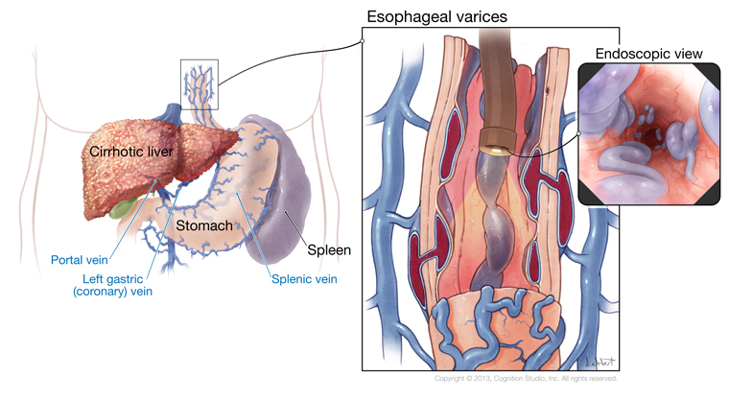

Slide 4
Pathophysiology
In portal hypertension, collateral circulation develops in the lower esophagus as venous blood, which is diverted from the GI tract and spleen because of portal obstruction, seeks an outlet.
Because of excessive intraluminal pressure, these collateral veins become tortuous, dilated, and fragile.
They are particularly prone to ulceration and hemorrhage. Rupture of esophageal varices is the most common cause of death of clients with hepatic cirrhosis.

Slide 5
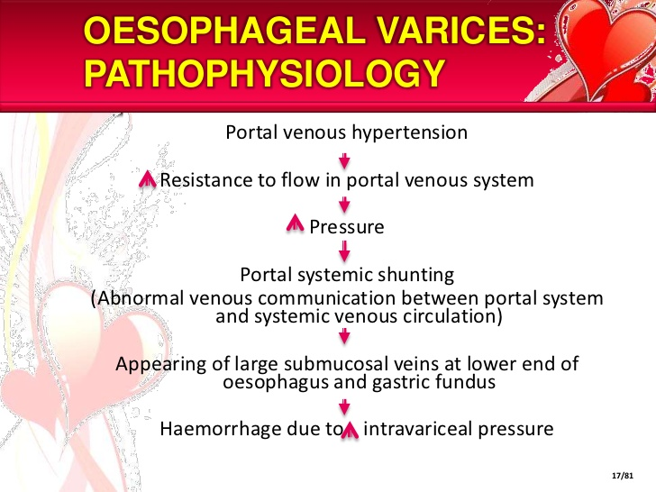

Slide 6
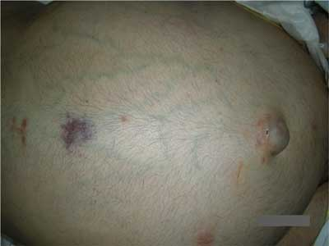
Assessment/Clinical Manifestations
Hematemesis and melena, if ulcerated massive hemorrhage occurs
Signs of hepatic encephalopathy
Dilated abdominal veins
Ascites

Slide 7
Laboratory and diagnostic study findings
Endoscopy identifies the cause and site of bleeding
Ultrasound and computed tomography assist in identifying the site of bleeding

Slide 8
Medical Management
Non-surgical treatment is preferred because of the high mortality associated with emergency surgery to control bleeding from esophageal varices and because of the poor physical condition of most of these patients.
Nonsurgical measures include:
Pharmacologic therapy: somatostatin, vasopressin, beta-blocker and nitrates
Balloon tamponade, saline lavage, endoscopic sclerotherapy
Transjugular intrahepatic portosystemic shunting (TIPS)
Esophageal banding therapy, variceal band ligation

Slide 9
Aggressive medical care includes evaluation of extent of bleeding and continuous monitoring of vital signs when hematemesis and melena are present.
Signs of potential hypovolemia are noted; blood volume is monitored with a central venous pressure or arterial catheter.
Oxygen is administered to prevent hypoxia and maintain adequate blood oxygenation, and intravenous fluids and volume expanders are administered to restore fluid volume and replace electrolytes.
Need for blood transfusion is assessed, and intake and output (insert indwelling catheter) are monitored.

Slide 10
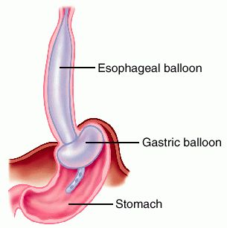
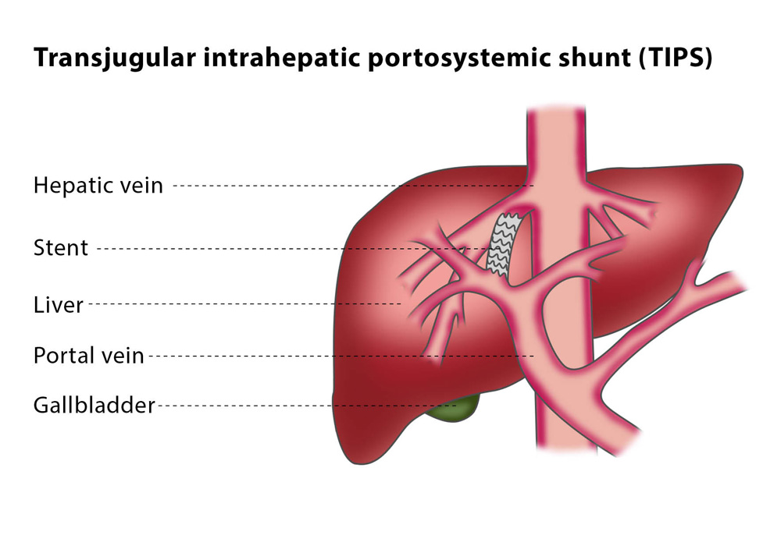
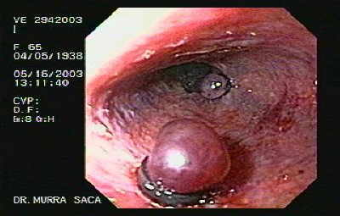

Slide 11
Nursing Diagnosis
Risk for bleeding
Imbalanced nutrition: less than body requirement
Nursing Management
Provide ongoing assessment
Assess for ecchymosis, epistaxis, petechiae, and bleeding gums
Monitor level of consciousness, vital signs, and urinary output to evaluate fluid balance.
Monitor the client during blood transfusion administration if prescribed.

Slide 12
provide nursing care for the client undergoing a prescribed balloon tamponade to control bleeding
Explain the procedure to the client to reduce fear and enhance cooperation with insertion and maintenance of the esophageal tamponade tube.
Monitor the client closely to prevent accidental removal or displacement of the tube with resultant airway obstruction.

Slide 13
Provide nursing intervention for the client undergoing a prescribed iced saline lavage
Ensure nasogastric tube patency to prevent aspiration
Observe gastric aspirate for evidence of bleeding.
Protect the client from chilling.

Slide 14
After injection sclerotherapy, assess for:
Aspiration
Esophageal perforation
Continued bleeding

Slide 15
Hepatic Encephalopathy
is an altered level of consciousness as a result of liver failure
Onset may be gradual or sudden.
Other symptoms may include movement problems, changes in mood, or changes in personality.
In the advanced stages it can result in a coma.

Slide 16
Risk Factors
Severe liver injury
Hepatocellular failure
Portal shunting directly from the portal system to systemic venous circulation
Increased serum ammonia levels from GI bleeding, a high-protein diet, or bacterial growth in the intestine and uremia

Slide 17
Pathophysiology
Hepatic encephalopathy results from accumulation of ammonia and other identified toxic metabolites in blood because of the liver cells’ inability to convert ammonia to urea.
Increased blood ammonia concentration leads to neurologic dysfunction and possible brain damage. Hepatic coma is the most advanced stage of hepatic encephalopathy.

Slide 18
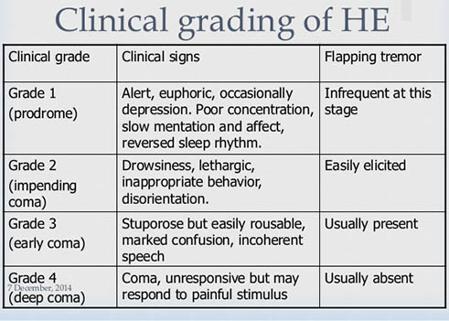
Assessment/Clinical Manifestations

Slide 19
Laboratory and diagnostic study findings
Serum ammonia level is elevated.
Serum bilirubin level is elevated.
Prothrombin time is prolonged.

Slide 20
Medical Management
Administer lactulose (Cephulac) to reduce serum ammonia level. Observe for watery diarrhea stools, which indicate lactulose overdose.
Reduce protein intake or eliminate signs of impending encephalopathy or coma occur.
Give enema to reduce ammonia absorption from the gastrointestinal tract.
Administer nonabsorbable antibiotics (neomycin) as an intestinal antiseptic.

Slide 21
Monitor serum ammonia level daily; monitor electrolyte status and correct if abnormal.
Discontinue medications that may precipitate encephalopathy (e.g. sedative medications, tranquilizers, analgesic agents)
Other treatments may include administration of intravenous glucose, vitamins and oxygen.

Slide 22
Nursing Diagnosis
Stage I: Activity intolerance; Self-care deficit; Disturbed sleep pattern
Stage II: Impaired social interaction; Ineffective role performance; Risk for injury
Stage III: Imbalanced nutrition; Impaired mobility; Impaired verbal communication
Stage IV: Risk for aspiration; Impaired gas exchange; Impaired tissue integrity; Disturbed sensory perception

Slide 23
Nursing Management
1-Closely monitor neurologic status for any changes:
Assess level of consciousness
Monitor for restlessness and agitation
Monitor handwriting daily; it becomes worse with increasing ammonia levels
Assess deep tendon reflexes

Slide 24
2-Provide ongoing assessment:
Evaluate serum ammonia values daily.
Monitor for signs of impending coma. Reduce or eliminate the client’s dietary protein intake if you detect evidence of impending coma.
Monitor electrolyte status and intervene as indicated to correct any imbalances.
Monitor the client closely, and administer a conservative dose of prescribed sedative or analgesic medication, because liver damage alters drug metabolism.

Slide 25
3- Administer a high cleansing enema to reduce ammonia absorption from the GI tract.
4- Administer prescribed medications, which may include antibiotics and laxatives.

