Slide 1
Systemic Inflammatory Response Syndrome (SIRS)
Dr. Mohammad Alnaeem
Assistance professor

Slide 2
Objectives
On completion of this chapter, the learner will be able to:
Identify different types of Systemic Inflammatory Response Syndrome (SIRS)
Identify the assessment process for patient with Systemic Inflammatory Response Syndrome (SIRS).
Identify clinical manifestations for patient with Systemic Inflammatory Response Syndrome (SIRS)
Describe the medical management in patient with Systemic Inflammatory Response Syndrome (SIRS)

Slide 3
Pathophysiology
In SIRS the body is insulted by some infection and inflammation occurs.
Cytokines are released and inflammation to attempt to repair.
When the body can not regain control a systemic reaction occurs with the activation of multiple cascade systems causing massive inflammation and the end result is end-organ failure.
Systemic inflammatory response syndrome (SIRS)
Inflammatory reaction ---------> homeostasis isn’t maintained
Multiple organ dysfunction (MODS)
Failure of two or more organs or systems

Slide 4
Systemic Inflammatory Response Syndrome (SIRS)
SEPSIS and Its Disease spectrum
Various stages of diseases
Bacteremia
SIRS
Sepsis syndrome
Sepsis shock: early and refractory
Definition
Infection :Presence of microorganisms in a normally sterile site.
Bacteremia: Cultivatable bacteria in the blood-stream.
Sepsis : SIRS criteria + suspected or proven infection

Slide 5
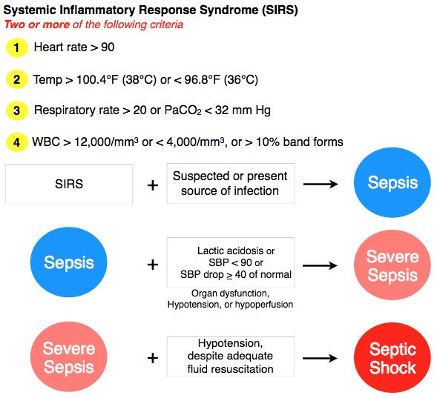

Slide 6
Systemic inflammatory response syndrome (SIRS)
is an exaggerated defense response of the body to a noxious stressor (infection, trauma, surgery, acute inflammation, ischemia or reperfusion, or malignancy) to localize and then eliminate the endogenous or exogenous source of the insult.

Slide 7
Systemic Inflammatory Response Syndrome
Triggered by insult
Infection-Sepsis: Inflammatory response to bacteria in body
Ischemia: Low perfusion causing response
Trauma: Damage to body causing response

Slide 8
SIRS (Systemic Inflammatory Response Syndrome)
Local cytokine production
Cytokines released into circulation
Recruit help in bloodstream
Goal = homeostasis
Homeostasis isn’t restored
Systemic reaction ---->destruction
Organ perfusion isn’t maintained –----> organ failure
Death

Slide 9
SIRS (Systemic Inflammatory Response Syndrome)
SIRS (Systemic Inflammatory Response Syndrome)
The systemic response to a wide range of stresses.
Temperature >38°C (100.4°) or <36°C (96.8°F).
Heart rate >90 beats/min.
Respiratory rate >20 breaths/min or PaCO2 <32 mmHg.
White blood cells > 12,000 cells/ml or < 4,000 cells/ml or >10% immature (band) forms.
Note: Two or more of the following must be present.
These changes should represent acute alterations from baseline in the absence of other known causes for the abnormalities.

Slide 10
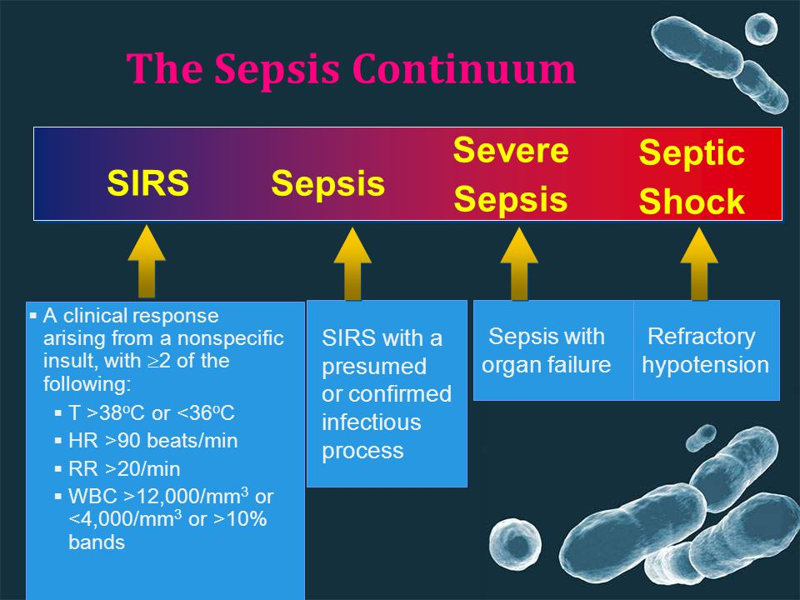

Slide 11
MODS (Multiple Organ Dysfunction Syndrome)
Multiorgan hypoperfusion (Two or more of the followings):
SBP < 90 mmHg
Acute mental status change
PaO2 /FiO2 ratio > 250
Increased lactic acid/acidosis
Oliguria
DIC or Platelet < 80,000 /mm3
Liver enzymes > 2 x normal

Slide 12
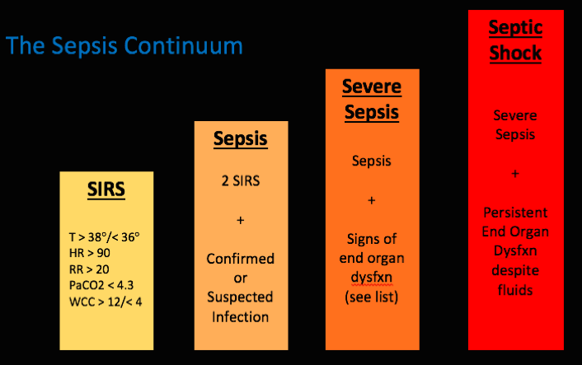
Severe Sepsis
Sepsis with organ hypoperfusion one of the criteria of MODS
Septic Shock= Severe sepsis + Hypotension
Refractory septic Shock= shock not controlled by IV fluids and vasopressor agents

Slide 13
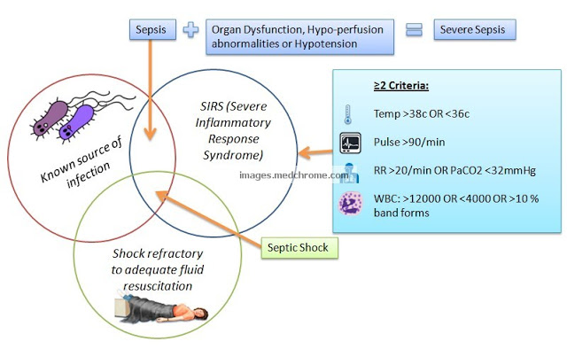

Slide 14
Sepsis resuscitation bundle
Serum lactate measured
Blood cultures obtained before antibiotics administered
Improve time to broad-spectrum antibiotics
In the event of hypotension or lactate > 4 mmol/L (36 mg/dL)
Deliver an initial minimum of 20 mL/kg of crystaloid (or colloid equivalent)
Apply vasopressors for ongoing hypotension
In the event of persistent hypotension despite fluid resuscitation or lactate > 4 mmol/L (36 mg/dL)
achieve central venous pressure of > 8 mmHg
achieve central venous oxygen saturation of > 70%

Slide 15
Sepsis management bundle
Fluid resuscitation
[
Appropriate cultures prior to antibiotic administration
Early targeted antibiotics and source control
Use of vasopressors/inotropes when fluid resuscitation optimized
Evaluation for adrenal insufficiency
Stress dose corticosteroid administration
Recombinant human activated protein C (Xigris) for severe sepsis
Low tidal volume mechanical ventilation for ARDS
Tight glucose control

Slide 16
Antibiotic use in Sepsis
Imipenem-cilastatin and aminoglycoside
or Pipercillin-tazobactam and Amphotericin
Vancomycin
Cefipime
Ciprofloxacin and aminoglycoside

Slide 17
Nursing Care Plan for Patient in Shock
ND: Ineffective peripheral tissue perfusion with risk for decreased cardiac tissue perfusion, risk for ineffective cerebral tissue perfusion, risk for ineffective renal perfusion, risk for impaired liver function, and/or risk for ineffective gastrointestinal perfusion related to low blood flow or maldistribution of blood as evidenced by the following possible findings:
Peripheral: ↓ peripheral pulses, cool and clammy skin, decreased capillary refill, pallor or cyanosis
Cardiopulmonary: ↓ BP, tachycardia; dysrhythmias, ↓ CVP and PAWP, ↓ CO; weak, thready pulses; flat neck veins; tachypnea, ↓ SpO₂; crackles; ↑ ventilation-perfusion mismatch, refractory hypoxemia, respiratory failure
Cerebral: anxiety, confusion, agitation, altered mentation, ↓ LOC, ↑↓ temperature
Renal: urinary output <0.5 mg/kg/hr; ↑ BUN, ↑ plasma creatinine, ↑ BUN/creatinine ratio, ↑ urine specific gravity
Hepatic: ↑ liver enzymes (e.g., ALT, AST, GGT), ↑ NH₃ and lactate
Gastrointestinal: ↓ bowel sounds, paralytic ileus, hyperglycemia or hypoglycemia

Slide 18
Nursing Interventions
Monitor vital signs, mental status, and urinary output to assess trends in patient’s condition and evaluate patient’s response to treatment.
Monitor trends in hemodynamic parameters (e.g., CVP, APCO, CO, PAWP) to assess the patient’s status and detect fluid deficits or excesses and to evaluate patient’s response to treatment.
Administer crystalloid or colloid intravenous fluids, as appropriate, to maintain blood pressure and CO.
Monitor laboratory evidence of inadequate tissue perfusion (e.g., increased lactic acid levels, decreased arterial pH levels) to assess trends in patient’s status and evaluate patient’s response to treatment.
Monitor determinants of tissue oxygen delivery (e.g., PaO₂, SpO₂, ScvO₂/SvO₂, MAP, hemoglobin levels, APCO, CO) to assess trends in patient’s status and evaluate patient’s response to treatment.
Monitor for symptoms of respiratory failure (e.g., low PaO₂, elevated PaCO₂ levels, respiratory muscle fatigue) to plan respiratory interventions.

Slide 19
Nursing interventions
Monitor fluid status, including intake and output and daily weights, to evaluate response to treatment.
Monitor renal function (e.g., BUN, Cr levels) to evaluate response to treatment.
Provide oxygen therapy and/or mechanical ventilation to maximize oxygenation and maintain SpO₂ ≥90%.
Monitor blood glucose levels, as indicated, to evaluate liver function.
Administer DVT and stress ulcer prophylaxis, as appropriate, because these conditions are common complications of shock.
Initiate early administration of antimicrobial agents and closely monitor their effectiveness to prevent progression of infection to septic shock.
Administer vasopressors, antidysrhythmic agents, antiinflammatory agents, diuretics, thrombolytics, inotropes, venodilators, and/or blood products as appropriate to maintain perfusion to vital organs.

Slide 20
Anxiety related to severity of condition as evidenced by verbalization of anxiety about condition and fear of death, or withdrawal with no communication; restlessness; sleeplessness; increase in heart and respiratory rate
Nursing Diagnosis: Risk For Deficient Fluid Volume Related to: Vasodilation & Membrane permeability
Nursing Diagnosis: Hyperthermia Related to: Dehydration & Increased metabolic rate & Inflammatory process

Slide 21
The nurse is caring for postoperative clients at risk for hypovolemic shock. Which of the following would cause the nurse to suspect that the client has early shock? A. Hypotension B. Bradypnea C. Irregular heart rhythm D. Tachycardia

Slide 22
When caring for an obtunded ED client with shock of unknown origin, which action should the nurse take first? A. Establish IV access and hang prescribed infusion B. Apply the automatic BP cuff C. Assess level of consciousness and pupil response to light D. Check the airway and respiratory status

Slide 23
How does the nurse recognize that the client with septic shock has severe tissue hypoxia? A. PaCO2 58mm Hg B. Lactate level 9.0mmol/L C. INR 1.6 D. Potassium 2.8mEq/mL

