Slide 1


Communication and Therapeutic Communication
Lecture 3 Communication Skills
1

Slide 2
Communication Skills
Active Listening, active listener
Giving constructive Feedback
Giving Presentation
Questioning skills
2

Slide 3



1) Active Listening
Effective communication is heavily dependent on effective listening. An additional purpose of effective listening is to convey interest and respect for the other person.
Hearing vs. Listening
Hearing is not the same as listening!
Hearing is a physiological activity occurs when sound waves hit our eardrums
It is passive and occurs even while we sleep.
Listening is active and involves hearing, paying attention and understanding.
3

Slide 4

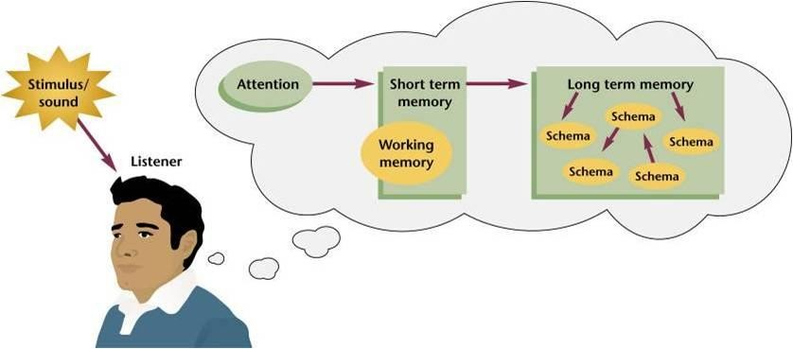
Listening
Listening is an active psychological process rather than passive process, which enables us to attach meaning to all the information we receive (receive and constructing meaning). It requires concentration and effort in order to respond to messages.
Studies have shown that listening is the most frequent aspect of workplace communication.
Listening is not simply a matter of hearing.
4

Slide 5

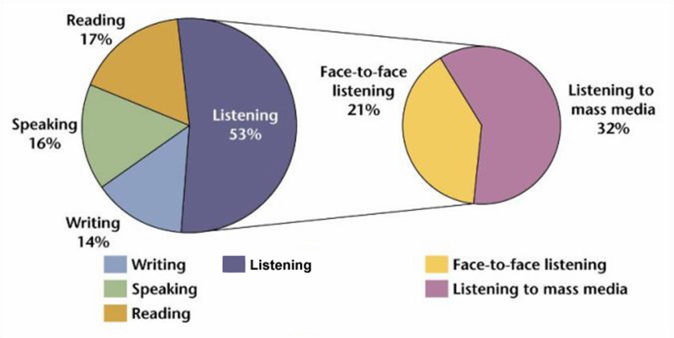
Listening
5

Slide 6

Hearing Vs Listening
Hearing
Listening
1. A physical ability and not a conscious act (Physiological)
A skill and conscious act (Psychological)
2. Is hearing randomly
Is listening intentionally and analyzing
3. Everyone who is physically able
to hears
Not everyone listens
Making an effort to understand using reception, analysis, and interpretation.
4. Perceiving sound by the ear
5. Involuntary
Voluntary
6. You just hear sound and noise but do not understand much
You understand what is being said or heard.
7. Does not need focus
Needs focus and care
8. Hearing uses only one of the five senses.
Listening uses hearing, seeing and sometimes the sense of touch.
Observing behaviour and adding meaning to what the speaker says
9. Receiving sound vibrations
6
10. Passive
Active

Slide 7
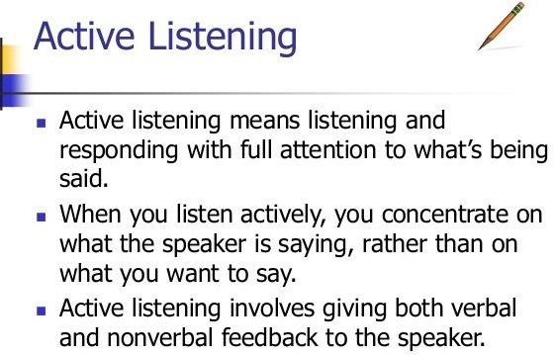
- Active listening motivates and encourages both the speaker and listener.
7

Slide 8
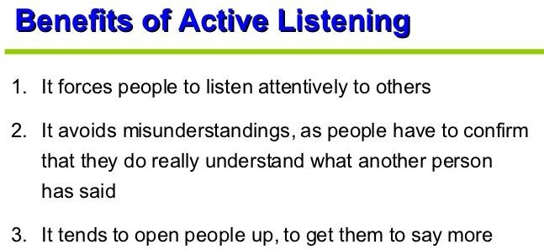
It shows the speaker respect and that you are paying close attention to what they are saying.
It encourages open and healthy communication.
8

Slide 9

Modes of Listening
Cautious Listening | Used for understanding and remembering concepts and details
Skimming Listening | Used for understanding general concepts
Scanning listening | Used for concentrating on specific details rather than general concepts
9

Slide 10

Listening Skills
Developing effective listening skills involves two specific steps
Recognizing and dealing with barriers to listening
Developing and using listening behaviors
Barriers to Listening
Jumping to conclusions.
Hearing what we want to hear.
Tuning out a point of view that differs from our own.
Formulating and rehearsing our response.
Being inattentive - thinking about something else entirely.

Slide 11
Barriers to Listening
Having a closed mind- you do not want to hear what the person has to say.
Feeling anxious or self-conscious.
Judging the person, either positively or negatively.
Subjective biases based on ignorance or prejudice.
Cultural issues, e.g. listening to the differences in pronunciation of a different accent, rather than the content of the message…..Excessive and incessant talking or interrupting

Slide 12
Active listening skills
Using attending skills (e.g. Maintaining an open posture, comfortable eye contact, leaning forward)
Delaying evaluation of what you have heard until you fully understand it.
Maintaining attention. Respond through your own facial expressions or body gestures such as a nod or a smile without interrupting the other person’s
Reflecting back or paraphrasing
Giving feedback
Listening for feelings
Asking appropriate questions
Stop talking- listen openly to the other person.
Remove distractions.
Be₁₂receptive to the other person.

Slide 13
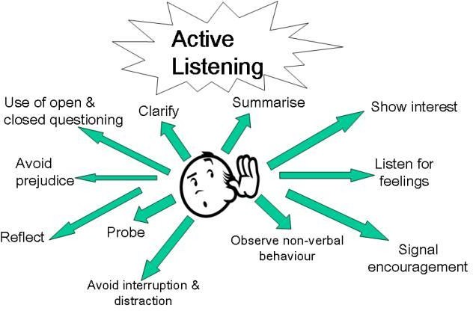

Slide 14
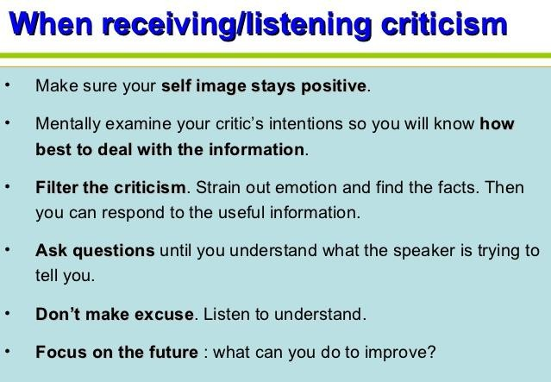

Slide 15
How to Be an Active Listener
Focus on the speaker and not yourself. Keep your eyes and ears focused on the speaker without making them feel uncomfortable.
If speaking on the phone, concentrate by focusing at a particular spot and do not look around.
Provide feedback on what the speaker has said.
Use paraphrasing (repeating what the other person has said, but not verbatim) skills to understand the speaker’s needs.
When there are people who talk a lot, they can politely be informed about the limited time, and be requested to talk about their important concerns (This applies when you have limited appointment times).

Slide 16
How to Be an Active Listener
Listen patiently to all concerns without interrupting and in the end do not forget to ask a customer if they have any questions for you.
Be patient when you wait for responses by maintaining silence.
Always keep an eye on the speaker’s body language and the tone of their voice, because these two behaviors speak a lot.
Write down important information in the form of keywords on a piece of paper.
Keep your emotions away from the situation.
Do not jump to conclusions before completely listening.
Ask the speaker to repeat if you have not understood something.

Slide 17

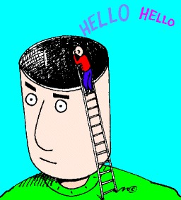
HURIER Model for Listening
The HURIER model details 6 sequential steps for effective • listening and can be used to improve your overall listening and communication skills.
Hearing
Focusing on the message Comprehending and interpreting Analyzing and Evaluating Responding
Remembering
17

Slide 18
HURIER Model: Hearing
Where listening begins with the physical process of perceiving sound.
Remember, active listening involves taking hearing to the next step!
HURIER Model: Understanding
Understanding what is being said.
Ask questions to clarify anything you have trouble understanding.
HURIER Model: Remembering
Remembering and storing information for future retrieval.
18

Slide 19
HURIER Model: Interpreting
Interpreting the message, including body language, tone of voice, facial expressions and emotions.
HURIER Model: Evaluating
Evaluating and separating facts from fiction.
How much of what was said is accurate?
HURIER Model: Responding
Responding or providing feedback to the speaker
19

Slide 20


2) Giving Constructive Feedback
Feedback: is the process through which the receiver communicates with the sender by returning another message.
Giving feedback often is associated with one person (receiver) communicating of what another person has said or done.

Slide 21
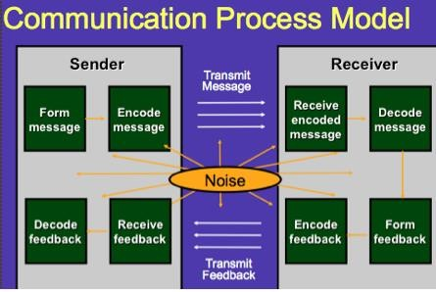

Slide 22


Forms of Feed back
Clarifying
Interpretive
Personal reaction
Characteristics of Constructive Feed back
Positive –Provide positive information and points for improvement. Offer positive before negative.
Directly expressed, specific and relevant – Feedback should be specific and concentrate on particular incidents and observable behaviour, performance and outcomes; it is not about the individual as a person.

Slide 23

Characteristics of Constructive Feed back
Descriptive and not judgemental –don’t pass judgement; reactions, perceptions and opinions should be presented as such, not as facts. Describe what have been seen or heard and its impact
Sensitive – Take account of the other person’s feelings and reactions; vary your style according to the needs of the individual and the situation.
Objective
6- Timely and in context. As soon as possible after the event. If you leave it too long, its usefulness will be lost.
7- Limited
8- Ensure understanding is two-way (reciprocal) 9- Regular

Slide 24
Guidelines toward giving feedback effectively (Constructive Feedback skills)
- Be Specific: Feedback should highlight specific events or examples rather than just general advice.
Offer a solution: Feedback should suggest ways of resolving any problems.
Deliver the feedback face to face.
Be sensitive: This is simply a reminder that feedback, even negative feedback, should be delivered in a positive way rather than simply attacking the other person
Be problem oriented, not people oriented.
Be descriptive, not evaluative
Own rather than disown the feedback. Use "I have a problem with your work", not "others have been complaining".

Slide 25
Guidelines toward giving feedback effectively (Constructive Feedback skills)
Check with the other, that they understand what has been said
Be open to hear new and possibly disconfirming information
Allow the recipient to accept or reject feedback – Give them time
-Encouraging – Emphasise the positives as well as the negatives; give praise where it is due and be specific. If the information is negative, ensure the behaviour is under the control of the recipient, so they are able to change or improve.
Be validating
- Feedback should be helpful to the receiver and directed toward behavior which the receiver can do something about

Slide 26

Receiving and Acting on Feedback
Good feedback is meant to be of benefit. To use it constructively we need to:
Be open and receptive
Listen carefully to what is being said
Consider the implications – examine the value of what has been said
Be aware of immediate reactions – don’t react instantly
Concentrate on the content – don’t ignore comments that don’t fit with our ideas
Question if we don’t understand – ask for clarification
Ask for help/suggestions/ideas, “What if I did it this way?”
Identify key issues that require change

Slide 27

3) Giving presentations
Giving presentations is a key employment related skill that needs to be learned.
Aim/purpose & context Planning & preparation Delivery
Overcoming nerves
27

Slide 28
Giving presentations
Purpose & Context
To inform, train, persuade, entertain, sell or demonstrate? Who is the audience?
How much time do you have? Where is the venue?
Formal or informal?
28

Slide 29
Giving presentations
Planning & Preparation
Relevance to aim and audience! Gather material relevant to message
It is a good idea to consult several types of sources (e.g. newspapers, journals, periodicals, government publications, Internet, reference books, etc.) for a higher quality presentation.
The key is to find a balance between too much information and poor preparation. The latter may be due to a lack of or inaccurate information. The presentation should be clear, accurate and analytical. Good knowledge of the subject provides confidence for getting up and delivering the presentation.
29

Slide 30
Giving presentations
Planning & Preparation:
Structure the material
Intro = catch attention Middle = logical, chunks
End = summarise main points

Slide 31
The introduction must catch the audience’s attention; especially important are the first 5 minutes. Some useful techniques for achieving this include:
An overview of the presentation outlining the issues and objectives
·
·
·
·
·
A statistic or shocking fact A quotation
A question
A humorous incident A headline

Slide 32
The middle or main portion of the presentation is where the argument or explanation is provided. This should consist of key points. A useful way to determine the best structure is to summarise notes gathered and focus on key points. Write them on cards or as a mind map (diagram) and then decide what order to present them in – should the most important go first or last, or should it be chronological?
The closing or conclusion summarises the main points. It is useful to include a concluding statement, perhaps related to the objectives stated in the introduction.

Slide 33

Giving presentations
Planning & Preparation:
Use of notes
Use of visual aids -KISS! Rehearse
33

Slide 34
It is a good idea to use speakers’ notes. One ways is to put everything down on note cards. Each card should contain one of the key ideas, followed by reminder words or examples.
Notes help the speaker to remember information and to control nerves; however, they should not be read as a script.
Advise students of some useful tips for preparing visual aids:
Use the KISS principle – Keep It Simple, Stupid!
Avoid too much text on slides or overheads - No more than five lines per slide, no more than five words per line.
Eliminate inefficient words such as a, an, the...
Use visual symbols, such as ↑ for increase. Imagery is powerful.
Use colour.
Use headings and bullet points.

Slide 35
Use headings and bullet points.
If using PowerPoint (or other graphics packages) to generate slides or visual aids, use a minimum 24-point font.
Make sure to have a hard copy standby.
If using more advanced technology ensure the equipment is available and know how to use it.
It is important to rehearse a presentation as it provides useful information and helps to contain nerves. Rehearsing will give an indication of the length of the presentation, and provides the opportunity to reduce or increase the content.

Slide 36

Giving presentations
Delivery:
Arrive early to check the room and to check any equipment. Make sure you have a watch or can see a clock to keep to the timetable.
Awareness of self – voice, body language, confidence
Use the first few moments to settle in, ask the audience if they can hear you, stating who you are.
Think positive and be aware of self as deliver presentation so can adjust accordingly.
36
Interpersonal Skills Module

Slide 37
Giving presentations
Delivery:
Dealing with questions
Handling questions. If you are asked questions at the end but are not sure of the answer, say so. You are not expected to know everything. You can mention that you will attempt to find out for them or ask the audience if they know.
37

Slide 38

Giving presentations Tips for delivering presentations Be aware of verbal language
-Pay attention to voice. Talk louder than normal and try to vary the pitch of your voice. Speak slowly enough for the audience to capture the meaning of what you are saying. Avoid a monotonous tone.
-Word choice. Long words are harder to understand than short words. Eliminate words or phrases that may be inappropriate, insulting or stereotyping. Avoid the overuse of similar words.
38
Interpersonal Skills Module

Slide 39



Giving presentations Tips for delivering presentations Be aware of non- verbal language
Keep eye contact. This helps to engage the audience and encourages their attention. Try to look at all members, however if you are nervous a useful tactic is to pick only one or two and imagine you are only addressing them, rather than a roomful of people.
Use hands in a variety of gestures. Do not fidget with notes, play with clothes, etc. Use your hands to describe and reinforce your verbal message. Avoid pointing at the audience.
·
39
Interpersonal Skills Module

Slide 40



Tips for delivering presentations
Be aware of non- verbal language
Be aware of posture. Stand straight, with chest up and shoulders relaxed. A little movement is helpful so long as you do so with clear purpose. This allows your voice to project. Anchor yourself spreading feet apart (1.5 feet). This ensures you stand still and forces shoulders back and reduces anxiety.
Face the audience. Bear in mind that your facial expression should reinforce your message. Smile from time to time. The warmth that you will emit can affect the listeners’ level of interest or motivation. Avoid turning your back to the audience and looking at the screen.
Clothes. Do not wear clothes that distract attention from what you are saying. Dress comfortably and appropriately.
40
Interpersonal Skills Module

Slide 41

Giving presentations Reasons for feeling nervous: Lack of experience
Lack of preparation Lack of enthusiasm Negative self-talk
41
Interpersonal Skills Module

Slide 42


Giving presentations
Overcoming nerves:
Be over-prepared Rehearse/practice
Use relaxation techniques Think positive
Allow for all eventualities Avoid stressors
42

Slide 43



4) Questioning Skills
Questioning Techniques
Most texts on interviewing techniques will differentiate between open and closed questions.
An open question allows the person to answer in whatever way they choose. For example, ‘How are you finding
writing up your case study report?
A closed question asks for specific information or a yes/no response. An example would be ‘Have you completed your case study report?

Slide 44
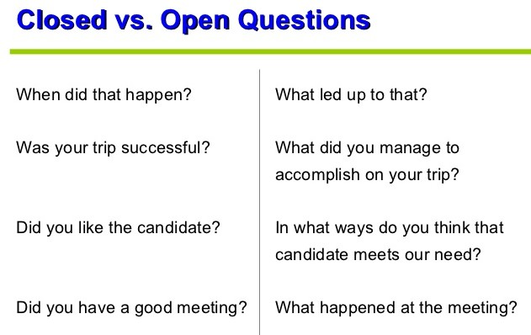

Slide 45

Types of Questions
Other more advanced types of questions include:
Probing/clarifying Questions
Reflective Questions
Direct Questions
Hypothetical Questions

Slide 46
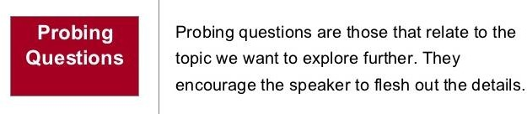
These are open or closed questions that serve to
build on the person’s previous answers, comments and responses. They use information already established in order that we can explore further. These questions also demonstrate to the person that they are being actively listened to.

Slide 47
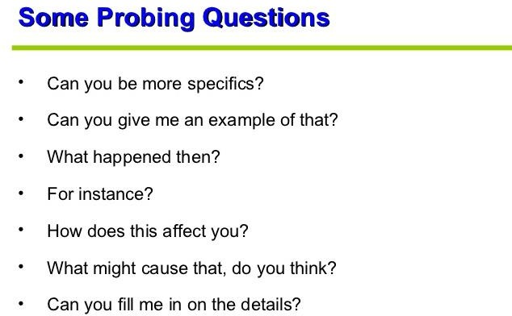

Slide 48

Reflective Questions
Reflective questions or statements are really comments made before another type of question, which serve to soften the questioning as well as demonstrate to the speaker that they are being well and truly listened to.
They typically constitute a short summary of what the other person has said, and may also be considered as a type of paraphrasing.

Slide 49
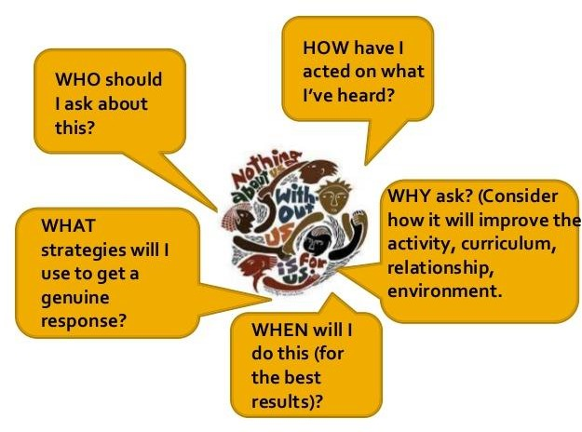
Reflective Questions

Slide 50
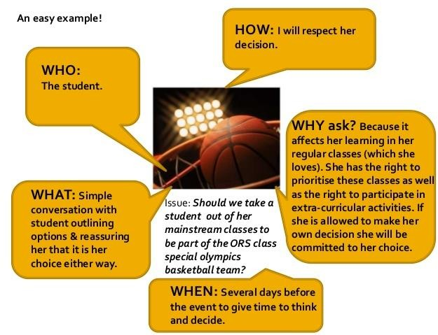

Slide 51
Hypothetical Questions
can be an excellent way to encourage your student to reflect on issues through thinking through previously unconsidered options. They are also often used in interview situations to test the creativity and mental agility of prospective students or employees

Slide 52
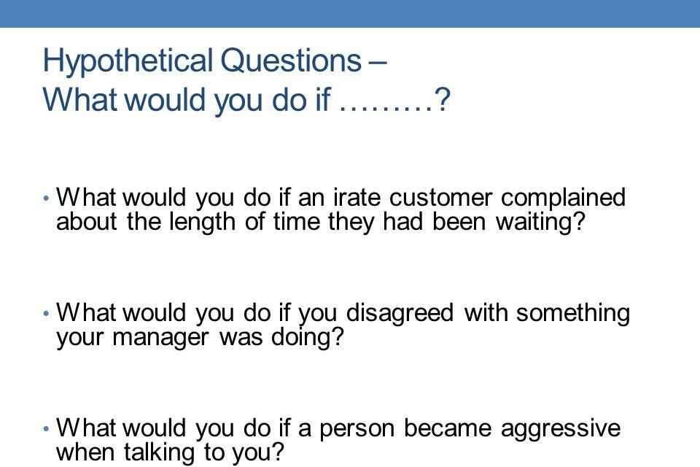

Slide 53

Direct Questions
Direct questions can be either open or closed questions. However, they tend to have the following characteristics:
When posing a direct question, you always use the name of the other person
You pose the question as an instruction.
Direct questions are especially helpful when you need to
get the other person’s attention and acquire specific information. A direct question tends to begin with phrases such as:
Tell me Jane, ....... Explain to me John, .....

Slide 54
Summary
Type of Question/ Use
Open Questions: For more information
Closed Questions: For specific information or a yes/no response
Probing Questions: For added detail
Reflective Questions: To get the other back on track
Hypothetical Questions: To get the other to think/reflect
Direct Questions: An instruction to get attention

