Slide 1
Therapeutic and Non-Therapeutic Communication Techniques
1

Slide 2
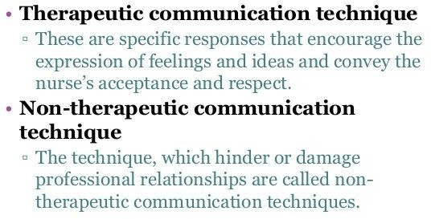
2

Slide 3
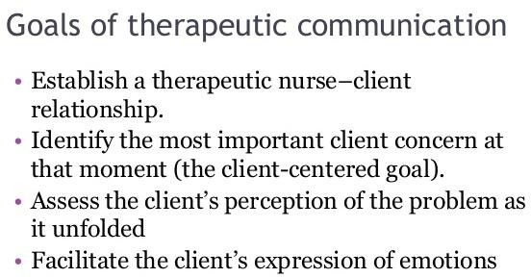
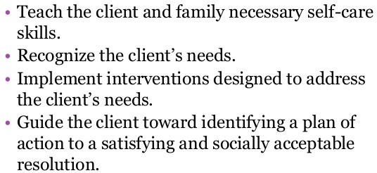

Slide 4
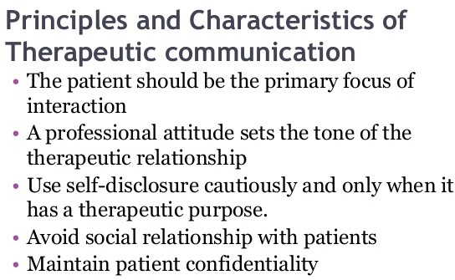

Slide 5
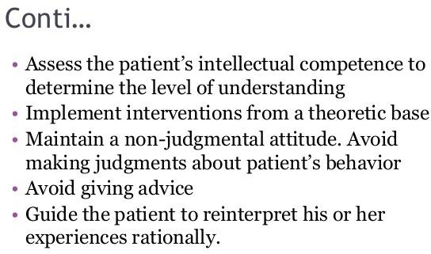

Slide 6
THERAPEUTIC COMMUNICATION TECHNIQUES
Technique | Explanation | Example
Focusing | Taking notice of a single idea or even a single word; works especially well with a client who is moving rapidly from one thought to another. This technique is not therapeutic with the client who is very anxious. Focusing should not be pursued until the anxiety | You feel angry when she doesn’t help This point seems worth looking at more closely. Perhaps you and I can discuss it together

Slide 7
Exploring | Delving further into a subject, idea, experience, or relationship; especially helpful with clients who tend to remain on a superficial level of communication. However, if the client chooses not to disclose further information, the nurse should refrain from pushing or probing in an area that obviously creates | Please explain that situation in more detail Tell me more about that situation

Slide 8
Seeking clarification and validation | Striving to explain that which is vague or incomprehensible and searching for mutual understanding; clarifying the meaning of what has been said facilitates and increases understanding for both client and nurse | I’m not sure that I understand. Could you explain? Tell me if my understanding agrees with yours Do I understand correctly that you said…

Slide 9
Presenting reality | When the client has a misperception of the environment, the nurse defines reality or indicates his or her perception of the situation for the client | I understand that the voices seem real to you, but I do not hear any voices There is no one else in the room but you and me
Voicing doubt | Expressing uncertainty as to the reality of the client’s perceptions; often used with clients experiencing delusional thinking | I find that hard to believe That seems rather doubtful to me

Slide 10
Verbalizing the implied | Putting into words what the client has only implied or said indirectly; can also be used with the client who is mute or otherwise experiencing impaired verbal communication. This clarifies that which is implicit rather | Are you feeling… It must have been very difficult…
Attempting to translate words into feelings | When feelings are expressed indirectly, the nurse tries to “desymbolize” what has been said and to find clues to the underlying true feelings | Client: I’m way out in the ocean Nurse: You must be feeling very lonely now

Slide 11
Formulating a plan of action | When a client has a plan in mind for dealing with what is considered to be a stressful situation, it may serve to prevent anger or anxiety from escalating to an unmanageable level | What could you do to let your anger out harmlessly? Next time this comes up, what might you do to handle it more appropriately?
Using silence 11 | Gives the client the opportunity to collect and organize thoughts, to think through a point, or to consider introducing a topic of greater concern than the one being discussed

Slide 12
Accepting | Conveys an attitude of receptivity and regard | Yes, I understand what you said
Giving recognition | Acknowledging; indicating awareness; better than complimenting, which reflects the nurse’s judgment | I notice that you…
Offering self | Making oneself available on an unconditional basis, increasing client’s feelings of self-worth | I’ll stay with you a while I’m interested in you
12

Slide 13
Giving broad
opening
Allows the client to take the initiative in introducing the topic; emphasizes the importance of the client’s role in the interaction
What would you like
to talk about today?
Tell me what you are
thinking
Offering general lead | Offers the client encouragement to continue | Yes, I see Go on..
 | Placing the event in time or sequence 13 | Clarifies the relationship of events in time so that the nurse and client can view them in perspective | And after that? What seemed to lead up to… Was this before or after.. When did this happen?

Slide 14
Making observations | Verbalizing what is observed or perceived. This encourages the client to recognize specific behaviors and compare perceptions with the nurse | You seem tense I notice you are pacing a lot You seem uncomfortable when you
Encouraging comparison 14 | Asking the client to compare similarities and differences in ideas, experiences, or interpersonal relationships. This helps the client recognize life experiences that tend to recur as well as those aspects of life that are changeable | Was this something like… How does this compare with the time when… What was your response the last time this occured?

Slide 15
Encouraging description of perceptions | Asking the client to verbalize what is being perceived; often used with clients experiencing hallucinations | Tell me what is happening now Are you hearing the voices again What do the voices seem to be saying

Slide 16
Restating | The main idea of what the client has said is repeated; lets the client know whether or not an expressed statement has been understood and gives him or her the chance to continue, or to clarify if necessary | Client: I can’t study. My mind keeps wandering. Nurse: You have difficulty concentrating. Client: I can’t take that new job. What if I can’t do it? Nurse: You’re afraid you will fail in this new position

Slide 17
Reflecting | Questions and feelings are referred back to the client so that they may be recognized and accepted, and so that the client may recognize that his or her point of view has value- a good technique to use when the client asks the nurse for advice | Client: What do you think I should do about my wife’s drinking problem? Nurse: What do you think you should do? Client: My sister won’t help a bit toward my mother’s care. I have to do it all! Nurse: You feel angry when she doesn’t help.

Slide 18
NON- THERAPEUTIC COMMUNICATION TECHNIQUES
Giving reassurance | Indicates to the client that there is no cause for anxiety, thereby devaluing the client’s feelings; may discourage the client from further expression of feelings if he or she believes they will only be downplayed or ridiculed | I wouldn’t worry about that if I were you Everything will be alright Better to say: We will work on that together

Slide 19
Rejecting | Refusing to consider or showing contempt for the client’s ideas or behavior. This may cause the client to discontinue interaction with the nurse for fear of further rejection | Let’s not discuss… I don’t want to hear about… Better to say: Let’s look at that more closely
Using denial 19 | When the nurse denies that a problem exists, he or she blocks discussion with the client and avoids helping the client identify and explore areas of difficulty | Client: I’m nothing. Nurse: Of course you’re something. Everybody is somebody. Better to say: You’re feeling like no one cares about you right now

Slide 20
Approving or disapproving | Sanctioning or denouncing the client’s ideas or behavior; implies that the nurse has the right to pass judgment on whether the client’s ideas or behaviors or “good” or “bad”, and that the client is expected to please the nurse. The nurse’s acceptance of the client is then seen as conditional depending on the client’s behavior | That’s good. I’m glad that you.. That’s bed. I’d rather that you… Better to say: Let’s talk about how your behavior evoked anger in the other clients at dinner
20

Slide 21
Agreeing or disagreeing | Indicating accord with or opposition to the client’s ideas or opinions; implies that the nurse has the right to pass judgment on whether the client’s ideas or opinions are “right” or “wrong”. Agreement prevents the client from later modifying his or her point of view without admitting error. Disagreement implies inaccuracy, provoking the need for defensiveness on | That’s right. I agree That’s wrong. I disagree I don’t believe that. Better to say: Let’s discuss what you feel is unfair about the new community rules
21

Slide 22
Giving advice | Telling the client what to do or how to behave implies that the nurse knows what is best, and that the client is incapable of self-direction. It nurtures the client in the dependent role by discouraging independent thinking | I think you should… Why don’t you.. Better to say: What do you think you should do
22

Slide 23
Probing | Persistent questioning of the client; pushing for answers to issues the client does not wish to discuss. This causes the client to feel used and valued only for what is shared with the nurse, and places the client on the defensive | Tell me how your mother abused you when you were a child Tell me how you feel toward your mother now that she is dead. Better technique: recognize the client’s response and discontinue the interaction at the first sign of discomfort
23

Slide 24
Defending | Attempting to protect someone or something from verbal attack. To defend what the client has criticized is to imply that he or she has no right to express ideas, opinions, or feelings. Defending does not change the client’s feelings and may cause the client to think the nurse is taking sides with those being criticized and against the client. | No one here would lie to you. You have a very capable physician. I’m sure he only has your best interest in mind
24

Slide 25
Requesting an explanation | Asking the client to provide the reasons for thoughts, feelings, behavior, and events. Asking “why” a client did something or feels a certain way can be very intimidating, and implies that the client must defend his or her behavior or feelings | Why do you think that? Why do you feel this way? Why did you do that? Better to say: Describe what you were feeling just before that happened
25

Slide 26
Indicating the existence of an external source of power | Attributing the source of thoughts, feelings, and behavior to others or to outside influences. This encourages the client to project blame for his or her thoughts or behaviors upon others rather than accepting the responsibility personally | What makes you say that? What made you do that? What made you so angry last night? Better to say: You became angry when your brother insulted your wife
26

Slide 27
Belittling feelings expressed | When the nurse misjudges the degree of the client’s discomfort, a lack of empathy and understanding may be conveyed. The nurse may tell the client to “perk up” or “snap out of it”. This causes the client to feel insignificant and unimportant. When one is experiencing discomfort, it is no relief to hear that others are or have been in similar situations. | Client: I have nothing to live for . I wish I were dead. Nurse: Everybody gets down in the dumps at times. I feel that way myself sometimes. Better to say: You must be very upset. Tell me what you are feeling right now.
27

Slide 28
Making stereotyped comments | Clichés and trite expressions are meaningless in a nurse- client relationship. For the nurse to make empty conversation is to encourage a like response from the client | I’m fine, and how are you? Hang in there. It’s for your own good. Keep your chin up. Better to say: The therapy must be difficult for you at times. How do you feel about your progress at this point?
28

Slide 29
Interpreting | With this technique the therapist seeks to make conscious that which is unconscious, to tell the client the meaning of his or her experience 29 | What you really mean is.. Unconsciously you’re saying… Better technique: the nurse must leave interpretation of the client’s behavior to the psychiatrist. The nurse has not been prepared to perform this technique, and in attempting to do so may endanger other nursing roles with the ^{client}

Slide 30
Introducing an unrelated topic | Changing the subject causes the nurse to take over the direction of the discussion. This may occur in order to get something that the nurse wants to discuss with the client or to get away from a topic that he or she would prefer not to discuss | Client: I don’t have anything to live for. Nurse: Did you have visitors this weekend? Better technique: the nurse must remain open and free to hear the client and to take in all that is being conveyed, both verbally and nonverbally
30

Slide 31
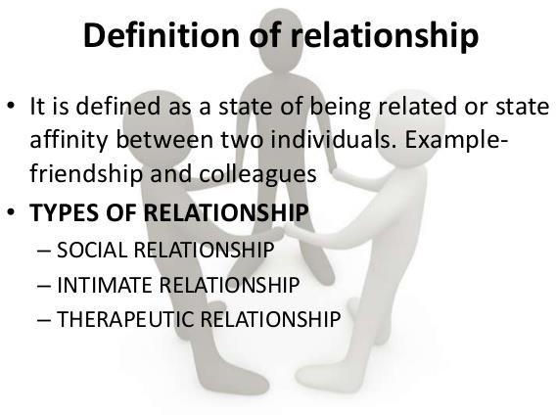
THERAPEUTIC Nurse-Patient Relationship
31

Slide 32
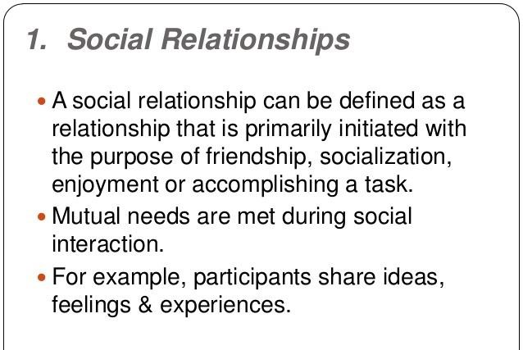

Slide 33
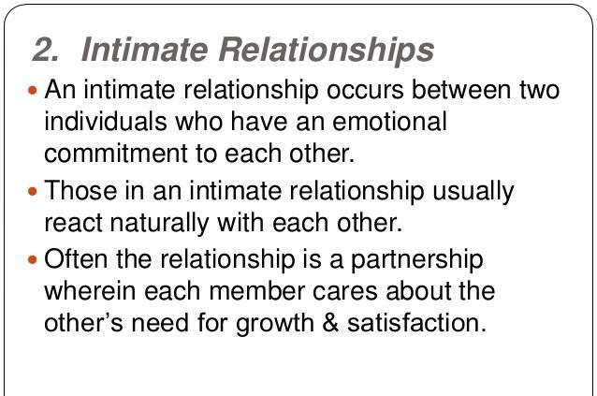

Slide 34
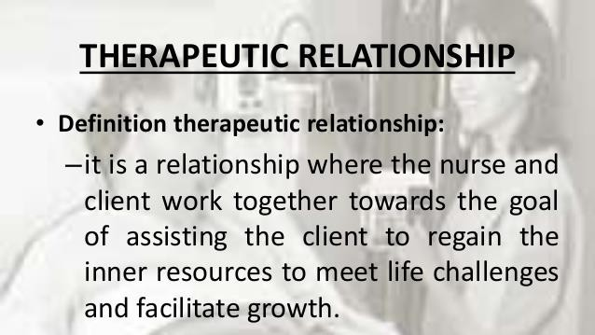
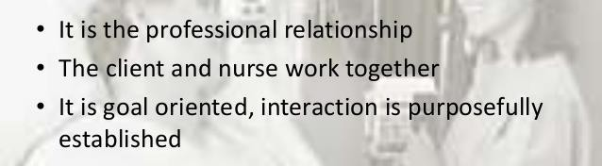

Slide 35
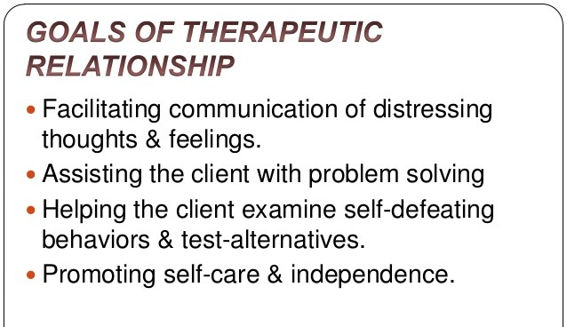

Slide 36
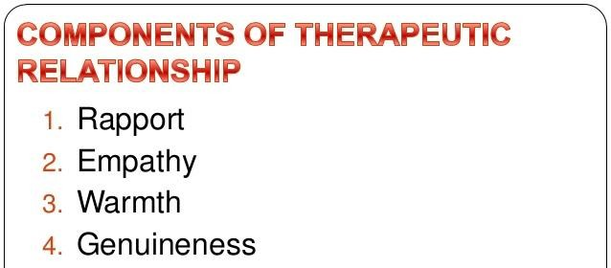

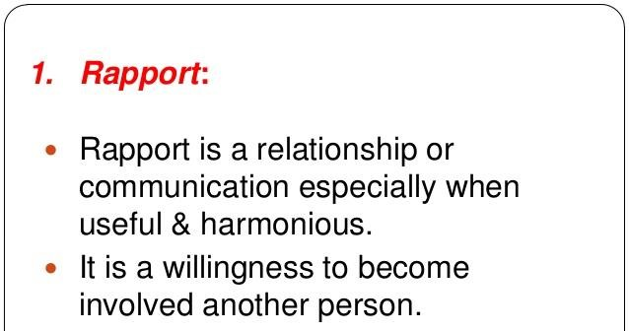
36

Slide 37
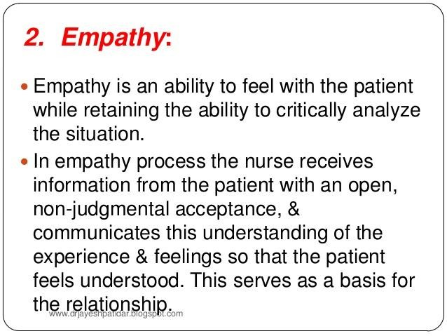
37

Slide 38
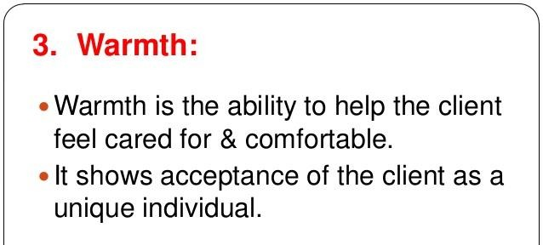
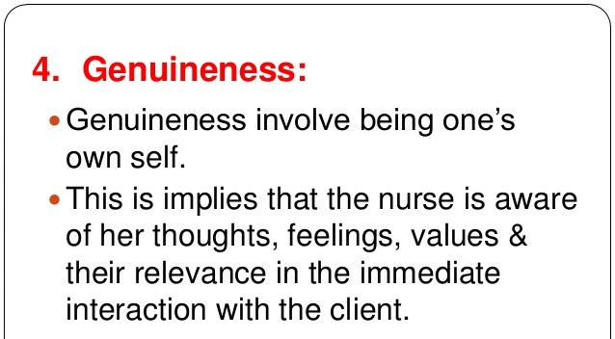
38

Slide 39
5) Respect

Slide 40
Helping Relationship Characteristics
Caring Hopeful Sensitive Genuineness Empathy
Positive regard
Empowering Assertive

Slide 41
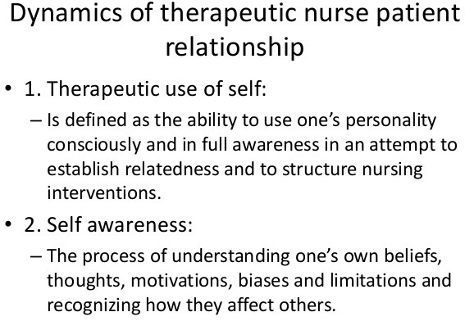
41

Slide 42
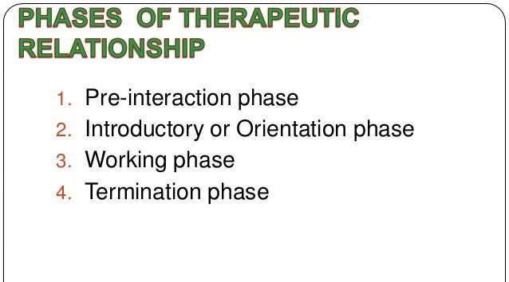
43
Dr. Malakeh.Z. Malak
6/23/2017

Slide 43
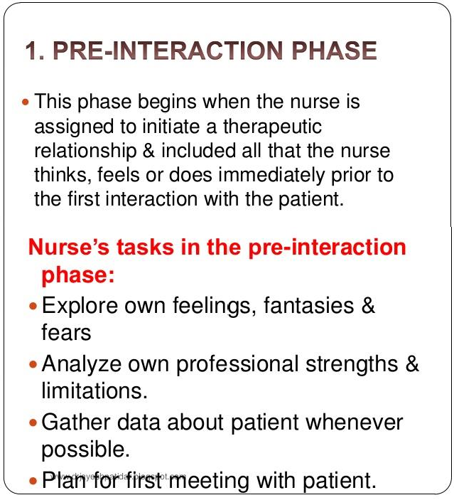
44

Slide 44
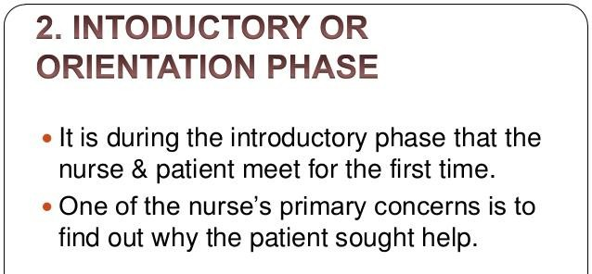
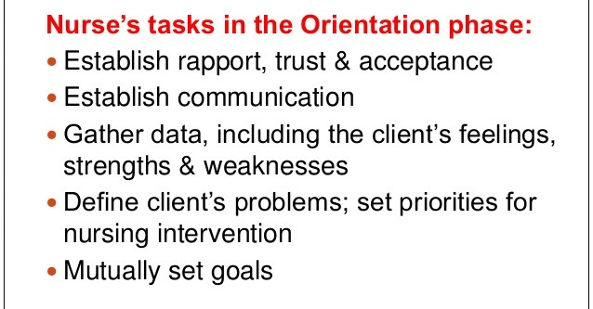
45

Slide 45
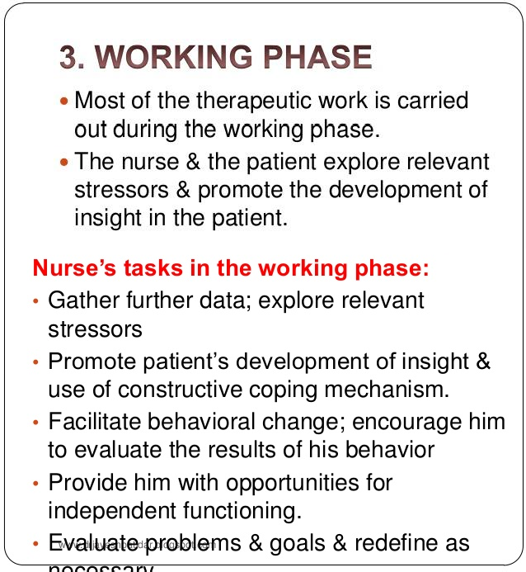
46

Slide 46
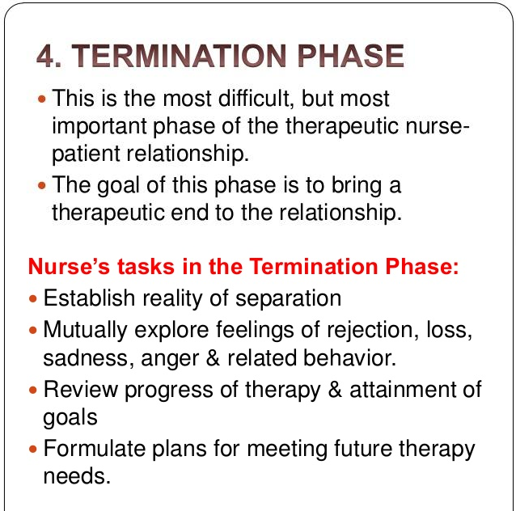
47

Slide 47
Avoid
Arguing Minimizing Challenging
Giving false reassurance
Interpreting or speculating on the dynamics of the client’s problems
“Selling” client on accepting treatment
Probing sensitive areas
Participating in criticism of any staff member
Joining any attacks led by the client
48

