Slide 1
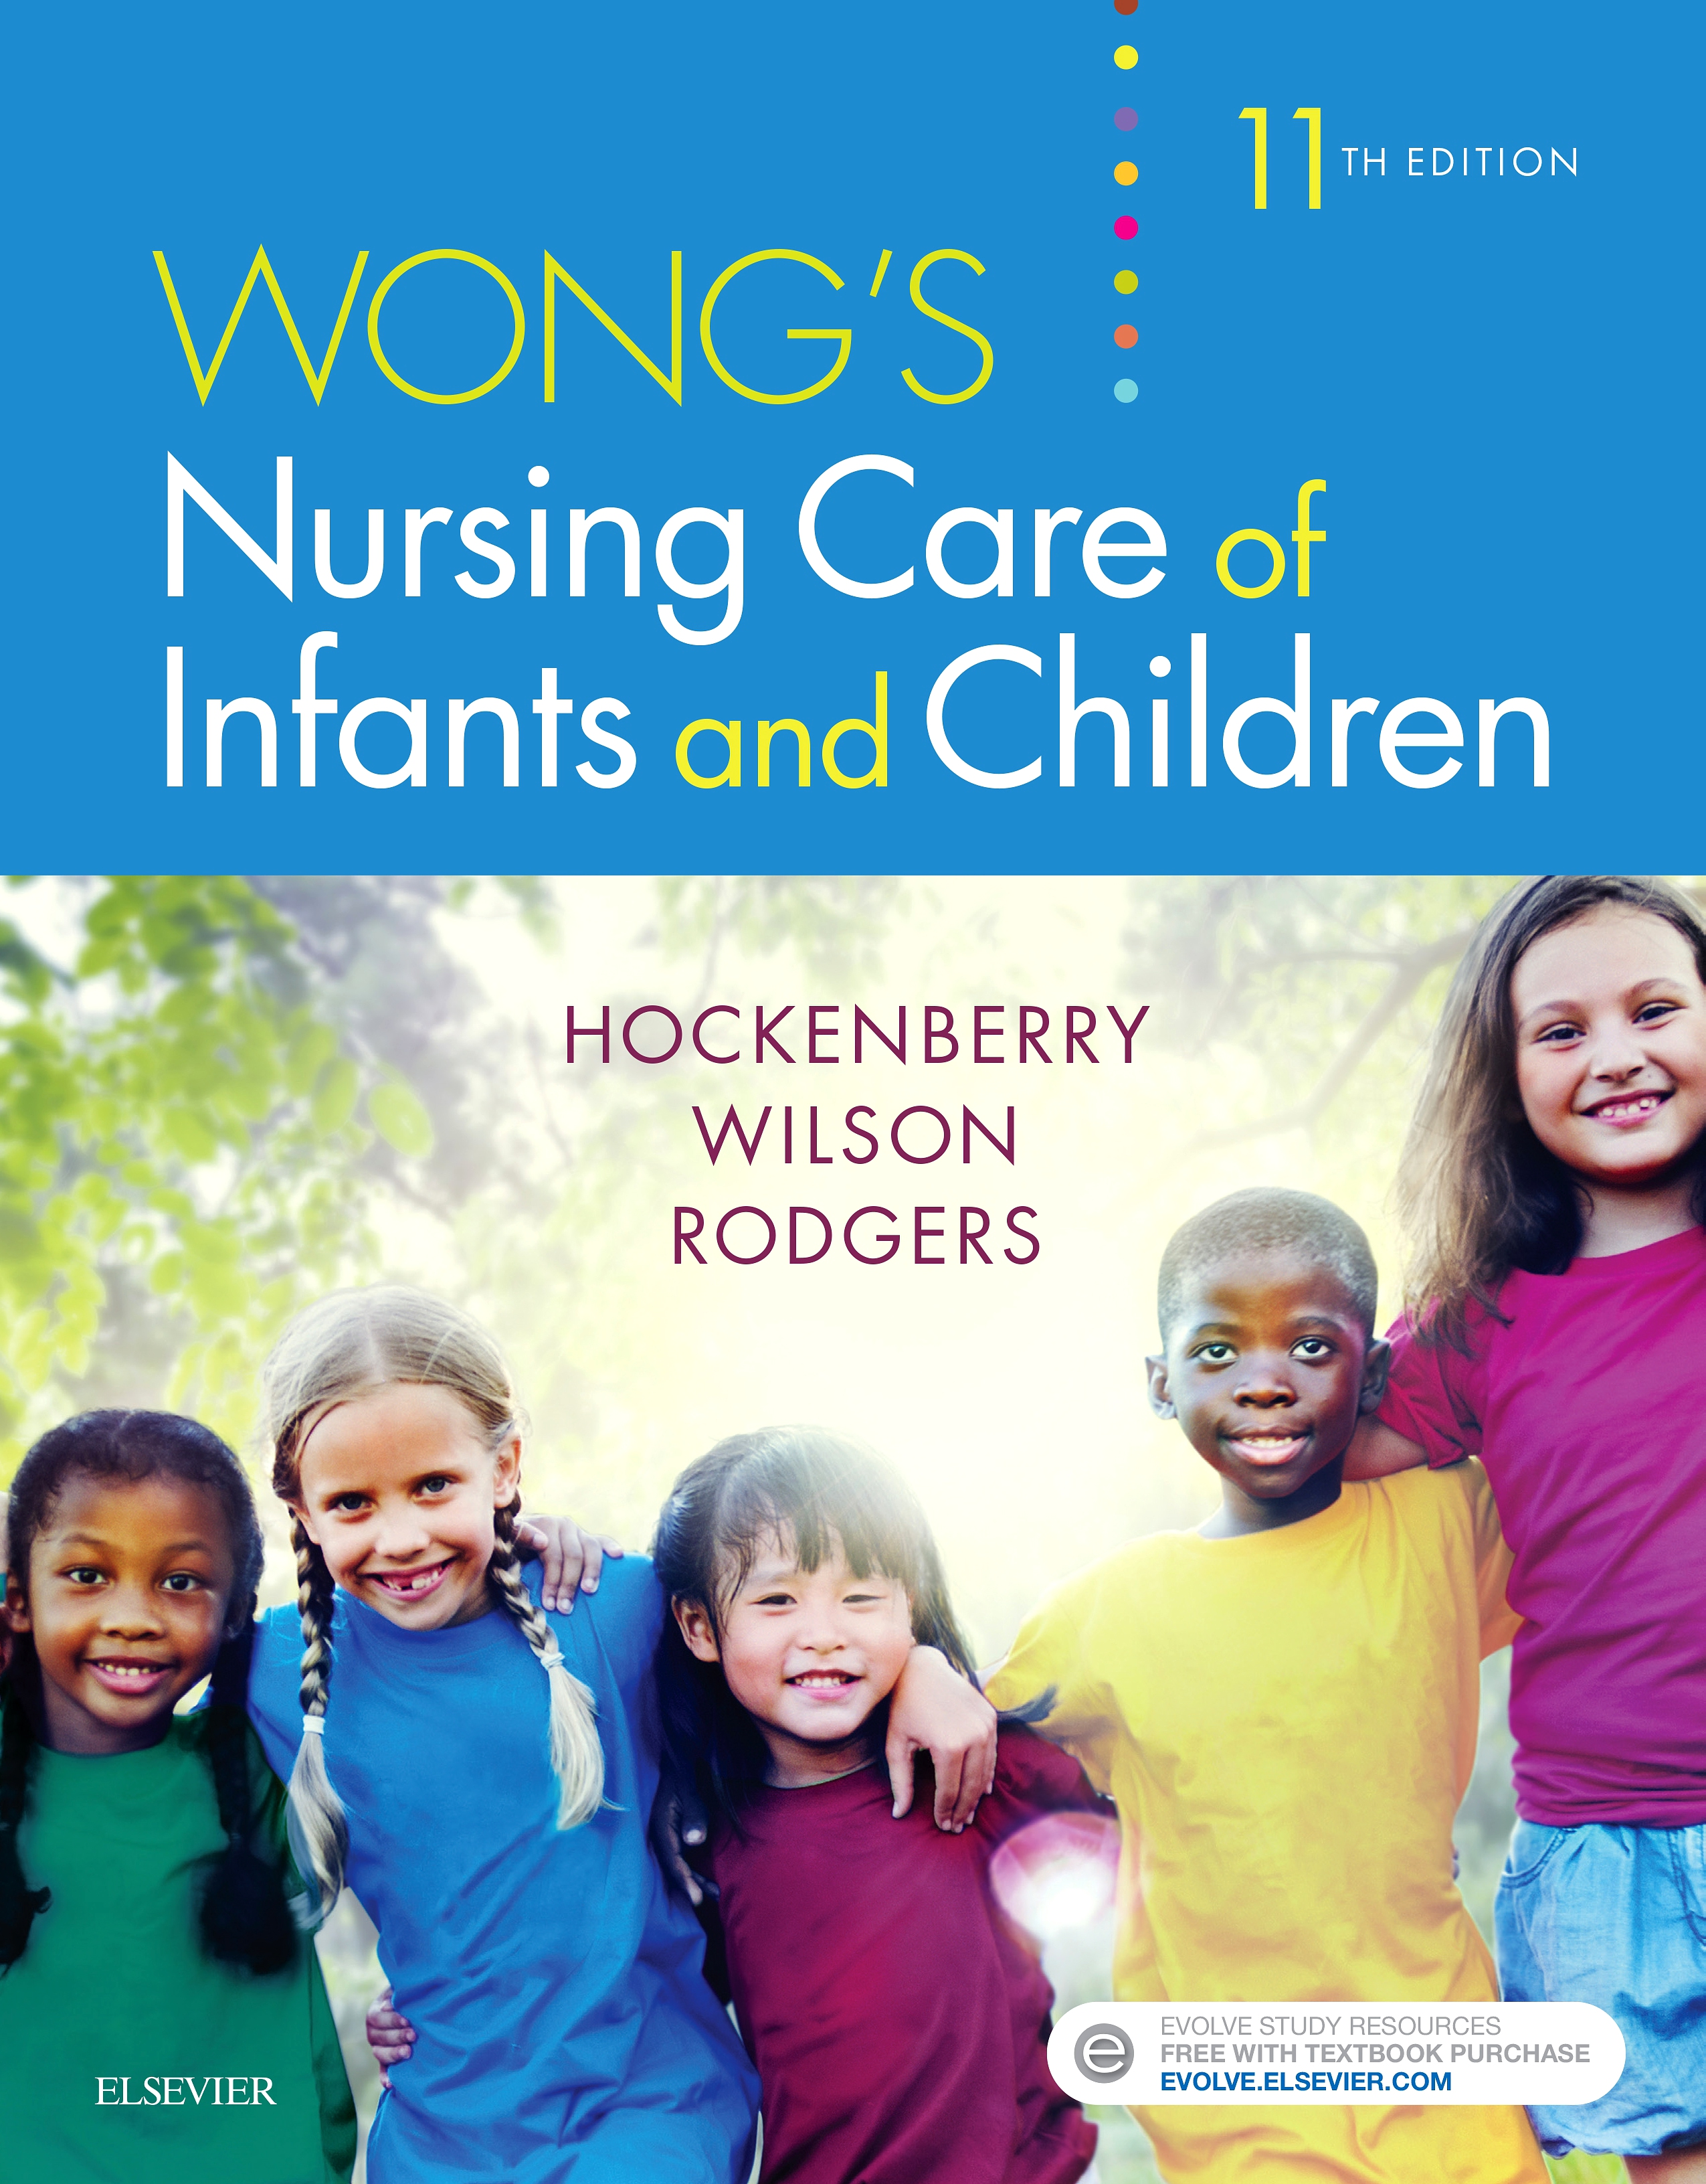
Pediatric
and New born Nursing
Unit 1 Introduction to Child Health Nursing

Slide 2
Unit 1 Introduction to Child Health Nursing
1. The Roles and characteristics of the Pediatric nurse
2. Communications with pediatrics
Perspective of child health nursing
The Bills of rights of children

Slide 3
Pediatrics (paediatrics)
'Paedia' means child, 'iatrike' which means physician.
It means healer of children.
It is the specialty of medical science concerned with the physical, mental, and social health of children from birth to young adulthood.
Pediatrician
A physician who is concerned primarily with the health, welfare, and development of children and is uniquely qualified for these endeavors by special training.
Pediatric Nursing
It is the branch of nursing concerned with the care of with the health children from birth to adolescents.

Slide 4
Scope of Practice of Pediatric Nurse
The scope of practice is defined as the activities that nurse perform in the delivery of patient care.
The scope of practice reflects:
a) The types of patients for whom the nurse may provide care
b) The procedures and care activities that they can perform

Slide 5
The Roles of the Pediatric nurse
1- Therapeutic Relationship
2- Family Advocacy and Caring
3-Disease Prevention and Health Promotion
4- Health Teaching
5- Injury Prevention
6- Support and Counseling.
7- Coordination and Collaboration
8-Ethical Decision Making
9- Research and Evidence-Based Practice(EBP),
10- Nursing Process

Slide 6
The Roles of the Pediatric nurse
11- Care for infants and children (up to 18 years old) with acute and chronic health problems in a variety of hospital and community-­based practice settings.
12- Promotion and maintenance of health
13-Applies individualized care with respect to gender, age, developmental level, race, cultural differences, individuality, ethnicity, spiritual beliefs, lifestyle, socio-economic status, disability, and family configuration.
14-Adopts family-­centered care, developmental care approach and humanism

Slide 7
The characteristics of the Pediatric nurse
Pediatric nursing is family-centered nursing
1- Knowledge
2- Excellent Nursing Practice and Performance
3- Work as an Effective Team member
4- Patience
5- Good observer
6- Good communication skills
7-Empathy
8- Critical thinking skills
9- Honest and truthful

Slide 8
The characteristics of the Pediatric nurse
10- Love to work with children and family
11- Good judgement
12- Commitment to Patient Advocacy
13- Playfulness , cheerful and Sense of Humor
14- Attention to Detail
15- Problem Solving Skills
16- Willingness to Learn
17- Leadership skills
18- Time Management

Slide 9
Perspective of Child Health Nursing
The major goal for pediatric nursing is to improve the quality of health care for children and their families.
1- Health Promotion
Promote Development stages
Promote Nutrition status
Promote Oral Health
Promote Immunization
Promote Access to health care

Slide 10
Perspective of Child Health Nursing
2- Childhood Health Problems:
Physical injury and violence
Overweight obesity and Type 2 Diabetes
Tobacco use and Substance abuse
Mental health problems
Infant and Childhood Mortality
Childhood Morbidity: Respiratory illness accounts for approximately 50% of all acute conditions

Slide 11
Communication With Children
Ways to think about communication with infants:
Even though infants are non verbal they are strong communicators.
When attempting to understand the world of infants it is important to:
Interact with the child
Holding them
Speaking to them
Observing them being fed and bathed
Watching their body responses in a number of different situations.

Slide 12
Communication With Children
Ways to think about communicating with toddlers
Positive strategies
Play
Pretend
Make faces
Watch body language
Look for explorative behavior
Where do they feel safe?
Watch for
Exploring behavior
Proximity seeking
Awareness of themselves

Slide 13
Communication With Children
Ways to communicate with primary school kids 4 – 8 years
Lots of drawing, play games, tell stories
Make things
Dress up
Avoid multiple or complex questions
Give them opportunities to talk in the third person
Let them move around if they need too
Use pictures
Sand play
Dance

Slide 14
Communication With Children
Ways to communicate with older kids - 8 up.
Make comic strips together
Write plays, Art/story book journals
Use technology
Chart success
Music and words to favorite songs
Write things down
Give them space to consider their answers
Do not over correct them
Answer their questions honestly

Slide 15
Communication With Children
Ways to communicate with adolescents:
Pick a safe environment
Be clear about what will happen to the information
Check if there are any no go areas
Expect to be ‘played’
Use Art and conversation together
Use music and conversation together
Use film and conversation together

Slide 16
Communication With Children
Ways to communicate with adolescents:
Let them write
Share your notes
Challenge them
Use feeling words
Map progress
Give them written information
Make plans together
Meet them half way whenever you can

Slide 17
Communication With Children
Time: children and young people need time to communicate
Time to feel safe
Time to get to know you
Time to get to trust you
Time to get to know themselves

Slide 18
Communication With Children Try to avoid
Close questioning
Leading questions
Suggestive questions
Complicated questions
Intimidation through personal or environmental factors

Slide 19
The Bills of Rights of Children Care
1. Equality, without distinction on account of race, religion or national origin.
2. Special protection for the child’s physical, mental and social development.
3. A name and a nationality.
4. Adequate nutrition, housing and medical services.

Slide 20
The Bills of Rights of Children Care
5. Special education and treatment when a child is physically or mentally handicapped.
6. Understanding and love by parents and society.
7. Recreational activities and free education.
8. Be among the first to receive relief in all circumstances.

Slide 21
The Bills of Rights of Children Care
The children’s rights.
9. Protection against all forms of neglect, cruelty and exploitation.
10. Be brought up in a spirit of understanding, tolerance, friendship among peoples, and universal brotherhood.

