Slide 1

Pediatric
and New born Nursing
Unit 2 Adjustment to Extra-Uterine Life

Slide 2
The Neonatal Period
It is the period that last from birth through first 28 days of life.
The goals of the newborn initial physical exam are:
Identify an obvious abnormality
Direct the plan of care
Obtain baseline data

Slide 3
Measurements of Term Neonate
Weight: 2.5 to 4 Kg
Length: 46 to 54 cm.
Head Circumference: From 34-35 cm at birth, - not < 33 or > 37cm.
Chest Circumference: From 32-33 cm at birth. It is less than the head with two cm until age of two years.

Slide 4
Vital Sings of Term Neonate:
1- Temperature: 36.8–37.2 °C
2- Blood pressure:
At birth: 80/50 mmHg.
By 10th day: 100/50.
3- Pulse: Palpated from the umbilical stump or femoral region or listened by stethoscope at apical area.
At birth: 120-160 beat/minute.
After 1 hour: 120-140 beat/minute.
4- Respiration: It is irregular with period of apnea
At birth: 80 breath /minute.
After rest: 30-60 breath /minute.

Slide 5
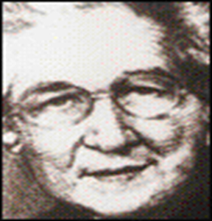
APGAR SCORE:
A standardized method of evaluating the neonate’s condition immediately after delivery.
APGAR score should be done at age 1 minute, 5 minutes and 10minutes after birth
Perform at first minute to assess clinical condition after birth
Perform at 5 minutes to assess response to resuscitation
If APGAR <7 at 5 minutes repeat every 5minutes until 20mins

Slide 6
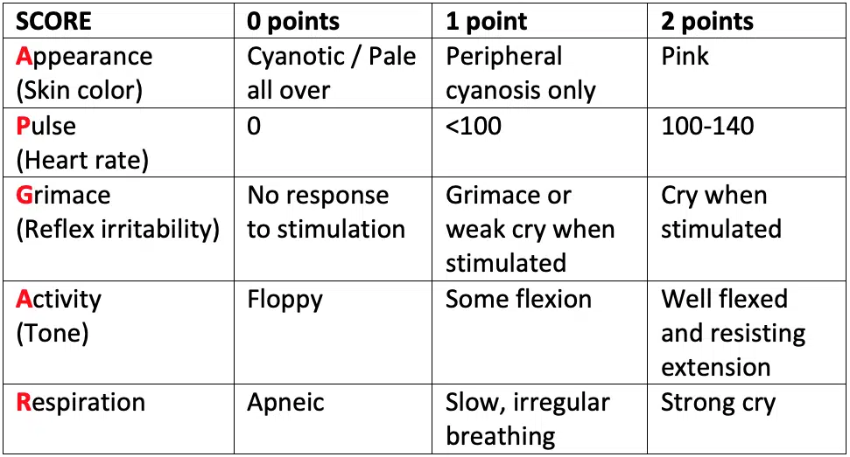

Slide 7
Score | Interpretation | Nursing Interventions
7 to 10 | Well baby | Rarely needs resuscitation
4 to 6 | At risk Newborn needs intensive care | Requires resuscitation Suction Dry immediately Ventilate until stable Careful observation
0 to 3 | Sick baby Prognosis for NB is grave | Intensive resuscitation ET/ Ambu bag Ventilate with 100% O2 CPR Maintain body temperature Parental support

Slide 8
Delivery Room Care
Care of a normal baby at birth (Until 1 hour after birth)
Is critical to the neonate because his transition must be very quickly from the intrauterine environment; that provided for all fetal needs to the extra-uterine environment that requires the neonate to function independently.
The first 24 hours of life is a very significant and a highly vulnerable time.

Slide 9
FOUR Basic Needs At Birth:
Normal breathing
Thermal protection
Mother’s milk
Protection from infection
NC-
Notes:
9

Slide 10
1- Normal breathing (Airway):
Initiation of respiration
a. Chemical factors stimulate breathing: Hypoxemia, Hypercarbia, Low pH
b. Thermal stimuli: Newborn leaves warm environment to cooler atmosphere. Sensory impulses to skin are transmitted to respiratory center in the medulla.
c. Fetal Lung fluid removal: Compression of chest with passage through birth canal ‘thoracic squeeze”
d. Expansion of alveoli

Slide 11
Circulation
Fetal’s circulation transition into Neonate’s Circulation.
Circulatory changes allow blood to flow through lungs.
Functional Closure of Fetal Shunts
a) Ductus Venosus:
It is a shunt connects the umbilical vein and the inferior vena cava.
Constrict after cord is clamped.
These will become ligaments (2-3 months).

Slide 12
Functional Closure Of Fetal Shunts
b) Foramen ovale:
It is a small hole located between the right and the left atrium.
Closes functionally as respirations are established
Permanent closure may take several months.
c) Ductus arteriosus:
It is a shunt connects the pulmonary artery to the aortic arch.
Constricts with establishment of respiratory function
Becomes ligament in (2-3 months).

Slide 13
Neonatal’ Transitions
Before birth
-Pulmonary arterioles constricted lead to High pressure in pulmonary circuit
-Umbilical arteries aiding low pressure placenta circulation lead to Low pressure in systemic circuit then all lead to very little pulmonary blood flow
- Blood flow is diverted across ductus arteriosus
After delivery
*Lungs expand with air
* Fetal lung fluid leaves alveoli
*Pulmonary arterioles dilate lead to Low pressure in pulmonary circuit
*When umbilical arteries and veins are clamped, high pressure in systemic circuit dramatic increase in pulmonary blood flow

Slide 14
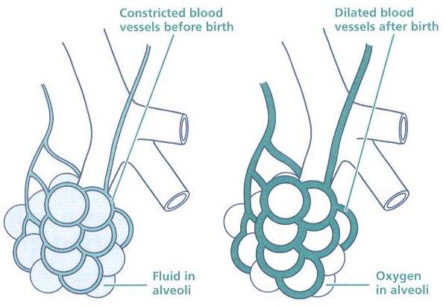
Pulmonary vessels dilate, causing increased blood flow to lungs

Slide 15
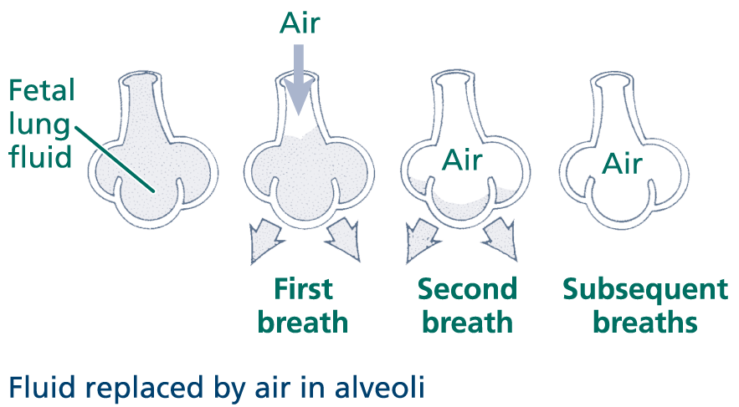

Slide 16
Neonatal Thermoregulation (Thermal protection)
Normal :36.5 to 37.3˚C (97.7 –99.2˚F)
Thermoregulation is important in the transition, initial stabilization and survival of the neonate
Neonate’s temperature in-utero is generally 0.5˚C higher than mother’s temperature.

Slide 17
Failure to maintain the neonate in the neutral thermal status can lead to the following:
Increased glucose consumption
Increased oxygen consumption
Increased respiratory distress
Increased pulmonary resistance
Vasoconstriction or vasodilatation
Decreased perfusion to vital organs
Seizures
Acidosis and Death

Slide 18
Heat Production:
The human body responds to cold in three ways:
Voluntary muscular activity (vasoconstriction and increased movement).
*Neonate conserves heat with a flexed posture.
2. Shivering: *Neonates are unable to shiver when cold.
3. Chemical non-shivering thermo genesis.
This mechanism is initiated in the hypothalamus where Nor Epinephrine is released and transmitted to the brown.
Brown fat will be broken down into glycerol & fatty acids;
Result in Vasoconstriction and increased metabolic activity

Slide 19
Brown Fat
It will not be found until 26-30 weeks gestation
In full term neonate brown fat is 4 % -10% of deposits.
It disappears 3-6 months after birth, except in cold stressed & Hypoxia
It is found at the neck, axillae, around the kidneys and in the mediastinum

Slide 20
Signs &Symptoms of Hypothermia In Neonate
Skin cool to touch & Mottling;
Central cyanosis
Tachypnea
Increasing Respiratory Distress.
Decreased responsiveness

Slide 21
Nursing Intervention and management (warm chain):
The newborn's Does not need routine measurement of temperature.
1-Warm delivery room: (25-28 °C/77.0-82.4 °F)
2-Immediate drying
3-Monitoring Body Temp
4-Plastic wrap/ bag
5-Head cap (hat)
6-Warm transportation
7-Use radiant warmers or incubators
8- Remove sources of heat loss

Slide 22
Nursing Intervention and management (warm chain):
9- Dress and swaddle neonates
10- Skin-to-skin on mother chest (Kangaroo Care)
11-Breast feeding
12- Postpone bathing and weighing
13- Training/awareness rising

Slide 23
Hyperthermia
Hyperthermia occurs when the newborn's body temperature rises above 37.5°C (99.5°F),
Environment is too hot
Overdressed neonate .

Slide 24
Nursing Management of hyperthermia
Assess for infection.
Move neonate away from the source of heat & undress.
Give frequent breast-feeds.
Monitor temperature.

Slide 25
3-Mother’s milk
Neonate develops own antibodies during 1st -3 months, but at risk for infection during first 6 weeks.
Umbilical cord stump is the primary site of infection if not kept clean.
Hand hygiene: is the primary method of preventing infection and/or the spread of infection

Slide 26
Essential Neonatal Care at Birth
Before delivery
Preparing room, equipments and resuscitation trolley.
Check all needed equipment and instruments
Available and Clean
Working well and ready to use

Slide 27
Basic Equipments
Equipment/supplies for clearing the airways: Suction machine, catheter and tubes, Bulb Syringe
Methods to administer oxygen: oxygen sources, flow meter, oxygen tubes.
Circulatory support: Stethoscope.
Medication: Vitamin K, ophthalmic medication emergency medication.
Preventive transmission measures: a clean apron, mask gloves: sterile / disposable

Slide 28
Basic Equipments
Pre heated 3-5 clean, preferably sterile, absorbent towels/linen, can be used for dryness of the neonate or as shoulder roll.
Umbilical clamps
Gauze preferably sterile, can be used to clean eyes
Insulin syringes that will be used to administer vitamin K
Axillary Thermometer
Weighing scale
Pre-warmed radiant warmer /resuscitator. It should be clean, and dry.

Slide 29
Immediate Newborn Care Steps
Deliver baby: Call out time of birth
Wipe eyes and face when head is delivered.
Receive the baby onto a warm clean towel.
Evaluate (Apger score): 30seconds
Position neonate on his back or side by slightly extend neck (sniffing position)
6. Wipe nose and mouth with towel or gauze.
Or suction with bulb syringe or suction catheter
A crying, well baby does not need active suctioning. Just wipe away secretions.

Slide 30
Immediate Newborn Care Steps:
7. Dry amniotic fluid from head and body of neonate
8. Revaluate:(30 seconds) Respiration, Heart, Tone, Reflex ,Color.
If the neonate is not breathing or gasping, then skilled care in the form of positive pressure ventilation etc.
(RESUSCITATION) would be required.
8. Clamp and cut the umbilical cord

Slide 31
Newborn Care Steps:
1) Eye care
Clean eyes immediately after birth with swab soaked in sterile water
Use separate swabs for each eye; clean from medial to lateral side
Give prophylactic eye drops within 1 hour of birth (as per hospital policy)
DO NOT put anything else in baby’s eyes
Teaching Aids: ENC
NC-
31

Slide 32
Newborn Care Steps:
2) Proper Identification
Places two identification bands on wrist and on ankle of neonate.
Write names of mother, date and time of birth, sex of neonate, obstetrician’s name, and type of delivery.
Foot print
Pertinent records should be completed including the ID bracelet before transferring to nursery
Teaching Aids: ENC
NC-
32

Slide 33
Newborn Care Steps:
3. Ensuring warmth /thermal protection
4. Administer vitamin K prophylaxis
Vitamin K1 should be given to all neonates
Single intramuscular injection
The injection prevents vitamin K deficiency bleeding
5. Initiate breastfeeding (as soon as possible)
6. Prevention of infection
7. Weigh the neonate
8- Head circumference, chest circumference, height, vital signs
9- Monitor the Neonate
10-Dressing/ Wrapping

Slide 34
Newborn Care Steps:
11. Cord care :
Observe blood oozing every 15 minutes; if blood oozes, place a second clamp
DO NOT apply any substance to the stump
DO NOT bind or bandage stump
Leave stump uncovered
Never apply harmful substances on cord, such as clay, ash, or herbal preparations.
11- Bathing:
Postpone 6 hours
Clean From cleanest to dirty part.
12- Decontamination, cleaning, and sterilization

Slide 35
Newborn Physiological Adjustment to Extra Uterine Life
Respiratory system
Cardiovascular system

Slide 36
3. Gastrointestinal and hepatic (Liver)
Newborn has deficiency of pancreatic lipase for fat absorption.
This makes cow’s milk indigestible.
Stomach capacity approximately 90 mL in term newborn.
Intestines are sterile in newborn, it cultured by normal flora in 5-24 hours.
Colon has small volume leading to frequent passing stool.
Progressive changes in stool pattern in newborn:

Slide 37
3. Gastrointestinal and hepatic (Liver)
First stool: is called meoconium,
It is black to green in color, odorless, sticky.
2nd -3rd day: called transitional stool, green in color, loose (like diarrhea).
4th day:
In breastfeed babies: Light yellow with sweat smelling (high in lactic acid). 3-4 times/ day.

Slide 38
Hunger Cycle:
Depending on mode of feeding:
Breast-fed infant :
May feed every 2-3 hours.
Bottle-fed infant :
May be fed every 3-4 hours.

Slide 39
Newborn Weight
In first day weight is stable
Newborn lose weight: 5%-10% of weight during the first 10 days of life, because:
Newborn is no longer under the influence of the maternal hormones.
Newborn pass urine and stool
Limited intake. Breast milk is low caloric.
Formula feed babies regain weight after next 7 days
Breastfeed babies regain weight after10 days.

Slide 40
Liver
Liver is immature in newborns.
This affects conjugation of bilirubin and contributes to physiologic jaundice.
Liver is deficient in forming plasma proteins (edema results).
Prothrombin and other coagulation factors are low at birth.
Liver stores of glycogen are lower at birth than later in life.
Newborn is at risk for hypoglycemia (importance of frequent feedings).

Slide 41
Fluid and Electrolytes
Newborn body weight is 73% fluid (Adult is 58% fluid)
Newborn has higher level of total body Na⁺⁺ & Cl
Newborn has lower level of total body K⁺, Mg ⁺ ⁺, and phosphate ⁺

Slide 42
RENAL AND GENITALIA
The average time for first void is within the first 24 hours of life.
The first is light-colored and odorless and about 15 ml.
The daily urine output: in first 1-2 days: 30-60ml.
Normal newborn urine production 1-2 mL/kg/hr
Kidney’s ability to concentrate urine deficient for first three months
Bladder capacity approximately 15-30 mL
Newborns may void 10-20 times/day. Indicative of sufficient fluid intake
Genitalia in proper anatomy, anal opening and patency

Slide 43
5- MUSCULOSKELETAL SYSTEM
Skeletal system contains more cartilage than ossified bone.
Rapid ossification in first year of life.
Muscular system almost completely formed at birth
Extremities : Count fingers and toes
Normal hand:
Usually the babies have 2 creases which do not cross the whole of the palm.
Simian crease-Transverse Crease associated with Down’s,

Slide 44
Assess Extremities
Polydactyly:
If the extra digit has a bony component referral to orthopaedic surgeon
If there is no bony component, referral may be needed to the plastic surgeon
Syndactyly:
If there is fusion of the bone referral is to the orthopaedic specialist.
If not the referral is to the plastic surgeon.

Slide 45
HEMOPOIETIC SYSTEM:
Newborn blood volume is approximately 80-85 mL/kg body weight.
Average blood volume for newborn = 500 mL +/- 100 mL

Slide 46
SENSORY FUNCTIONS:
1- Hearing:
Fetus hears in uterus before birth,
As they born they hear from near distance.
They calm in respond to soothing voice and startle at loud voice.
2- Vision:
Newborn see when they born
They focus on white & black objects at distance of 9-12 inches.
Pupils react to light; blink and corneal reflexes.
Tear glands minimal function until age 2-4 weeks

Slide 47
SENSORY FUNCTIONS:
3- Taste:
Newborn prefers sweet taste of milk or glucose water.
4- Smell:
They can smell after clearness of nose from mucus & amniotic fluid.
5-Touch:
Newborn is well-prepared to receive tactile message.
Mother demonstrates touch progression in initial bonding activities.

Slide 48
Sleep Cycle
Newborn usually sleeps 17 hours/day
Six States of Consciousness
Deep sleep
Light sleep
Drowsy
Quiet alert
Active alert
Crying

Slide 49
Neourologic System
At birth the nervous system is incompletely integrated
Primitive reflexes
Autonomic nervous system crucial in newborns
When newborn perform the following activities, his nervous system consider normal:
Moving extremities.
Attempting to control movement.
Cry strongly.
Demonstrate reflexes

Slide 50
Newborn’s Reflexes :
Sucking
Rooting
Grasp
Moro (startle)
Stepping
Babinski
Truncal incurvation (Galant's reflex)
Tonic neck (fencing position)

Slide 51
Blink Reflex:
Newborn close his lids when any near object come close to his eye.
Rooting Reflex:
When brushing the cheek near to the corner of the mouth, the newborn will turn to that direction,
It disappear at 6 weeks of life.
Sucking Reflex:
Newborn suck when his lips is touch
Disappear in 6 months.
Newborn should be given pacifier to keep this reflex.

Slide 52
Swallowing, Gag, Cough And Sneeze Reflex:
Swallowing occur automatically when food reaches the posterior portion of the tongue
Extrusion Reflex:
Protect the newborn from swallowing objects.
Extrude (force out) any object that is placed in the anterior portion of the tongue.
It disappears in the forth month.
Palmer Grasp:
Grasp objects placed in their palm by closing their fingers on it.
Disappears by the third month.

Slide 53
Step In Place (Dancing) Or Walk In Place:
Newborn who are held in vertical position with their feet touching a hard surface, will take a few quick alternating steps.
Disappear by the third month.
Planter Grasp:
When touching the sole of the newborn’s feet at the base of the toe, the toes grasp.
Disappears in about 8-9 months.
Tonic Neck Reflex:
When you turn the newborn’s head to one side, the leg and the arm of the same side will extend and the opposite side will flex.
Disappears at 2-3 months.

Slide 54
Babaniski Reflex:
When stroking the foot with inverted “J”, from heel to upward. Newborn will fan his fingers and extend them outward.
Disappears at 12-18 month.
Moro Reflex
By startling the newborn with loud voice or sudden motion , the newborn will abduct and extend their arms and legs. And their fingers assume a typical “C” position. Then they adduct their legs and arms.
Disappears at 4-5 months.
Startle:
By startling the newborn with loud voice use for hearing check
Crying
Loud and vigorous. Heard when infant is hungry, disturbed or uncomfortable.

Slide 55
Crawling Reflex
Place the newborn on the abdomen . The newborn begins making crawling movements with the arm and legs
Reflex usually disappears after 6 weeks
Crossed Extension:
If one leg is irritated at sole while supine and legs are extended. The newborn will raise the other leg and cross it to the first leg.
Trunk Incurvation:
When newborn is on prone position, and touched on one side,
He will flex and swing their pelvis toward the touch.

Slide 56
Gestational Maturity
Birth weight is poor indicator of gestational and fetal maturity
Gestation is actual time from conception to birth that the fetus remains in the uterus.
Gestational age reflects fetal maturity:
AGA = Appropriate for gestational age10-90% on growth chart
SGA = Small for gestational age< 10% on growth chart
LGA = Large for gestational age> 90% on growth chart
Other Descriptions of Maturity
Term: 36-42 completed weeks gestation
Preterm: <36 completed weeks gestation
Post term: >42 completed weeks gestation

Slide 57
Assessment of Gestational Age
New Ballard Scale of Dubowitz Scale
Appropriate for 20-44 weeks' gestation
Perform in immediate post delivery period for highest accuracy
Best done after 24 hours
Ballard exam has two parts :
a. Physical maturity portion ,
b. Neuromuscular maturity portion

Slide 58
1- The Physical Maturity Portion of the Ballard exam
1- Skin.
Texture, transparency, turgor, Thickens
May be dry/peeling if post-mature
2-Lanugo Hair
Downy hair on trunk and extremities
Disappears as pregnancy progresses
3-Sole Planter Creases
Increase with gestational age (both depth & number.)

Slide 59
1- The Physical Maturity Portion of the Ballard exam
4-Areola of Breast:
At term, 5-10 mm in diameter
5-Eyes—Opening
6-Ear Cartilages:
Cartilage stiffens, recoil increases, and curvature of Pinna increases with advancing gestational age.
7-Genitalia:
A. Female, look for the labia majora to cover the labia minora and clitoris
B. Male, check for descended testicles & scrotal rugae

Slide 60
2- The Neuromuscular Portion of The Gestational Exam
1-Resting posture
Relaxed posture (extension) seen in the premature
Flexion increases with maturity
2-Square window angle:
Flex hand onto underside of forearm, identify angle at which you feel resistance.
Angle decreases with increasing gestational age.
3-Arm recoil :
Flex infant’s arms, extend for 5 sec. Then release . Note angle formed as arms recoil. Decreases with increasing gestational age.

Slide 61
2- The Neuromuscular Portion of The Gestational Exam
4-Popliteal angle :
Place infant on back. Extend one leg and measure angle at point of resistance
Angle becomes more acute as gestation progresses.
5-Scarf’s sign :
Draw one arm across chest until resistance is felt; Note relation of elbow to midline of chest.
Resistance increases with advancing gestational age.
6-Heal to Ear :
Attempt to raise foot to ear, Noting point at which foot slips from your grasp
Resistance increases with gestational age

Slide 62
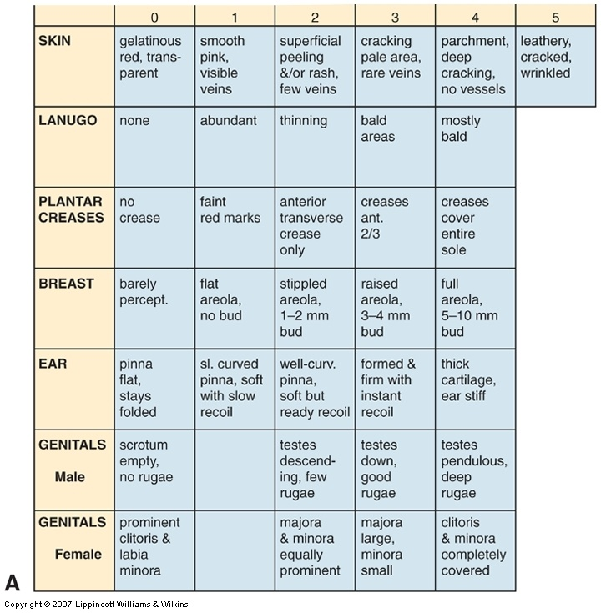
Physical maturity
19

Slide 63
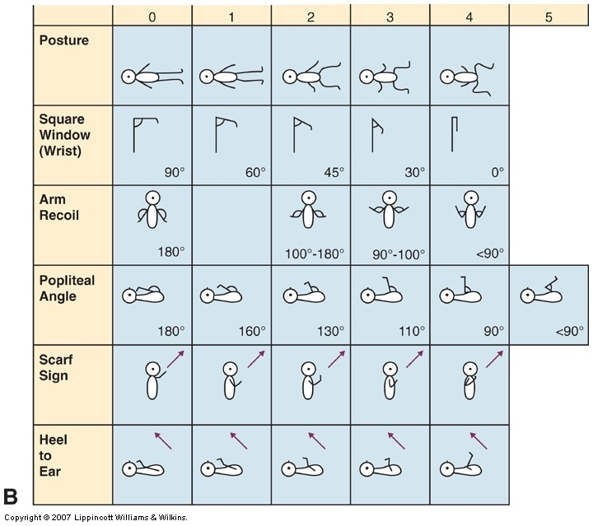
Neuromuscular Maturity
17
Neonatal Care

Slide 64
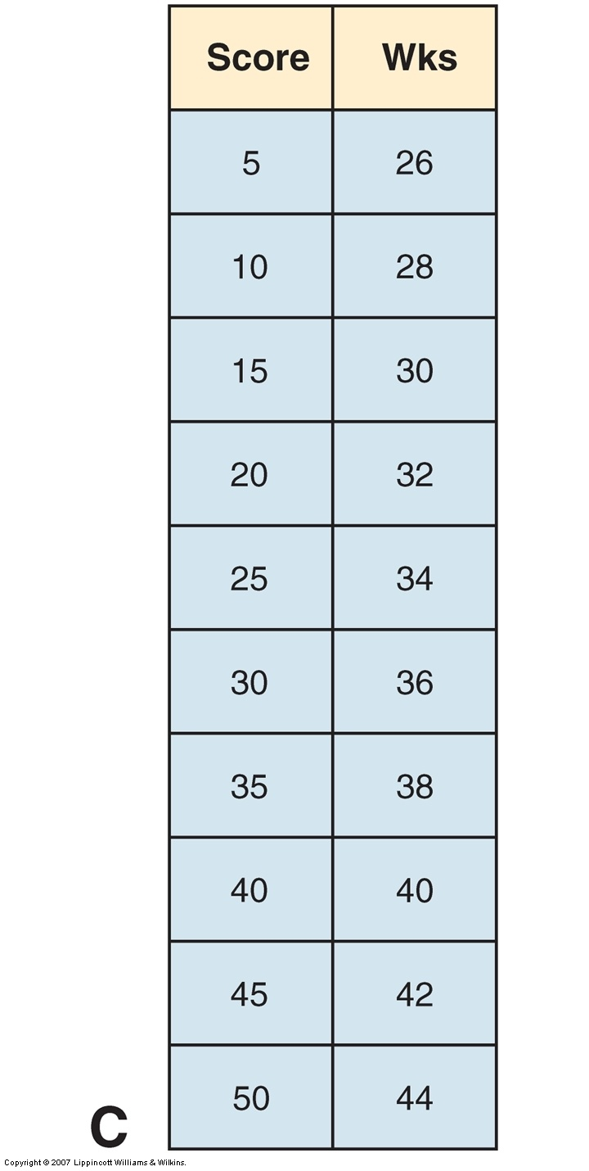
Scoring
19+17=36
36
39
Neonatal Care
64

