Slide 1

Pediatric
and New born Nursing
Unit 3
Birth Injuries

Slide 2
Birth Injuries
Birth injury is any condition that has adverse effects on the neonate resulting from the process of labor and delivery.
These effects can affect the neonate's ability and capacity to regulate physical or neurological function
Sites of injuries can include:
Scalp,
Skull,
Plexus
Spinal cord,
Cranial and peripheral nerves.

Slide 3
Risk Factors of Birth Injuries
1. Cephalo-pelvic disproportion (CPD)
2. Gestational age (LGA)
3. Precipitous delivery
4. Abnormally long labor and/or delivery
5. Maternal diabetes
6. Fetal position at delivery: breech, extremity first, transverse lie
8. Difficult delivery requiring instrumental intervention
9. Premature neonate
10. The mechanics of labor and delivery

Slide 4
Birth Injuries Classification 1- Soft tissue injuries
Caput succedaneum
Swelling of the soft tissues of the scalp
Caput can cross over suture lines (since it affects the scalp)
Rapid resolution over 24 - 48 hours.
Cephalohematoma.
A collection of blood beneath the cranial bone
Does not cross the suture line

Slide 5
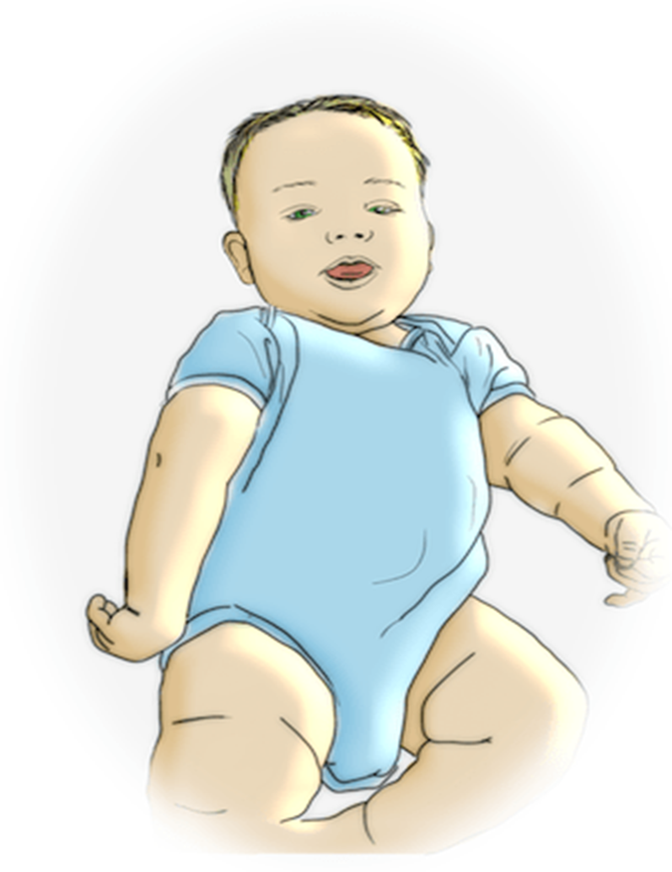
Birth Injuries Classification: 2) Nerve Injury
a. Brachial plexus injury (BPI)
Erb's paralysis:
It involves cervical nerves 5 and 6
Resulting in an upper arm paralysis.
Moro, biceps and radial reflexes are absent
Grasp reflex is intact,

Slide 6
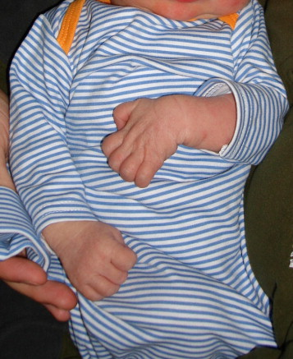
Birth Injuries Classification: 2) Nerve Injury
Brachial plexus injury (BPI)
Klumpke's Paralysis:
It involves cranial nerve 8 and thoracic nerve 1
Resulting in a lower arm paralysis.
Intrinsic muscles of the hand and the long flexors of the wrist and fingers affected
Grasp reflex is absent
Tendon reflexes are present.

Slide 7
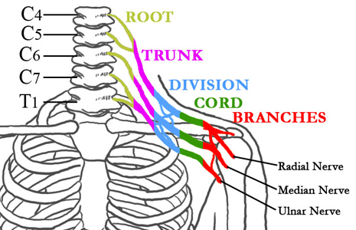
Brachial plexus

Slide 8
Managements of Brachial plexus injury
1-2 week rest of affected limb
Physiotherapy
Parents should be instructed on how to handle baby:
No traction of affected arm, no pressure under axilla.
Baby to be carried in football hold
If not recover during 3-6month period will require surgical intervention.

Slide 9
Birth Injuries Classification: 2) Nerve injury
b. Diaphragmatic and Phrenic nerve paralysis
Signs and symptoms:
Unexplained respiratory symptoms
Limited or no spontaneous movement of upper extremity .
Cyanosis, irregular and labored respirations
Breathing is almost completely thoracic, no bulging of the abdomen
US shows abnormal motion of the diaphragm

Slide 10
Treatment Phrenic nerve paralysis
Oxygen, IV fluids, gavage feedings, antibiotics are indicated if pneumonia occurs
If bilateral, assisted ventilation shortly after delivery
Plication (tightening of stretched or weakened )of the diaphragm early in the 2nd month of life

Slide 11
Birth Injuries Classification: 2) Nerve injury
C. Facial Nerve Palsy
Caused by prolonged second stage and forceps delivery
-It can be central paralysis: limited to lower 1/2 or 2/3 of the contra lateral side
-It can be peripheral-entire side of the face
-Persistently open eye on the affected side

Slide 12
Birth Injuries Classification: 2) Nerve injury
d. Vocal Cord Paralysis
Uncommon injury
Manifested by free or hoarseness with mild inspiratory stridor or bilateral-stridor
Require gentle handling and frequent small feedings, usually resolves within 6 weeks
If bilateral is caused by hypoxia or hemorrhage into the brain stem. It requires immediate intubation, tracheostomy

Slide 13
Birth Injuries Classification: 2) Nerve injury
e. Injuries to Spine and Spinal Cord
Result from breech deliveries brow and face presentations
This injury may lead into:
Stillborn,
Respiratory depression,
Flaccidity and immobility of the lower limbs
Constipation
Shock,
Hypothermia
Contractures and bony deformities
Cerebral palsy

Slide 14
Treatment Spinal cord injuries
-Basic resuscitative measures
-In case of vertebral fracture: Reduction and relief of cord compression, Followed by appropriate immobilization
-Position of paralyzed parts should be changed every 2 hours
-Indwelling urinary catheter should be inserted
-Urology consult

Slide 15
Birth Injuries Classification: 3) Fractures
Skull Fractures
Caused by forceful contact of the fetal skull against the maternal pelvis
Linear fractures of the skull are accompanied by soft tissue changes &cephalohematoma
Depressed fractures are visible palpable indentations in the smooth contour of the skull ( ping-pong) ball
Simple fractures heal without complication
Repeat radiographs within 2-3 months to detect early widening of the fracture line

Slide 16
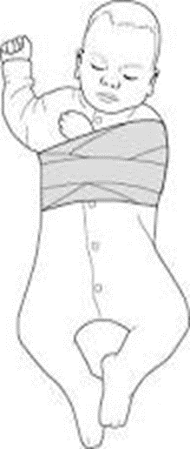
Birth Injuries Classification: 3) Fractures
b. Clavicular fractures
Increased in instrumental delivery resulting from LGA, or shoulder dystocia.
The fracture is noticeable with movement of the shoulder secondary to a snapping sensation (crepitus) palpable over the bone involved.
Complete and some greenstick fractures may be apparent shortly after birth.
Obvious callus at 7-10 days of age
Movement of the arm may be affected
Pain subsides in 7-10 days
Management by Immobilization of a limb

Slide 17
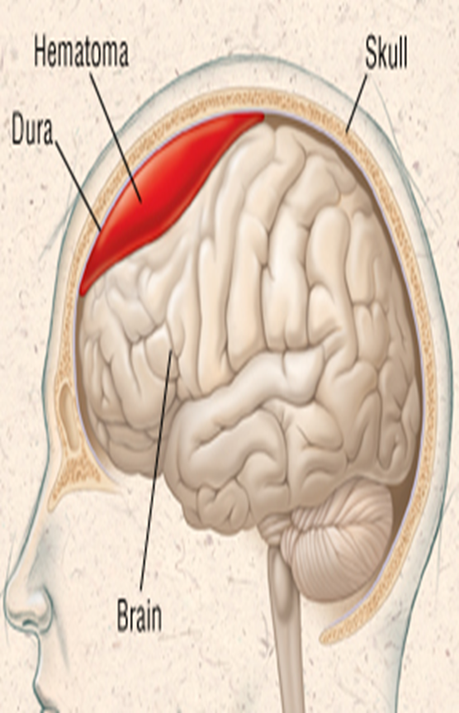
Birth Injuries Classification: 4) Hemorrhages
Subdural hemorrhage
It is tearing of cerebral veins or venous sinuses.
Risk factors are:
Cephalo-pelvic disproportion (CPD),
Mal-presentation,
Abnormal length of labor,
Breech vaginal delivery,
Instrument-assisted delivery.
Clinical presentation can vary from normal to seizure activity with behavioral changes.
Subarachnoid hemorrhage

Slide 18
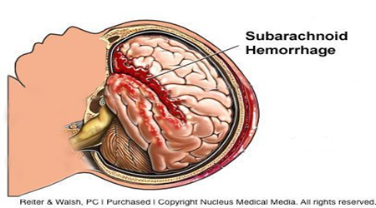
Birth Injuries Classification: 4) Hemorrhages
b. Subarachnoid hemorrhage
It is venous bleeding in the subarachnoid space.
Risk factors are: prematurity, trauma, or hypoxia.
It has the highest incidence of neonatal intracranial hemorrhage.
The clinical presentation ranges from normal to seizure activity.
The outcome is usually good.

Slide 19
Diagnostics of birth injury:
X-rays
Ultrasound
MRI
CT

