Slide 1

Unit 6
1- Children With Skin Disorder
2-Rest and Sleep
3- Pain Management
4-Sudden Infant Death Syndrome (SIDs)
5-Pediatric Medications
6-Play Therapy

Slide 2
1- Children with DERMATITIS
Dermatitis is the inflammation of the skin
Causes of Dermatitis
⬥ Allergies
⬥ Irritants
⬥ Ultraviolet light
⬥ Foods
⬥ Medications
⬥ Hereditary

Slide 3
Types of dermatitis: a.Contact dermatitis
Inflammation of skin caused by direct contact with an external irritating substance.
Common Allergens Associated with Contact Dermatitis
Poison ivy, oak, sumac, cobalt, copper, chromium, gold, mercury, nickel, zinc, Antibiotics, Topical anesthetics

Slide 4
Symptoms and Signs of Contact Dermatitis
Itching (pruritus)
Skin redness or inflammation , swelling and Warmth
Skin lesion or rash
Diagnosis and Tests of Contact Dermatitis
1- Physical examination
2- Skin lesion biopsy or culture of the skin lesion
3-Patch testing is standard for contact allergen identification.

Slide 5
Prevention of Contact Dermatitis
Avoid contact with known allergens. Use gloves or other barriers
Wash skin surfaces thoroughly after contact with substances.
Treatment of Contact Dermatitis:
Cold compresses with water or saline, calamine
Used nonirritating moisturizers
Topical T-cell selective inhibitors
Systemic corticosteroids might offer faster relief (12-24hr).
Antibiotics should be used for secondary infections.
Antihistamines

Slide 6
Types of dermatitis b-Atopic dermatitis
AD is a highly pruritic, recurring inflammatory skin disease.
It develops in early childhood with a history of respiratory
In infants, associated with formula feedings and early introduction of solid foods
Causes of Atopic Dermatitis:
Staphylococcus aureus
Extremes of climate cold or heat, dry atmosphere
Sun exposure improves lesions, but sweating increases pruritus.
Genetic background and family history

Slide 7
Clinical Presentation of Atopic Dermatitis
1-Xerosis: abnormal skin dryness without inflammation.
2-Ichthyosis, "fish" : thick, scaly skin
3-Intense pruritus
4-Keratosis Pilaris: small goose bumps, which are actually dead skin cells that build up around the hair follicle.
5- Periorbital darkening: blue-gray discolorations
6-Pityriasis Alba: hypopigmentation patches
7-Reddish marks appear on face, neck, elbows.

Slide 8
Treatment of Atopic Dermatitis:
Use soap substitutes e.g Cetaphil or Hypoallergenic Soaps
Reduce exposure to allergens
Topical corticosteroids
Avoidance of hot baths
Moisturization
Antihistamines
Antibiotics

Slide 9
Types of dermatitis c-Sebrorrheic dermatitis
Inflammatory skin condition that causes flaky (peeling), white to yellowish scales to form on oily areas such as the scalp or inside the ear.
Varies from mild dandruff to exfoliative erythroderma
Cradle cap is the term used when seborrheic dermatitis affects the scalp of infants.
Cause Unclear may be due to a combination of an over production of skin oil and irritation from a yeast called malessizia. Or Immunologic response
Increase in winter and early spring. Remission commonly in summer

Slide 10
Symptoms of Seborrheic Dermatitis:
Skin lesions
Greasy, oily areas of skin
Skin scales: white and flaking, or yellowish, oily, and adherent, "dandruff"
Itching
Mild redness
Hair loss
Diagnosis and Tests of Seborrheic Dermatitis
Physical exam
A skin biopsy may be needed in exfoliative erythroderma,
Fungal culture

Slide 11
Treatment of Seborrheic Dermatitis
Avoid shampoo and topical product that dry the hair and skin
Steroid
Antifungal drug: selenium sulfide
Olive oil or mineral oil compresses with warm water

Slide 12
Children with DIAPER RASH AND DERMATITIS
Cutaneous inflammation as a mild redness and scaling at the area of skin covered by infant's diaper.
In bad cases, the rash can cause pimples, blisters
Rash may spread outside the diaper area.
It is common in infancy 25% of infants had diaper rash
High risk at age of 3 – 6 months

Slide 13
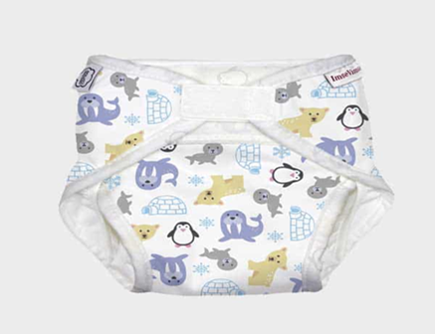
Causes of Diaper Rash
Occlusion, humidity and friction when the skin is wetted
Caused by diapers that rub against skin, fit too tightly or are left on for too long.
Laundry soap, fabric softener, or bleach used to wash reusable diaper are irritant
Skin PH and fecal enzymes: normal skin ph is 4 – 5.5.
Candidal growth: Candida albicans has extended from GIT
Plastic pants. It increase germs growth
Diarrhea: the feces is more liquid and spread more across the skin
Nutritional factors: malnutrition, zinc deficiency, bottle fed babies

Slide 14
Treatments of Diaper Dermatitis
Use absorbance diaper and changed frequently
Washing the diaper area with warm water and mild soap then drying the skin
Skin protectants: Zinc oxide (1-25%), Petrolatum
Don’t use powder on skin.
Avoided use of hydrocortisone
Antifungal cream

Slide 15
Children with CANDIDA INFECTIONS
Candidiasis is the most common oral fungal infection. (Candida albicans) which are considered normal growth. Sometimes Candida overgrowth occurs after antibiotics usage
Infection can occur with the steroid use

Slide 16
Causes of Oral Thrush
Newborn infants often are exposed during delivery
Candida contamination of formula bottle nipples and pacifiers
Prolonged or repeated oral antibiotics, diabetes
Corticosteroids inhalers require water rinsing and spitting out in order to eliminate residual
Immune-compromised individuals
Poor oral hygiene

Slide 17
Signs and Symptoms of Oral Thrush
Cracked skin in the corners of the mouth or whitish patches on the lips, tongue, or inside the cheeks that look a little like cottage cheese
This coating may be differentiated from the very common off-white discoloration of the tongue associated with infant formula debris by several means:
Oral Candida is a very bright white color; milk debris is an off-white color
Oral Candida may also involve the buccal surface, inner lip area and gingiva while milk debris is limited to the tongue;
Oral Candida is rather adherent to an involved skin surface while milk debris may more easily be wiped off with a damp facecloth.

Slide 18
Diagnosis of Oral Thrush
Physical exam
Tissue culture examination; biopsy in chronic cases.
Treatment of Oral Thrush
a.)Topical antifungal : Nystatin, Azole derivatives, Amphotericin
b.)Systemic azoles for 14 days

Slide 19
Rest and Sleep

Slide 20
Rest and Sleep
Rest: It calmness, relaxation without emotional stress and freedom from anxiety.
Rest restores a person's energy, allowing the individual to resume optimal functioning.
Sleep: is a basic human need according to Maslow's hierarchy.
Sleep is characterized by:
Minimal physical activity,
Variable levels of consciousness,
Changes in the body’s physiologic process,
Decreases responsiveness to stimuli.

Slide 21
Stages of Sleep
  1- NREM (Non Rapid Eye Movement):
  It is also referred to as slow-wave sleep.
  Most sleep during a night is NREM sleep.
  It is a deep, restful sleep, and brings a decrease in all physiologic functions (blood pressure, heart rate respiratory, muscles activity…. ) except gastrointestinal tract Activity (increase)
2- REM (Rapid Eye Movement
It constitutes about 25% of the sleep of a young adult.
It is not a restful as NREM sleep, and most dreams take place during REM sleep.
Those dreams are usually remembered.
The sleeper may be difficult to arouse
Rapid eye movements
Brain metabolism increases

Slide 22
Factors Affecting Sleep
Age
Illness
Environment
Fatigue
Stress
Medication

Slide 23
Common Sleep Disorders:
1- Primary sleep disorders: in which person's sleep problem is the main disorder.
Insomnia: the inability to obtain an adequate amount of sleep.
Hypersomnia: is excessive sleep, particularly in the day time.
Narcolepsy: is a sudden sleepiness that occurs during the day.
Sleep apnea: is a periodic cessation of breathing during sleep.
Sleep Deprivation: It is a prolonged disturbance result in decreases in amount, quality and consistency of sleep. It is not a sleep disorder in itself but a result of sleep disturbances.

Slide 24
Common Sleep Disorders:
2-Parasomnia: is a cluster of waking behaviors that appear during sleep and interfere with sleep.
Parasomnia includes:
Sleep walking: occurs 1-2 hours after falling a sleep.
Sleep talking: Talking during sleep occurs during NREM sleep before REM sleep.
Nocturnal enuresis: It is bed wetting during sleep, and usually occurs in children over 3 years old.
Bruxism: It is clenching and grinding of teeth.

Slide 25
Ways to Reduce Environmental Distraction:
Close the door of the client's room.
Pull curtains around the client's bed.
Provide soft music.
Reduce or eliminate lightening.
Decrease amount & type of stimuli (e.g. T.V, staff conversations).
Place the client with a compatible roommate.

Slide 26
Safety Measures for Sleep:
Use night light.
Place the bed in low position.
Use side rails if appropriate.
Place the call bell within easy reach.
Instruct the client with I.V fluid how to move about.
Provide tubing long enough to permit the client to move.

Slide 27
Pain Management

Slide 28
Pain Management
Assessment of pain in children depends on the cooperation and developmental stage of the child.
Signs of Pain in Infants
Crying
Tightly closed eyes
Eyebrows lowered and tightly drawn together
Rigid body
Whipping
Increase in heart rate

Slide 29
Signs of Pain in Toddlers
Expressing pain verbally
Beating extremities
Crying loudly
Screaming
Being uncooperative
Palpating (examining with the hands) a source of pain
Requesting to be comforted
Clinging to a significant person

Slide 30
Signs of Pain in School-age children
Delaying, trying to talk out of the situation where pain is anticipated
Having muscular rigidity
Signs of Pain in Adolescent
Muscle tension, but with control
Verbal expressions and description

Slide 31
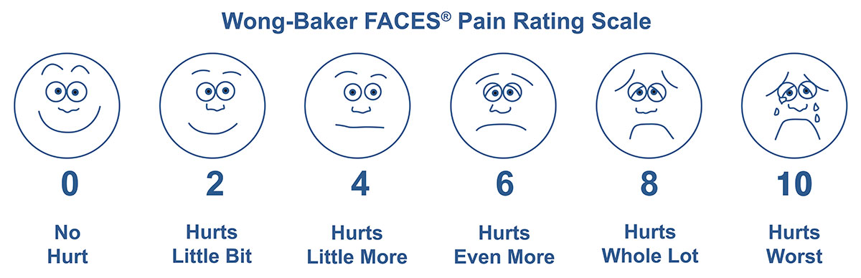
Pain Scales
Wong–Baker Faces Pain Rating Scale

Slide 32
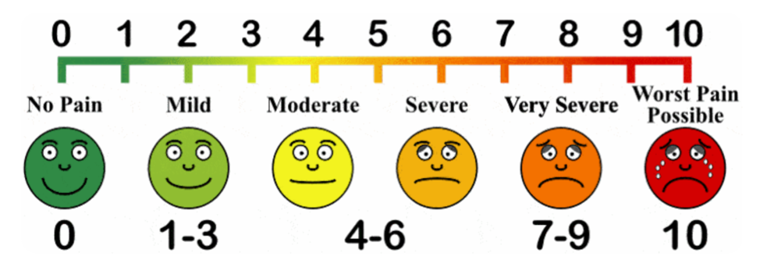
Visual Analog Scale

Slide 33
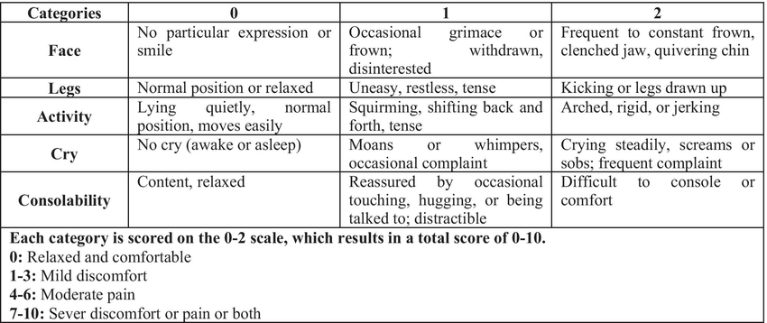
FLACC Scale or Face, Legs, Activity, Cry, Consolability Scale

Slide 34
Management of Pain
a. Non-pharmacological
Oral treatment with a sweet-tasting solution (pacifier)
Breastfeeding
Skin-to-skin care (kangaroo care)
Gently rocking the baby
Swaddling
b. Pharmacological
Analgesic: Paracetamol, NSAIDs,
Opioids: codeine, morphine

Slide 35
Sudden Infant Death Syndrome (SIDs)

Slide 36
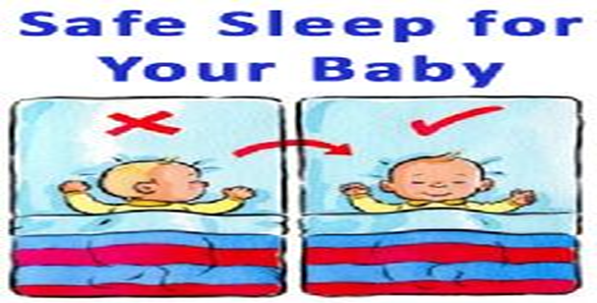
Sudden Infant Death Syndrome (SIDs)
Is the unexplained death, usually during sleep, of a seemingly healthy baby less than a year old.

Slide 37
Sudden Infant Death Syndrome (SIDs) Causes
The cause is unknown
A combination of physical and sleep environmental factors
These factors vary from child to child.
Physical factors associated with SIDS include: brain defects, low birth weight, respiratory infection
Sleep environmental factors: sleeping on the abdomen or side, sleeping on a soft surface, overheating.
3. Maternal risk factors: mother is younger than 20 smokes cigarettes, uses drugs or alcohol

Slide 38
Prevention Sudden Infant Death Syndrome
There's no guaranteed way to prevent SIDS
Following safely measures:
Back to sleep. Place baby to sleep on his or her back
Keep the crib as simple as possible: Remove all toys and stuffed animals from the crib
Have baby sleep in in mother room.
Breast-feed baby, if possible.
Sucking on a pacifier without a strap or string at naptime and bedtime might reduce the risk of SIDS.
Use a firm mattress and avoid fluffy pads and blankets.
Don't cover a baby's head

Slide 39
Treatment Sudden Infant Death Syndrome
There's no treatment for SIDS
Coping and support
Parents’ emotional support
Mother might feel guilt as well as grief,
Need to deal with the mandatory police investigation into cause of death.
Mother might find it comforting to talk to other parents whose have lost a child touched by SIDS.

Slide 40
Pediatric Medications

Slide 41
Pediatric Medications
Pediatric medication administration is a critical component of safe and effective nursing care. That requires knowledge base about the drug and its action.
The nurse must adhere to the “rights” of medication administration
Drugs are administered to children via many of the same routes that are used for adults.
Basic Rights of Pediatric Medication Administration
Right Medication Right Patient Right Time Right Route of Administration | Right Dose Right Documentation Right to Be Educated Right to Refuse

Slide 42
Drug’s Pharmacodynamics and Pharmacokinetics
Pharmacodynamics: behavior of the medication at the cellular level
Children may not respond to the drug as intended, it may be enhanced or diminished,
Necessitating a change in the dosage to ensure optimal effectiveness without increasing the child’s risk for toxicity
2) Pharmacokinetics: movement of drugs throughout body via absorption, distribution, metabolism, excretion).

Slide 43
Drug’s Pharmacodynamics and Pharmacokinetics
In children :
Oral medications is affected by: slower gastric emptying, increased intestinal motility, large small intestine surface area, higher gastric ph, and low lipase and amylase secretion
Intramuscular affected by: muscle mass, tone and perfusion,
Subcutaneous: affected by decreased perfusion
Absorption by oral and IM routes is unpredictable and may be decreased
Absorption of topical medications is affected by large body surface area, greater permeability of the their skin

Slide 44
Dose Determination by Body Weight
The most common method for calculating pediatric medication doses is based on body weight.
The recommended dosage is usually expressed as the amount of drug to be given over a 24-hour period (mg/kg/day) or as a single dose (mg/kg/dose).
Guidelines to determine the correct dose by body weight:
Weigh the child/ kilograms
Check a drug reference for the safe dose range (for example, 10 to 20 mg/kg of body weight).
Calculate the low safe dose (e.g., 10 to 20 mg/kg and the child weighs 30 kg):
Calculate the high safe dose 20 mg/1 kg = x mg/30 kg

Slide 45
Dose Determination by Body Weight
5. Solve for x by cross-multiplying: 1*x= 10*30
x=300mg
1*x=20x30
x=600
6. Determine if the dose ordered is within this range (for this example, 300 to 600 mg)
Generally, once a child or adolescent weighs 50 kg or greater, the adult dose is frequently prescribed

Slide 46
Dose Determination by Body Surface Area
Guidelines to determine BSA:
1. Measure the child’s height.
2. Determine the child’s weight.
3. Using the nomogram, draw a line to connect the height measurement in the left column and the weight measurement in the right column.
4. Determine the point where this line intersects the line in the surface area column.
This is the BSA, expressed in meters squared (m2 ).
Once determined the BSA, use the recommended dosage range to calculate the safe dosage.

Slide 47
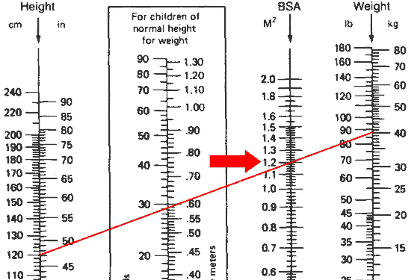

Slide 48
Child’s dose
Surface area of the child (m2) X normal adult dose/
1.7m2
e.g, child who weighs 10 k.g and is 50 cm tall has a body surface area of 0.4 m2.
The child’s dose of Tetracycline corresponding to an adult dose of 250 mg.
Child’s dose = 0.4 m2 X 250 mg / 1.7 m2
= 0.23 X 250 = 58.82 mg

Slide 49
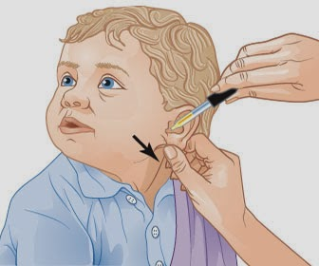
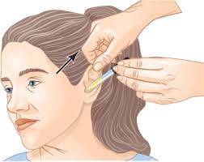
Otic Medications Instillation
In child, the nurse should straighten the ear canal of a child by pulling the pinna down and back)
In adult, the nurse should straighten the ear canal by pulling the pinna up and back

Slide 50
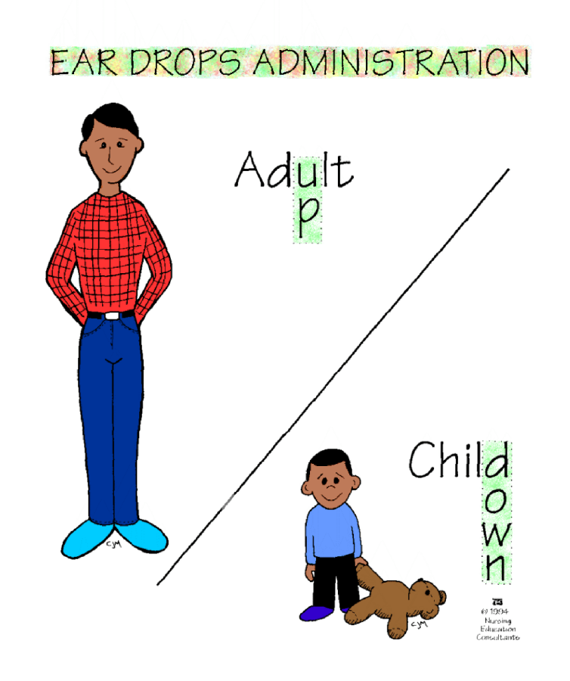
pull outer ear to straighten ear canal:

Slide 51
Respiratory Inhalation
Medications administered by inhalation such as bronchodilators
Medications for inhalation are often administered with the use of neubilizers that deliver a fine spray or mist of medications to the client.
A metered- dose inhaler (MDI) is a handheld neubilizer that can be used by clients to self-administer measured doses of an aerosol medication.
Client needs to be instructed about how to use inhalers.

Slide 52
Oral Medication
It is used to provide a medication that has systemic effects and/or local effects on gastrointestinal tract.
Oral medications liquids (syrup and suspension).

Slide 53
Parenteral Medications
It is administered by needle.
Intradermal: under the epidermis (into dermis), small amount of liquid is used 0.1 ml.
Intramuscular: into a muscle, Vastus lateralis is the proffered for children under 7 months of age.
Other sites Dorosgluteal, Deltoid, and Rectus femoris for older children
Subcutaneous : into subcutaneous tissue, small doses (0.5-1 ml)
Intravenous: into a vein, directly into blood stream

Slide 54
PLAY THERAPY

Slide 55
PLAY THERAPY
Normal play is an essential component of healthy child development.
Function of the play: it Enhances:
Sensor motor development
Creativity
Socialization
Intellectual activities
Self-awareness: explore their bodies

Slide 56
Principles of Selecting Play Products
Principles of selecting play products must be
✓Age appropriate
✓Safe and resilient
✓Have multiple uses
✓Appealing
✓Develop necessary skills

Slide 57
Toy Safety:
Avoid toys with small parts that may cause fatal choking or aspiration hazards.
Avoid toes with strings or cords because they may cause strangulation.
Avoid arrows or darts.
Avoid electrical toys with heating elements.
Avoid toys that make loud noises
Avoid toys with sharp edges that can cut
Select strong toys that can survive rough play
Select toys light enough that they will not cause harm if falls on child.
Select toys with smooth, rounded edges.
Select toys with nontoxic materials

Slide 58
PLAY THERAPY
It is a method for children to express their experiences and feelings
Use of Play Therapy
▪Counseling or psychotherapy to help and communicate with children, to prevent or resolve psychosocial challenges and decrease tension and stress
▪It supports social integration, growth and development.
▪Diagnosis: therapist observes a child playing with toys (play-houses, pets, dolls, etc.) to determine the cause of the disturbed behavior.
▪Release children’s anxieties.

