Slide 1

Pediatric
and New born Nursing
Unit 7
Metabolic, and Endocrine Disorders

Slide 2
1- Children with DIABETES MELLITUS
An endocrine disorder in which there is insufficient amount or lack of insulin secretion to metabolize carbohydrates.
Types of Diabetes Mellitus
1-Type 1 Insulin-Dependent Diabetes Mellitus (IDDM)
Little to no insulin produced, 20-30% hereditary
2- Type 2 Non-Insulin-Dependent Diabetes Mellitus (NIDDM)
Some insulin produced, 90% hereditary

Slide 3
Insulin Dependent Diabetes Mellitus (IDDM) Juvenile
Is the most common childhood endocrine disorder
It is an autoimmune process resulting in the destruction of pancreatic β-cells that manufacture and secret insulin
It is mostly due to genetic predisposition.
Environmental triggers:-Viral infections (mumps, influenza), Environmental toxins

Slide 4
Signs and Symptoms of IDDM
➢Onset usually childhood or adolescent, But, can occur at any age
➢Polyuria
➢Polydipsia
➢Polyphagia
➢Diabetic Ketoacidosis (DKA)

Slide 5
Diagnostic studies of IDDM
Urine tests are not sufficient. When urine glucose is positive it means that the blood glucose is about 180mg/dl.
Blood glucose level and HbA1c blood test

Slide 6
Management of IDDM
▪Lifestyle modification: diet, exercise
▪Lifetime insulin therapy
Insulin: is a hormone, produced by the b-cells in the Islets of Langerhans of the pancreas.
When glucose increased in blood stream insulin is released into the blood to transfer glucose to body cells.
The insulin connects to cell insulin receptors which allows for energy.

Slide 7
Four basic forms of insulin:
a. Rapid-acting
b. Short-acting
c. Intermediate-acting
d. Long-acting
▪ Insulin onset is how soon it starts working
▪ Insulin peak is when it reaches the highest
▪ Insulin duration is how long it lasts in body

Slide 8
Type of Insulin | Onset | Peak | Duration:
Rapid-acting :crystalline | 15min | 1-1.5 hours | 3-4 hours
Short acting: Actropid | 1/2 to 1hour | 2-3 hours | 4-6 hours.
Intermediate acting : Mixtard | 2 hours | 6-8 hours | 12-16 hours.
Long- acting: protamine Zine | 2 hours | 16-20 hours | 24-30 hours.

Slide 9
Insulin Injection Sites
▪Subcutaneous tissue of upper arm.
▪Anterior and lateral aspects of the thigh, buttocks, and abdomen
▪IM not recommended but can be used
▪Rotation of injection site recommended to prevent lipoatrophy

Slide 10
Insulin Injection Sites
▪Short-acting: Clear insulin drawn into syringe first before Intermediate-acting Cloudy insulin
▪Rapid-acting insulin can be mixed with NPH and Lente
▪When rapid acting insulin is mixed with either intermediate or long-acting insulin the mixture should be injected within 15 min before meal.
▪Phosphate-buffered insulin (NPH) should not be mixed Lente insulin

Slide 11
Complications of Diabetes Mellitus:
1- Acute complication of DM
✓Diabetic ketoacidosis (DKA) occurs mostly in type IDDM.
✓In DKA, glucose can’t be properly used for cellular energy, cellular starvation release and breakdown stored fat and protein to provide the needed energy, free fatty acids metabolized in the liver and produce ketenes.
✓Management of DKA:
Administer of rapid acting insulin (I.V, I.V fluids Nacl and Electrolyte replacement.
Assessment of mental status, Strict monitoring.
Intake and output chart.
Assessment of blood glucose, urine ketoses, ECG.

Slide 12
2- Chronic Complications of Diabetes
o Cardiovascular disease
o Cerebrovascular disease
o Retinopathy (vision) problems
o Diabetic neuropathy
o Diabetic nephropathy

Slide 13
2- Children with PHENYLKETONURIA (PKU)
Lack the liver enzyme phenylalanine hydroxylase, which is necessary for the metabolism of the amino acid phenylalanine.
If PKU is detected early enough, mental retardation can be prevented

Slide 14
Clinical manifestation of PKU
Newborns are normal at birth
If not diagnosed and untreated early, they become:
Hyperactive,
Suffer seizures,
Fair skin
Mentally retarded between 6 to 18 months.

Slide 15
Lab investigation of PKU
Routine newborns screen for PKU.
Regular blood tests PKU level,

Slide 16
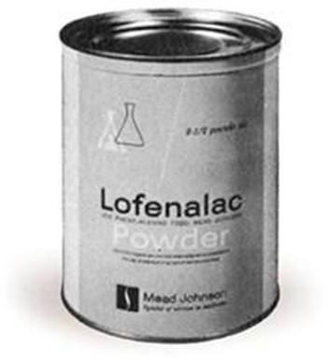
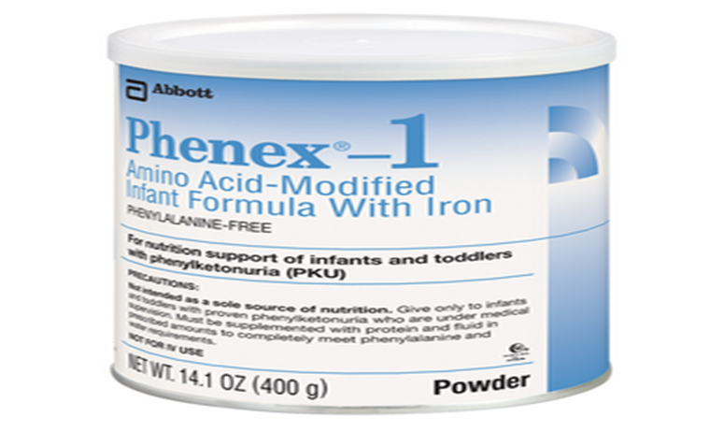
PKU Therapy:
Phenylalanine restricted diet
Phenylalanine an essential amino acid cannot be entirely removed from the diet
Commercial formula “Lofenalac” for newborn
Synthetic milk for older children,
Avoidance of phenylalanine

Slide 17
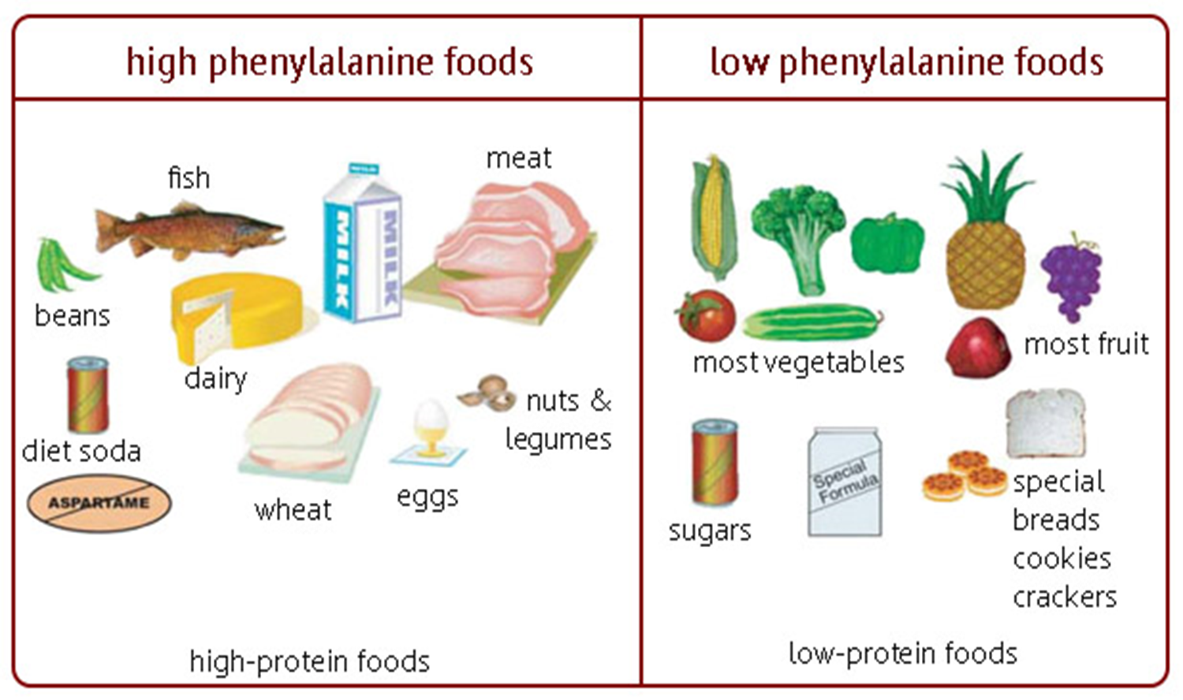

Slide 18
PKU Therapy:
By monitoring the level of phenylalanine in the blood, it is possible to supply sufficient amounts to meet normal requirements and avoid levels that would result in complication.
Once brain development is complete dietary restriction can be relaxed – from adolescence onwards

Slide 19
3) Children with CONGENITAL HYPOTHYROIDISM
Defined as inadequate thyroid hormone production
Characterized by increased thyroid stimulating hormone (TSH) concentration and decreased thyroxin (T4) concentration.
Insufficient thyroid hormone impacts brain development; specifically, myelination and neuronal connections are impacted
Most common treatable causes of mental retardation

Slide 20
Etiology of Congenital Hypothyroidism
Dys-genesis (thyroid gland developmental defect)
Dys-hormongenesis (defects in thyroid hormone synthesis)
Iodine deficiency
Defects in hypothalamus or pituitary (central or secondary/tertiary hypothyroidism) ~ rare
Mutations in thyroid development genes or TSH receptor

Slide 21
Clinical Manifestations of Congenital Hypothyroidism:
Newborns are protected for 1st few weeks of life.
Maternal thyroid hormone crosses placenta
Newborns are asymptomatic at birth
Head circumference slightly higher % due to brain myxedema
Large fontanels and wide sutures
Distended abdomen with umbilical hernia
Skin mottling
Hoarse cry
Cool to touch

Slide 22
Newborn Screen Programs include
Congenital Hypothyroidism (CH)
Congenital Adrenal Hyperplasia (CAH)
Galactosemia (GAL)
Phenylketonuria (PKU)
Glucose-6-Phosphate-Dehydrogenase Deficiency (G6PD Def)

Slide 23
Timing of Testing
Acceptable samples : 1-7 days after birth
Best time for sample: 2-3 days after birth
If tested before 1 day (24 hours) of age Repeat the test within 5 days

Slide 24
Disorder Screened | If not screened | If screened
Congenital Hypothyroidism | Severe mental retardation | Normal
Congenital Adrenal Hyperplasia | Death | Alive and normal
Galactosemia | Death or Cataracts | Alive and normal
PKU | Severe mental retardation | Normal
G6PD Deficiency | Severe Anemia, Kernicterus | Normal

