Slide 1

Pediatric
and New born Nursing Unit 8 Care of Child with Cardiovascular Disorders

Slide 2
Congenital Heart Disease (CHD)
Occur early in gestation (3-8 weeks) in the first trimester
VSD ventricular septal defect 30-50%
ASD atrial septal defect7%
PS pulmonary stenosis7%
AS aortic stenosis
TPGA transposed great arteries 5%
PFO patent foramen ovale
PDA patent ductus arteriosus10%

Slide 3
Causes and risk factors of CHD
Unknown
It is a combination of genetic and environmental factors
X-ray exposure
Maternal Rubella
Maternal alcoholism
Maternal type 1 diabetes
Associated with Down syndrome

Slide 4
Signs and Symptoms of CHD
Poor feeding
Failure to thrive
Fatigue
Tachypnoea .
Tachycardia
Hepatomegally
Sweating

Slide 5
Classification of CHD:
Cyanotic
Acyanotic
Pulmonary
blood flow
Mixed
blood flow
Pulmonary
Blood flow
Obstruction to
Blood flow
from ventricles
Tetrology of Fallot
Tricuspid atresia
Transposition
of great vessels
Total anomalous pulmonary venous return
Truncus arteriosus
Hypo plastic left heart syndrome
Atrial septal defect (ASD)
Ventricularr septal defect (VSD)
PDA
AV-canal
Coarctation of Aorta
Aortic stenosis
Pulmonic stenosis

Slide 6
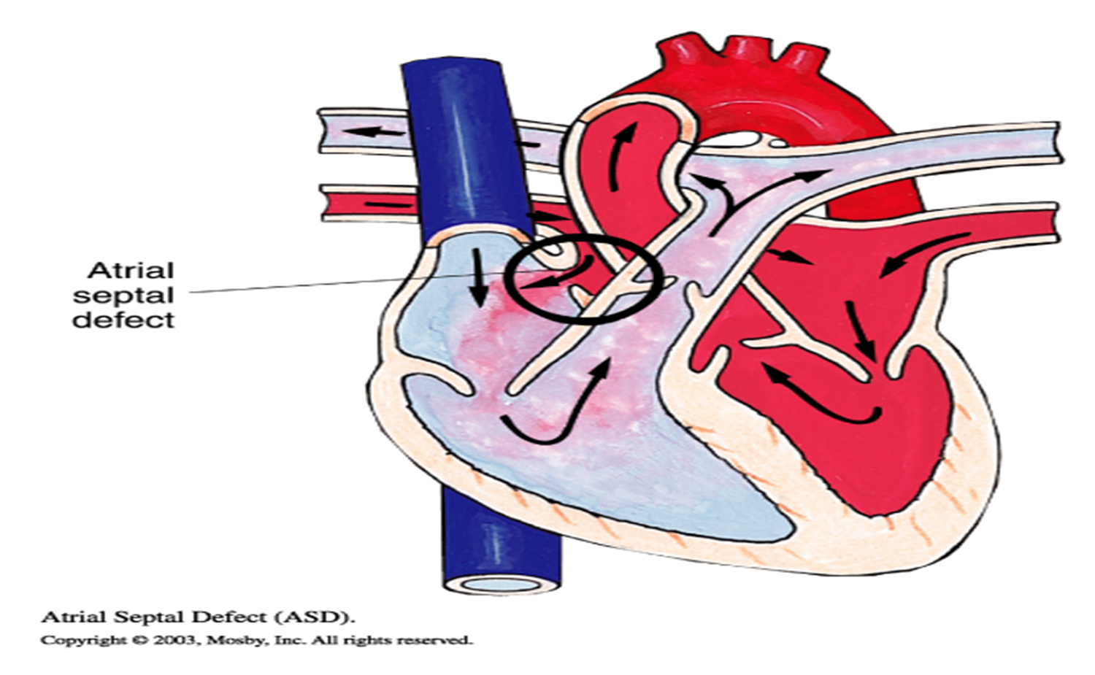
(1)ASD Atrial Septal Defect:
It is an abnormal opening between atria
It allows blood to move from left atrium (higher pressure) to right atrium (lower pressure).
It adds extra blood volume.
The new volume in the right ventricle is tolerable because it was sent by a low pressure from the right artium.

Slide 7
Signs and Symptoms of ASD:
May be asymptomatic.
May develop heart failure,
Atrial arrhythmias are present.
Patients with ASD may live several decades without signs and symptoms

Slide 8
Treatments of ASD
Non-surgical repair: using catheterization, a repair pad is implanted.
Surgical treatment: Dacron Patch Closure.
The prognosis after operation is very high.

Slide 9
2) VSD Ventricular Septal Defect:
It is an abnormal opening between the right and the left ventricles
It is the most common CHD (26%)
The blood turns from the left ventricle (higher pressure) to the right ventricle (lower pressure).
It causes left-to-right shunt, then to pulmonary Artery, which increases right ventricle pressure causing right ventricle hypertrophy and by time failure.

Slide 10
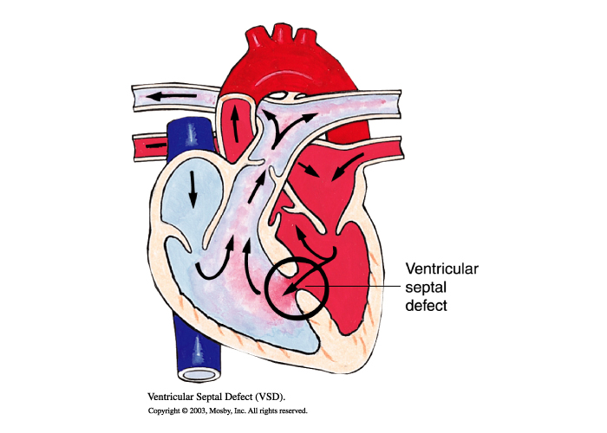
Sign and symptoms of VSD:
Congestive heart failure is common

Slide 11
Treatment of VSD:
20% of all VSDs close spontaneously during the first year of life
Non-surgical treatment: closure devise is usually implanted during cardiac catheterization.
Surgical treatment: complete repair.

Slide 12
3) Patent Ductus Arteriosus (PDA).
It is a connection between Pulmonary artery and aorta
Compromise 10% of CHD
It causes Left to Right shunt, reverses if pulmonary resistance increases
It leads to Right Ventricle enlargement.

Slide 13
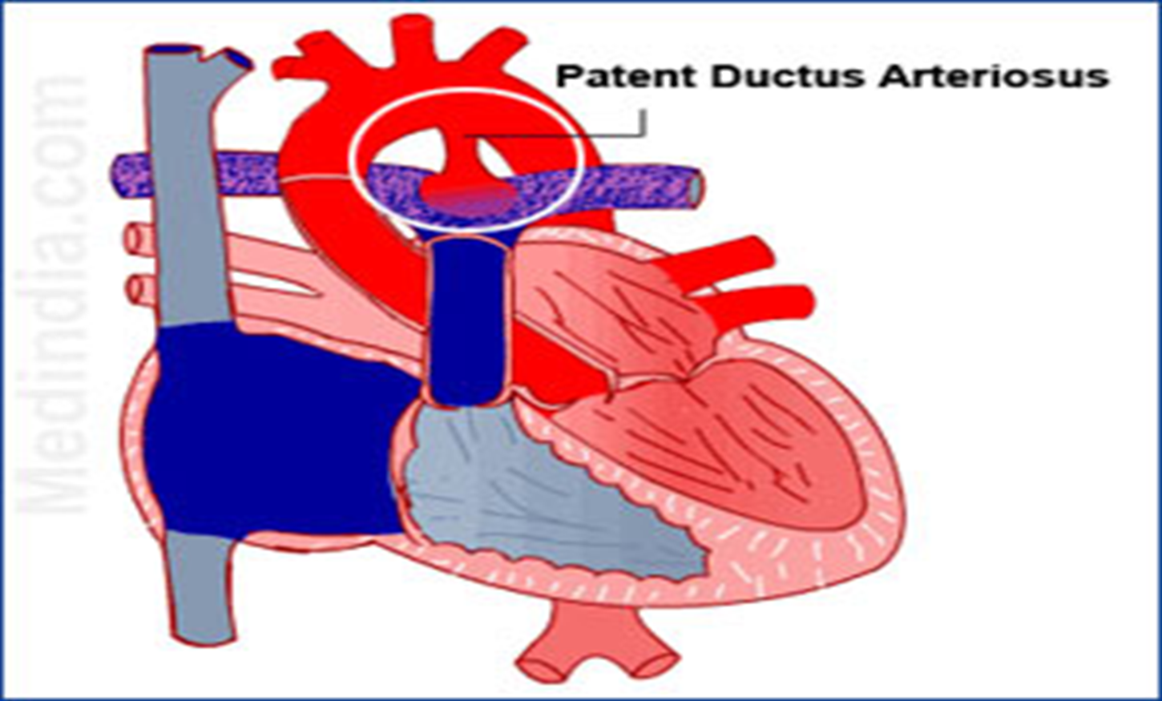
3) Patent Ductus Arteriosus (PDA).
Clinical features of PDA:
Depend on size and direction of flow
Slow growth,
Short of breath,
Cyanosis
Bounding pulse
Continuous murmur
Loud S2

Slide 14
3) Patent Ductus Arteriosus (PDA).
Treatment of PDA:
Indomethacin.(NSAIDs)
Surgical: ligation is curative.

Slide 15
4) Aortic Stenosis:
Narrowing of the aortic valve causing resistance to blood flow in the left ventricle decreasing output
This narrowing prevents the valve from opening fully, which reduces blood flow from heart into the aorta and onward to the rest of the body.
It causes left ventricle hypertrophy and pulmonary vascular congestion

Slide 16
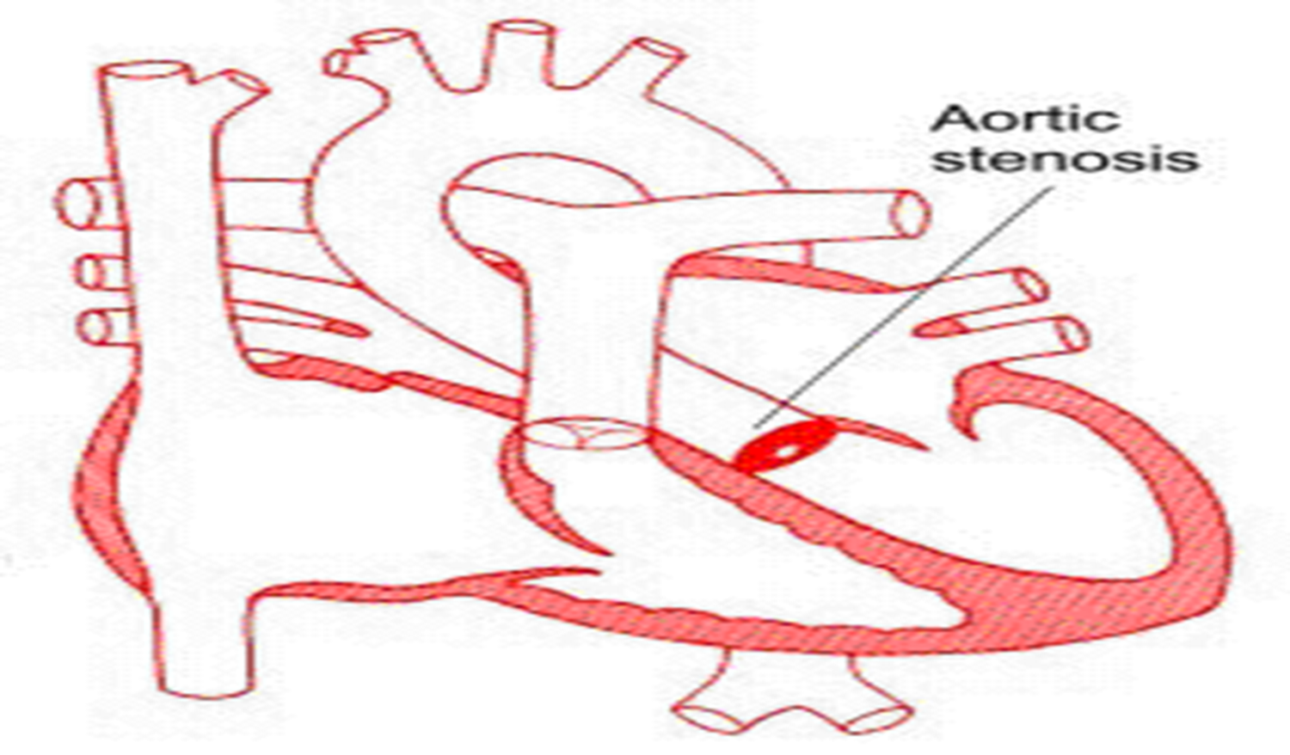
Signs and Symptoms of Aortic Stenosis:
It may asymptotic for many years. It ranges from mild to severe.
Heart murmur
Chest pain or tightness , Shortness of breath,
Fatigue,
Heart palpitations
Difficulty feeding
Not gaining weight
Faint or dizzy

Slide 17
Treatment Of Aortic Valve Stenosis
It depends on the severity of condition
Surgery options include:
Aortic valve repair
Balloon valvuloplasty
Aortic valve replacement

Slide 18
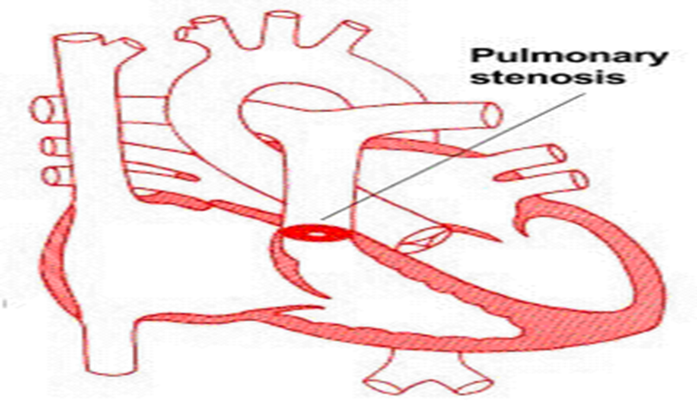
5) Pulmonary Stenosis:
Narrowing at entrance to the pulmonary artrey
Pulmonary Atresia is the severe PS

Slide 19
Signs and symptoms Pulmonary Valve Stenosis
No symptoms in mild or moderately lesions.
Cyanosis
Heart murmur
Ejection click often present
Fatigue
Shortness of breath, Chest pain
Loss of consciousness (fainting)
Right-sided heart failure in severe cases.

Slide 20
Treatment of Pulmonary Valve Stenosis
Balloon valvuloplasty
Surgical repairs the pulmonary artery or valve or replaces the valve with an artificial valve.

Slide 21
The Five Ts of Cyanotic Congenital Heart Disease
 | Transposition of the great arteries
 | Tetralogy of Fallot
 | Truncus arteriosus
 | Total Anomalous Pulmonary Venous Return
 | Tricuspid Atresia

Slide 22
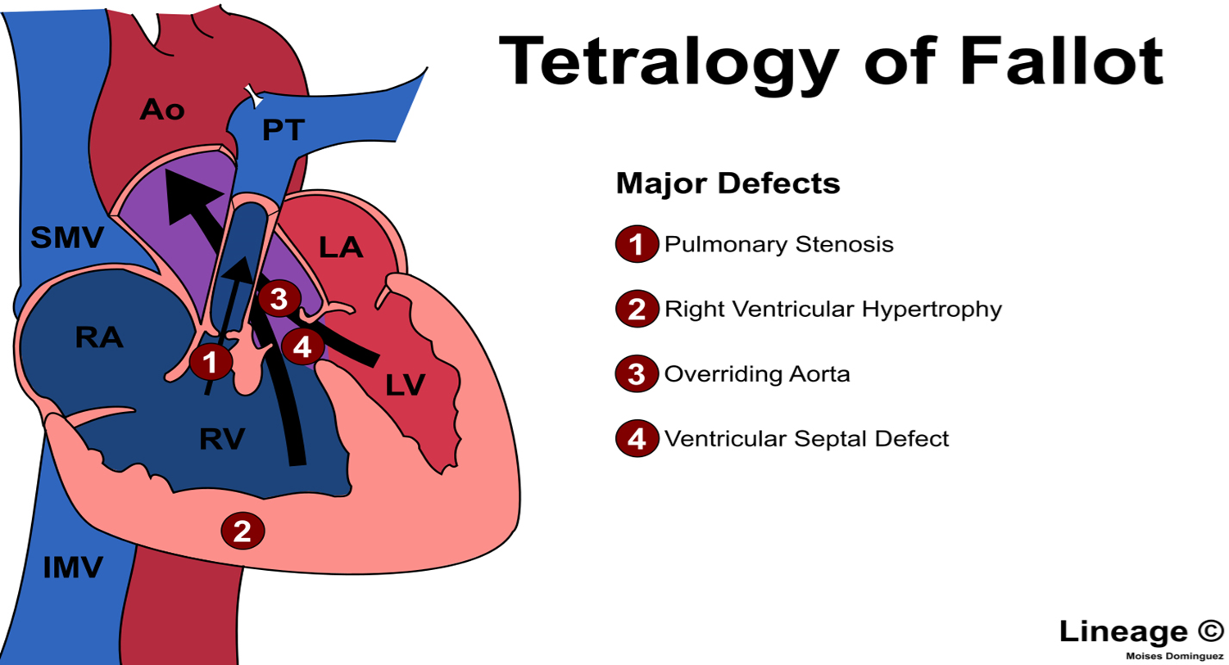
1-Tetrology of Fallot (TOF):
The classic form includes four defects:
(1) Ventricular Septal Defect,
(2) Pulmonic Stenosis,
(3) Overriding Aorta,
(4) Right Ventricular Hypertrophy
It is the most common complex congenital heart defect.

Slide 23
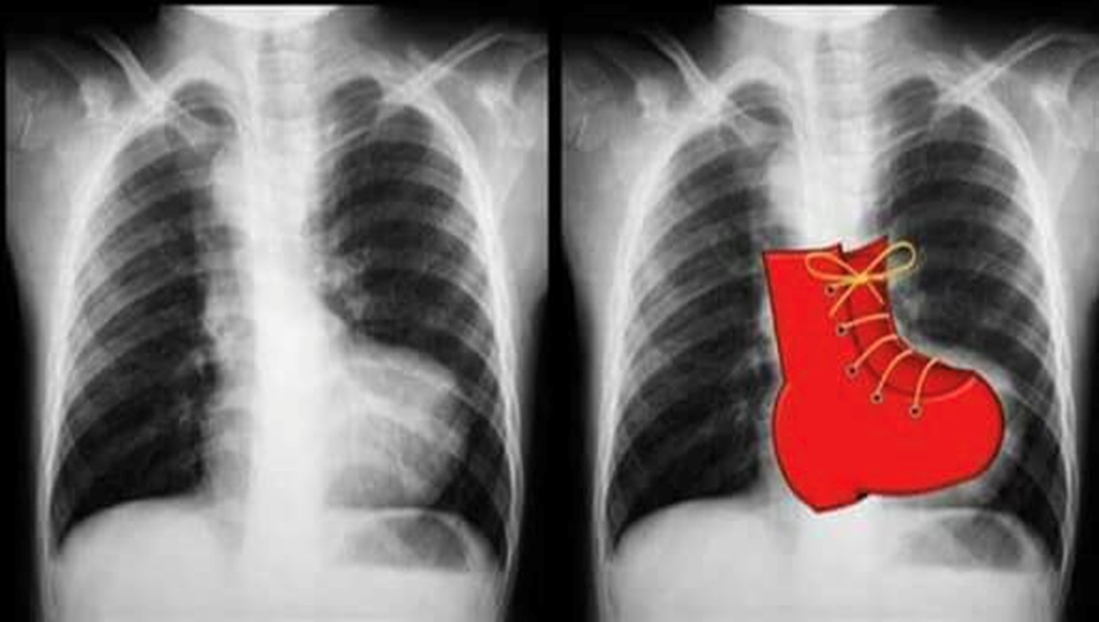
Signs and Symptoms of Tetrology of Fallot
Cynosis
Heart murmur,
Finger clubbing,
Tiring upon breastfeeding.
Boot shape heart
May develop a "tet spell" :
They turn very blue,
Have difficulty breathing,
Become limp,
Occasionally lose consciousness

Slide 24
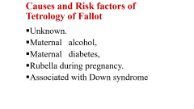
Surgical treatment of Tetrology of Fallot:
Total complete repair is required,
Open heart surgery
VSD closure.

Slide 25
2-Tricuspid Atresia
A complete absence of the tricuspid valve
Failure of the tricuspid valve to develop resulting in no communication from the right atrium to the right ventricle
This leads to a hypoplastic (undersized) or absent right ventricle.
The causes of Tricupsid atresia are unknown

Slide 26
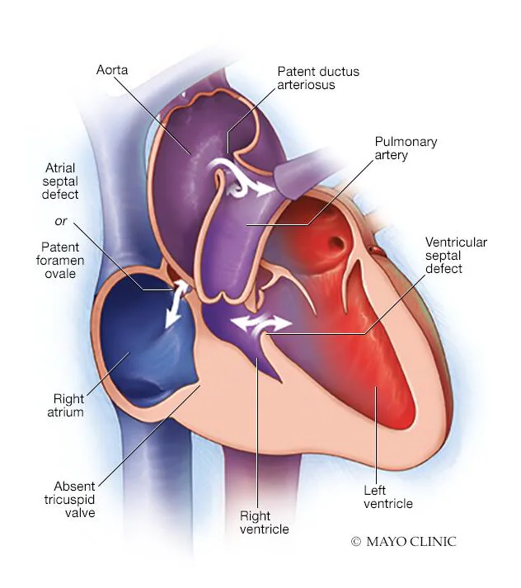
Signs and Symptoms of Tricuspid Atresia:
Cyanosis
Poor feeding
Tachypnea
Murmur due to the VSD
Left axis deviation on electrocardiography and left ventricular hypertrophy (since it must pump blood to both the pulmonary and systemic systems)
Normal or mildly enlarged heart

Slide 27
Treatment of Tricuspid Atresia:
PGE1 to maintain patent ductus arteriosus
Blood flows from right atrium to left atrium through foramen ovale
Fontan procedure to redirect inferior vena cava and hepatic vein flow into the pulmonary circulation

Slide 28
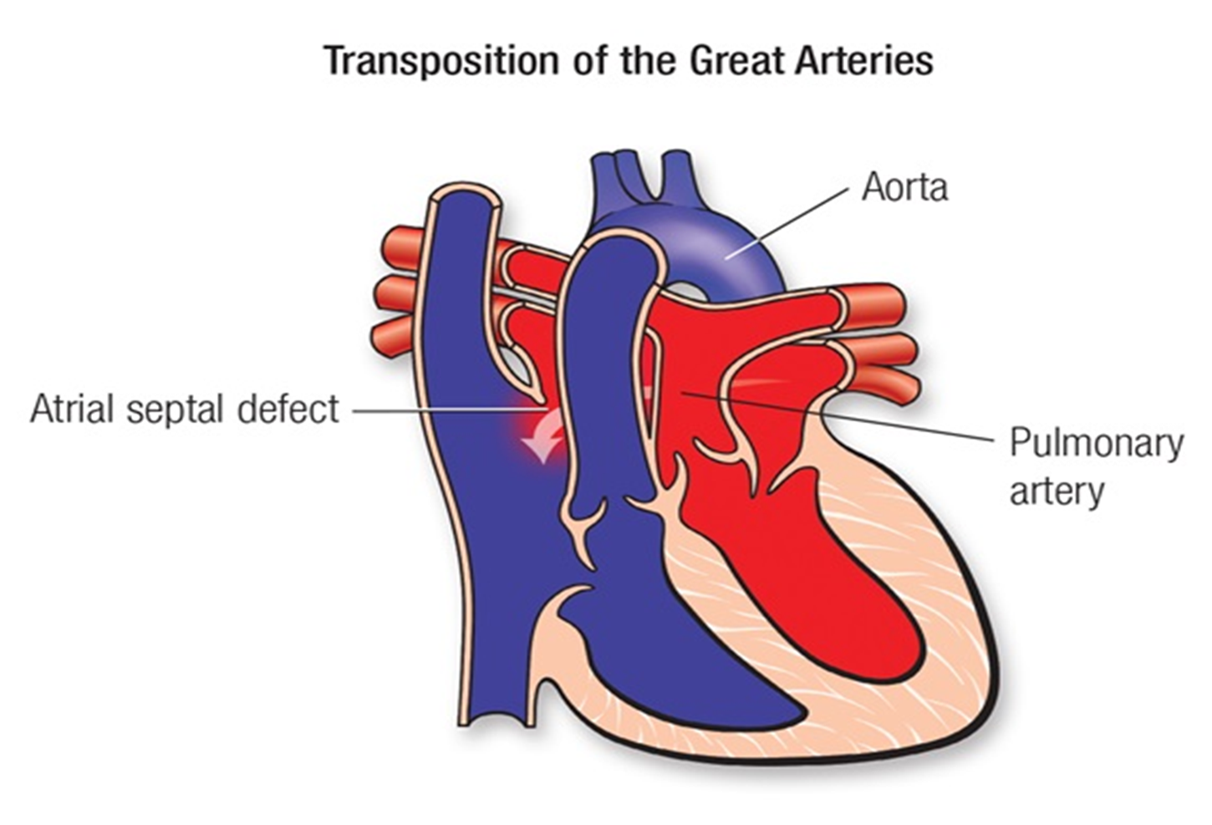
3-Transposition of the Great Arteries
Transposition of the great arteries is a serious but rare congenital heart defect in which the two main arteries leaving the heart are reversed (transposed).
Aorta exits from right ventricle, pulmonary artery leaves the left ventricle with communication between the systemic and pulmonary circulation.

Slide 29
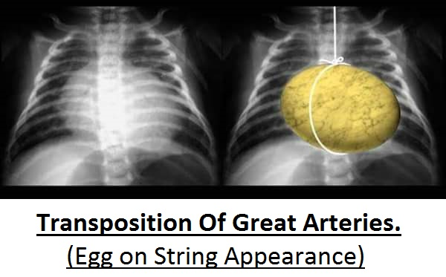
Signs and symptoms of Transposition of great arteries
Cyanosis from birth, hypoxic spells sometimes present.
Shortness of breath
Heart failure and Lung damage often present.
Diminished pulmonary artery segment on x-ray
Egg on string appearance of the heart

Slide 30
Treatments of Transposition of the great arteries
Surgery is required for all babies within the first week.
The most common type of surgery to correct transposition when identified in babies is the arterial switch operation.
During this operation, the surgeon moves the great arteries so they are connected to the correct pumping chamber.
The arteries that supply the heart (coronary arteries) must also be moved.
Although this operation is lifesaving, problems may occur later in life

Slide 31
4-Total Anomalous Pulmonary Venous Connection
Pulmonary veins attach to the heart in incorrect places, instead of attaching correctly to the upper left heart chamber (left atrium).
Oxygenated blood flowing returning to the heart from the pulmonary veins returns to the upper right heart chamber (right atrium) and mixes with oxygen-poor blood either before entering the heart or in the right atrium.
Blood reaches the left atrium only through an atrial septal defect or patent foramen ovale

Slide 32
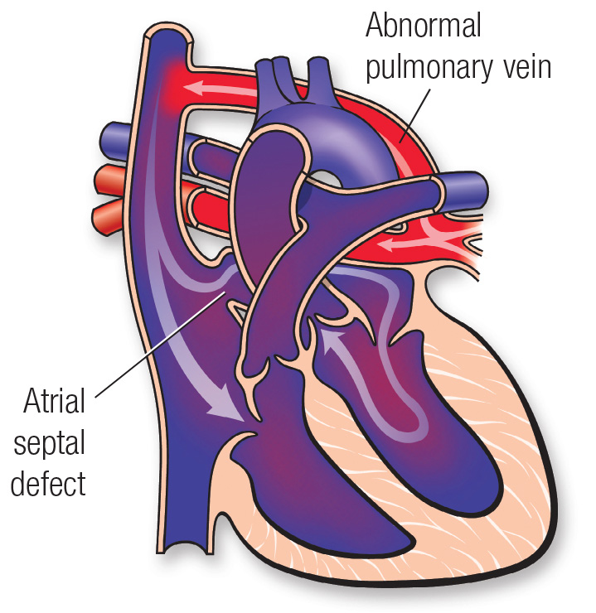

Slide 33
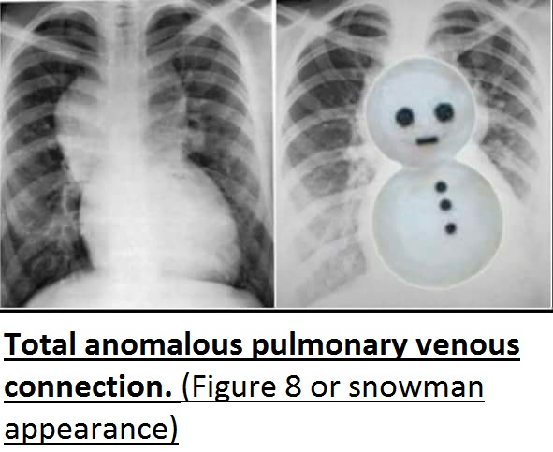
Signs and symptoms of Total Anomalous Pulmonary Venous Connection
Pulmonary congestion,
Tachypnea,
Cardiac failure
Cyanosis.
Snowman appearance of the heart

Slide 34
Treatment of Total Anomalous Pulmonary Venous Connection:
Operative repair in all cases.
To repair this congenital heart defect, surgeons connect the pulmonary veins to the left atrium and close the hole between the atria.

Slide 35
5-Truncus Arteriosus
Failure of normal separation and division of the embyronic bulbar trunk into Pulmonary and aorta
Resulting in a single vessel that overrides both ventricles causing de-saturation and hypoxima.
Pulmonary and aorta are single large vessel overrides the ventricular septum and distributes all the blood ejected from the heart.
Large VSD is present.

Slide 36
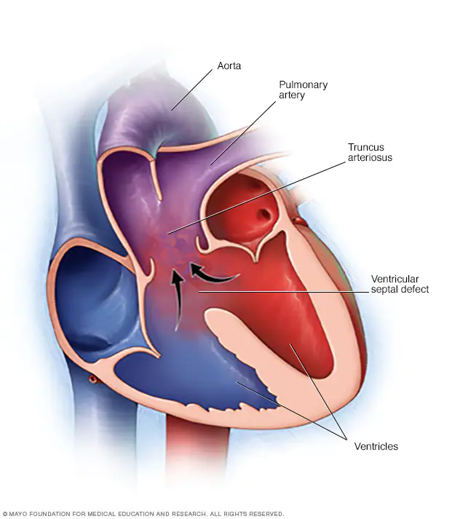
Signs and symptoms of Truncus Arteriosus:
Cyanosis
Poor feeding
Excessive sleepiness
Poor growth
Shortness of breath (dyspnea)
Rapid breathing (tachypnea)

Slide 37
Treatment of Truncus Arteriosus
1) Medications
Diuretics
Ionotropic agents to strengthens the heart's contractions.
2) Surgical procedures : done first few weeks after born.
Most commonly surgeon will:
Close the hole between the two ventricles with a patch
Separate the upper portion of the pulmonary artery from single large vessel
Implant a tube (conduit) and valve to connect the right ventricle with upper portion of the pulmonary artery , creating a new, complete pulmonary artery
Reconstruct the single large vessel and aorta to create a new, complete aorta

Slide 38
Children with HEART FAILURE (HF)
Heart failure is a medical term that describes an inability of heart pumping blood to lungs and other organs
It may affect one or both of the heart’s pumping systems.
Left side fails first because of greatest workload.
Failure one side usually leads to failure of the other side.
Congestive heart failure (CHF) is failure of both left and right side of heart

Slide 39
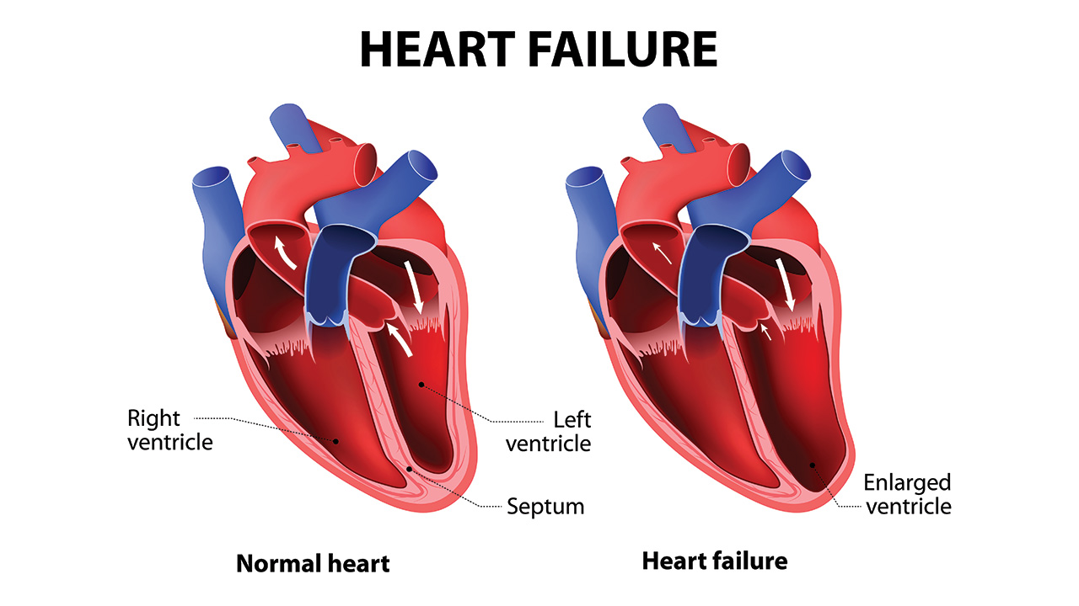
Causes of Heart Failure
➢Narrowed arteries that supply blood to the heart muscle coronary artery disease
➢High blood pressure
➢Heart valve disease
➢Cardiomyopathy
➢Congenital heart defects.
➢Endocarditis and myocarditis

Slide 40
Symptoms and signs of Suspected Heart Failure
a. Asymptomatic
b. Tachycardia
c. Increased exercise intolerance
d. Dyspnea: Shortness of breath
e. Peripheral and pulmonary edema
f. Grunting
g. Cardiomegaly: Cardiac enlargement
h. Hypotension: Low blood pressure
i. Marked urine retention
j. Diaphoresis
k. Prolonged feeding times with growth failure

Slide 41
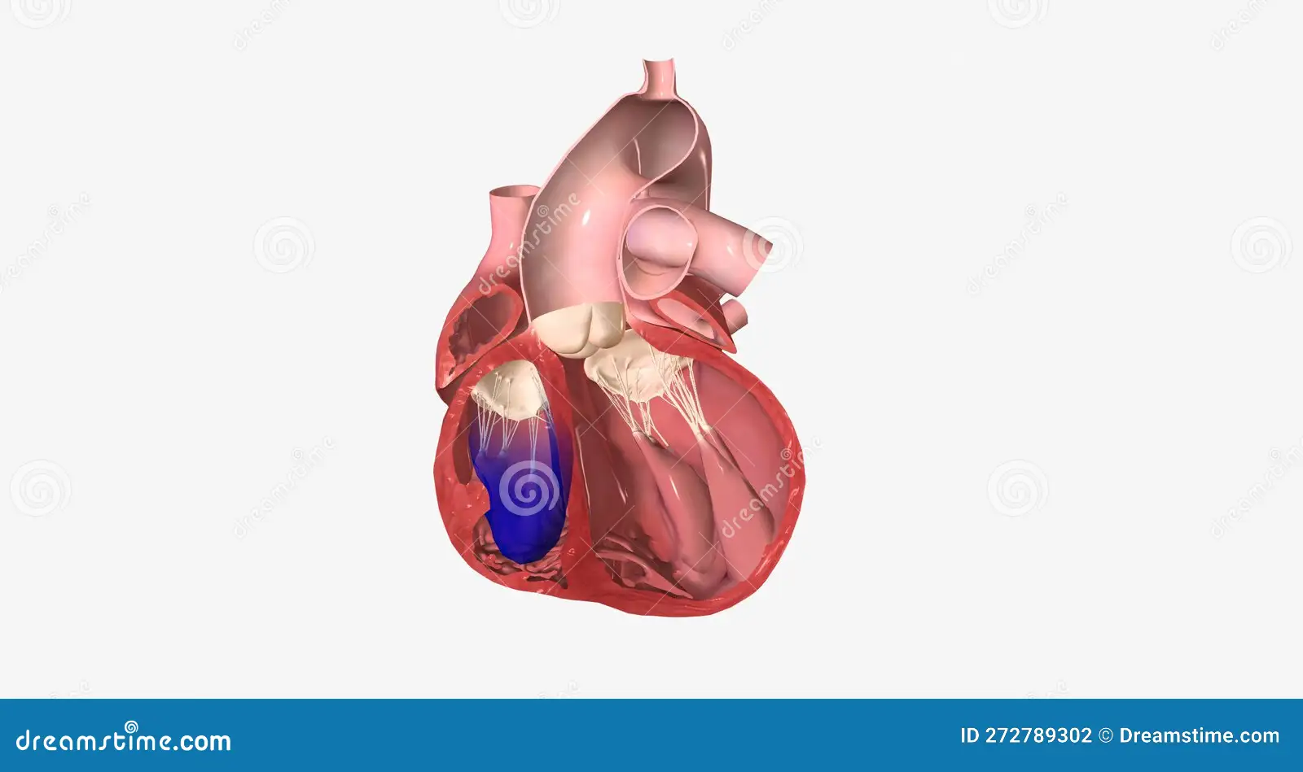
Symptoms and signs of Right-Sided Heart Failure
Jugular vein distension
Peripheral edema , Ascites , Weight gain
Fatigue and Weakness
Splenomegaly
Hepatomegaly
GI discomfort
Nocturia
Tachycardia

Slide 42
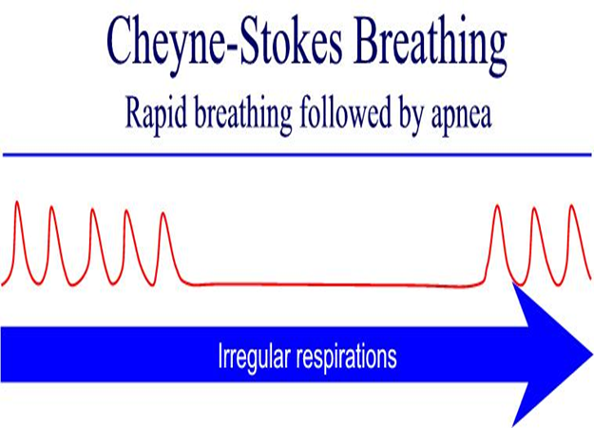
Symptoms and signs of Left-Sided Heart Failure
1-Dyspnea “Paroxysmal” nocturnal dyspnea
2- Dry cough
3- Crackles and Wheezes
4- Orthopnea
5- Hemoptysis , Pulmonary edema
6- Cheyne-stokes respirations
7-Fatigue and Weakness
8-Cyanosis
9-Nocturia
10-Tachycardia
11-Serious: life threatening

Slide 43
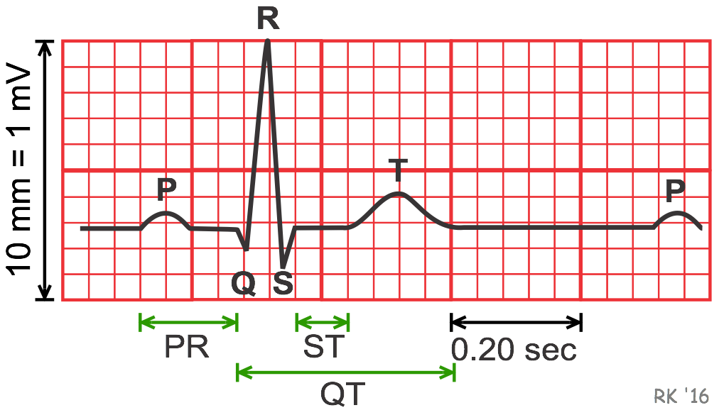
Diagnostic tests of Heart Failure
➢History and Physical exam
➢ Electrocardiogram ECG,
➢X-ray: cardiomegaly
➢ECHO
➢Angiography
➢Magnetic resonance imaging MRI
➢Serum labs: ABG”s, NUN, creatinine, liver enzymes, electrolytes

Slide 44
Treatment of Heart Failure
Administer medication: Diazepam (Valium), Vasodilators: reduce load on myocardium, Diuretics: decrease extracellular fluid volume, Inotropic: increase strength of contraction of cardiac muscle, ACE inhibition., Beta-blockers, Digitalis
Treat Hypertension
Treat lipid disorders
Dietary salt restriction
Mechanical assist devices
Continuous IV inotropic infusions
Heart transplantation
Hospice care

Slide 45
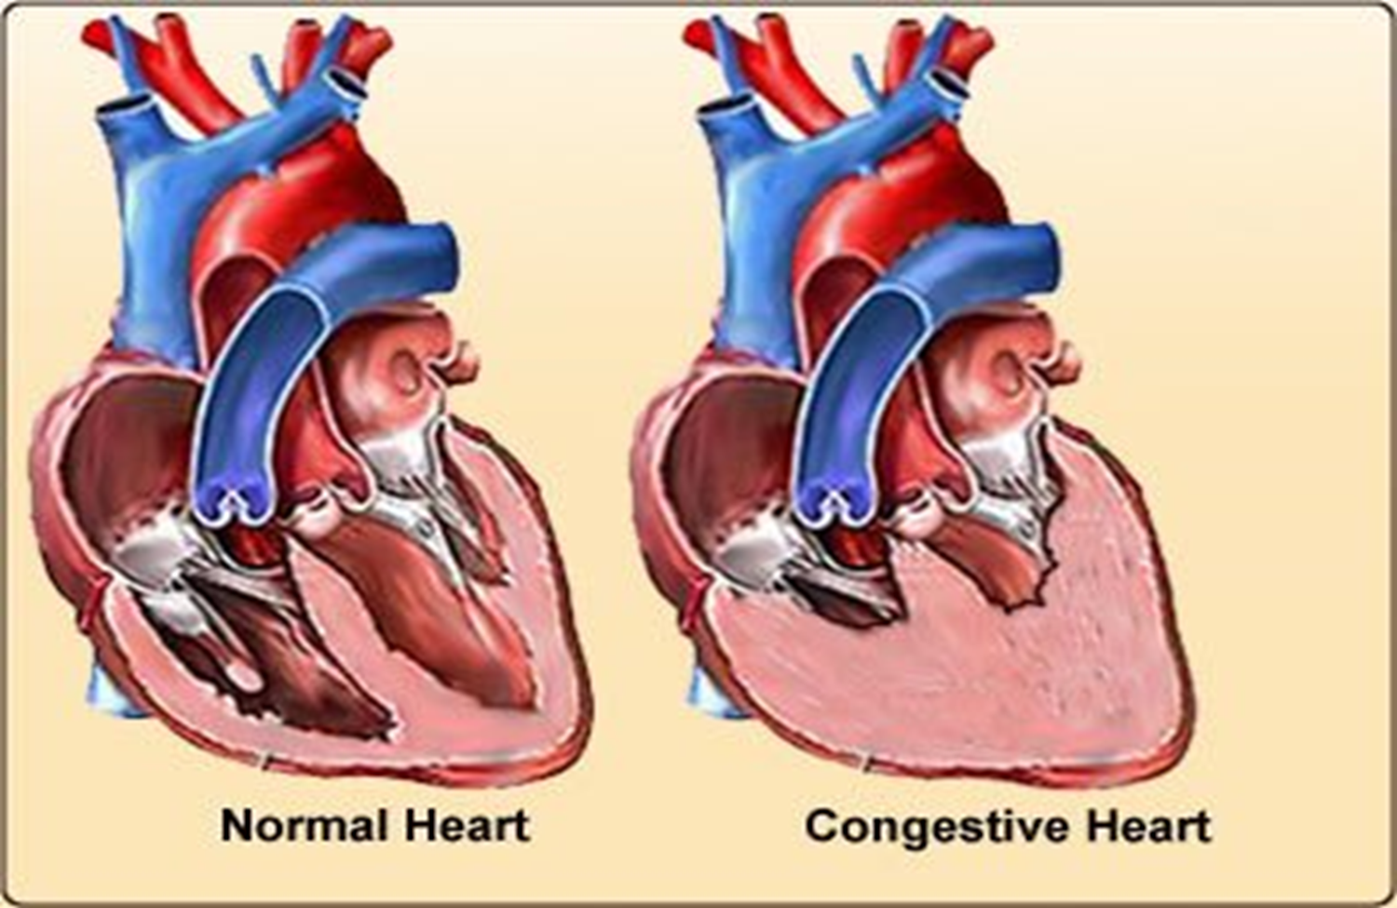
Children with Congestive Heart Failure (CHF):
Cardiac output (CO) inadequate to support circulatory and metabolic needs
Causes of CHF:
a. Volume overload,
b. Pressure overload,
c. Decreased contractility,
d. High cardiac output demands

Slide 46
Signs and symptoms of CHF
Tired during feeding (often first indication of CHF)
Tachycardia
Diaphoresis,
Tachypnea, Crackles and respiratory distress
Edema, increase weight
CXR shows large heart.
Symptoms increase with progressing disease
Cardiomegaly

Slide 47
Management of CHF:
Digoxin to make heart work more efficiently
Lasix/Diuretics to remove excess fluid
Oxygen: potent vasodilator which decreases pulmonary vascular resistance
Rest, a neutral thermal environment,
Cluster care to promote uninterrupted rest
Fowler/semi position

Slide 48
Children with RHEUMATIC FEVER
Rheumatic fever is an inflammatory autoimmune disorder as a consequence to Group A Beta Hemolytic Streptococcal (GAS) infection, that involves tonsils and pharynx. (Not the skin infection). There is no direct invasion to the tissue by microorganism.
After GAS infection, body produces antibodies against streptococci . These antibodies react with human tissues because of antigenic similarity between streptococcal components and human connective tissues (molecular mimicry).
R.F. causes permanent damage to the heart but not to the joint (it causes only arthritis).
It is a preventable disease
It is a childhood disease: first attack usually between 5-15 years
More common in girls than boys

Slide 49
Signs and Symptoms of Rheumatic Fever
➢Carditis
➢Murmur
➢Heart failure , Cardiac enlargement
➢Pericardial rub or effusion
➢Polyarthritis: short-term, in large joints, leave no residual deformity,
➢Chorea involuntary movement of legs and arms
➢Speech affected, twitchy, late manifestation

Slide 50
Diagnosis of Rheumatic Fever
✓History and physical exam
✓Laboratory: Raised Erythrocyte Sedimentation Rate (ESR), Raised C - reactive protein (CRP) Test, Positive GAS throat culture, Elevated streptococcal antigen test, Elevated streptococcal antibody titer
✓ECG
✓Chest x-ray show cardiomegaly, pulmonary venous congestion
✓Echocardiogram show cardiac dilatation, valve involvement, pericardial effusion
✓Rapid response to Aspirin within 24to48hrs joint pain will disappear

Slide 51
Treatment of Rheumatic Fever
➢ Bed rest 2-6 weeks, till inflammation subsided
➢ Supportive therapy: treatment of heart failure
➢ Anti-streptococcal therapy: Benzathine Penicillin, Penicillin, if allergic to Penicillin Erythromycin
➢ Anti-inflammatory agents:
-Aspirin in the absence of Carditis
-Corticosteroids in presence of Carditis

