Slide 1

Pediatric
And New Born Nursing
Unit 9 Children With Musculoskeletal Problems

Slide 2
1) Children with JUVENILE RHEUMATOID ARTHRITIS (JRA)
JRA is systemic autoimmune illness where body's immune system attacks and destroys healthy body’s connective tissues.
JRA occur at age of < 16 years
JRA duration of disease > 6 weeks

Slide 3
Types of JRT
1-Systemic arthritis: Entire body is affected involves joint swelling or pain, fevers, and rash. It is the least common category.
2-Polyarticular arthritis: Arthritis in five or more joints with major symptoms of Constant pain in the knees, ankles, wrist, fingers, elbows and shoulders. It may involve large and small joints of the legs and arms, and cervical spine.
3-Pauciarticular arthritis: Arthritis in four or fewer joints within the first 6 month of onset; large joints of knee, ankle, elbow, and wrist are affected.

Slide 4
Clinical Manifestations of JRA
Joint stiffness in the morning
Joint Back pain
Joint damage which affects mobility, strength limited range of motion
Joints warm or swollen and red
A child may stop using an affected limb or may limp
There is periods when symptoms reduce in severity or disappear/ absent for months to years
Lymphadenopathy: Swollen lymph nodes
Hepato-splenomegaly,
Uveitis : eye inflammation, blindness

Slide 5
Diagnosis and Tests of JRA
The physical examination
Laboratory Studies: CBC, Erythrocyte sedimentation rate ESR , Antinuclear Antibodies (ANA):positive, Rheumatoid Factors (RF): usually negative, Synovial fluid: class II (inflammatory)
X-ray findings: soft tissue swelling, osteoporosis, growth disturbance, loss of joint space
Chest X-ray
ECG
Eye exam : should be done on a regular basis, even if there are no eye symptoms

Slide 6
Prevention and Treatment of JRA
There is no known prevention for JRA.
Non-Steroid anti-inflammatory drugs NSAIDs
Aspirin, Tolmetin sodium, ibuprofen, Naproxen
Corticosteroids: Prednisone; methyl-prednisolone
Used for uncontrolled or life-threatening systemic disease;
Treatment of chronic uveitis as local ophthalmic drops;

Slide 7
Complications of JRA
Wearing away or destruction of slow rate of growth musculoskeletal disabilities.
Uneven growth of an arm or leg
Loss of vision or decreased vision
Anemia
Pericarditis
Chronic pain, poor school attendance.

Slide 8
Children with MUSCULAR DYSTROPHY (Duchenne: DMD)
It is a genetic an inherited disorder (X-linked recessive) with progressive degeneration of muscle, that gradually weakens and loss of body’s muscle
Muscles are made up of bundles of fibers (muscle-fiber membrane).
A group of interdependent proteins along the membrane surrounding each fiber helps to keep muscle cells working properly.
DMD is caused by a mutation in the gene that produces an important muscle protein called Dystrophin, that needed to build and maintain healthy muscles

Slide 9
Children with MUSCULAR DYSTROPHY (Duchenne: DMD)
Onset is before ages 6 years begin by pelvic muscles weaken. By age 12, the majority of children will be unable to walk and made to use a wheelchair.
People with DMD lose muscle all their lives, but it is usually not noticed until an unusual walking and/or talking around the age of 3 appears
It is the most common and severe form of childhood dystrophy. Lifespan for this type is about 20years.
Girls rarely get this disease. Females with DMD have some of the symptoms like weaker muscles in the back, legs and arms that fatigue easily. May need a wheelchair or other mobility aids

Slide 10
Early Signs and Symptoms of DMD
Delayed onset walking
Difficulty in performing a standing up, jump
Waddling when walking
Enlarged Calves
Late Signs and Symptoms of DMD:
✓Stumbling
✓Waddling , A sway-back (Lordosis) and Toe walking
✓Difficulty going up stairs, Struggle standing up
✓Hypotonia , poor head control, tightness in ankles, hips, knees and elbows, Sometimes, dislocated hips, Frequent falls

Slide 11
Treatment of DMD
No cure
Medication to slow down the process of DMD and manage symptom. Albuterol (beta adrenergic receptor agonist drug that increases strength and muscle mass, Utrophin (as substituted for dystrophin
Assistive devices for children: power wheelchairs and scooters to improve mobility, Crutches, walkers, leg braces to help them walk
Physical Therapy
Support breathing with a ventilator and respiratory care
Specially trained dog to assist in carrying books
Embryonic stem cell transplants

Slide 12
Complications of DMD
Cardiomyopathy
Deformities
Mental impairment (minimal)
Permanent, progressive disability and mobility
Decreased ability to care for self
Pneumonia and Respiratory failure

Slide 13
2) Children with OSTEOMYELITIS
It is a severe infection of the bone, bone marrow, and surrounding soft tissue.
It occur by:
a. Exogenous: direct extension from the outside as a result of penetrating wound, open fracture contamination during surgery
b. Hematogenous: spread of organism from preexisting infections including URTI, Tonsilites
Occur at any age but most frequently at 4-14 years of age.

Slide 14
Causes of Osteomyelitis
The most common infecting microorganism is:
1- Staphylococcus Aureus in children more than 5 years.
2-Haemophilus influenza: in the younger children

Slide 15
Systemic Manifestations of Osteomyelitis:
➢ Fever, Chills,
➢ Night sweats,
➢ Restlessness, Malaise
➢ Nausea,
Local Manifestations Include:
Constant bone pain that is unrelieved by rest and worsens with activity
Swelling
Tenderness
Warmth at the infection site
Restricted movement of the affected part

Slide 16
Diagnostic Studies of Osteomyelitis
A bone or soft tissue biopsy
Blood cultures, CBC, Erythrocyte sedimentation rate (ESR) elevated.
Wound cultures
Magnetic resonance imaging (MRI)
Computed tomography (CT) scans

Slide 17
Treatment of Osteomyelitis
Intravenous (IV) antibiotic:
Surgical treatment for chronic osteomyelitis includes removal of the poorly vascularized tissue and dead bone.

Slide 18
Complications of Osteomyelitis
Septicemia,
Septic arthritis,
Pathologic fractures,
Amyloidosis: an abnormal amyloid protein builds up in tissues and organs.

Slide 19
3) CLUB FOOT (Congenital Talipes Aquinovarus )
One or both feet and ankles are twisted into an abnormal position at birth.
Clubfoot is painless in a baby
Causes of Congenital Clubfoot
Unknown
Teratogenic agents
Genetic associations

Slide 20
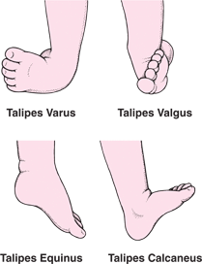
Positions Variations of Clubfoot
Talipes varus: an inversion or a bending inward.
Talipes valgus: an inversion or bending outward
Talipes equines: plantar flexion in which the toes are lower than the heel.
Talipes caleaneus: dorsi-fexion, in which the toes are higher than the heel.

Slide 21
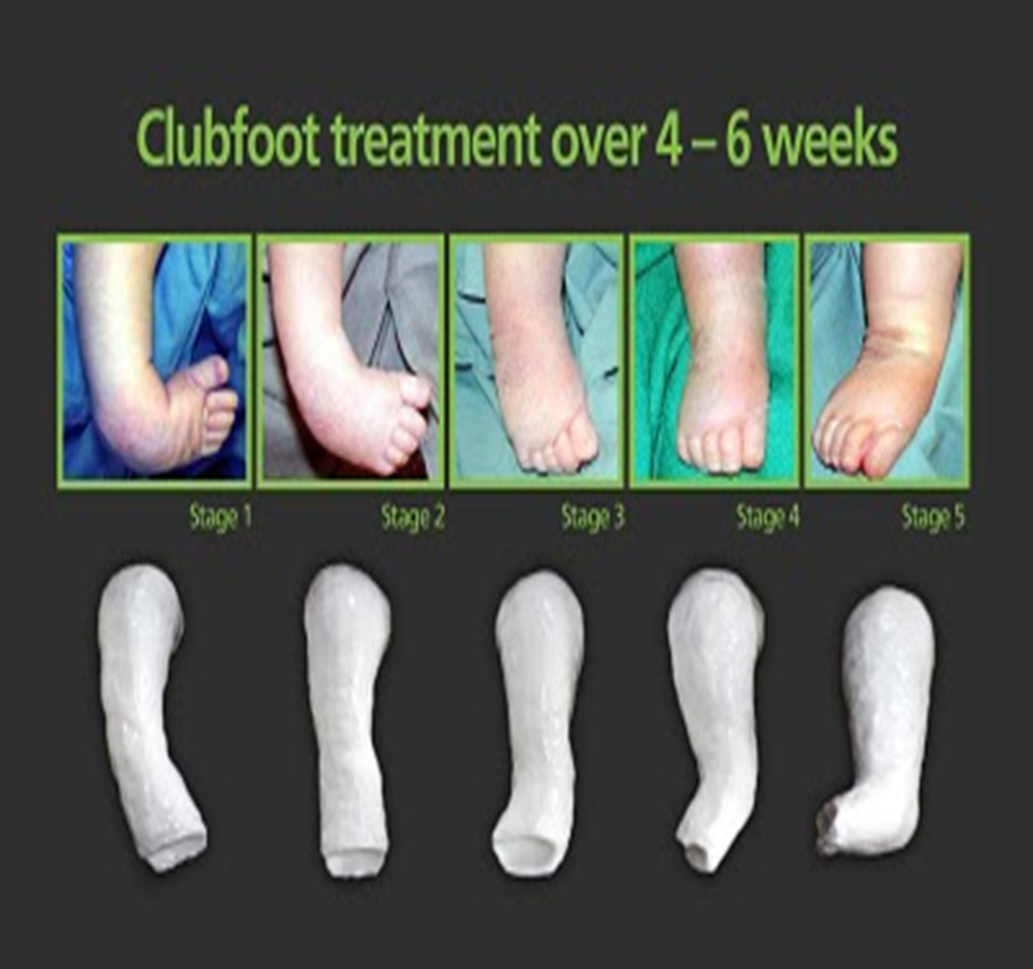
Diagnostic Procedures of Clubfoot
Ultrasonography
X-ray
CT-scan
Treatment of Clubfoot
Stretching and casting (Ponseti Method)
Stretching and taping (French Method)
Surgery
Brace

Slide 22
4) Children with Developmental Dysplasia Of The Hip (DDH) Congenital Hip Dysplasia (CDH)
DDH Head of femur does not lie deep enough within the acetabulum and slips out on movement
CDH misalignment is present at birth.
DDH misalignment developed after birth.
7 times more in females than males

Slide 23
Classification of DDH / CDH
1-Acetabular dysplasia (unstable hip) mildest form
Femoral head remains in acetabulum, but can be partially or completely dislocated with manual manipulation.
2- Subluxation (most common form)
Femoral head partially displaced or positioned under the edge of acetabulum.
3- Dislocation
Femoral head not in contact with acetabulum, it is completely positioned outside

Slide 24
Causes of DDH / CDH
1- Genetic factors
2- Hormonal changes in late pregnancy lead to leg laxity
3- Intrauterine malposition (breech, extended legs)
4- Postnatal factors (swaddling)

Slide 25
Clinical manifestations of DDH / CDH
Asymmetry in abduction of leg on affected side in supine position
Asymmetry of gluteal, popliteal, and thigh folds
Waddling gait and lordosis when child begins to walk
Asymmetrical skin creases
Affected leg is Shorter
Delayed walking and Limping

Slide 26
Diagnostic tests of DDH / CDH
1) Galeazzi’s signs: With child in a supine position, the side of the subluxation appears lower than the normal because of malposition of the femur head
2) Positive Barlow’s maneuvers /test: Put infant on a supine position. Then abducts hips by moving bent hips and knees apart. If hip feels like it can be pushed out the back of the socket, this is considered abnormal.
3) Ortolani maneuver/test: As hip is abducted further, examiner might feel femoral head slide forward as it slips back into the socket. Or audible click when abducting and externally rotating hip on affected side
4) Ultrasound of hip
5) C-scan of hip
6) X- rays

Slide 27
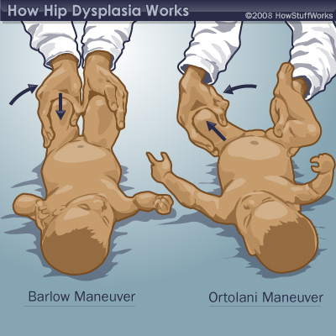

Slide 28
Treatment of DDH / CDH
Double diapering is not effective
Stable hip splinted with a pavlik harness to maintain them in flexion, abduction and external rotation.
Traction or surgery is usually required to release muscles, tendons, and ligaments
A spical cast is applied following surgery.

