Slide 1

Pediatric
and New born Nursing
Unit 10 Care of the Child with Neurological Disorders

Slide 2
1) Children with Spina Bifida
As embryo forms, bones in spinal column come together and tissue grows around vertebrae, closing it.
Neural plate development at 18th day
Cranial closure by 24th day (upper spine)
Caudal closure by 26th day (lower spine)
This process is usually complete by the 28th day of pregnancy.
Spina Bifida is birth defect result from incomplete closure of embryonic neural tube. The term Spina Bifida means “open spine”
It is complex birth defects.
The size of the opening varies from almost pinpoint to several inches.

Slide 3
Causes of Spina Bifida:
It is not completely understood include combined genetic and environmental factors
95% of affected babies are born to parents with no family history of these disorders.
Risk Factors of Spina Bifida
Family with history of Spina Bifida
Uncontrolled diabetes.
Anti-seizure medication
Folic acid deficiency,
Viral,
Radiation

Slide 4
Types of Spina Bifida 1) Occulta
“Occulta,” means “hidden,” the malformation, or opening in spine, is covered by a layer of skin
The mildest and most common form in which one or more vertebrae are malformed
It appears as spine dimple, hair patch dark spot or swelling over affected area spinal cords and nerves.
Usually normal neural function
No treatment is needed.

Slide 5
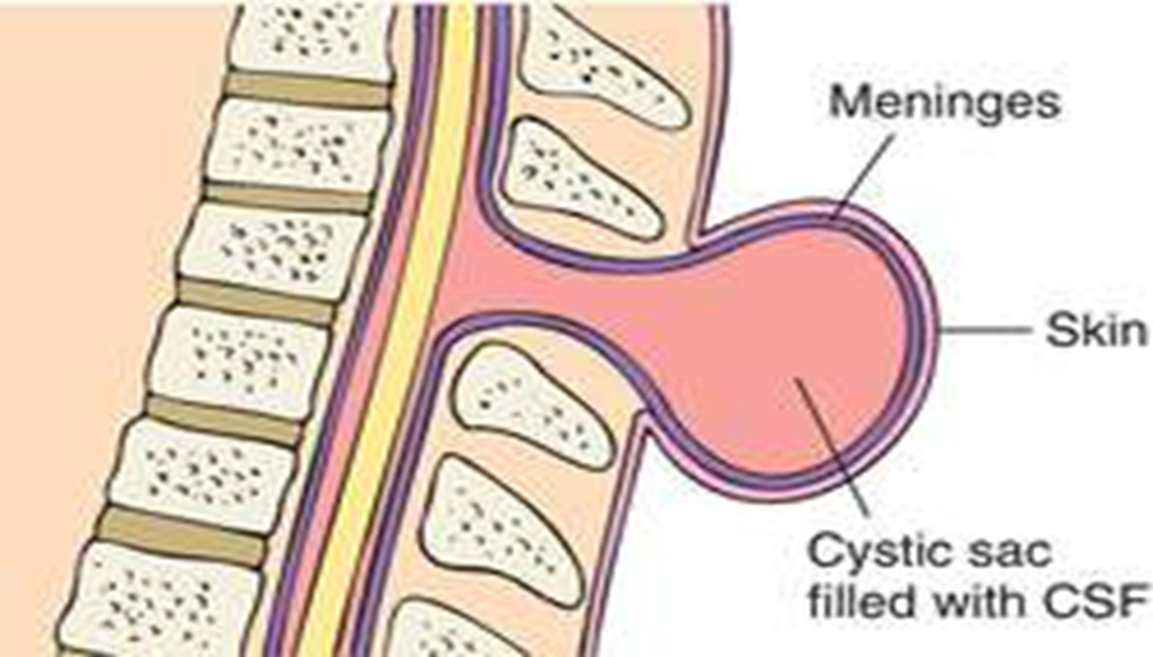
Types of Spina Bifida 2) Meningocele
Cyst or fluid-filled sac pokes through open part of spine sac contains membranes that protect spinal cord, but not spinal nerves cyst.
It is the rarest form
It allows normal development of child
Treatment by surgical removable

Slide 6
Types of Spina Bifida 3) Myelomeningocele:
The cyst holds both membranes and nerve roots of spinal cord and, often, the cord itself.
It is the most severe form
A fully exposed section of spinal cord and nerves closed surgically after birth
Affected babies suffer from:
Leg paralysis
Bladder and bowel control problems

Slide 7
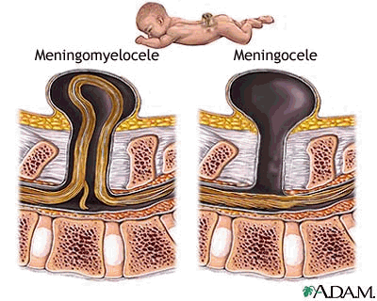
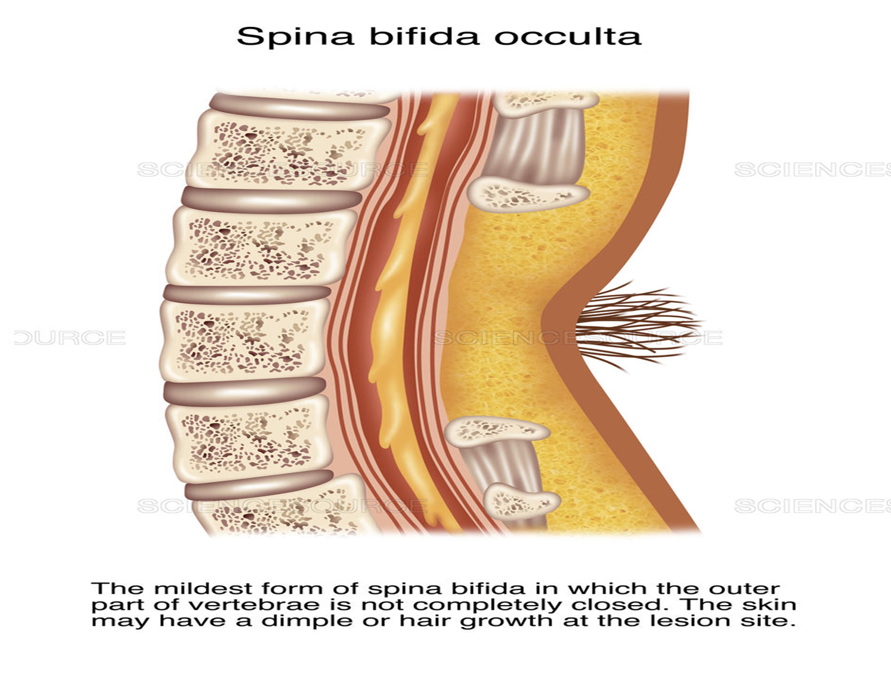

Slide 8
Diagnosis and Detection of Spina Bifida
Amniocentesis
Blood test: Maternal blood samples of alpha-fetoprotein (AFP) which is made naturally by the fetus and placenta. But if abnormally high levels of this protein appear in the mother’s bloodstream it may indicate that the fetus has a neural tube defect.
Ultrasonography: for locating back lesion cranial

Slide 9
Medical Problems and Complication of Spina Bifida
Bowel Dysfunction
Respiration/Sleep Apnea
Seizures
Vision disabilities
Skin breakdown/ Pressure sores
Social/Emotional Issues
Various degrees of leg , foot deformities, Paralysis
Hydrocephalus (70-90%)
Urinary tract disorders/ Neurogenic Bladder Dysfunction
Latex allergy (73%)
Loss of sensation
Learning disabilities

Slide 10
Treatment of Spina Bifida
There is no cure for Spina Bifida.
Newborn with the mild form need no treatment.
Surgical repair
Prevent infection and trauma of the exposed nerves and tissue
Fetal surgery: involves opening the mother’s abdomen and uterus and closing opening spinal cord.

Slide 11
Prevention of Spina Bifida:
Folic Acid 70% Neural Tube Defects can be prevented
Multivitamin of 400 micrograms of folic acid every day
Foods high in folic acid: dried beans, oranges, liver, nuts, juices: orange, pineapple, tomato, avocado, leafy green vegetables

Slide 12
2) Children with Hydrocephalus
Buildup of Cerebrospinal Fluid (CSF) inside the skull within brain ventricles
Causes of Hydrocephalus:
Congenital: Present at birth
Acquired : As a result of disease process

Slide 13
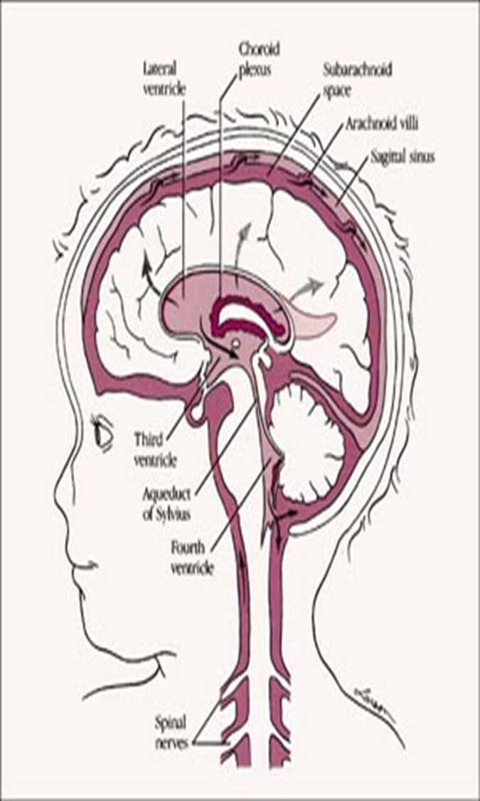
Signs and Symptoms of Hydrocephalus
Head enlargement
Fontanels bulging or tense
Vomiting
Irritability
Lethargy
Downward displacement of eyes
Seizures
High pitched crying

Slide 14
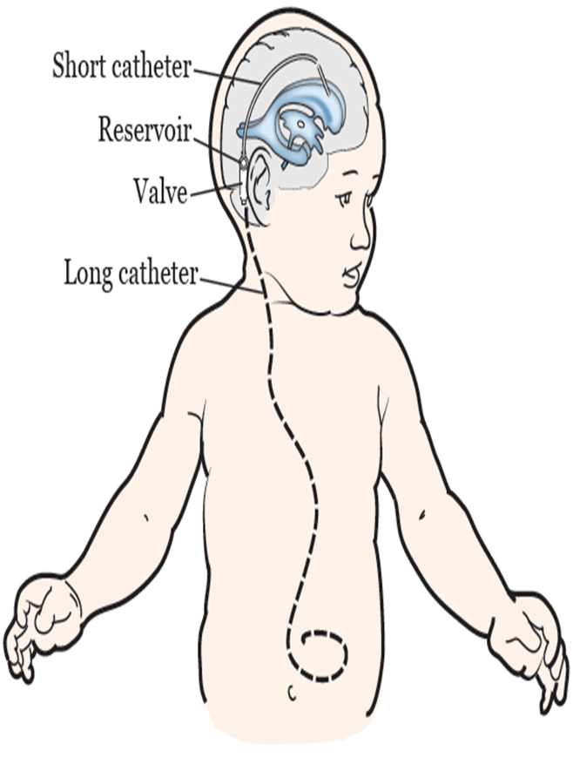
Treatment of Hydrocephalus
Surgical removal of obstruction
Placement of shunt VP shunt (Ventriculo-Peritoneal Shunt)
Their management is complex and long term

Slide 15
Complications of Hydrocephalus:
VP shunt obstruction/malfunction
Infection/meningitis
Permanent disability.
Permanent disability

Slide 16
3) Children with MENINGITIS
Most common in infancy. 95% of the cases occur between 1 month- 5 years of age
Routes of Meningitis Infection:
Nasopharynx
Blood stream
Direct spread (skull fracture, encephalocel
Infected Ventriculo-peritoneal shunts.
Congenital defects
Sinusitis
Middle ear infection

Slide 17
Signs and Symptoms of Meningitis
Fever
Lethargy
Altered consciousness
Irritability
Headache
Photophobia
Skin rashes
Vomiting, poor appetite
Seizures 20 - 30%
Bulging fontanel 30%
A high-pitched cry
Increased intracranial pressure
Papilledema
Changes in pupils
Cushing’s triad:
Bradycardia ,
Hypertension,
Irregular respiration

Slide 18
Signs and Symptoms of Meningitis
Brudzinski sign:
Child lies supine, head is passively elevated by examiner, involuntary flexion of knees
Kernig sign:
Child lies supine with knees flexed, knees extended, complain of pain in back or neck
Stiff neck or nuchal rigidity:
Inability to flex head forward due to rigidity of neck muscles
If flexion of the neck is painful but full range of motion is present, nuchal rigidity is absent.

Slide 19
Types of Meningitis
1-Bacterial Pyogenic (Producing pus): Haemophilus Influenzae. Type B Streptococcus
2-Viral: Polio, Varicella, Mumps, Measles, Rubella, Rabies, HIV
3-Fungal: rare Cryptococcus Neoformans, Candida, H. capsulatum.
4- Parasitic: infrequent, life-threatening, Acanthamoeba, Balamuthia, Naegleria
5- Non-infectious: Rare, caused by exposure to medications, Immune globulin, Levamisole , Metronidazole , Mumps and rubella vaccines NSAID (Ibuprofen, Diclofenac, Naproxen)
6-Tuberculous meningitis:

Slide 20
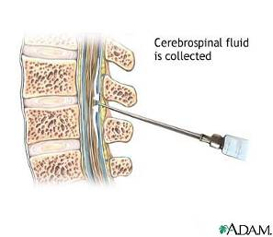
Investigations of Meningitis
❖ CBC,
❖ Blood culture,
❖ Gram staining,
❖ Lumbar Puncture (LP)
❖ Coagulation profile
❖ Liver and kidney function,
❖ Chest X-ray,
❖ CT/ MRI
❖ Blood gases,
❖ EEG,
❖ ECG

Slide 21
Treatments of Meningitis
The vaccines is best prevention
Maintain fluid and electrolyte
Transfuse whole blood, PRC, FFP ,platelets
Maintain temperature control
Strict monitor
Steroids: Dexamethasone useful for H. influenzae B
Antibiotics IV.
Anti-Viral
Anti-fungal

Slide 22
Complications of Meningitis
a. Hydrocephalus
b. Subdural effusion
c. Stroke
d. Abscess
Dural sinus thrombophlebitis
Cerebral edema and Convulsions
g. Shock:
i. Hyponatremia.
j. Hyperpyrexia

Slide 23
4) Children with ENCEPHALITIS:
It is inflammation, irritation and swelling of brain parenchyma, most often due to infections.
Encephalitis caused by: bacteria, fungi protozoa, viruses (most frequent)
Mode of Transmission of Encephalitis
Respiratory droplets
Skin contact
Mosquito, tick, and other insect bites, Tick of Horses
Migratory Birds
Contaminated food or drink

Slide 24
Signs and Symptoms of Encephalitis
Severe headache
Fever
Altered consciousness, Confusion or agitation
Personality changes
Muscle weakness, Loss of sensation or paralysis
Hallucinations
Double vision
Perception of foul smells
Problems with speech or hearing
Seizures

Slide 25
Diagnostic Procedure of Encephalitis:
Lumbar puncture
Electroencephalography (EEG)
Blood tests
Computed tomography
Magnetic resonance imaging

Slide 26
Treatments of Encephalitis
Antiviral medications
Antibiotics
Anti-seizure medications (Phenytoin)
Steroids (Dexamethasone): to reduce brain swelling
Sedatives: to treat irritability or restlessness
Acetaminophen: fever and headache.

Slide 27
5) Children with CEREBRAL PALSY (CP)
CP is an abnormality of motor function in motor pyramidal system (motor cortex basal ganglia and cerebellum), as opposed to mental function, and postural tone that is acquired at an early age, even before birth.
Signs and symptoms of cerebral palsy usually show in the first year of life

Slide 28
Causes of Cerebral Palsy
Gene mutations that lead to abnormal development
Maternal infections
Fetal stroke, a disruption of blood supply to developing brain
Brain Bleeding in womb or a newborn
Infant infections
Traumatic head injury to an infant e.g fall down
Lack of oxygen to the brain during delivery: rare

Slide 29
Signs and Symptoms of Cerebral Palsy
Excessive drooling or problems with swallowing and feeding
Respiratory problems,
Variations in muscle tone, stiff, floppy, spasticity
Ataxia lack of balance and muscle coordination
Tremors or involuntary movements, slow, twisting movements
Delays in motor skills sitting, crawling
Favoring one side of body, e.g reaching with one hand or dragging a leg while crawling
Difficulty walking, walking on toes, a crouched gait, a scissors-like gait with knees crossing, a wide gait or an asymmetrical gait

Slide 30
Signs and Symptoms of Cerebral Palsy
Delays in speech development or difficulty speaking
Learning difficulties, Intellectual, Mental disabilities
Difficulty with fine motor skills, buttoning clothes
Seizures
Difficulty seeing and hearing
Abnormal touch or pain perceptions
Oral diseases
Urinary incontinence
Coma

Slide 31
Diagnostic tests of Cerebral Palsy
Clinical picture and history
EEG
Computerized tomograohy
Electrolyte count

Slide 32
Treatment of Cerebral Palsy
Physical therapy
Occupational therapy
Speech and language therapy
Recreational therapy
Medications for spasticity, seizures,
Surgery for spasticity, seizures, vision issues

Slide 33
6) Children with SEIZURES
Seizure is an abnormal neural discharge in the cerebral cortex that result in abnormal function, the nature of clinical manifestations depend on the region(s) of the brain affected.
Manifestation of Seizure:
Transient, involuntary alteration or loss of consciousness,
Abnormal motor activity
Behavioral abnormalities
Sensory disturbance or autonomic dysfunction

Slide 34
Causes of Seizures
A. Congenital seizures, Galactosemia, Hypocalcemia, Hypoglycemia, Hypomagnesemia,
B. Acquired seizures
Trauma, cerebral ischemia, hypoxia,
Infections: Febrile Convulsion ≥38oC
Drugs: Insulin, Prednisolone, Procaine, Antibiotics: Penicillin,
Withdrawal of drugs: Fentanyl
Tumor
Toxic disorders: uremia, hepatic encephalopathy, leads poisoning, tetanus

Slide 35
Causes of Seizures
C. Epilepsy:
It is a recurrent seizures unrelated to fever or acute cerebral insult.
Less than 1/3rd of seizures are caused by epilepsy
In 72% of Epilepsy are Idiopathic Causes
Short, uncomplicated seizures does not cause permanent/ progressive neorological dysfunctions in brain
Chronic epileptic discharges and status epilepticus may lead to high neurological morbidity and permanent brain damage due to hypo perfusion, hypoxia, acidosis and other metabolic disturbance.

Slide 36
Types Of Generalized Seizures :
a. Absence seizures. (Petit mal seizures)
Common in children and are characterized by staring into space or by subtle body movements, such as eye blinking or lip smacking.
These seizures may occur in clusters and cause a brief loss of awareness.
b. Tonic seizures.
It causes stiffening of muscles.
These seizures usually affect muscles in back, arms and legs and may cause to fall to the ground

Slide 37
Types of Generalized Seizures :
c. Atonic seizures (drop seizures)
It causes a loss of muscle control, which causes to suddenly collapse or fall down.
d. Clonic seizures.
It associated with repeated or rhythmic, jerking muscle movements.
These seizures usually affect the neck, face and arms

Slide 38
Types of Generalized Seizures :
e. Tonic-clonic seizures. (Grand mal seizures):
The most dramatic type of epileptic seizure and can cause an abrupt loss of consciousness, body stiffening and shaking, and sometimes loss of bladder control or biting tongue.

Slide 39
Diagnosis of Epilepsy
▪History
▪Physical Examination/ neurological system
▪Laboratory Investigation: Serum electrolytes, blood sugar, CBC, Thyroid function tests (TFT), LFT, RFT, CSF
▪Imaging: EEG, CT Scan of Brain, MRI of Brain,

Slide 40
Management of Epilepsy
1. Medical treatment: first aid
▪Move persons away from danger
▪Recovery position on side .
▪Ensure clear airway
▪Do not insert anything into mouth
▪Urgent medical attention: patent airway, O2, anticonvulsant
▪Should not be left alone after recovery
Anticonvulsant Therapy : Phenytoin , Lorazepum ,Clonazepum ,Phenobarbital
Surgical treatment: Removal of epileptic focus. Anterior Temporal Lobectomy
4. Vagus Nerve stimulation

