Slide 1

Pediatric
and New born Nursing
Unit 12
Care of the Child with Gastrointestinal Problems

Slide 2
1) Children with Cleft Lip and Cleft Palate
Congenital failure of the maxillary processes to fuse occurring during weeks 6-12 gestation
Each abnormality may appear by itself or may be seen together
It has varying degrees of severity.

Slide 3
Cleft Lip
Opening between the nose and lip, Apparent at birth
Should be documented during newborn assessment
Assess child’s ability to suck and swallow.
Cleft lip repair is performed during first month of life,
Special feeding techniques if surgery is delayed

Slide 4
Feeding A Newborn before Cleft Lip Repair
Bottle with special nipple: longer and narrower,
Hold newborn in upright position,
Large cross-cut hole in nipple to allow the child to get food into back of throat without strong sucking
Allow newborn to swallow and burp frequently.
Allow newborn to rest frequently

Slide 5
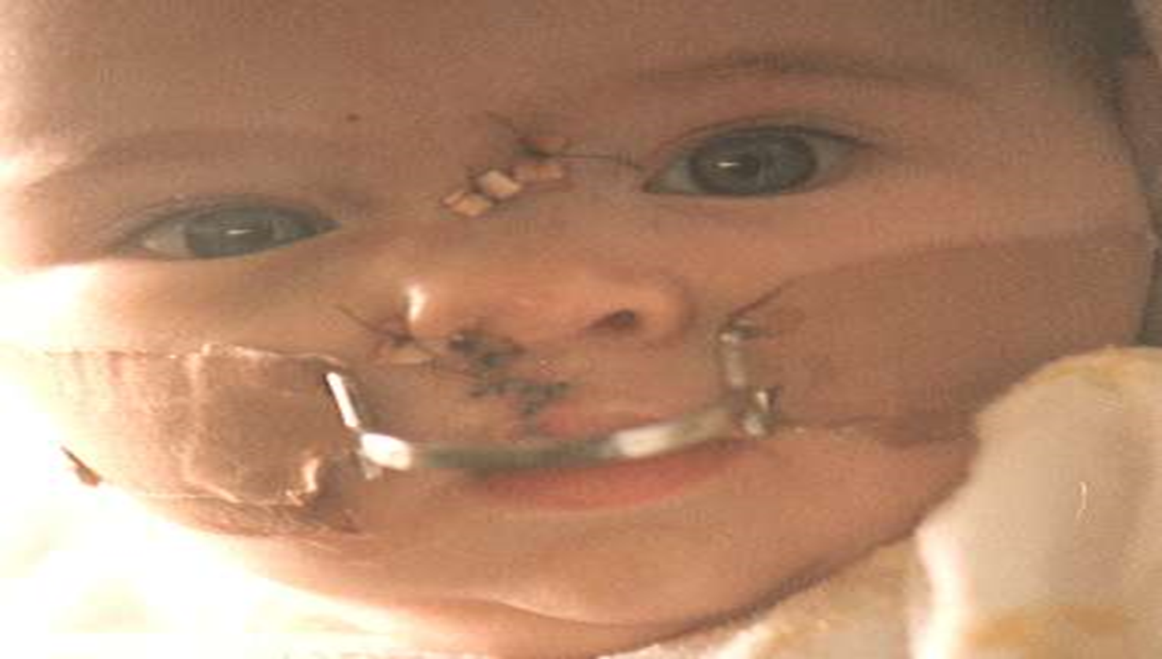
Surgery for Cleft Lip repair:
Done first few days to 1st month of life
Plastic surgery with a staggered suture line.
Often in shape of letter “Z” to minimize scarring.
After surgery Logan Bar over child’s mouth to reduce tension on suture line.

Slide 6
Cleft Palate
The two plates of the skull that form the hard palate (roof of the mouth) are not completely joined.
Feeding by using specialized bottles and nipples.
Repaired surgically between 6 months to 2 years prior to talking,

Slide 7
Cleft Palate
Problems
Altered dentition and speech dysfunction
Frequent episodes of Otitis Media, (due to opening into nasopharynx)

Slide 8
Cleft Palate
Parents will care for child at home until surgical repair.
Post-op care:
Sutures in child’s mouth,
Keep straws, pacifiers, and spoons away from child’s mouth for 7-10 days post-op
Elbow restraints.
Feeding: soft foods
Short nipples may be used
Rinsing mouth with water to clean suture line after feed
No brushing teeth X 1-2 weeks

Slide 9
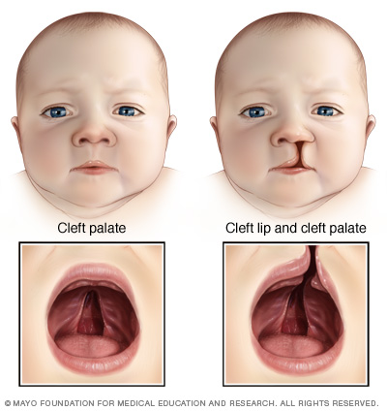
Complication Associated with Cleft Lip or Cleft Palate:
1-Feeding problems
2-Speech development
3-Dental and orthodontic developmental delay

Slide 10
2) Children with Esophageal Atresia (EA) and Tracheo-esophageal Fistula (TEF)
Incomplete formation of oesophagus or an abnormal connection between oesophagus and trachea. Due to faulty separation of primitive trachea and esophagus. Foregut fails to lengthen, separate and fuse into 2 parallel tubes (at 4-5 weeks gestation)
Associated with maternal polyhydramnios.
The fetus begins swallowing around 14 weeks and since secretions enter the blind pouch, they have nowhere to go except back out into the amniotic fluid, leading to polyhydramnios
EA and TEF can occur separately, they most commonly occur together

Slide 11
Types of TEF
Type A: isolated EA: It is an interruption in esophagus resulting in a blind pouch
Type B: EA with proximal TEF
Type C: EA with distal TEF: most common presentation
Type D: EA with proximal and distal TEF
Type H: isolated TEF with no EA: the easiest to repair

Slide 12
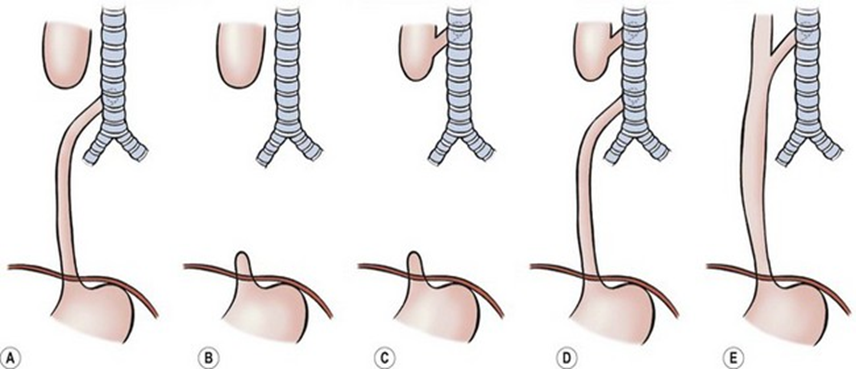

Slide 13
Physical Assessment of TEF:
Pooling of secretions: excessive drooling, salivation
Inability to swallow feedings
Coughing and Choking
Inability to pass NG/OG tube
Abdominal distension
Recurrent pneumonia
Respiratory distress and Cyanosis

Slide 14
Diagnosis of TEF:
Confirmed by attempting to pass a 5 or 8 French NG Tube into stomach.
On chest x-ray, the NG/OG appears coiled in the upper esophageal pouch.
On abdominal x-ray, air in the GI tract indicates a TEF.
A gasless abdomen indicates an isolated EA.

Slide 15
Management of TEF:
Antibiotics
Medications used to treat reflux.
NPO with total parenteral nutrition (TPN
TEF is a surgical emergency condition
Pre-operatively
Catheter set to continuous or intermittent low suction is placed in esophageal pouch to prevent aspiration
Surgical repair depends on the type of esophageal obstruction (anastomosis)
Post-operatively
Low-pressure ventilation
Care of chest tube
Feedings through the gastrostomy tube

Slide 16
3) Children with Hernias
A protrusion of a part or whole organ from its normal cavity through a congenital or acquired defect or opening.
A hernia may contain peritoneal fat, a loop of intestine, a section of a bladder or a portion of the stomach.
Types of Hernias:
Indirect inguinal hernia
Umbilical Hernia
Congenital diaphragmatic hernia

Slide 17
a. Indirect inguinal hernia:
When a loop of intestine passes through abdominal ring to the inguinal canal . Caused by increase in intra-abdominal pressure which forces the intestines to be pushed into a congenital defect
Failure of the processus vaginalis to close during fetal development
It is present from around the 12th week of gestation
Management of Indirect inguinal hernia
Surgery: Herniorrhaphy : herniating tissues are returned to abdominal cavity and defect in fascia or muscle is closed with sutures

Slide 18
b. Umbilical Hernia
Results from imperfect closure of the umbilical muscle ring
Often associated with diastasis recti (lateral separation of abdominal muscles). Around week 11 gestation and obliterated umbilical vessels occupy the space in the umbilical ring.
Etiology unknown
Clinical Manifestations of Umbilical Hernia:
1-Herniated umbilicus protrudes with coughing, crying or straining.
2-Hernia can be reduced by pushing contents back into fibrous ring.

Slide 19
Managements of Umbilical Hernia:
Most defects spontaneously resolve by 3-4 years of age as the muscular ring closes.
Surgery indicated in cases of strangulation, increased protrusion after 2 years of age or no improvement in large defect after 4 years

Slide 20
4) Children with Anorectal Malformations
Associated anomalies up to 70% of the time
Types of Anorectal malformations
Anal stenosis:
A thickened and constricted anal wall characterize by ribbon-like stools
b. Anal Atresia (Imperforated Anus)
Absence of an anal opening.
Occur in during the 4th-6th week of gestation

Slide 21
Physical Assessment of Anorectal Malformations
Imperforate anus is often obvious at birth, can range from mild stenosis to a complex
Abdominal distention, Failure to pass meconium during the first 24 hours
Emesis
Most neonates with anorectal malformations have an abnormal pathway between rectum and the genitourinary system or perineum called a fistula.
Careful exam of anal area: may be missed if fistula present
Stool in urine due to fistula to perineum
Stool in vagina due to fistula.

Slide 22
Diagnosis of Anorectal Malformations:
Rectal Exam
Ultrasound Abdominal
X-Rays show bowel distention and a contrast study can show if a fistula exists.
CT Scans.

Slide 23
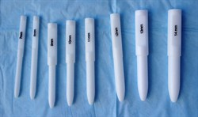
Managements of Anorectal Malformations:
For low lesions with just an anal membrane, serial rectal digital dilations are effective
For higher lesions: 2 stage surgical repair:
a. Temporary colostomy
b. Abdominal pull-through.

Slide 24
5) Children with PYLORIC STENOSIS
(Infantile Hypertrophic Pyloric Stenosis (IHPS),
▪The most common cause of intestinal obstruction in infancy.
▪IHPS occurs secondary to hypertrophy and hyperplasia of muscular layers of the pylorus, causing a functional gastric outlet obstruction.
▪The pyloric canal becomes lengthened, and the whole pylorus becomes thickened

Slide 25
Symptoms and Signs of Pyloric Stenosis
1.Vomiting: It is the first symptom in most children, Occur after every feeding , Starts between 1 week and 5 months of age, Is forceful (projectile vomiting)
2.The infant is hungry after vomiting
3.Abdominal pain
4.Burping
5.Constant hunger
6.Dehydration
7.Failure to gain weight or weight loss

Slide 26
Diagnosis and Tests of Pyloric Stenosis
▪A physical exam:
Infant has a swollen abdomen, abnormal pylorus, which feels like an olive-shaped mass, when touching stomach area.
▪An ultrasound of the abdomen
▪Barium x-ray: reveals a swollen stomach and narrowed pylorus
▪Blood chemistry panel: reveals an electrolyte imbalance

Slide 27
Treatment of Pyloric Stenosis
▪Pyloromyotomy surgery: to split the overdeveloped muscles.
▪Balloon dilation does not work as well as surgery, but may be considered for infants when the risk of general anesthesia is high.
▪Intravenous fluids
Surgery usually provides complete relief of symptoms

Slide 28
6) Children with Hirschsprung’s Disease
Is a congenital condition that affects large intestine (colon) and causes problems with passing stool.
There is missing nerve cells in muscles of baby's colon.
Without these nerve cells stimulating intestine muscles to help move stool through colon, the stool can back up and cause blockages in the bowel.
Usually signs and symptoms appear shortly after birth, but sometimes they're not apparent until later in life. It vary with the severity of the condition.

Slide 29
Signs and symptoms of Hirschsprung's disease
The most obvious sign is a newborn's failure to have a bowel movement within 48 hours after birth.
Swollen belly
Vomiting, including vomiting a green or brown substance
Constipation
Gas
Fatigue
Failure to thrive

Slide 30
Causes Hirschsprung's disease
It's not clear what causes Hirschsprung's disease. Can be associated with a genetic mutation.
Risk factors
Having a sibling who has Hirschsprung's disease. (inherited).
Being male. Hirschsprung's disease is more common in males.
Having other inherited conditions. such as Down syndrome

Slide 31
Diagnosis Hirschsprung's disease
Biopsy of colon tissue to determine whether nerve cells are missing.
Abdominal X-ray using a contrast dye.
Treatment:
Surgery to bypass or remove the part of the colon that's lacking nerve cells.
There are two ways this can be done: abnormal portion of the colon is removed then
a pull-through surgery (normal section is pulled through the colon from the inside and attached to the anus
an ostomy surgery.(healthy portion of the colon is connected to an opening the surgeon creates in the child's abdomen.
Serve high-fiber foods.

Slide 32
7) Children with CELIAC DISEASE Celiac Sprue or Gluten-Sensitive Enteropathy.
Celiac disease is a digestive and autoimmune disease.
It develops when the immune system forms antibodies to gluten, which attack the intestinal lining. This causes inflammation in intestine and damages villi (hair-like structures on the lining of the small intestine). Villi normally allow nutrients from food to be absorbed through the walls of the small intestine into the bloodstream. If villi are damaged, nutrients cannot be absorbed and person will become malnourished.
Gluten is the Protein flour in Wheat , Rye الذرة

Slide 33
Cause of Celiac Disease
Celiac disease follows a multifactorial inheritance pattern (genetic and environmental). It is an autosomal recessive mutation. It is associated with specific genes known as HLA-DQ2 and HLA-DQ8 located on chromosome 6p21. Most of Celiac disease patients (95%) express HLA-DQ2 and the remaining 5% are HLA-DQ8 positive.
Patient must have a genetic predisposition and then, environment stimulus trigger the immune system, which makes the disease active.
Factors that can provoke celiac disease are: Surgery, Severe emotion stress, A viral infection.

Slide 34
Symptoms of Celiac Disease
There may be up to 300 symptoms with Celiac Disease. Most people do not experience all of the symptoms.
Abdominal bloating and pain, Increased gas, Diarrhea, Pale, fatty stools
Weight loss, Growth problems, Failure to thrive,
Severe skin rash,
Iron deficiency anemia,
Muscle cramps, Joint and bone pain, Tingling sensation in legs,
Seizures,
Sores in the mouth.

Slide 35
Diagnostic Tests of Celiac Disease
Blood tests
Check for anti-body levels in the blood Called a “celiac panel”
Endoscopy and biopsy of the small intestine
Symptoms and physical exam

Slide 36
Management of Celiac Disease
No cure or medication
The only treatment for celiac disease is a gluten-free diet
⬥ Don't eat foods that contain wheat, rye; oats and barley شعير or foods and products made from these grains
They can eat plain meat, fish, rice, fruits, and vegetables
Supplements of vitamins, minerals: iron, folate, or vitamin B12, k
Following this diet will stop symptoms, heal existing intestinal damage, and prevent further damage.
Improvement begins within days of starting the diet. Small intestine usually heals in 3 to 6 months in children

Slide 37
8) Children with INTUSSUSCEPTION:
Invagination (انغلاف of one portion of intestine pulled inward into itself (like a sock). It block passage of food through intestine. If the blood supply is cut off, segment of intestine pulled inside can die. The patient can have significant bleeding. If a hole occurs, infection, shock, and dehydration can take place very rapidly.
Commonly occurs in children between 3 months-6 years
The outcome is good with early treatment. There is a risk the condition will come back.

Slide 38
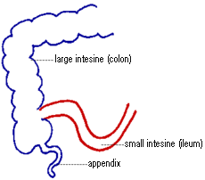
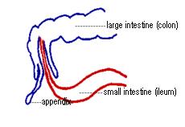

Slide 39
Symptoms and Signs of Intussusception
▪First sign sudden, loud crying caused by abdominal pain.
▪Pain is colicky and intermittent, it increasing in both intensity and duration.
▪An infant may draw the knees to chest while crying.
▪Currant jelly stool: bloody, mucus
▪Fever,
▪Shock (pale color, lethargy, sweating),
▪Vomiting

Slide 40
Causes of Intussusception:
Unknown
Viral infections in some cases.
A lymph node, polyp, or tumor can trigger problem.

Slide 41
Diagnosis of Intussusception
History and physical examination
Barium Enema is therapeutic and curative in most cases with less than 24-hour duration.
Digital rectal exam reveals mucous, blood
Laboratory tests – CBC, Lytes
Abdominal x-ray.

Slide 42
Treatment of Intussusception
✓The child will first be stabilized.
✓Nasogastric tube insertion
✓Intravenous (IV) fluids to prevent dehydration.
The bowel obstruction can be treated with an air or contrast enema performed by a skilled radiologist. There is a risk of bowel tearing (perforation) with this procedure,
It is not used if the bowel has already developed a hole.
✓If these treatments are unsuccessful, the child will need surgery.
✓The bowel tissue can usually be saved, but any dead tissue will be removed.

Slide 43
9) Children with Gastroesophageal reflux disease (GERD)
GERD is a common condition in which the stomach contents move up into the esophagus. Reflux becomes a disease when it causes frequent or severe symptoms or injury. Reflux may damage the esophagus, pharynx or respiratory tract.
Types of GER
Physiologic reflux: often silent with infrequent emesis
Functional reflux: can occur immediately after feeding or a prolonged period of time
Pathologic reflux: reflux that causes detrimental problems; called (GERD)

Slide 44
Cause of GERD
The specific cause of GERD is unknown.
It is thought that compromise to any or all of the barriers (lower esophageal sphincter (LES) muscles fibers, esophageal motility, gastric emptying) leads to GERD.
GERD may be a primary disease or a manifestation of another disorder.

Slide 45
Symptoms od GERD
Coughing and Choking
Apnea and Wheezing
Pneumonitis
Frequent non-bilious emesis suggesting GERD
Weight loss or poor weight gain
Irritability

Slide 46
Laboratory/Radiology of GERD
Abnormal electrolytes can be the first sign of a problem.
A barium swallow may be done to assess esophageal motility
A pH probe study is the best available test for assessing GER. This is performed continuously for a period of 12-24 hours. The patient is fed normally and feedings are recorded during the test. This study measures the number of reflux episodes, the number of episodes lasting more than 5 minutes, and the percentage of time the pH is < 4. When these parameters are above normal, the diagnosis of GERD is confirmed.

Slide 47
Medical Management of GERD
Medications most commonly used to treat GER are H2 blockers such as ranitidine, cimetidine, and famotidine.
Prokinetic drugs such as metoclopramide can be added to improve gastric emptying.
Formulas thickened by manufacturer or the use of rice cereal to thicken the feedings and frequent small volume feedings are the most common interventions.
Generally, one tablespoon of cereal is added to 4-6 ounces of breastmilk or formula.

Slide 48
Nursing Management of GERD
Elevate the head of the bed 30°, especially 30 minutes to 1 hour after feedings.
Slit the nipple to enlarge the hole, if necessary.
Limit seated position to decrease intra-abdominal pressure.
Give medications at appropriate times

Slide 49
10) Children with Diarrhea
An increase in the fluidity, volume and frequency of stools. In infants and children diarrhea can cause dangerous dehydration fairly quickly.
Second most common cause of morbidity and mortality worldwide
Types of Diarrhea
Acute watery diarrhea: (80% of cases)
Dysentery infection (10% of cases)
Persistent diarrhea: (10% of cases)

Slide 50
Kinds of Diarrhea
Acute diarrhea: Short in duration (less than 2 weeks). Due to Gastroenteritis, Systemic infection, Antibiotic association
Chronic diarrhea: 6 weeks or more due to Post infections, Enzyme deficiency, Irritable colon syndrome , Milk protein intolerance

Slide 51
Common Causes of Diarrhea
1-The most common cause of diarrhea is viral gastroenteritis
2-Food poisoning ..
3-Medications, especially antibiotics, laxatives containing magnesium, and chemotherapy for cancer treatment
4-The following medical conditions can also lead to diarrhea:
a) Celiac disease
b) Inflammatory bowel diseases
c) Irritable bowel syndrome (IBS)
d) Malabsorption syndromes such as lactose intolerance

Slide 52
Home Care & Treatment
Drink plenty of fluid to avoid becoming dehydrated. Start with sips of any fluid
Foods like rice, dry toast, and bananas can sometimes help with diarrhea.
Avoid over-the-counter antidiarrhea medications
Get rest.

Slide 53
Treatments
Antibiotics or antiviral medications may be given to very young children or children with weak immune system
In parasitic infection – antiparasitic medicine usually given
Oral rehydration solutions (ORS) : Contain carbohydrate (glucose or rice syrup) and electrolytes (Na, K, Cl, citrate, HCO₃⁻)
Infants and children
Infants with mild dehydration – ORS at home
Infants with moderate – severe dehydration, IV fluids at hospital
Avoid caffeine and lactose containing product

Slide 54
Prevention
Wash hands
Use clean tools eating and preparing the meals.
Cover food or put them in the fridge to prevent contamination.
Teach children to not put objects in their mouth.

Slide 55
Complication
Dehydration
Hypokalemia
Hypocalcemia
Hyponatremia
Hypovolmic shock
Anal irritation

Slide 56
11) Chillaren with DEHYDRATION
Occurs when the body loses more water than is taken in.
It is often accompanied by disturbances in the body's mineral salt or electrolyte balance especially sodium and potassium.
Dehydration can be caused by losing too much fluid, not drinking enough water or fluids, or both.
Vomiting and diarrhea are common causes.
Dehydration is classified as mild, moderate, or severe based on how much of the body's fluid is lost or not replenished.
When severe, dehydration is a life-threatening emergency.

Slide 57
Degree of Dehydration
Factors | Mild Wt loss < 5% | Moderate Wt loss 5-10% | Severe Wt loss >10%
General Condition | Well, alert | Restless, thirsty, irritable | Drowsy, cold extremities, lethargic
Eyes | Normal | Sunken | Very sunken, dry
Anterior fontanelle | Normal | depressed | Very depressed
Tears | Present | Absent | Absent
Mouth + tongue | Moist | Sticky | Dry
Skin turgor | Slightly decrease | Decreased | Very decreased
Pulse (N=110-120 beat/min) | Slightly increase | Rapid, weak | Rapid, sometime impalpable
BP (N=90/60 mm Hg) | Normal | Deceased | Deceased, may be un-recordable
Respiratory rate | Slightly increased | Increased | Deep, rapid
Urine output | Normal | Reduced | Markedly reduced

Slide 58
DEHYDRATION
Children more vulnerable to dehydration because :
1-Children have greater need for water
2-Body surface area greater
3-Basal metabolic rate is high
4-Kidney function is immature

Slide 59
Types of dehydration :
Isonatremic volume depletion (Isotonic)
Hyponatremic volume depletion(Hypotonic)
Hypernatremic volume depletion(Hypertonic)

Slide 60
Types of dehydration
1-Isotonic Dehydration
Is characterized by isotonic loss of both water and solutes from the extracellular fluid, that is when both water and sodium are lost in equivalent amounts,
This type of dehydration more in young children.
e.g. through vomiting, diarrhea or through inadequate intake.
Notes:
Si hay más de un problema, duplique esta diapositiva tantas veces como sea necesario.
Ésta y las diapositivas relacionadas se pueden colocar en el apéndice u ocultarlas si fuera necesario.

Slide 61
Types of dehydration
2-Hypotonic Dehydration
In hypotonic dehydration more sodium lost than water
It is characterized by an osmotic shift of fluid from the extracellular area to the intracellular.
It also occurs with excessive intakes of plain water or other liquids with little or no sodium content. e.g. in some instances of high sweat or gastro-intestinal water losses or when water and electrolyte deficits are treated with water replacement only,
This complication can be life-threatening if swelling causes pressure on the brain (cerebral edema).
This is called hyponatremia.
Notes:
Si hay más de un problema, duplique esta diapositiva tantas veces como sea necesario.
Ésta y las diapositivas relacionadas se pueden colocar en el apéndice u ocultarlas si fuera necesario.

Slide 62
Types of dehydration
3-Hypertonic Dehydration
In hypertonic dehydration water loss exceeds salt loss, that is when more water than sodium is lost (e.g. through inadequate water intake, excessive sweating, osmotic diuresis and diuretic drugs).
This is characterized by an osmotic shift of water from the intracellular fluid to the extracellular fluid.
This type of dehydration is more common in people who have diabetes

Slide 63
Types of Dehydration
 | Isotonic (isonatremic) | Hypertonic (hypernatremic) | Hypotonic (hyponatremic)
Loses | H₂O = Na | H₂O > Na | H₂O < Na
Plasma osmolality | Normal | Increase | Decrease
Serum Na | Normal | Increase | Decrease
ECV ICV | Decrease maintained | Decrease Decrease +++ | Decrease +++ Increase
Thirst | ++ | +++ | +/-
Skin turgor | ++ | Not lost | +++
Mental state | Irritable/lethargic | Very irritable | Lethargy/coma
shock | In severe cases | Uncommon | Common

Slide 64
Dehydration Causes an Electrolyte Imbalance.
Dehydration produces a higher amount of sodium and a lower amount of potassium.
A very high sodium level can cause confusion, paralysis, coma, and seizures. Although there is not an immediate problem, extended time with low potassium levels may produce less insulin, which may increase the amount of sugar in the body.
If the potassium level becomes very low, fatigue, confusion, and muscle weakness and cramps typically occur.
A very low potassium level can cause paralysis and abnormal heart rhythms (arrhythmias).

Slide 65
Clinical Manifestation Dehydration
Dry, sticky mouth
Absent tears and salivation :
Sunken eyes
Lack urine
Cool, gray colour with poor turgor of skin
Fatigue, dizziness, Lethargic, irritable, comatose
Anterior fontanelle markedly depressed
Hypotension
Weak pulsation.
Respiratory deep, rapid .

Slide 66
Diagnosis & Tests
A physical examination
Tests include: Blood chemistries, Urine specific gravity (a high specific gravity indicates significant dehydration), BUN , Creatinine ,Complete blood count

Slide 67
Management
Oral Rehydration Solution (ORS): compose of Sodium Chloride, Tri-Sodium Citrate (bicarbonate), Potassium Chloride Glucose
Effective in all types & all degrees of dehydration.
Can prevent dehydration if given early in the disease.
Cheap, easy to administer; can be given by mother at home.
No chance of over-hydration or electrolyte overdose.
Methods of administration: spoon, cup, dropper, syringe, naso-gastric tube or iv.

Slide 68
12) Children with CONSTIPATION
Delay or difficulty in defecation, present for two or more weeks, sufficient to cause significant distress to the patient.
The normal frequency of bowel movements at different ages
Infants 4 stools per day during the first week of life.
2 years of age average of 2 stools per day at and
4 years of age1.2 stools per day
After 4 years, frequency of bowel movements remains unchanged

Slide 69
Constipation causes :
1. Underlying disease,
Anatomic: Congenital anorectal malformation (Anal stenosis, Imperforate)
Abnormal musculature: Down syndrome
Cystic fibrosis
Cow’s milk protein intolerance
2. Diet low fiber high milk
3. Psychological factors
4. Medication
5. Major change in the child daily routine

Slide 70
Symptoms
Difficulty in evacuation
Hard, Sticky, Bad odour faeces
Gastric distension
Burping and Indigestion
Headache, epigastric legs, heal, neck , shoulder, low back pain
Nausea, Vomiting
Pain in the
Drowsiness, Lazy feeling
Lack of appetite

Slide 71
Diagnostic tests
History and physical exam
Abdominal radiology
Rectal exam should be avoided in children as much as possible

Slide 72
Medical Management Of Constipation
Fiber, fluids, and stool softeners
Usually involves 2 stages (for severe constipation)
1-Soften stool (Lactulose) ,Colace
2-Evacuate stool (laxative) sorbitol, Polyethylene glycol, Dulcolax, Senna
Enemas
DO NOT give laxatives or enemas to children without doctor order

Slide 73
Prevention
Avoiding constipation altogether is easier than treating it, but involves the same lifestyle measures:
Eat lots of fiber.
Drink plenty of fluids each day (at least 8 glasses of water per day).
Exercise regularly.
Go to the bathroom when there is urge.

Slide 74
13) Children with APPENDICITIS
Is an inflammation of appendix. Occurs most often in adolescent males (10-19yr). Rare in children under 2 years
Caused when the opening from the appendix into the cecum becomes blocked. The blockage may be due to a build-up of thick mucus within the appendix or to stool that enters the appendix from the cecum.
As edema continues, vascular supply is compromised, bacteria followed by an immune response…can lead to rupture.

Slide 75
Signs and symptoms Appendicitis
Pain on the umbilical area and throughout the abdomen then become localized at right lower quadrant (RLQ) specifically at mcburney’s point
Nausea, vomiting
Direct tenderness and rebound tenderness in the RLQ
Abdominal muscle rigidity
WBC, neutrophil count above 75%
Fever, temp= 38-38.5, pr
Rigidity of the whole abdomen may indicate rupture and peritonitis

Slide 76
Appendicitis Diagnosis
History and Physical Exam
Abdominal CT or ultrasound
Labs: CBC: elevation of white blood cells.

Slide 77
Appendicitis Managements
Surgery Appendectomy
as soon as possible to prevent rupture with subsequent peritonitis
Antibiotics

