Slide 1
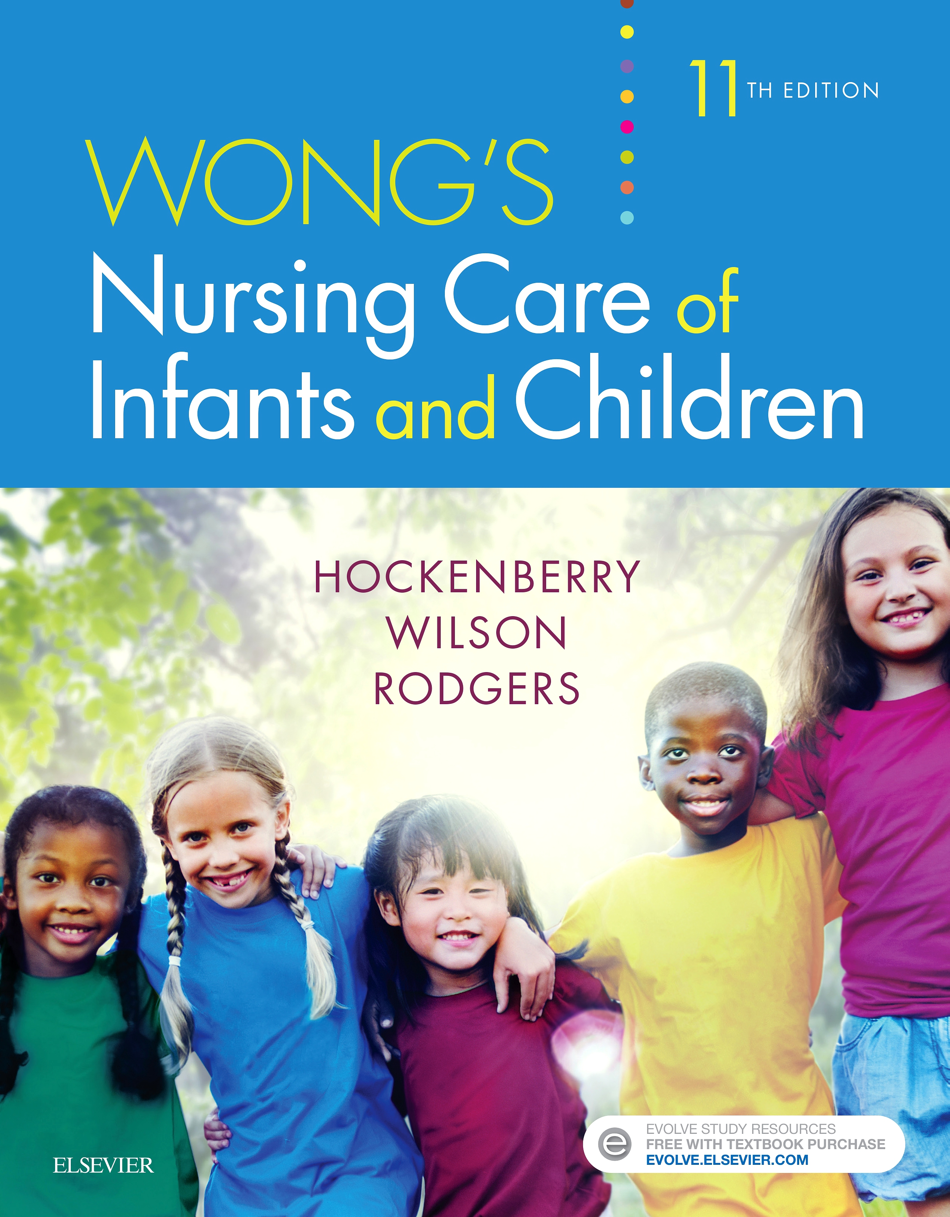
Pediatric
and New born Nursing
Unit 13
Care of the Child with Hematological Problems

Slide 2
1) Children with IRON DEFICIENCY ANEMIA
Iron is necessary for oxygen transport by Hb.
Common in children from 6 months to 2 years, and teenage
Total body iron content is decreased below a normal level.
Initially iron stores are depleted but the RBC is normal
When all iron stores decrease, Hb synthesis decrease with gradual fall of RBC production by bone marrow.
The new RBCs are smaller and paler lead to decrease tissue oxygenation.

Slide 3
Causes Iron Deficiency Anemia
Decrease dietary intake of iron
Excessive cow’s milk consumption
Decrease iron absorption
Blood loss
Long duration of breast feeding
Increased juice, soda pop intake

Slide 4
Signs and symptoms of Iron Deficiency Anemia
a. Pallor of skin
b. Irritability, fatigue, lethargy,
c. Tachycardia,
d. Pale conjunctiva, nail beds and skin color
e. Dyspnea tachypnea, short of breath,
f. Headache,
g. Hypotension
h. Dizziness

Slide 5
Diagnostic tests of Iron Deficiency Anemia
History and physical History: bleeding disorders, trauma or Surgeries
CBC
Bone marrow aspiration to rule out oncology
Ferritin level

Slide 6
Treatment of Iron Deficiency Anemia
⬧ Iron supplement as ferrous sulfate 5-6mg/kg/day orally for 6 months.
It will increase Hb 1.0g/dl in 3-4 weeks.
⬧ Should be given with vitamin C to absorb better the iron.
⬧ Shouldn't take iron with antacids

Slide 7
2) Children with Thalassemia
Most common in Mediterranean (Greece; Italy),
It is an inherited blood disorder characterized by reduced or absent synthesis of either Alpha or Beta goblin chains of Hb.
Forms of Thalassemia:
1- Alpha-thalassemia
2- Beta-thalassemia

Slide 8
1- Alpha-thalassemia
Gene deletions on chromosome 16
Four genes are involved in making the alpha hemoglobin chain.
Person gets two from each of parents.
When person inherit:
a. Carrier: one mutated gene and no signs or symptoms of thalassemia.
b. Alpha-thalassemia trait: two mutated genes with mild thalassemia signs and symptoms.
c. Three mutated genes will have moderate to severe signs and symptoms.
d. Inheriting four mutated genes is rare. Babies born with this condition often die shortly after birth or require lifelong transfusion therapy and a stem cell transplant.

Slide 9
2- Beta-thalassemia
▪Point mutations on chromosome 11
▪Two genes are involved in making the beta hemoglobin chain.
▪Person gets one from each parent.
▪If person inherit:
Beta-thalassemia minor: one mutated gene with mild signs and symptoms.
Beta-thalassemia major, or Cooley anemia: two mutated genes with moderate to severe signs and symptoms. Babies born with two defective beta hemoglobin genes usually are healthy at birth but develop signs and symptoms within the first two years of life.

Slide 10
Symptoms and Signs of Thalassemia
➢Depend on the type and severity of condition.
➢Persons with the minor form of thalassemia have small red blood cells (which are identified by looking at their red blood cells under a microscope), but no symptoms.
Fatigue and Weakness
Pale or yellowish skin
Facial bone deformities
Slow growth
Abdominal swelling
Dark urine
Stillbirth
Shortness of breath
Hepato-splenomegaly due to RBC destruction and attempts at production of RBCs in these organs

Slide 11
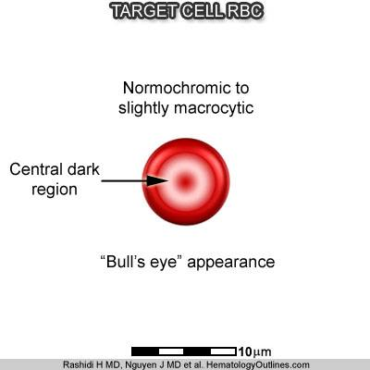
Diagnostic Findings of Thalassemia
CBC
Peripheral blood
smear: RBCs have a “bull’s eye” appearance
3. Prenatal diagnosis: DNA study of fetal cells

Slide 12
Treatment of Thalassemia
Mild thalassemia trait don't need treatment.
Moderate to severe thalassemia, treatments might include:
Regular packed RBC transfusions
Iron chelation therapy with Deferoxamine
Splenectomy when transfusion requirements very excessive, so RBC no longer destroyed in spleen.
4. Frequent monitoring of cardiac function
5. Folic acid supplementation
7. Bone marrow or stem cell transplantation only chance for cure 90%

Slide 13
Prognosis of Thalassemia
1. Survival significantly shortened, but at least into 3rd decade if transfusion therapy performed with iron chelation
2. Bone marrow or stem cell transplant only chance for cure

Slide 14
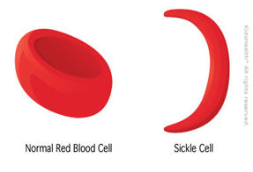
3)Children with SICKLE CELL ANEMIA
⬥ Red blood cells are small cells, circular and flattened with depressed centers on both sides resembling to that of a doughnut when viewed under a microscope.
▪Sickle cell anemia is an inherited disorder on the beta chain of the hemoglobin resulting to abnormally shaped red blood cells.
▪RBC’s assume a crescent or C-shape that decreases the cell’s life span and ability to function which produce various complications.
▪In some cases, these sickled cells may block the flow causing pain and organ damage ( vaso- occlusive crises)
▪ Sickled cell’s lifespan is only 20 days.

Slide 15
Sickle Cell Anemia
The deformed erythrocytes rupture easily and they tend to be trapped in the microcirculation, obstructing blood flow and oxygen transport that might lead to painful episodes of ischemic injury.

Slide 16
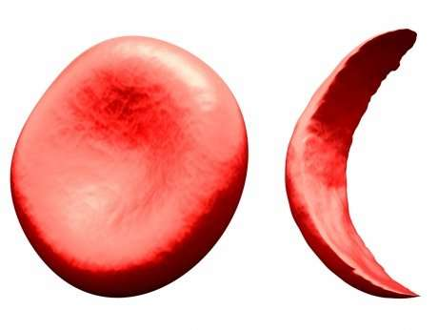
Sickle Cell Crisis
An episodes of acute and severe sickling that blocks the circulation posing a threat of extensive organ damage.
Severe pain is noted during these incidents caused by occluded vessels in the bone possibly resulting to bone necrosis.
The crisis is triggered by hypoxemia, acidosis, dehydration, infection, vigorous exercise, pregnancy or cold weather.

Slide 17

Sickle Cell Trait
▪ It is presence of a single defective gene, instead of two.
▪Individuals with this trait are essentially normal however, they are carriers.
Meaning two sickle cell trait carrier parents can contribute a defective gene to a child that will carry the sickle cell disorder.

Slide 18
Diagnosis of Sickle Cell Anemia
✓Prenatal: Chorionic Villi sampling, Amniocentesis (blood from the cord)
✓At birth: Newborn Screening, Hemoglobin electrophoresis

Slide 19
Signs and Symptoms of Sickle Cell Anemia
S&S observed at 6 months of age (because fetal hemoglobin contains gamma, not a beta chain
Fever
Anemia
Swelling of the hands and feet caused by blood stasis and infarction
Protruding abdomen due to enlarged spleen and liver
Icteric sclera caused by bilirubin release during hemolysis

Slide 20
Management of Sickle Cell Anemia
➢Pain relief with Acetaminophen (Tylenol) or IV of morphine
➢IV fluids and electrolyte
➢Oxygenation
➢Antibiotics.
➢Blood transfusion with packed RBC’s
➢Hydroxyurea antineoplastic agent increases production of fetal hemoglobin in children
➢Exchange transfusion replacing sickled with normal cells
➢Stem cell transplantation

Slide 21
4) Children with GLUCOSE-6-PHOSPHATE DEHYDROGENASE DEFICIENCY (G6PD)
▪It is enzyme deficiency.
▪G6PD enzyme is located on sex chromosome X at q28 locus.
▪Males are more likely to have defective gene than females do because G6PD deficiency will only manifest itself in females when there are two defective copies of the gene in the genome.
▪As long as there is one normal G6PD gene in a female, a normal enzyme will be produced and function instead of the defective enzyme.

Slide 22
Clinical manifestation of G6PD Deficiency
▪ Hemolytic Anemia: G6PD deficiency causes red blood cells early destruction
▪ Neonatal jaundice
▪ Abdominal, back pain,
▪ Dizziness,
▪ Headache,
▪ Irregular breathing,
▪ Palpitations.

Slide 23
Clinical manifestation of G6PD Deficiency
▪ An anemic response can occur when G6PD deficient individual takes oxidative drugs (acetylsaliclic acid) antipyretics, sulfonamides, aspirin or Fava beans.
▪ Some G6PD patients are allergic to Fava beans and smell of Fava pollen. This condition is called Favism.

Slide 24
Diagnosis of G6PD Deficiency
A new-born child:
▪ Complete Blood Count
▪ Newborn Screening Test is used to test and measure G6PD enzyme’s activity.

Slide 25
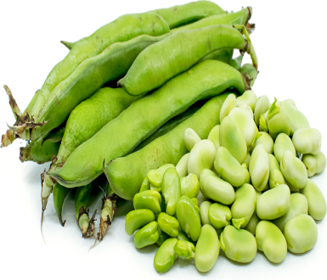
Treatment of G6PD Deficiency
▪ The best treatment now to prevent Favism and hemolytic anemia is to have drug control.
▪ G6PD deficient people should not eat fava beans or take drugs that contain oxidizing agent.

Slide 26
5) Children with IDIOPATHIC THROMBOCYTOPENIC PURPURA (ITP)
ITP increase destruction of platelets by circulating anti-platelets antibody.
Peak age: 2-5 years.
Classification of ITP
a. Acute: remission in less than 6 months
b. Chronic: remission more than 6 months
Causes of Thrombocytopenia
Viral illness ( varicella, mumps, rubella, Mono) 65%
Immune mechanism- autoantibodies to foreign antigen

Slide 27
Signs and symptoms of Thrombocytopenia
Bruises, urine/stool blood, epistaxis, gum bleeding
Recent immunizations (MMR).
Drug history affecting platelets: ASA, heparin, seizure meds.
Clusters of Petecchia,
Purpura in the oropharynx, dry blood or clots in the nares

Slide 28
Diagnosis of Thrombocytopenia
⬧ CBC : Thrombocytopenia
⬧ PT/PTT
⬧ Bleeding Time: prolonged
⬧ Peripheral Smear:
⬧ Bone Marrow:
⬧ Only if treating with Steroids and exclude leukemia
⬧ Fundoscopic (eye) exam is important

Slide 29
Treatment of Thrombocytopenia
- IV Corticoids. Then oral steroids 2 mg/d for 2-4 weeks
- IV Immunoglobulin (IVIG): 1g/kg/day

Slide 30
6) Children with HEMOPHILIA
Commonest inherited bleeding disorder
Bleeding due to deficiency of coagulation Factors VIII (8), IX (9), XI (11)
Severity of bleeding is related to FVIII / IX /XI concentration level in blood
Hemophilia lead to tissue injury because of delayed composition of platelet plug and fibrin clot causing prolonged bleeding
Types of Haemophilia
Haemophilia A Deficiency of Factor VIII(8)
Haemophilia B Deficiency of Factor IX (9)
Haemophilia C Deficiency of Factor XI (11)

Slide 31
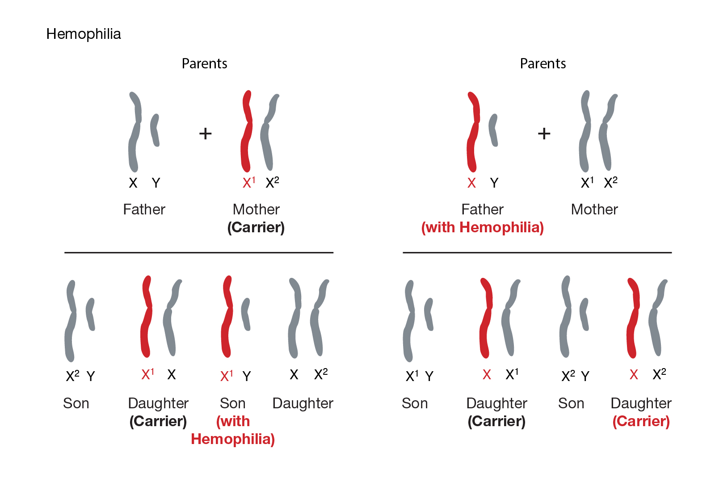
Mode of Inheritance it is a X- linked recessive

Slide 32
Severity of Haemophilia:
Severity | Factor level iu/dl (%) | Type of presentation
Severe | < 1 | Spontaneous bleeds, Severe bleeding
Moderate | 1-5 | Few bleeds, Haemathrosis - traumatic
Mild | 5-30 | Few bleeds, Post-traumatic Post-dental surgery

Slide 33
Signs and Symptoms of Haemophilia
a.) In Babies
✓ Bleeding as a baby rare
✓ Prolonged bleed from umbilical cord
✓ Muscle hematoma during immunization
✓ Bleeding during circumcision
b.) In Toddlers
✓Large and prolonged bleed to minor injury/cuts/abrasions
✓Lip bleeds (hematomas)
✓First bleeding in childhood
✓Tooth extraction
✓Trauma with walking
✓Gum bleeds while brushing teeth

Slide 34
Signs and Symptoms of Haemophilia
c.) Significant hemorrhages:
✓ Retroperitoneal causing severe abdominal pain, anemia and shock
✓ Hematuria
✓ GI bleed
✓ Intracranial: extradural, subdural, intracerebral
✓ Headache, vomiting, coma
d.) Hemarthrosis (joint bleed): hallmark of hemophilia
✓ Joints affected:
✓ In toddlers: ankle (most common)
✓ Older child: knee, elbow
✓ Later: all joints

Slide 35
Signs and Symptoms of Haemophilia
e.) Chronic Haemophilic Arthropathy:
✓ Repeated bleeds for many years lead to chronic degenerative changes, deformities, Crippling deformities and Wheel chair-bound

Slide 36
Diagnosis of Haemophilia
▪ Hb low
▪ Activated Partial Thromboplastin Time (APTT) prolonged > 2-3 times (normal 70/ 30 to 40 seconds)
▪ Low levels of clotting factors
▪ Genetic analysis
▪ Radiographs of joints
▪ USG joints for effusions
▪ MRI joints/ abdomen
▪ Head computerized tomography (CT)

Slide 37
Management of Haemophilia:
Control bleeding episodes: replacement therapy
Replacement therapy:
Fresh whole blood, FFP: contains F VIII and IX, Cryoprecipitate
Factor concentrates: Recombinant/ porcine factor VIII FIX
Prophylaxis and prevention
Life style modifications
Treatment of complications
Rehabilitation
Antenatal diagnosis and counseling

Slide 38
Prevention:
⬥ Immunization: SC not IM
⬥ Avoid IM injections- apply pressure 5 minutes
⬥ Avoid contact sports
⬥ Orthopaedic care- traction, splinting, reconstructive surgery
⬥ Regular dental exam and hygiene
⬥ Prophylactic immunization- Hep B

