Slide 1

Pediatric
and New born Nursing
Unit 14 Children with Urinary Tract Disorders

Slide 2
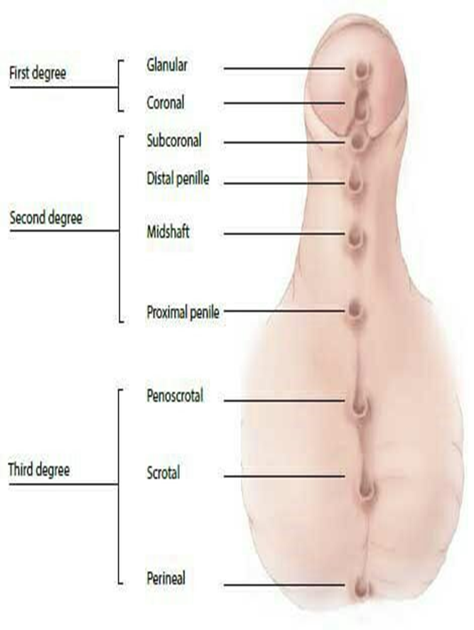
1) Children with Hypospadias:
The opening (urethral meatus) of urethra in males is located below the normal location
It caused by incomplete development of the urethra in utero between 8 and 20 weeks of gestation
Various degrees of hypospadias result in an opening located anywhere along the length of the urethra.

Slide 3
Risk Factors and Causes of Hypospadias
The cause is unknown. It may be:
Genetic,
Endocrinological,
Environmental factors.
Associations: with :
Undescended testes
Urinary tract anomalies

Slide 4
Management of Hypospadias:
Avoid circumcision
Repair of the foreskin, surgery
Without surgical correction, severe hypospadias may result in the inability to urinate and infertility.

Slide 5
2) Children with Vesico-ureteral Reflux (VUR)
Urine normally travels from the kidneys via the ureters to the bladder
In vesicoureteral reflux the direction of urine flow is reversed (retrograde), from the bladder into ureters or kidneys.
Younger children are more prone to VUR because of the relative shortness of the submucosal ureters. This susceptibility decreases with age as length of ureters increases as children grow.

Slide 6
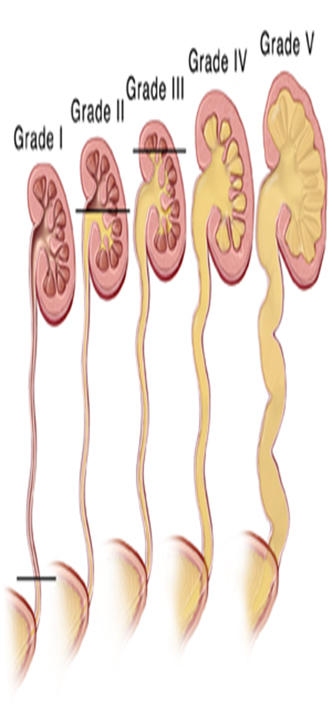
Signs and Symptoms of Vesicoureteral Reflux
In fetus
➢ Prenatal hydronephrosis: an abnormal widening of the ureter
➢ Acute pyelonephritis
In newborns:
➢ Lethargy
➢ Faltering growth,
In infants and young children:
➢ Pyrexia,
➢ Dysuria,
➢ Frequent urination,
➢ Malodorous urine

Slide 7
Treatment of Vesicoureteral Reflux
▪ Prevention of urinary tract infection
▪ Perineal hygiene :Wipe front to back.
▪ Avoid tight clothing
▪ Wear cotton underwear's
▪ Avoid holding urine
▪ Encourage generous fluid intake
▪ Antibiotic
▪ Surgical

Slide 8
3) Children with URINARY TRACT INFECTION (UTI)
▪UTI is a bacterial infection of the urinary tract.
▪UTI are common in children for both anatomic and hygienic reasons.
▪UTI affects all age groups.
▪Males predominate in the newborn period, beyond this age, females predominate

Slide 9
Categories of Acute Urinary Tract Infection
a. Lower Tract Infection: Urethritis and Cystitis.
b. Upper Tract Infection: Acute Pyelonephritis, Prostatitis

Slide 10
Acute Urinary Tract Infection
The invading organism ascends the urinary tract, irritating the mucosa and causing characteristic symptoms
Causative Organisms of UTI:
Escerichia coli (54.7%),
Enterobacter,
Pseudomonas
Serratia

Slide 11
Symptoms and Signs of UTI
Asymptomatic
Fever, Chills with shaking
Poor appetite, Nausea and vomiting,
Foul odor, Cloudy, Bloody urine
Frequent or urgent need to urinate, Pain or burning with urination
Malaise
Wetting problems after child been toilet trained
Pain in the side (flank) or back

Slide 12
Investigations of UTI
❖ Blood Urea, Creatinine
❖ Urine analysis and culture
❖ Radiological Evaluation
❖ Intravenous Pyelography (IVP): show renal size, renal scars
❖ VCUG (voiding cystourethrogram)
❖ Vesicoureteral Reflux VUR
❖ Ultrasound of the kidney and urinary bladder

Slide 13
Treatment of UTI
Antibiotics
Conservative treatment :
Increased oral fluids intake.
Regular and complete bladder emptying.
Good personal hygiene

Slide 14
4) Children with GLOMERULONEPHRITIS (GN)
Inflammation and proliferation of cells and capillaries within the renal glomerulus which may occur as primary condition or associated with a systemic disorder.
The majority of cases caused by an immune response that is triggered by: an infection such as streptococcal, pharyngitis 1-2 weeks before, staphylococci, salmonella , Or other disease such as SLE, malaria, diabetes mellitus
Complete recovery occurs in more than 95% of cases, second attacks are rare.
Renal function usually returns to normal within 10-14 days
GN is most common in children aged 5-12 years, GN uncommon before age of 3 years.

Slide 15
Signs and Symptoms of Glomerulonephritis
✓Asymptomatic
✓Hematuria, Proteinuria,
✓Hypertension,
✓Edema, Puffy face
✓Azotemia (abnormally high levels of nitrogen-containing compounds, e,g urea, creatinine ).
✓Abdominal or flank pain,
✓Fever.
✓Malaise, lethargy,

Slide 16
Investigations of Glomerulonephritis
➢ Urinalysis
➢ Blood urea and creatinine are elevated
➢ Electrolytes : high K, phosphate low Ca, acidosis.
➢ Recent streptococcal infection. Throat swab, Antistreptolysin O (ASO) titer

Slide 17
Management: of Glomerulonephritis
▪ Daily weight, BP, and fluid balance
▪ Salt and fluid restriction
▪ Diuretics
▪ Antihypertensive
▪ 10 day course of penicillin
▪ Dialysis may be needed.

Slide 18
Complications of Glomerulonephritis
❖ Congestive heart failure
❖ Pulmonary edema
❖ Chronic glomerulonephritis
❖ Nephrotic syndrome
❖ Acute renal failure

Slide 19
5) Children with NEPHROTIC SYNDROME
Inflammatory reaction, derangement in capillary walls of glomeruli
Increase permeability to plasma protein, allows protein to escape from plasma into glomerular filtrate, proteinuria, drop in plasma colloid osmotic pressure, fluid escapes into tissues lead to edema

Slide 20
Clinical Manifestation of Nephrotic Syndrome
Massive proteinuria
Hypoalbuminemia, Hyperlipidemia
Generalized edema, genitalia, leg, ankle edema, weight gain, periorbital edema (earliest sign)
Ascites, Pleural effusion
Malaise
Diarrhea

Slide 21
Classification of Nephrotic Syndrome
1- Congenital present during the first 6 months life
2-Primary/ Idiopathic
3-Secondary: complication of:
-Diseases: DM, SLE,
-Ingestion of drugs (lithium, heroin),
Infections (malaria, syphilis, hepatitis B,
Malignancy ( carcinoma, melanoma)

Slide 22
Investigation of Nephrotic Syndrome
✓ Urine for protein, creatinine
✓ Blood ESR
✓ KFT: urea, electrolyte, creatinine
✓ Serum cholesterol,
✓ LFT - albumin
✓ Antistreptolysin O titre
✓ Throat swab,
✓ Serum C3 complement level(protein)

Slide 23
Investigation of Nephrotic Syndrome
✓ Imaging Studies:
✓ Ultrasound,
✓ Void cysturethrogram (VCUG)
✓ IV pyelogram ,
✓ Magnetic resonance imaging (MRI)
✓ computed tomography (CT or CAT)
✓ Renal biopsy: only indicated if a child does not respond to the prednisolone therapy within 4 weeks.

Slide 24
Management of Nephrotic Syndrome
a. Bed rest
b. Diet: adequate calories, normal protein diet with salt restriction
c. Antibiotic: penicillin
d. Fluid
e. Diuretic therapy: Human albumin 25% with IV diuretic (Furosemide)
f. Corticosteroid Therapy; Prednisolone
g. Cyclophosphamide therapy(chemotherapy): indicated for child who show signs of steroid toxicity

