Slide 1

Gynecology and
Maternity Nursing

Slide 2
Unit 3 Assessment and Caring of intrauterine Fetus and Maternal Women Well-beings
Conception, fertilization, implantation.
Embryonic and fetal development

Slide 3
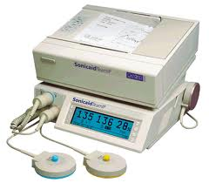
Introduction
-During antenatal period, both maternal and fetal growth must be continually monitored.
-Individualized care will improve the accuracy of antenatal observations.
-The condition of fetus before delivery is assessed by:
*Documenting fetal growth.
*Recording fetal movements.

Slide 4
Fetal Growth Assessment Methods
1-Measure the size of uterus on abdominal examination.
2-Palpate fetal head and body on abdominal examination.
3-Measure the size of fetus using antenatal ultrasonography (ultrasound).
If the assessed fetal weight is within the expected range for the duration of pregnancy, then the fetal growth is regarded as normal.

Slide 5
Fetal movements
-It indicate that the fetus is well.
-The fetal movements first felt:
a. At about 20 weeks in a Primigravida.
b. At about 16 weeks in a Multigravida.

Slide 6
Pregnancy/ Gestation
Length of time from conception (fertilization followed by implantation) to birth is about nine months (266 days)

Slide 7
Human Development Divided Into Two Parts
Embryonic development (months 1 and 2) :
Major organs are formed
b Fetal development (months 3-9):
Structures are refined

Slide 8
Extraembryonic Membranes
The membranous structures which surround the embryo during its developmental period.
They function are protection, nutrition, respiration, and excretion of embryo

Slide 9
Extraembryonic Membranes
1-Allantois:
A membranous sac that develops from the posterior part of the alimentary canal in the embryos.
It is important in the formation of the umbilical cord and placenta.
2-Amnion:
A thin, tough, membranous sac that encloses the embryo.
It is filled with a serous fluid in which the embryo is suspended keep from falling, sinking) .

Slide 10
Extraembryonic Membranes
3-Chorion:
The outer membrane enclosing the embryo.
It contributes to the development of the placenta.
4-Yolk sac:
A membranous sac attached to an embryo,
Providing early nourishment and functioning as the circulatory system of the human embryo before internal circulation begins.

Slide 11
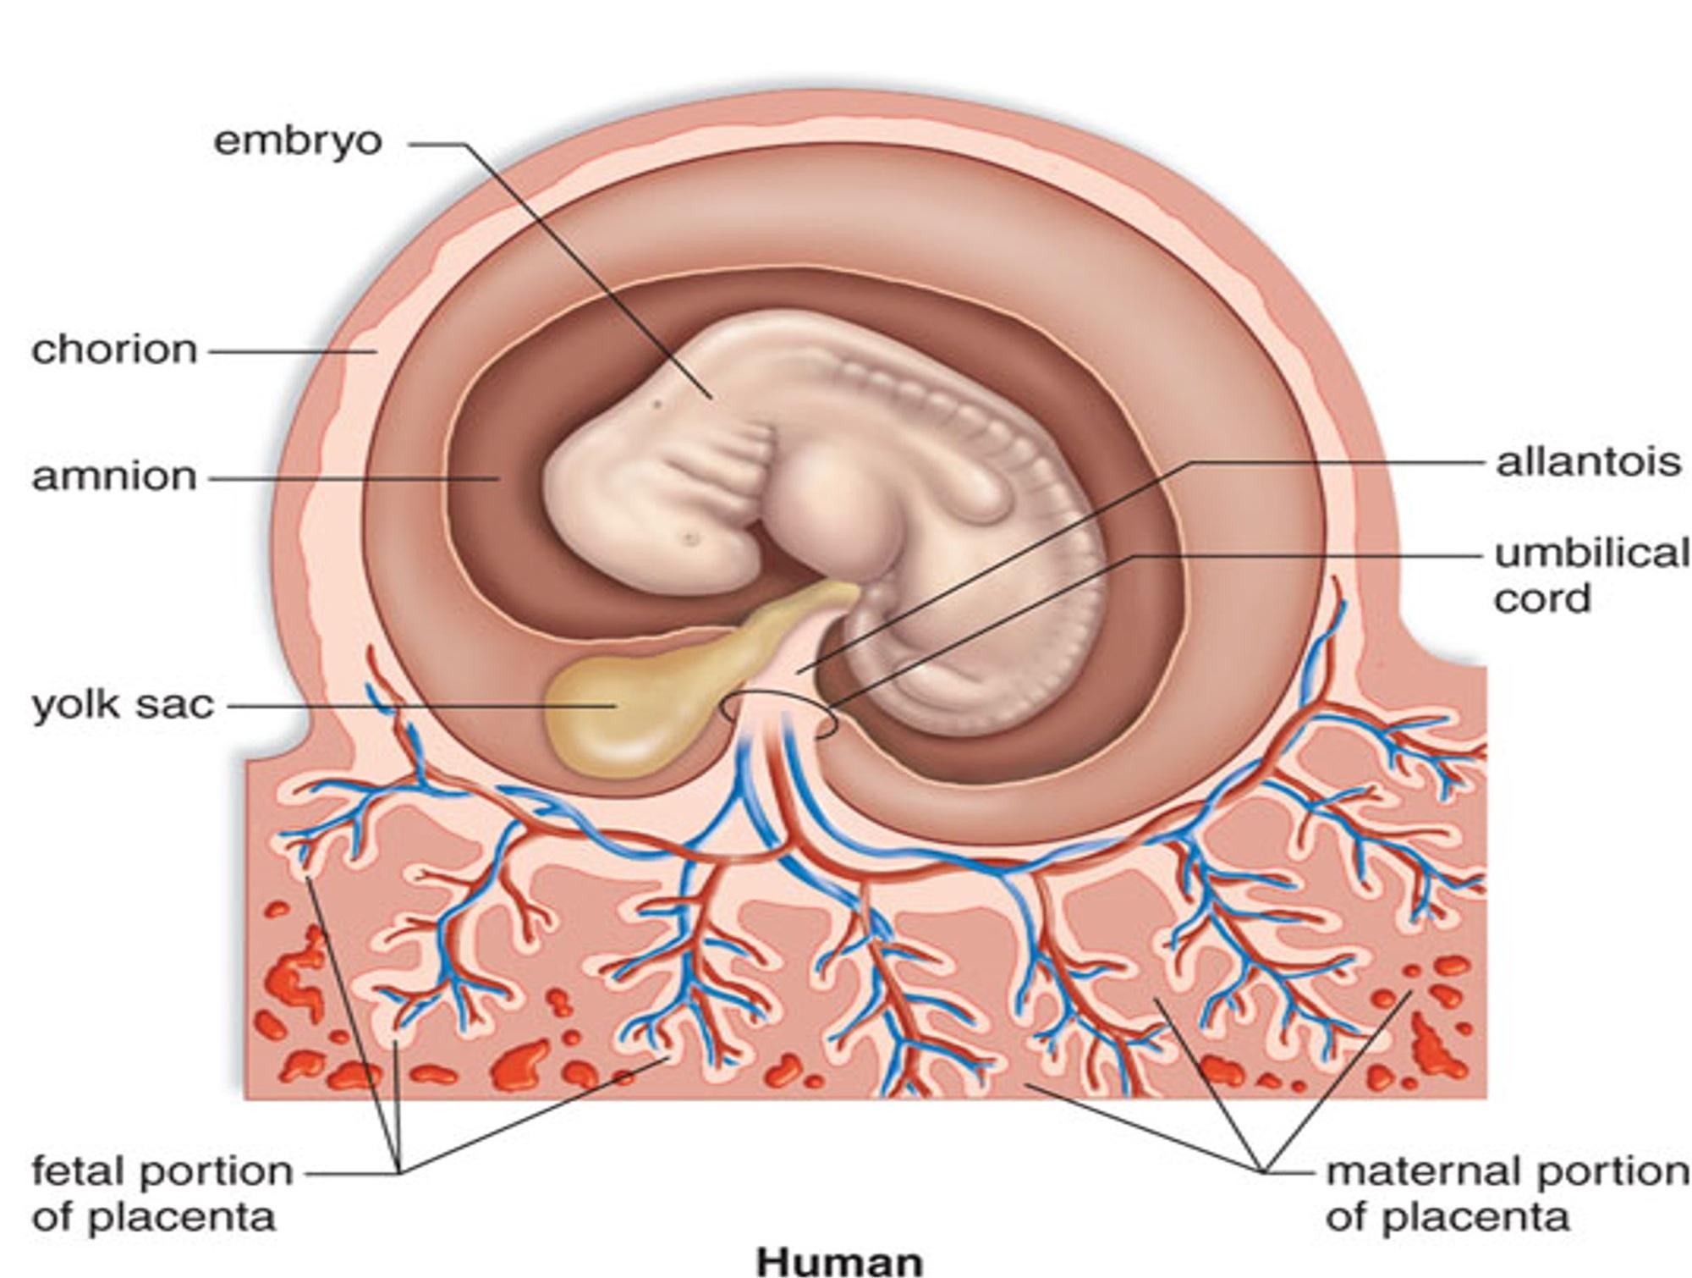
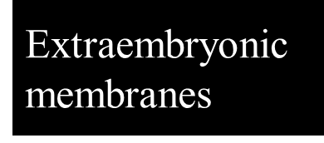

Slide 12
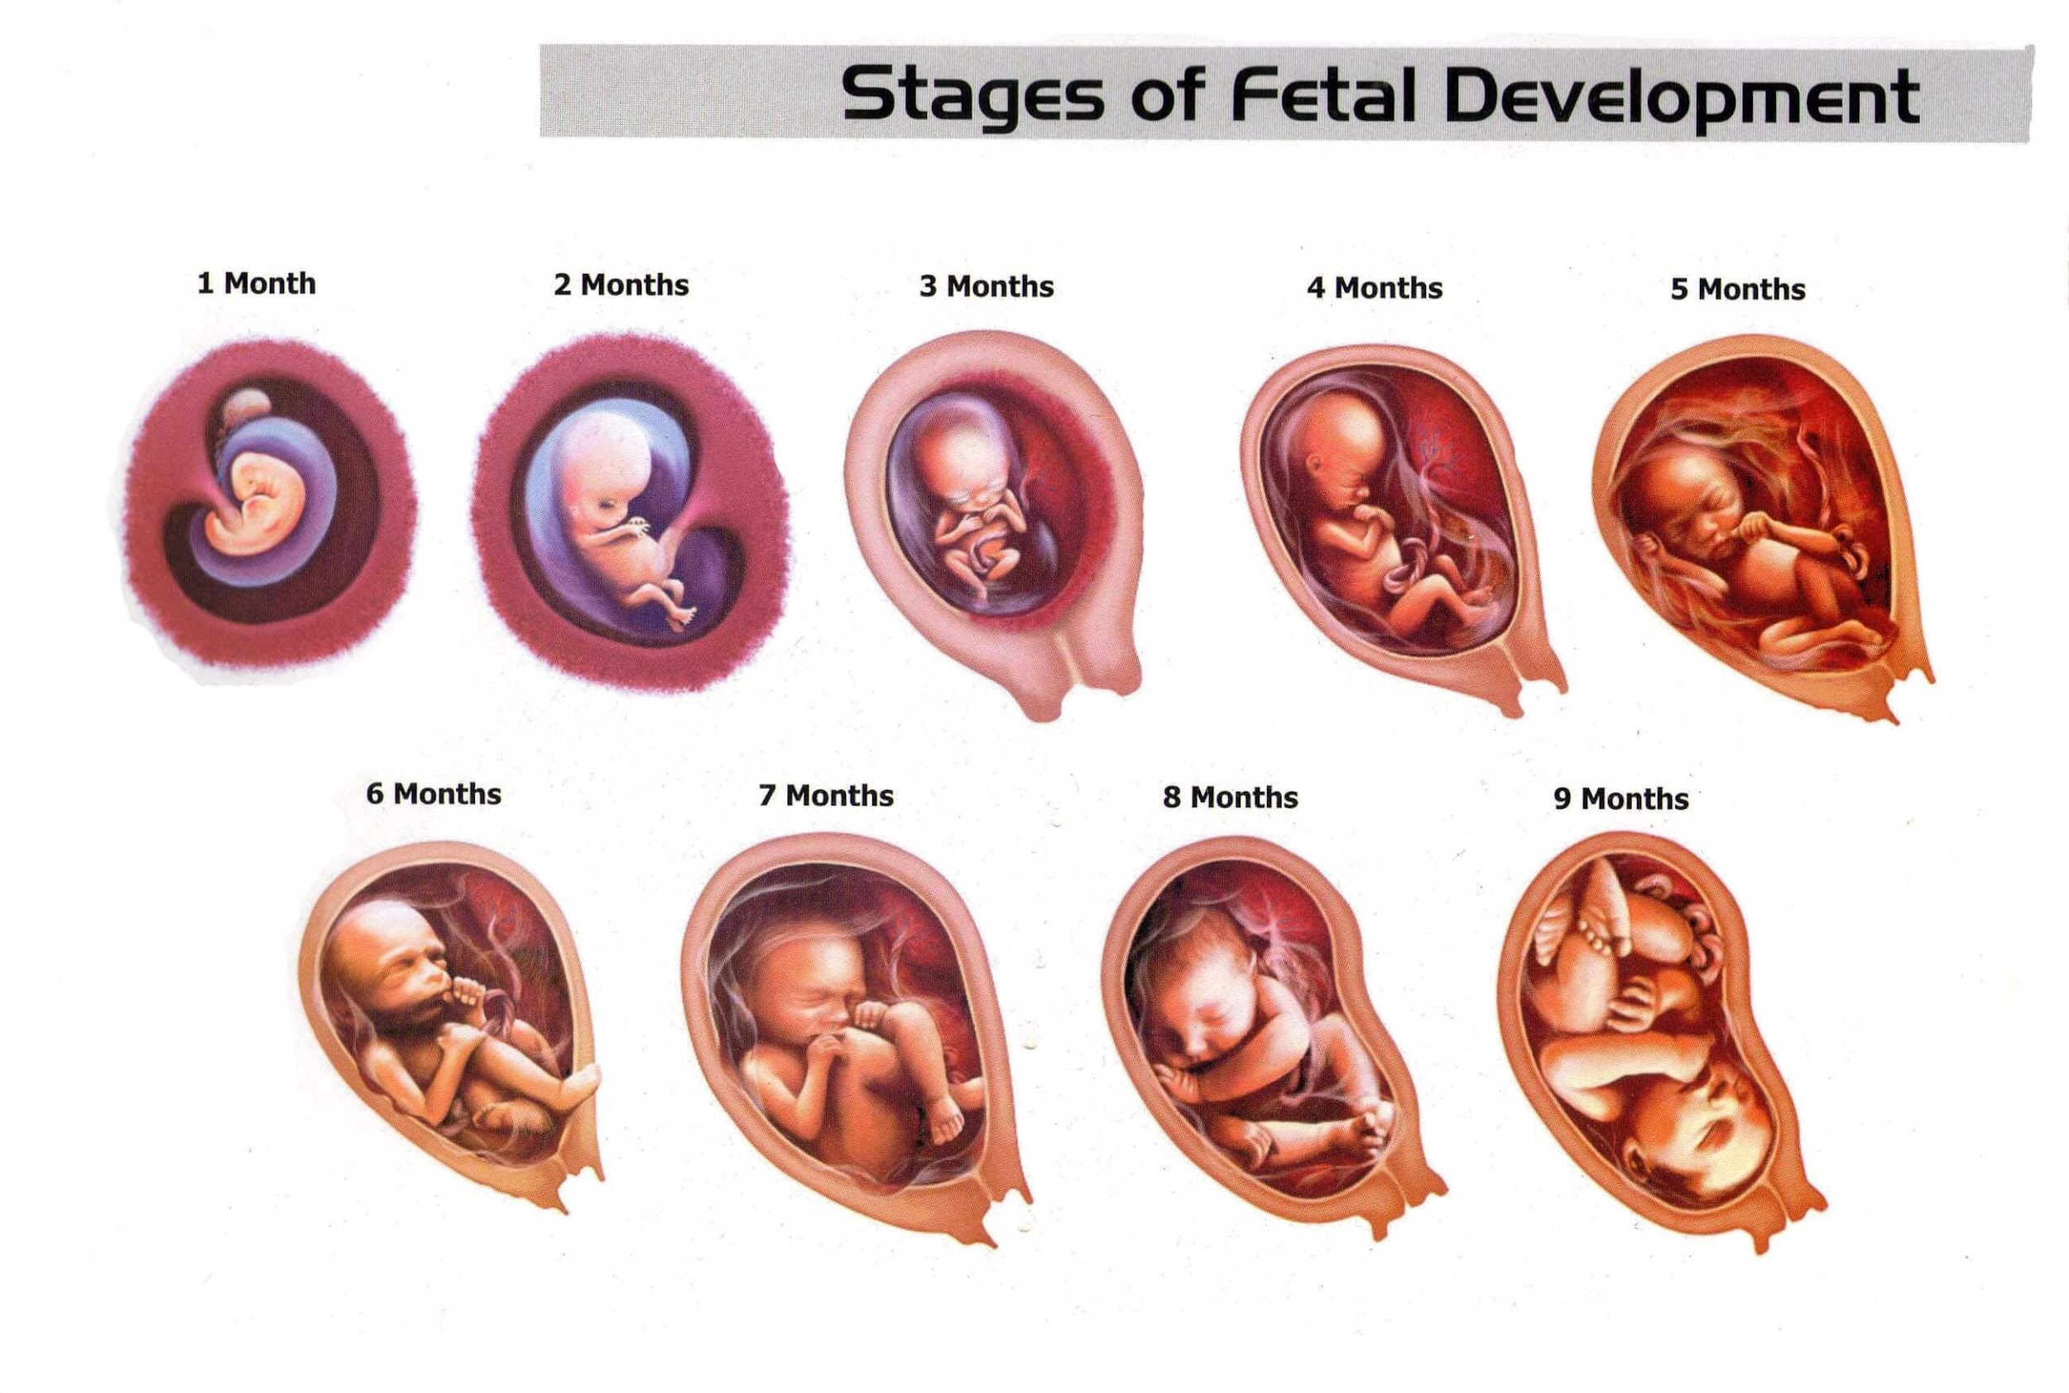
Stages of Fetal Development

Slide 13
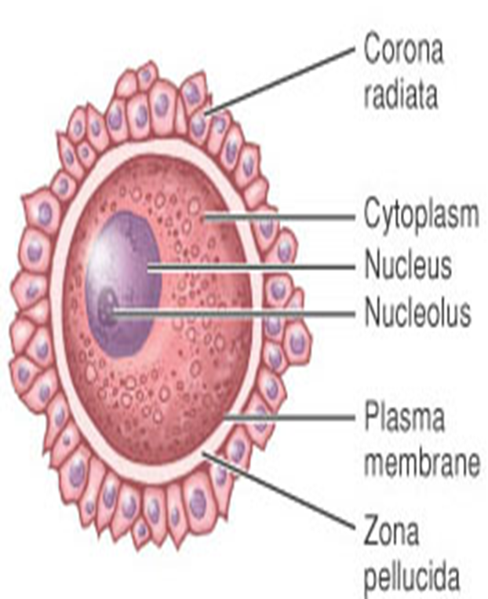
Ovum
The ovum is the female sex cell.
It is regularly released by the ovary through the process of ovulation.
It has two layers of protective covering,
a. The outer layer is the Corona Radiata
b. The inner layer is the Zona Pellucida.
The egg cell has a lifespan of 24 hours, it can only be fertilized within this period.
After 24 hours, it regresses and is resorbed.

Slide 14
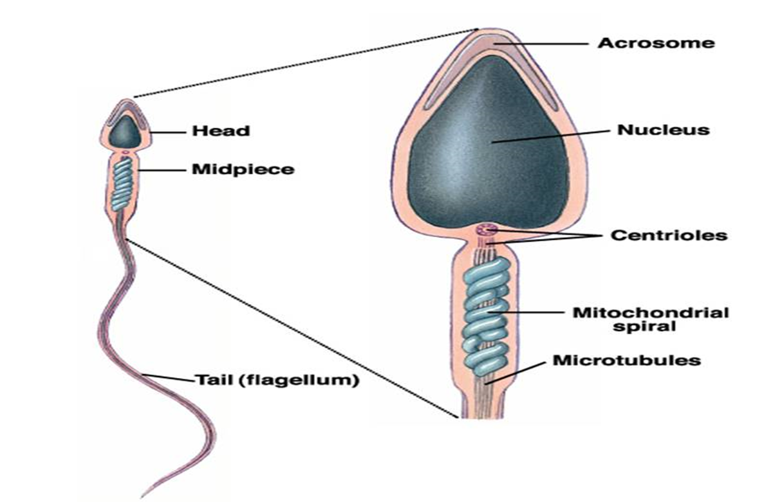
Sperm Cell
-The sperm cell has three parts:
1-A head that contain chromatin materials,
2-A neck or mid-piece that provides energy for movement,
3-A tail that is responsible for it’s mobility.
-The sperm cell has a lifespan of 48 to 72 hours or 3 to 4 days after ejaculation.
-It must be in genital tract 4-6 hours before they are able to fertilize an ovum to give time for the enzyme Hyaluronidase to be activated.

Slide 15
Sperm Cell kinds
Gynosperm
This is the X carrying sperm cell.
It has a large oval head, are lesser in number than androsperms and thrive better in acidic environment.
b. Androsperm
The sperm cell which carries the Y chromosome, with a small head, and thrive better in alkaline environment.

Slide 16
Zygote :Initial name for fertilized ovum(From fertilization to implantation)
Embryo: Name of product of conception from second through 8th week of pregnancy(From fertilization to 5 to 8 weeks)
Fetus: Name of product of conception from 9th week through duration of gestational period(From 8 weeks until term)
Conceptus: Developing embryo or fetus and placental structures throughout term

Slide 17
Fertilization
During ovulation the ovum leaves the ovary and enters the fallopian tube.
Fertilization generally occurs in the outer third of the fallopian tube.
Subsequent changes in the fertilized ovum from conception to implantation are depicted
Per ejaculation the average 2.5ml of seminal fluid contains 50 to 200 million spermatozoa per ml or 400 million per ejaculation.
Sperm reach ovum and cluster around it

Slide 18
Fertilization
Hyaluronidase
Released by the spermatozoa dissolves the layer of cells protecting the ovum, facilitating the penetration of the spermatozoon.
Only one sperm is allowed to penetrate egg
When the sperm penetrates the egg, the egg immediately releases a chemical creating a hard “shell” around it to keep all other sperm out.
Upon fertilization, the resulting structure is called zygote.

Slide 19
Fertilization
Only the father can determine the gender of the child – X – carrying spermatozoon leads to XX combination for a female offspring; Y-carrying spermatozoon leads to XY combination for a male offspring.
The ovum carries only X chromosome.

Slide 20
Segmentation
-Within a few hours after fertilization, after the nucleus of the sperm has united with the nucleus of the egg, the result of their union, the zygote, begins a process of internal division.
-This process of cell division or cleavage in the zygote is called segmentation.
-First, it divides into two cells, then four, eight, sixteen, and so on, doubling the number with each new division.

Slide 21
Segmentation
It transforms the zygote into a cluster of cells called Morula which, seen through a microscope, resembles a mulberryالتوت.
The morula slowly moves down the Fallopian tubes toward the uterus, where it arrives after about three days.
By this time, it has developed into a hollow ball of cells called Blastocyst.

Slide 22
Implantation
-It takes 3 to 4 days for the zygote journey to the uterus (where implantation will take place), and during such journey mitotic cell division happens.

Slide 23
Implantation
Floating freely in the uterus for the next 3 to 4 days,
The Morula (16 to 50 cell bumpy appearance resulting from mitotic cell division) grows to become a Blastocyst
Tropoblast cells: form placenta, fetal membrane umbilical cord and amniotic fluid in later development
Absorbs nutrients from the endometrium
Secretes the hormone HCG

Slide 24
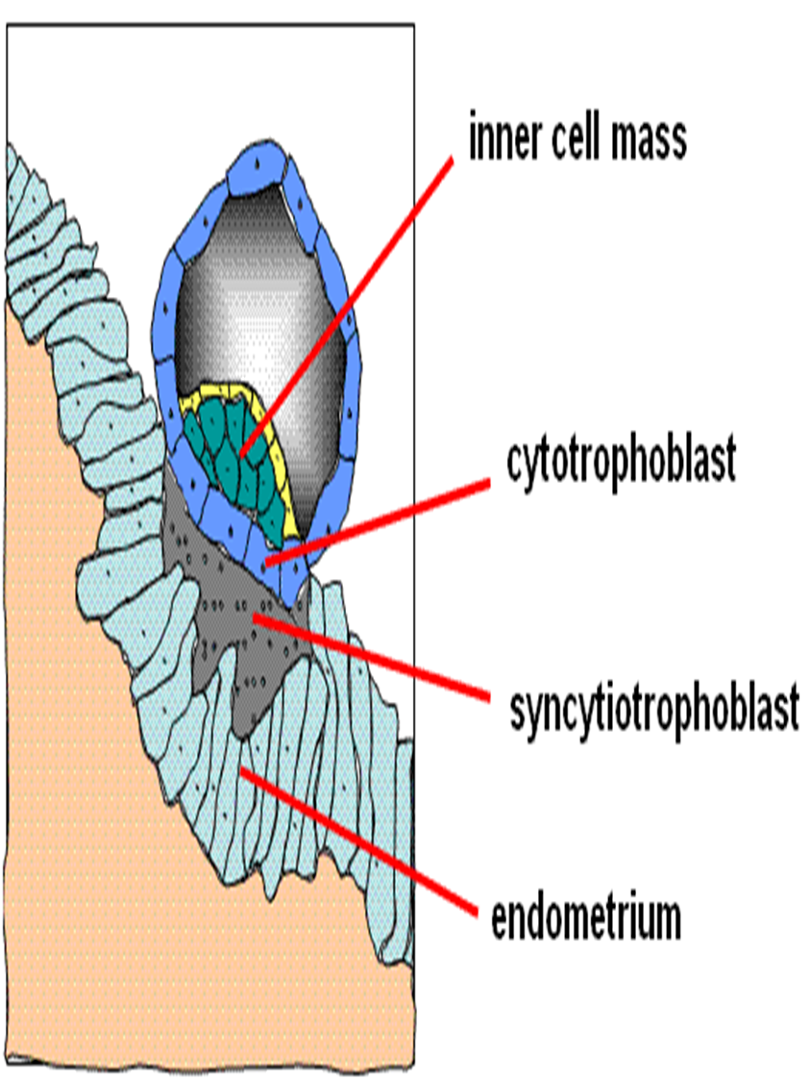
Implantation
BLASTOCOELE or embryonic disc gives rise to the three primary germ layer.
Ectoderm
Endoderm
Mesoderm

Slide 25
Implantation
It takes 7 to 8 days from fertilization to implantation.
-Implantation occurs at high and posterior portion of the uterus.
(The ideal site for implantation is the FUNDAL PORTION. 2/3 of the cases implant at the upper post. Uterine and 1/3 anterior surface of uterine portion.)

Slide 26
Implantation
-On implantation, the structure is called embryo until 5-8 weeks when it begin to be referred to as fetus.
-Implantation bleeding (mistaken as menstrual period) results from capillary rupture on implantation.
-Endometrium (the inner lining of the uterus) is termed decidua on conception.

Slide 27
Fetal development stages
-In the beginning sperm joins with ovum (egg) to form one cell - smaller than a grain of salt.
-This union brings together the 23 chromosomes from the father with the 23 chromosomes from the mother to make a single new life with 46 chromosomes - the genetic blue print for the development of every detail this new person will ever have.

Slide 28
Fetal development stages
-For the next few days the fertilized egg travels down the fallopian tube into the uterus.
At the end of the first week it implants itself into the lining of the uterine wall and draws nourishment from its mother.

Slide 29
Fetal development stages
Day 1 – conception takes place
7 days – tiny human implants in mother’s uterus
10 days – mother’s menses stop
From Days 10-14 the developing embryo signals its presence through placentaI chemicals and hormones to the mother’s body telling it to cease menstruation.

Slide 30
Fetal development stages
Day 15
The primitive streak can be seen on the left side of this embryo.
Day 17
The primitive streak can still be seen, and the opposite end of the embryo is starting to fold up.
18 days – heart begins to beat.
The fetus’s heart beats 54 million beat during pregnancy

Slide 31
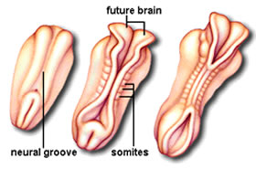
Day 19
The neural tube is seen along with somites on either side of it.
Somites -
zipper-like motion of the neural tube closing together, three pairs of small bumps form on either side of the closure.
they will form the skeleton and the major muscles of the body.
Thirty-eight pairs of somites will line the neural tube within 2 weeks.

Slide 32
Fetal development stages
By only Day 20 foundations of the brain, spinal cord and nervous system are already established
21 days – heart pumps own blood through separate close circulatory system with own blood type

Slide 33
Fetal development stages
By the 4th week, the backbone and muscles are forming. Arms, legs, eyes, and ears have begun to show.
28 days – eye, ear, and respiratory system begin to form
42 days – brain waves recorded skeleton complete, reflexes present

Slide 34
Fetal development stages
- One month old, the embryo is 10,000 times larger than the original fertilized egg and is developing rapidly.

Slide 35
Fetal development stages
At Week 5 five fingers can be discerned in the hand. The eyes darken as pigment is produced. Brain waves can be detected and recorded
The embryo has a marked C-shaped body and a rudimentary tail.

Slide 36
Fetal development stages
At Week 6 :
The liver is now taking over production of blood cells, the brain begins to control muscle movements and organs.

Slide 37
Fetal development stages
Week 7 - The embryo begins to move spontaneously.
The jaw forms, including teeth buds in the gums. capable of thumb sucking
Soon the eyelids will seal to protect the embryo’s developing light-sensitive eyes, and will reopen at about the seventh month
The head is rounded and nearly erect.
The eyes have shifted forward and closer together, and the eyelids begin to form.

Slide 38
Fetal development stages
By the 8th Week now-called fetus is a little more than an inch long.
The fetus has now everything found in a fully developed adult, all body systems present.
The heart has been beating for more than a month, the kidneys are functioning; the stomach is producing digestive juices.
And it responds to touch.

Slide 39
Fetal development stages
At Week 9 the tiny one has fingerprints and will curve its hand around an object placed in its palm.
By Week 10 the fetus can squint, swallow, and wrinkle its forehead moves tongue, makes fist
11 weeks – spontaneous breathing movements, has fingernails, all body systems working
The fetus is now about 2 inches long.
Urination occurs.
Muscle movements are becoming more coordinated

Slide 40
Fetal development stages
12 weeks – weighs one ounce Now 3 months old, the unborn sleeps, awakens, and exercises its muscles.
It “breathes” amniotic fluid to help develop its respiratory system.
Fine hair is growing on the head.

Slide 41
The fetus at 14 weeks
During this period of rapid growth, the skin is so transparent that blood vessels are visible beneath it.
More muscle tissue and body skeleton have developed, and they hold the fetus more erect.

Slide 42
Fetal development stages
16 weeks –
Genital organs clearly differentiated,
Grasps with hands,
Swims, kicks, turns, somersaults, ( still not felt by the mother)

Slide 43
Fetal development stages
At 4 months the fetus is 8-10 inches long and weighs half a pound.
The mother starts to “show.”
The baby’s ears are functional. It can hear its mother

Slide 44
Fetal development stages
18 weeks – Vocal cords work
20 weeks
Has hair on head, weighs one pound, 435 to 465 G and measures about 19 cm.
Subcutaneous deposits of brown fat make the skin a little less transparent. “Woolly” hair covers the head, and nails have developed on the fingers and toes.
There is definite movement felt by the mother.
The unborn may jump in reactions to startling or loud noises.

Slide 45
Fetal development stages
23 weeks –
15% chance of viability outside of womb if birth premature
24 weeks – 56% of babies survive premature birth.
At the 6th month oil and sweat glands are now functioning.
The delicate skin is protected from the fetal waters by a special ointment called “vernix.”
25 weeks
79% of babies survive premature birth

Slide 46
Fetal development stages
At Month 7 the baby now uses the four senses of hearing, vision, taste, and touch.
The child can respond to his or her mother’s voice.

Slide 47
Fetal development stages
In the 8th month
The skin begins to thicken with a layer of fat stored underneath for insulation and nourishment.
Antibodies increasingly build up.
The baby is nearly ready for life outside the womb Toward the end of this month the baby is ready for birth.
By this time the infant normally weighs 6 to 9 pounds, and his or her heart is pumping 300 gallons of blood per day.

Slide 48
Two Major Accessory Structures of Pregnancy
1-Amniotic sac
-Strong, thin-walled membranous sac that envelops and protects the growing fetus
Also known as the fetal membrane
-Outer layer of sac is called the chorion
-Inner layer of sac is called the amnion
-Amniotic fluid within sac cushions and protects fetus during pregnancy

Slide 49
Two Major Accessory Structures of Pregnancy
2- Placenta
-Temporary organ of pregnancy
-Provides for fetal respiration, nutrition, excretion
-15-20cm in diameter, 2-3 cm deep, 400-600g at full term
- Placenta has 25-30 cotyledons (placental compartments that lie on the maternal side)
-Functions as an endocrine gland by producing hormones necessary for normal pregnancy
-Human chorionic gonadotropin (HCG), estrogen, progesterone, and human placental lactogen (HPL)

Slide 50
2- Placenta
Maternal side of placenta
Attached to wall of uterus
Has a “beefy” red appearance dirty rough
Fetal side of placenta
Has shiny, slightly grayish appearance
Contains arteries and veins that intertwine to form umbilical cord
Umbilical cord arises from center of placenta and attaches to umbilicus of fetus

Slide 51
AMNIOTIC FLUID
800-1200ml
Contains fetal urine, lanugo from fetal skin, epithelial cells and subaqueous materials.
pH – 7.2; specific gravity – 1.005 – 1.025
The fetus sallow the fluid

Slide 52
Functions of AMNIOTIC FLUID
-Protects fetus from temperature change
-Aids in muscular development because it allows fetus’ freedom to move
-Provides a cushion against injury
-Excretion collection system
-Protects the umbilical cord from pressure protecting fetal oxygen supply
-Provides a cushion against injury
Excretion collection system

Slide 53
Amniotic Fluid
Poly-Hydramnios – excessive amniotic fluid - more than 2000ml
Oligohydramnios – reduction in the amount of amniotic fluid - less than 300ml .

Slide 54
UMBILICAL CORD
Formed from the amnion and chorion
53cm (21 in) length; 2 cm thick
Wharton’s jelly – a gelatinous mucopolysaccharide that forms the bulk of the umbilical cord giving it its body; prevents pressure on the veins and arteries
Outer surface is covered with amniotic membrane

Slide 55
UMBILICAL CORD
Composed of 1 vein (carrying blood from placental villi to the fetus) and 2 arteries (blood from fetus back to palcental villi)
Blood flow is 350ml/min at term
Walls are with smooth muscles, no nerve supply
Function:
-Transports oxygen and nutrients to the fetus from placenta and return waste products from fetus to placenta

